Slide 1
Smart Campus Placement System
REVIEW 2 · DESIGN, METHODOLOGY AND PROGRESS
Design, methodology and progress: calibrated XGBoost with kNN refinement behind a FastAPI service and a React interface
Presented by
Under the guidance of
Mopidevi Bhagyasri 23K91A05F9
Pamulaparthi Harsha Vardan Reddy 23K91A05J0
Mohammad Faruk Baba 23K91A05F3
Prahalladh Terati 23K91A05J8
S Usha Devi, [DESIGNATION]
Department of Computer Science and Engineering
TKR College of Engineering & Technology · Batch C5 (CSE-C) · [ACADEMIC YEAR]
Notes:
This review shows how the system is designed and built: the data and model, what is implemented, the first measured results and the open items.

Slide 2
Contents
01
02
03
Recap and architecture
Methodology and dataset
Preprocessing and model
04
05
06
Training and decision logic
Data flow, database and UML
Technology stack
07
08
09
Implementation progress and results
Output screens and testing
Challenges and next steps
Notes:
Agenda for the design and progress review.

Slide 3
Recap: problem and proposed system
!
Problem
i
Proposed system
B
Base papers
Placement cells hold student records but do no prediction: students get no early signal, shortlisting is manual, and nobody tells a student which skill or which company to aim for.
For a student, company and role: build 24 features, estimate the placement probability with calibrated XGBoost (kNN refines borderline cases), explain the gaps, and recommend higher-probability company-role pairs.
Declared base [1] predicts placement with LR, RF and boosting but reports no numbers. The method we adapt is the hybrid XGBoost + kNN framework of [2], built for admissions on real data.
Notes:
One-minute recap of Review 1: the placement-cell gap, our adaptation of the hybrid model, and how the two base papers relate.

Slide 4
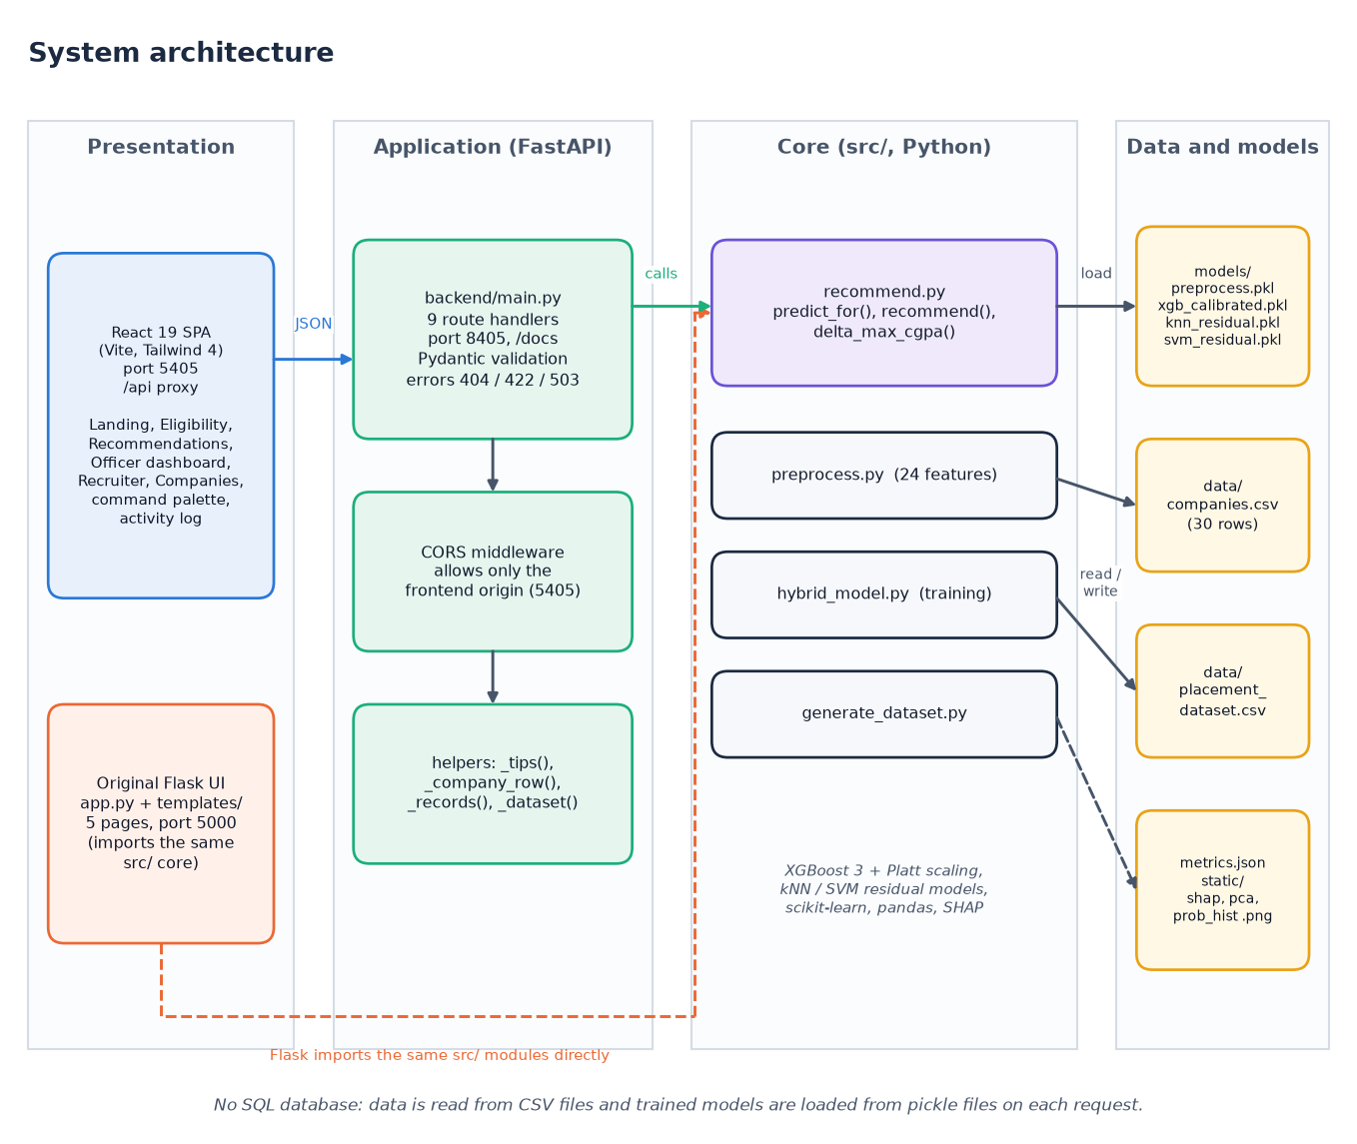
System architecture
Layers
Presentation: React 19 app (port 5405) and the original Flask pages (port 5000).
Application: FastAPI (port 8405), 9 endpoints, Pydantic validation, CORS for the front end only.
Core: src/ modules (features, training, prediction, recommendation) shared by both interfaces.
Storage: CSV data and pickled models; no SQL database.
Notes:
The FastAPI layer imports the original src.recommend functions, so Flask and React use exactly the same models.

Slide 5
Methodology: end-to-end workflow
Generate 3,000 students
24 features
70/15/15 split
6 baselines
Platt calibration
kNN / SVM residual
Models + metrics.json
One feature function
Stratified split
Reproducible
Training, the API and the recommender all call the same build_features, so there is no train/serve mismatch.
Placed ratio kept in every part: 2,100 train / 450 validation / 450 test, seed 42; test used once.
src/ scripts regenerate data, models and plots; scripts/run_experiments.py adds the extra measurements.
Notes:
The training scripts are three commands. The experiments script re-derives confusion matrices, a five-seed study and a label-free hybrid check.

Slide 6
Dataset (synthetic)
3,000
30
59.7%
2,100 / 450 / 450
synthetic students, 19 columns
companies: 7 Tier-1, 15 Tier-2, 8 Tier-3
placed (1,791 / 3,000)
train / validation / test
No real student data. Records come from src/generate_dataset.py (seed 42): scores follow CGPA with noise; the label is drawn from a logistic score of cutoff gaps, internships, projects, backlogs and tier.
The 30-company table (cutoffs, packages 4.0 to 28.0 LPA, hiring rates) is invented but plausible.
No missing values; classes 59.7 / 40.3, so no resampling was applied.
Because the labels follow a logistic rule, even Logistic Regression scores well; results are not claims about real placements.
Notes:
Be upfront: the dataset is synthetic because real placement records are private. Placed rate by tier is strongly structured (9.6%, 49.5%, 81.6%), which is how the generator was built.

Slide 7
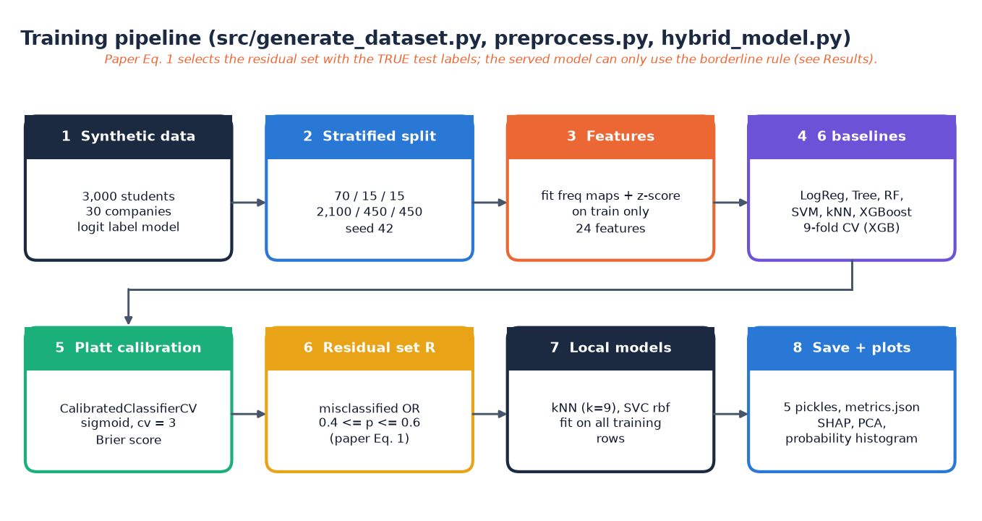
Data preprocessing and features
1 Frequency-encode 5 categoricals (branch, company, role, degree, student type)
2 Z-score 13 numeric columns
3 Add 6 engineered columns: skill index, company hiring rate, CGPA x tier, CGPA / aptitude / technical gap to the company's cutoffs
= 24 features. Maps and scaler are fitted on the training split only and saved in preprocess.pkl.
Gap features carry the placement logic: SHAP ranks CGPA gap, backlogs, technical gap, aptitude gap and CGPA x tier highest.
Notes:
Frequency encoding avoids sparse one-hot columns for company and role. The gap features compare the student against the chosen company's cutoffs.

Slide 8
Model design
Component | Configuration
Baselines | Logistic Regression, Decision Tree, Random Forest (200), SVM (RBF), kNN (k = 9)
XGBoost | 100 trees, depth 8, learning rate 0.1, subsample 0.8, colsample 0.8, L1 0.1, L2 1.0
Calibration | Platt scaling: CalibratedClassifierCV(sigmoid, cv = 3)
Residual set R | calibrated prediction wrong OR probability in [0.4, 0.6] (base paper Eq. 1)
Local models | kNN (k = 9) and SVM (RBF) fitted on all training rows, applied to R only
Serving rule | p = XGBoost; if 0.4 <= p <= 0.6 then p = 0.5 p + 0.5 kNN; ready if p >= 0.5
24
input features
1.49 MB
calibrated XGBoost file
CPU only
about 3 s to retrain
Notes:
The residual set in the paper uses the true labels. The served model cannot, so predict_for refines only the borderline band; the label-free effect is measured later.

Slide 9
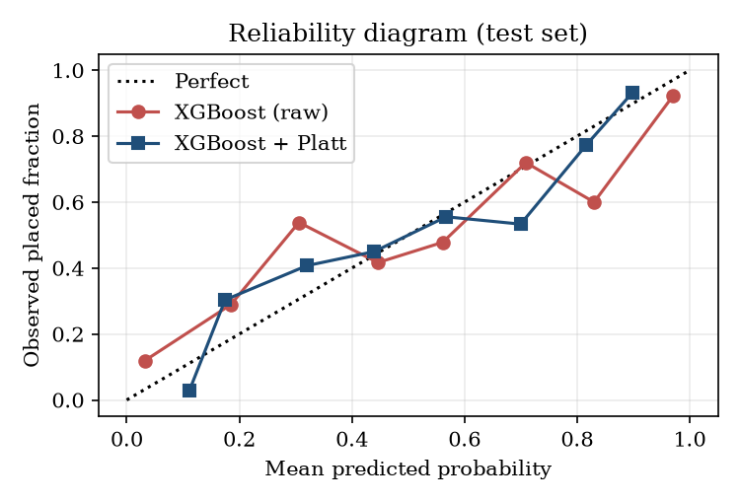
Training configuration
Setting | Value
Split | stratified 70 / 15 / 15, seed 42 (2,100 / 450 / 450)
Cross-validation | 9-fold on the training split for XGBoost: accuracy 0.8147
Calibration quality | Brier score 0.1352 after Platt scaling (raw XGBoost 0.1379)
Residual rate | 22.9% of test rows with the label-based rule; 6.9% borderline only
Hardware | Intel Core i5-12500 (6 cores, 12 threads), 15.7 GB, no GPU; Python 3.14.7, scikit-learn 1.9.0, XGBoost 3.4.1
Platt scaling improves Brier only slightly (0.1379 to 0.1352) and Logistic Regression is better calibrated (0.1180): calibration is needed for ranking recommendations, but it is not a large gain here. Mean predicted probability on test is 0.592 against an observed rate of 0.596.
Notes:
All hyper-parameters are the base paper's. We did not tune them further.

Slide 10
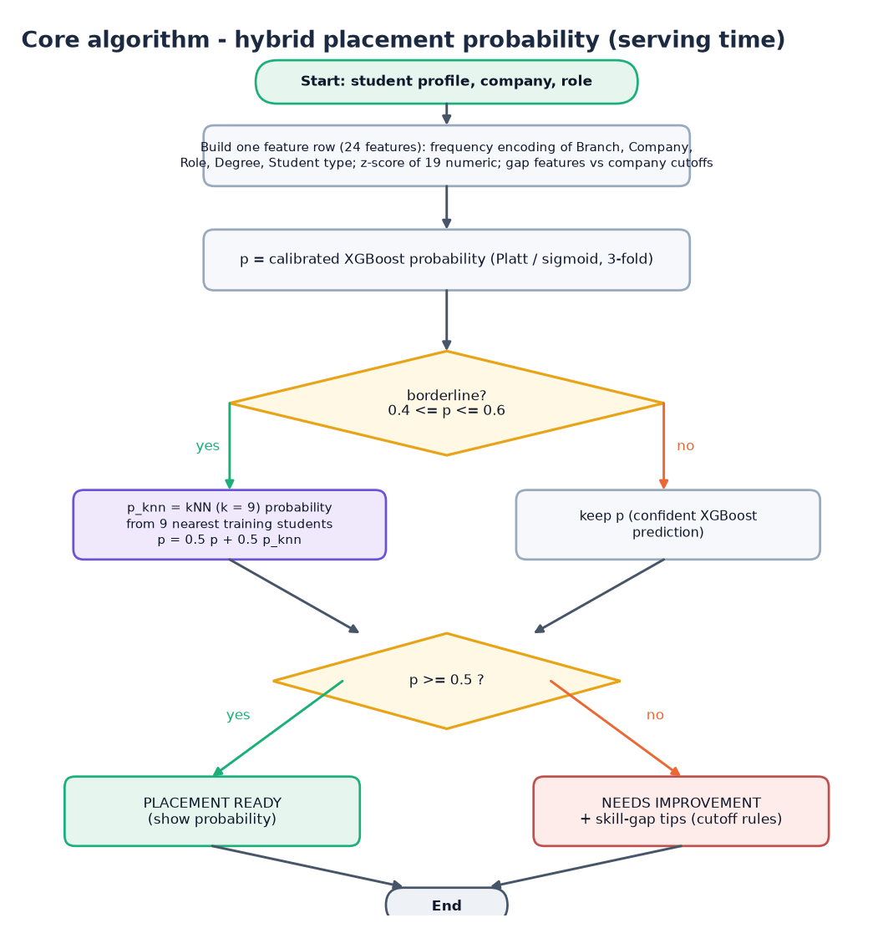
Decision logic
Calibrated probability. XGBoost output after Platt scaling.
Borderline refinement. If p is between 0.4 and 0.6, blend with the kNN probability (0.5 / 0.5).
Decision. Placement ready if p >= 0.5, otherwise needs improvement with skill-gap tips.
Tips. Rules on the company cutoffs: CGPA, aptitude, technical, internship.
Notes:
This is predict_for in src/recommend.py. The recommendation algorithm calls it for every feasible company and role.

Slide 11
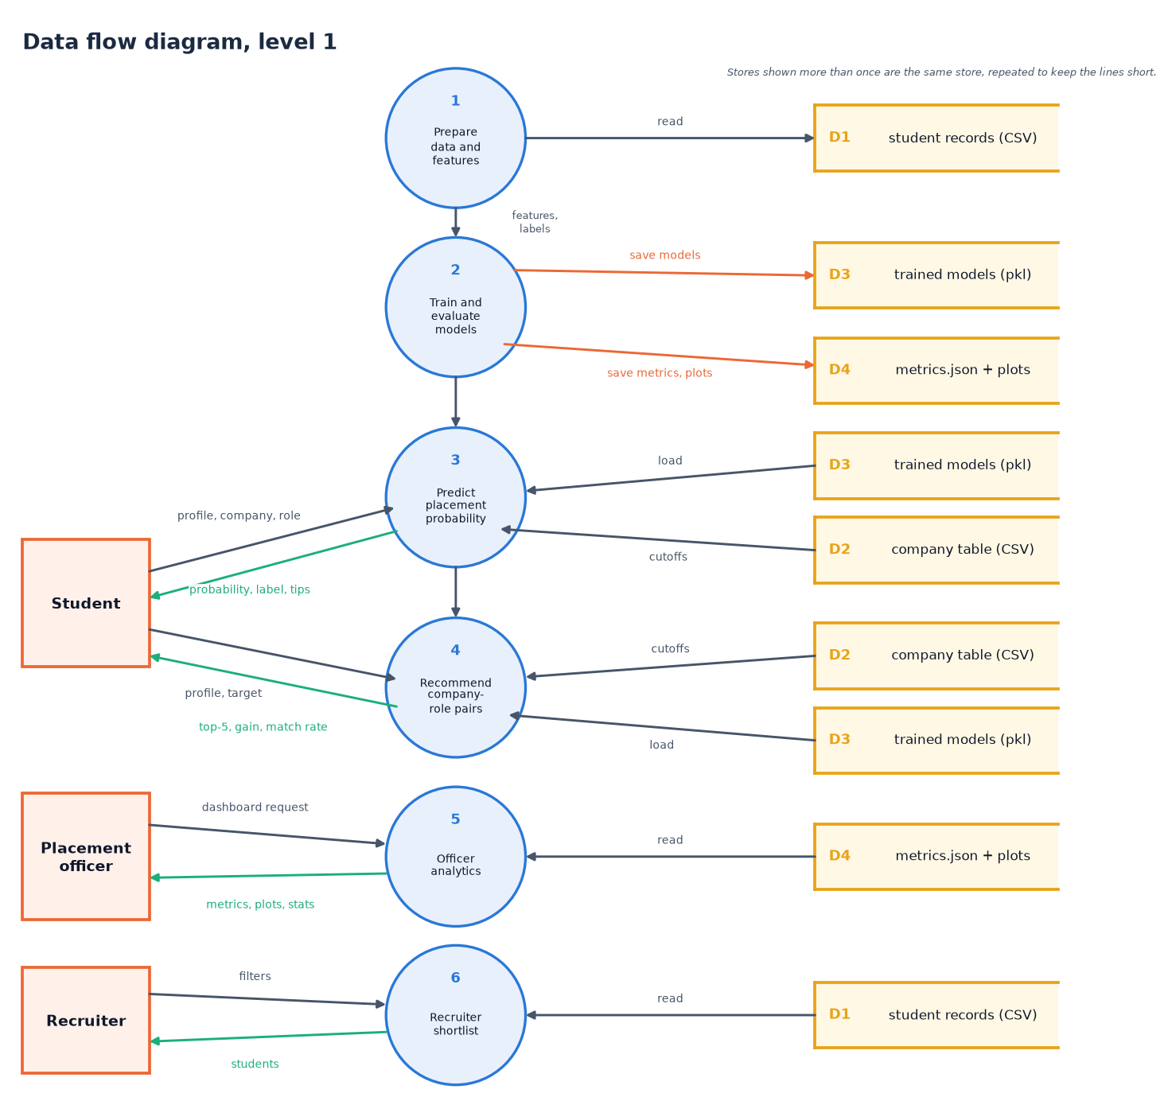
Data flow and modules
Module | Role
generate_dataset.py | synthetic students, 30 companies
preprocess.py | encode, scale, gap features
hybrid_model.py | train, calibrate, hybrid, plots
recommend.py | predict_for, recommend
backend/main.py | 9 FastAPI routes
app.py + templates/ | original Flask pages
frontend/src | React pages and charts
Notes:
Level-1 data flow. The src/ modules are the original code; the backend and the React front end are the new layers.

Slide 12
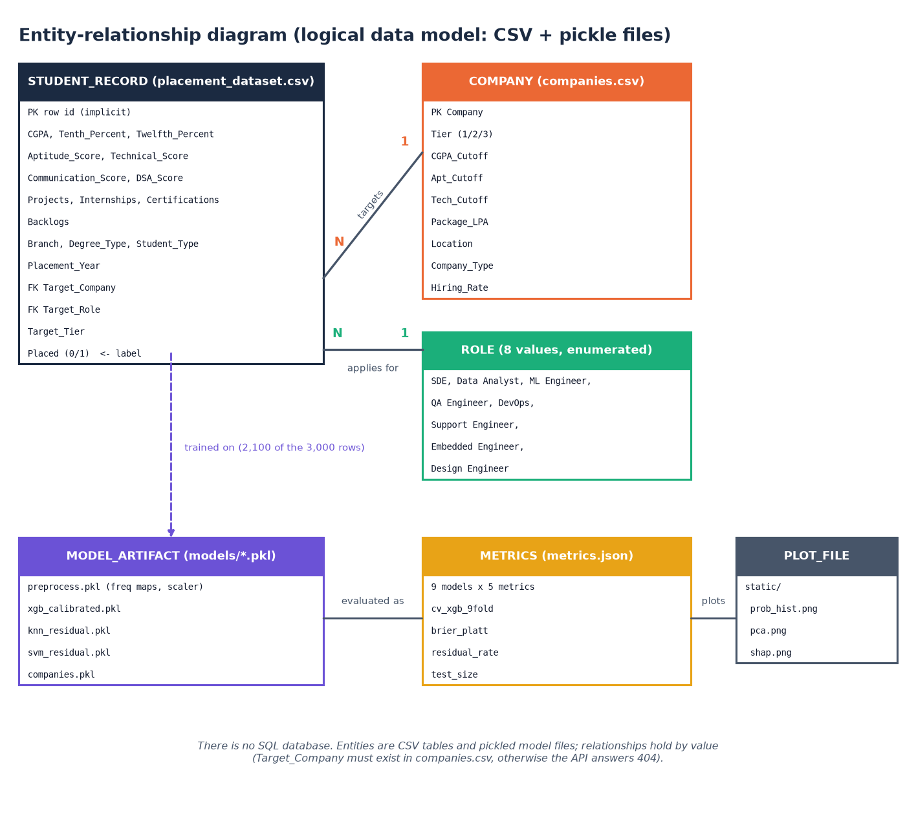
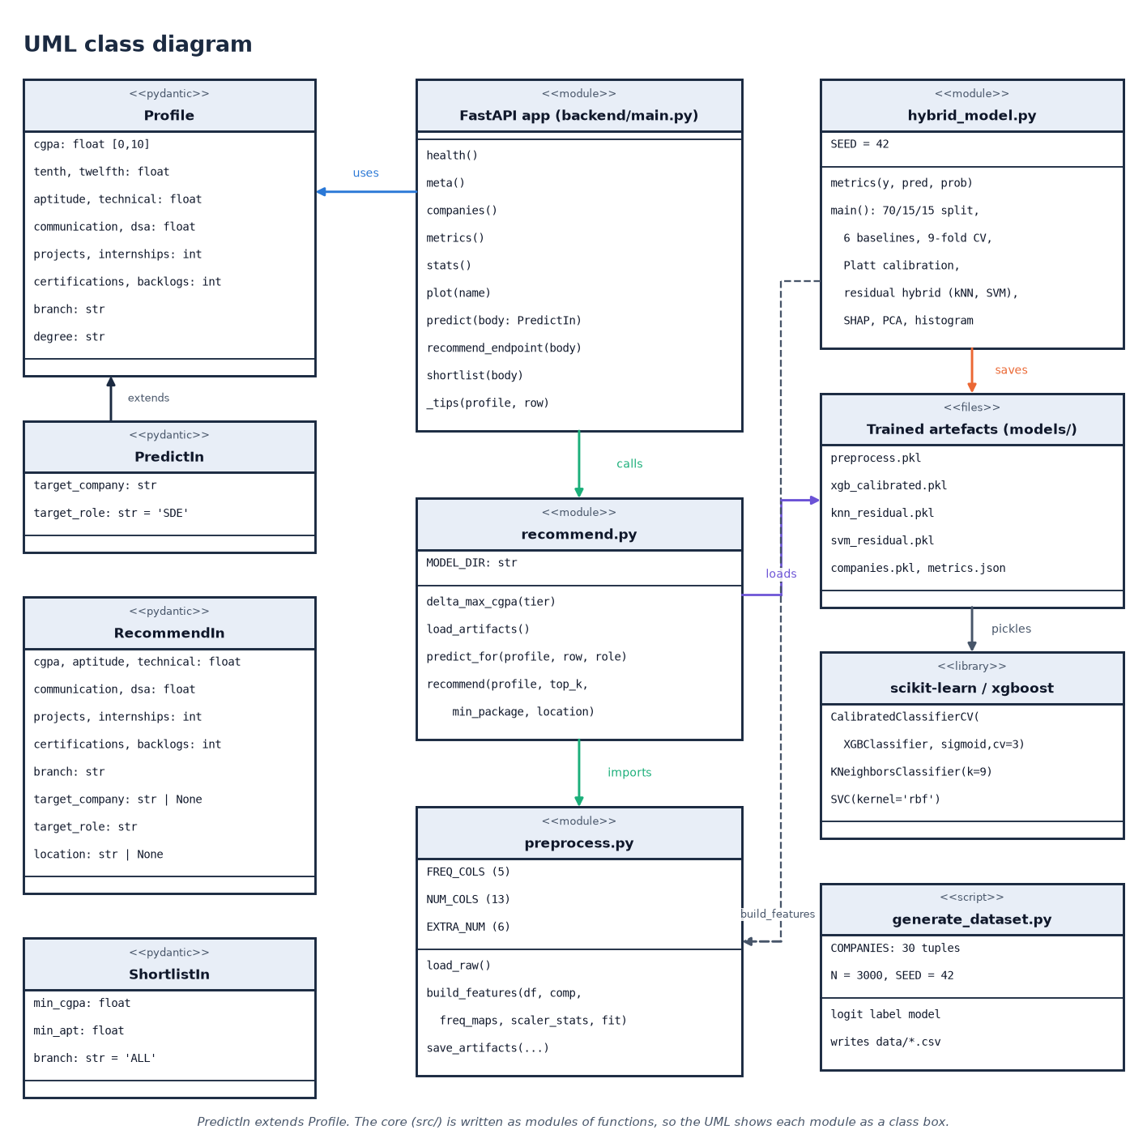
Database design and UML
There is no SQL database: students and companies are CSV files, models are pickles and metrics are JSON. The ER diagram shows these stores; the class diagram shows the Pydantic models and the modules.
Notes:
The batch description mentions MySQL; the implementation uses files. The ER diagram models the logical entities.

Slide 13
Technology stack
Layer | Technology
Machine learning | scikit-learn 1.9.0, XGBoost 3.4.1, SHAP 0.52.0, pandas 3.0.5, NumPy 2.5.3
Plots | matplotlib (PCA, probability histogram, SHAP bars)
API | FastAPI 0.159.1, Uvicorn 0.54.0, Pydantic 2.14.1 (port 8405)
Original UI | Flask 3.1.3, Jinja templates (port 5000)
Front end | React 19.3, Vite 8.3, Tailwind 4.3, Recharts, three.js, framer-motion (port 5405)
Testing | 46 scripted checks, smoke test, Playwright for screenshots
Notes:
Python 3.14.7 on Windows 11. run.bat creates the virtual environment, installs packages, trains if needed and starts both servers.

Slide 14
Implementation progress
Component | Status | Evidence
Dataset generator, features, training, calibration, hybrid | Done | src/, models/metrics.json
Prediction with skill-gap tips; company-role recommendation | Done | src/recommend.py, 46 checks pass
FastAPI service (9 endpoints) | Done | smoke test 15 / 15
React interface (6 pages, command palette) | Done | 10 screenshots
Officer dashboard and recruiter shortlist | Done | metrics, SHAP, PCA, 1,394-match filter
Real placement data, login, database, PDF / e-mail reports | Not done | stated limitations
Recommendation speed | Weak | 3 to 8 s per request (pickles reloaded)
Notes:
State of the code base. The honest gaps: no real data, no authentication or database, slow recommendations.

Slide 15
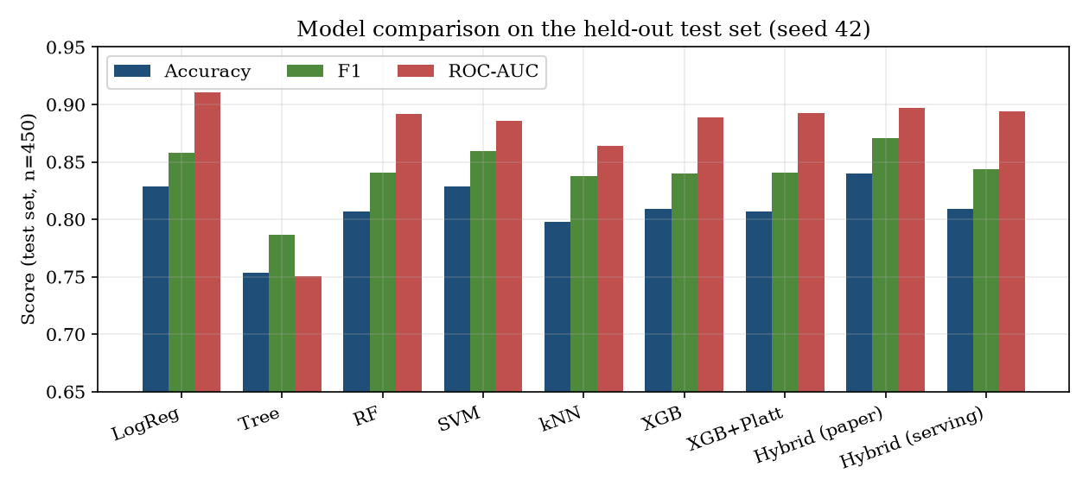
Preliminary results: held-out test split
0.8067
0.8400
0.8089
0.9106
XGBoost + Platt accuracy
hybrid, true labels used
hybrid, label-free
Logistic Regression AUC (best)
i
Reading
450 test students, seed 42. The hybrid's 0.84 relies on the true labels to choose the refined rows; without them it is 0.8089 vs 0.8067 for XGBoost + Platt: one student. Logistic Regression has the highest AUC (0.9106).
Notes:
Numbers are models/metrics.json for the shipped pickles (reproduced exactly) plus the label-free variant measured by scripts/run_experiments.py.

Slide 16
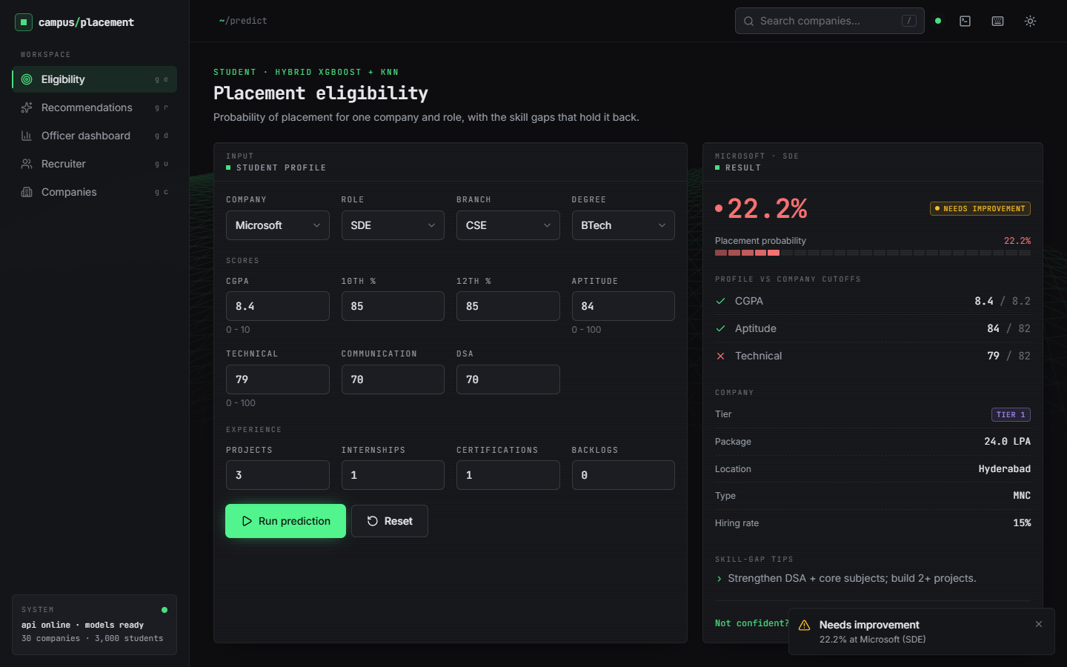
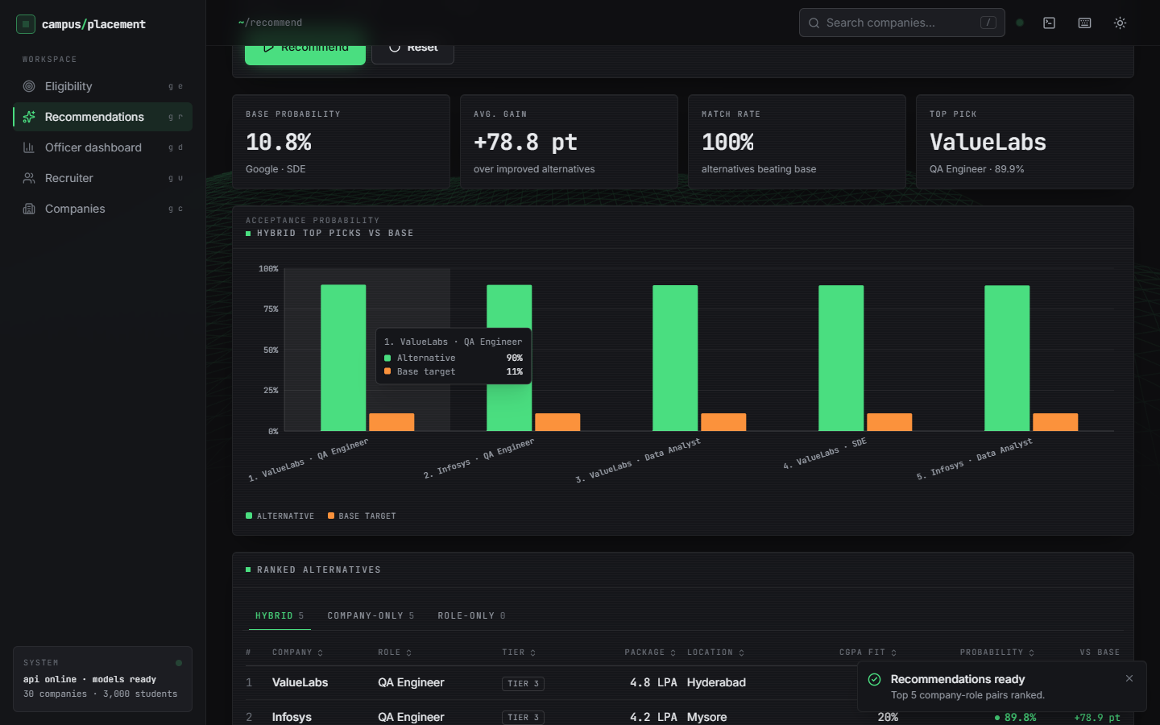
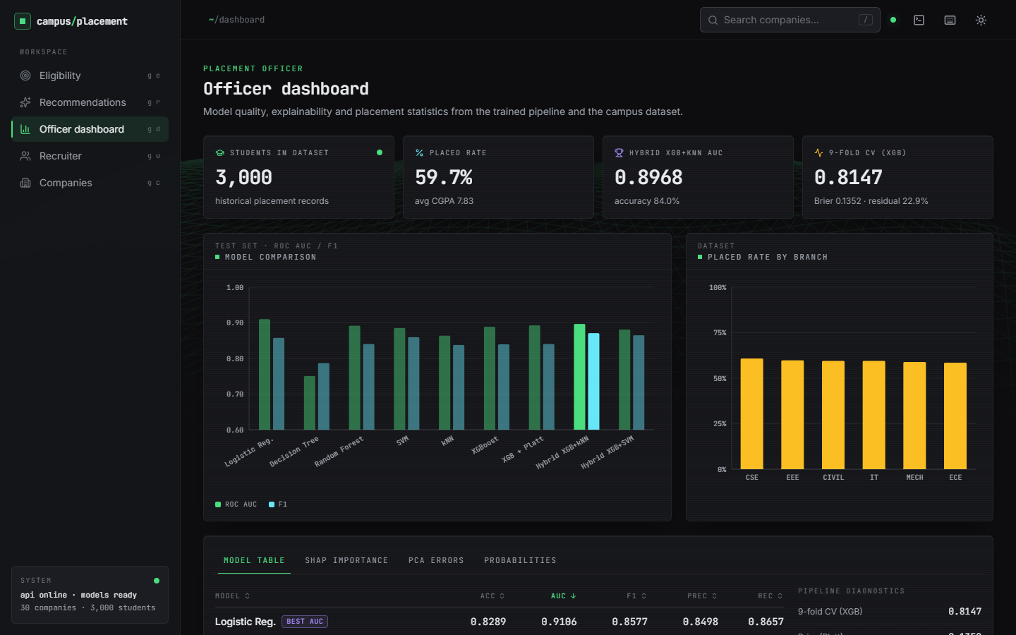
Output screens
Eligibility: Microsoft SDE for a CGPA 8.4 student, 22.2% (technical 79 below the 82 cutoff). Right: recommendations (base 10.8% at Google) and the officer dashboard. Real application, 3,000-student dataset.
Notes:
Real screenshots from the running application captured with Playwright; nothing is mocked.

Slide 17
Initial testing and observations
46 / 46
15 / 15
66 ms
5.4 s
scripted checks passed
smoke-test checks
mean POST /api/predict
mean POST /api/recommend
Observation | Action
The hybrid's gain depends on the true labels; the label-free rule gains one student of 450 | Report both; recommend the label-free number as the deployable one
Unknown branch or role values are accepted (frequency 0) | Documented as a validation gap
Role-only list is empty when the target company fails the feasibility filter | Documented; hybrid and company-only lists still work
Notes:
46 checks: 10 unit, 8 integration, 6 functional, 13 validation, 9 security. Timings on 127.0.0.1.

Slide 18
Challenges and corrective actions
Challenge | Corrective action
No real placement records are available | Synthetic generator with a stated logistic rule; limitation reported
The paper's residual rule uses true labels | Added a label-free variant and a five-seed study
The pickled company table needs pyarrow with pandas 3 | pyarrow added to requirements.txt
Recommendation reloads four pickle files for every call | Measured 3 to 8 s; caching listed as future work
Python clients to localhost add about 2 s here | Latency measured on 127.0.0.1
Notes:
Each challenge led to a concrete change in the code base or in how results are reported.

Slide 19
Next steps
1
Evaluate
2
Speed up
3
Harden
4
Extend
Re-run on real, anonymised placement records if the cell can share them; keep the split free of leakage.
Cache the model files once per process so a recommendation takes well under a second.
Validate categories, add login and roles, store data in a database.
Batch CSV prediction, PDF reports and per-student SHAP explanations.
Notes:
Plan to the final review and beyond; the first item depends on data access.

Slide 20
Thank you
Questions and suggestions are welcome.
Notes:
Likely questions: why synthetic data; why the hybrid gain disappears without labels; how recommendations are validated (they are not, yet).

