Slide 1

Smart Campus Placement System
Final Review · Smart Campus Placement System
Team Details : Batch C5
Under the Esteemed Guidance of
S Usha Devi
[DESIGNATION], Department of CSE
23K91A05F9 Mopidevi Bhagyasri
23K91A05J0 Pamulaparthi Harsha Vardan Reddy
23K91A05F3 Mohammad Faruk Baba
23K91A05J8 Prahalladh Terati
DEPARTMENT OF COMPUTER SCIENCE AND ENGINEERING · TKR College of Engineering & Technology · Academic Year [ACADEMIC YEAR]
Notes:
Introduce the team and the project: a placement-prediction and company-recommendation system with officer and recruiter tools.

Slide 2
Table of Contents
Abstract
Base Paper & Literature Survey
Research Gap, Problem Statement & Objectives
Proposed System & Architecture
Methodology, Dataset & Model
Decision Workflow, Interaction & Storage
Implementation Highlights
Results, Confusion Matrices & Threshold Analysis
Performance & Testing
Comparison with Base Papers
Output Screens
Conclusion, Future Scope & References
Dept. of CSE | Batch C5 | Final Review
2
Notes:
The agenda follows the report: problem, design, method, results, comparison, screens, conclusion.

Slide 3
Abstract
Placement cells keep student records but do no predictive analysis: students learn their readiness late, shortlisting is manual and nobody says which skill or company to target.
The Smart Campus Placement System estimates the probability that a student is placed at a chosen company and role (24 features, calibrated XGBoost, kNN refinement of borderline cases), gives skill-gap tips, recommends company-role pairs, and offers an officer dashboard and a recruiter shortlist.
On a synthetic 3,000-student dataset (450 test students) XGBoost + Platt reaches 80.67% accuracy (AUC 0.8928); the hybrid reaches 84.0% only when the true labels choose the refined rows, and 80.89% without them.
A FastAPI service and React interface wrap the original code; 46 scripted checks pass; a prediction takes about 66 ms, a recommendation about 5.4 s.
Not done: real placement data, login, database storage and real-outcome validation of recommendations.
Dept. of CSE | Batch C5 | Final Review
3
Notes:
Read the first two bullets, then the headline numbers with their protocol and the honest caveat about the hybrid.

Slide 4
Base Papers
M. Prasanna Kumari, B. Punith, M. Srinath, P. Koushik and Y. Gourav, "Student placement prediction system using machine learning," Int. J. Eng. Technol. Manage. Sci. (IJETMS), vol. 10, no. 3, pp. 47-51, May-Jun. 2026, doi: 10.46647/ijetms.2026.v10i03.008.
Aspect | Declared base paper [1] (IJETMS 2026) | Technique source [2] (arXiv:2603.29881)
Task / data | Placement prediction; synthetic records, 80:20 split | Graduate admission prediction; 13,000 real GradCafe records, 70/15/15
Method | Logistic Regression, Random Forest, Gradient Boosting; Streamlit app, batch CSV, PDF report, e-mail | XGBoost + Platt; kNN / SVM refinement of residual cases; university-program recommendation; SHAP
Reported results | None numeric (only the split and model names) | XGBoost 0.7241; XGBoost + kNN hybrid 0.8723; Brier 0.1864; recommendation +65.1% mean acceptance probability
Stated limits | No company recommendation; no numbers | Residual set uses true labels; US-centric self-reported data
Dept. of CSE | Batch C5 | Final Review
4
Notes:
The batch's declared base paper reports no numbers, so numeric context comes from the admissions paper whose hybrid method the code adapts. Both are cited.

Slide 5
Literature Survey
Author / Year | Methodology | Dataset | Key Results | Limitations
Prasanna Kumari et al. 2026 [1] | Logistic Regression, Random Forest and Gradient Boosting on student attributes; Streamlit app with batch CSV prediction, skill-gap analysis, PDF report and e-mail | Synthetic student records (size not stated); 80:20 split | No accuracy, F1 or AUC is reported in the paper | No numeric evaluation; no company recommendation; synthetic data
Heidari Fard and Tabrizi 2026 [2] | XGBoost with Platt calibration; kNN / SVM refinement of residual (misclassified or borderline) cases; university-program recommendation with feasibility filters; SHAP | 13,000 real GradCafe admission records, 2021-2025, enriched with QS rankings | XGBoost 0.7241 accuracy; XGBoost + kNN hybrid 0.8723; Brier 0.1864; recommendation raised mean acceptance probability by 65.1% | Residual set uses true labels; US-centric self-reported data; admissions, not placements
Thangavel et al. 2017 [21] | Decision-tree classifiers on historical student data; predicts one of five placement statuses (Dream, Core, Mass Recruiter, Not Eligible, Not Interested) | Historical student records (size not read) | Abstract only: identifies students needing technical and interpersonal support | Categorical status, no probability; no company-level recommendation
Khandale and Bhoite 2019 [22] | Logistic, SVM, kNN, decision tree, random forest, bagging, boosting and voting compared | Past placed / unplaced student records | About 78% accuracy for XGBoost and for AdaBoost (abstract) | Moderate accuracy; full results table not read
Baffa et al. 2023 [15] | Logistic regression, decision tree and random forest for graduate employability from CGPA, work-experience score, union group and gender | 218 Computer Science graduates, 2016-2021, one university | Random forest 98% accuracy, F1 0.99 | Tiny single-department dataset; six variables
Pathak et al. 2025 [18] | Voting classifier with hyper-parameter search and cross-validation | Public Kaggle placement dataset | Accuracy 0.8923, precision 0.9430, recall 0.8567, F1 0.8978, AUC 0.9433 | Public tabular benchmark; no recommendation layer
Dept. of CSE | Batch C5 | Final Review
5
Notes:
Representative work. Where a work's figures were not checked they are not quoted. Four further titles from the project survey could not be verified online and are listed in the report as unverified.

Slide 6
Research Gap
Prediction only: placement predictors rarely recommend which company and role a student should target.
Actionable feedback: few give the student the specific gaps against a company's requirements.
Calibrated probabilities: a recommendation ranking needs reliable probabilities; calibration is seldom reported.
Honest evaluation: results often lack several seeds, a confusion matrix, or a check that a refinement rule works without labels.
Real data: placement records are private, so published work, including the base paper, uses synthetic data.
Dept. of CSE | Batch C5 | Final Review
6
Notes:
Five gaps. We address the first three directly, measure the fourth, and state the fifth as a limitation.

Slide 7
Problem Statement
Given a student's academic record, skill and aptitude scores and a target company and role, estimate the probability that the student is placed, explain which gaps against the company's requirements hold it back, recommend company-role alternatives where the estimated probability is higher, and give placement officers and recruiters dashboards and shortlists - through a web application that a placement cell can run on an ordinary PC, with accuracy reported honestly on the data actually available.
Input
Output
Users
Academics, aptitude and technical scores, projects, internships, backlogs, target company and role
Probability, label, skill-gap tips and top-5 company-role pairs
Students, placement officers, recruiters
Dept. of CSE | Batch C5 | Final Review
7
Notes:
The statement has three parts: estimate, explain and recommend, and serve three user groups.

Slide 8
Objectives
1. Collect student academic records, technical skills, aptitude scores and historical placement outcomes.
2. Clean and encode the data and address imbalance between placed and unplaced students.
3. Train and compare classifiers to predict placement eligibility for each student.
4. Recommend suitable companies by matching student profiles against recruiter requirements.
5. Identify the skill gaps that most reduce a student's placement probability.
6. Provide dashboards for placement officers and evaluate using accuracy, precision and recall.
Dept. of CSE | Batch C5 | Final Review
8
Notes:
The six objectives of the proposal. The conclusion reports for each whether it was met; objective 1 (collect real records) was met only with synthetic data.

Slide 9
Proposed System
Profile + company + role
24 features
XGBoost + Platt
kNN on borderline
Probability, tips, top-5
Features include the gaps between the student's CGPA, aptitude and technical scores and the target company's cutoffs.
Calibrated XGBoost; when the probability is between 0.4 and 0.6 it is blended with a kNN estimate; ready if p >= 0.5.
Recommendation filters feasible companies (CGPA proximity, aptitude, backlogs, tier) and ranks company-role pairs.
FastAPI service over the unchanged Python core; React interface and the original Flask pages.
Dept. of CSE | Batch C5 | Final Review
9
Notes:
The proposed system in one line of boxes, then four properties that matter.

Slide 10
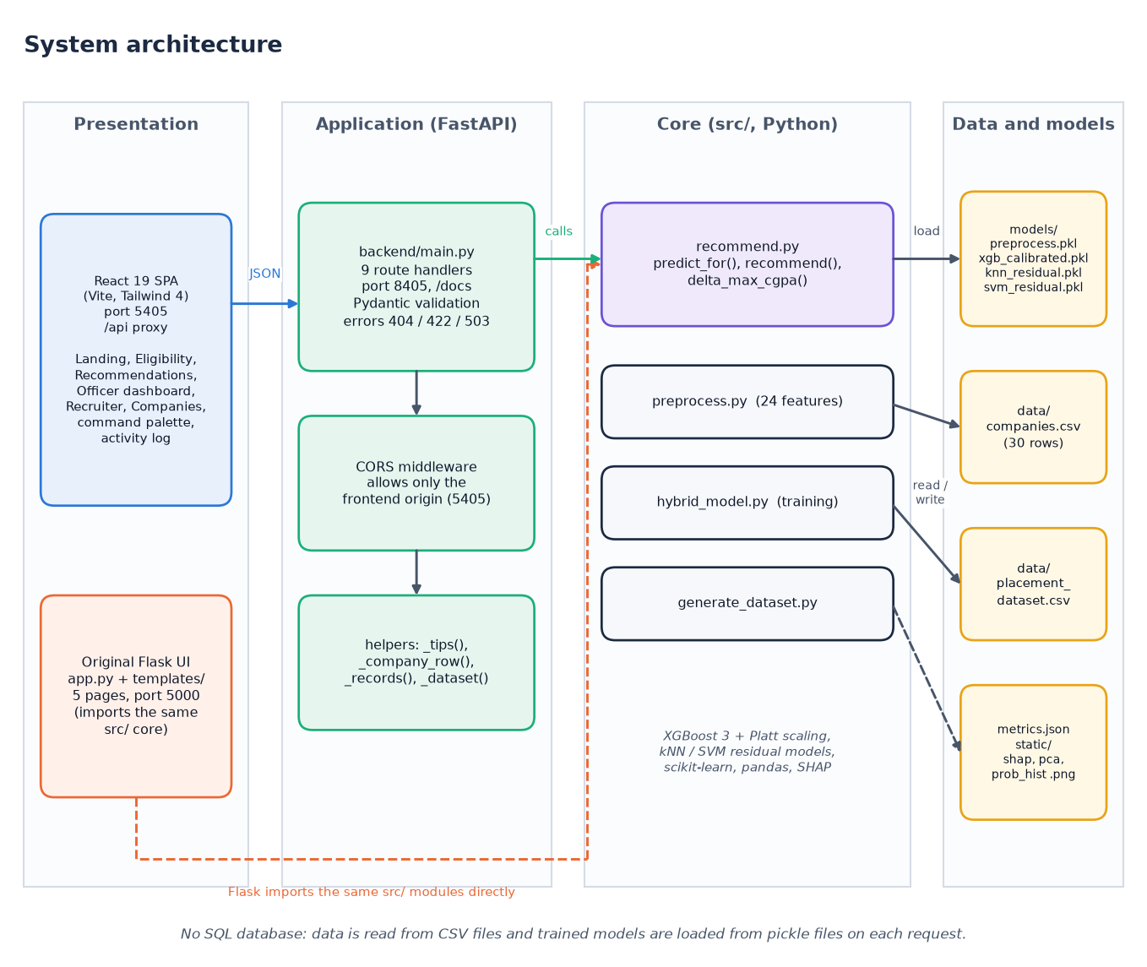
System Architecture
Presentation: React app (5405) and Flask pages (5000)
Application: FastAPI (8405), 9 endpoints
Core: features, training, prediction, recommendation
Storage: CSV data and pickled models, no SQL database
Dept. of CSE | Batch C5 | Final Review
10
Notes:
Interfaces on the left, one shared core in the middle, files on the right.

Slide 11
Methodology
Synthetic generator
24 features
70/15/15 split
6 baselines
Platt calibration
Residual hybrid
metrics + plots
One feature function for training, the API and the recommender: no train/serve mismatch.
Stratified 70 / 15 / 15 split with seed 42; maps and scaler fitted on the training part only; 9-fold CV for XGBoost.
Extra measurements: confusion matrices, label-free hybrid, borderline-band and threshold sweeps, five seeds, SHAP, recommender gains, latency.
The shipped model files reproduce models/metrics.json exactly; every extra number comes from scripts/run_experiments.py.
Dept. of CSE | Batch C5 | Final Review
11
Notes:
Workflow and measurements. The shipped pickles reproduce the stored metrics; a fresh retrain drifts by at most 0.011.

Slide 12
Dataset, Features & Model
3,000
Component | Setting
XGBoost | 100 trees, depth 8, lr 0.1
Calibration | Platt, cv = 3
Local model | kNN k = 9
Split | 2,100 / 450 / 450
synthetic students, 19 columns
30
invented companies (7 / 15 / 8 by tier)
24
Placed 59.7%; no missing values; no resampling.
Labels come from a logistic rule plus noise, so linear models do well.
The company table is invented, not recruiter data.
features: 5 freq-encoded, 19 z-scored
Placed rate by tier (Tier 1 9.6%, Tier 2 49.5%, Tier 3 81.6%) follows how the generator was built; 9-fold CV accuracy of XGBoost is 0.8147.
Dept. of CSE | Batch C5 | Final Review
12
Notes:
Dataset, features and model in one view. The dataset is synthetic; the tier effect is a property of the generator, not a finding about real placements.

Slide 13
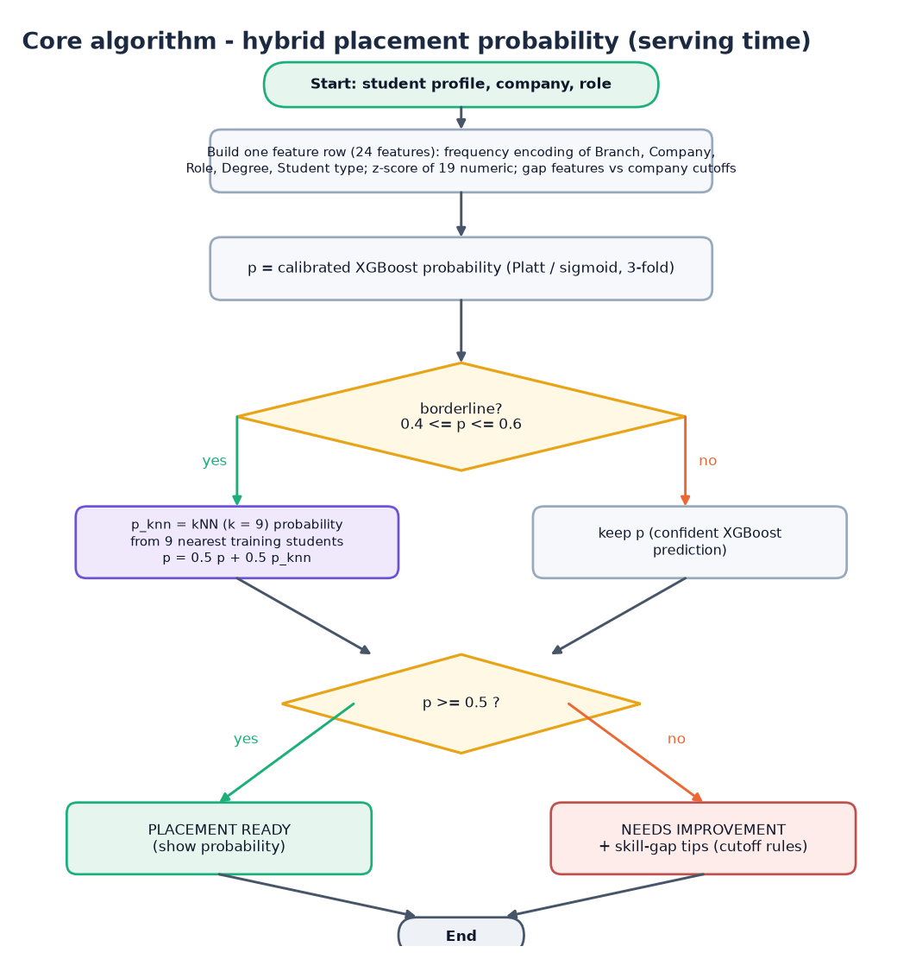
Decision Workflow
Probability: calibrated XGBoost output (Platt scaling).
Refine: if p is in [0.4, 0.6], p = 0.5 p + 0.5 kNN probability.
Decide: placement ready if p >= 0.5, otherwise needs improvement plus tips.
Recommend: the same prediction is called for every feasible company and role; top 5 by score = p + 0.05 proximity + location bonus.
Dept. of CSE | Batch C5 | Final Review
13
Notes:
The serving rule in src/recommend.py. The threshold behaviour is analysed on slide 19.

Slide 14
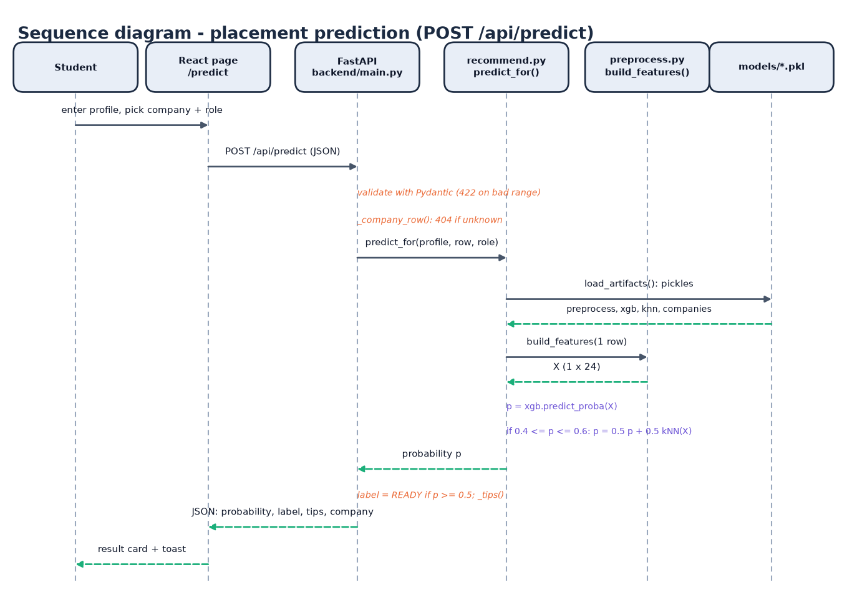
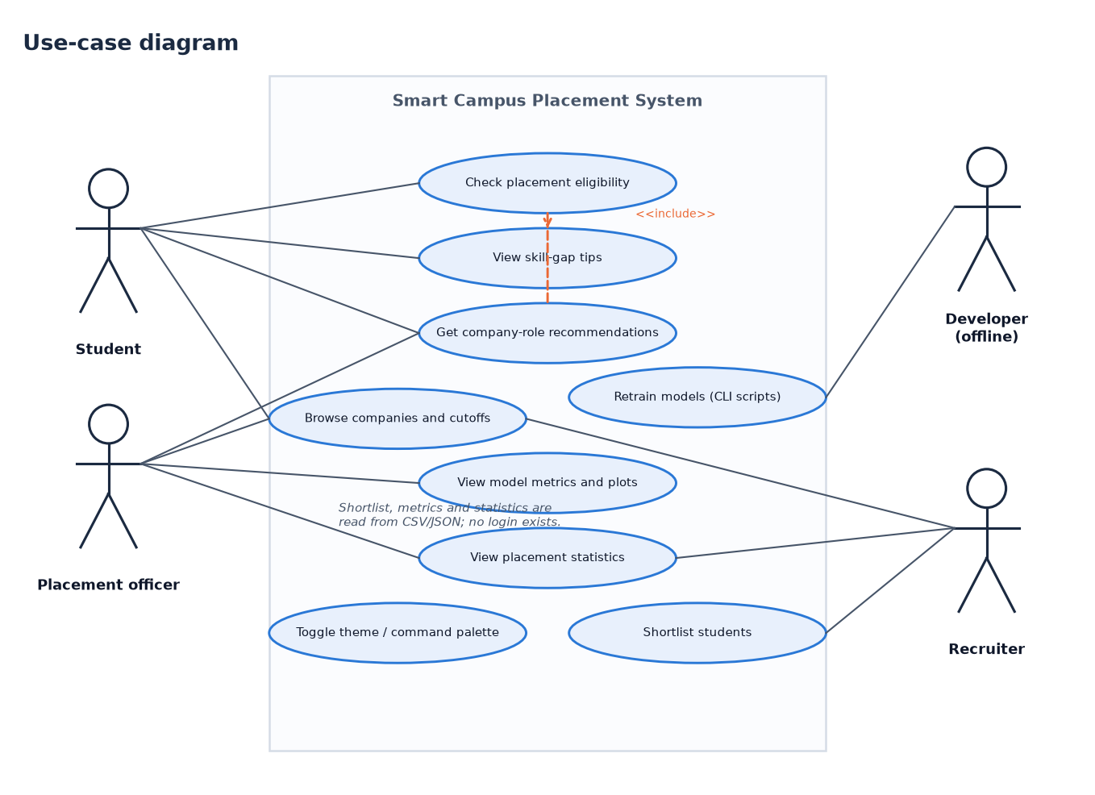
User – System Interaction
Dept. of CSE | Batch C5 | Final Review
14
Notes:
Sequence of one prediction request and the use cases of student, officer, recruiter and developer.

Slide 15
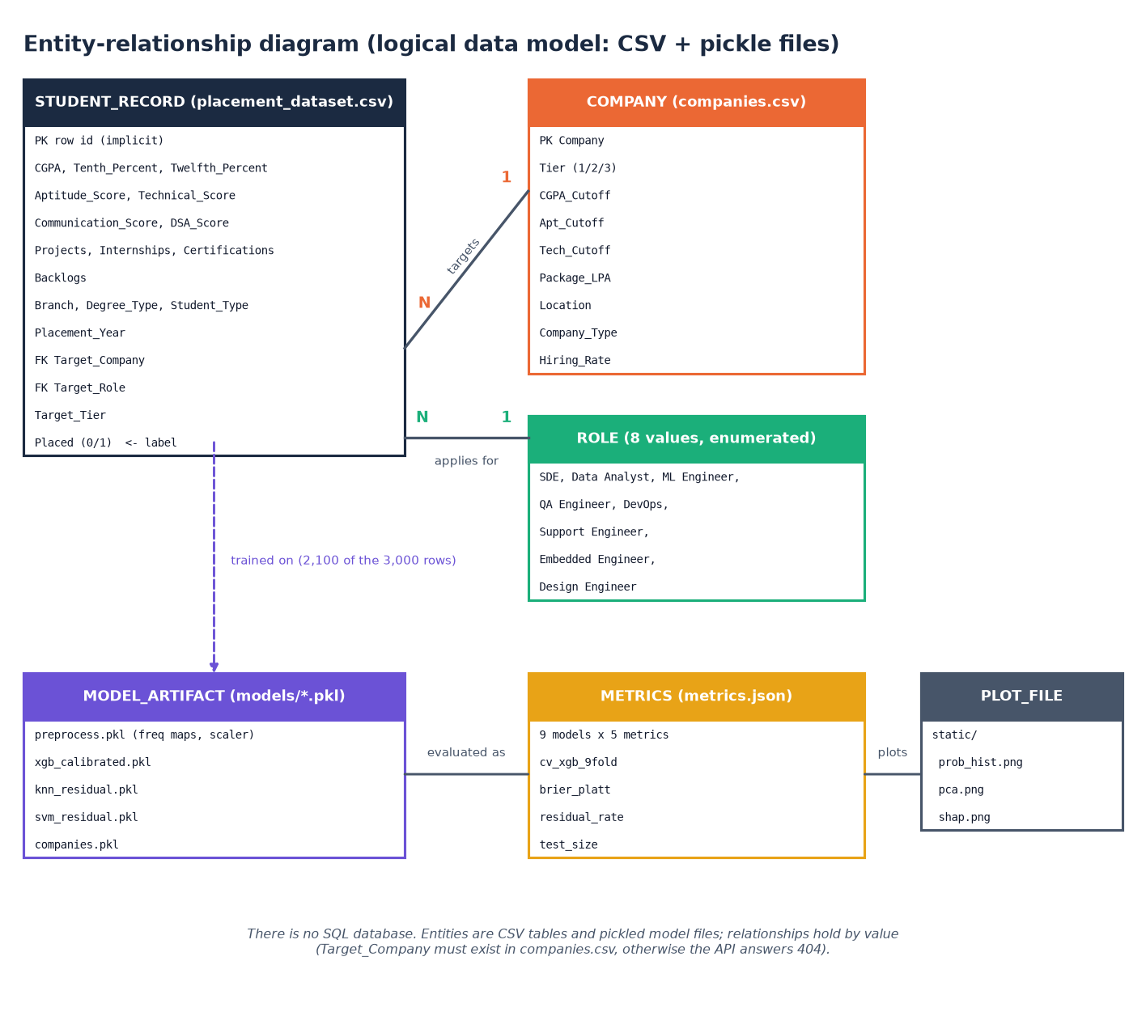
Database Design (file store)
Store | Content
data/placement_dataset.csv | 3,000 students
data/companies.csv | 30 companies
models/xgb_calibrated.pkl | calibrated XGBoost
models/knn_residual.pkl | kNN (k = 9)
models/svm_residual.pkl | SVM (RBF)
models/preprocess.pkl | maps and scaler
models/metrics.json | 9 models x 5 metrics
static/*.png | SHAP, PCA, histogram
There is no SQL database (the batch description mentions MySQL): the ER diagram models the CSV and pickle files.
Dept. of CSE | Batch C5 | Final Review
15
Notes:
Honest point: the project stores files, not rows.

Slide 16
Implementation Highlights
9
46
6
1
REST endpoints (+ /docs)
scripted checks, all pass
React pages
command to start (run.bat)
Pydantic validation: CGPA 0-10, scores 0-100, counts 0-20; unknown company gives 404, bad range 422, missing models 503.
The FastAPI layer imports the original src.recommend functions, so the Flask and React interfaces give identical numbers.
Skill-gap tips are cutoff rules (CGPA, aptitude, technical, internship); the officer dashboard shows metrics, SHAP, PCA and branch rates.
CORS allows only the front-end origin; there is no authentication, rate limiting or database (documented limits).
Dept. of CSE | Batch C5 | Final Review
16
Notes:
Highlights: validation, reuse of the original code, rule-based tips and the known limits.

Slide 17
Results – Model Performance (450 test students, seed 42)
Model | Accuracy | ROC-AUC | F1 | Recall | 5-seed accuracy
Logistic Regression | 0.8289 | 0.9106 | 0.8577 | 0.8657 | 0.8231 ± 0.0194
Random Forest | 0.8067 | 0.8918 | 0.8404 | 0.8545 | 0.8004 ± 0.0216
SVM (RBF) | 0.8289 | 0.8855 | 0.8597 | 0.8806 | 0.8129 ± 0.0169
kNN (k = 9) | 0.7978 | 0.8638 | 0.8378 | 0.8769 | 0.7960 ± 0.0208
XGBoost + Platt | 0.8067 | 0.8928 | 0.8404 | 0.8545 | 0.8138 ± 0.0115
Hybrid (labels used) | 0.8400 | 0.8968 | 0.8710 | 0.9067 | 0.8391 ± 0.0154
Hybrid (label-free) | 0.8089 | 0.8954 | 0.8442 | 0.8694 | 0.8142 ± 0.0180
i
Reading
Logistic Regression has the best AUC (0.9106) because the labels come from a logistic rule. The label-based hybrid is the best accuracy (0.8400) but the label-free one equals XGBoost + Platt (0.8089 vs 0.8067).
Shipped models (models/metrics.json). The five-seed column is a retrain on five random splits (mean ± sd); one seed differs from the shipped model by at most 0.011. Differences of one to two points are within one standard deviation.
Dept. of CSE | Batch C5 | Final Review
17
Notes:
The table is the headline result. Stress the reading: the data is synthetic, so Logistic Regression is strong, and the hybrid gain depends on using the labels.

Slide 18
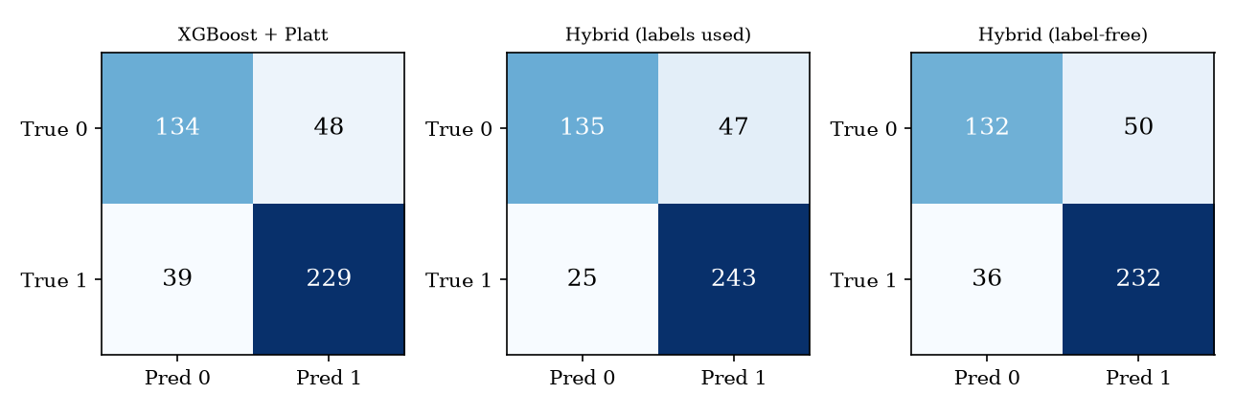
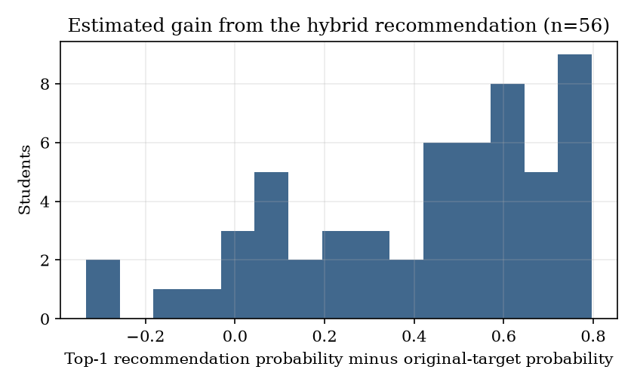
Confusion Matrices & Recommendation Gain
XGBoost + Platt: 39 placed students missed, 48 false alarms.
Hybrid with labels: 25 missed (recall 0.9067): 72 of the 87 XGBoost errors are chosen for refinement only because the label shows they are wrong.
Hybrid serving rule (label-free): 36 missed, 50 false alarms; kNN is right on 54.8% of the 31 borderline rows against 51.6% for XGBoost.
Recommendation on 60 test students rated below 0.5: 52 get a better option; mean base 0.222, top-1 0.643. The histogram covers the 56 with at least one feasible company.
Top pick reaches 0.5 for 39 of 60. Gains are model estimates, not realised placements; picks lean to Tier-3 companies.
Dept. of CSE | Batch C5 | Final Review
18
Notes:
Rows are the true class, columns the prediction. The hybrid's recall gain disappears without labels. The recommendation gains are estimates from the same model.

Slide 19
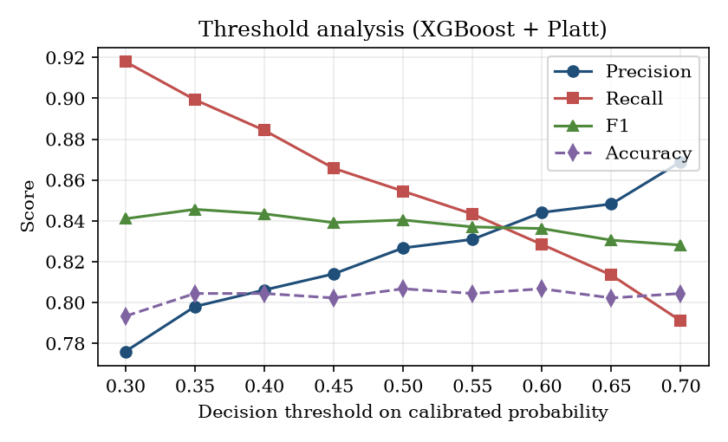
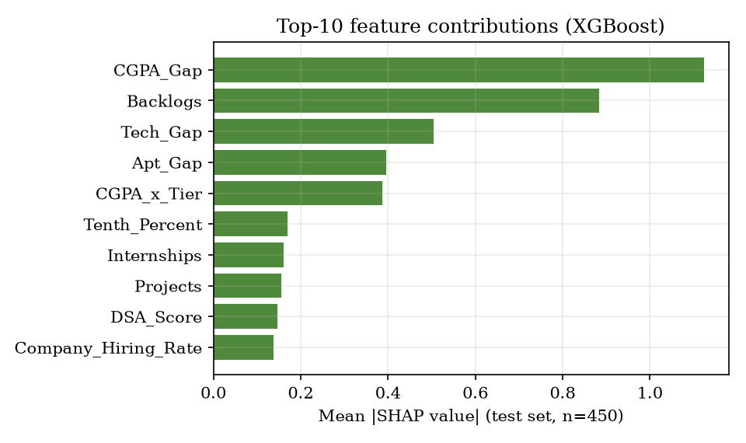
Threshold, Band & Feature Analysis
Refinement band (kNN replaces p) | none | 0.45-0.55 | 0.40-0.60 | 0.35-0.65 | 0.30-0.70 | 0.20-0.80
Rows replaced of 450 | 0 | 13 | 31 | 45 | 73 | 133
Accuracy | 0.8067 | 0.8022 | 0.8089 | 0.8067 | 0.8067 | 0.8067
Accuracy is flat (0.793-0.807) across thresholds 0.30-0.70 while precision rises 0.776 to 0.869 and recall falls 0.918 to 0.791; widening the band changes accuracy by at most 0.4 points. SHAP: CGPA gap, backlogs, technical gap, aptitude gap lead.
Dept. of CSE | Batch C5 | Final Review
19
Notes:
The decision threshold trades precision for recall; accuracy hardly moves. The kNN refinement band makes no measurable difference. SHAP shows the gap features dominate, as the generator intended.

Slide 20
Performance & Testing
66 ms
66 ms
28 ms
5.4 s
predict_for, in process (mean)
POST /api/predict (mean, HTTP)
POST shortlist (mean)
POST /api/recommend (mean, n = 8)
Test layer | What it covers | Result
Unit | tier deltas, 24-feature matrix, determinism, monotonicity, recommendation filters | 10 / 10
Integration and functional | all 9 endpoints, predict, recommend, shortlist | 14 / 14
Validation | out-of-range, missing and unknown values, boundary profiles | 13 / 13
Security | injection-like input, path traversal, CORS, 100 kB input, undefined routes | 9 / 9
Smoke test | running server, every endpoint the React app uses | 15 / 15
Sequential calls on 127.0.0.1, Intel Core i5-12500, CPU only. Recommendation is slow because four pickle files are reloaded per call. Not tested: real data, load, automated browser tests. No authentication exists.
Dept. of CSE | Batch C5 | Final Review
20
Notes:
46 scripted checks plus the 15-check smoke test. Recommendation takes 3 to 8 s; caching the models is the obvious fix and was not done.

Slide 21
Comparison with Base Papers (context only – data differ)
Aspect | IJETMS paper [1] | arXiv paper [2] | This project
Task | Placement prediction | Admission prediction + recommendation | Placement prediction + company-role recommendation
Data | Synthetic, size not stated; 80:20 | 13,000 real records; 70/15/15 | 3,000 synthetic students; 70/15/15
Models | LR, RF, Gradient Boosting | 7 baselines; XGBoost + kNN / SVM | 6 baselines; calibrated XGBoost + kNN / SVM
Accuracy | not reported | XGBoost 0.7241; hybrid 0.8723 | XGBoost 0.8089; hybrid 0.8400 (labels) / 0.8089 (label-free)
Brier score | not reported | 0.1864 (Platt) | 0.1352 (Platt)
Explainability | feature importance, skill gap | SHAP | SHAP ranking + cutoff-rule tips
Deliverable | Streamlit app, PDF, e-mail | method only | Flask + FastAPI + React, officer and recruiter tools
Different data and conditions: our data is synthetic and rule-generated (even Logistic Regression scores 0.8289), the paper's real data is noisier. No superiority is claimed.
Dept. of CSE | Batch C5 | Final Review
21
Notes:
State plainly that the datasets differ. The accuracy numbers are context, not a ranking.

Slide 22
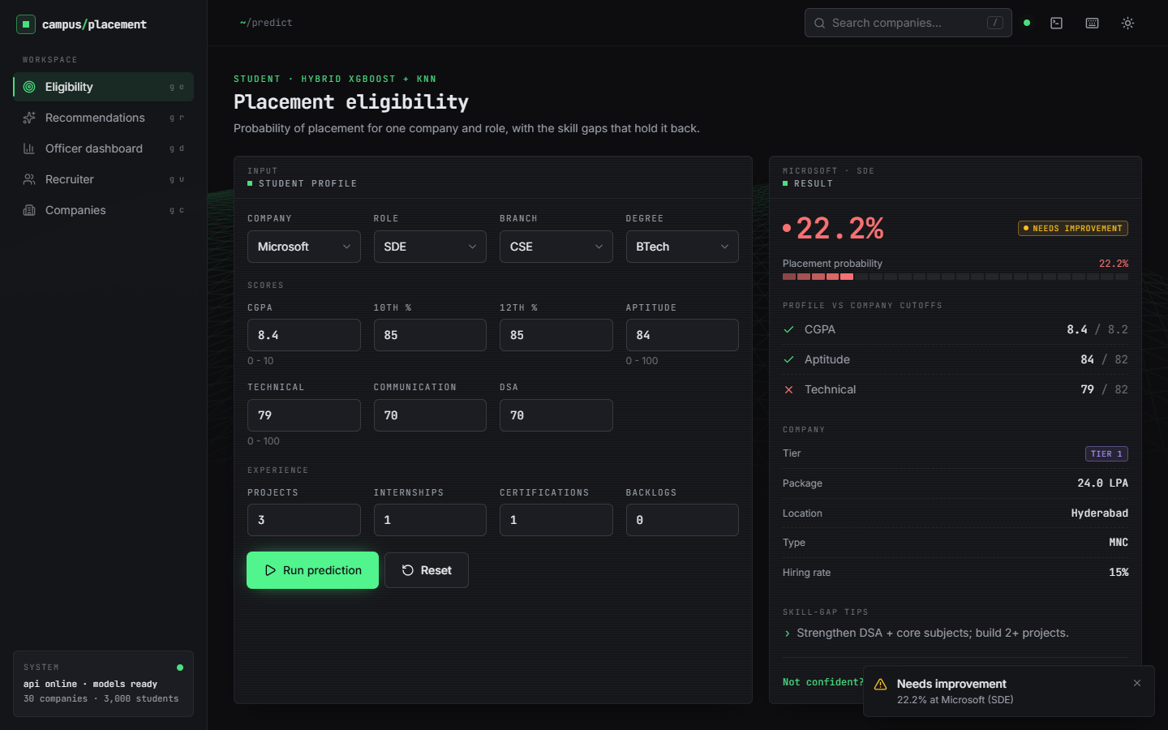
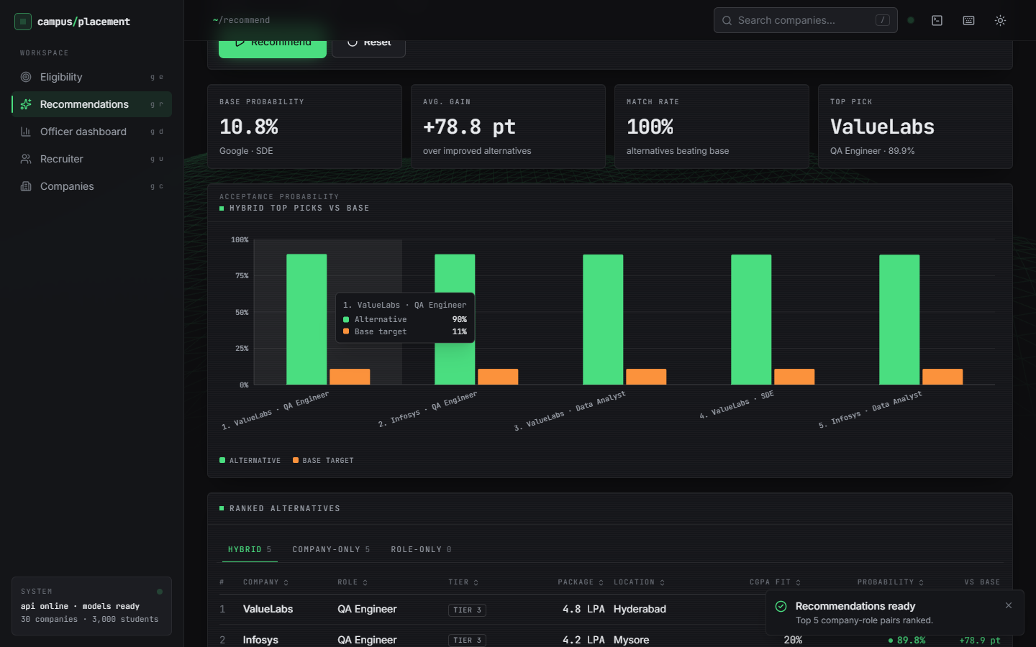
Output – Eligibility and Recommendations
Left: Microsoft SDE for CGPA 8.4, aptitude 84, technical 79 gives 22.2%, needs improvement; the cutoff panel shows technical 79 below 82 and the tip. Right: for a CGPA 7.5 student targeting Google SDE (10.8%) the top picks are ValueLabs and Infosys at about 90%.
Dept. of CSE | Batch C5 | Final Review
22
Notes:
Real screenshots of the running application. Point out that recommendations lean to easier Tier-3 companies because the ranking maximises probability.

Slide 23
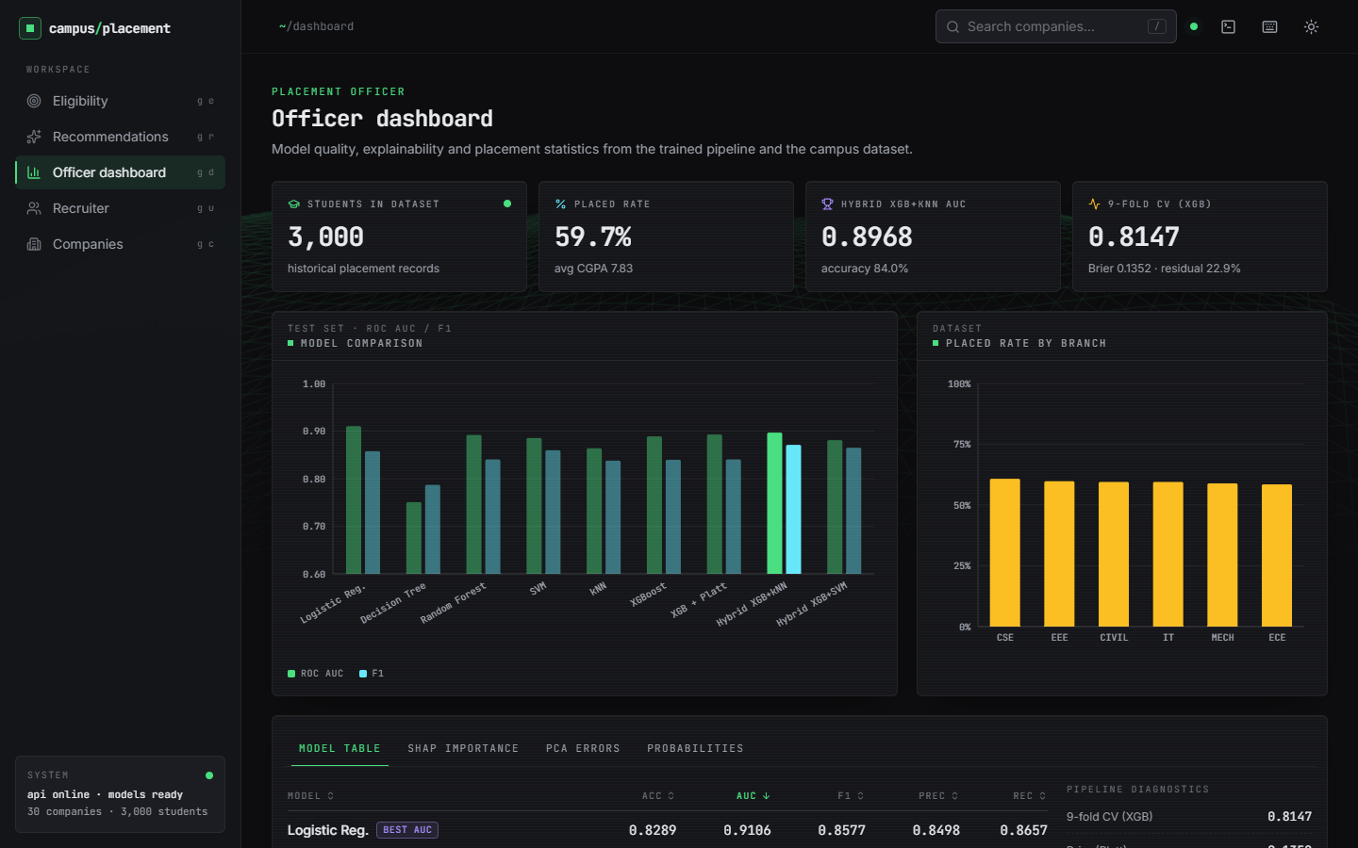
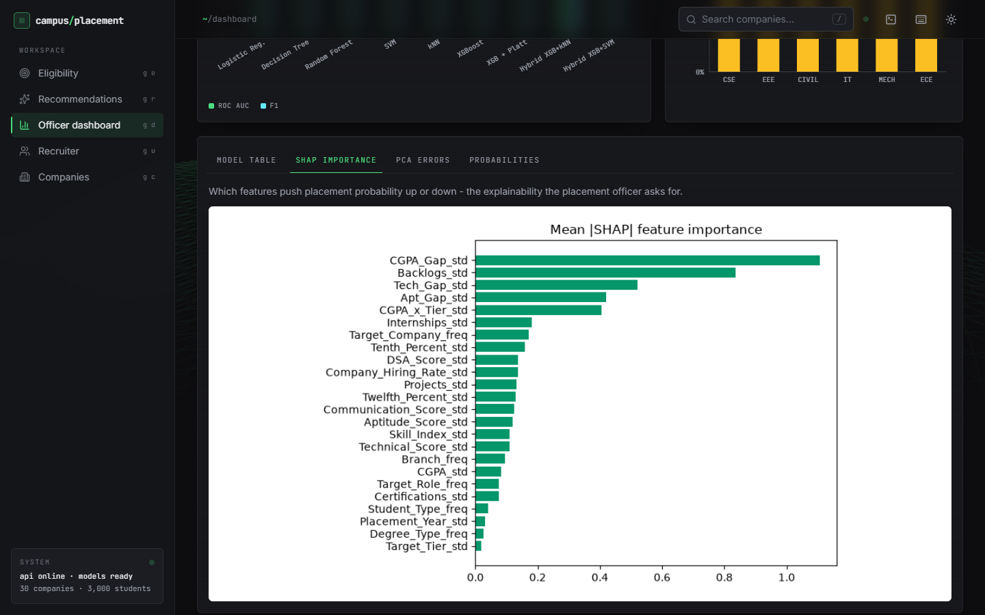
Output – Officer Dashboard and SHAP
Left: 3,000 students, placed rate 59.7%, hybrid AUC 0.8968, 9-fold CV 0.8147, Brier 0.1352, model comparison and placed rate by branch. Right: mean |SHAP| of all 24 features; the gap features lead.
Dept. of CSE | Batch C5 | Final Review
23
Notes:
The dashboard shows shipped metrics (the label-based hybrid); the label-free check is in this deck and the report.

Slide 24
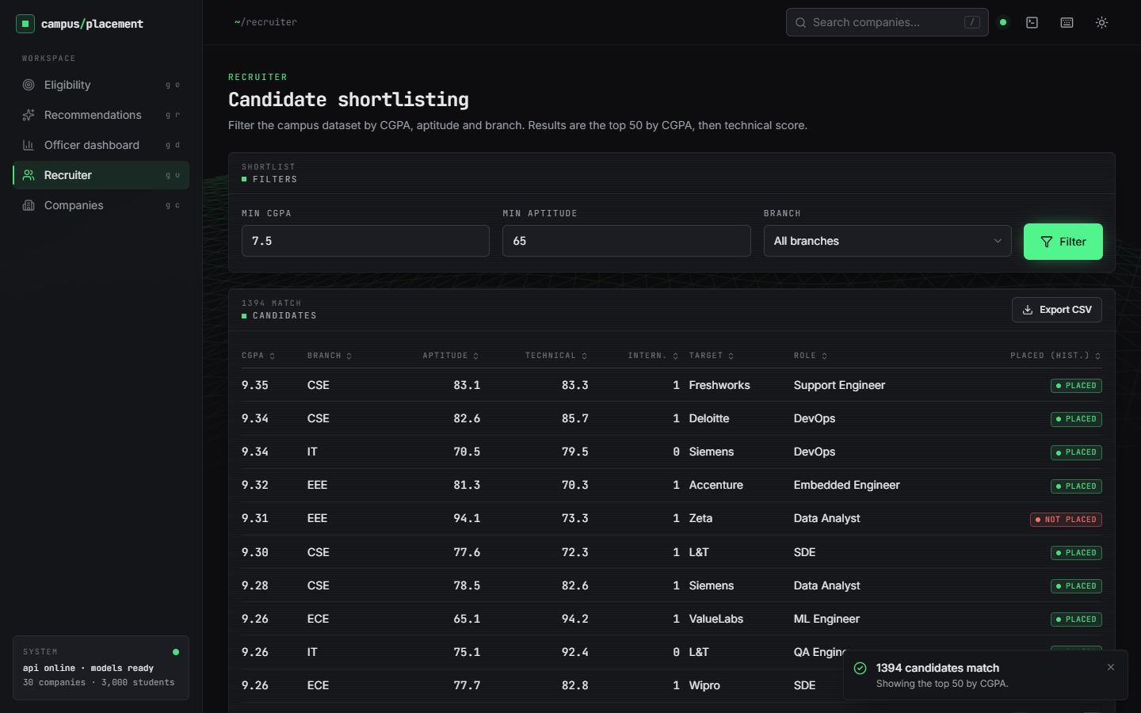
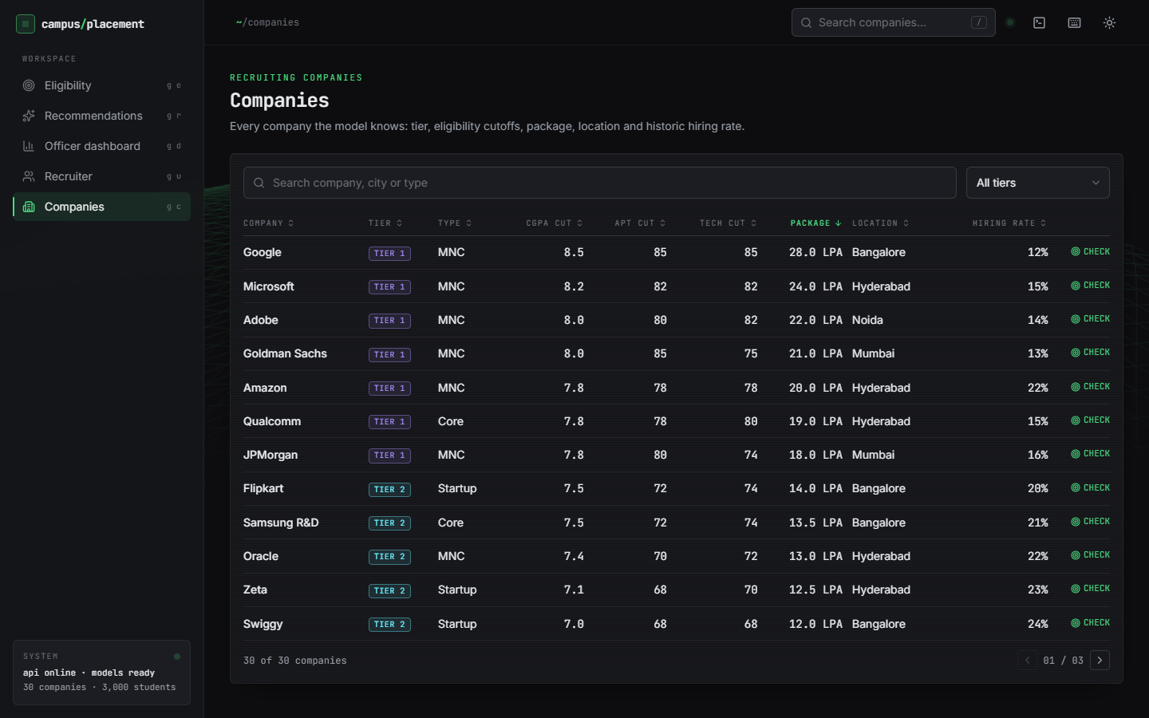
Output – Recruiter Shortlist and Companies
Left: minimum CGPA 7.5 and aptitude 65 match 1,394 students; the top 50 by CGPA are listed with their historical placed tag. Right: the 30-company table with tier, cutoffs, package, location and hiring rate (invented values).
Dept. of CSE | Batch C5 | Final Review
24
Notes:
Recruiter shortlist and the company board. The placed tags are the synthetic labels.

Slide 25
Conclusion
Delivered: a working placement system: 24-feature pipeline, calibrated XGBoost with kNN refinement, skill-gap tips, company-role recommendation, officer dashboard, recruiter shortlist, FastAPI and React interfaces, and 46 passing checks.
Measured: 80.67% accuracy and AUC 0.8928 for XGBoost + Platt on 450 synthetic test students; the hybrid's 84.0% needs true labels, 80.89% without; Logistic Regression has the best AUC.
Objectives: 3, 4, 5 and 6 met; 2 met for encoding (no resampling needed); 1 only with synthetic data.
Limits: synthetic data and invented companies, no real-outcome validation, 3-8 s recommendations, no login or database. Not a decision tool for real students.
Dept. of CSE | Batch C5 | Final Review
25
Notes:
Be explicit about which objectives were met and which were not.

Slide 26
Future Scope
Train and evaluate on real, anonymised placement records with a time-based split.
Cache the model files per process so a recommendation takes well under a second.
Validate categories, add login and roles, and store data in a database as the batch plan describes.
Batch CSV prediction, PDF reports and per-student SHAP explanations.
Check recommendations against realised outcomes; balance probability with package and fit.
Dept. of CSE | Batch C5 | Final Review
26
Notes:
Concrete next steps, ordered by value.

Slide 27
References
[1] M. Prasanna Kumari, B. Punith, M. Srinath, P. Koushik and Y. Gourav, "Student placement prediction system using machine learning," Int. J. Eng. Technol. Manage. Sci. (IJETMS), vol. 10, no. 3, pp. 47-51, May-Jun. 2026, doi: 10.46647/ijetms.2026.v10i03.008.
[2] M. Heidari Fard and E. Tabrizi, "A hybrid machine learning approach for graduate admission prediction and combined university-program recommendation," arXiv:2603.29881 [cs.IR], Feb. 2026.
[3] T. Chen and C. Guestrin, "XGBoost: A scalable tree boosting system," in Proc. 22nd ACM SIGKDD Int. Conf. Knowl. Discovery Data Mining, San Francisco, CA, USA, Aug. 2016, pp. 785-794.
[4] J. C. Platt, "Probabilistic outputs for support vector machines and comparisons to regularized likelihood methods," in Advances in Large Margin Classifiers, A. J. Smola, P. Bartlett, B. Scholkopf and D. Schuurmans, Eds. Cambridge, MA, USA: MIT Press, 1999, pp. 61-74.
[5] S. M. Lundberg and S.-I. Lee, "A unified approach to interpreting model predictions," in Advances in Neural Information Processing Systems 30 (NIPS 2017), Long Beach, CA, USA, Dec. 2017, pp. 4765-4774.
[6] F. Pedregosa et al., "Scikit-learn: Machine learning in Python," J. Mach. Learn. Res., vol. 12, pp. 2825-2830, Oct. 2011.
[8] G. W. Brier, "Verification of forecasts expressed in terms of probability," Mon. Weather Rev., vol. 78, no. 1, pp. 1-3, Jan. 1950.
[9] A. Niculescu-Mizil and R. Caruana, "Predicting good probabilities with supervised learning," in Proc. 22nd Int. Conf. Mach. Learn. (ICML), Bonn, Germany, Aug. 2005, pp. 625-632.
[13] J. B. Schafer, J. A. Konstan and J. Riedl, "E-commerce recommendation applications," Data Min. Knowl. Discov., vol. 5, no. 1-2, pp. 115-153, Jan. 2001, doi: 10.1023/A:1009804230409.
[15] M. H. Baffa, M. A. Miyim and A. S. Dauda, "Machine learning for predicting students' employability," UMYU Scientifica, vol. 2, no. 1, pp. 1-9, Mar. 2023, doi: 10.56919/usci.2123_001.
[17] A. Gupta, S. Gupta, P. K. Mall, S. Srivastava, A. S. Saluja, N. Yadav, V. Narayan, M. K. Verma and S. Sriramulu, "ML-CPC: A pathway for machine learning based campus placement classification," J. Electr. Syst., vol. 20, no. 3s, 2024, doi: 10.52783/jes.1521.
[18] A. Pathak, M. Matcha, M. Gopisetti and S. Joshi, "A machine learning framework for predicting student placement outcomes," Ing. Syst. Inf. (ISI), vol. 30, no. 7, pp. 1715-1721, Jul. 2025, doi: 10.18280/isi.300704.
[19] A. D. P. Kumar, V. Kuchhadia, G. Charan, G. Sreeja and N. Pavan, "Predicting student employability using machine learning: A comparative study of classification algorithms," in Proc. Int. Conf. Comput. Sci. Commun. Eng. (ICCSCE 2025), Hyderabad, India, Apr. 2025, pp. 799-812, doi: 10.2991/978-94-6463-858-5_68.
[21] S. K. Thangavel, P. D. Bkaratki and A. Sankar, "Student placement analyzer: A recommendation system using machine learning," in Proc. 4th Int. Conf. Adv. Comput. Commun. Syst. (ICACCS), IEEE, 2017 (authors as listed in the Amrita University publication record).
[23] C. Romero and S. Ventura, "Educational data mining: A review of the state of the art," IEEE Trans. Syst., Man, Cybern. C, Appl. Rev., vol. 40, no. 6, pp. 601-618, Nov. 2010.
Dept. of CSE | Batch C5 | Final Review
27
Notes:
Selected references; the complete numbered list is in the report.

Slide 28
THANK YOU
Questions & Suggestions
Dept. of CSE | Batch C5 | Final Review
28
Notes:
Invite questions.

