Slide 1

Privacy-Preserving Machine Unlearning in Federated LLMs: A Certified Right-to-Be-Forgotten Framework
Final Review
Team Details : Batch A9
Under the Esteemed Guidance of
[GUIDE NAME]
[DESIGNATION], Department of CSE (Data Science)
23K91A6761 G.SHASHANK
23K91A6719 B.SATHISH
23K91A6759 G.RAKESH
23K91A6721 B.AKHIL
DEPARTMENT OF COMPUTER SCIENCE AND ENGINEERING (DATA SCIENCE) · Academic Year [ACADEMIC YEAR]
Notes:
Final review of ForgetSafe: a certified federated-unlearning demonstrator with a tamper-evident compliance ledger.

Slide 2
Table of Contents
Abstract
Base Paper & Literature Survey
Research Gap & Problem Statement
Objectives
Proposed System & Architecture
Methodology & Algorithm
Design & Implementation
Results, Parameter Analysis, Testing & Comparison
Output Screens
Conclusion & Future Scope
References
Dept. of CSE | Batch A9 | Final Review
2

Slide 3
Abstract
Federated LLMs keep each client's data local, yet every client's influence stays in the shared parameters; GDPR Article 17 lets a user demand removal.
ForgetSafe is a runnable demonstrator: five simulated clients train a character-bigram model (1,089 parameters, standing in for an LLM adapter update) with L2 clipping and Gaussian noise.
A client is removed by subtracting its tracked clipped update, with no retraining; each request gets a certificate, a membership-inference check, a utility check and a SHA-256 hash-chained audit record.
Measured: certificate gap 1e-14 (an identity check); 250 requests all CERTIFIED; retention 97.1 % ± 3.5; 5 unit tests and 14 smoke checks pass.
Honest findings: at the default noise the model is worse than a uniform guess (perplexity 142 vs 32) and the attack is at chance (AUC 0.52); epsilon 1.61 lies outside the classical bound's range.
Keywords: machine unlearning, federated learning, differential privacy, right to be forgotten, audit.
Dept. of CSE | Batch A9 | Final Review
3
Notes:
Abstract: problem, approach, headline measurements and the honest limits.

Slide 4
Base Paper
A. Khan, S. Jin, G.-H. Lee, G. E. Arzu, L. M. Dang, T. N. Nguyen, W. Choi, and H. Moon, "Deep learning approaches for continuous sign language recognition: A comprehensive review," IEEE Access, vol. 13, pp. 55524-55544, 2025, doi: 10.1109/ACCESS.2025.3554046.
What it is: a survey of deep-learning continuous sign language recognition; it organises the field into a taxonomy (spatial, temporal and alignment approaches), compares strengths and drawbacks and lists open gaps.
Relevance: its subject is unrelated to unlearning. The batch records adopt only its review method: taxonomy, comparison of strengths and limitations, research-gap identification. No numeric comparison with it is possible and none is made.
Technical anchor: Wei et al., KDD 2026 [2] - Grouped Memorization Evaluation and FedMemPrune, a pruning-based federated unlearning that closely matches retraining baselines on CIFAR-10, CIFAR-100 and EMNIST.
Companion: Oblivionis [3], a federated LLM learning-and-unlearning framework motivated by GDPR.
Dept. of CSE | Batch A9 | Final Review
4
Notes:
[1] is the base paper recorded in the batch files; [2] and [3] are the closest technical works, read from the PDFs in archived_base_papers.

Slide 5
Literature Survey
Author / Year | Methodology | Dataset | Key Results | Limitations
Khan et al., 2025 (base) [1] | Survey; taxonomy of sign-language recognition models | Sign-language video datasets (surveyed) | Taxonomy, challenges and gaps | Unrelated subject; review method only
Wei et al., KDD 2026 [2] | Grouped Memorization Evaluation; FedMemPrune (prune memorising parameters) | CIFAR-10, CIFAR-100, EMNIST; ResNet, VGG-9 | Closely matches retraining; removes memorisation better than federated-unlearning baselines | Image classifiers, not LLM pipelines
Zhang et al., 2025 (Oblivionis) [3] | Unified FL + unlearning; 6 FL and 5 unlearning algorithms | TOFU, MUSE; Llama-2-7B, Llama-3.1/3.2 | Beats local training; balances forgetting and utility | Empirical comparison of algorithms; certification not its focus
Jiang et al., 2025 (FedORA) [4] | Primal-dual optimisation for sample/label unlearning | Income, MedMNIST, CIFAR-10/100, Tiny-ImageNet | Comparable to retraining at lower cost; bounded gap to train-from-scratch | Vertical FL; not LLMs
Zhang, 2024 [7] | Short review of FedEraser, FedCIO, FedRecovery, F2UL | Review (no data) | Precision vs cost vs privacy-risk trade-offs | 5-page review
Items [5], [6], [8] | Titles in the batch survey | Not retrieved | Not retrieved | Not independently verified; no claims made
Dept. of CSE | Batch A9 | Final Review
5
Notes:
[1]-[4] and [7] were read or verified; [5], [6] and [8] could not be found online, so nothing beyond their titles is claimed.

Slide 6
Research Gap
Source | Research Gap
Base paper [1] | Reviews an unrelated field; it supplies a method of organising work, not an unlearning technique
Memorization pruning, primal-dual [2], [4] | Empirical or vertical-FL unlearning on image and tabular benchmarks; not designed for federated LLM pipelines; no per-request compliance record
Federated LLM unlearning [3] | Compares unlearning algorithms on TOFU and MUSE; evaluation is empirical (ROUGE, truth ratio); the abstract describes no certificate or regulator-facing audit record
Reviews and audits [5]-[8] | List challenges (efficiency, metrics, non-IID data) and robustness risks of certified unlearning (titles only for [5], [6], [8])
Existing practice (batch survey) | Full retraining is too costly; heuristic weight edits give no proof; SISA needs a sharded design; DP training limits influence but does not remove it
Open problem | Certified, auditable client-level unlearning for federated LLM pipelines. ForgetSafe prototypes the workflow on a proxy model and tests it honestly
Dept. of CSE | Batch A9 | Final Review
6
Notes:
The gap is the certified, auditable workflow; the prototype does not close the evidence gap because it uses a proxy model.

Slide 7
Problem Statement
A client's influence remains embedded in the shared parameters of a federated LLM after training.
Retraining a large federated model for every deletion request is impractical.
Heuristic unlearning gives no formal proof that data was forgotten.
Without verifiable unlearning a model cannot demonstrate compliance with the Right to Be Forgotten.
Need: a certified unlearning framework that removes a client's influence efficiently and proves it to regulators and users - with an auditable record of every request.
Dept. of CSE | Batch A9 | Final Review
7

Slide 8
Objectives
O1 Federated fine-tuning across clients - partly met: 5 simulated clients on a bigram proxy, no LLM.
O2 Parameter-level unlearning without retraining - met on the proxy: exact subtraction of the tracked update.
O3 Certify forgetting with DP guarantees - partly met: epsilon 1.61 reported, outside the classical range; noise reused; check is an identity.
O4 Verify by membership inference and retraining comparison - met as implemented; attack uninformative at default noise (AUC 0.52).
O5 Preserve utility - met by the metric (97.1 % retention) but the baseline model is weak at sigma = 3.
O6 Auditable record per request - met with limits: tamper-evident against edits, not against forgery.
Dept. of CSE | Batch A9 | Final Review
8

Slide 9
Proposed System
Train - each client's bigram update is L2-clipped (C = 25); the coordinator adds Gaussian noise (sigma = 3) to the sum and averages.
Track - the clipped update of every client is stored so it can be removed later.
Request - an operator selects a client for removal (POST /api/unlearn).
Unlearn - subtract the stored update, divide by n - 1: no retraining.
Verify - retained-only recomputation (L2 <= 1e-10), loss-based membership attack, perplexity, accuracy and a 70 % retention floor.
Certify - a certificate with epsilon, delta, hashes and metrics is issued and downloadable as JSON.
Record - training and unlearning events are appended to a SHA-256 hash-chained ledger that anyone can re-verify.
Dept. of CSE | Batch A9 | Final Review
9

Slide 10
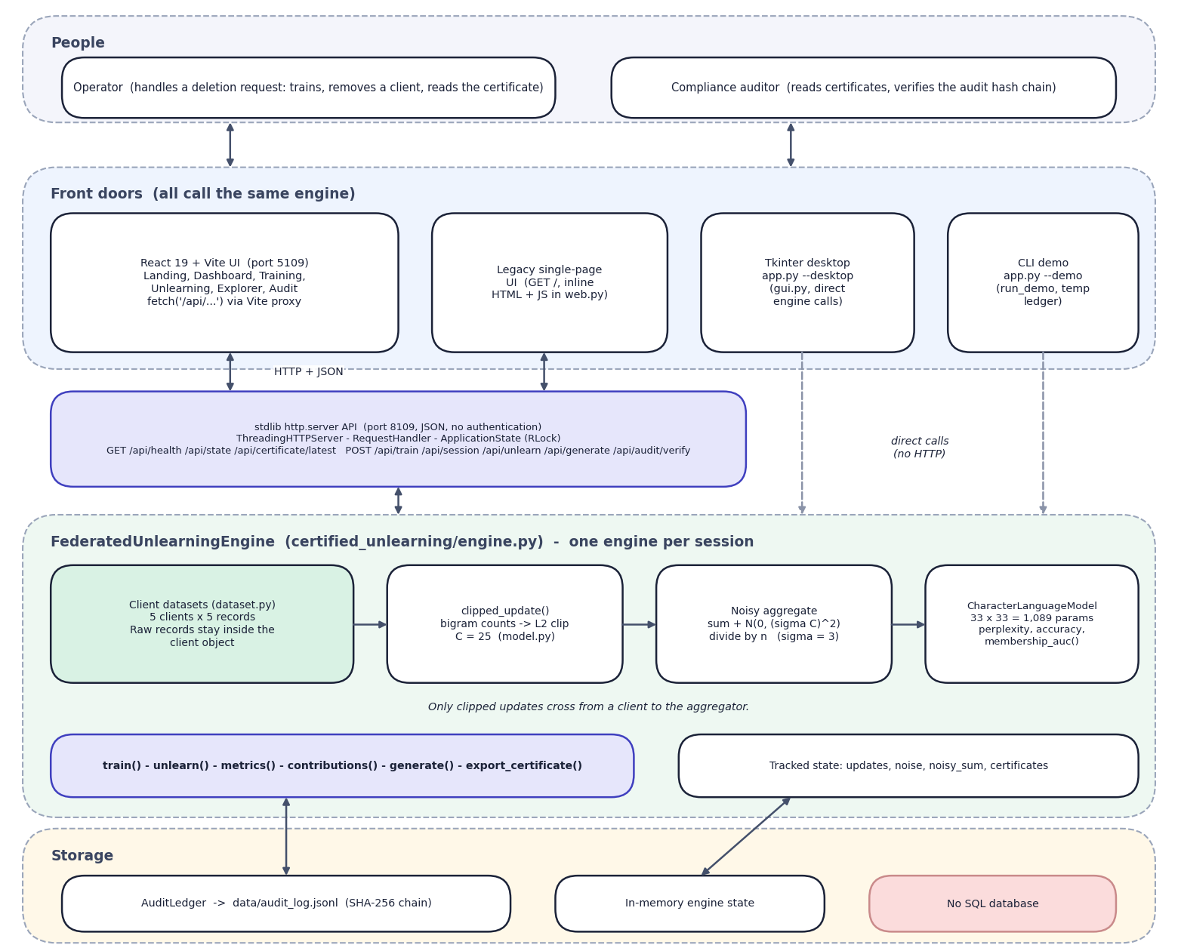
System Architecture
• React 19 + Vite UI on port 5109: dashboard, training, unlearning, explorer, audit; proxies /api
• Python standard-library HTTP API on port 8109: 9 routes, JSON errors
• Engine: clipping, noisy aggregation, unlearning, certification; bigram model; membership attack
• Audit ledger: append-only JSONL, SHA-256 chain
• No SQL database and no login: state lives in memory and the ledger file
Dept. of CSE | Batch A9 | Final Review
10

Slide 11
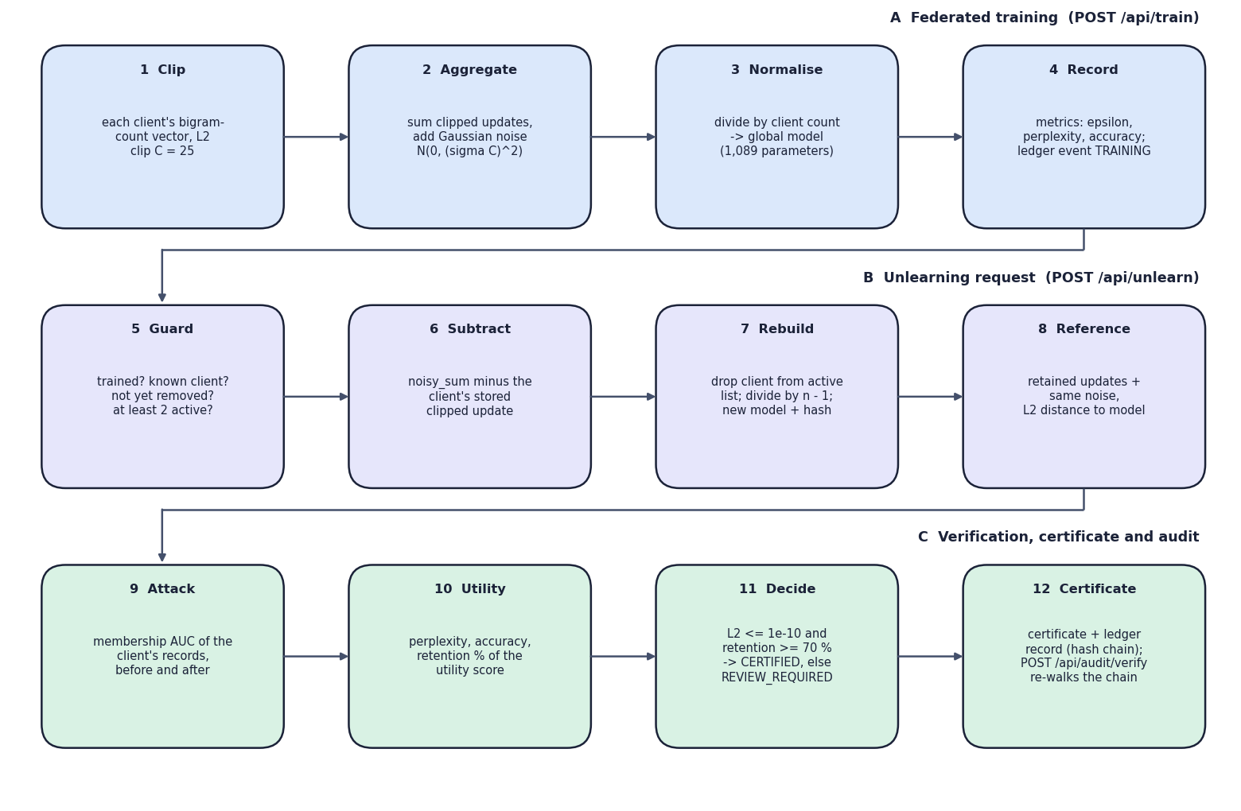
Methodology
End-to-end workflow: train, track updates, request, subtract, verify, certify, record
Dept. of CSE | Batch A9 | Final Review
11

Slide 12
Data, Model & Parameters
Data: built-in synthetic corpus, 5 clients (Finance, Healthcare, Education, Retail, Travel) x 5 sentences = 25 records; 5 public evaluation sentences; 5 non-member sentences. No external dataset and no train/test split beyond these fixed sets.
Model: character-bigram language model over a 33-symbol alphabet; 33 x 33 = 1,089 parameters; add-0.15 smoothing. It stands in for a LoRA-style adapter update.
Clipping: C = 25; all five raw update norms (25.2-28.2) are clipped (scale 0.886-0.991).
Noise: Gaussian, std sigma x C = 75 per coordinate; expected noise L2 = 2475 against a clipped client norm of 25.
Privacy: epsilon = sqrt(2 ln(1.25/delta)) / sigma = 1.6149 at delta = 1e-5; the classical bound needs epsilon < 1, i.e. sigma > 4.845.
Thresholds: reference tolerance 1e-10; retention floor 70 %; utility = 0.65 x accuracy + 0.35 / (1 + ln(1 + perplexity)).
Dept. of CSE | Batch A9 | Final Review
12
Notes:
Everything is synthetic and tiny by design; the findings describe the algorithm and the demonstrator, not an LLM.

Slide 13
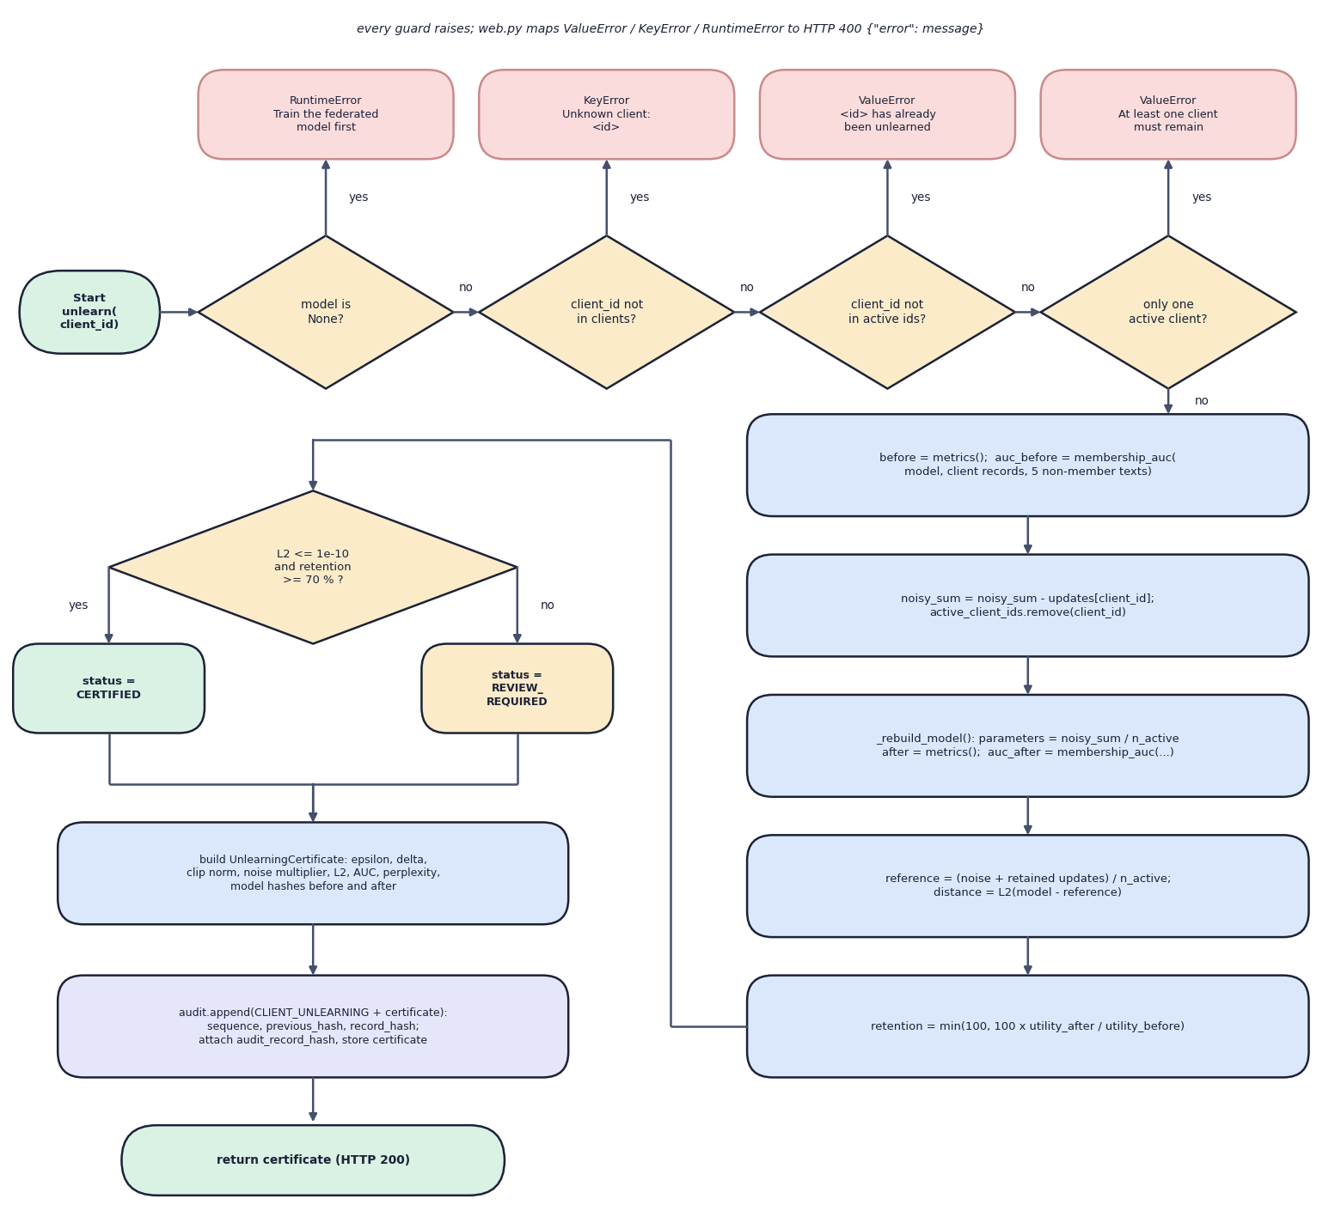
Decision Workflow
• Guards: trained, client exists, not already removed, at least one client remains
• Subtract the stored clipped update from the noisy sum; rebuild the model over n - 1 clients
• Recompute the retained-only aggregate from stored updates and the same noise; L2 <= 1e-10 and retention >= 70 % gives CERTIFIED, otherwise REVIEW_REQUIRED
• Append the certificate to the hash-chained ledger
Dept. of CSE | Batch A9 | Final Review
13

Slide 14
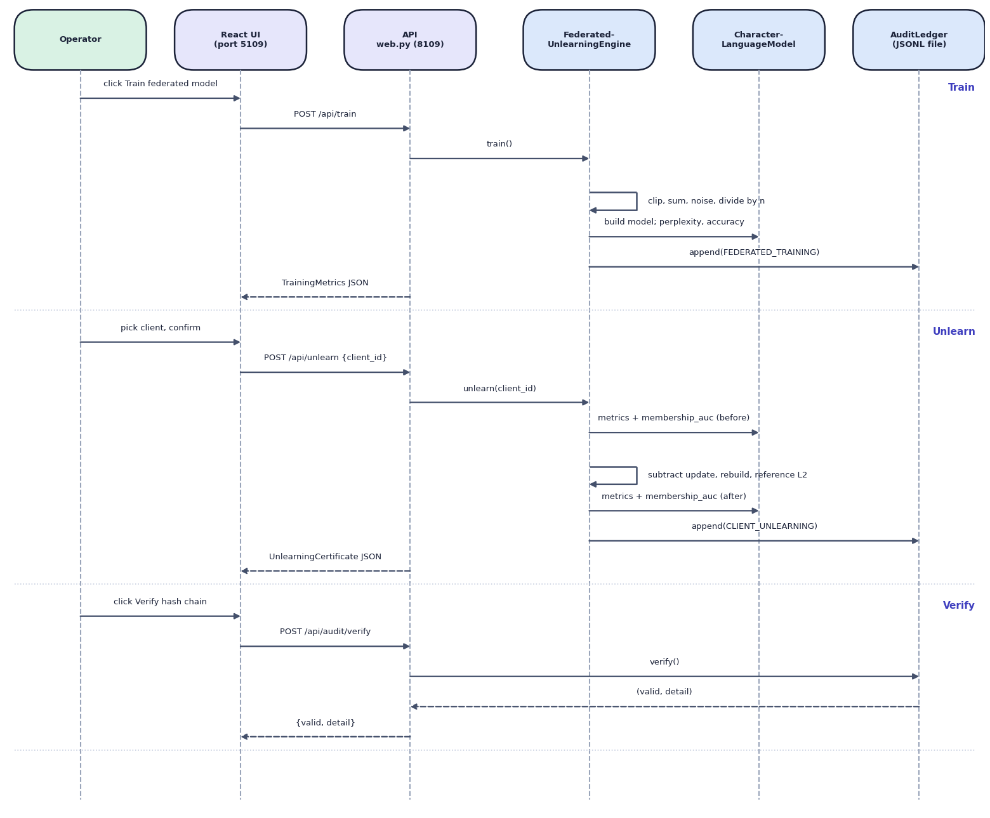
User–System Interaction
• The UI calls POST /api/train; the engine clips, aggregates and logs a FEDERATED_TRAINING event
• POST /api/unlearn runs unlearn(): subtract, rebuild, verify, issue the certificate and append the ledger record
• GET /api/certificate/latest downloads the JSON; POST /api/audit/verify re-walks the hash chain
Dept. of CSE | Batch A9 | Final Review
14

Slide 15
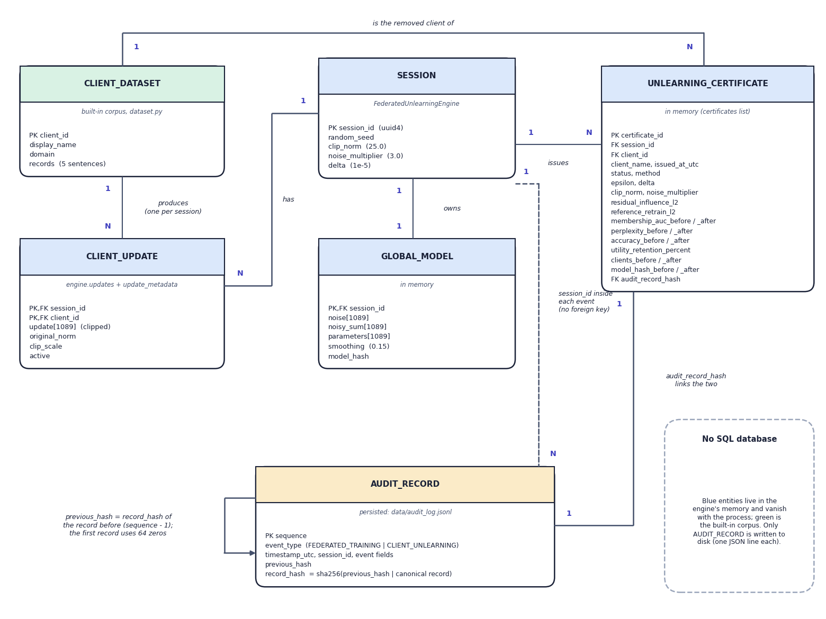
Data Model (no SQL database)
• Session / engine: seed, clip norm, noise multiplier, delta
• ClientDataset and ClientUpdate: records, clipped vector, original norm, clip scale
• GlobalModel: 1,089 parameters and a SHA-256 model hash
• UnlearningCertificate: 25 fields incl. metrics and hashes; one AuditRecord per event, chained by previous_hash
Dept. of CSE | Batch A9 | Final Review
15

Slide 16
Implementation Highlights
Module | Implementation
model.py | Bigram counts, L2 clipping, perplexity, next-character accuracy, loss-based membership AUC, sampling
engine.py | train(): clip, sum, add noise; unlearn(): subtract, rebuild, verify, certificate; epsilon formula; guards for repeat and last client
audit.py | Append-only JSONL; record_hash = SHA-256(previous_hash | canonical JSON); verify() re-walks the chain
web.py + app.py | Standard-library threaded HTTP server; 9 routes; 1 MB body limit; JSON errors; also --demo and --desktop modes
frontend/ | React 19, Vite 8, Recharts; five pages plus landing; toasts, confirm dialogs, dark mode
tests/ + scripts/ | 5 unit tests, 14-check smoke test, and run_experiments.py (11 measurement experiments)
Dept. of CSE | Batch A9 | Final Review
16

Slide 17
Results – Measured Performance
Measure | Result | Note
Default run (seed 2026), 5 removals | 5 / 5 CERTIFIED | reference L2 <= 2.8e-14; retention 93.6-98.8 %
Seed study, 250 requests | 250 / 250 CERTIFIED | retention 97.1 ± 3.5 % (min 79.9)
Perplexity at sigma = 3 | 130.2 (seed 2026); 142 ± 28 | uniform model = 32; accuracy about 4-5 %
Membership AUC before / after | 0.524 / 0.495 | chance = 0.5; sd 0.22; change -0.029
Unlearned vs fresh retrain (L2, sigma 3) | 875 vs 881 | retrain vs retrain; both are just the noise
Noise-free membership AUC | 0.99 → 0.54 | sigma = 1e-6: the removal itself works
Audit tamper cases detected | 4 of 7 attacks | edit, flip, delete, swap caught; truncation and re-hash forgery not
Automated checks | 5 unit + 14 smoke pass | no load, LLM or penetration tests
Measured on a 5-client, 25-sentence synthetic demonstrator with a bigram proxy; not an estimate of LLM-scale behaviour.
Dept. of CSE | Batch A9 | Final Review
17
Notes:
The headline certificate result is an identity; the gold-standard comparison and the noise-free attack supply the real evidence.

Slide 18
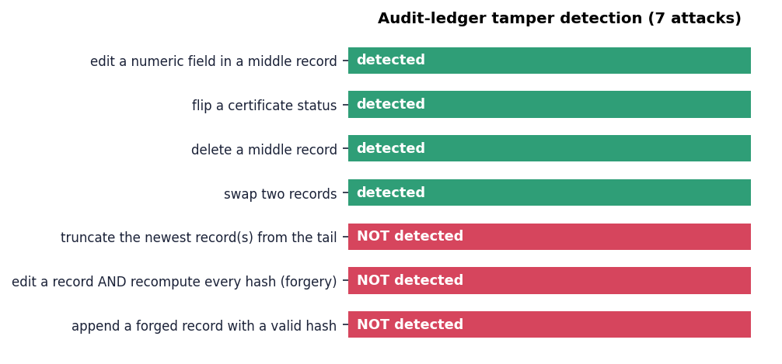
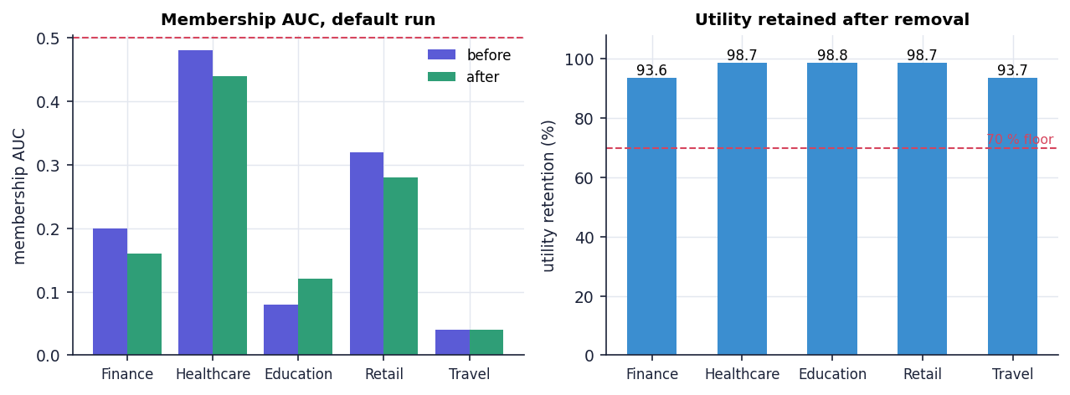
Per-Client Outcomes & Tamper-Detection Matrix
Default run: membership AUC before/after and utility retention (93.6-98.8 %) for each removed client
Ledger tamper matrix: 4 of 7 attacks detected; truncation, re-hash forgery and forged append pass
Dept. of CSE | Batch A9 | Final Review
18
Notes:
There is no classifier here, so the equivalent of a confusion matrix is the per-client outcome table and the detected / not-detected matrix of tamper attacks.

Slide 19
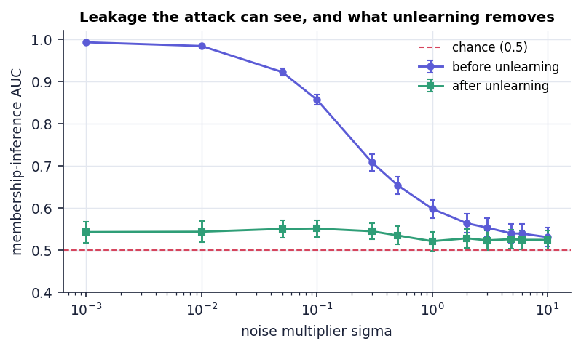
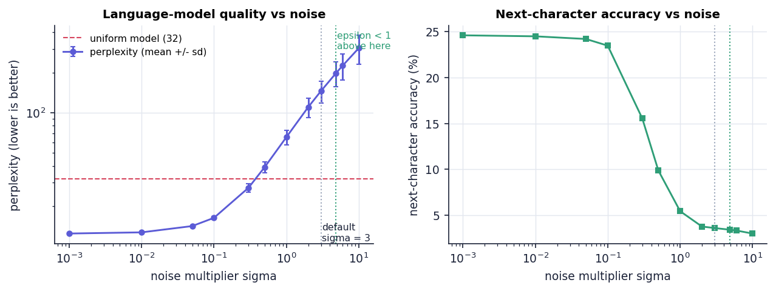
Parameter Analysis: Noise Multiplier
Quality vs sigma: useful only at sigma <= 0.1 (epsilon >= 48); sigma = 3 gives perplexity 145
Attack AUC 0.99 → 0.54 at sigma = 0.001; near chance from sigma = 2
Dept. of CSE | Batch A9 | Final Review
19
Notes:
20 seeds x 5 clients per sigma. epsilon < 1 needs sigma > 4.85, where perplexity is 198-305.

Slide 20
Performance & Testing
Measurement | Result
API response, median / p95 (ms, 127.0.0.1) | health 3.0 / 25.4; train 36.5 / 60.0; unlearn 57.9 / 82.4; generate 7.3 / 23.6; audit verify 5.8 / 25.2
Unlearn vs retrain (proxy) | 5 clients: 45 vs 13 ms (unlearn slower); 100 clients 1.4x faster; 500 clients (50,000 records) 6.8x faster
Ledger cost | append re-reads the file: 0.44 ms at 1 record, 19.6 ms at 2,000; verify 2,000 records 44 ms
Automated tests | 5 unit tests (workflow, repeat rejection, tamper, export, HTTP) and 14 smoke checks all pass
Edge cases | malformed JSON, non-object body, unknown client, repeat and last-client removal -> HTTP 400 with a message; 2 MB body aborts the connection; PUT returns an HTML 501 page
Not measured | concurrent load, real LLM, GPU, authentication (none exists), penetration testing
Dept. of CSE | Batch A9 | Final Review
20
Notes:
Machine: Intel Core i5-12500, 15.7 GB RAM, no GPU. Latencies are single-client medians; proxy retraining is itself cheap, so these say nothing about LLM-scale cost.

Slide 21
Comparison with Base Paper and Closest Work (context only)
System | Task and data | Method | Reported / measured | Guarantee and audit | Comparable?
Base paper [1] | Review of continuous sign language recognition | Taxonomy of spatial, temporal, alignment models | No unlearning results | - | No: unrelated subject
Wei et al. [2] (KDD 2026) | Federated unlearning on CIFAR-10/100, EMNIST | FedMemPrune: prune memorising parameters | Closely matches retraining baselines | Empirical memorisation metric | No: images, not LLMs
Oblivionis [3] | Federated LLM unlearning on TOFU, MUSE (Llama models) | 6 FL x 5 unlearning algorithms | Beats local training; forgetting/utility balance | Empirical metrics (ROUGE, truth ratio) | No: real LLMs
ForgetSafe (ours) | Federated bigram proxy, 5 clients, 25 synthetic sentences | Tracked-update subtraction, DP release bound, verification, hash ledger | 250/250 certified; AUC 0.52; retention 97.1 % | Certificate + hash-chained ledger (forgeable) | -
Different tasks, data and metrics: no numeric head-to-head is possible. The comparison is of scope and approach, and ForgetSafe is a small demonstrator.
Dept. of CSE | Batch A9 | Final Review
21
Notes:
State plainly: no claim that ForgetSafe beats any of these works.

Slide 22
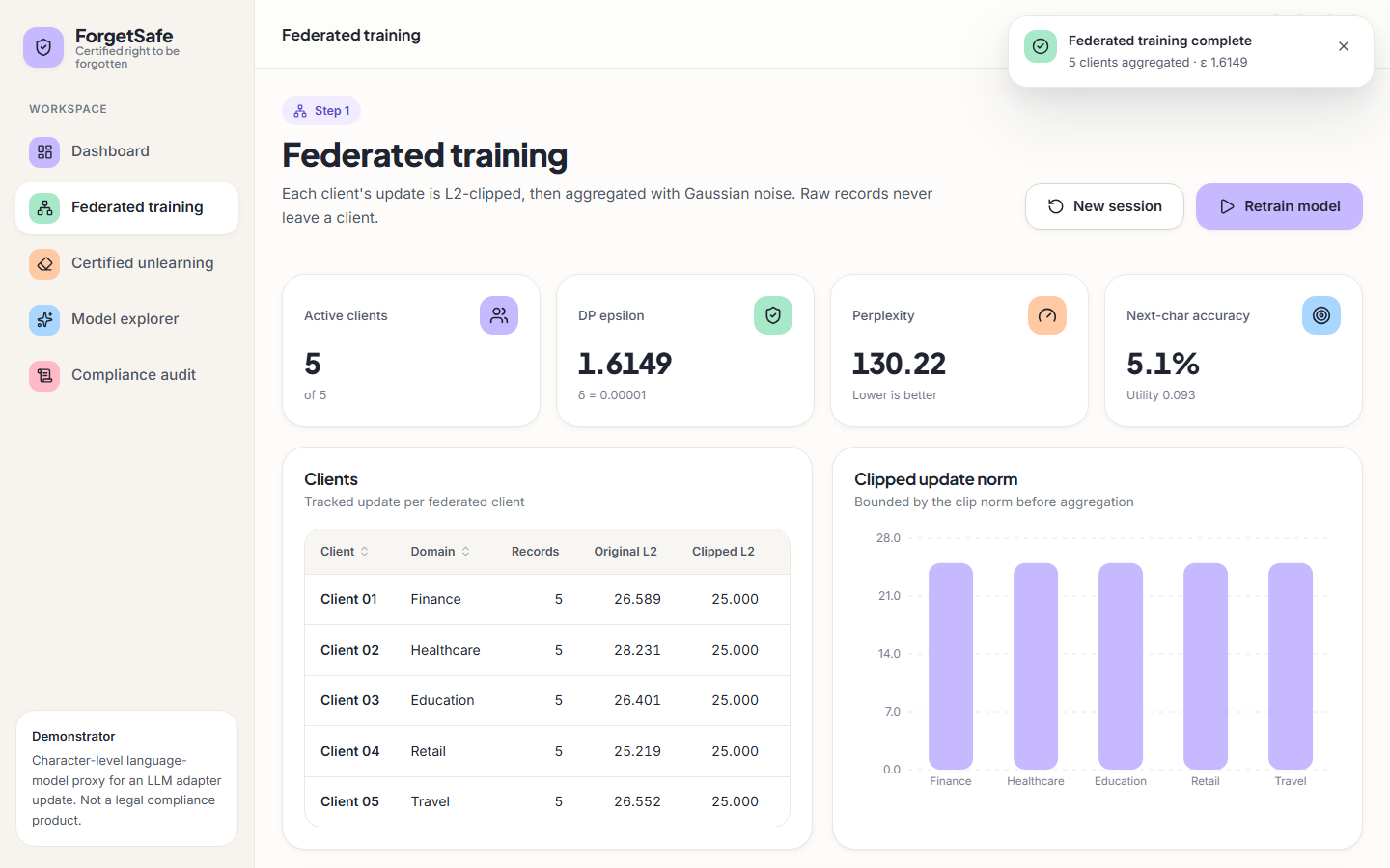
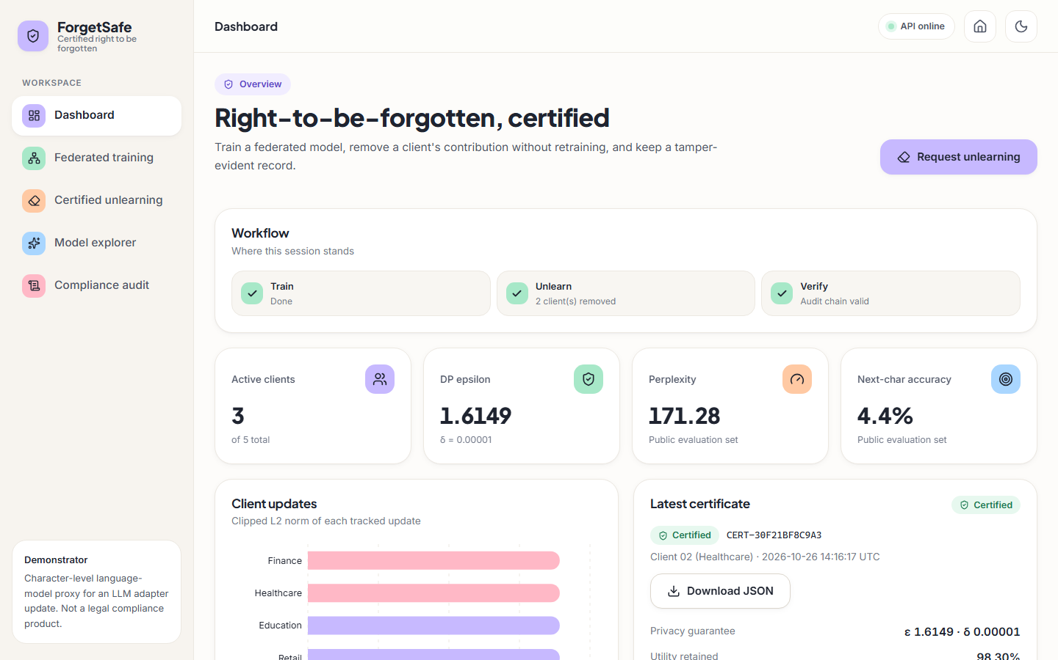
Output – Training and Dashboard
Federated training: 5 clients, epsilon 1.6149, perplexity 130.22, accuracy 5.1 %, clipped norms 25.000
Dashboard after two removals: 3 of 5 clients active, latest certificate shown
Dept. of CSE | Batch A9 | Final Review
22

Slide 23
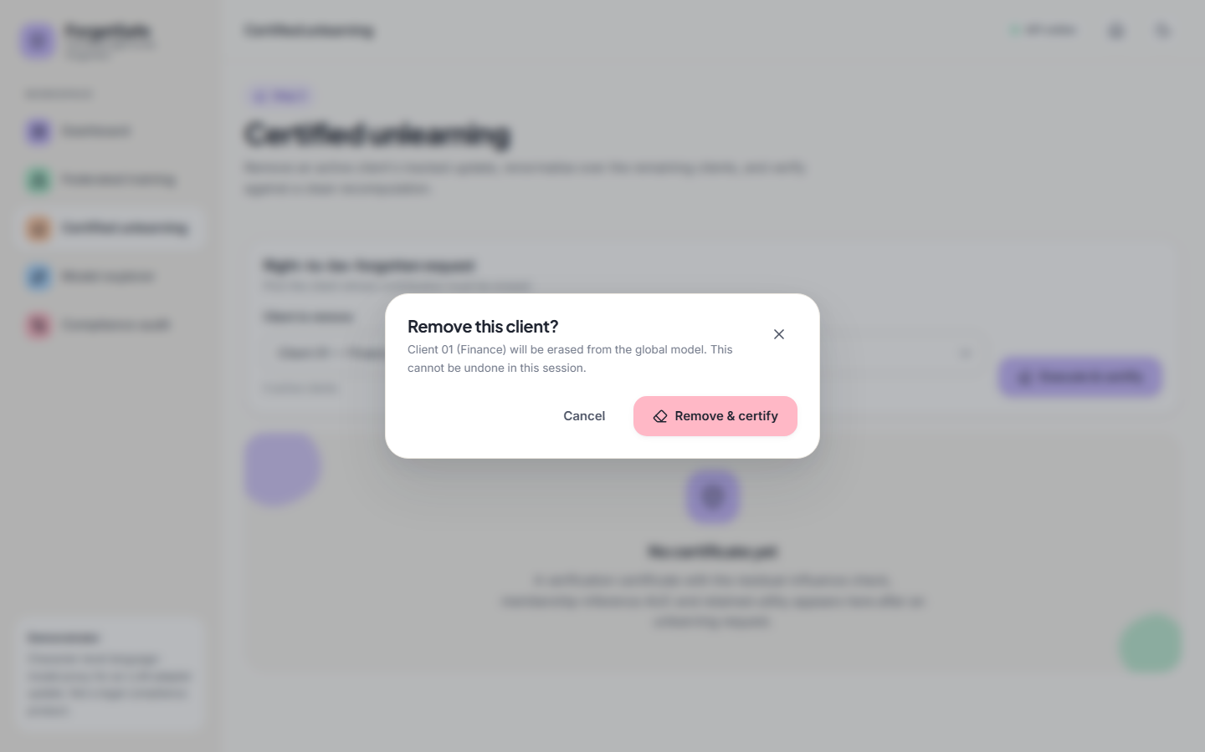
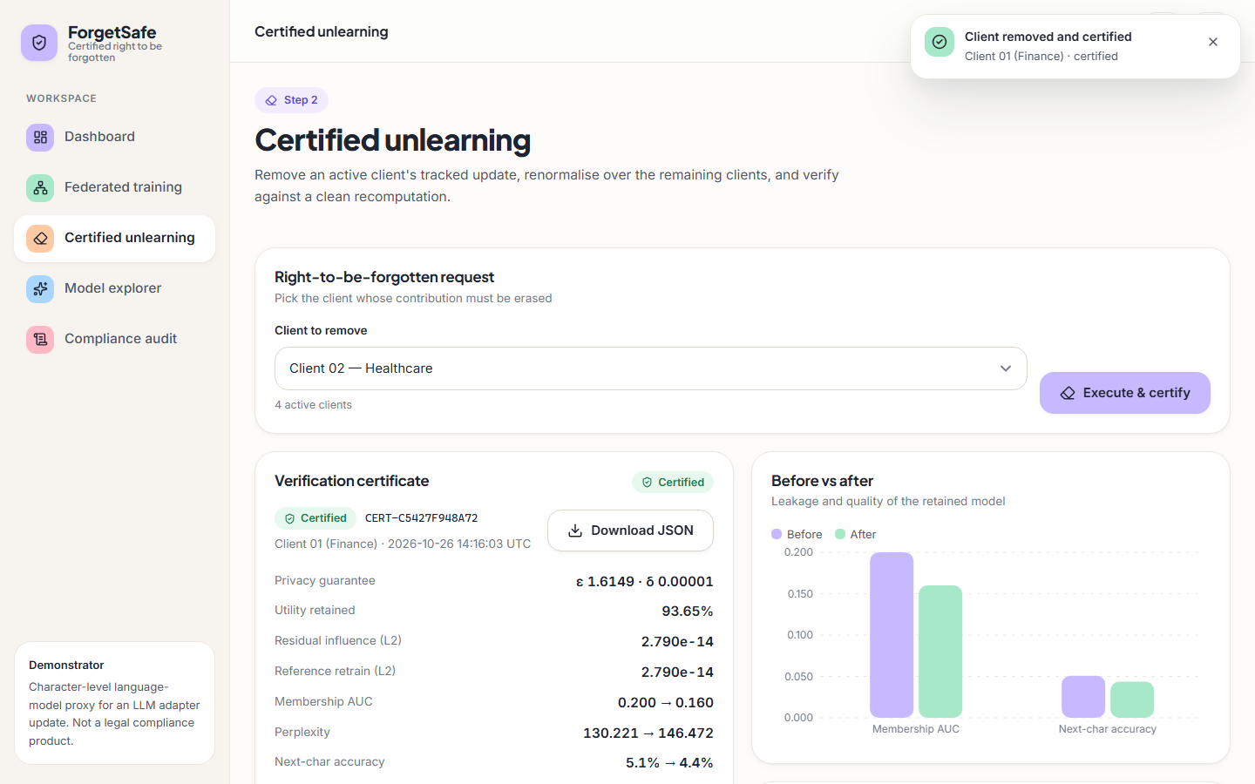
Output – Certified Unlearning
Confirmation dialog before removing Client 01 (Finance)
Certificate CERT-C5427F948A72: epsilon 1.6149, retention 93.65 %, AUC 0.200 → 0.160
Dept. of CSE | Batch A9 | Final Review
23

Slide 24
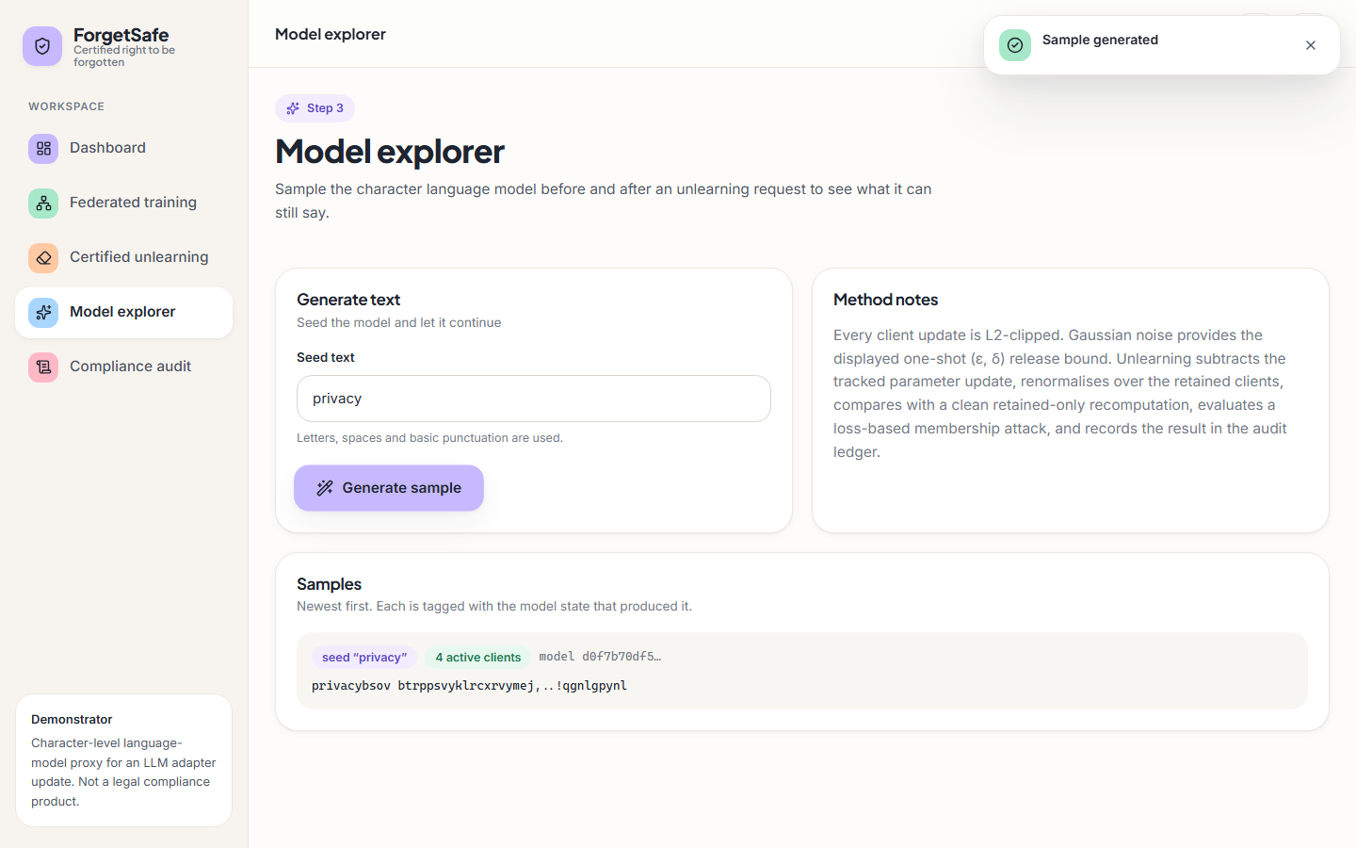
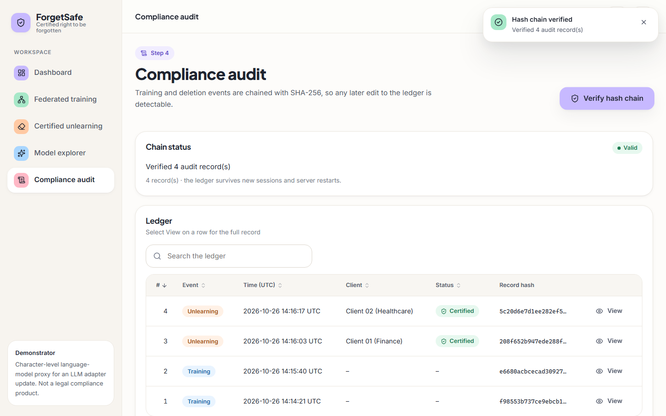
Output – Model Explorer and Audit Ledger
Sample text from the 4-client model: seed “privacy” continues as noise-like characters
Ledger of 4 events (2 training, 2 unlearning); hash chain verified
Dept. of CSE | Batch A9 | Final Review
24

Slide 25
Conclusion
Built ForgetSafe: federated training, tracked-update subtraction, DP release bound, membership and utility checks, certificates and a hash-chained ledger, with a React UI and a JSON API.
Measured: 250 of 250 requests certified; retention 97.1 %; 5 unit tests and 14 smoke checks pass.
Key findings: at sigma = 3 the model is worse than uniform (perplexity 142 vs 32) and the attack is at chance; the certificate is an identity; with no noise the attack falls from 0.99 to 0.54, so removal itself works.
Limits: bigram proxy, 25 sentences, epsilon 1.61 outside the classical range, noise reused, forgeable ledger, no authentication.
Objectives O2, O4 and O6 are met on the proxy; O1, O3 and O5 are only partly met.
Dept. of CSE | Batch A9 | Final Review
25

Slide 26
Future Scope
Replace the proxy by LoRA adapters on a small Hugging Face model with Flower for transport; measure real forgetting and utility.
Use accounted DP-SGD (a privacy accountant, a valid epsilon for the sigma used) and fresh noise per release.
Sign ledger records and anchor the head hash externally; add authentication and per-client authorisation.
Stronger attacks (more members, shadow models) and a retrain-from-scratch reference with fresh randomness for every certificate.
Batched ledger append, load testing, and a user study with a compliance officer.
Dept. of CSE | Batch A9 | Final Review
26

Slide 27
References
[1] A. Khan et al., “Deep learning approaches for continuous sign language recognition: A comprehensive review,” IEEE Access, vol. 13, pp. 55524-55544, 2025 (base paper).
[2] J. Wei et al., “Rethinking federated unlearning via the lens of memorization,” KDD ’26, 2026, arXiv:2605.24545.
[3] F. Zhang et al., “Oblivionis: A lightweight learning and unlearning framework for federated large language models,” arXiv:2508.08875, 2025.
[4] Y. Jiang et al., “Certifying the right to be forgotten: Primal-dual optimization ... in vertical federated learning,” arXiv:2512.23171, 2025.
[5] “Federated illusion: Multi-level geometric privacy audit for federated graph unlearning,” Information, 2026 (batch survey; not verified).
[6] “Computationally efficient federated unlearning,” Proc. 26th Int. Middleware Conf., 2025 (batch survey; not verified).
[7] W. Zhang, “A comprehensive investigation of federated unlearning ...,” Proc. DAML, SciTePress, 2024, pp. 569-573.
[8] “Unlearning under siege: Robustness risks of certified machine unlearning,” Neurocomputing, 2026 (batch survey; not verified).
[9] H. B. McMahan et al., “Communication-efficient learning of deep networks from decentralized data,” AISTATS, 2017.
[10] C. Dwork and A. Roth, “The algorithmic foundations of differential privacy,” Found. Trends Theor. Comput. Sci., 2014.
[11] M. Abadi et al., “Deep learning with differential privacy,” ACM CCS, 2016.
[12] L. Bourtoule et al., “Machine unlearning,” IEEE S&P, 2021.
[13] C. Guo et al., “Certified data removal from machine learning models,” ICML, 2020.
[14] A. Sekhari et al., “Remember what you want to forget: Algorithms for machine unlearning,” NeurIPS, 2021.
[15] R. Shokri et al., “Membership inference attacks against machine learning models,” IEEE S&P, 2017.
[16] S. Yeom et al., “Privacy risk in machine learning: Analyzing the connection to overfitting,” IEEE CSF, 2018.
[17] G. Liu et al., “FedEraser: Enabling efficient client-level data removal from federated learning models,” IWQoS, 2021.
[18] Y. Cao and J. Yang, “Towards making systems forget with machine unlearning,” IEEE S&P, 2015.
[19] B. Balle and Y.-X. Wang, “Improving the Gaussian mechanism for differential privacy,” ICML, 2018.
[20] European Parliament and Council, Regulation (EU) 2016/679 (GDPR), OJ L 119, 2016, Art. 17.
[21] N. Carlini et al., “Extracting training data from large language models,” USENIX Security, 2021.
[22] E. J. Hu et al., “LoRA: Low-rank adaptation of large language models,” ICLR, 2022.
Dept. of CSE | Batch A9 | Final Review
27

Slide 28
THANK YOU
Questions & Suggestions
Dept. of CSE | Batch A9 | Final Review
28
Notes:
Thank you. Questions are welcome.

