Slide 1
CAREFLOW
AI Powered Intelligent Hospital Patient Flow Management System
REVIEW 2 · DESIGN, METHODOLOGY AND PROGRESS
A. RAMU · 23K91A6715 B. RUSHI · 23K91A6720
B. RAJ KUMAR · 23K91A6725 A. PRABHAS · 23K91A6703
Guide: [GUIDE NAME] · CSE (Data Science) · Batch A10
Evidence-based documentation · Synthetic model data · Real running-system captures
Notes:
This review shows how the system is designed and built, the data and model, what has been implemented, and the first measured results from the held-out test split.

Slide 2
NAVIGATION
Contents
01
Recap
07
Implementation
02
Architecture
08
Results
03
Methodology
09
Outputs
04
Data and models
10
Testing
05
Decision logic
11
Next steps
06
Database and UML
Review 2
2
Notes:
Agenda for the design and progress review.

Slide 3


RECAP
Problem and Proposed System
Problem: fragmented internal queues, laboratory work and bed checks.
System: one persisted Visit state with role-based actions.
Assistance: triage classification and expected-wait regression.
Boundary: academic local prototype using synthetic data.
23
Demo visits
18
Beds
Recap
3
Notes:
One-minute recap of Review 1: the base paper is text-only; we add a visual track, a fusion network, an AI-generated media check and a web application.

Slide 4
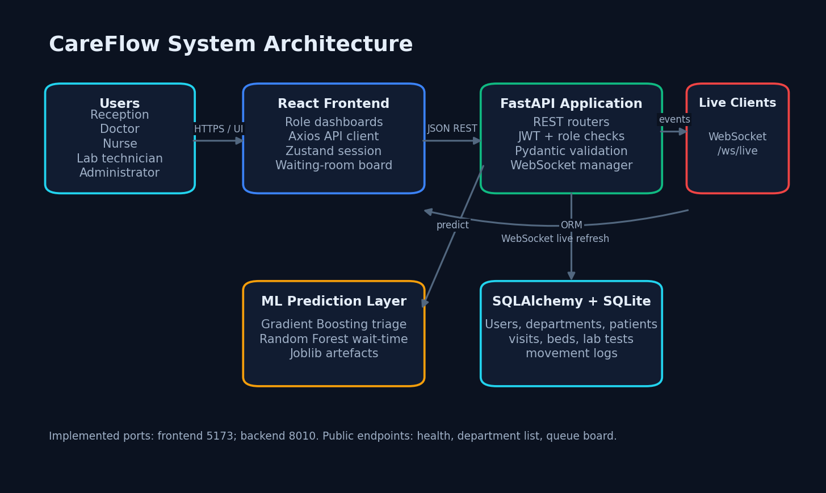

DESIGN
System Architecture
Implemented layers and live channel
Design
4
Notes:
Four tiers: browser, Flask application (blueprints, security, services), inference (predictor, shared preprocessing, three networks, AI detector) and data (SQLite, uploads, trained artifacts).

Slide 5
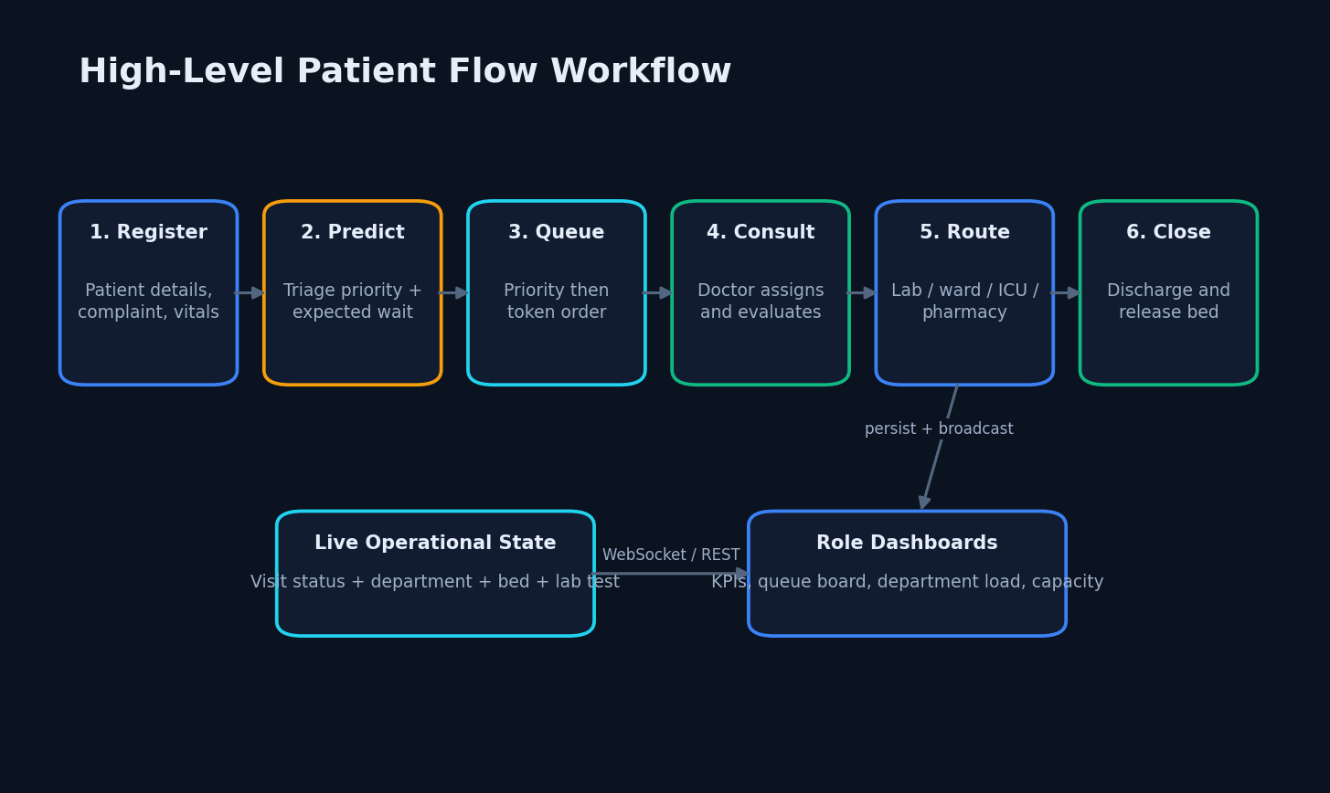
METHOD
End-to-End Methodology
Validate input
Predict once
Persist state
Broadcast changes
Registration through discharge
Method
5
Notes:
The training pipeline is one command and resumes after a crash. Every metric is written to JSON and read by the application, so no number is typed by hand.

Slide 6
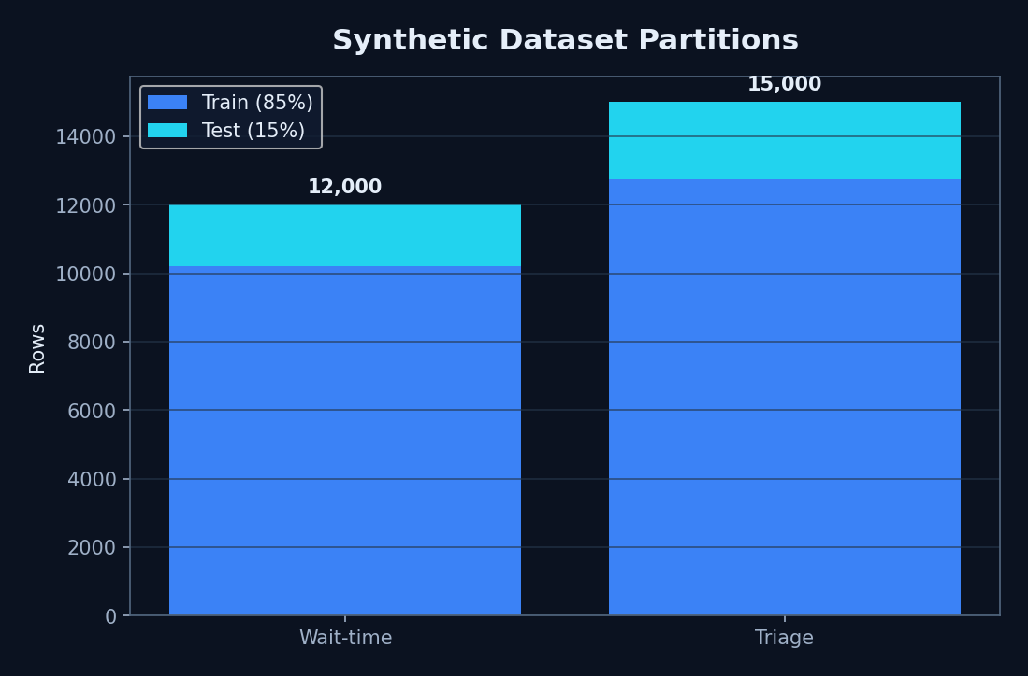
DATA
Dataset
Wait: 12,000
Triage: 15,000
85/15 train/test
Seed 42
No clinical records
Synthetic generator sizes and split
Data
6
Notes:
CareFlow project subset for the multimodal model, CareFlow project for the text-only rumour model and the base-paper replication, CareFlow project only for out-of-domain testing, and Tiny-GenImage plus recent web images for the AI-media check.

Slide 7



DATA
Preprocessing
Label-encode department type and priority for wait regression.
Keep numerical features on operational scales for tree ensembles.
Store encoders and triage feature order with Joblib artefacts.
Complete missing individual vitals with documented defaults.
Preserve named pandas columns at inference.
6
Wait features
6
Triage features
Data
7
Notes:
Text cleaning matches the base paper's description; images and video frames go through the backbone's own preprocessing. The JPEG re-encoding stops the AI detector from learning file format instead of content.

Slide 8

MODELS
Model Architecture
Wait: RandomForestRegressor; 200 trees; max depth 10.
Triage: GradientBoostingClassifier; 150 estimators; max depth 3.
Triage labels come from a simplified early-warning scoring rule.
Runtime returns wait minutes, priority label and confidence.
RF
Wait model
GB
Triage model
Models
8
Notes:
Text: three Conv1D channels over frozen GloVe, max-pooled to 896-d. Visual: ResNet50 per frame, averaged, batch-norm, Dense 256. Fusion: concatenate to 1152-d, dense 512-256-128-64 with dropout 0.2, sigmoid.

Slide 9

TRAINING
Training Configuration
NumPy random seed 42; scikit-learn random state 42.
Both splits: 85% train / 15% test.
Triage split is stratified.
Models saved under backend/app/ml/artifacts.
Existing artefacts evaluated without retraining during documentation.
10,200
Wait train
12,750
Triage train
Training
9
Notes:
The base paper's hyperparameter table is an image we could not read, so these values were chosen and documented. Early stopping restored the epoch-2 weights in every stage.

Slide 10
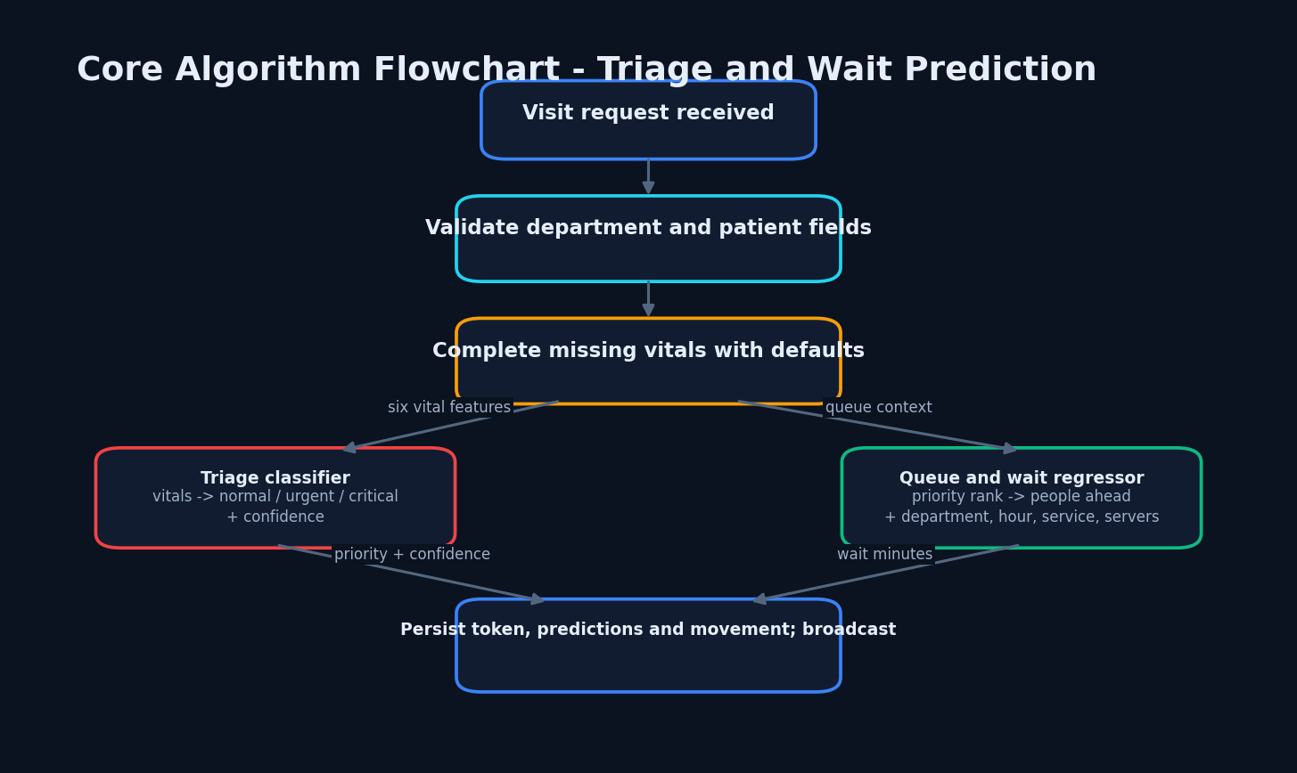

LOGIC
Decision Logic
Prediction, persistence and broadcast
Logic
10
Notes:
The administrator can change the threshold. A missing image becomes a zero visual vector, so text-only posts still get a fused score. Warnings tell the user when few words were recognised or when only media was given.

Slide 11
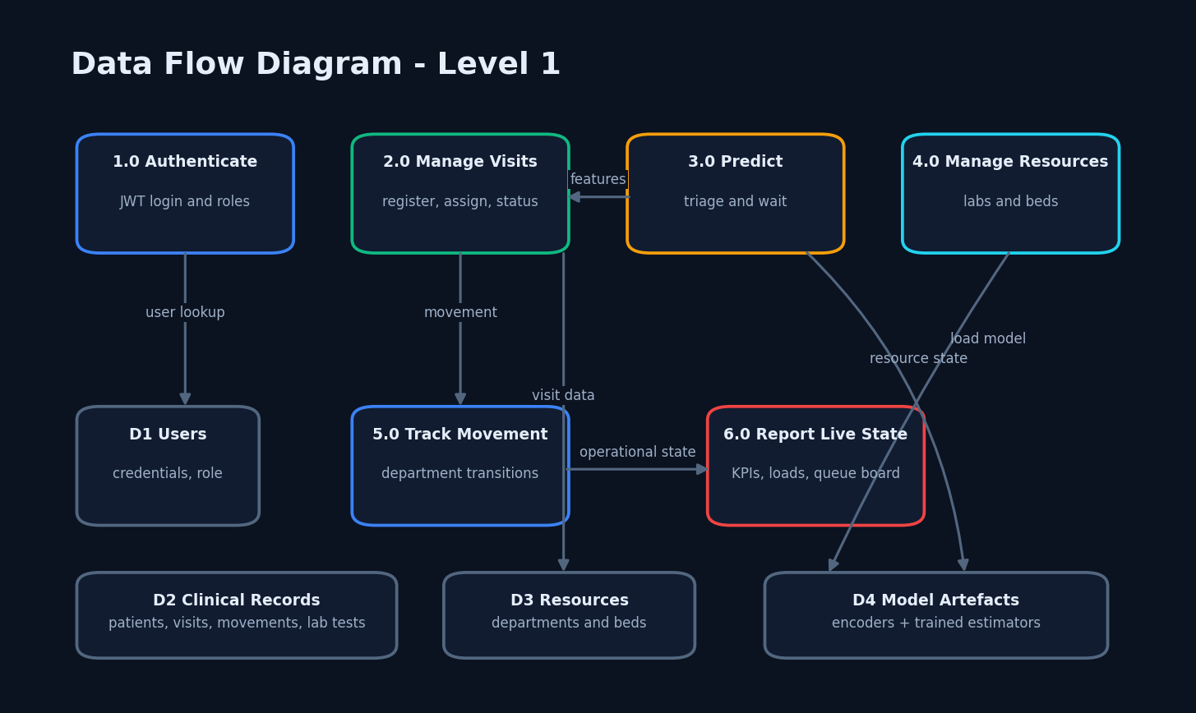

FLOW
Data Flow
DFD Level 1
Flow
11
Notes:
Six processes and six data stores. Process 3.0 is expanded in the report as a level-2 DFD.

Slide 12
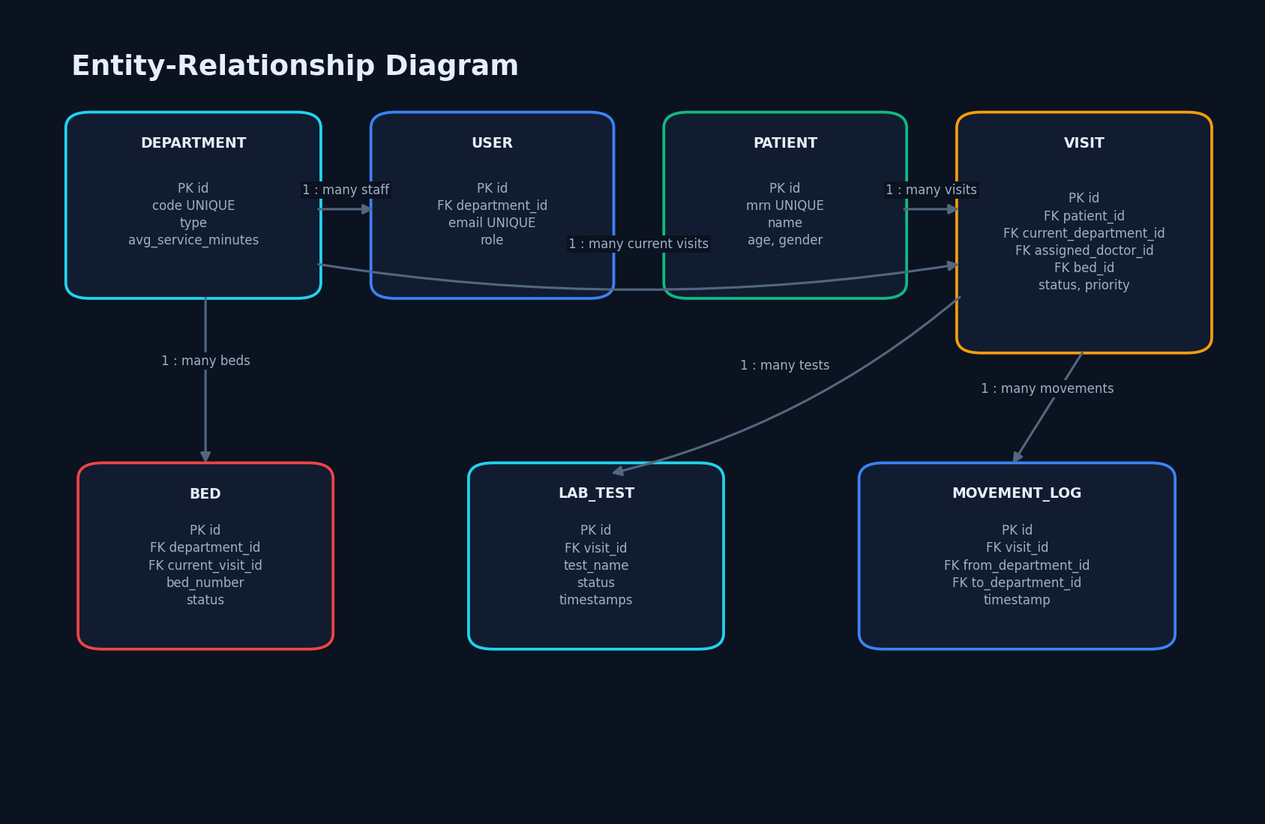
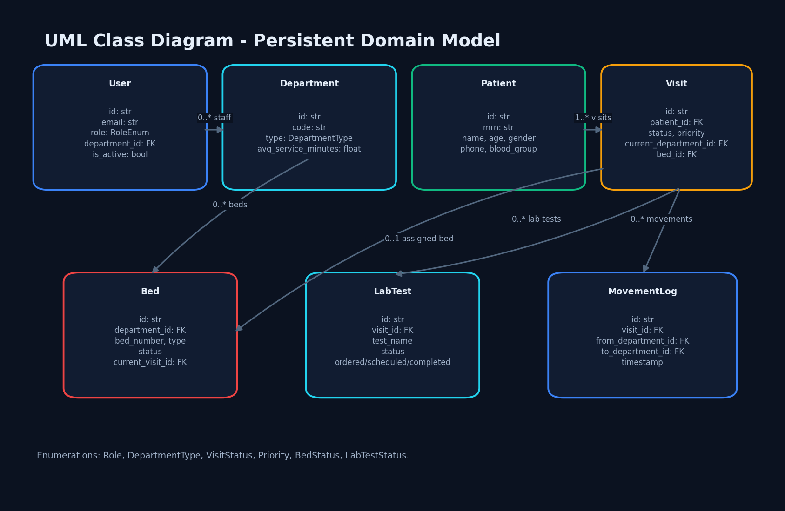

DESIGN
Database and UML
Entity relationships
Persistent domain classes
Design
12
Notes:
Five tables (class and sequence diagrams are in the report). Users own analyses and batch jobs; activities feed the admin overview; settings store the threshold and access switches. The use case diagram shows guest, user and admin.

Slide 13






BUILD
Technology Stack
Frontend: React 19, TypeScript, Vite, Tailwind, Axios, Zustand, Recharts.
Backend: FastAPI, Pydantic, SQLAlchemy, SQLite, JWT, WebSockets.
ML: scikit-learn, pandas, NumPy, Joblib.
Verified runtime: Windows 11, Python 3.11.9, Chrome.
5173
Frontend port
8010
Backend port
Build
13
Notes:
Everything is open source. All browser libraries are served locally, with no CDN calls.

Slide 14
PROGRESS
Implementation Progress
Authentication and five staff roles implemented.
Visit, queue and movement routes implemented.
Laboratory and bed workflows implemented.
Admin KPIs and public waiting board implemented.
Two model artefacts present and measured.
Thirteen populated screens captured.
7
Entities
22
Application routes
Progress
14
Notes:
State of the code base when this deck was prepared. The remaining items are documentation and evaluation steps, not missing features.

Slide 15
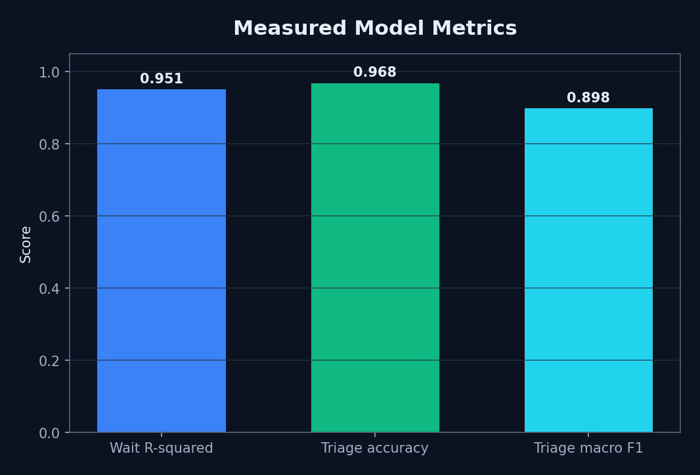
RESULTS
Preliminary Results
Wait R² 0.951041
MAE 5.982 min
RMSE 8.580 min
Triage accuracy 0.9680
Macro F1 0.898475
Critical recall 0.63
Measured synthetic-test scores
Results
15
Notes:
Measured on 1,232 held-out posts. Fusion beats the best single track on every metric: F1 0.714 vs 0.644, AUC 0.817 vs 0.771.

Slide 16
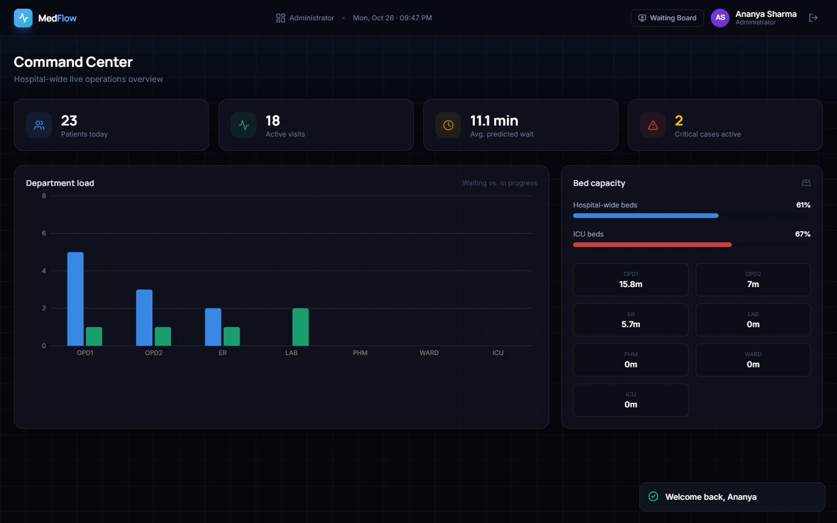
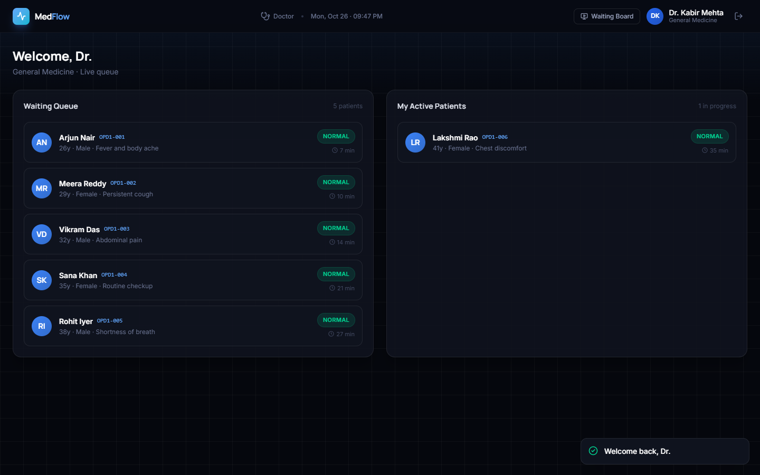


OUTPUTS
Output Screens
Administrator command centre
Doctor queue
Outputs
16
Notes:
Real screenshots from the running application with the trained models: a multimodal check result and the user dashboard.

Slide 17
TESTING
Initial Testing and Observations
150/150 sequential read requests returned HTTP 200.
Mean endpoint latency: 3.985–14.231 ms on local loopback.
WebSocket connection: 46.657 ms.
Frontend lint and production build exited zero.
Observed nurse initial-tab defect and large JavaScript chunks.
No automated repository test suite exists.
150
Successful reads
14
Lint warnings
Testing
17
Notes:
The suite runs offline with a stub predictor for web tests and the real models for ML tests. Observations come from the evaluation files.

Slide 18



RISKS
Challenges and Corrective Actions
Synthetic data → seek governed real data and external validation.
63% critical recall → cost-sensitive learning and calibration.
State coupling gaps → explicit transition service and tests.
Public WebSocket → authenticated channels and audit.
SQLite/single process → PostgreSQL, broker and resilient deployment.
63%
Critical recall
0
Clinical studies
Risks
18
Notes:
Each challenge was met by a concrete change in the code or the evaluation protocol.

Slide 19
PLAN
Next Steps
Automate unit, integration and end-to-end state tests.
Validate on de-identified temporal patient-flow data.
Conduct clinician-led usability and safety assessment.
Integrate hospital systems through HL7 FHIR.
Add production security, monitoring, backups and load testing.
First
Safety validation
Then
Production scaling
Plan
19
Notes:
Plan to the final review.

Slide 20
THANK YOU
Questions and suggestions are welcome
CareFlow · Batch CSDS-A-A10 · Review 2
20
Notes:
Likely questions: why fusion helps (independent evidence, ablation numbers); why the CareFlow project result is poor (labels reflect Reddit communities); how the webcam keeps data private.

