Slide 1

CAREFLOW
AI Powered Intelligent Hospital Patient Flow Management System
FINAL REVIEW · COMPLETE PROJECT
A. RAMU · 23K91A6715 B. RUSHI · 23K91A6720
B. RAJ KUMAR · 23K91A6725 A. PRABHAS · 23K91A6703
Guide: [GUIDE NAME] · CSE (Data Science) · Batch A10
Evidence-based documentation · Synthetic model data · Real running-system captures

Slide 2
NAVIGATION
Contents
01
Problem and research
05
Measured results
02
Objectives and approach
06
Output screens
03
Architecture and methodology
07
Conclusion and future work
04
Implementation
Final Review
2

Slide 3
OVERVIEW
Abstract
CareFlow coordinates patient visits across queues, consultation, laboratory and bed state.
One persisted Visit record drives role dashboards and a public board.
Random Forest estimates wait; Gradient Boosting estimates triage priority.
Evidence is synthetic-model evaluation plus local software verification.
7
Departments
13
Captured screens
Overview
3

Slide 4
RESEARCH
Base Paper
Alleviate, IEEE Access, 2025.
Integrated mobile healthcare access, recommendation, prescriptions, maps and planning.
Its 97.24% precision concerns specialist recommendation.
CareFlow changes the problem to internal operational flow; metrics are not comparable.
97.24%
Different task
2025
IEEE Access
Research
4

Slide 5
RESEARCH
Literature Survey
Access and facility-location systems.
Disease and specialist recommendation.
Personalised diet/exercise and monitoring.
Healthcare chatbots and NLP.
Waiting-time prediction and interpretability.
19
References
4
Survey themes
Research
5

Slide 6
RESEARCH
Research Gap
No single shared state across tokens, movement, tests and beds.
Prediction studies often stop at a score, without operational action.
Patient-facing apps do not coordinate the internal hospital journey.
Evidence boundaries between synthetic metrics and real impact are often unclear.
Gap
Operational integration
Need
Auditable state
Research
6

Slide 7
PROBLEM
Problem Statement
Coordinate patients through OPD, emergency, laboratory, pharmacy, ward and ICU while preserving priority and current state.
Give each role the actions and visibility needed for its part of the journey.
Use AI assistance without overstating clinical validity or operational impact.
One
Visit state
Many
Role views
Problem
7

Slide 8
OBJECTIVES
Objectives
Digital tokens and priority queues.
Visit state and movement tracking.
Laboratory workflow.
Live ward and ICU capacity.
Triage and wait prediction.
Role dashboards and public board.
6
Project objectives
5+1
Views
Objectives
8

Slide 9
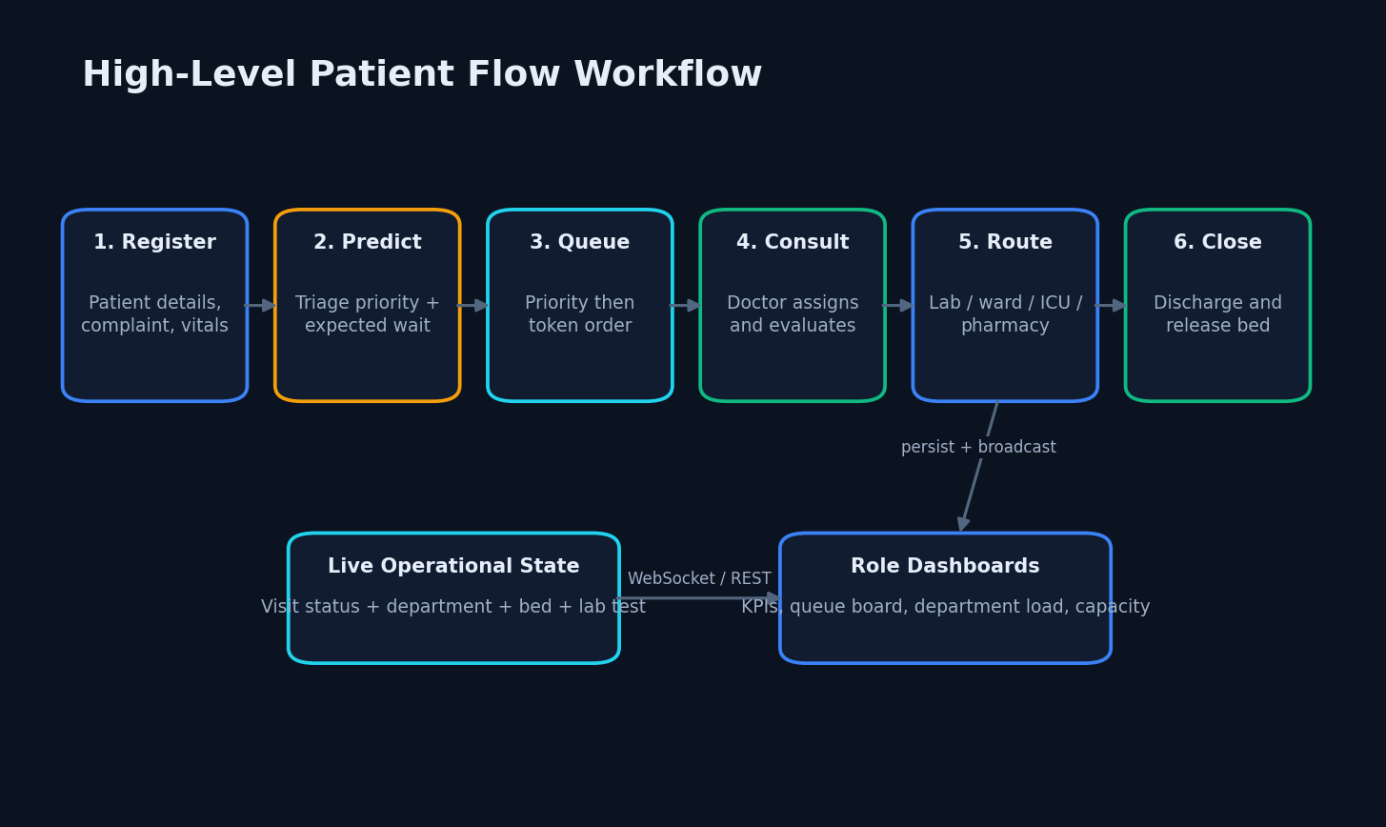
APPROACH
Proposed System
End-to-end operational flow
Approach
9

Slide 10
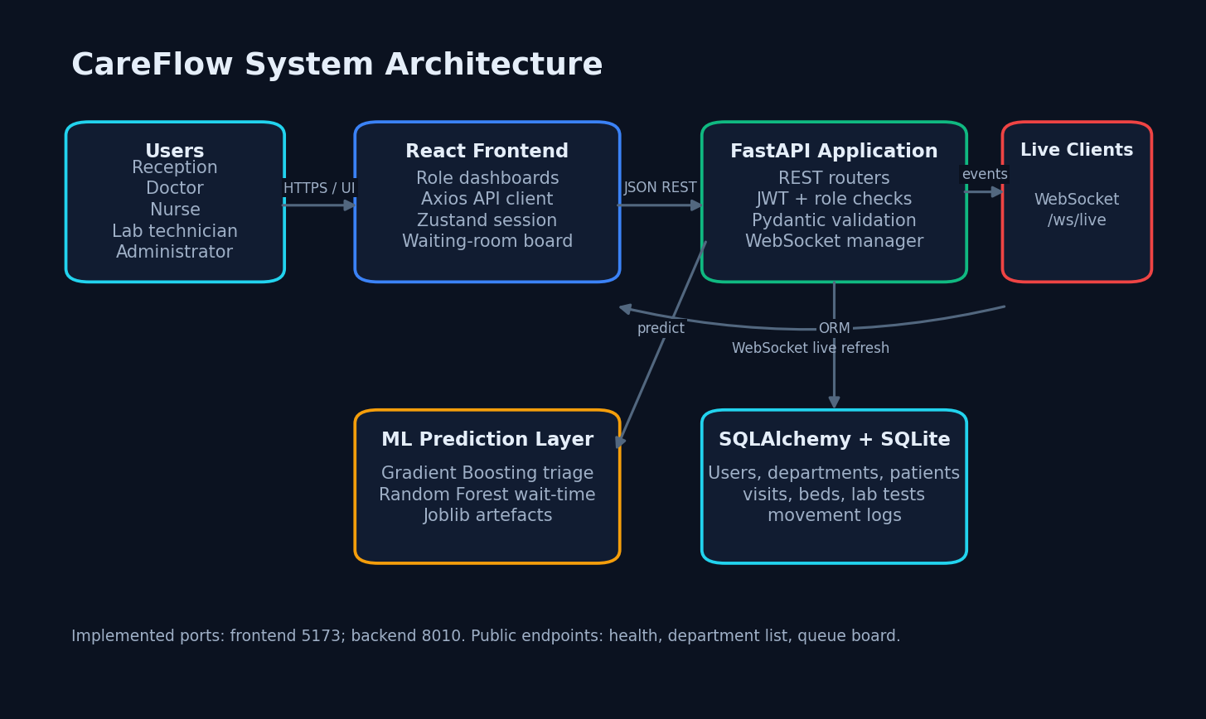

DESIGN
System Architecture
React, FastAPI, ML, SQLite and WebSocket
Design
10

Slide 11
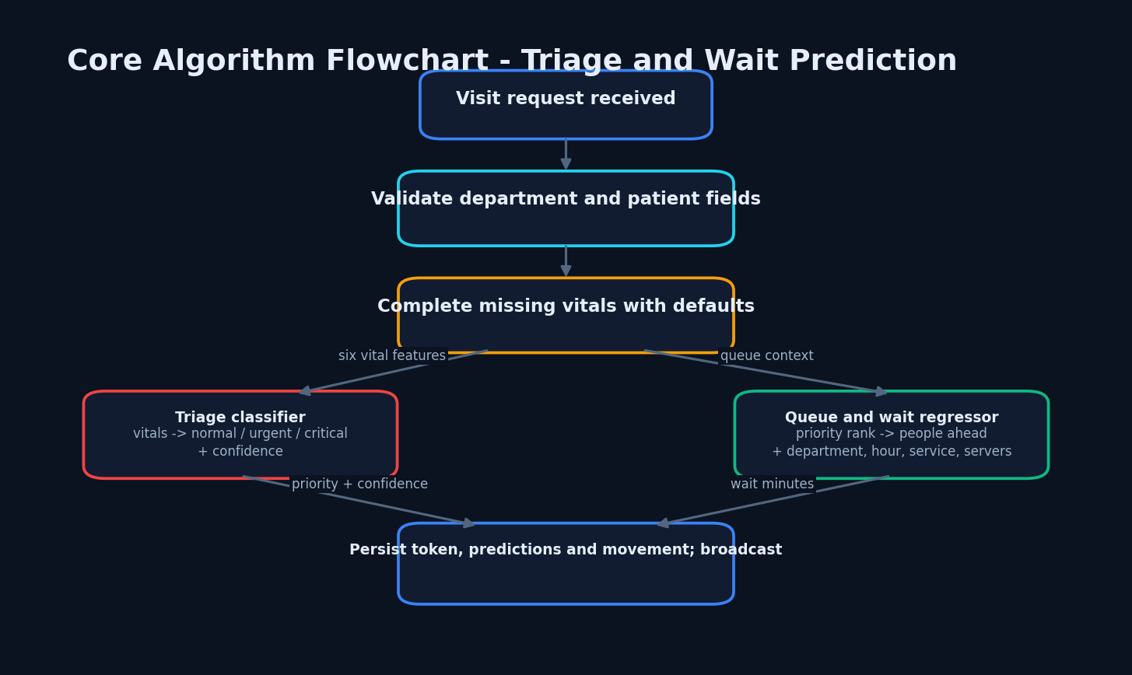

METHOD
Methodology
Triage and wait inference integrated with persistence
Method
11

Slide 12
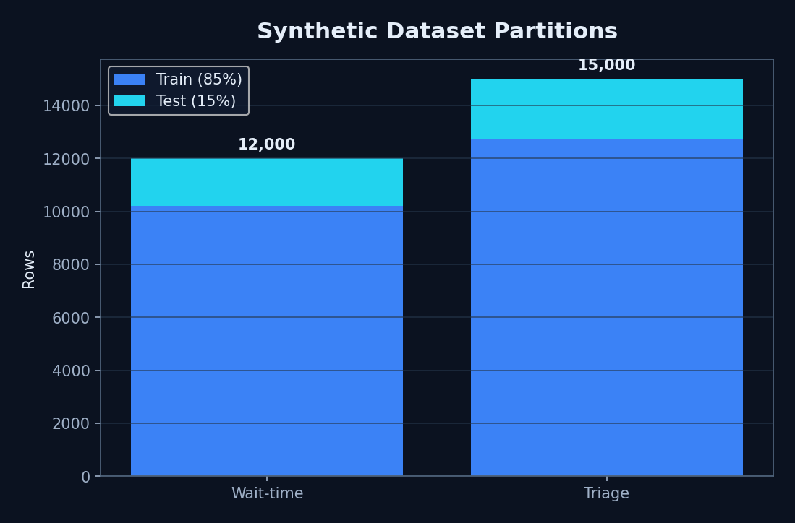
DATA
Dataset and Models
RF: 200 trees
GB: 150 estimators
Seed 42
No real patient data
Synthetic datasets and 85/15 splits
Data
12

Slide 13

LOGIC
Decision Logic
Missing vital components are completed with documented defaults.
Classifier returns normal, urgent or critical plus confidence.
Queue-ahead count respects priority rank.
Regressor returns non-negative wait minutes.
Visit and movement are committed before broadcast.
3
Priority classes
2
Default servers
Logic
13

Slide 14
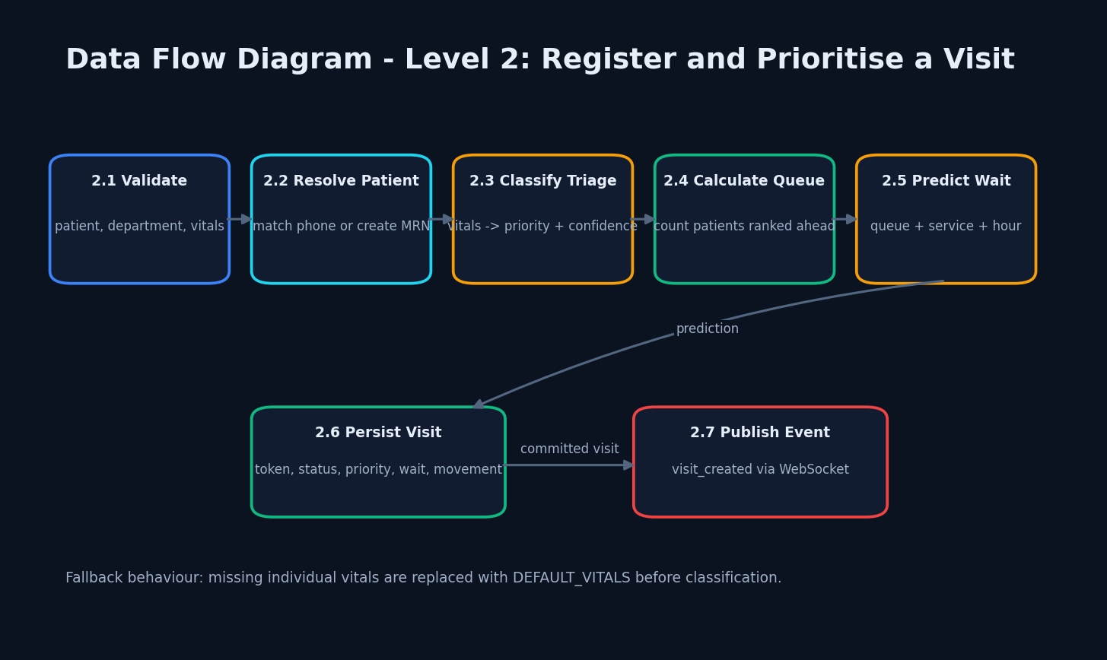

FLOW
Data Flow
Level 2: register and prioritise
Flow
14

Slide 15
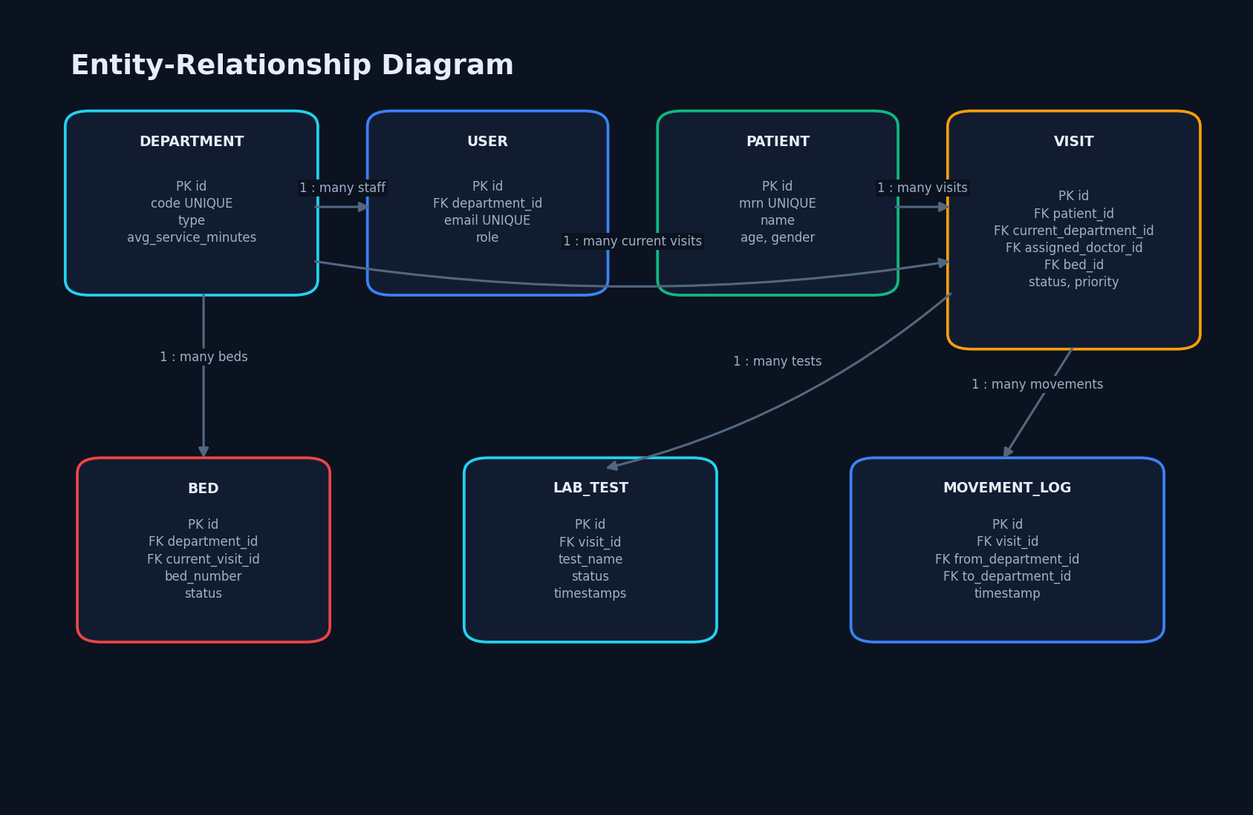
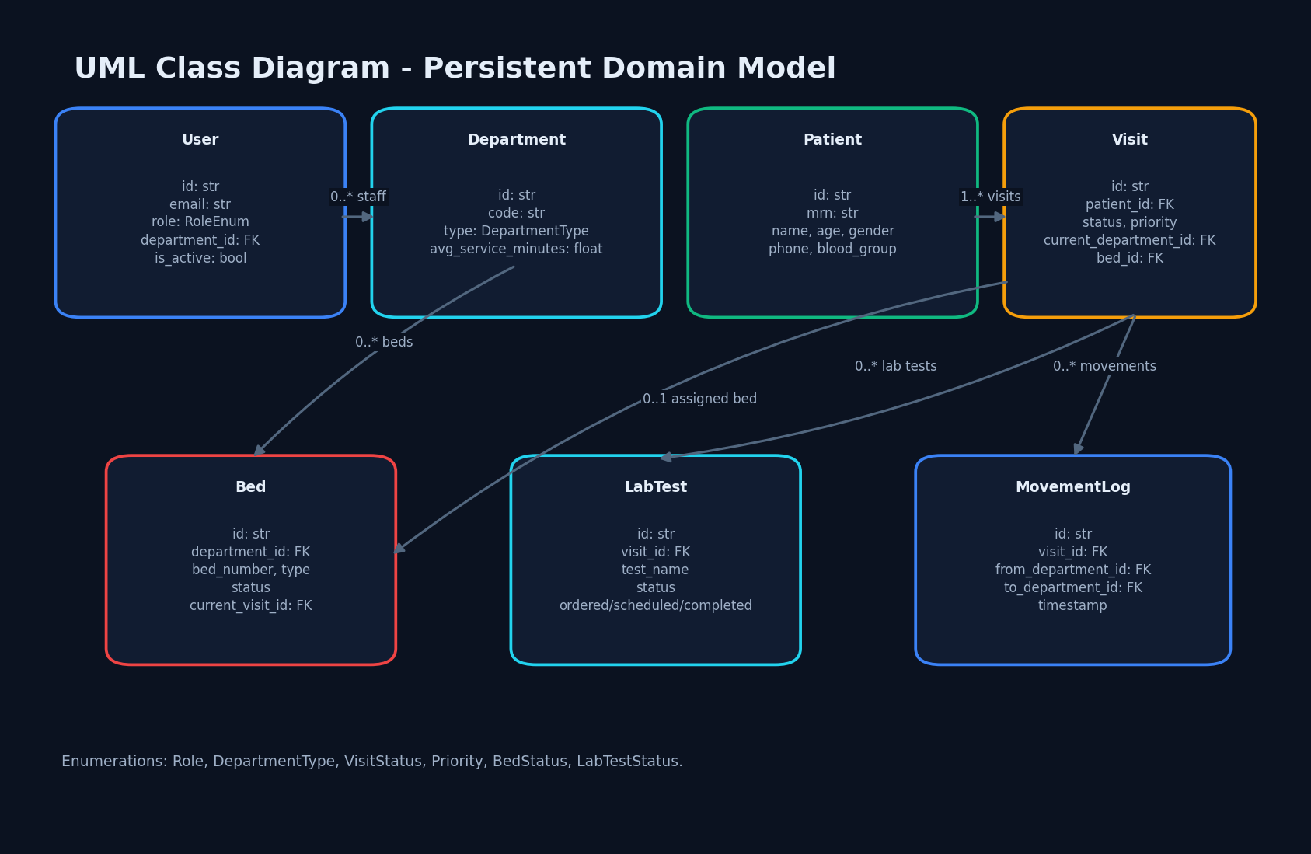

DESIGN
Database and Classes
Seven persistent entities
Domain model
Design
15

Slide 16
BUILD
Implementation Highlights
JWT login and role dependencies.
Priority-first queue service and movement logs.
Bed admission/release and laboratory-state routes.
Public queue board and administrator KPIs.
Axios token injection and WebSocket refresh.
Joblib artefacts with stored encoders and feature order.
22
Application routes
7
Persistent entities
Build
16

Slide 17
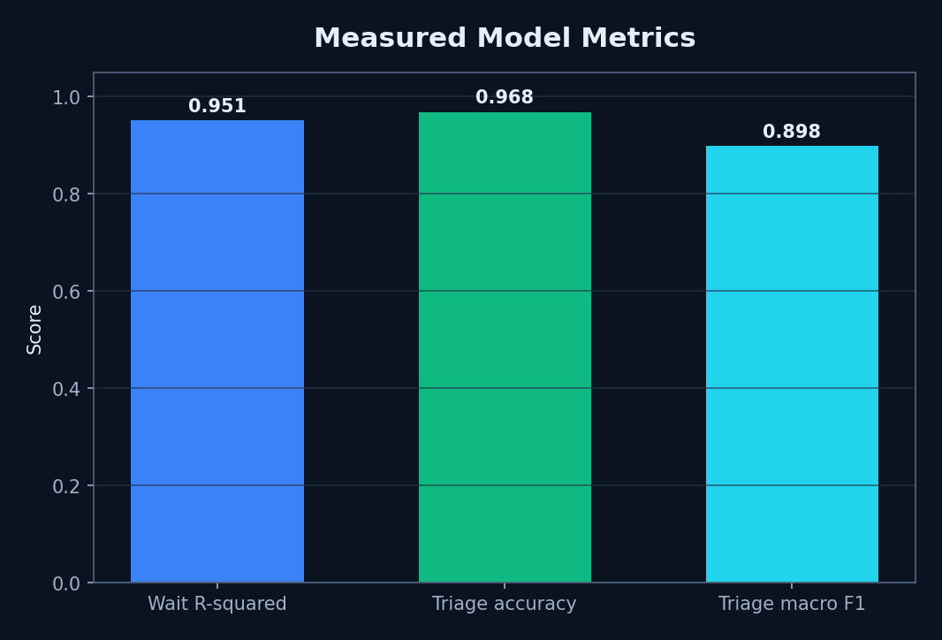
RESULTS
Model Performance
Wait R² 0.951041
Triage accuracy 0.9680
Macro F1 0.898475
Not clinical validation
Generator-matched test scores
Results
17

Slide 18
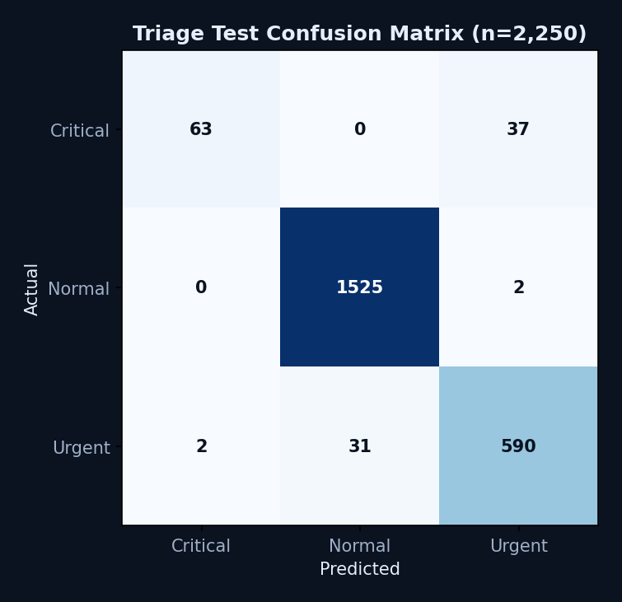
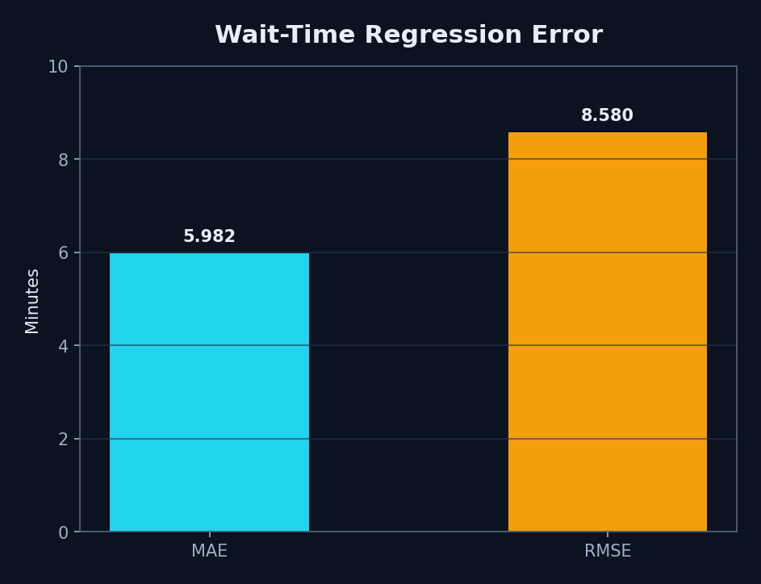


RESULTS
Confusion and Error
Critical recall = 63%
MAE 5.982 · RMSE 8.580 min
Results
18

Slide 19


ANALYSIS
Parameter and Limitation Analysis
Fixed Random Forest: 200 trees, max depth 10.
Fixed Gradient Boosting: 150 estimators, max depth 3.
No threshold sweep or calibration artefact exists—none is invented.
Overall accuracy hides 37 critical-to-urgent errors.
Real-data temporal and subgroup analysis remains future work.
63%
Critical recall
None
Threshold sweep
Analysis
19

Slide 20
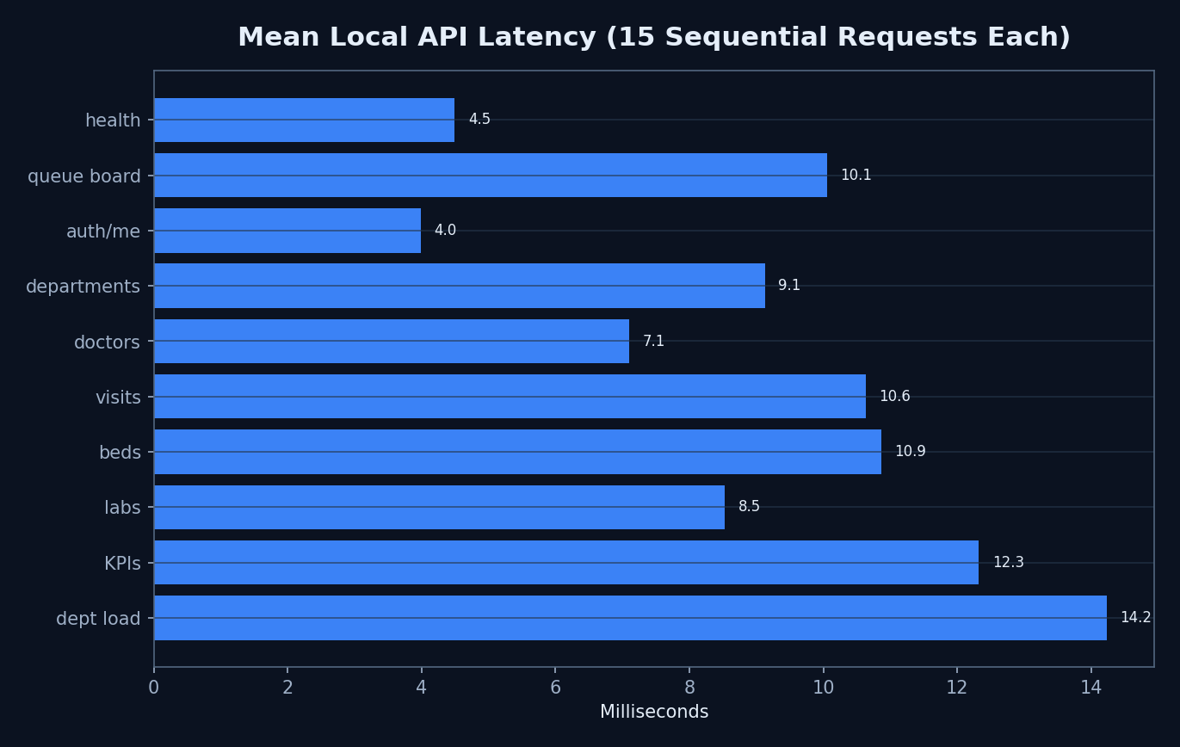
TESTING
Performance and Testing
150/150 HTTP 200
3.985–14.231 ms means
46.657 ms WebSocket
Build passed
14 lint warnings
No load test
Sequential local mean latency
Testing
20

Slide 21
COMPARISON
Comparison with Base Paper
Alleviate: patient access, specialist recommendation, prescriptions, maps and personalised plans.
CareFlow: internal queue, visit, laboratory and capacity coordination.
Different tasks, datasets, splits and conditions make numeric comparison invalid.
The valid comparison is functional coverage and research gap.
Base
Patient-facing
Ours
Operations-facing
Comparison
21

Slide 22
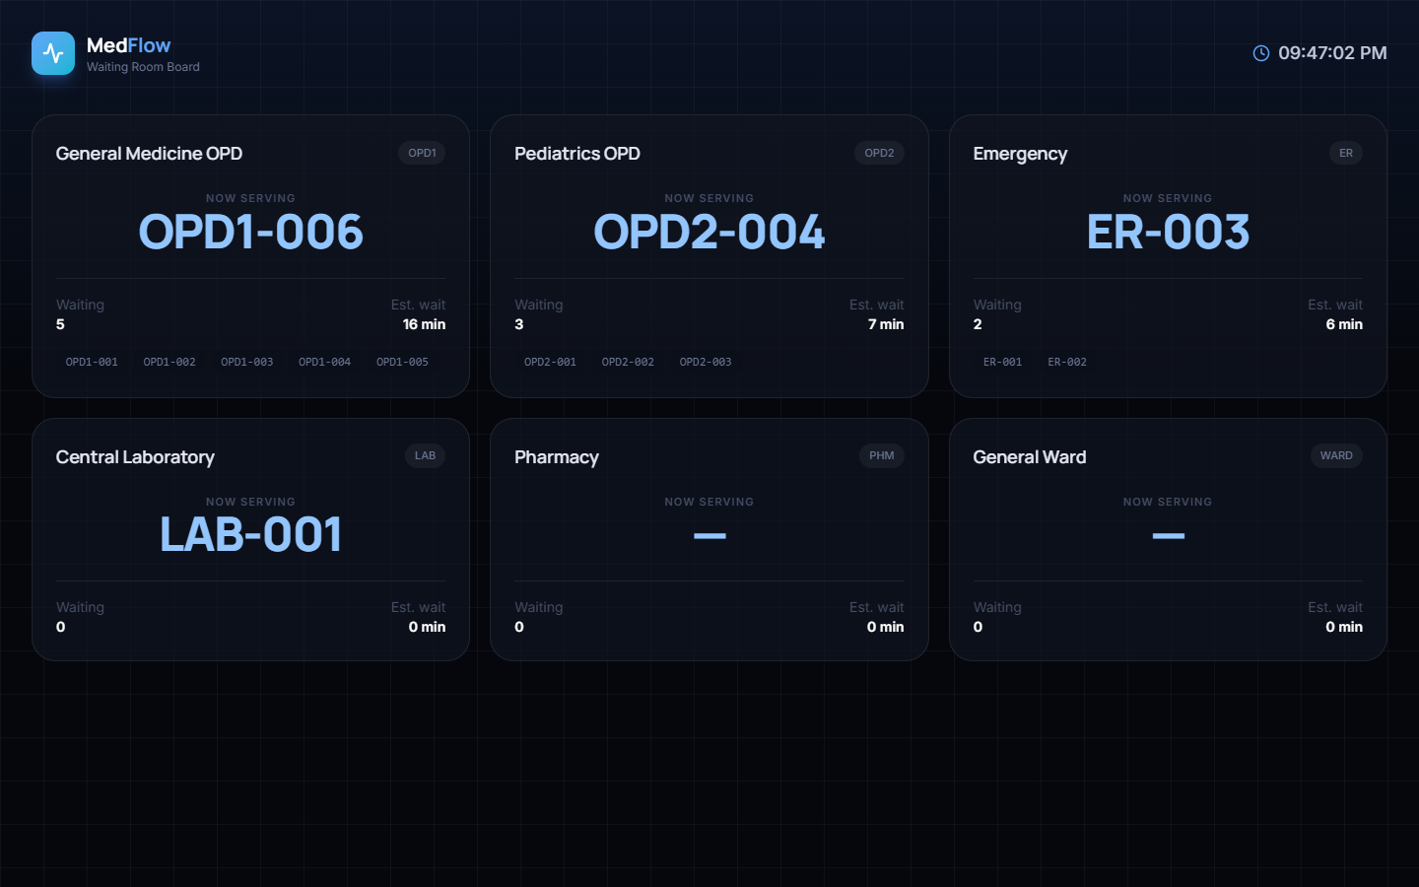
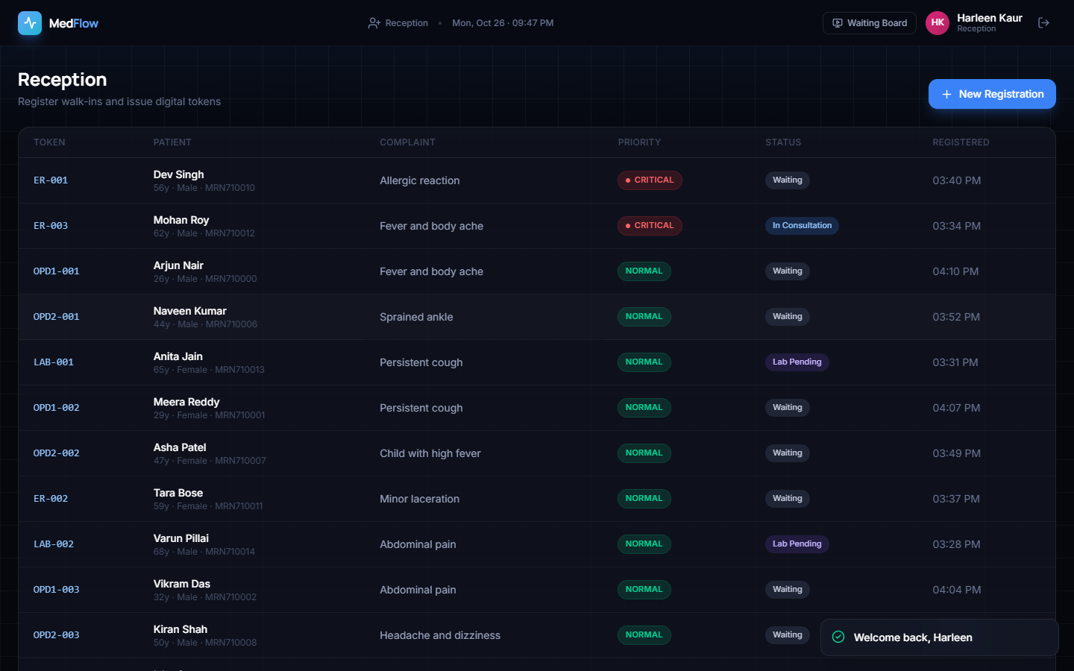


OUTPUTS
Output 1 · Public and Reception
Public token board
Registration list
Outputs
22

Slide 23
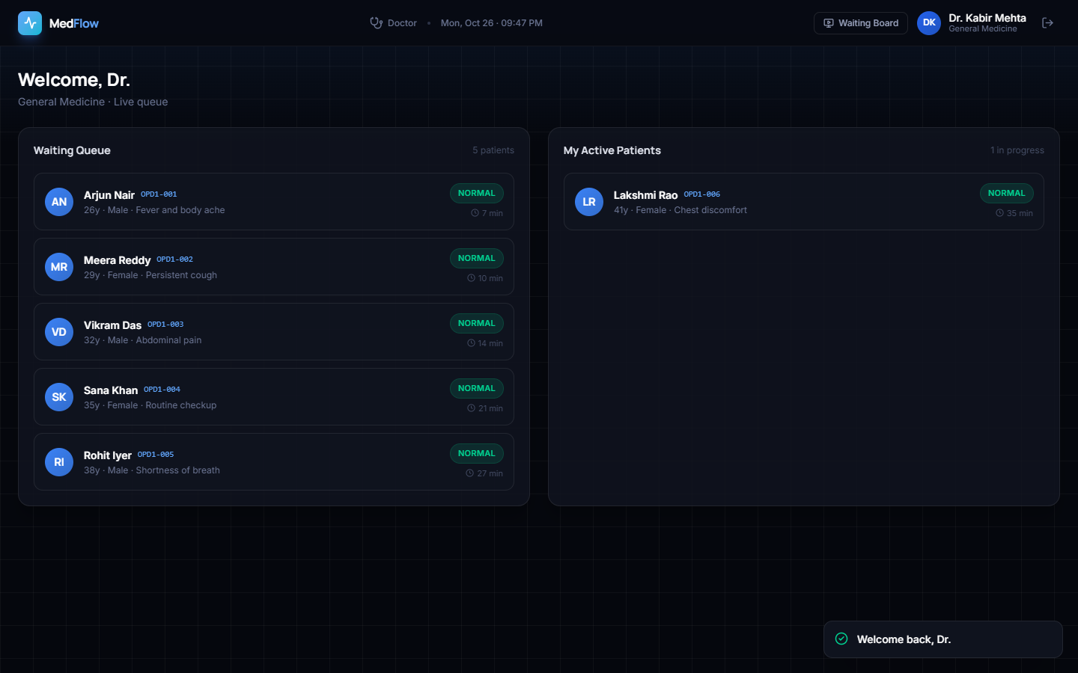
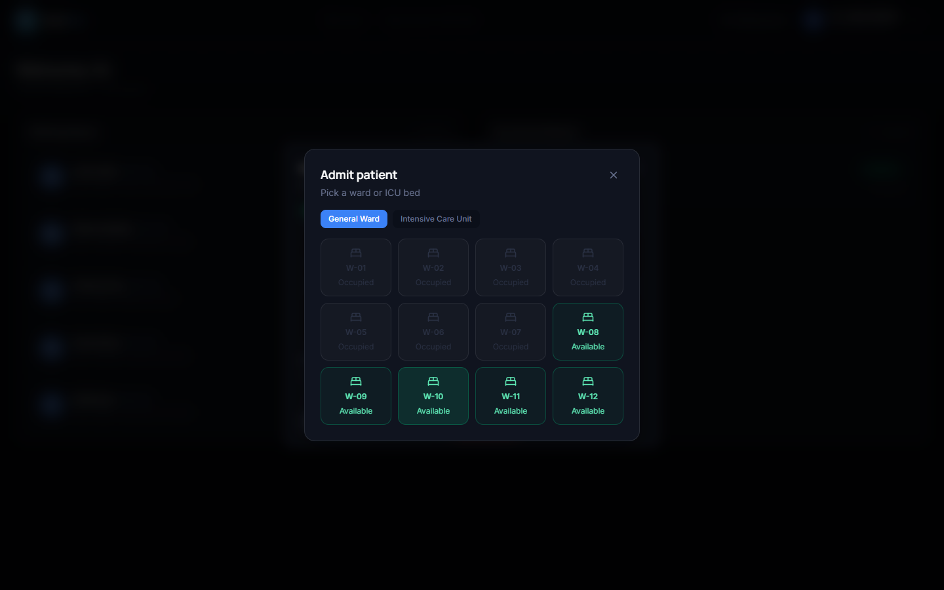


OUTPUTS
Output 2 · Clinical Workflow
Doctor queue
Available-bed selection
Outputs
23

Slide 24
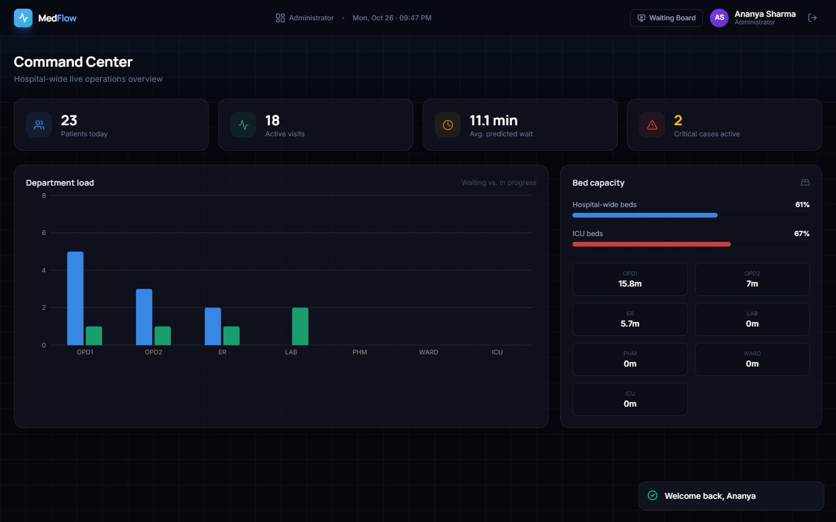
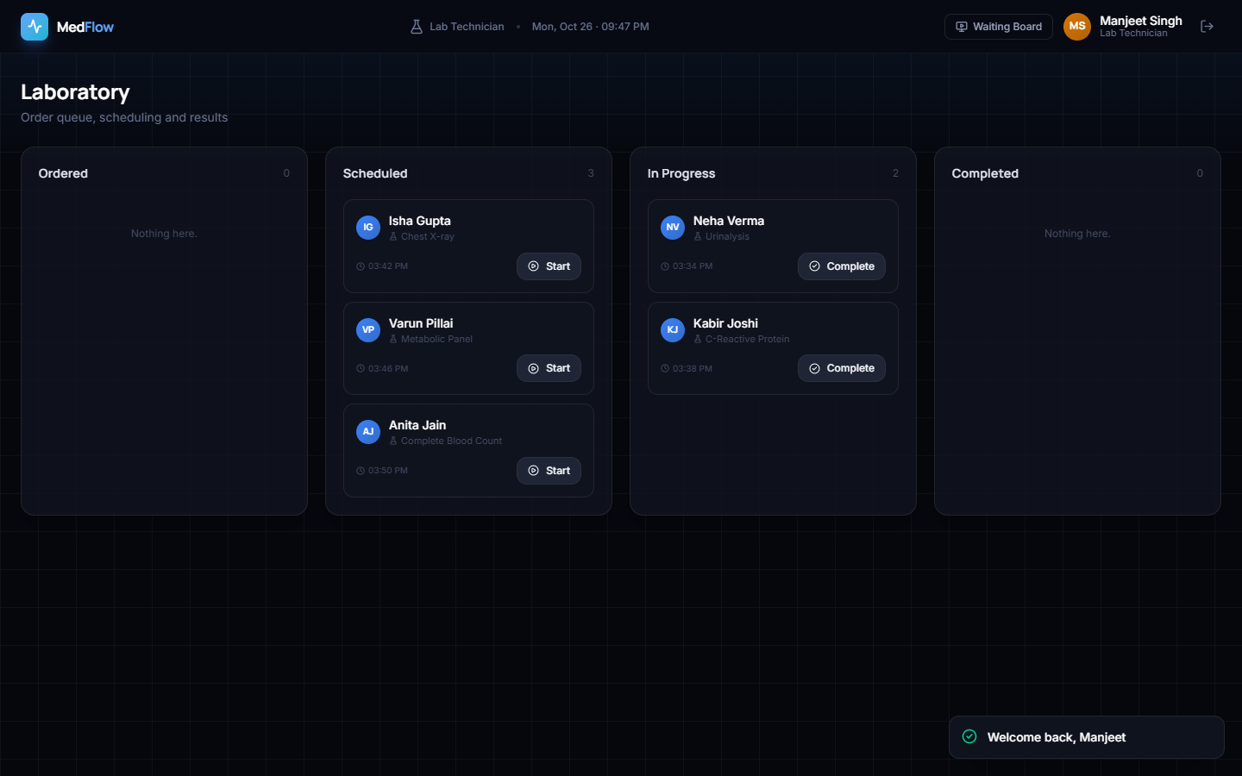


OUTPUTS
Output 3 · Operations
Administrator overview
Laboratory work queue
Outputs
24

Slide 25
CLOSE
Conclusion
Implemented one coherent multi-role patient-flow prototype.
All 150 measured read requests returned HTTP 200.
Models produced reproducible synthetic-test results.
Critical recall and missing clinical validation define the safety boundary.
No real wait-reduction or deployment claim is made.
Achieved
Functional integration
Limited
Clinical evidence
Close
25

Slide 26
NEXT
Future Scope
Governed real-data collection and temporal validation.
Cost-sensitive triage, calibration and uncertainty display.
Automated state-transition and end-to-end tests.
HL7 FHIR integration with EHR, lab and admission systems.
PostgreSQL, message broker, authenticated live channels and observability.
Clinician-led usability, safety and prospective impact study.
1
Validate safety
2
Scale securely
Next
26

Slide 27
FINAL REVIEW
References
[1] Saritha et al., Alleviate, IEEE Access, 2025, doi: 10.1109/ACCESS.2025.3647089.
[2] Tan et al., Personalized healthcare, JIWE, 2024.
[3] Abinaya and Ganesan, Nearest healthcare facilities, GCCT, 2015.
[4] Umbare et al., Smart healthcare using AI/ML, ICIPCN, 2024.
[5] Mogaveera et al., E-health monitoring and planning, ICICT, 2021.
[6] Surve et al., Healthcare chatbot using ML/NLP, ICAST, 2023.
[7] Waiting Time Prediction in Queue Management, ICRPSET, 2024.
[8] Outpatient waiting-time prediction, Translational Pediatrics, 2023.
Final Review
27

Slide 28
THANK YOU
Questions and suggestions are welcome
CareFlow · Batch CSDS-A-A10 · Final Review
28

