Slide 1
ClauseGuard
REVIEW 2 · DESIGN, METHODOLOGY AND PROGRESS
Legal Contract Complexity and Predatory Clause Detector
Presented by
Under the guidance of
CH.PRANATHI 23K91A6744
G.PRANAVI 23K91A6762
G.CHARAN JOSEPH 23K91A6753
G.BHAGWATH 23K91A6760
[GUIDE NAME], [DESIGNATION]
Department of Computer Science and Engineering (Data Science)
[COLLEGE NAME] · Batch A6 (CSE-DS, Section A) · [ACADEMIC YEAR]
Notes:
Review 2 covers the design, methodology and progress of ClauseGuard, a contract complexity and predatory-clause detector for Indian agreements.

Slide 2
Contents
01
02
03
04
Recap
Architecture
Methodology
Dataset
05
06
07
08
Preprocessing
Model and configuration
Decision logic
Data flow, modules, database
09
10
11
12
Technology stack
Progress
Preliminary results and screens
Testing, challenges, next steps
Notes:
Twelve parts: recap, architecture, methodology, data, preparation, model and configuration, decision logic, data flow and database, technology, progress, results and screens, testing and next steps.

Slide 3


Recap: problem and proposed system
Problem
Proposed system
Freelancers and small businesses sign contracts they cannot assess. Legal review is costly, and existing tools target US or EU law and read each clause alone.
Upload a PDF or DOCX: clauses are classified, 8 Indian-law rules flag predatory terms, 3 combinations are checked, and a complexity grade A-F comes with a plain-language report.
Upload PDF or DOCX
Segment, embed, classify into 20 CUAD types
8 rules + 3 risky combinations
Gemini: reason and safer wording
Grade A-F, report, clause graph
Notes:
Recap of Review 1. The base paper [1], SmartLaw Advisor, is a Gemini RAG legal chatbot and contract checker for Saudi law; ClauseGuard keeps the Gemini-based idea for Indian contracts and adds clause-level rules, combinations and a complexity score. Note: the abstract mentions the Claude API, pgvector and Neo4j; the build uses Gemini, SQLite with NumPy, and an in-memory NetworkX graph.

Slide 4
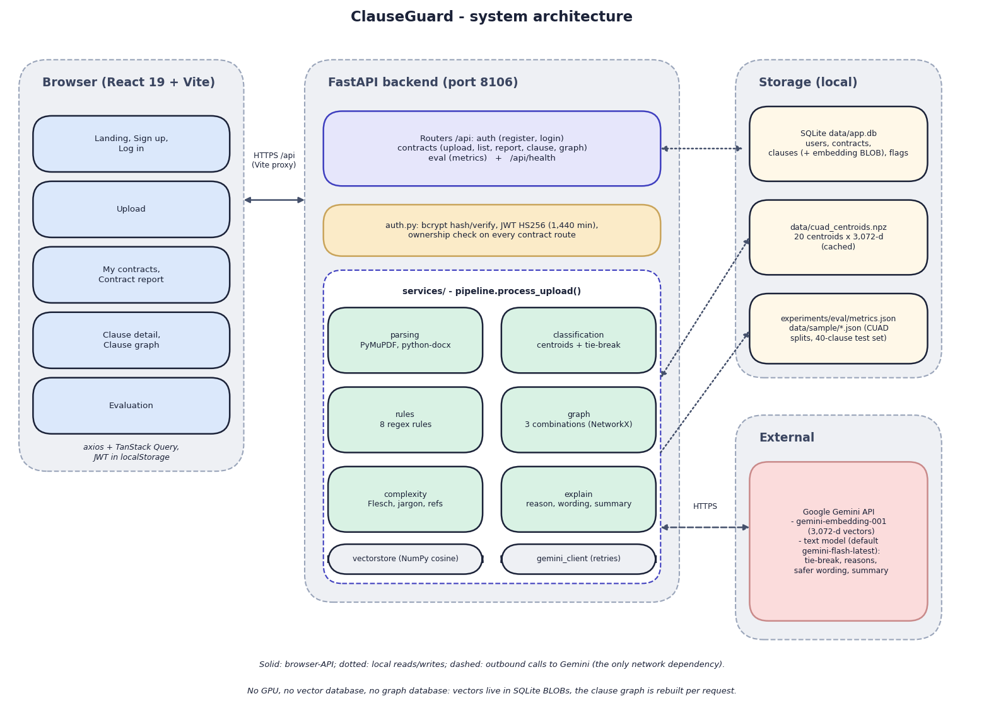

System architecture
Client: React 19 + Vite (port 5106); the dev server proxies /api to the backend.
API: FastAPI (port 8106), 9 REST endpoints; JWT sign-in, bcrypt, owner check on every contract route.
Services: PyMuPDF / python-docx parsing, clause classifier, 8 rules, NetworkX combinations, complexity score.
Data: SQLite (4 tables), cached centroid file, evaluation metrics file.
Only external dependency: the Google Gemini API.
Notes:
Everything runs on one machine. The browser talks only to the Vite server, which proxies to FastAPI. Gemini supplies embeddings, tie-break answers, explanations and summaries; there is no vector or graph database.

Slide 5
Methodology: end-to-end workflow
Parse PDF / DOCX
Split into clauses
Embed + classify
Apply 8 rules, 3 combos
Gemini explains flags
Score complexity A-F
Store + show report
Rules decide, Gemini explains
Two scores, kept apart
Reproducible
Whether a clause is flagged is decided by auditable regex rules; Gemini only writes the reason, the quote and the safer wording.
Clause classification (CUAD) and predatory detection (curated clauses) are evaluated separately, as objective 6 requires.
Scripts scripts/exp_*.py regenerate every figure into experiments/*/metrics.json.
Notes:
Seven-step workflow from upload to report. The two evaluations are separate by design; an extra independent probe set was added because the shipped test set was written together with the rules.

Slide 6
Dataset and input sources
Dataset | Size | Use
CUAD v1 [8] (CC BY 4.0) | 510 contracts, 41 categories | Corpus run, centroids
Training spans | 500 (20 categories x 25) | Build 20 centroids
Held-out spans | 240 (12 per category) | Classification test
Predatory test set | 40 clauses, written by the team | Rule test (shipped)
Probe set | 24 predatory + 16 benign | Independent rule test
Notes:
CUAD contracts are US SEC filings; there is no public Indian contract corpus, so the rules (Indian statutes) are tested only on clauses written by us. The train and held-out spans are split by text, not by contract: 192 of 240 held-out spans share a contract with a training span (accuracy is 0.800 when that is removed).

Slide 7



Data preparation
Parsing
Segmentation
Features
PDF text is read page by page with PyMuPDF (real page numbers); a DOCX is read as one page. Scanned images cannot be read.
A page with 2 or more numbered headings (1., 2.1, Section 3) is split at them; otherwise paragraphs are merged to about 400 characters. Fragments under 25 characters are dropped; text before the first heading is lost.
Each clause becomes a 3,072-number Gemini embedding. The complexity score uses Flesch reading ease, legal-jargon density, cross-references and average sentence length.
Notes:
Preparation = turning a file into clauses and each clause into a vector. Measured on all 510 CUAD contracts: 444 split on headings and 84 give fewer than 5 clauses because their headings are in other styles.

Slide 8
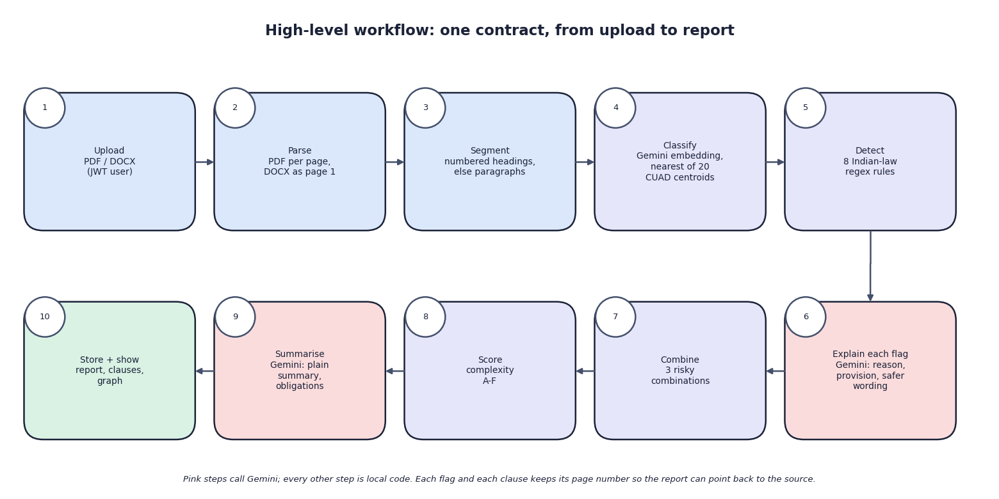

Models and components
Component | Detail
Embedding | gemini-embedding-001, 3,072-d
Classifier | nearest of 20 centroids
Tie-break | Gemini text model, top 3
Rules | 8 regex rules, Indian statutes
No model is trained: the centroids are averages and the text model is called through the API.
Notes:
The abstract speaks of a RAG pipeline with the Claude API and pgvector. The implemented pipeline classifies by cosine distance to 20 centroids and prompts Gemini with the matched rule's legal basis; there is no retrieval from a legal corpus.

Slide 9
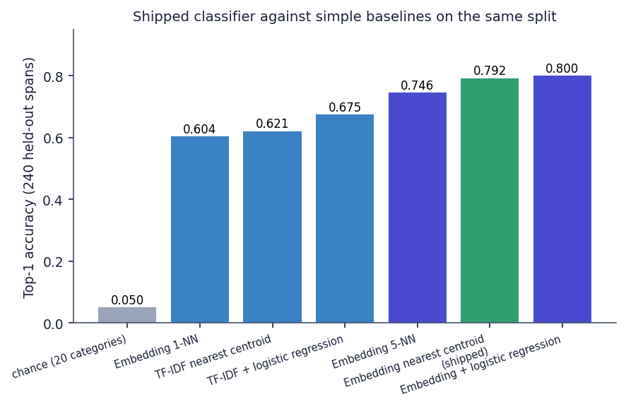

Configuration
Setting | Value
Training spans | 500 = 20 categories x 25, seed 42
Centroid | mean of 25 embeddings per category
Held-out set | 240 spans, 12 per category
Tie-break trigger | top-1 minus top-2 < 0.03 and top-1 < 0.60
Unclassified floor | confidence < 0.35
Complexity weights | 0.35 / 0.30 / 0.20 / 0.15
Text model | gemini-flash-latest (demo: 3.1-flash-lite)
Top-1 accuracy of the shipped centroid classifier (0.792) against simple baselines on the same 240 spans
Notes:
Embedding logistic regression scores 0.800 and 5-NN 0.746; TF-IDF with logistic regression 0.675; chance is 0.05. The shipped centroid method is simple and nearly as good as the best baseline. The text model was changed for the demo run only, because the default model hit its free-tier limit of 20 requests per day.

Slide 10
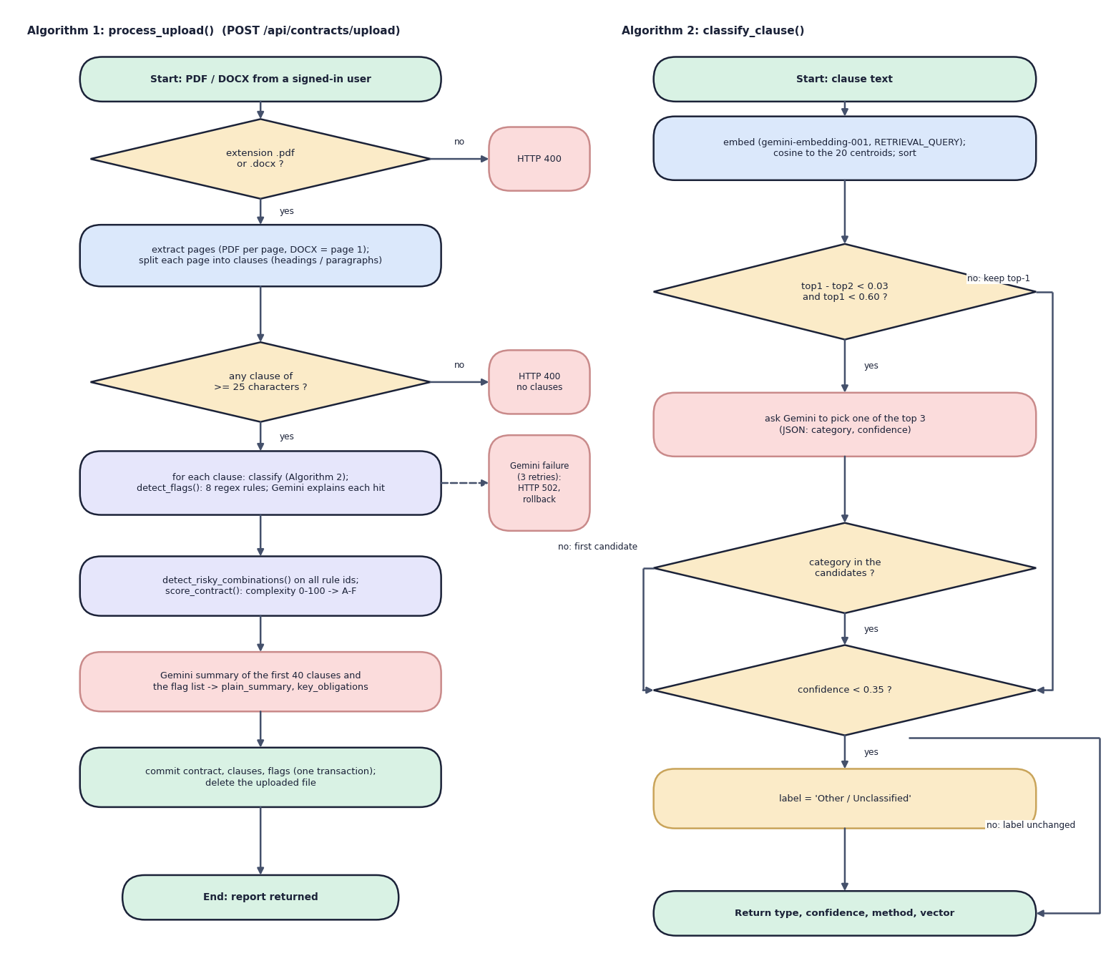

Decision logic
Classification
Nearest of 20 centroids by cosine. The tie-break needs top-1 < 0.60, but similarities range 0.657-0.849, so it never fires: every clause gets a label.
Predatory flag
A regex rule decides (8 rules). Gemini then writes the reason, quotes the provision and drafts safer wording.
Risk and grade
A combination fires when all its rule ids appear anywhere in the contract (3 patterns). Score = 0.35 readability + 0.30 jargon + 0.20 references + 0.15 sentence length; grade cut-offs 20 / 40 / 60 / 80.
Notes:
Left: Algorithm 1 (process_upload) and Algorithm 2 (classify_clause). Right: the three decisions. Complexity measures wording, not fairness: the one-sided freelance sample scored B (23.3) and the fair one A (13.7).

Slide 11
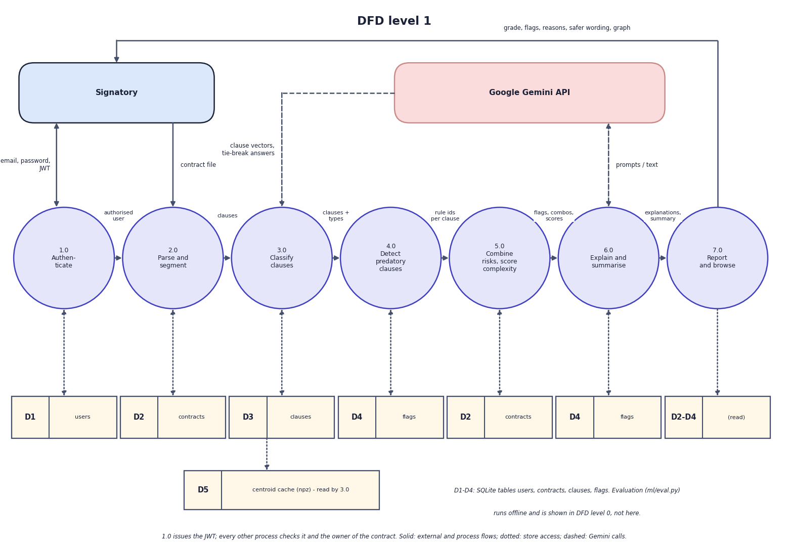
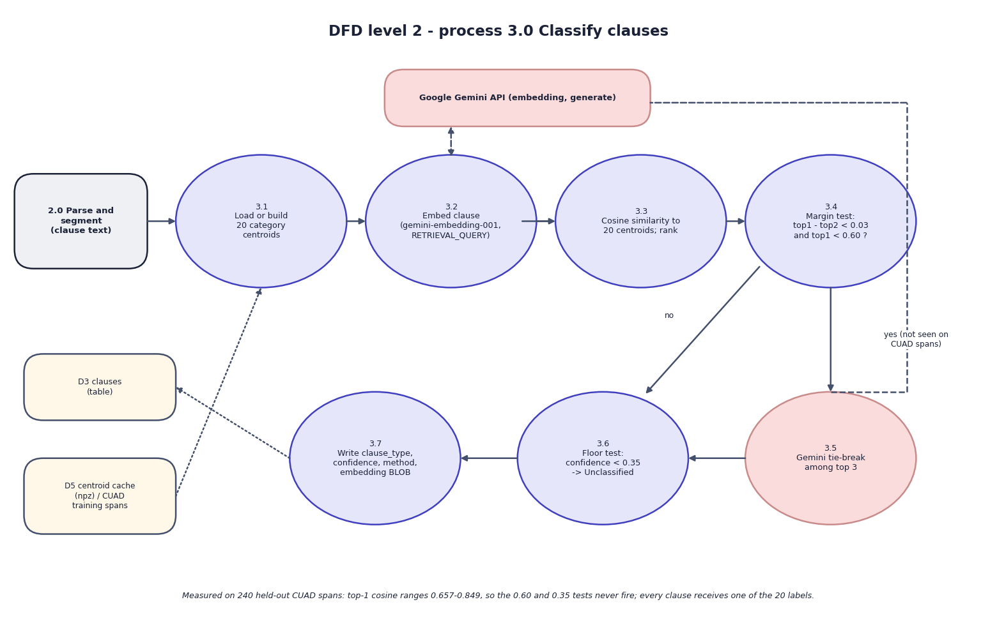

Data flow and modules
DFD level 1 (left) and level 2 expansion of 'Classify clauses' (right)
Module | Responsibility
Parsing and segmentation | PDF / DOCX text, page numbers, numbered-heading split
Classification and rules | Gemini embedding, 20 centroids, 8 regex rules, 3 combinations
Explanation and report | Gemini reasons, safer wording, summary; complexity grade; JSON report
Notes:
Level 1 has seven processes and five data stores; level 2 opens the classification process and shows where the 0.60 and 0.35 tests sit.

Slide 12
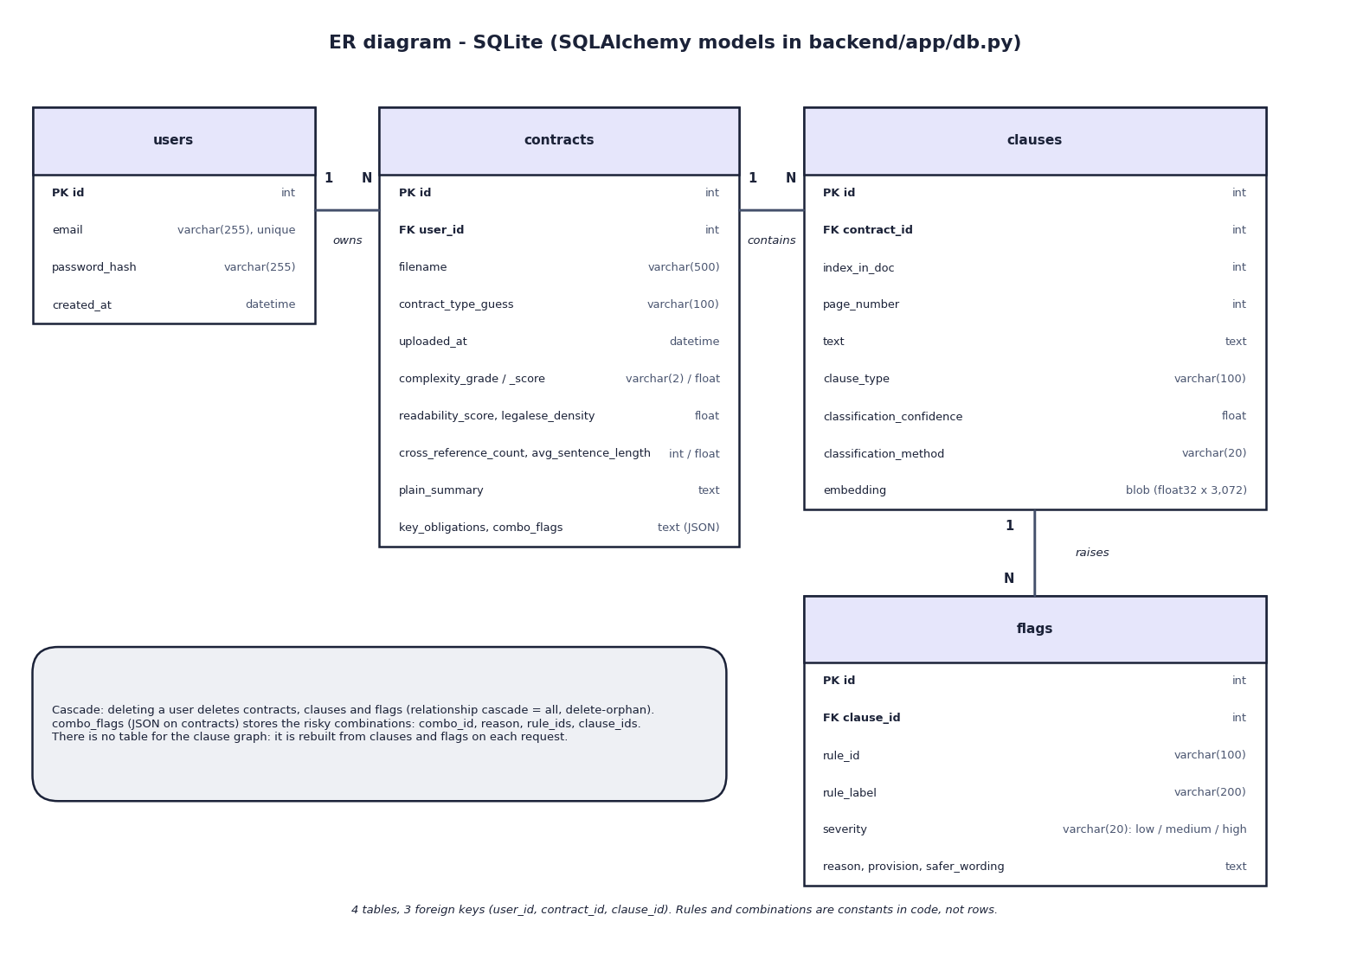
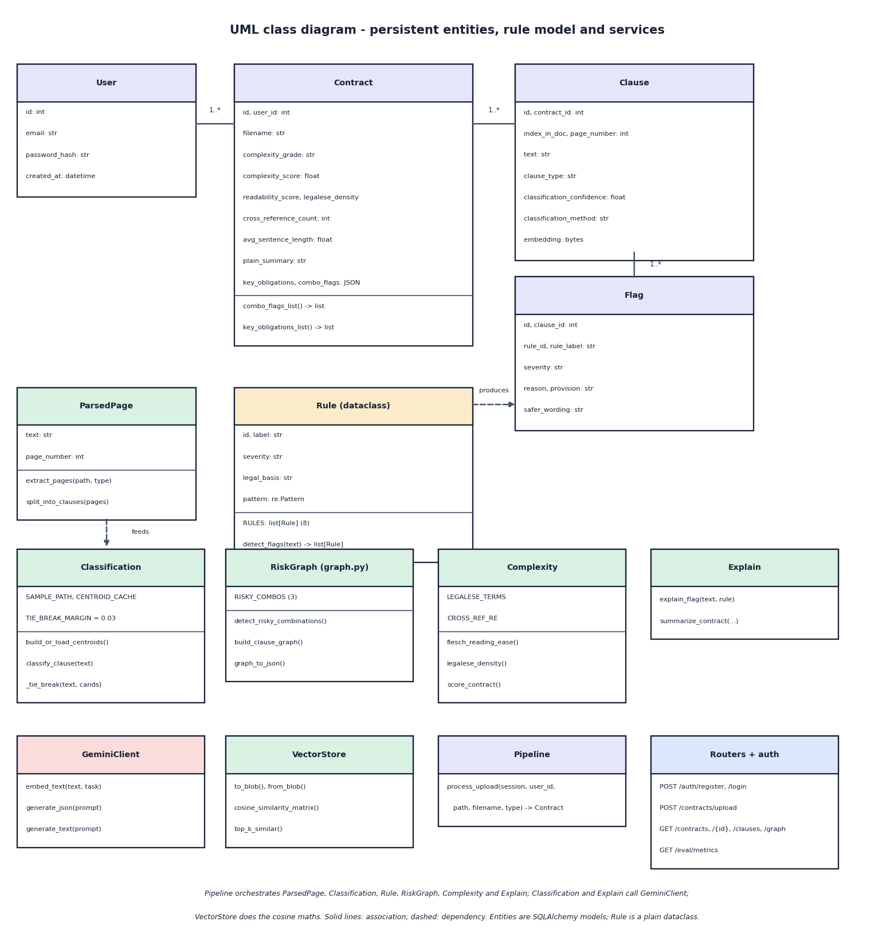

Database design and UML
Table | Key fields | Relations
users | email, password hash | 1:N contracts
contracts | grade, score, summary, combos | 1:N clauses
clauses | text, page, type, embedding | 1:N flags
flags | rule, severity, reason, wording | N:1 clause
ER diagram, 4 tables (left) and UML class diagram (right)
Notes:
Four SQLite tables created by SQLAlchemy. The clause graph is not stored: it is rebuilt from clauses and flags on each request. contract_type_guess is never set by the code.

Slide 13






Technology stack
Language
AI services
Documents and graph
Python 3.11, JavaScript and TypeScript
Google Gemini API (embedding-001 and a flash text model), NumPy cosine search
PyMuPDF 1.24, python-docx 1.1, NetworkX 3.3
Backend
Frontend
Storage and tests
FastAPI 0.115, SQLAlchemy 2.0, Pydantic, PyJWT 2.9, bcrypt 4.2
React 19, Vite, Tailwind CSS 4, TanStack Query, Recharts, axios
SQLite, npz centroid cache, pytest (68 pass, 5 expected fail), Playwright captures
Notes:
Versions are the ones pinned in backend/requirements.txt and frontend/package.json. scikit-learn was used only for the baseline experiments.

Slide 14
Implementation progress
Component | Status
Upload, parsing, clause segmentation | Completed
Classification into 20 CUAD types (79.2 % top-1) | Completed
8 Indian-law rules and 3 risky combinations | Completed
Gemini reasons, safer wording, summary | Completed
Complexity score and A-F grade | Completed
Report, clause, graph, evaluation screens | Completed
Experiments, 73 tests, latency measurements | Completed
Claude / pgvector / Neo4j, Indian corpus, lawyer review | Not done
9
REST endpoints
4
database tables
68
tests pass; 5 expected failures
Notes:
Every feature of the build is implemented and tested. The open items are the technologies named in the abstract that were replaced (Claude, pgvector, Neo4j), an Indian contract corpus, and expert review of the explanations.

Slide 15
Preliminary results: classification and rules
79.2 %
CUAD top-1 (top-3 97.9 %), 240 spans
1.00 / 0.94
rule precision / recall, shipped 40 clauses
0.79 / 0.46
rule precision / recall, independent probe
Notes:
Classification: top-1 0.792 (190 of 240), top-3 0.979; weakest categories Non-Compete and Cap On Liability (recall 0.50). Rules: the shipped 40 clauses were written with the rules (P 1.000, R 0.941, F1 0.970). On the independent probe set (24 predatory paraphrases, 16 benign look-alikes) precision is 0.786, recall 0.458, F1 0.579: the regexes miss paraphrases and flag some fair clauses. These are measured values from experiments/*/metrics.json.

Slide 16
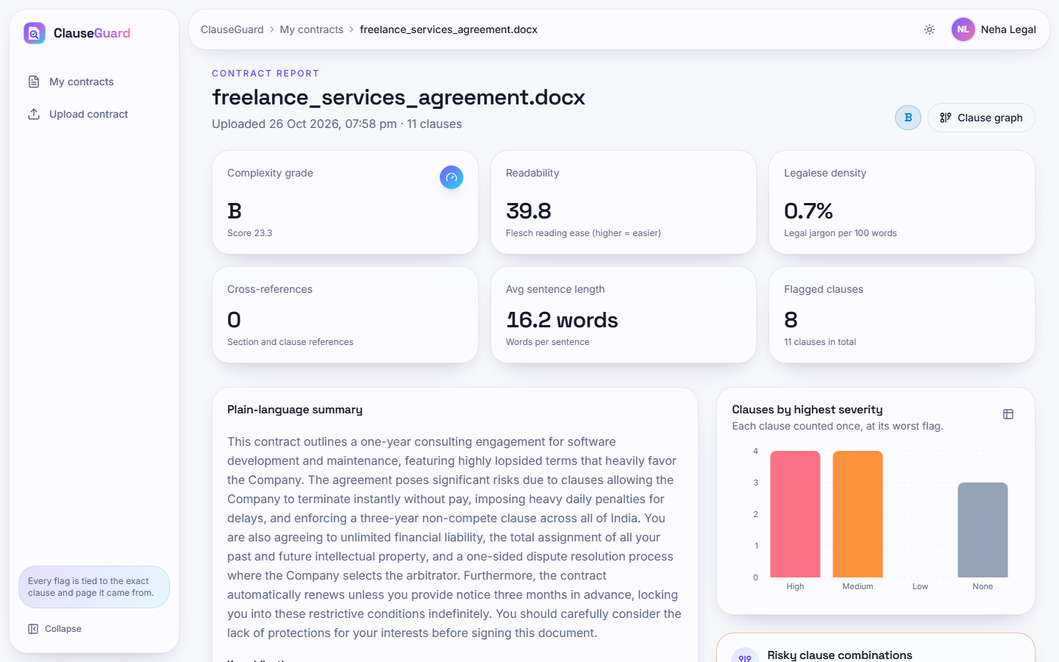
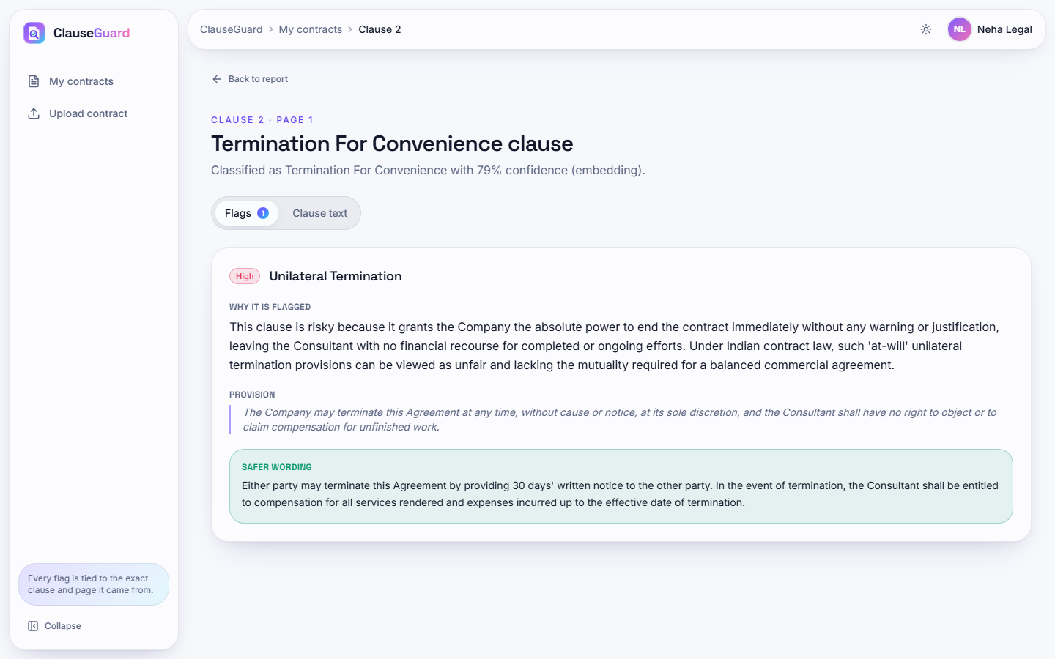


Output screens
Report of the one-sided freelance contract: grade B (23.3), 8 flagged clauses, 3 combinations
Clause 2: Unilateral Termination, reason, quoted provision, safer wording
Notes:
Real captures of the running application. The contract is an invented sample written for this review; the explanation text is produced by the Gemini text model.

Slide 17
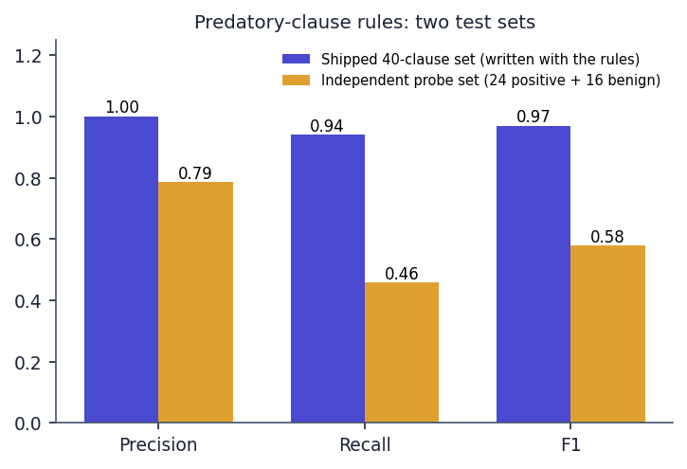
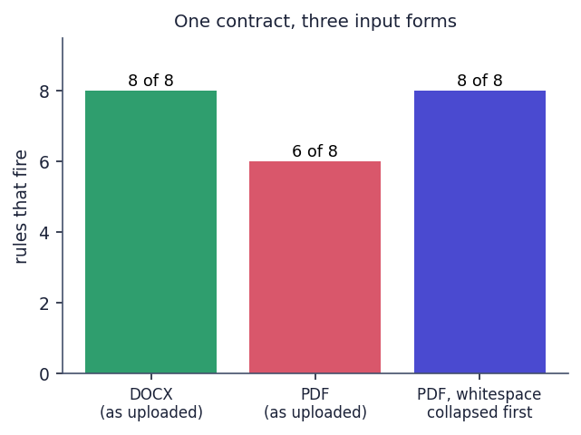
Testing and observations
Test group | Tests | Result
Rules, combinations, graph | 26 | 22 passed, 4 expected fail
Complexity, parsing, vector store | 21 | 21 passed
Classification (Gemini stubbed) | 6 | 6 passed
API: auth, upload, ownership, errors | 20 | 19 passed, 1 expected fail
Total | 73 | 68 passed, 5 expected fail
68 tests pass in about 10 s; the 5 expected failures record known limits (paraphrases the rules miss, a fair clause that is flagged, malformed Gemini JSON answered 400).
Independent probe set: rule precision 0.79, recall 0.46, against 1.00 / 0.94 on the set written with the rules.
The same contract as DOCX fires 8 of 8 rules, as PDF 6 of 8: line breaks defeat the patterns.
API medians: report 9.3 ms, clause 5.0 ms, login 254.7 ms; upload to report 15.5 s (0 flags) to 113.6 s (8 flags).
Not done: UI automation, load and security tests, lawyer review.
Notes:
Expected-fail tests are reported as such rather than hidden. Latencies were measured on 127.0.0.1 on an i5-12500 with other jobs running; upload time is dominated by about 12 s per Gemini text call.

Slide 18



Challenges and corrective actions
Abstract versus build
Rules miss paraphrases
Thresholds never fire
Claude, pgvector and Neo4j became Gemini, SQLite with NumPy and in-memory NetworkX; no legal-corpus retrieval.
Independent recall 0.46 and precision 0.79, against 1.00 / 0.94 on our own set.
Similarities run 0.657-0.849, so tie-break (< 0.60) and 'Unclassified' (< 0.35) never act.
PDF line breaks
Gemini quota and speed
No Indian contracts
8 of 8 rules on DOCX, 6 of 8 on the same PDF; text before the first heading is dropped.
Default model allows 20 requests a day; 113.6 s for 8 flags; the UI times out at 180 s.
CUAD holds US filings; Indian-law rules are tested on our clauses only; no lawyer review.
Notes:
Six challenges and findings, each backed by a measurement in docs/REPORT_FACTS.md.

Slide 19
Next steps
Fix rules and parsing
Recalibrate classifier
Indian data and review
Final report and demo
Normalise whitespace before matching, keep text before the first heading, widen the rules, and test them on clauses written by someone other than the rule author.
Set the tie-break and 'Unclassified' thresholds for the embedding model's similarity range; split train and test by contract.
Collect Indian contracts with lawyer-reviewed labels; show the honest scores on the Evaluation screen.
Run user testing with signatories (not yet done); complete the report and final demo.
Notes:
What remains: repair the weaknesses found in testing, collect Indian-law data and expert review, then the report and the final demonstration.

Slide 20
Thank you
Questions and suggestions are welcome.
Notes:
Thank you. Questions are welcome.

