Slide 1
Sign Language Recognition System Based on Convolutional Neural Networks (CNNs)
REVIEW 2 · DESIGN, METHODOLOGY AND PROGRESS
Design, methodology and progress: a segmentation-plus-CNN recogniser behind a FastAPI service and a React interface
Presented by
Under the guidance of
AJAY 24K95A0502
A NAVADEEP REDDDY 23K91A0514
B MANIDEEP 23K91A0540
B MAHESHWARI 23K91A0536
V. PALLAVI, [DESIGNATION]
Department of Computer Science and Engineering
TKR College of Engineering & Technology · Batch A16 (CSE-A) · [ACADEMIC YEAR]
Notes:
This review shows how the system is designed and built: the data and model, what is implemented, the first measured results and the open items.

Slide 2
Contents
01
02
03
Recap and architecture
Methodology and dataset
Preprocessing and model
04
05
06
Training and decision logic
Data flow, database and UML
Technology stack
07
08
09
Implementation progress and results
Output screens and testing
Challenges and next steps
Notes:
Agenda for the design and progress review.

Slide 3
Recap: problem and proposed system
!
Problem
i
Proposed system
B
Base paper link
Deaf and hearing people cannot converse without an interpreter, and interpreters are scarce. Recognisers that exist often need special sensors or stop at a static-image accuracy figure.
A webcam frame is cropped to a hand region, segmented, resized to 64 x 64 and classified by a CNN into 29 classes; a decision layer turns letters into a sentence that is shown and spoken.
Shares the aim of accessible, real-time recognition. Does not use skeletons or knowledge distillation; it is an image CNN for letters, and its results are not comparable.
Notes:
One-minute recap of Review 1: the communication gap, our CNN-based approach, and how the base paper relates (motivation only).

Slide 4
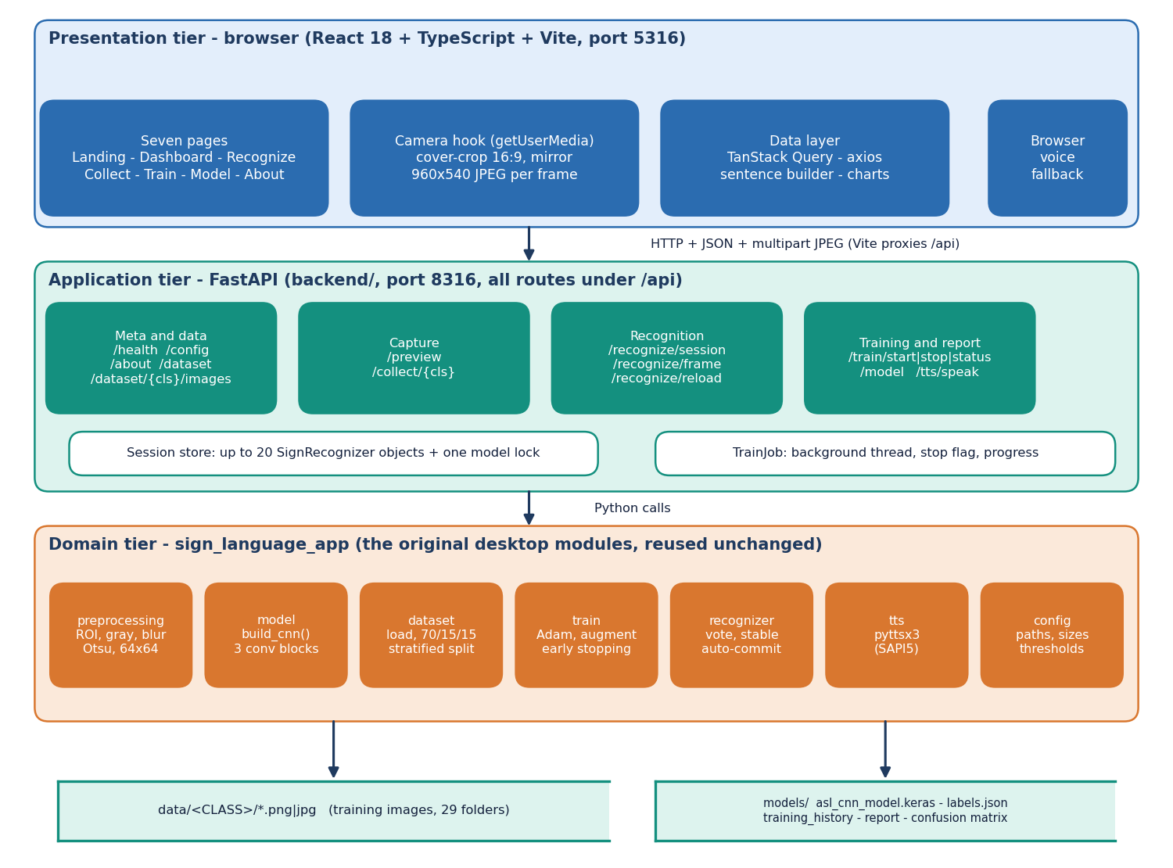
System architecture
Three tiers
Presentation: React 18 app (port 5316) owns the webcam through getUserMedia.
Application: FastAPI (port 8316), 16 endpoints under /api, in-memory sessions.
Domain: the original desktop modules (preprocessing, model, recognizer, tts) reused unchanged.
Storage: image folders and model files on disk.
Notes:
The FastAPI layer wraps the original sign_language_app modules, so the web and desktop apps run the same pipeline and the same model.

Slide 5
Methodology: end-to-end workflow
Kaggle ASL Alphabet
250 images per class
ROI + segmentation
70 / 15 / 15 split
Train CNN (Adam)
Test once
metrics.json + figures
One pipeline
Stratified split
Reproducible
Collection, training and live recognition call the same preprocessing function, so there is no train/serve mismatch.
Same 250 images per class in every class; split 5,075 / 1,087 / 1,088 with seed 42; the test part is used once.
scripts/measure_metrics.py writes every number to docs/metrics/metrics.json; figures are regenerated from it.
Notes:
The training script and the measurement script are one command each. Preprocessing is the same function the live recogniser uses.

Slide 6
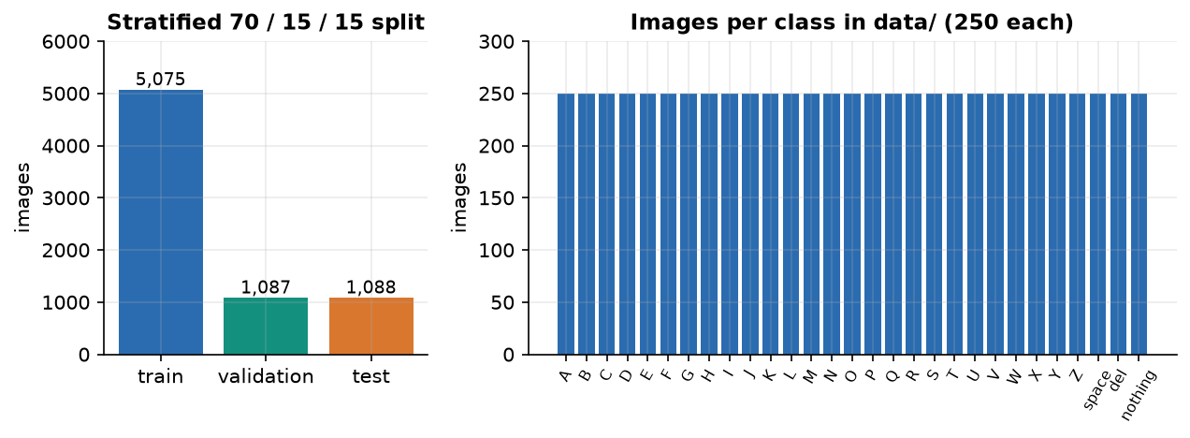
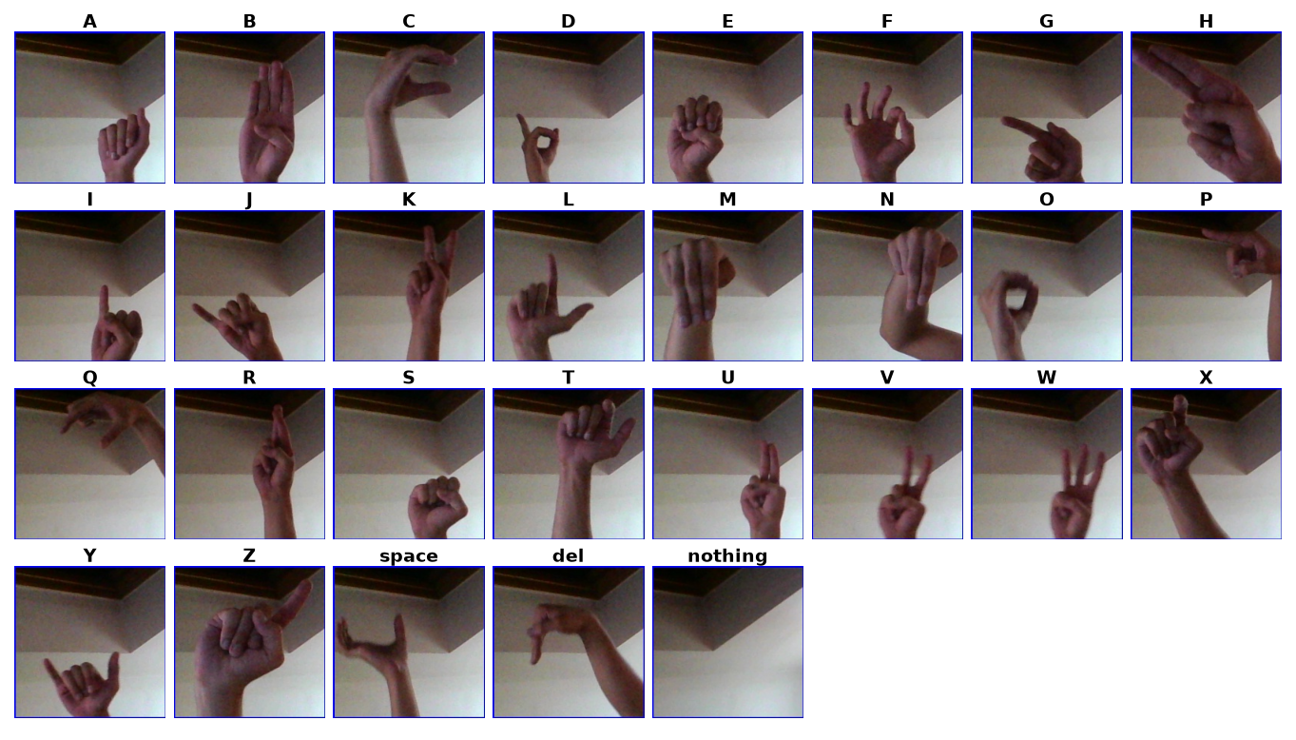
Dataset
87,000
29
7,250
5,075 / 1,087 / 1,088
images in the Kaggle archive (29 x 3,000)
classes: A-Z, space, del, nothing
images used: 250 per class
train / validation / test
Frames from video: neighbouring images are near-duplicates, and no signer id is given.
So the test split is not an unseen-signer test. Licence is not bundled; Kaggle page to be re-checked.
Notes:
Kaggle ASL Alphabet: 87,000 training images of 200 x 200 pixels. We used an evenly spaced subset of 250 per class to keep CPU training practical. Important caveat: frames come from video, so the split is not signer-independent.

Slide 7
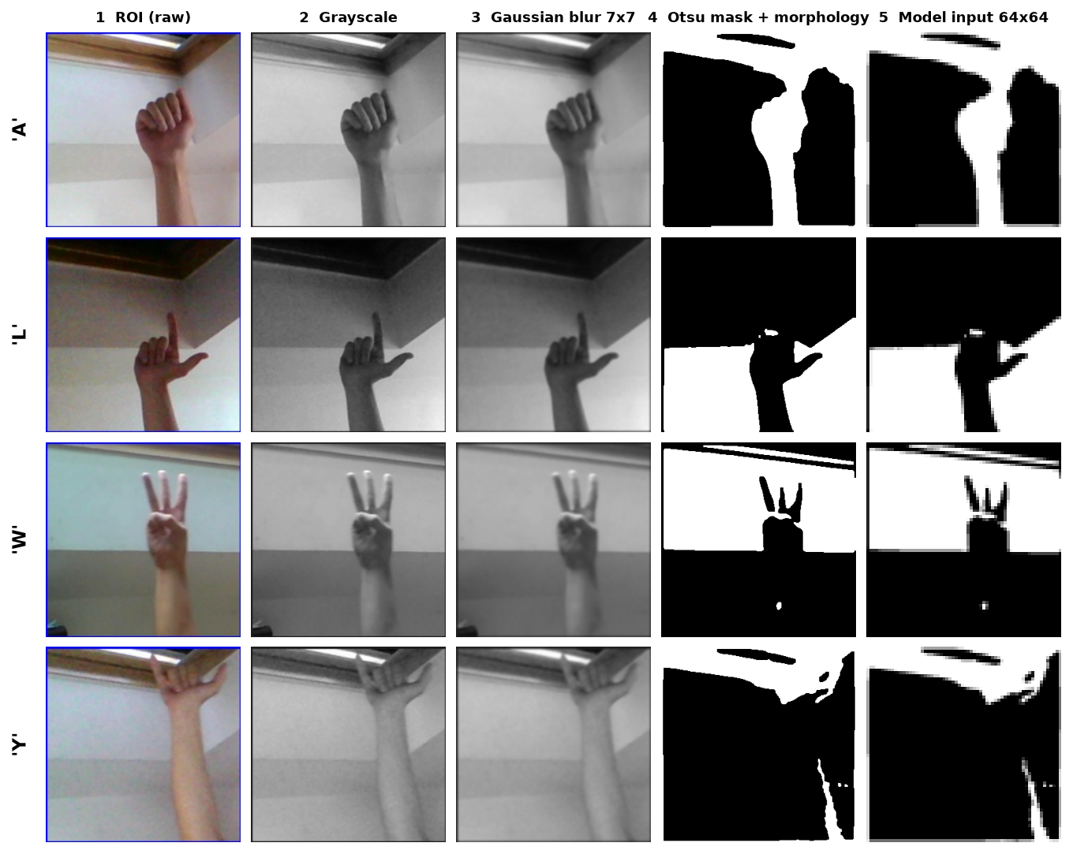
Data preprocessing
1 Crop the 300 x 300 region of interest
2 Convert to grayscale
3 Gaussian blur, 7 x 7
4 Otsu threshold (invert if mean > 127)
5 Morphology: open once, close twice (3 x 3)
6 Resize to 64 x 64, divide by 255
Same six steps for collection, training and recognition. Training adds rotation, shift, zoom and shear.
Notes:
The six steps. Weakness: Otsu thresholding does not isolate the hand on a cluttered background, so some masks contain background structure; this is a stated limitation.

Slide 8
Model architecture
Block | Layers | Output
1 | Conv 3x3, 32 · BN · MaxPool | 32 x 32 x 32
2 | Conv 3x3, 64 · BN · MaxPool · Dropout 0.25 | 16 x 16 x 64
3 | Conv 3x3, 128 · BN · MaxPool · Dropout 0.25 | 8 x 8 x 128
Head | Flatten · Dense 256 · BN · Dropout 0.4 | 8,192 -> 256
Output | Dense 29, softmax | 29 class probabilities
2,199,453
parameters
26.48 MB
saved model file
No GPU
Input is one 64 x 64 channel (the segmented mask). 'same' padding keeps the size before each 2 x 2 pooling. ReLU after each convolution and the first dense layer.
trains and runs on a CPU
Notes:
A compact CNN written for the project: three convolution blocks and one dense layer, 2,199,453 parameters, 26.48 MB on disk.

Slide 9
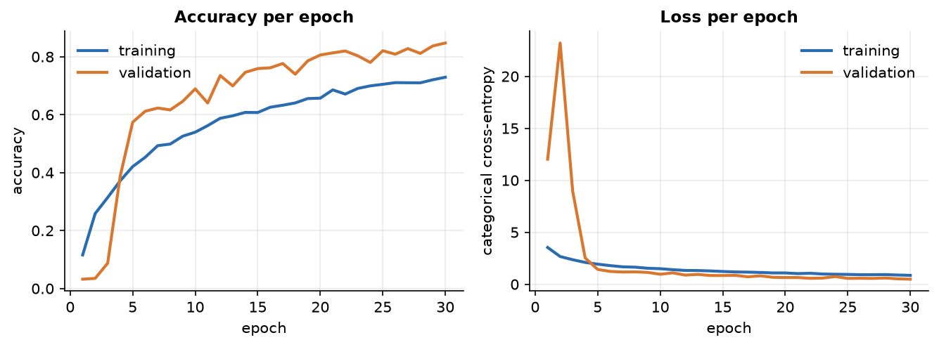
Training configuration
Setting | Value
Optimiser / loss | Adam, learning rate 1e-3 / categorical cross-entropy
Batch / epochs | 32 / UI default 25; the saved run used 30
Split | 70 / 15 / 15 stratified, seed 42
Augmentation | rotation 12 deg, shift 10 %, zoom 12 %, shear 8 % (training only)
Callbacks | EarlyStopping on val. accuracy (patience 6, restore best), ModelCheckpoint
Hardware | Intel Core i5-12500, CPU only, about 9.9 s per epoch (2-epoch benchmark)
Saved run: 30 epochs, best validation accuracy 84.7% at epoch 30 (the cap; accuracy was still rising). Validation exceeds training accuracy (72.9%) because dropout and augmentation act only during training.
Notes:
Training configuration from sign_language_app/config.py and train.py. The saved run reached the 30-epoch cap, so it may be slightly under-trained; this is stated, not hidden.

Slide 10
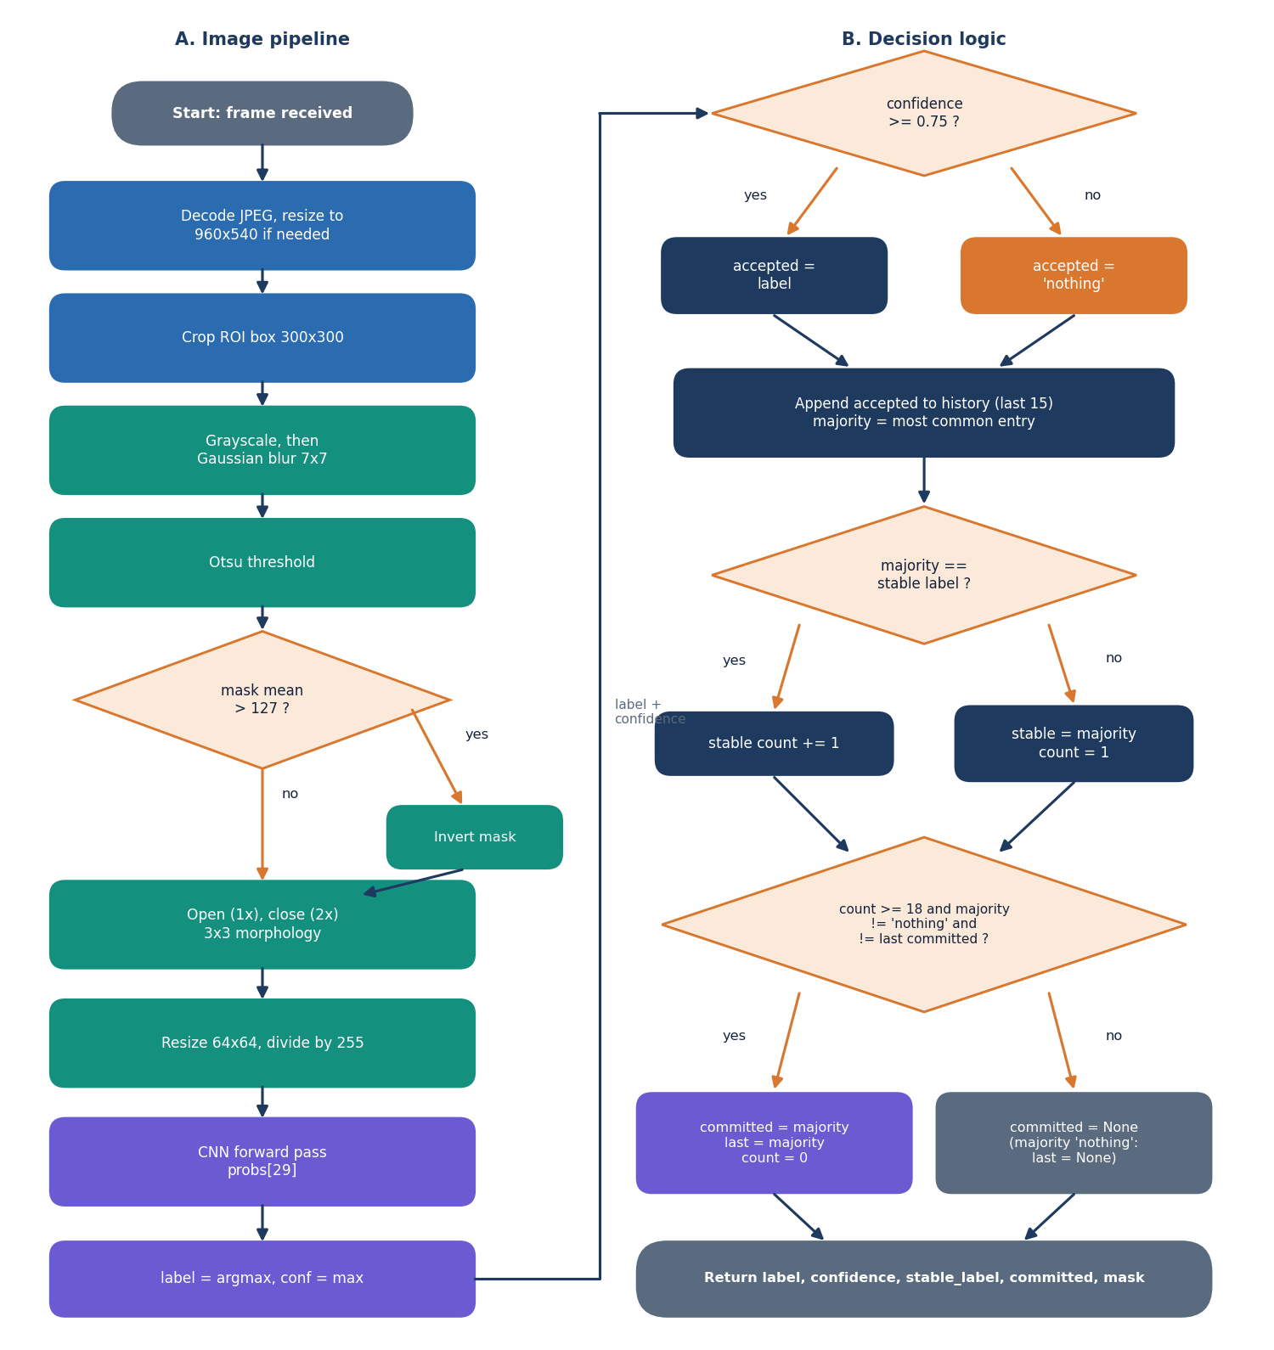
Decision logic
Confidence gate. If the top softmax probability is below 0.75 the frame counts as 'nothing'.
Majority vote. The last 15 frame labels are voted, which removes single-frame flicker.
Stability counter. A letter is committed after 18 consecutive stable frames, if it is not 'nothing' and differs from the last committed letter.
Control signs. 'space' and 'del' commit as edit actions; 'nothing' resets the repeat guard.
Notes:
The decision rules are in SignRecognizer.predict_frame. They trade speed for accuracy: a letter needs about 18 stable frames, roughly a second at 17-19 frames per second.

Slide 11
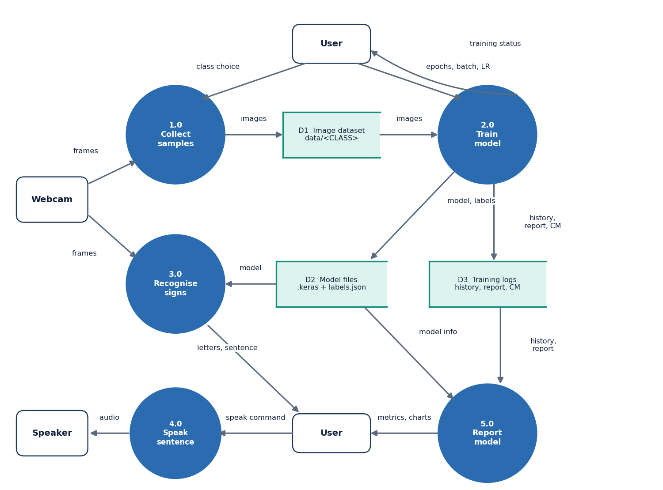
Data flow and modules
Module | Role
preprocessing.py | ROI, blur, Otsu, 64x64
model.py | build the CNN
dataset.py | load, split, augment
train.py | training loop, report
recognizer.py | vote, stability, commit
tts.py | offline speech
backend/main.py | FastAPI routes
frontend/src | React screens
Notes:
Level-1 data flow. The original desktop modules are untouched; the backend and frontend are new.

Slide 12
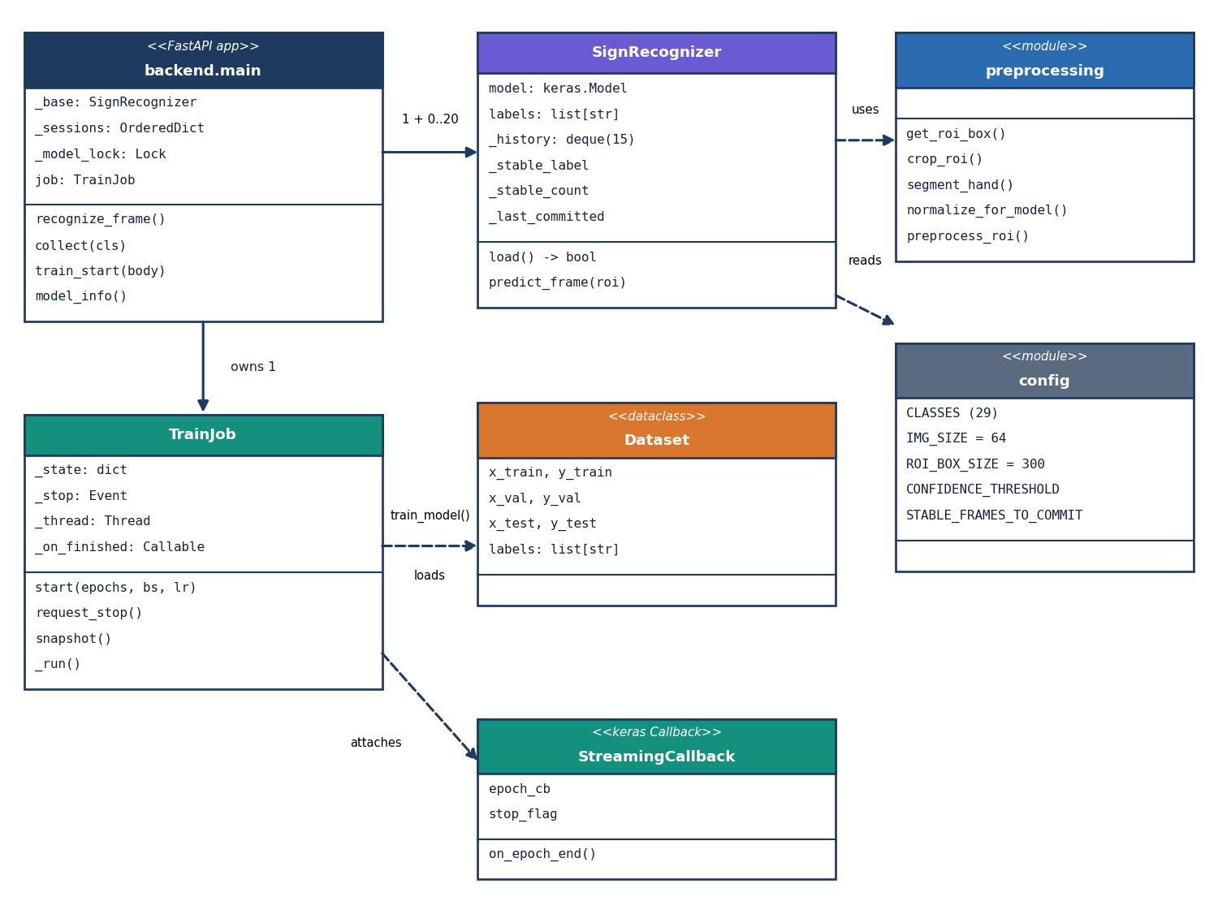
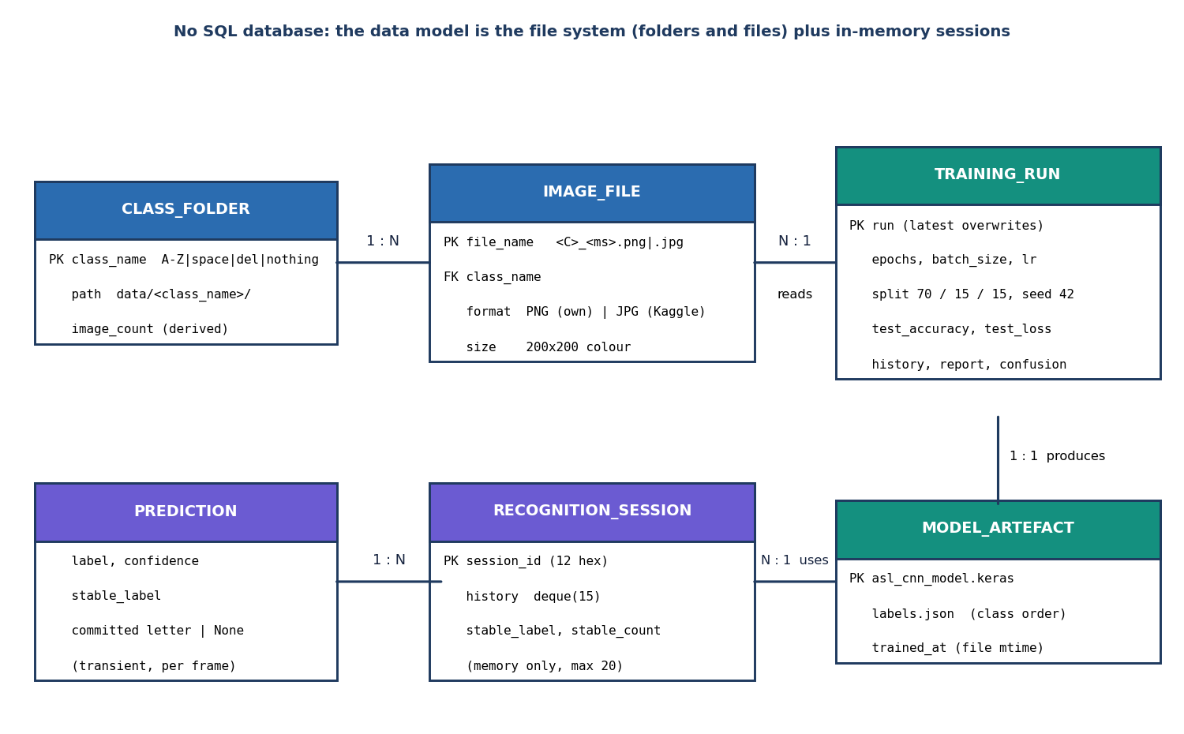
Database design and UML
There is no SQL database: training images are files under data/<CLASS>/, model files live in models/, recognition sessions are in memory (at most 20). The ER diagram shows these stores.
Notes:
Honest point: the project stores files, not rows. The ER diagram therefore models the file-system entities; the class diagram shows the real Python classes.

Slide 13
Technology stack
Layer | Technology
Deep learning | TensorFlow / Keras 2.15.0, NumPy 1.26.4, scikit-learn, matplotlib
Image processing | OpenCV 4.11.0, Pillow
Speech | pyttsx3 (offline); browser voice fallback
Desktop app | customtkinter (original, unchanged)
API | FastAPI, Uvicorn, python-multipart (port 8316)
Front end | React 18, Vite 8, Tailwind 4, TanStack Query, Recharts (port 5316)
Testing | pytest, FastAPI TestClient, Playwright, smoke script
Notes:
Python 3.11.9 on Windows. Everything is open source and starts with run.bat.

Slide 14
Implementation progress
Component | Status | Evidence
Preprocessing, CNN, recogniser, speech | Done | sign_language_app/, 25 unit tests
Training and evaluation | Done | models/, scripts/measure_metrics.py
FastAPI service (16 endpoints) | Done | 27 API tests, 26/26 smoke checks
React interface (7 screens) | Done | 16 screenshots, browser walk 360-1440 px
Recognition of words / dynamic signs | Not done | letters only; stated as a limitation
Evaluation on unseen signers | Not done | dataset has no signer ids
Model optimisation (quantisation, TFLite) | Not done | CNN call is 50 ms via model.predict
Notes:
State of the code base. Three honest gaps: words, unseen signers, and model optimisation.

Slide 15
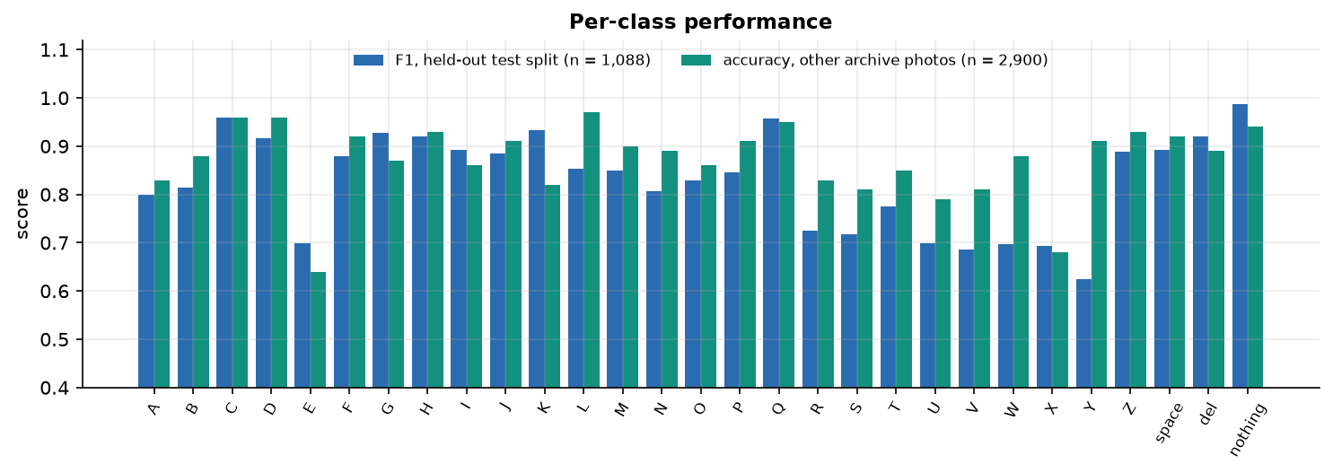
Preliminary results: held-out test split
82.81%
0.830
92.9%
26 / 28
test accuracy (n = 1,088)
macro F1
top-3 accuracy
official Kaggle test photos
i
Reading
Test split = the 15 % never used for training or model selection. Weakest: Y, V, X, U, W, E (F1 0.62-0.70). Best: nothing, C, Q. 87.2 % on other archive photos is optimistic (near-duplicate frames) and is not used as the headline.
Notes:
Headline: 82.81 % on the 1,088-image test split (loss 0.5569, macro F1 0.830). The 87.24 % on 2,900 other archive photos is inflated by near-duplicate frames, so it is context only.

Slide 16
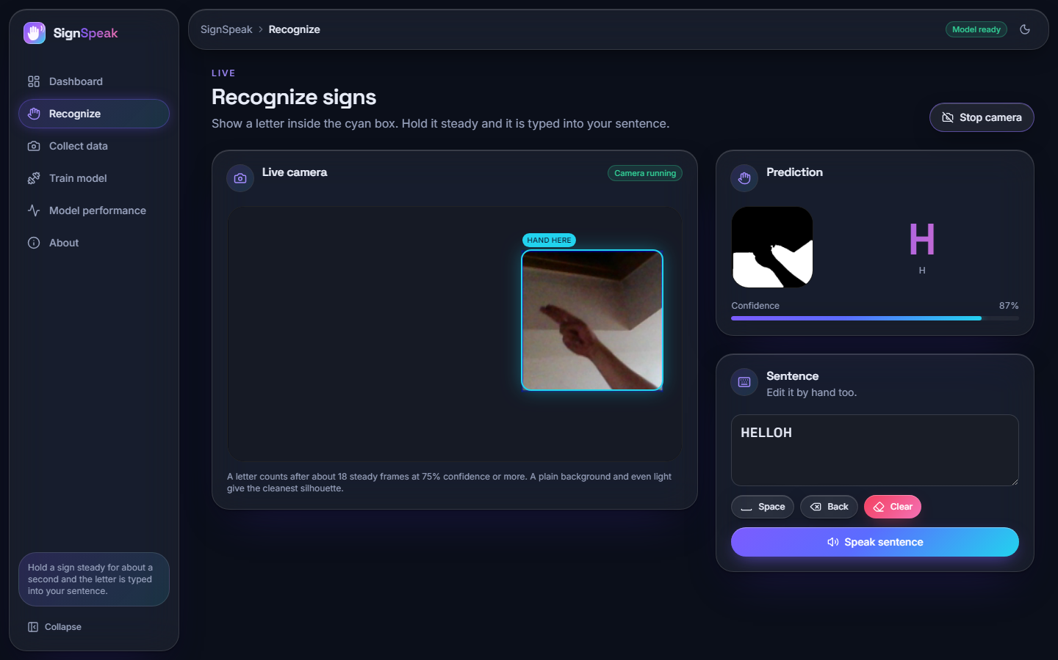
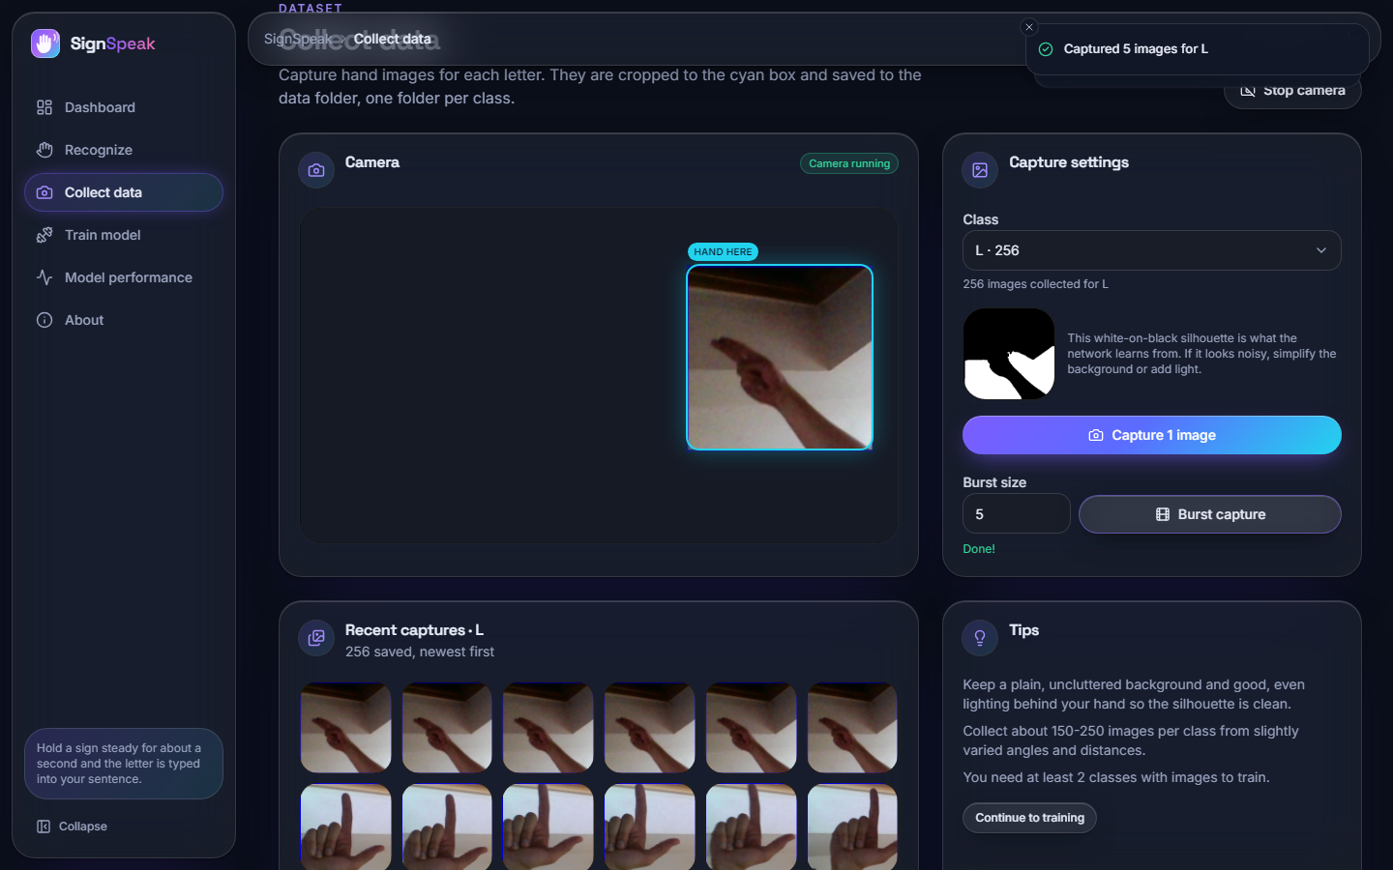
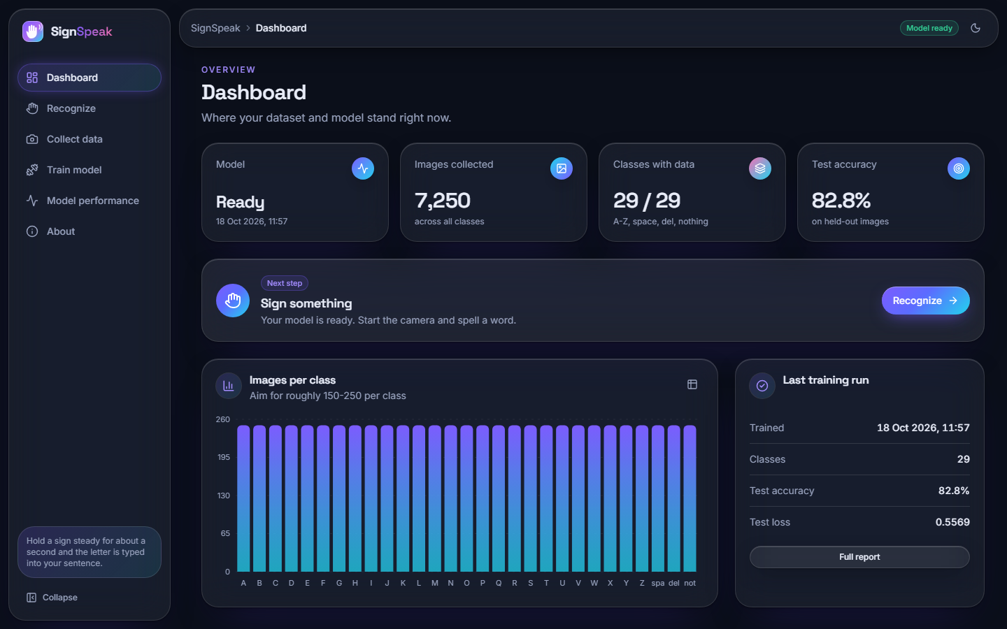
Output screens
Live recognition: letter H at 87 %, segmentation mask preview and the sentence built so far. Collection and dashboard screens on the right. Real application, trained model, 7,250 real images; the camera was a Chromium fake camera fed with real photos.
Notes:
Real screenshots from the running application. The recognition clip was assembled from real held-out photos and fed to a fake camera because the build machine had no physical webcam.

Slide 17
Initial testing and observations
52
26 / 26
0
360-1440 px
pytest tests passed
smoke-test checks
console errors in the browser walk
light and dark themes
Observation | Action
Archive photos beyond the training subset are near-duplicates of trained frames | Headline uses the held-out split; the 87.2 % figure is flagged as optimistic
Rotating a hand by +/- 10 degrees drops accuracy from 85.0 % to about 68 % | Documented; rotation augmentation planned
No physical webcam on the build machine | Browser flow tested with a fake camera; live webcam test left to the user
Notes:
27 API, 10 preprocessing, 7 recogniser and 8 dataset/model tests. The observations on the right shaped how results are reported.

Slide 18
Challenges and corrective actions
Challenge | Corrective action
87,000 images are too slow to train on a CPU | Evenly spaced 250 per class (7,250 images); 75 s to load and preprocess
Otsu masks keep background structure on cluttered scenes | Stated as a limitation; skin-colour mode exists in config for future work
Validation loss spiked in the first epochs (BatchNorm warm-up) | Settled by epoch 6; best-weights checkpoint kept
TensorFlow failed to load after scikit-learn on Windows | Import TensorFlow first in the scripts
CNN forward pass dominates latency (50 ms) | Measured; optimisation listed as future work
Notes:
Each challenge was met by a concrete change in the data, the scripts or the way results are reported.

Slide 19
Next steps
1
Evaluate
2
Improve robustness
3
Speed up
4
Extend (future)
Test on signers and backgrounds the model has never seen, and with a physical webcam.
Add rotation and brightness augmentation; compare with skin-colour segmentation.
Export the model for faster inference than model.predict (quantisation, TFLite).
Common words and motion signs, two-hand signs, sentence-level translation.
Notes:
Plan to the final review and beyond. Unseen-signer evaluation needs new data with signer ids; it is not possible with the Kaggle archive alone.

Slide 20
Thank you
Questions and suggestions are welcome.
Notes:
Likely questions: why a 64 x 64 mask instead of the colour image; how the system handles unseen signers (not tested); why letters only.

