Slide 1

Sign Language Recognition System Based on Convolutional Neural Networks (CNNs)
Final Review · SignSpeak
Team Details : Batch A16
Under the Esteemed Guidance of
V. PALLAVI
[DESIGNATION], Department of CSE
24K95A0502 AJAY
23K91A0514 A NAVADEEP REDDDY
23K91A0540 B MANIDEEP
23K91A0536 B MAHESHWARI
DEPARTMENT OF COMPUTER SCIENCE AND ENGINEERING · TKR College of Engineering & Technology · Academic Year [ACADEMIC YEAR]
Notes:
Introduce the team and the project: SignSpeak, a CNN-based recogniser for the ASL alphabet with a complete web application.

Slide 2
Table of Contents
Abstract
Base Paper & Literature Survey
Research Gap, Problem Statement & Objectives
Proposed System & Architecture
Methodology, Dataset & Model
Decision Workflow, Interaction & Storage
Implementation Highlights
Results, Confusion Matrix & Threshold Analysis
Performance & Testing
Comparison with Base Paper
Output Screens
Conclusion, Future Scope & References
Dept. of CSE | Batch A16 | Final Review
2
Notes:
The agenda follows the report: problem, design, method, results, comparison, screens, conclusion.

Slide 3
Abstract
Sign language is the main way many deaf and hard-of-hearing people communicate, but few hearing people understand it, and interpreters are scarce.
SignSpeak recognises the ASL alphabet from a webcam: the hand region is cropped, segmented (grayscale, blur, Otsu), resized to 64 x 64 and classified by a CNN into 29 classes; recognised letters build a sentence that is shown and spoken.
The CNN (2,199,453 parameters, CPU-trained on 7,250 images) reaches 82.81% accuracy on a held-out 1,088-image split (macro F1 0.830); on the server a frame takes about 53 ms, so the live loop runs at roughly 17 to 19 frames per second.
A FastAPI service and a React interface add collection, training and a model report; 52 pytest tests and a 26-check smoke test pass.
Not done: words and motion signs, and evaluation on unseen signers; accuracy drops sharply when the hand is rotated by 10 degrees.
Dept. of CSE | Batch A16 | Final Review
3
Notes:
Read the first two bullets, then give the headline number with its protocol (held-out split). End on the honest limits.

Slide 4
Base Paper
D. T. D. Vo, V. D. Nguyen, T. H. M. Nguyen and M. H. Vo, "MAG-KD: Mask-Guided Adaptive Gating Knowledge Distillation for Skeleton-Based Sign Language Recognition on Edge Devices," IEEE Access, vol. 14, pp. 54761-54775, 2026, doi: 10.1109/ACCESS.2026.3681176.
Aspect | Base paper (MAG-KD)
Method | Skeleton-based GCN student (STA-GCN) distilled from three teachers (SL-GCN, CTR-GCN, TD-GCN); hard correctness mask plus adaptive gating network
Data | AUTSL (38,336 videos, 43 signers, 226 signs) and WLASL-100 (1,442 train / 596 validation videos); seeds 1, 42, 100
Reported results | 94.25 +/- 0.19 % Top-1 on AUTSL with 0.48 M parameters; 66.33 +/- 0.54 % on WLASL-100 (baseline 54.92 %); Jetson Nano 33.13 FPS at 6.23 W (TensorRT FP16)
Stated limits | Mask needs ground-truth labels; accuracy bounded by the upstream pose extractor in difficult scenes
Dept. of CSE | Batch A16 | Final Review
4
Notes:
A skeleton and distillation method for video word signs on an edge device. We share the goal of accessible real-time recognition but not the method or the task.

Slide 5
Literature Survey
Author / Year | Methodology | Dataset | Key Results | Limitations
Vo et al. 2026 [1] | MAG-KD: a small skeleton GCN student distilled from three GCN teachers with a hard correctness mask and an adaptive gate | AUTSL (38,336 videos, 43 signers, 226 signs); WLASL-100 | 94.25 +/- 0.19 % Top-1 on AUTSL with 0.48 M parameters; 66.33 +/- 0.54 % on WLASL-100; 33.13 FPS at 6.23 W on a Jetson Nano | Needs a pose estimator in front of it; correctness mask needs ground-truth labels; video word signs, not fingerspelling
Starner et al. 1998 [4] | Hidden Markov models over features from a desk-mounted or wearable camera | Sentence-level ASL video, restricted vocabulary | Early real-time ASL recognition (figures not quoted here) | Restricted vocabulary and grammar
Pugeault and Bowden 2011 [5] | Colour and depth from a Kinect sensor, Gabor-filter features, classification of fingerspelled letters | ASL fingerspelling captured with a depth camera | Real-time letter recognition (figures not quoted here) | Needs a depth sensor
Bheda and Radpour 2017 [6] | Deep convolutional network on images of ASL letters and digits | Static images of ASL letters and digits | CNNs can classify static fingerspelling images (figures not quoted here) | Static images only; no live pipeline
Camgoz et al. 2018 [16] | Neural sign language translation: sign video to spoken-language text | Continuous sign video with sentence translations | First end-to-end neural video-to-text translation (figures not quoted here) | Needs large annotated video corpora
Rastgoo et al. 2021 [3]; Al Abdullah et al. 2024 [2] | Surveys of deep-learning sign language recognition | Review of datasets and methods | Map the field: static, isolated-word and continuous recognition | Reviews, no system of their own
Dept. of CSE | Batch A16 | Final Review
5
Notes:
Representative work. Where a work's figures were not checked they are not quoted. Four further 2024-2025 papers named in the project survey are in the report's reference list with that caveat.

Slide 6
Research Gap
End-to-end system: few works go from a live webcam to letters, a sentence and speech in one usable application.
Accessible hardware: skeleton and depth pipelines need extra models or sensors; an ordinary webcam and CPU should suffice for letters.
Honest evaluation: results are rarely given with split, per-class scores, confidence behaviour and latency together.
Robustness: effects of clutter, lighting and hand orientation are seldom measured.
Unseen signers: public alphabet data has no signer identity, so signer-independent accuracy is hard to test.
Dept. of CSE | Batch A16 | Final Review
6
Notes:
Five gaps. We address the first three directly, measure the fourth, and state the fifth as not done.

Slide 7
Problem Statement
Given a live webcam stream of a signer's hand, recognise the ASL fingerspelling letter being shown (and the control signs space and delete), turn the letters into a sentence on screen and speak it aloud, fast enough to follow the signer and with a stated, measured accuracy - through an application that a non-expert can run.
Input
Output
Record
Webcam frames, 960 x 540, hand inside a 300 x 300 region
Letter and confidence, sentence on screen, spoken text
Collected images, trained model, metrics, confusion matrix
Dept. of CSE | Batch A16 | Final Review
7
Notes:
The statement has three parts: recognise, speak, and keep an inspectable record.

Slide 8
Objectives
1. Build a dataset of hand gesture images covering the target sign alphabet and common words.
2. Preprocess images with segmentation, resizing and augmentation to improve generalisation.
3. Design and train a CNN architecture for gesture classification.
4. Optimise the model for real-time inference from a live camera feed.
5. Convert recognised signs into on-screen text and synthesised speech output.
6. Evaluate accuracy, per-class performance and inference latency on unseen signers.
Dept. of CSE | Batch A16 | Final Review
8
Notes:
The six objectives of the proposal. The conclusion reports for each whether it was met; objectives 1 (words) and 6 (unseen signers) were not fully met.

Slide 9
Proposed System
Webcam frame
ROI + segmentation
CNN classify
Vote + stability
Sentence + speech
Compact three-block CNN, 2.2 million parameters, trained from scratch on the CPU; the same preprocessing for collection, training and recognition.
Confidence threshold 0.75, majority vote over 15 frames and 18 stable frames before a letter is typed.
Sentence builder with offline text-to-speech (browser voice fallback); in-app collection, background training and a model report.
FastAPI service reusing the original desktop code; React interface in light and dark themes, usable at phone width.
Dept. of CSE | Batch A16 | Final Review
9
Notes:
The proposed system in one line of boxes, then four properties that matter.

Slide 10
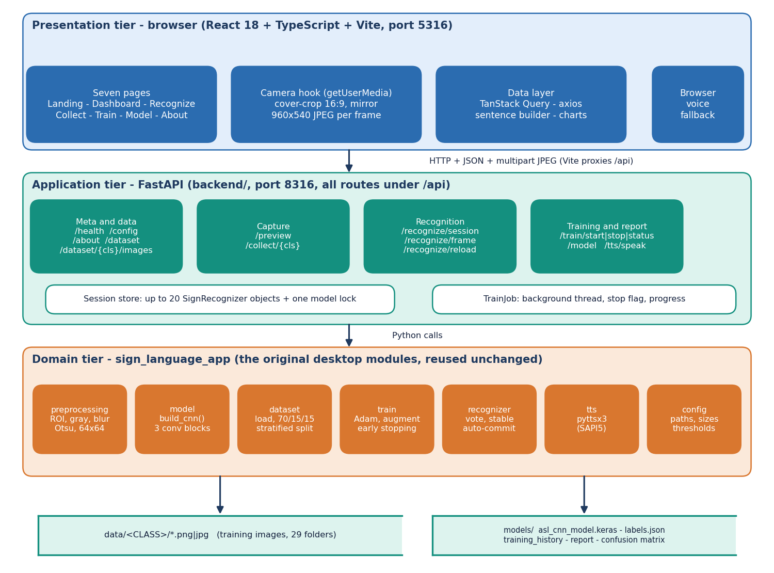
System Architecture
Presentation: React app owns the webcam
Application: FastAPI, 16 endpoints, in-memory sessions
Domain: preprocessing, CNN, recogniser, speech
Storage: image folders and model files
Dept. of CSE | Batch A16 | Final Review
10
Notes:
Three tiers plus storage; the domain code is shared by the desktop and web interfaces.

Slide 11
Methodology
Kaggle ASL Alphabet
250 per class
ROI + Otsu mask
Stratified split
Train CNN
Test once
metrics.json
One preprocessing function for collection, training and live recognition: no train/serve mismatch.
Stratified 70 / 15 / 15 split with seed 42; test part used once; augmentation only in training.
Extra measurements: confidence threshold sweep, robustness to rotation, brightness, noise and blur, latency per stage.
Every number is written to docs/metrics/metrics.json by one script and re-derived from the saved model.
Dept. of CSE | Batch A16 | Final Review
11
Notes:
Workflow and measurements. The test accuracy was independently reproduced from the saved model and the same seed.

Slide 12
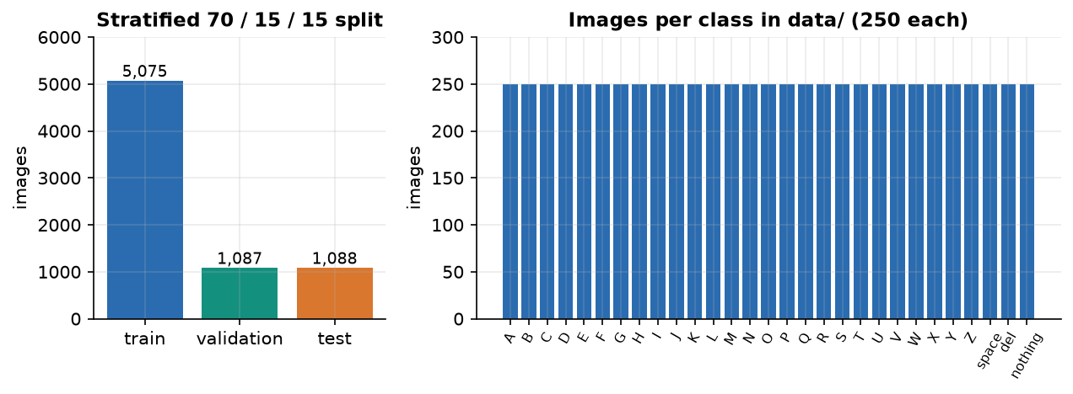
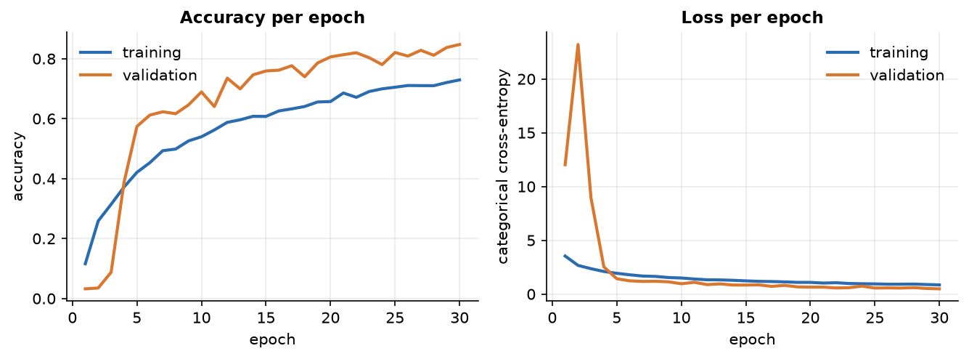
Dataset, Features & Model
7,250
Layer | Output
3 x (Conv3x3 + BN + MaxPool) | 8x8x128
Flatten, Dense 256, Dropout 0.4 | 256
Dense 29, softmax | 29 classes
images, 250 x 29 classes (of 87,000)
64 x 64 x 1
segmented mask, scaled to [0, 1]
Train 5,075 / validation 1,087 / test 1,088.
Adam 1e-3, batch 32, 30 epochs, augmentation, early stopping on validation accuracy.
Frames come from video: near-duplicates, no signer id.
2,199,453
CNN parameters
Saved run: best validation accuracy 84.7% at epoch 30 of 30 (the cap), final training accuracy 72.9%.
Dept. of CSE | Batch A16 | Final Review
12
Notes:
Dataset, input and model in one view. The training curves show validation above training accuracy because dropout and augmentation act only in training.

Slide 13
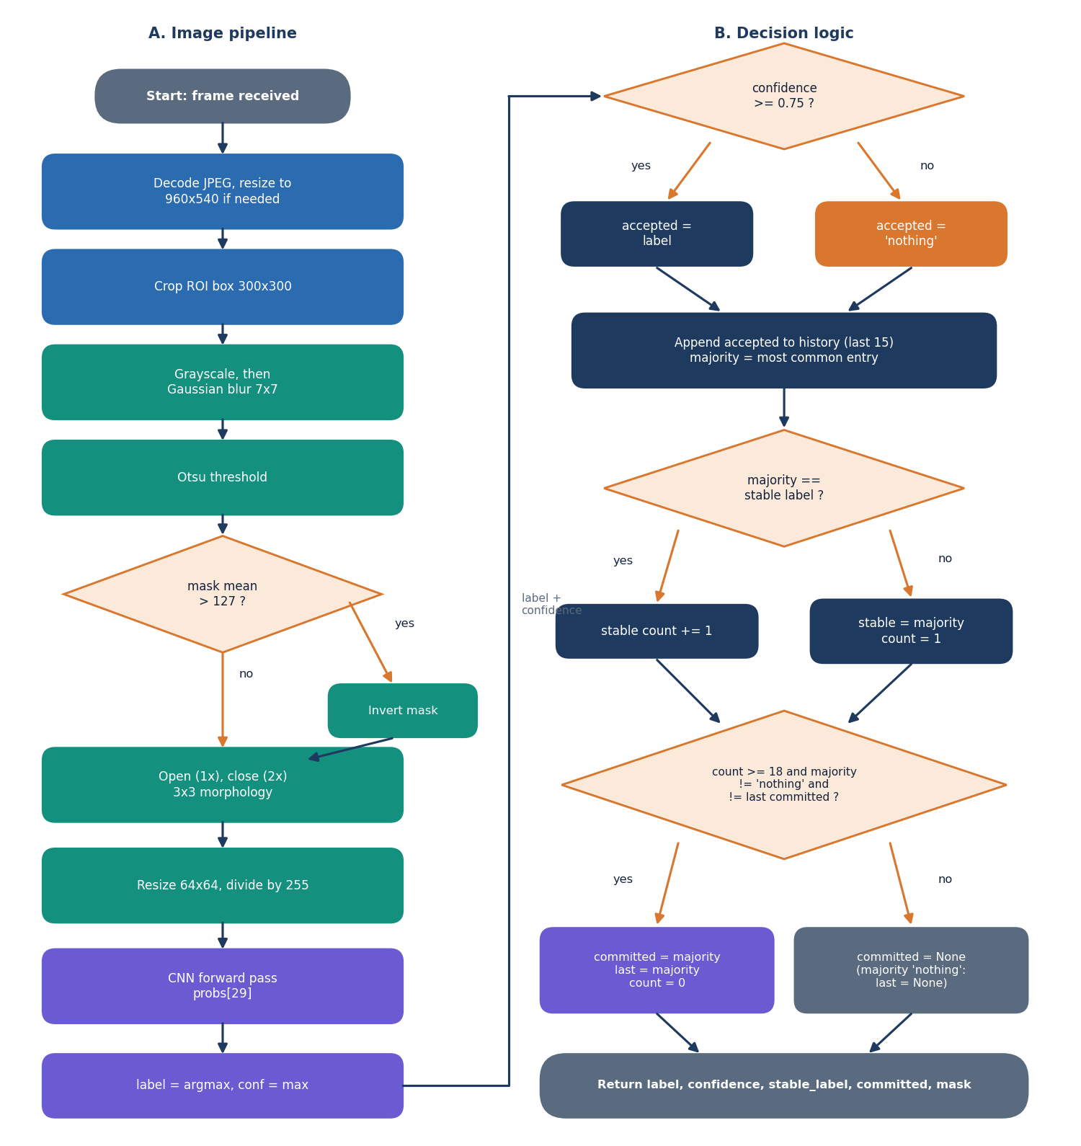
Decision Workflow
Gate: top softmax probability below 0.75 counts as 'nothing'.
Smooth: majority vote over the last 15 frame labels.
Commit: 18 stable frames, label not 'nothing' and different from the last committed letter.
Controls: 'space' and 'del' edit the sentence; 'nothing' resets the repeat guard.
Dept. of CSE | Batch A16 | Final Review
13
Notes:
The decision rules in SignRecognizer.predict_frame. The threshold behaviour is analysed on slide 19.

Slide 14
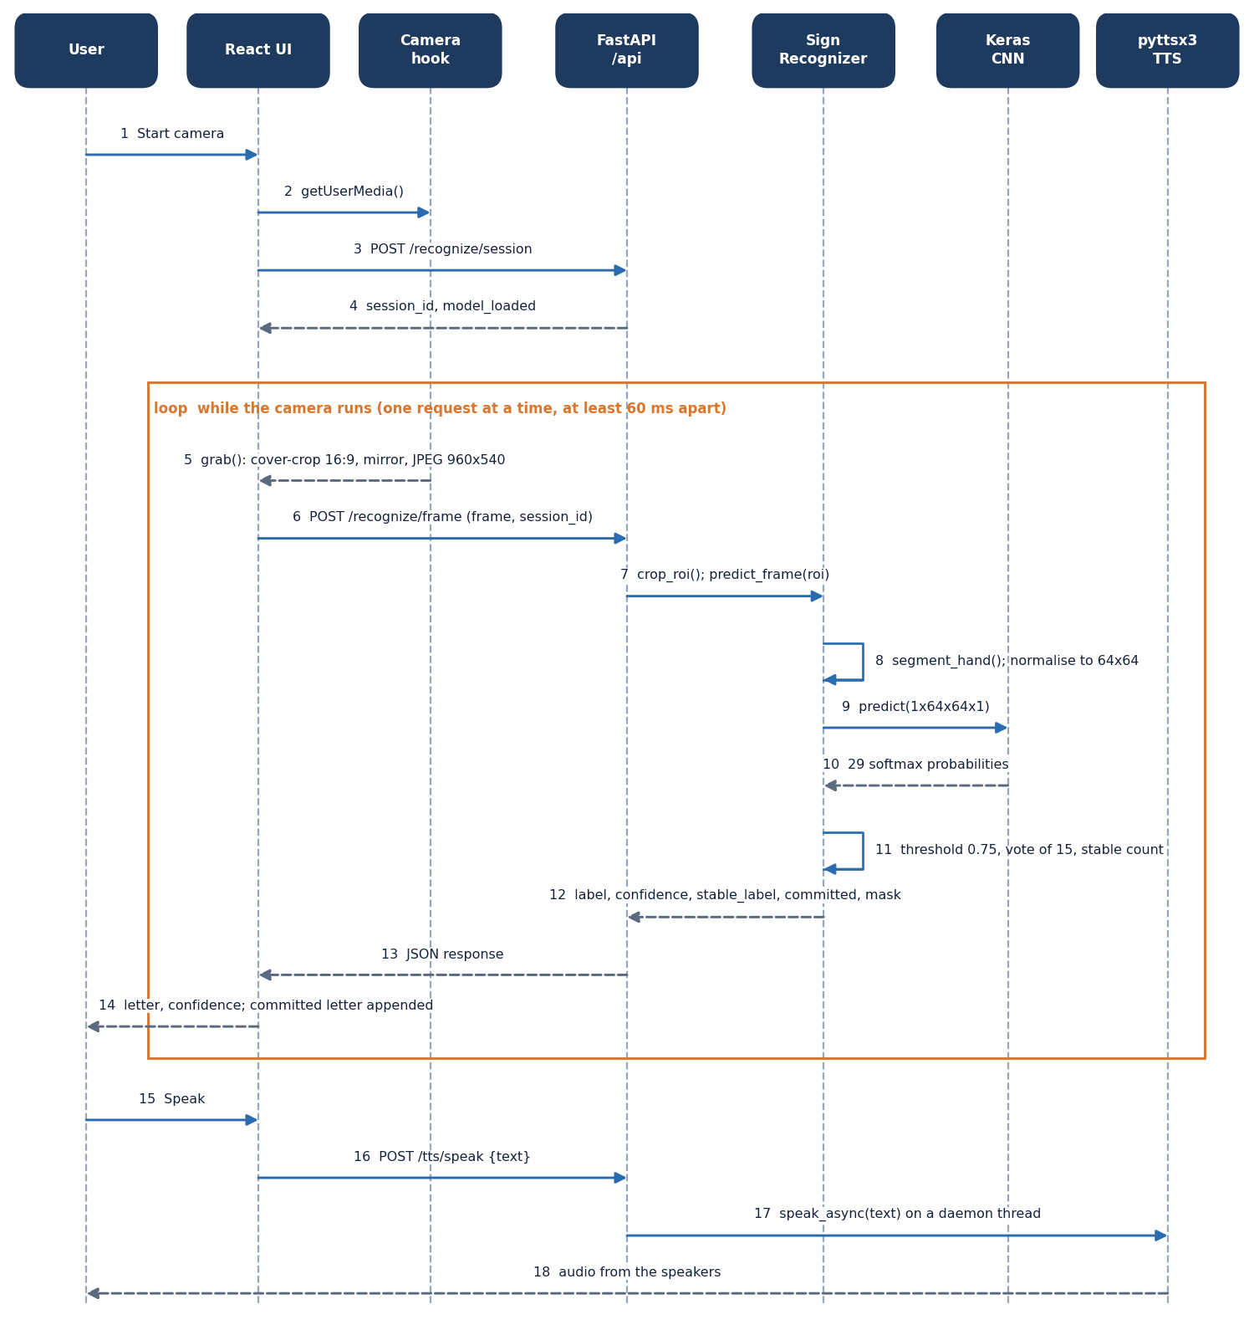
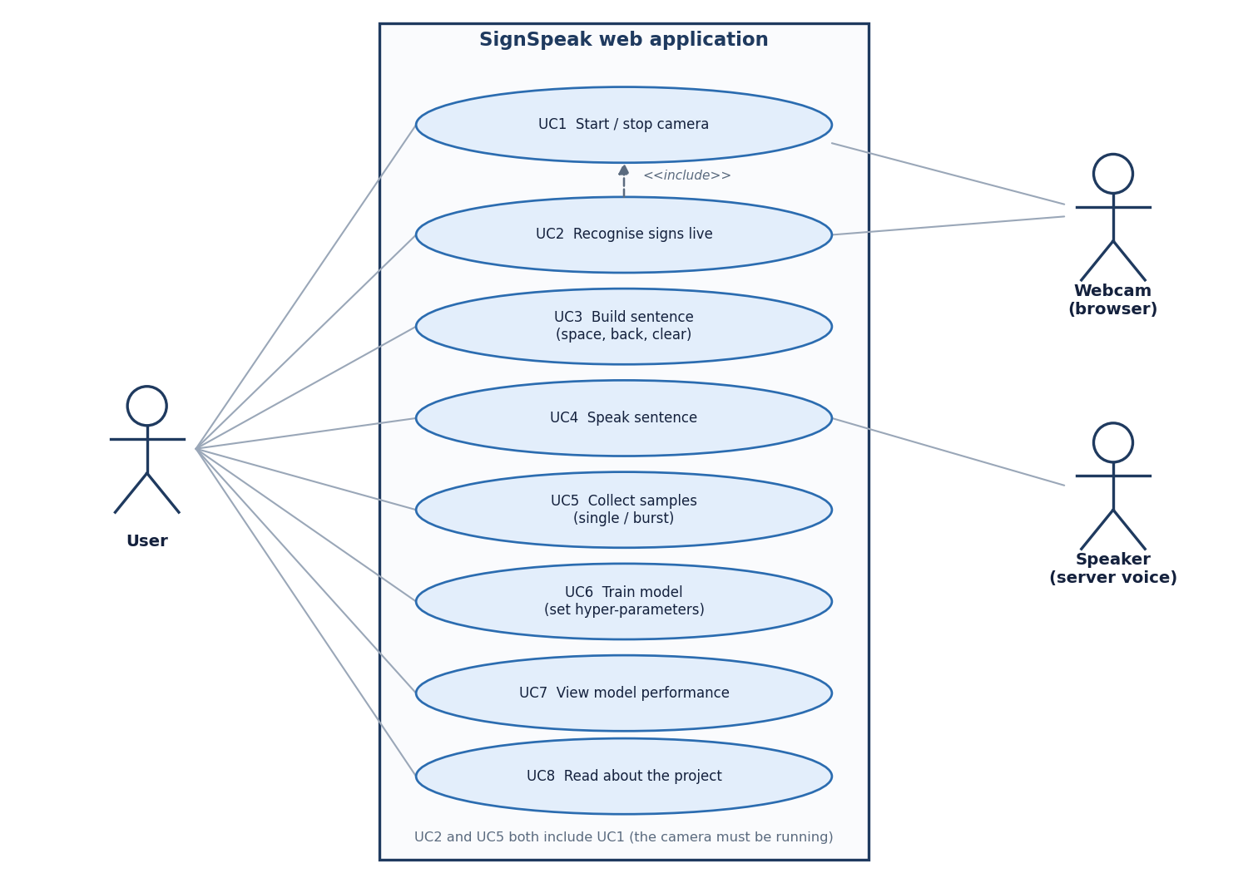
User – System Interaction
Dept. of CSE | Batch A16 | Final Review
14
Notes:
Sequence of one recognition request and the use cases of the signer and the operator.

Slide 15
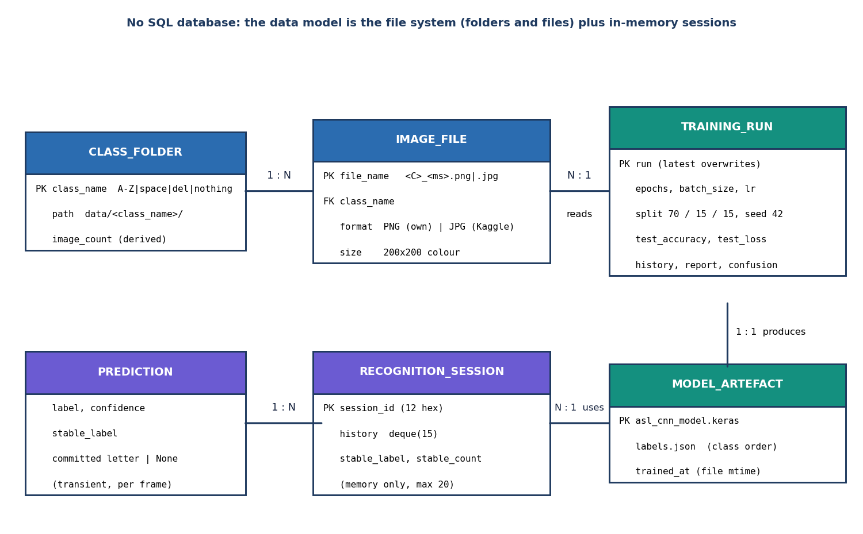
Database Design (file store)
Store | Content
data/<CLASS>/ | training images, 29 folders
models/asl_cnn_model.keras | trained network
models/labels.json | class order
models/training_history.json | per-epoch curves
models/classification_report.txt | test report
models/confusion_matrix.json | 29 x 29 counts
memory: sessions | at most 20 recognisers
There is no SQL database: the ER diagram models the file-system entities. Recognition sessions are not persisted.
Dept. of CSE | Batch A16 | Final Review
15
Notes:
Honest point: the project stores files, not rows.

Slide 16
Implementation Highlights
16
52
7
1
REST endpoints (+ /docs)
pytest tests
React screens
command to start (run.bat)
Browser captures frames with getUserMedia, cover-crops to 16:9, mirrors, and posts a 960 x 540 JPEG (quality 0.8, about 27 KB); one request in flight, at least 60 ms apart.
Validation: epochs 1-500, batch 1-1024, learning rate 1e-6 to 1, at least two classes with images, 2,000-character speech limit, image-name pattern.
Training runs in a background thread with a stop flag and live progress; speech is offline (pyttsx3) with a browser-voice fallback.
The original desktop app is unchanged; the API imports its modules.
Dept. of CSE | Batch A16 | Final Review
16
Notes:
Highlights: the capture loop, validation, background training and reuse of the original code.

Slide 17
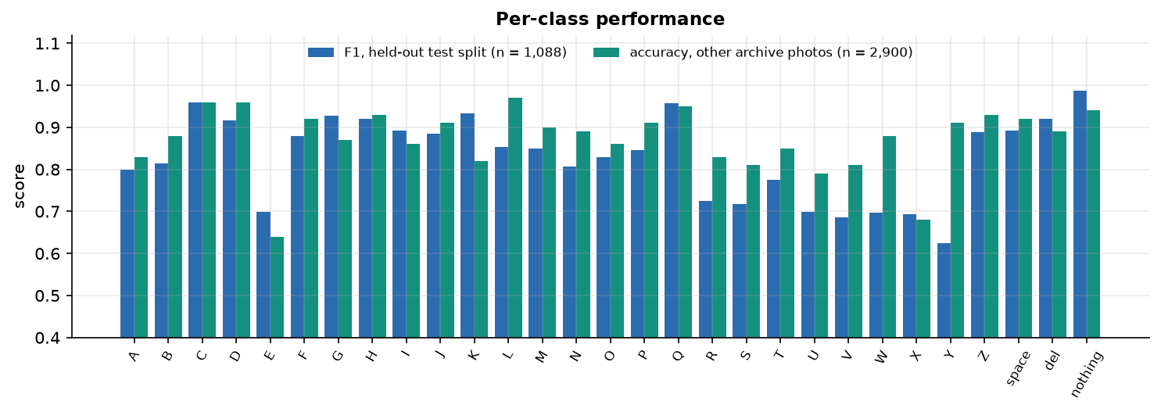
Results – Model Performance (held-out test split)
82.81%
0.830
92.9%
0.5569
accuracy, n = 1,088
macro F1
top-3 accuracy
test loss
Best F1 | Weakest F1
nothing 0.99, C 0.96, Q 0.96, K 0.93 | Y 0.62, V 0.69, X 0.69, W 0.70
Other archive photos (n = 2,900): 87.24%, optimistic: near-duplicate frames of trained images.
Official Kaggle test: 26 of 28 (A read as S, I read as D).
Test split = 15 % never used for training or model selection; single run, seed 42.
Dept. of CSE | Batch A16 | Final Review
17
Notes:
Headline 82.81 %. The weakest letters are Y, V, X, W, E, U: hand shapes that differ by a finger or an angle. The 87.24 % figure is not used as the headline.

Slide 18
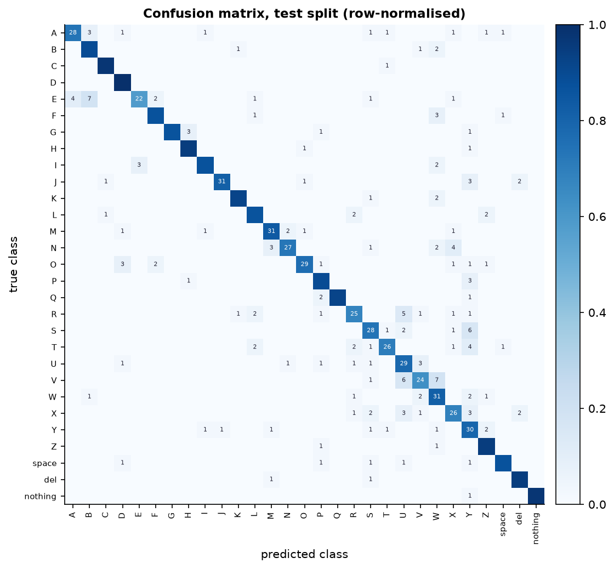
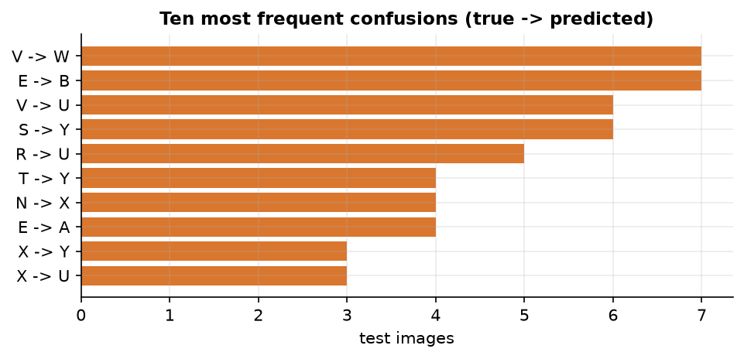
Confusion Matrix & Frequent Confusions
Most frequent: V read as W (7), E read as B (7), V read as U (6), S read as Y (6).
V, U, W and R, T, S share similar finger layouts; E is confused with B and A.
Dept. of CSE | Batch A16 | Final Review
18
Notes:
Rows are the true letter, columns the prediction. Errors concentrate on letters whose hand shapes differ by a finger position.

Slide 19
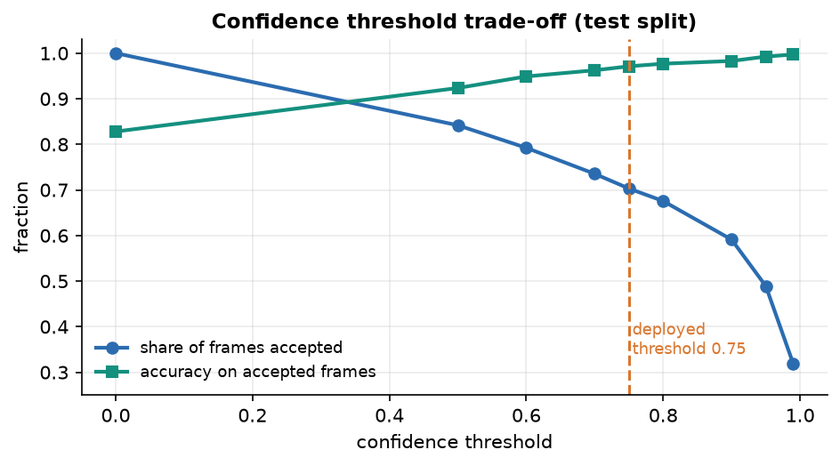
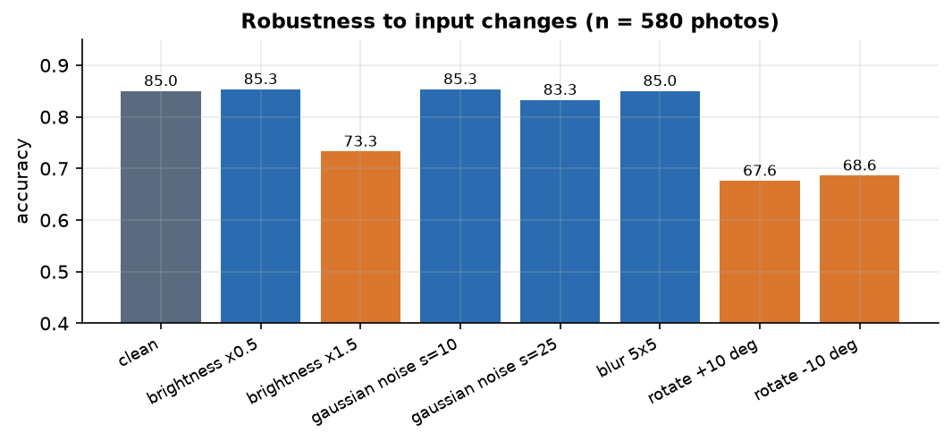
Threshold & Robustness Analysis
Confidence threshold | 0.50 | 0.60 | 0.70 | 0.75 | 0.80 | 0.90 | 0.95 | 0.99
Frames accepted | 84.2% | 79.2% | 73.5% | 70.3% | 67.6% | 59.1% | 48.9% | 31.9%
Accuracy on accepted | 92.4% | 94.9% | 96.2% | 97.1% | 97.7% | 98.3% | 99.2% | 99.7%
Deployed threshold 0.75: 70.3 % of frames accepted at 97.1 % accuracy. Rotation of +/- 10 degrees drops accuracy from 85.0 % to 67.6 % / 68.6 % (580-photo robustness set).
Dept. of CSE | Batch A16 | Final Review
19
Notes:
Raising the confidence threshold trades coverage for accuracy. At 0.75, seven in ten frames are used and 97 % of them are right. Rotation is the weak spot.

Slide 20
Performance & Testing
1.7 ms
0.8 ms
50.3 ms
56.7 ms
JPEG decode
crop + segmentation
CNN forward (model.predict)
HTTP round trip (about 17.6 fps)
Test layer | What it covers | Result
Unit (pytest) | preprocessing, recogniser logic, dataset and model | 25 passed
API (pytest) | all endpoints, validation, errors, sessions | 27 passed
Smoke test | running server: collect, train, recognise, errors | 26 / 26 checks
Browser walk | 7 screens, 360 / 768 / 1440 px, light and dark, fake camera | no console or network errors
Build | npm run build (tsc + vite) | passes
Median of 300 frames on an Intel Core i5-12500 (CPU only, 15.7 GB). Not tested: a physical webcam, load, a user study, React component tests.
Dept. of CSE | Batch A16 | Final Review
20
Notes:
The CNN call dominates the 53 ms server time. Latency was measured on an otherwise idle desktop; the live loop is limited to about 17-19 fps.

Slide 21
Comparison with Base Paper (context only – different task and data)
Aspect | Base paper [1] | This project (SignSpeak)
Task | Isolated word signs from video (AUTSL 226 signs; WLASL-100) | Static ASL fingerspelling: 26 letters + space, del, nothing from single frames
Input | 2D skeleton sequences (27 keypoints) from a pose estimator | One 64 x 64 segmented hand mask cropped from a webcam frame
Model | 0.48 M-parameter GCN student distilled from three GCN teachers | 2.20 M-parameter CNN trained from scratch; no distillation
Accuracy | 94.25 +/- 0.19 % (AUTSL), 66.33 +/- 0.54 % (WLASL-100); 3 seeds | 82.81% on a held-out split (one run); not signer-independent
Hardware / speed | Jetson Nano, TensorRT FP16: 33.13 FPS at 6.23 W | Desktop CPU, no optimisation: about 17.6 fps end to end; power not measured
Deliverable | Research method and measurements | Application: collect, train, recognise, speak
Different task, data, model family and hardware: the numbers are context, not a ranking, and no superiority is claimed.
Dept. of CSE | Batch A16 | Final Review
21
Notes:
State plainly that the tasks differ: video word signs versus static letters. Even the accuracy numbers measure different things.

Slide 22
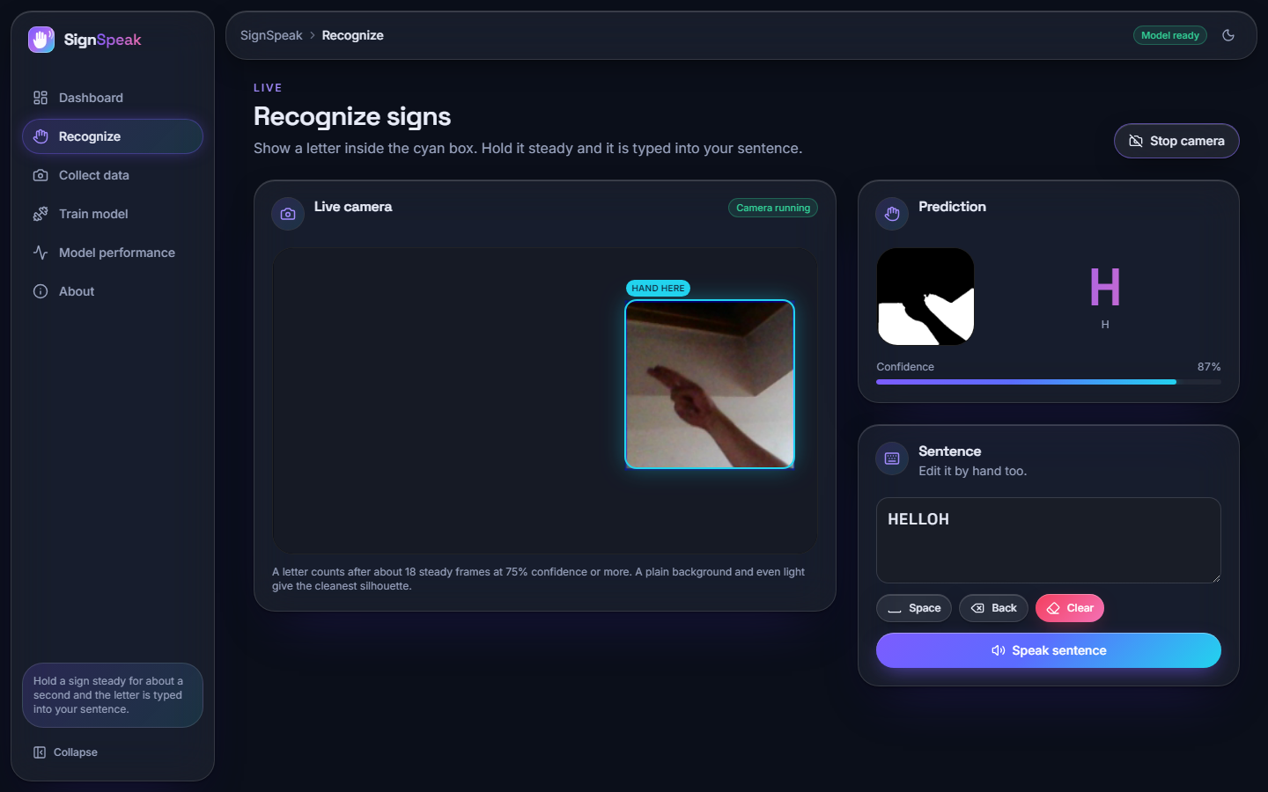
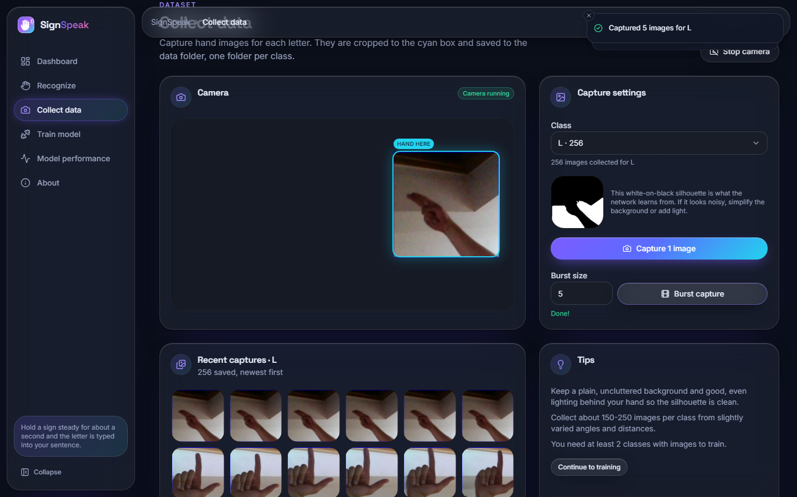
Output – Live Recognition and Collection
Left: recognition (letter H at 87 %, mask preview, sentence). Right: collection with the ROI box and recent captures. Camera = Chromium fake camera fed with real photos.
Dept. of CSE | Batch A16 | Final Review
22
Notes:
Real screenshots. The recognition clip was assembled from real held-out photos because the build machine had no physical webcam.

Slide 23
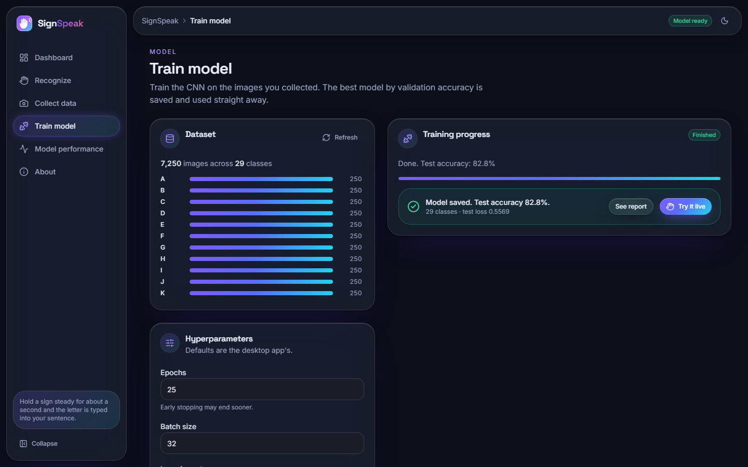
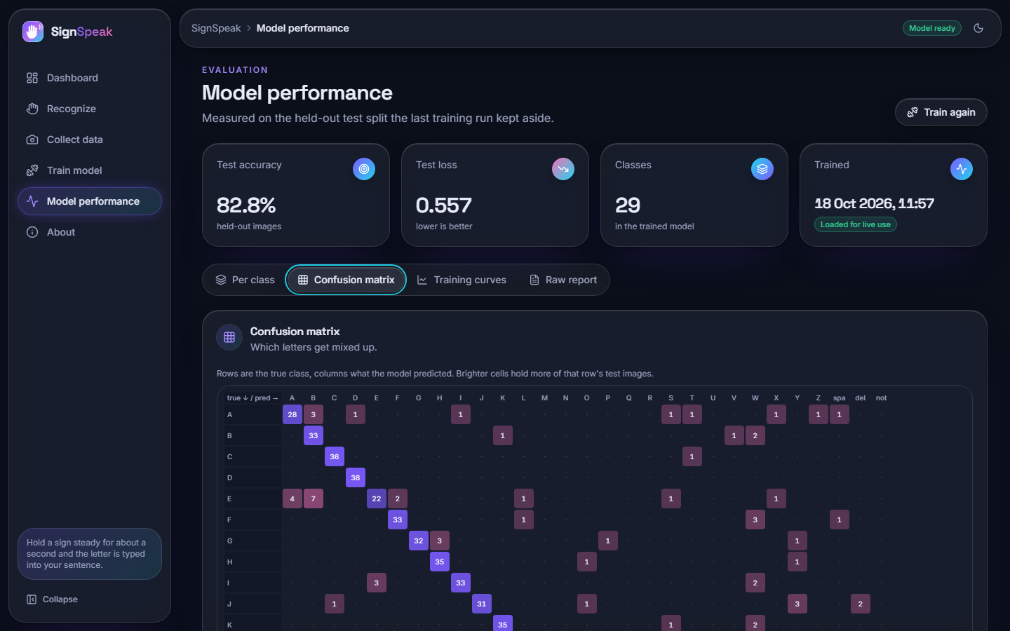
Output – Training and Model Performance
Left: training screen (coverage 7,250 images, hyper-parameters, finished run 82.8 %). Right: model screen with the confusion matrix.
Dept. of CSE | Batch A16 | Final Review
23
Notes:
Training runs in the background with live curves; the model screen shows true per-class results.

Slide 24
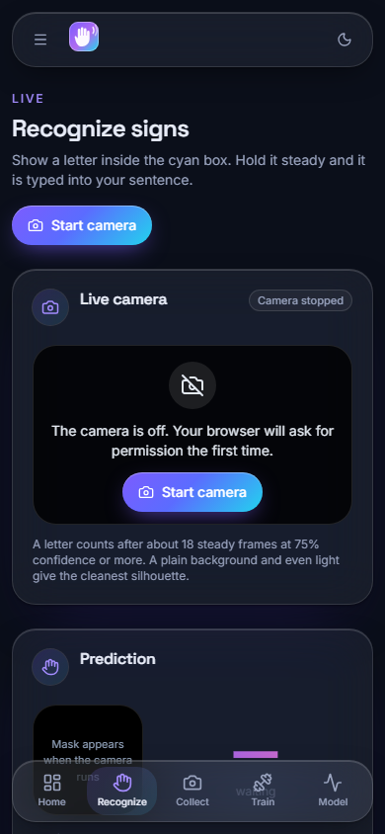
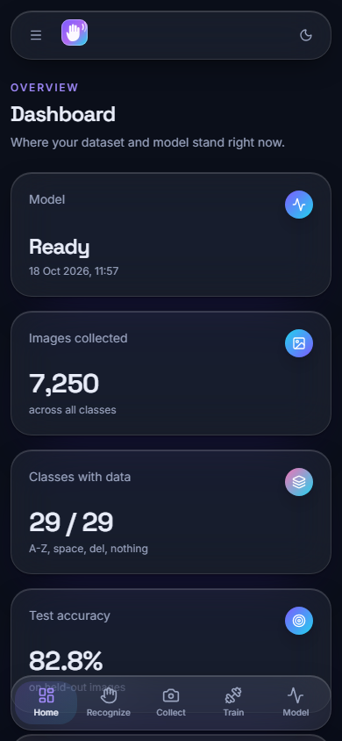
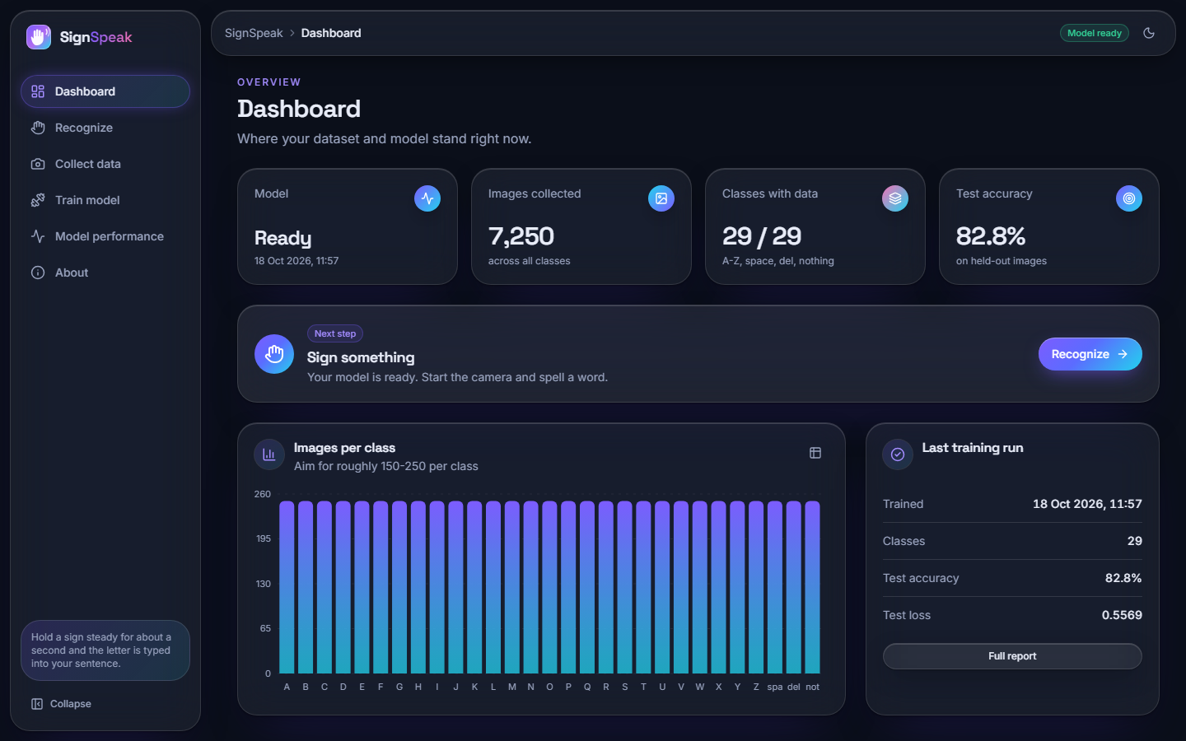
Output – Dashboard and Phone Layout
Left: dashboard (7,250 images, 29 of 29 classes, 82.8 %). Right: the same app at 390 x 844 px (recognition and dashboard).
Dept. of CSE | Batch A16 | Final Review
24
Notes:
Dashboard with real counts and the phone-width layout.

Slide 25
Conclusion
Delivered: a working ASL-alphabet recogniser: segmentation, a trained 2.2 M-parameter CNN, decision logic, sentence builder with speech, collection, training and a model report, with tests.
Measured: 82.81% accuracy on a held-out 1,088-image split; 97.1% on the frames passing the 0.75 confidence gate; about 53 ms per frame on a CPU.
Objectives: 2, 3, 5 met; 4 partly (17-19 fps without model optimisation); 1 and 6 not fully met (no words; no unseen-signer test).
Limits: same-recording data, Otsu masks keep background, rotation sensitivity, letters only, no physical-webcam test. Not a certified communication aid.
Dept. of CSE | Batch A16 | Final Review
25
Notes:
Be explicit about which objectives were met and which were not.

Slide 26
Future Scope
Collect data from many signers and backgrounds with signer ids, and report signer-independent accuracy.
Rotation, brightness and background augmentation; compare skin-colour segmentation or hand landmarks with the Otsu mask.
Faster inference: quantisation or TFLite export in place of model.predict; measure power as the base paper does.
Words and motion signs: sequence models over several frames; two-hand signs and sentence-level translation.
Packaging: installer, calibration screen for the ROI, user study with deaf signers.
Dept. of CSE | Batch A16 | Final Review
26
Notes:
Concrete next steps, ordered by value.

Slide 27
References
[1] D. T. D. Vo, V. D. Nguyen, T. H. M. Nguyen and M. H. Vo, "MAG-KD: Mask-guided adaptive gating knowledge distillation for skeleton-based sign language recognition on edge devices," IEEE Access, vol. 14, pp. 54761-54775, 2026, doi: 10.1109/ACCESS.2026.3681176.
[2] B. A. Al Abdullah, G. A. Amoudi and H. S. Alghamdi, "Advancements in sign language recognition: A comprehensive review and future prospects," IEEE Access, vol. 12, pp. 128871-128895, 2024.
[3] R. Rastgoo, K. Kiani and S. Escalera, "Sign language recognition: A deep survey," Expert Syst. Appl., vol. 164, Art. no. 113794, Feb. 2021.
[4] T. Starner, J. Weaver and A. Pentland, "Real-time American Sign Language recognition using desk and wearable computer based video," IEEE Trans. Pattern Anal. Mach. Intell., vol. 20, no. 12, pp. 1371-1375, Dec. 1998.
[5] N. Pugeault and R. Bowden, "Spelling it out: Real-time ASL fingerspelling recognition," in Proc. IEEE Int. Conf. Comput. Vis. Workshops (ICCV Workshops), Barcelona, Spain, Nov. 2011, pp. 1114-1119.
[6] V. Bheda and D. Radpour, "Using deep convolutional networks for gesture recognition in American Sign Language," 2017, arXiv:1710.06836.
[7] Y. LeCun, L. Bottou, Y. Bengio and P. Haffner, "Gradient-based learning applied to document recognition," Proc. IEEE, vol. 86, no. 11, pp. 2278-2324, Nov. 1998.
[11] S. Yan, Y. Xiong and D. Lin, "Spatial temporal graph convolutional networks for skeleton-based action recognition," in Proc. AAAI Conf. Artif. Intell., vol. 32, no. 1, 2018.
[14] O. M. Sincan and H. Y. Keles, "AUTSL: A large scale multi-modal Turkish Sign Language dataset and baseline methods," IEEE Access, vol. 8, pp. 181340-181355, 2020.
[15] D. Li, C. R. Opazo, X. Yu and H. Li, "Word-level deep sign language recognition from video: A new large-scale dataset and methods comparison," in Proc. IEEE Winter Conf. Appl. Comput. Vis. (WACV), Mar. 2020, pp. 1448-1458.
[17] N. Otsu, "A threshold selection method from gray-level histograms," IEEE Trans. Syst., Man, Cybern., vol. SMC-9, no. 1, pp. 62-66, Jan. 1979.
[19] S. Ioffe and C. Szegedy, "Batch normalization: Accelerating deep network training by reducing internal covariate shift," in Proc. 32nd Int. Conf. Mach. Learn. (ICML), 2015, pp. 448-456.
[20] N. Srivastava, G. Hinton, A. Krizhevsky, I. Sutskever and R. Salakhutdinov, "Dropout: A simple way to prevent neural networks from overfitting," J. Mach. Learn. Res., vol. 15, no. 56, pp. 1929-1958, 2014.
[21] D. P. Kingma and J. Ba, "Adam: A method for stochastic optimization," in Proc. Int. Conf. Learn. Represent. (ICLR), 2015, arXiv:1412.6980.
[23] M. Abadi et al., "TensorFlow: A system for large-scale machine learning," in Proc. 12th USENIX Symp. Oper. Syst. Design Implement. (OSDI), 2016, pp. 265-283.
[25] Akash, "ASL Alphabet," Kaggle dataset (grassknoted/asl-alphabet). [Online]. Available: https://www.kaggle.com/datasets/grassknoted/asl-alphabet (accessed Oct. 2026).
Dept. of CSE | Batch A16 | Final Review
27
Notes:
Selected references; the complete numbered list is in the report.

Slide 28
THANK YOU
Questions & Suggestions
Dept. of CSE | Batch A16 | Final Review
28
Notes:
Invite questions.

