Slide 1
SeatWise
REVIEW 2 · DESIGN, METHODOLOGY AND PROGRESS
AI-Enabled Digital Examination Seating Management System
Presented by
Under the guidance of
A.SANJAY 23K91A6702
CH.NAVEEN 23K91A6743
D.KOTESH 24K95A6705
A.AKSHITH [Roll number to be confirmed]
[GUIDE NAME], [DESIGNATION]
Department of Computer Science and Engineering (Data Science)
[COLLEGE NAME] · Batch A13 (CSE-DS, Section A) · [ACADEMIC YEAR]
Notes:
Review 2 covers design, methodology and progress of SeatWise.

Slide 2
Contents
01
02
03
04
Recap
Architecture
Methodology
Dataset
05
06
07
08
Data preparation
Engine and configuration
Decision logic
Data flow, modules, database
09
10
11
12
Technology stack
Progress
Preliminary results and screens
Testing, challenges, next steps
Notes:
Twelve parts, from a recap of Review 1 through the design and the engine to progress, results, testing and next steps.

Slide 3


Recap: problem and proposed system
Problem
Proposed system
Seating by hand or in spreadsheets is slow, error-prone and predictable: neighbours write the same paper, several rules clash, and candidates cannot look up a seat.
A two-stage OR-Tools CP-SAT engine and an independent validator, served by a FastAPI backend and a React web application.
Excel / CSV data
Stage A: halls + colour classes
Stage B: seats per hall
Validator + scorecard
Publish, charts, QR slips
Notes:
Recap of Review 1: the problem and the proposed system as a five-step pipeline.

Slide 4
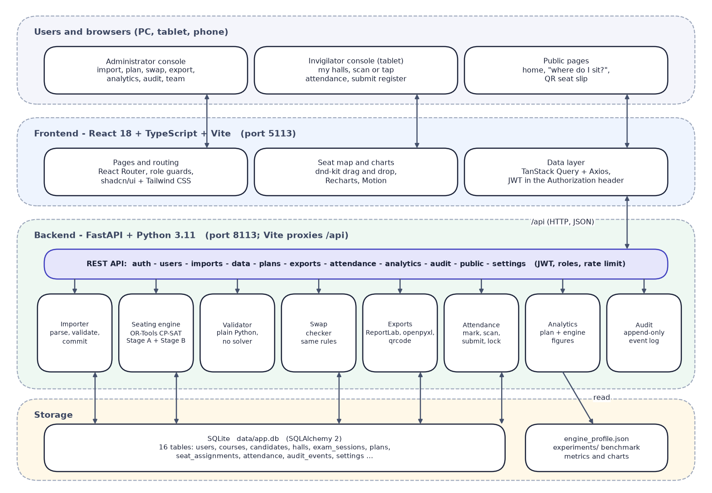

System architecture
Client: React 18 + TypeScript + Vite (port 5113), role guards, seat map with dnd-kit, TanStack Query.
Application: FastAPI (port 8113): JWT sign-in, administrator and invigilator roles, rate-limited public endpoints.
Engine: OR-Tools CP-SAT Stage A and Stage B, an independent validator and a swap checker.
Data: SQLite with 16 tables and an append-only audit trail.
Outputs: ReportLab PDFs, openpyxl Excel files, qrcode slips.
Notes:
The browser talks only to the Vite server, which proxies /api to FastAPI. The backend owns every rule; the frontend never decides whether a move is legal.

Slide 5
Methodology: end-to-end workflow
Import files
Validate rows
Pre-check capacity
Stage A: halls + classes
Stage B: seats per hall
Validate + scorecard
Publish + outputs
Two separate stages
One rule set
Reproducible
Stage A decides each paper's hall and colour class; Stage B only places seats inside that class. Each stage can be tested alone.
The engine, the swap checker and the validator share the neighbour-graph and roll-gap code, so map, exports and benchmark agree.
Sub-seeds derive from the plan seed with SHA-256; inputs, result and seating are fingerprinted; Verify re-runs the engine.
Notes:
End-to-end workflow in seven steps. The key idea: confine each paper to one colour class of the seat grid, so same-paper neighbours are impossible by construction.

Slide 6
Dataset and input sources
Dataset | Size | Use
Sample workbook (synthetic, seed 2026) | 49 courses, 908 candidates, 14 halls (871 seats), 6 sittings | Demo, import test
Registrations | 2,724; 10 candidates need an accessible seat | Subject and access rules
Benchmark scenarios (seeded) | 150 to 2,000 candidates, 8 scenarios | Engine evaluation
Import templates | 4 empty files + 1 workbook | Real data entry
External data | None; no downloads, no API keys | Fully offline
Notes:
All data is synthetic and generated by a seeded script, so the same seed always gives the same files. There is no external dataset and no train/test split because nothing is trained.

Slide 7



Data preparation and validation
Import parsing
Validation
Engine inputs
CSV or XLSX with flexible headers (Roll No, roll_number and candidate_id are all accepted); lists split on ; , or |; dates in two formats; combined workbook or single files.
Row-by-row checks: required columns, duplicates, unknown departments or courses, seat labels outside the layout, aisle positions, time order, split paper groups and timetable clashes. Nothing is saved until the administrator imports.
Candidates become (paper, department, accessible need) groups; courses that share a question paper count as one paper. Each hall becomes a seat graph; blocked seats and aisles remove neighbours. Halls without accessible seats get 2 by default.
Notes:
Preprocessing in this project means parsing and validating the four data files, then turning them into the engine's plain data types.

Slide 8
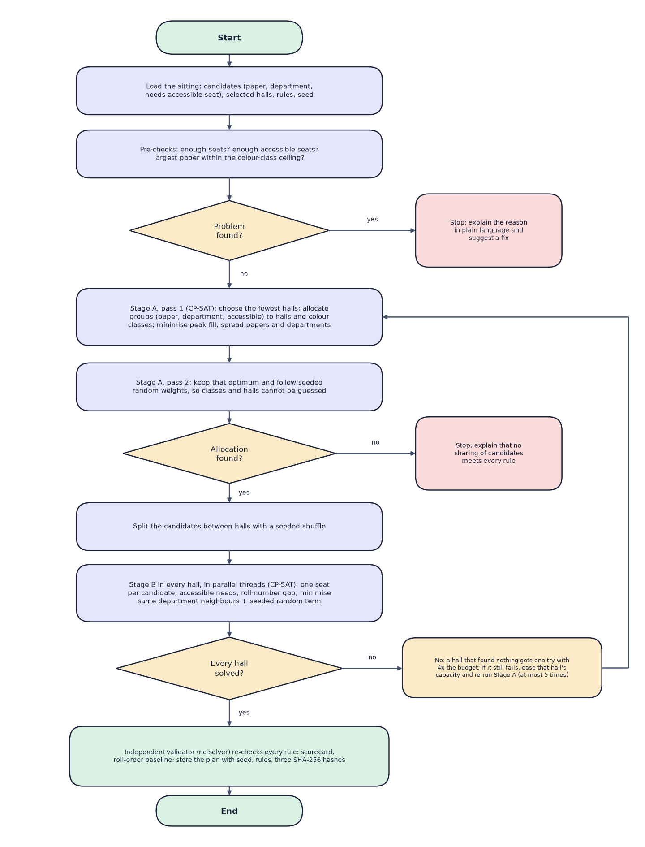

Model architecture: the seating engine
Component | Detail
Stage A (CP-SAT) | groups to halls and colour classes, 2 passes
Stage B (CP-SAT) | x[candidate, seat] per hall, in parallel
Colour classes | 4 (8 neighbours) or 2 (4 neighbours)
Validator | plain Python, no solver; scorecard
No neural network or trained parameters: the model is a constraint model solved by OR-Tools.
Notes:
The flowchart is the real algorithm. Stage A confines each paper to one colour class per hall; Stage B picks seats inside the class with a seeded random objective.

Slide 9
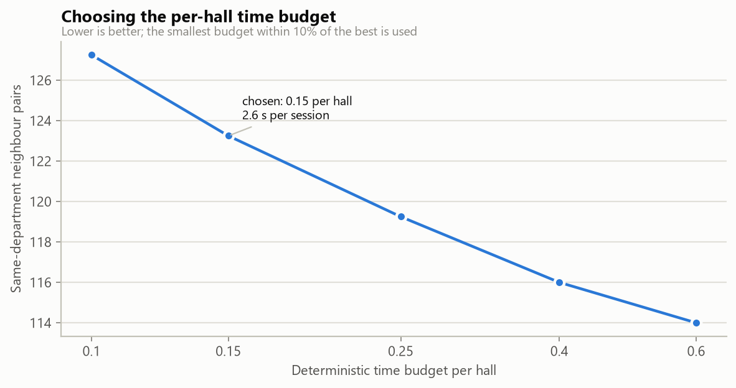

Engine configuration (nothing is trained)
Setting | Value
Solver | OR-Tools CP-SAT 9.15.6755
Per-hall budget | 0.15 deterministic seconds (tuned)
Stage A budget | 0.3 (pass 2: half)
Workers per hall | 1 (deterministic); halls in parallel
Retries | up to 5 re-balancing rounds
Random weights | 0-19 per seat, 0-999 per class
Hardware | 12-thread Intel desktop, Python 3.11.9
Budget tuning: 0.15 is the fastest budget within 10% of the best department mix
Notes:
The only setting that matters for speed is the per-hall budget. The benchmark tried five values on 600 and 1,000 candidates and chose 0.15: 2.63 seconds with 123 same-department pairs; 0.6 gives 114 pairs but takes 6.58 seconds.

Slide 10

Decision logic
Valid plan
A plan is hard-valid when same-paper pairs, roll-gap violations, accessible misses and capacity violations are all 0 and everyone is seated.
Impossible input
The pre-check names the cause and suggests a fix. A failing hall is retried at 4x budget, then re-balanced (max 5).
Saving
Each plan stores seed, rules, engine version and three SHA-256 fingerprints; publishing archives the previous version; every action is audited.
Notes:
Decision logic: the engine either returns a plan that satisfies every hard rule or explains why none exists.

Slide 11
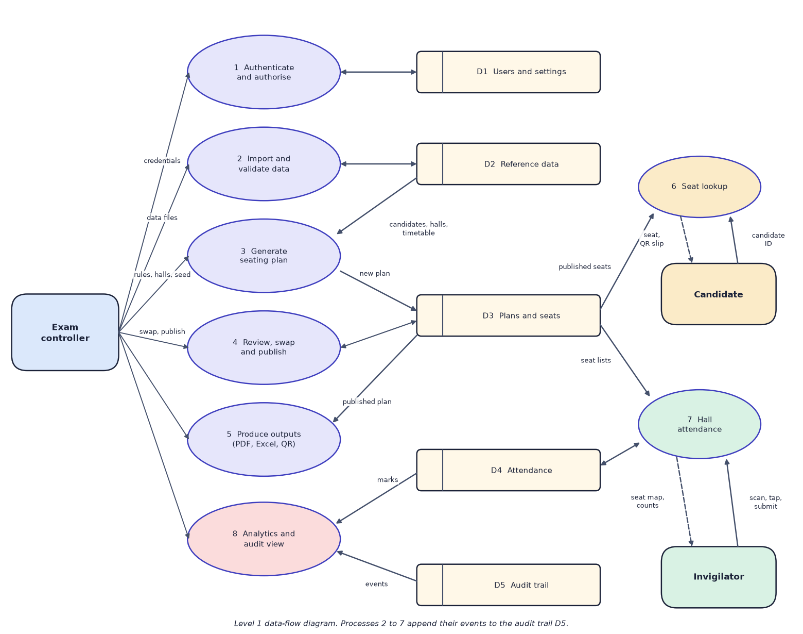
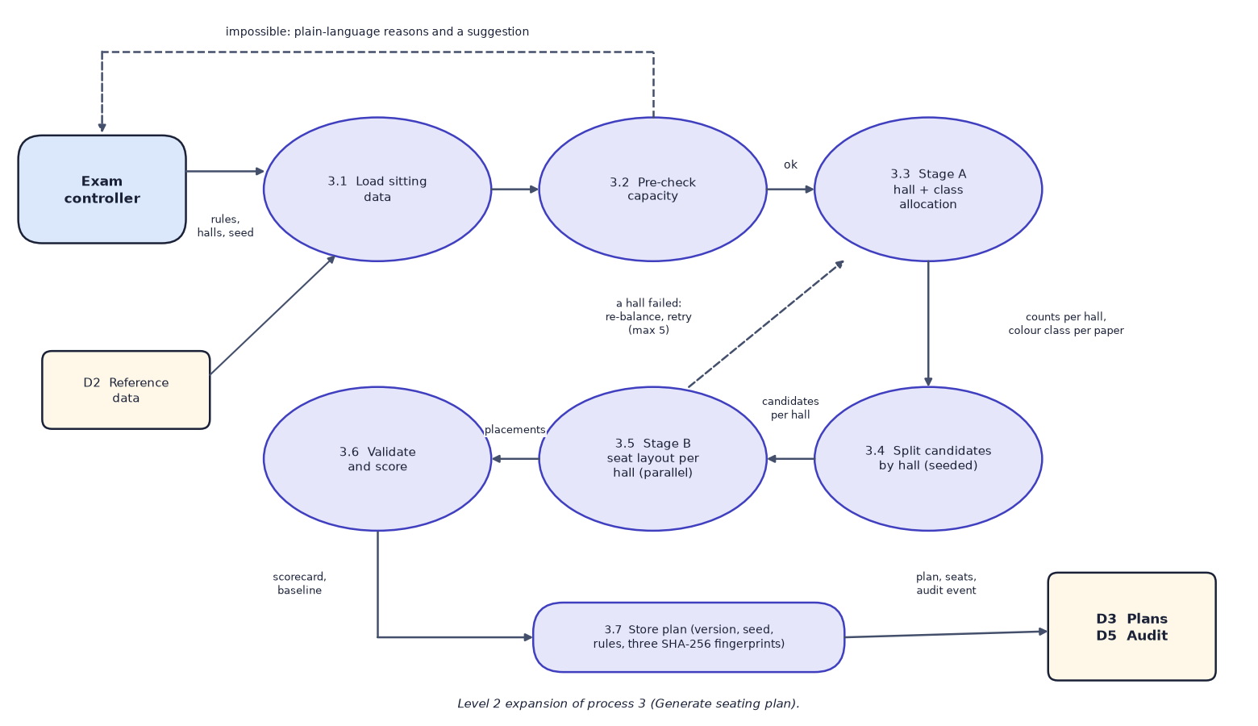

Data flow and modules
DFD level 1 (left) and level 2 expansion of 'Generate seating plan' (right)
Module | Responsibility
Importer | parse CSV/XLSX, validate row by row, preview, commit; re-validates against current data
Engine and validator | pre-check, Stage A, Stage B in parallel, independent scorecard, roll-order baseline
Outputs and attendance | PDF charts and sheets, Excel lists, QR slips, tablet register with lock
Notes:
Level 1 shows eight processes and five data stores; level 2 opens the plan-generation process.

Slide 12
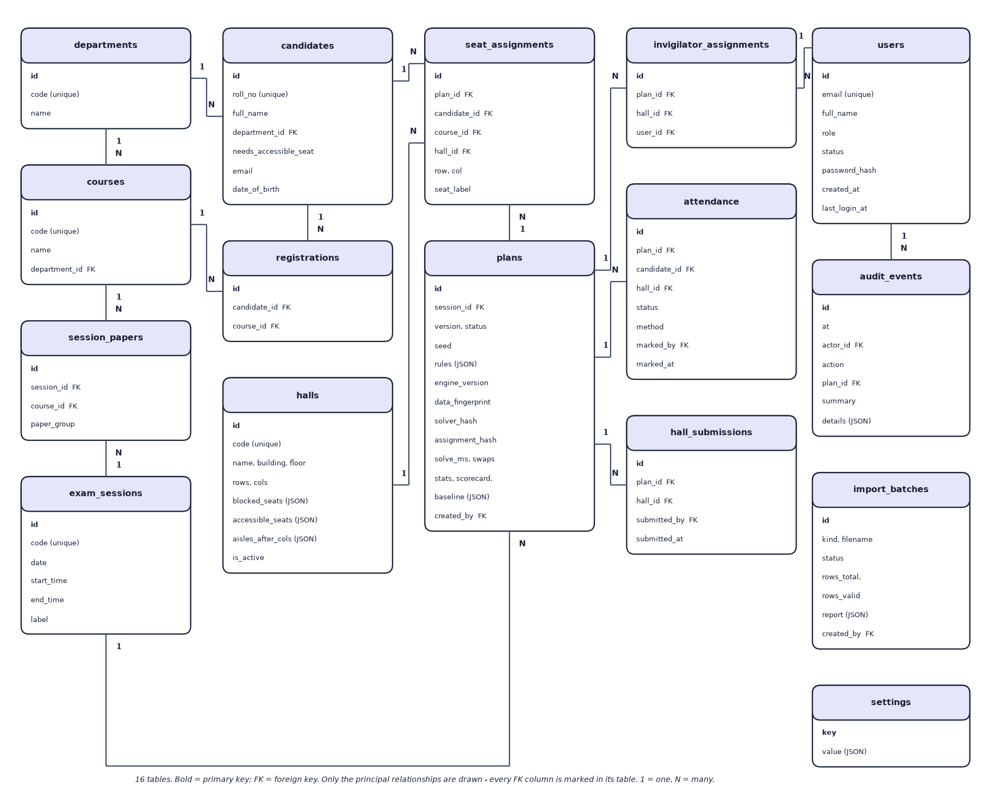
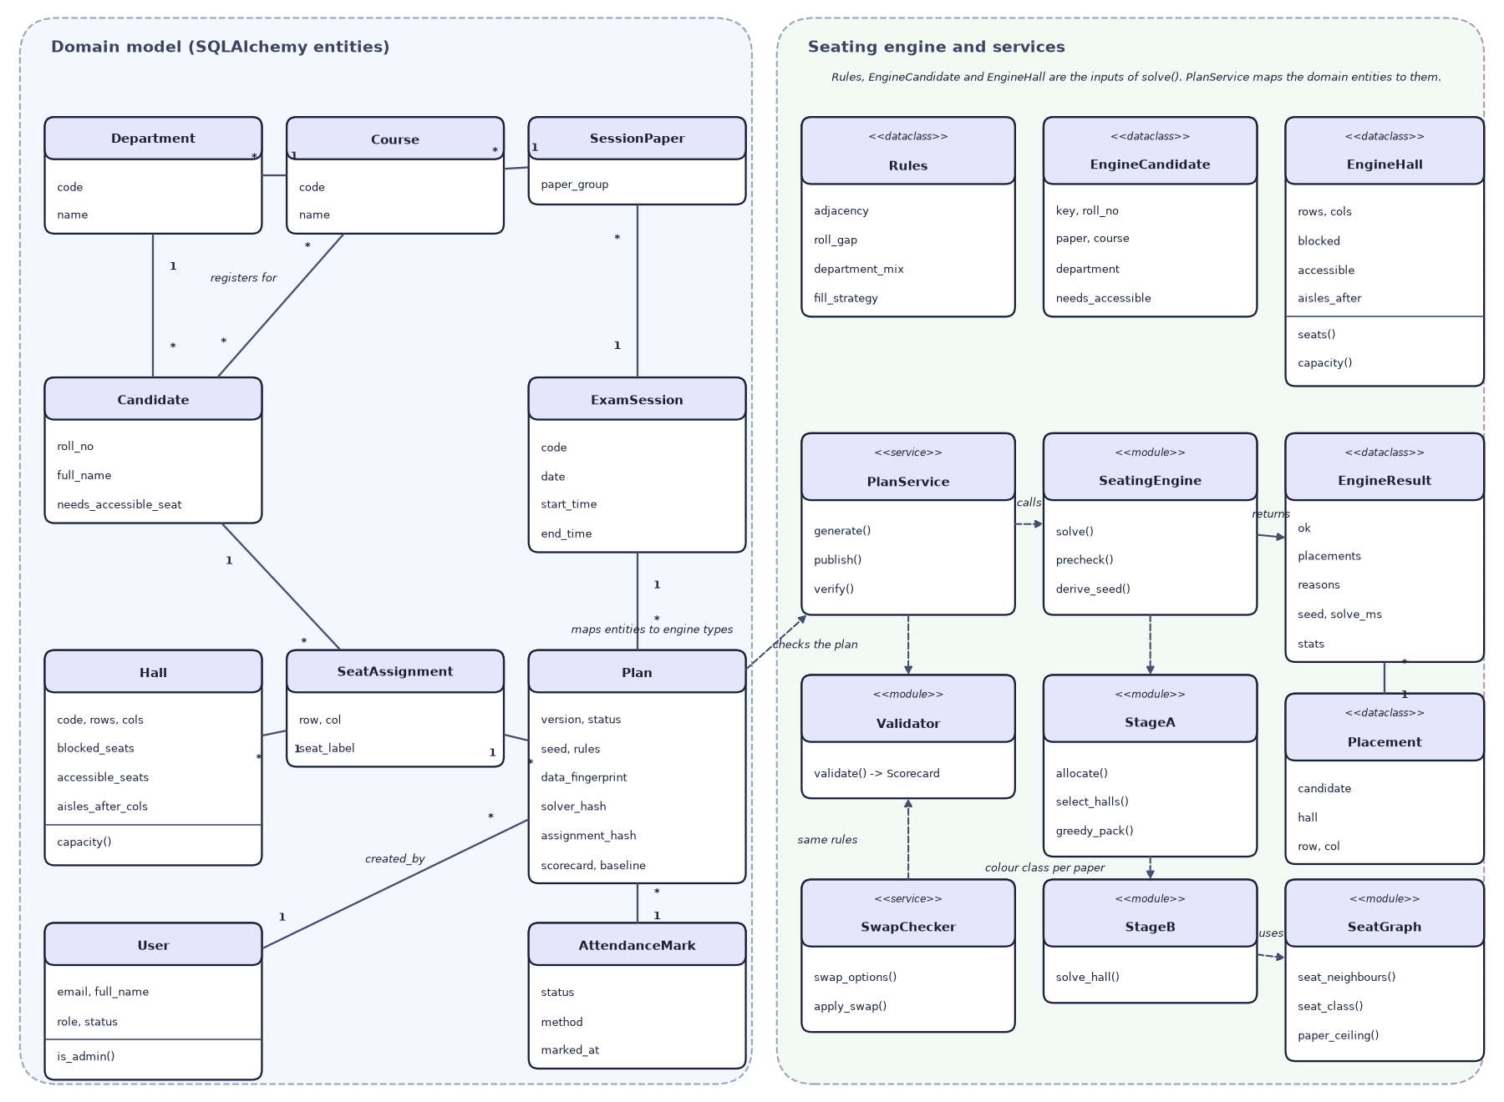

Database design and UML
ER diagram, 16 tables (left) and UML class diagram (right)
Table | Key fields | Relations
plans | session, version, status, seed, rules, three hashes, scorecard | 1:N seat_assignments, attendance
seat_assignments | plan, candidate, hall, row, col, seat_label | unique per plan+candidate and plan+seat
candidates | roll_no, department, needs_accessible_seat | N:M courses through registrations
Notes:
Sixteen tables created by SQLAlchemy. The UML diagram shows the domain entities and the engine's data types and services.

Slide 13






Technology stack
Language
Optimisation
Frontend
Python 3.11, TypeScript 5.8
Google OR-Tools CP-SAT 9.15, NumPy, pandas
React 18, Vite 6, Tailwind CSS, shadcn/ui, Recharts, dnd-kit
Backend
Storage and outputs
Testing
FastAPI, Pydantic v2, SQLAlchemy 2, PyJWT, bcrypt
SQLite, ReportLab (PDF), openpyxl (Excel), qrcode
pytest (58 tests), strict TypeScript check, Playwright captures
Notes:
Everything runs offline: no API keys and no external services.

Slide 14
Implementation progress
Component | Status
Validated import (CSV/XLSX, four kinds) | Completed
Two-stage CP-SAT engine + independent validator | Completed
Plans: generate, verify, publish, versions | Completed
Seat map with drag-to-swap and live rule checks | Completed
Exports: charts, hall lists, sheets, QR slips, attendance report | Completed
Tablet attendance, public lookup, analytics, audit trail | Completed
Automated tests (58 passed) and engine benchmark | Completed
User acceptance testing with real users | Not done
57
API operations
16
database tables
58/58
backend tests passing
Notes:
Every planned feature is implemented. The one open item is user-acceptance testing with real invigilators and examination staff.

Slide 15
Preliminary results: engine benchmark
24 / 24
plans meeting every hard rule
2.4 s
to seat 600 candidates (4.8 s for 2,000)
0
same-paper neighbours (roll order: 1,253)
Notes:
Benchmark run engine-benchmark-20260921: 8 scenarios, 3 seeds each. Every SeatWise plan met every hard rule; the maximum solve time was 6.1 seconds (4-neighbour mode).

Slide 16
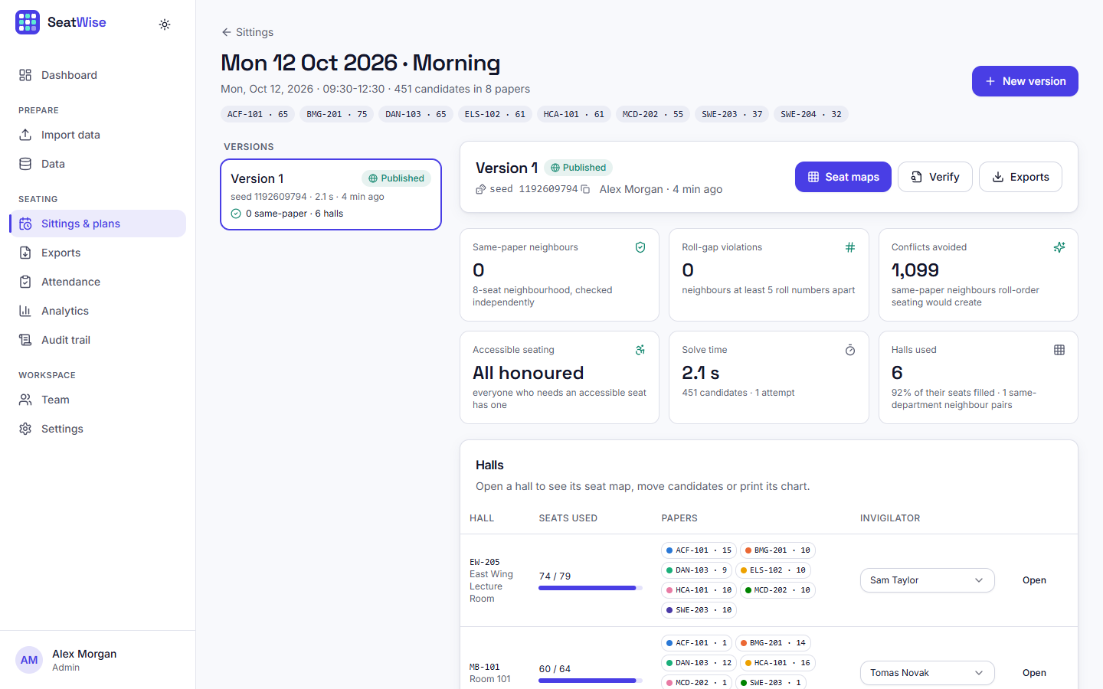
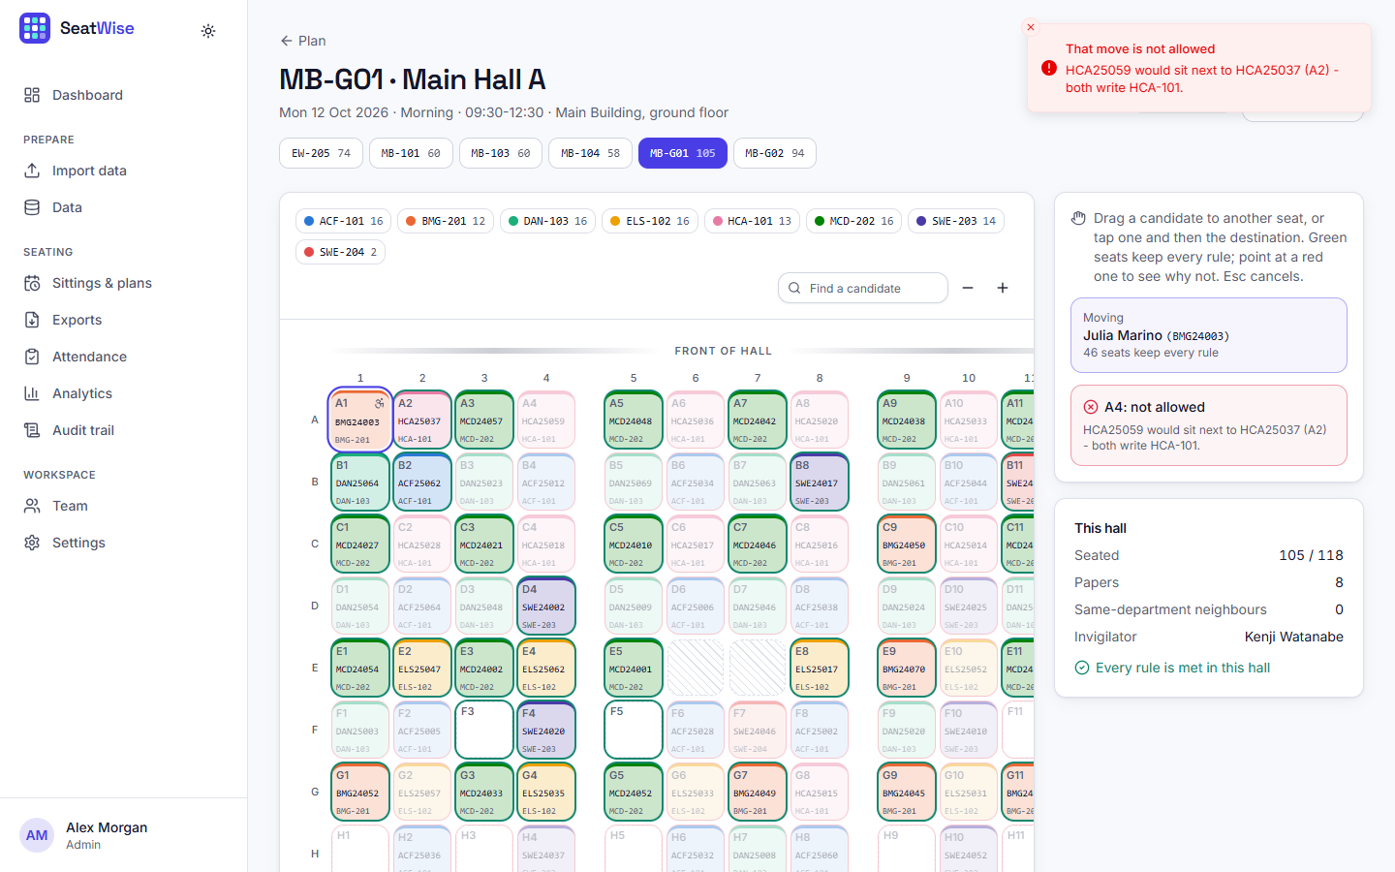


Output screens
Plan page: 0 same-paper neighbours, 0 roll-gap violations, 1,099 conflicts avoided
Seat map: an illegal move is refused with the reason
Notes:
Real captures of the running application with the sample data imported and three plans published.

Slide 17
Testing and observations
Test group | Tests | Result
Authentication, roles, team | 8 | Passed
Engine and rules | 14 | Passed
Import and validation | 9 | Passed
Plans, swap, verify | 6 | Passed
Exports, attendance, public, analytics | 21 | Passed
Total | 58 | 58 passed
58 backend tests passed on a throw-away database; the slowest takes 7.1 s.
The same seed reproduces the plan exactly (hashes equal); different seeds give different plans.
Illegal swaps are refused with reasons; impossible inputs are explained; the public lookup returns 429 after 30 requests a minute.
Demo scenario: import, three plans (1.8-2.2 s, 0 same-paper pairs), exports, lookup and attendance in 11.4 s.
Not done: user-acceptance testing and load testing.
Notes:
58 backend tests plus a scripted end-to-end demo. The frontend is checked by a strict TypeScript compile, a production build and walkthroughs in Chrome.

Slide 18



Challenges and corrective actions
Rules by construction
Speed
Reproducibility
Each paper is confined to one colour class per hall, so same-paper neighbours are impossible before seats are chosen.
Halls solve in parallel; the 0.15 budget was tuned. 2.4 s at 600 candidates.
Deterministic budget, one worker per hall and SHA-256 sub-seeds give the same plan from the same seed.
Impossible inputs
Front-row bias
Public data
A pre-check explains the cause; a failing hall is retried at 4x budget, then re-balanced.
The construction gives a 4.7-point front-row bias (random shuffle 1.6); recorded as a limitation.
Lookup shows published seats only, a shortened name, rate-limited; no e-mail or date of birth.
Notes:
Six challenges and how each was handled.

Slide 19
Next steps
User acceptance testing
Anonymised real-sitting pilot
Final report
Final presentation and demo
Collect feedback from invigilators and the examination cell on the seat map, attendance screen and lookup page (not yet done).
Run the engine on a real, anonymised sitting and compare it with the cell's manual plan.
Reduce the front-row bias and speed up 4-neighbour mode (6.0 s at 600 candidates).
Document every diagram, test and result in the report.
Notes:
What remains: real-user feedback and a pilot with real data, then the report and the final demo.

Slide 20
Thank you
Questions and suggestions are welcome.
Notes:
Thank you. Questions are welcome.

