Slide 1

AI-Enabled Digital Examination Seating Management System
Final Review
Team Details : Batch A13
Under the Esteemed Guidance of
[GUIDE NAME]
[DESIGNATION], Department of CSE (Data Science)
23K91A6702 A.SANJAY
23K91A6743 CH.NAVEEN
24K95A6705 D.KOTESH
[Roll number to be confirmed] A.AKSHITH
DEPARTMENT OF COMPUTER SCIENCE AND ENGINEERING (DATA SCIENCE) · Academic Year [ACADEMIC YEAR]
Notes:
Final review of SeatWise: AI-enabled digital examination seating management.

Slide 2
Table of Contents
Abstract
Base Paper & Literature Survey
Research Gap & Problem Statement
Objectives
Proposed System & Architecture
Methodology & Engine
Design & Implementation
Results, Testing & Comparison
Output Screens
Conclusion & Future Scope
References
Dept. of CSE (Data Science) | Batch A13 | Final Review
2

Slide 3
Abstract
Exam seating is prepared by hand or in spreadsheets before every cycle: slow, error-prone and predictable, so candidates of the same paper can end up side by side.
SeatWise treats seating as constraint optimisation: OR-Tools CP-SAT seats everyone so that no two neighbours (diagonals included) write the same paper, close roll numbers are apart and accessible seats are honoured.
Every plan is a random valid choice from a recorded seed, scored by an independent validator and reproducible with one click (Verify).
A FastAPI + React application adds validated import, a drag-to-swap seat map, PDF/Excel outputs, QR seat slips, tablet attendance, public lookup, analytics and an audit trail.
Benchmark (8 scenarios x 3 seeds): 24 of 24 plans met every hard rule; 2.4 s for 600 and 4.8 s for 2,000 candidates; roll-order seating leaves 1,253 same-paper pairs at 600 candidates.
Keywords: exam seating, constraint programming, CP-SAT, malpractice prevention, web application.
Dept. of CSE (Data Science) | Batch A13 | Final Review
3
Notes:
Abstract: problem, approach, application, and the benchmark headline.

Slide 4
Base Paper
P. Yukth, I. S. Mahmood, K. H. Shashank, S. G. Thejus and M. S. Darshini, "Exam Seating Arrangement System," International Journal of Research Publication and Reviews (IJRPR), vol. 6, no. 12, pp. 2093-2105, Dec. 2025.
Method: Flask + SQLite web application; students uploaded as CSV or PDF; a zipper algorithm (itertools.zip_longest) interleaves two subject lists; optional branch constraint; blocked seats skipped.
Output: grid map, ReportLab PDF chart, hall-wise reports, public search by USN.
Reported results: none measured. The only quantitative statement is a requirement: 100 students allocated in under 3 seconds.
Limitations (our reading): two subjects only; no roll-number or accessible-seat rule; fixed pattern; no attendance; no optimisation. Authors' future work: mobile app, e-mail/SMS, face recognition, cloud, drag-and-drop swap.
Dept. of CSE (Data Science) | Batch A13 | Final Review
4
Notes:
The base paper is a practical Flask system with no measured results, so we compare rules and behaviour.

Slide 5
Literature Survey
Author / Year | Methodology | Dataset | Key Results | Limitations
Yukth et al., 2025 (base) [1] | Flask app; zipper interleaving of two subjects | Institutional lists | No measured results; 100 students < 3 s target | Two subjects; no roll or accessibility rule
Adetona and Akintoye, 2023 [4] | Web app; greedy graph colouring; SMS reminders | University test group | Limited testing reported in abstract | Same-course separation only; figures not read
Kashyap et al., 2021 [6] | Genetic multi-objective search | Not reviewed | Not reviewed | Not reviewed in detail
Jitha and Fathima, 2022 [7] | Web portal, CSV upload, static seat table | Student CSV lists | Per [1]: reduces notice-board crowding | Per [1]: no interleaving
Patel, 2021 [8] | Biometric attendance + QR seat lookup | University | Per [1]: seat lookup by QR | Per [1]: costly, needs internet
LCG allocation, 2021 [9] | Linear congruential generator shuffle | Student lists | Per [1]: fully random seats | Per [1]: confuses invigilators
Dept. of CSE (Data Science) | Batch A13 | Final Review
5
Notes:
Works [2], [3] and [5] from the batch survey could not be retrieved, so they are not summarised here.

Slide 6
Research Gap
Author / Paper | Research Gap
Base paper [1] | Interleaves two subjects only; no guarantee for diagonals, roll-number gaps or accessible seats; no measured results
Adetona and Akintoye [4] | Colouring separates same-course students; no roll-number, accessibility or randomness control reported
Kashyap et al. [6] | Search-based and not guaranteed to satisfy every rule; no reproducible seed or audit
Fixed-pattern tools [7], [9] | Predictable patterns or full randomness that breaks rules; no hybrid
All reviewed work | No complete application joining validated import, optimisation, live swap checks, QR slips, attendance and audit
Dept. of CSE (Data Science) | Batch A13 | Final Review
6
Notes:
The gap is rule-respecting randomness with measured evidence in a complete application.

Slide 7
Problem Statement
Seating plans are slow to prepare and error-prone, and predictable patterns allow malpractice.
Many rules apply together: capacity, papers, roll-number spacing, accessible seats and department mix.
Candidates and staff have no reliable digital way to find or track seat allocations.
Problem: given candidates, courses, halls and a timetable, produce a fair, unpredictable seating plan in which no two neighbours write the same paper, close roll numbers are apart and accessible seats are honoured, and deliver it through a secure web application whose correctness is measured.
Dept. of CSE (Data Science) | Batch A13 | Final Review
7

Slide 8
Objectives
Automate seat allocation from uploaded student, course, hall and timetable data, with row-level validation.
Satisfy capacity, subject-combination and roll-number constraints with OR-Tools CP-SAT.
Enforce anti-cheating spacing and randomise seating from a recorded, reproducible seed.
Generate seating charts, hall lists, invigilator sheets and QR seat slips.
Provide real-time seat lookup and tablet attendance tracking.
Reduce the time and errors of manual preparation, and benchmark the engine against manual methods.
Verify with automated tests and a reproducible benchmark.
Dept. of CSE (Data Science) | Batch A13 | Final Review
8

Slide 9
Proposed System
1. Import - Excel/CSV for courses, halls, candidates and timetable, validated row by row before saving.
2. Pre-check - seats, accessible seats and the largest paper are checked; impossible requests are explained.
3. Stage A - CP-SAT shares candidates between halls and gives each paper one colour class of the seat grid.
4. Stage B - CP-SAT lays out seats per hall: roll gap, accessible seats, department mix, seeded random choice.
5. Validate - an independent checker scores the plan; seed and hashes are stored.
6. Review and publish - drag-to-swap with live checks, versions, audit trail.
7. Use - charts, QR slips, public lookup, tablet attendance, analytics.
Dept. of CSE (Data Science) | Batch A13 | Final Review
9

Slide 10
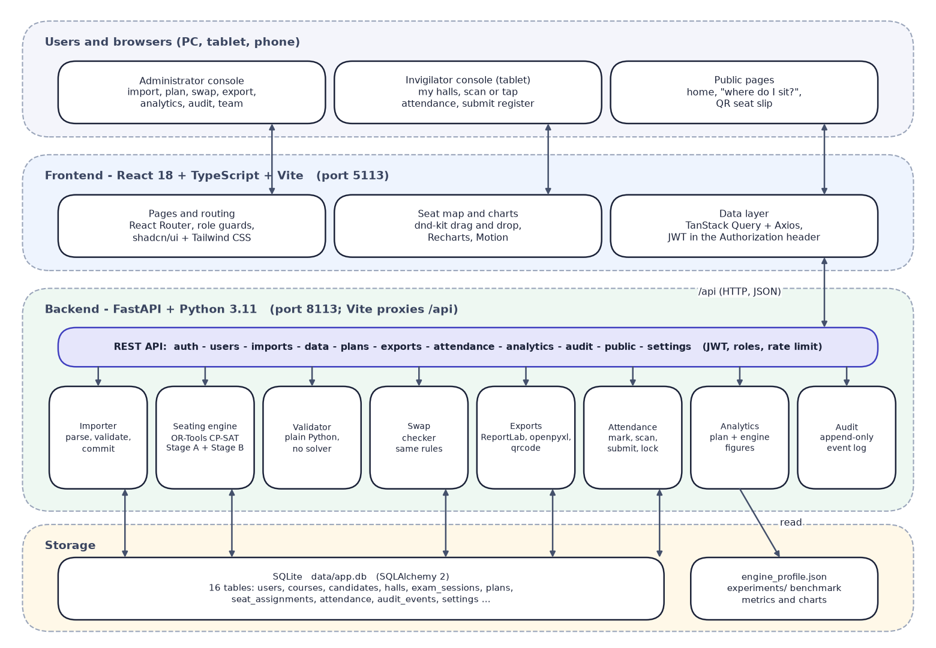

System Architecture
Layered architecture: browsers, React frontend, FastAPI backend with engine and services, SQLite storage
Dept. of CSE (Data Science) | Batch A13 | Final Review
10

Slide 11
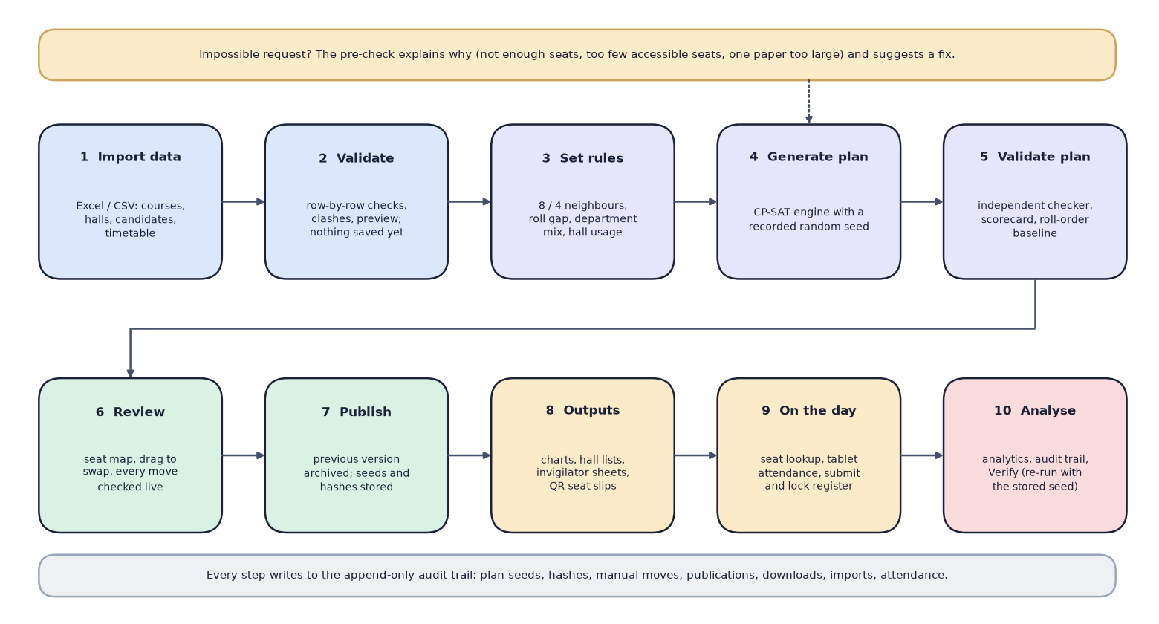

Methodology
End-to-end workflow: import, validate, set rules, generate, validate, review, publish, outputs, on the day, analyse
Dept. of CSE (Data Science) | Batch A13 | Final Review
11

Slide 12
Dataset, Rules & Model
Synthetic sample (seed 2026): 49 courses, 7 departments, 908 candidates, 2,724 registrations, 14 halls (871 seats), 6 sittings; no real person or record.
Benchmark scenarios: 150 to 2,000 candidates, 4 to 14 papers, 3 to 39 halls; rebuilt from their seeds.
Rules (the model's parameters): 8- or 4-neighbour adjacency, roll gap 5, department mix, compact or balanced halls, 2 accessible seats by default.
Model: a two-stage CP-SAT constraint model. Nothing is trained, so there is no train/validation/test split.
Settings: per-hall budget 0.15 (tuned), Stage A budget 0.3, one worker per hall, engine 1.0.0, OR-Tools 9.15.6755.
Groups: candidates are grouped by (paper, department, accessible need); courses sharing a question paper count as one paper.
Dept. of CSE (Data Science) | Batch A13 | Final Review
12
Notes:
The model is a constraint model, not a trained model: the honest evaluation is a benchmark against manual methods.

Slide 13
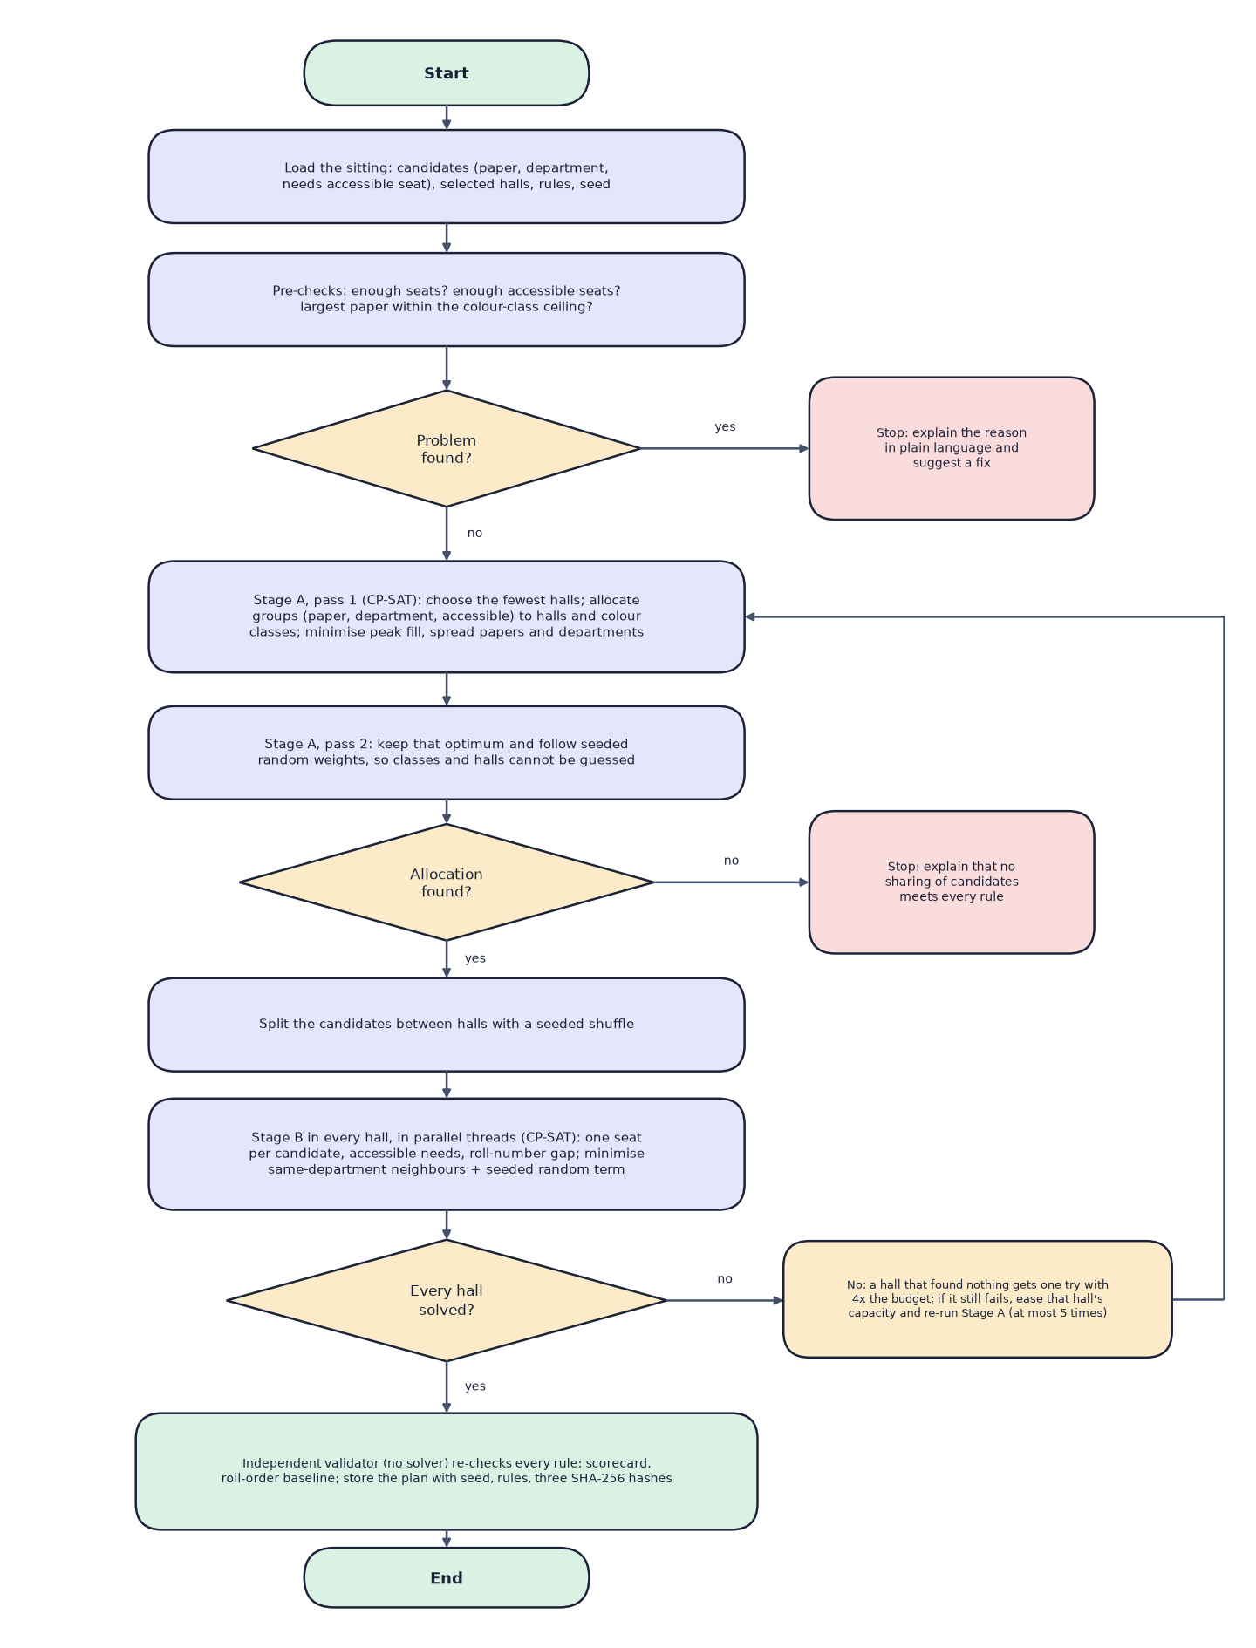

Decision Workflow
Core algorithm: pre-checks, Stage A (2 passes), seeded split, Stage B per hall, retry, validate and store
Dept. of CSE (Data Science) | Batch A13 | Final Review
13

Slide 14
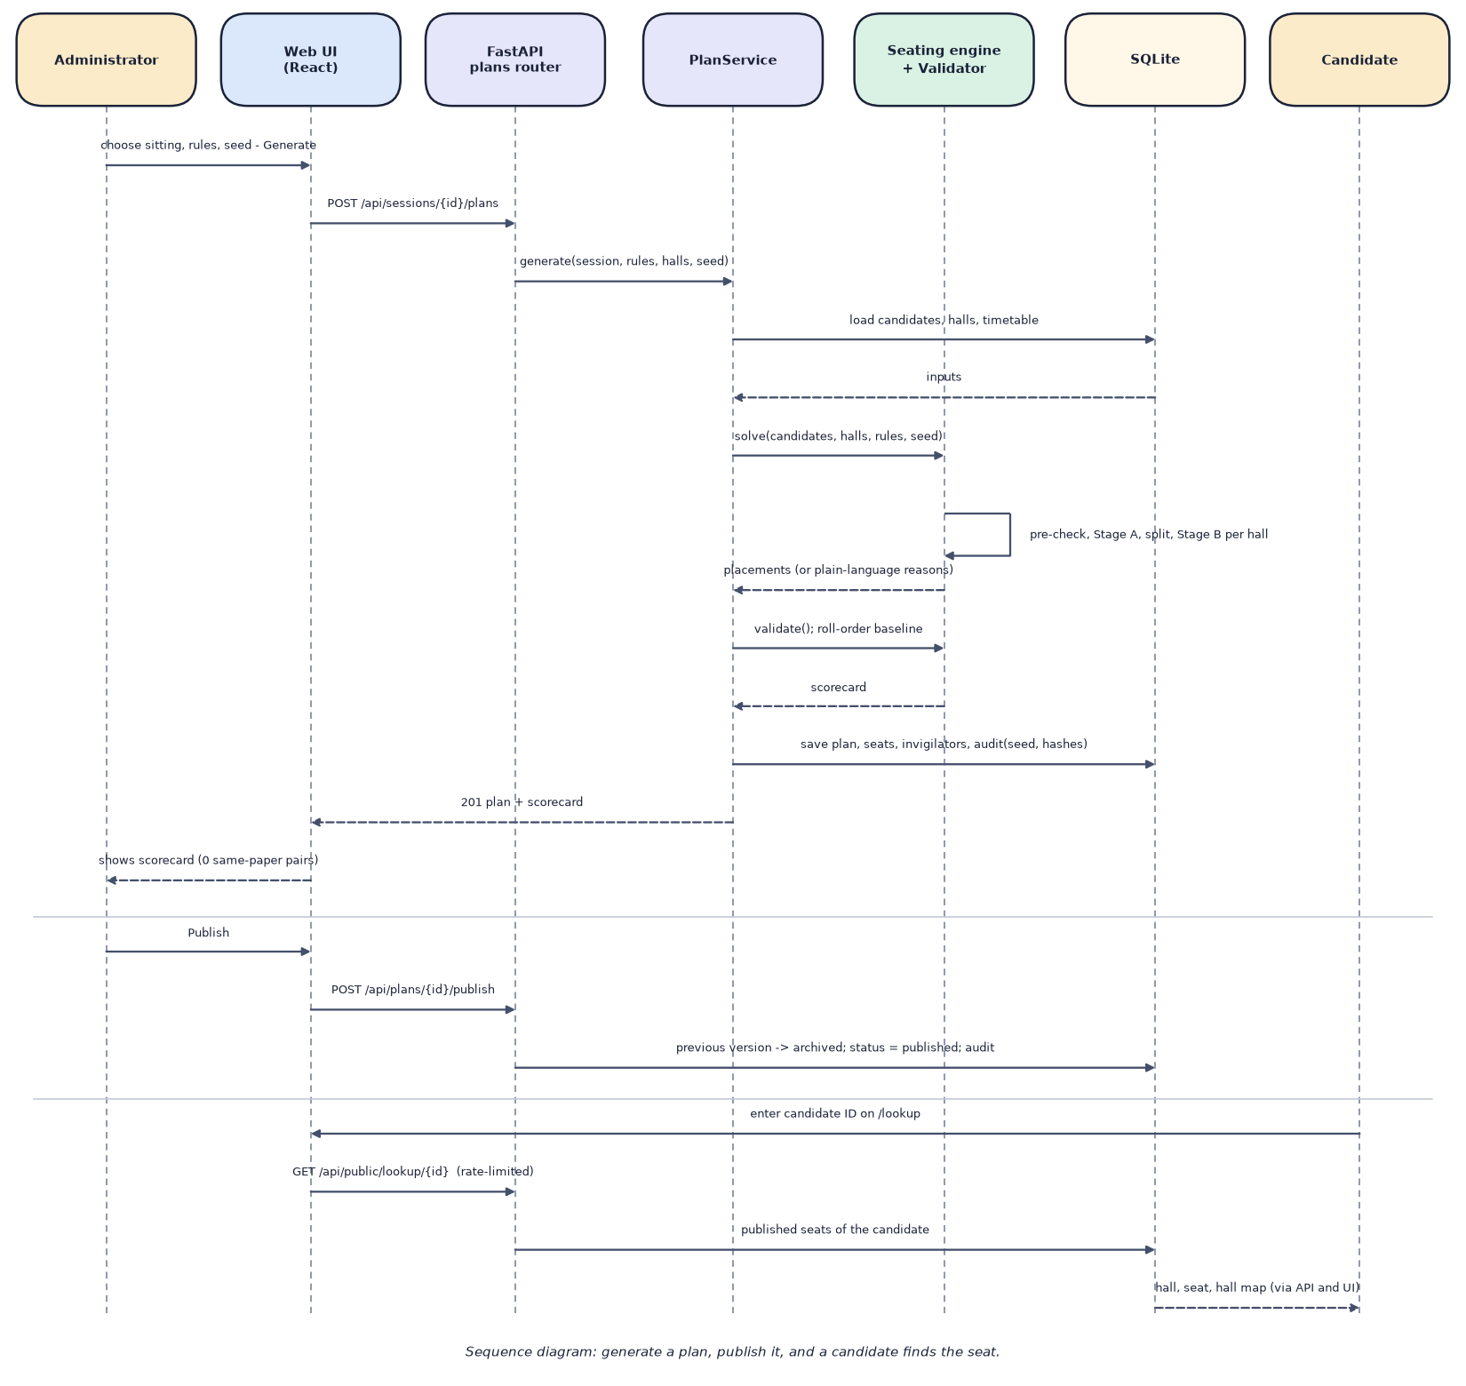

User–System Interaction
Sequence: generate a plan, publish it, and a candidate finds the seat
Dept. of CSE (Data Science) | Batch A13 | Final Review
14

Slide 15
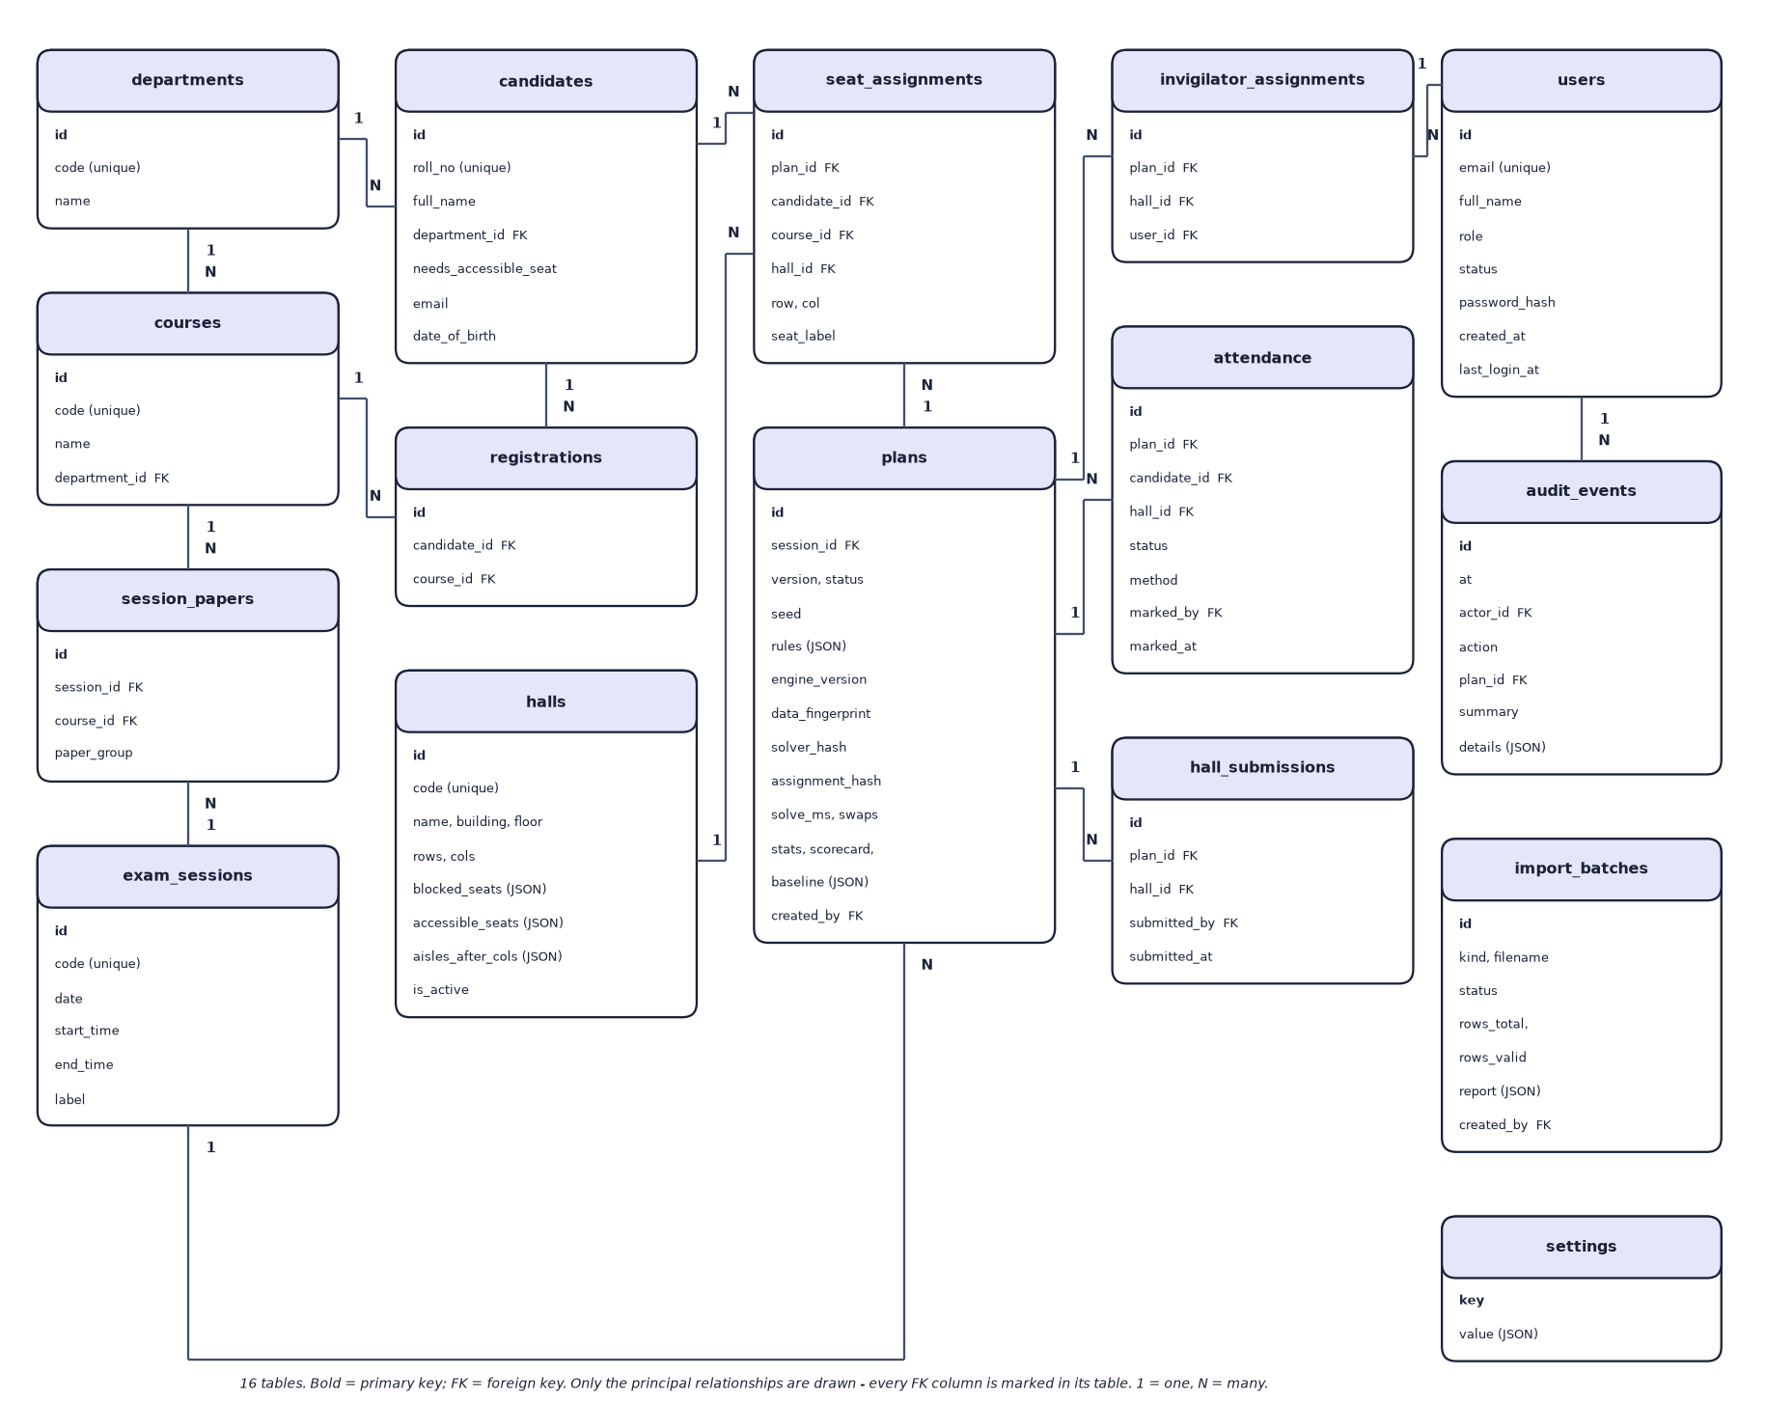

Database Design
Entity–relationship diagram (16 SQLite tables)
Dept. of CSE (Data Science) | Batch A13 | Final Review
15

Slide 16
Implementation Highlights
Module | Implementation
Import | CSV/XLSX parsing, row checks incl. timetable clashes, preview, re-validation at commit, a batch applies once
Engine | CP-SAT Stage A (two passes) and Stage B per hall in parallel threads; seeded; at most 5 retries
Reproducibility | SHA-256 sub-seeds; data_fingerprint, solver_hash, assignment_hash; Verify re-runs the engine
Seat map | dnd-kit drag or tap; swap-check marks every seat green or red with the reason
Outputs | ReportLab PDFs (charts, sheets, QR slips), openpyxl hall lists and attendance report
Security and tests | bcrypt, JWT 12 h, roles, rate-limited public lookup, audit trail; 58 backend tests
Dept. of CSE (Data Science) | Batch A13 | Final Review
16

Slide 17
Results – Engine Benchmark (600 candidates)
Measure (mean of 3 seeds) | SeatWise | Sequential (roll order)
Same-paper neighbour pairs | 0 | 1,253
Roll-gap violations | 0 | 453
Accessible seats missed | 0 | 6
Same-department neighbour pairs | 109 | 1,648
Solve time | 2.36 s | under 0.001 s
Plans meeting every hard rule | 100% (24 of 24 overall) | 0%
Synthetic 600-candidate sitting (8 papers, 6 departments, 12 halls); run engine-benchmark-20260921; not an estimate of real-world performance.
Dept. of CSE (Data Science) | Batch A13 | Final Review
17
Notes:
There is no accuracy or F1: nothing is trained. These are the measured rule violations and solve time.

Slide 18
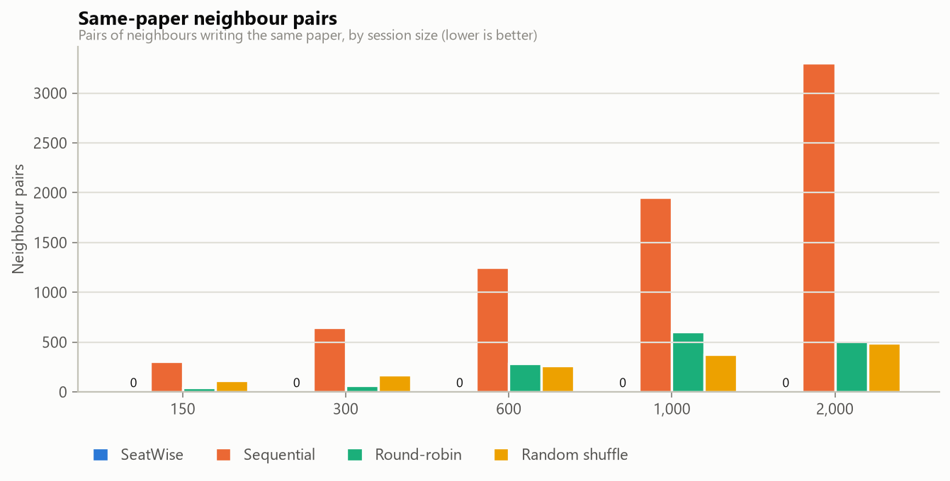
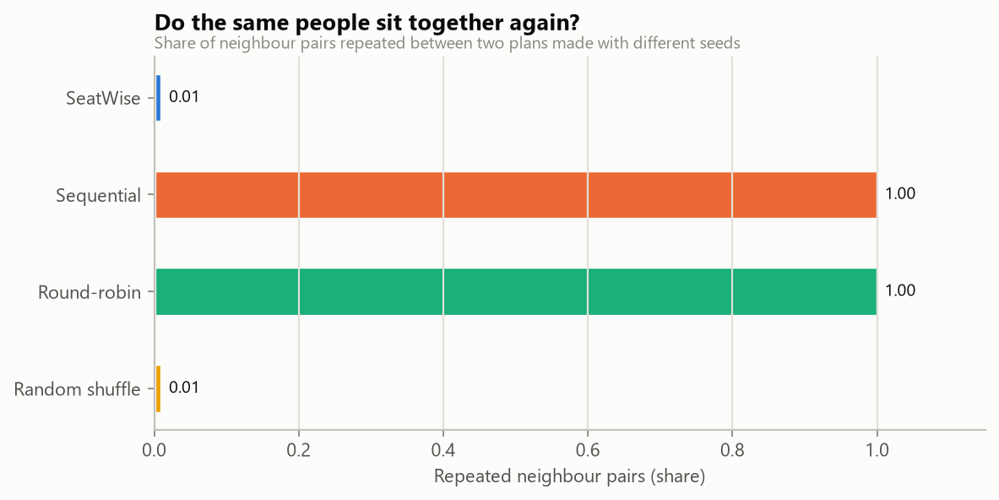


Rule Violations & Predictability by Method
Same-paper neighbour pairs by method and size (SeatWise: 0)
Neighbour pairs repeated across seeds: SeatWise 1.0%, sequential 100%
Dept. of CSE (Data Science) | Batch A13 | Final Review
18
Notes:
This is the equivalent of a confusion matrix for an optimisation engine: how many rule violations each method leaves, and how predictable each method is.

Slide 19
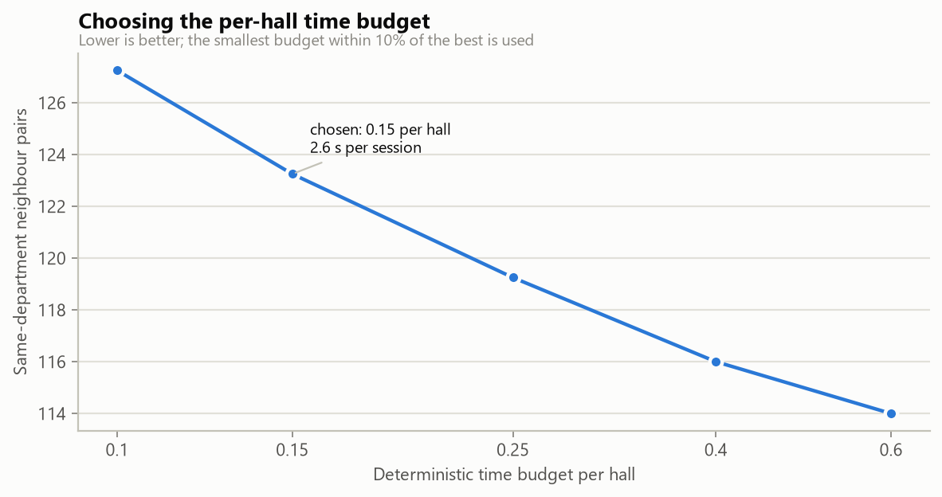
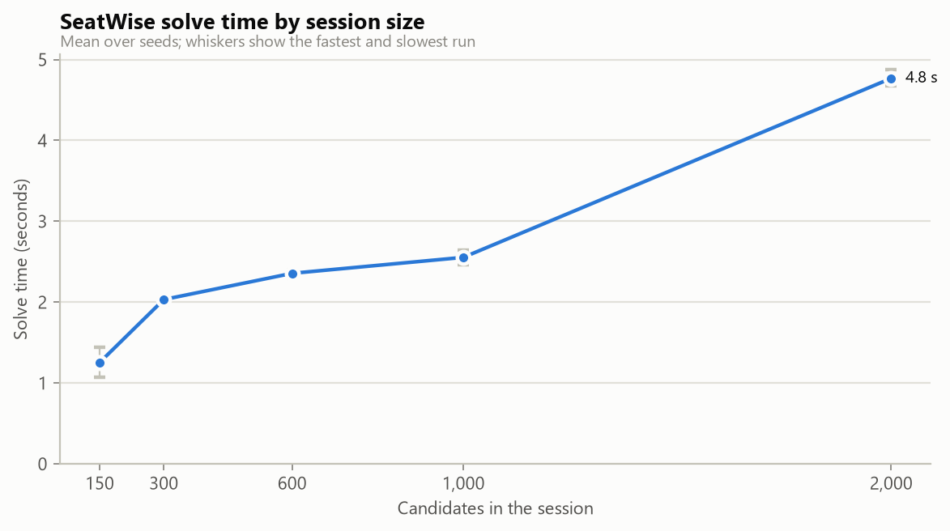


Parameter Analysis & Scaling
Per-hall budget: 0.15 chosen (2.63 s, 123 same-department pairs)
Solve time grows slowly with sitting size: 4.8 s at 2,000 candidates
Dept. of CSE (Data Science) | Batch A13 | Final Review
19
Notes:
The budget is the one tunable setting; the scaling chart shows near-linear growth with the number of halls.

Slide 20
Performance & Testing
Measurement | Result
Solve time | 2.4 s (600 candidates), 4.8 s (2,000); slowest benchmark run 6.1 s (4-neighbour mode)
API latency (local) | median 2-11 ms for data endpoints; seat map 7 ms; seating-chart PDF 96 ms; Excel lists 314 ms; QR slips PDF 3.2 s
Verify a plan | reproduced exactly (hashes equal) in about 2.2 s
Automated tests | 58 passed, 0 failed (engine 14, import 9, plans 6, exports 7, attendance 5, public 5, analytics 4, auth 8)
Demo scenario | end to end in 11.4 s: import, three plans (1.8-2.2 s, 0 same-paper pairs), exports, lookup, attendance
Dept. of CSE (Data Science) | Batch A13 | Final Review
20
Notes:
Not measured: concurrent-user load, memory use, other hardware; user-acceptance testing was not performed.

Slide 21
Comparison with Base Paper (context only – different datasets)
System | Data | Method | Rules enforced | Reported / measured | Extras
Base paper [1] | Institutional lists; none reported | Zipper interleave of two subjects | Subject alternation, optional branch rule, blocked seats | No results; 100 students in < 3 s target | PDF chart, grid map, public search
Round-robin baseline (ours) | Synthetic, 600 candidates | Papers interleaved cyclically | None guaranteed | 281 same-paper pairs, 198 roll-gap violations | -
SeatWise | Synthetic, 150-2,000 candidates | CP-SAT, seeded, validated | No same-paper neighbours (8 sides), roll gap, accessible seats, capacity | 0 violations in 24 of 24 plans; 2.4 s at 600 | Swap map, QR slips, attendance, analytics, audit
Different data: the base paper reports no measured results, so no numeric head-to-head is possible. Round-robin is our closest proxy for its interleaving idea, not a re-implementation of the base paper.
Dept. of CSE (Data Science) | Batch A13 | Final Review
21

Slide 22
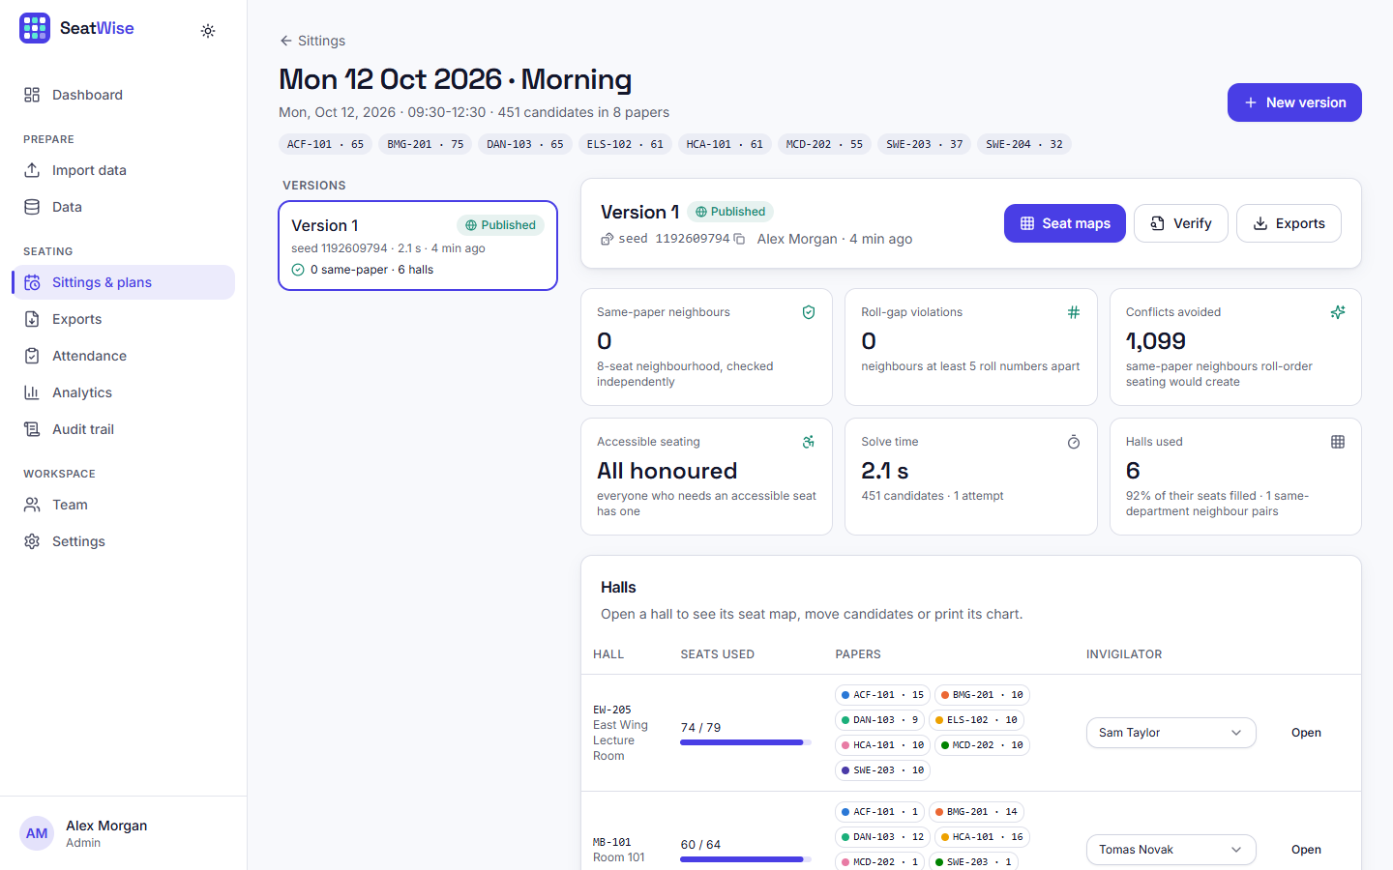
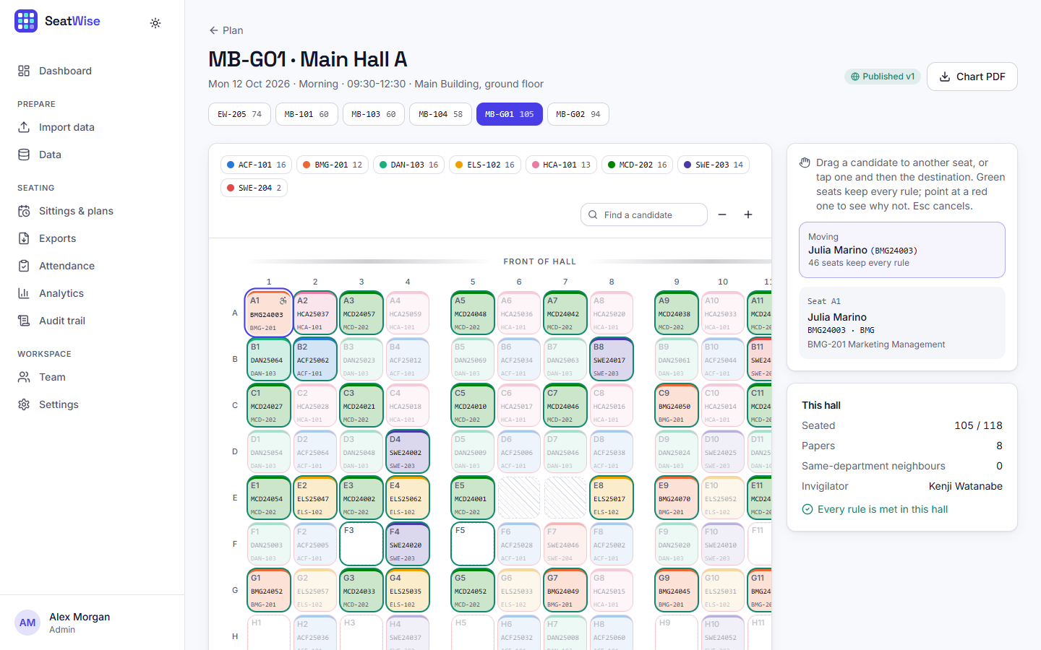


Output – Plan and Seat Map
Plan page: scorecard, versions, halls, Verify
Seat map: a picked-up candidate and the seats that keep every rule
Dept. of CSE (Data Science) | Batch A13 | Final Review
22

Slide 23
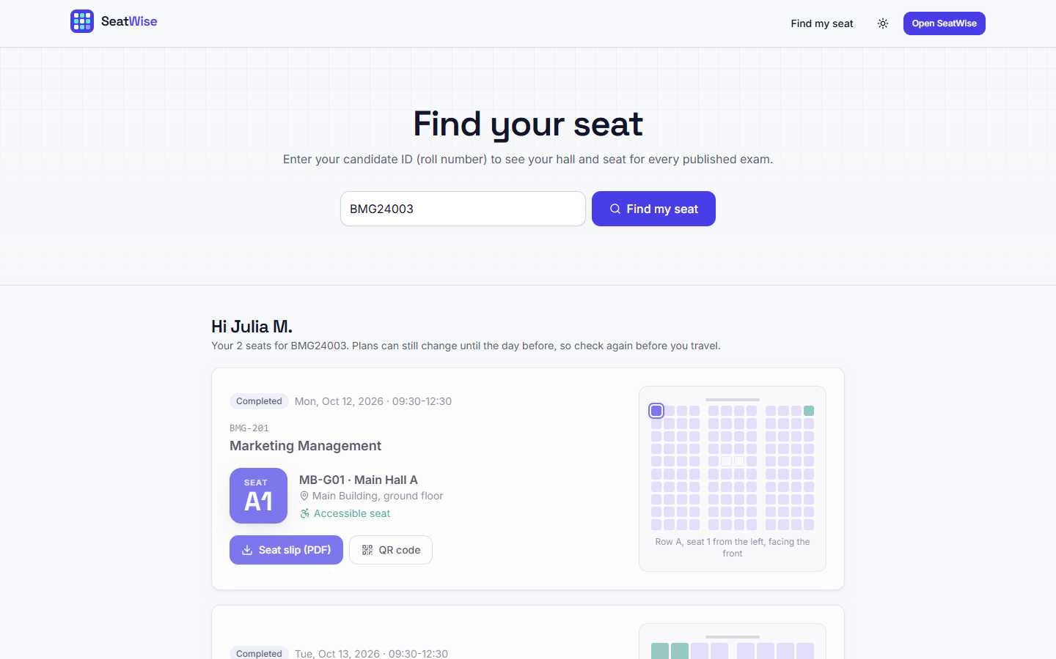
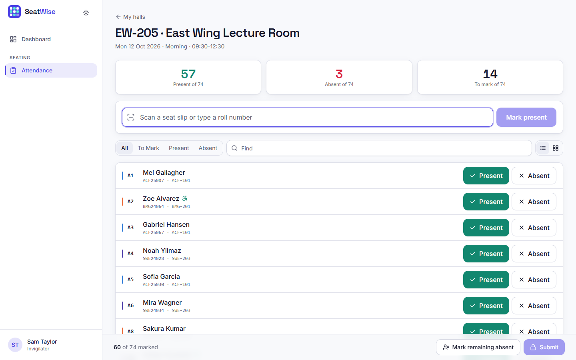


Output – Seat Lookup and Attendance
Public seat lookup with hall map and QR slip
Tablet attendance: present, absent, to mark; submit and lock
Dept. of CSE (Data Science) | Batch A13 | Final Review
23

Slide 24
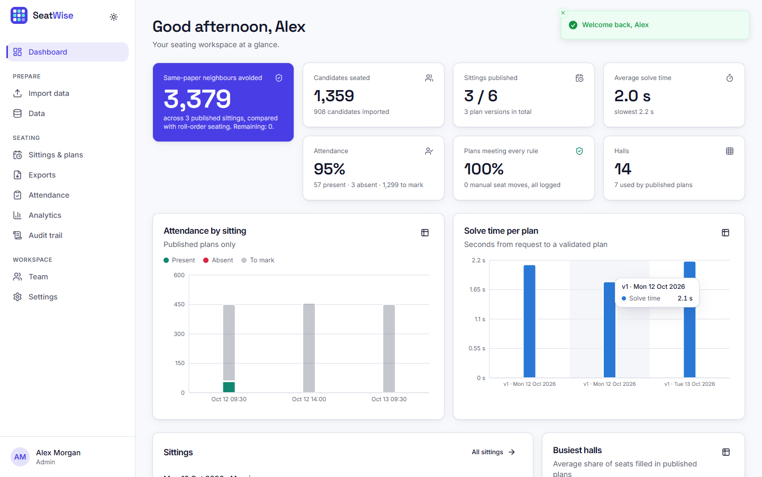
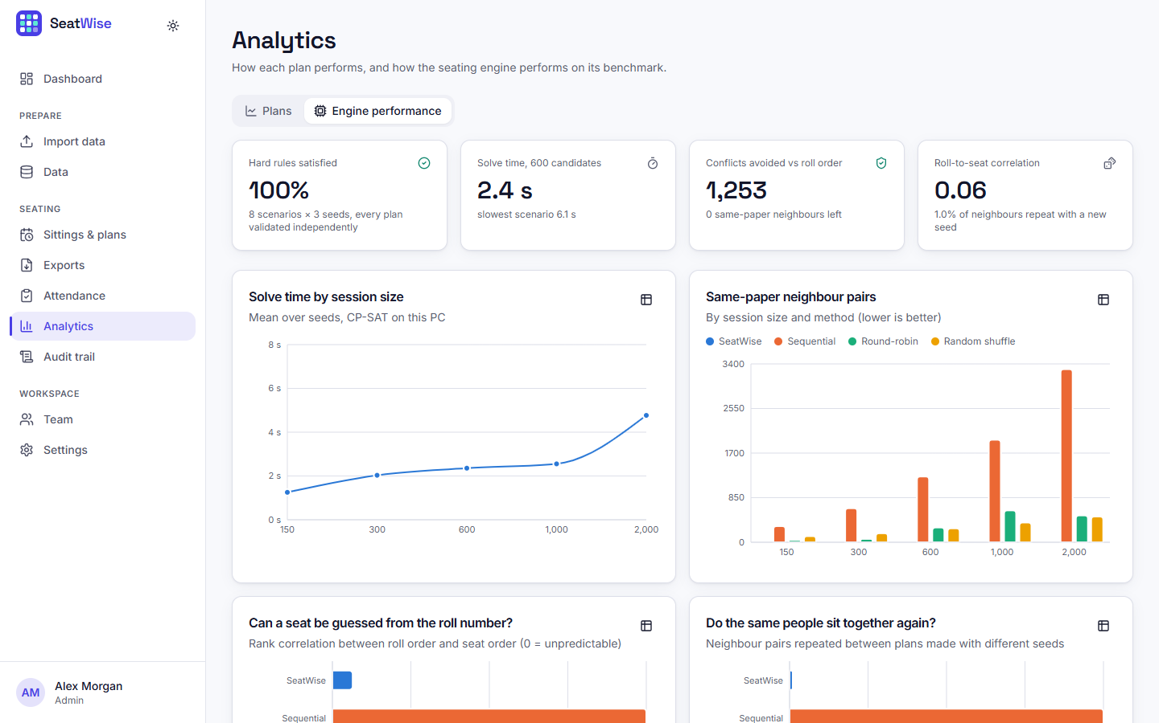


Output – Dashboard and Analytics
Dashboard after three published plans and attendance
Analytics: engine performance from the benchmark
Dept. of CSE (Data Science) | Batch A13 | Final Review
24

Slide 25
Conclusion
Built SeatWise: constraint-optimised, reproducible exam seating with a complete web application.
24 of 24 benchmark plans met every hard rule: 0 same-paper neighbours against 1,253 for roll-order seating (600 candidates).
2.4 s for 600 and 4.8 s for 2,000 candidates; roll-to-seat correlation 0.065; 1% of neighbour pairs repeat across seeds.
58 backend tests pass; the demo scenario runs import, planning, exports, lookup and attendance end to end.
Limits: synthetic data only; no user-acceptance test; front-row bias 4.7 points; 4-neighbour mode slower (6.0 s).
Dept. of CSE (Data Science) | Batch A13 | Final Review
25

Slide 26
Future Scope
Pilot on a real, anonymised sitting and gather feedback from invigilators and the examination cell.
E-mail or SMS seat notifications and an installable mobile app (also the base paper's future work).
Reduce front-row bias (for example by rotating colour classes) and speed up 4-neighbour mode.
Invigilator rostering and objectives such as seat visibility and distance.
Multi-institution deployment with a server database; face-recognition attendance only after a privacy review.
Dept. of CSE (Data Science) | Batch A13 | Final Review
26

Slide 27
References
[1] P. Yukth, I. S. Mahmood, K. H. Shashank, S. G. Thejus and M. S. Darshini, "Exam Seating Arrangement System," International Journal of Research Publication and Reviews (IJRPR), vol. 6, no. 12, pp. 2093-2105, Dec. 2025.
[2] "Automated examination seating arrangement and hall allocation system," International Journal of AI, Electrical, Civil and Mechanical Engineering, 2026.
[3] "An intelligent machine learning-based system for automated examination hall seating arrangement in universities," in Proc. 2026 Int. Conf. AI-Driven Solutions for Sustainable Smart Cities: Challenges and Opportunities (ADSSSC), 2026.
[4] S. O. Adetona and F. A. Akintoye, "Design and implementation of an examination seating arrangement application to curb examination malpractice," ABUAD Journal of Engineering Research and Development (AJERD), vol. 6, no. 2, pp. 143-156, Dec. 2023.
[5] "Automated seating arrangement for conducting examination," in Proc. 2025 Int. Conf. Multi-Agent Systems for Collaborative Intelligence (ICMSCI), 2025.
[6] Kashyap et al., "Exam seating allocation to prevent malpractice using genetic multi-optimization algorithm," Springer, 2021, doi: 10.1007/978-981-16-0419-5_11.
[7] K. Jitha and A. Fathima, "Web application based exam hall seating management system," in Proc. IEEE Int. Conf. Applied Artificial Intelligence and Computing (ICAAIC), 2022 (as described in [1]).
[8] M. Patel, "Smart seating system for universities," in Proc. IEEE Int. Conf. Computing, Communication and Automation, 2021 (as described in [1]).
[9] "Automated students examination seat allocation using linear congruential generator," International Journal of Computer Trends and Technology (IJCTT), 2021 (as described in [1]).
[10] "AI powered automated exam hall allocation and management system," International Journal of Science and Research (IJSART), 2025 (as described in [1]).
[11] D. J. A. Welsh and M. B. Powell, "An upper bound for the chromatic number of a graph and its application to timetabling problems," The Computer Journal, vol. 10, no. 1, pp. 85-86, 1967.
[12] R. Qu, E. K. Burke, B. McCollum, L. T. G. Merlot and S. Y. Lee, "A survey of search methodologies and automated system development for examination timetabling," Journal of Scheduling, vol. 12, no. 1, pp. 55-89, 2009.
[13] F. Rossi, P. van Beek and T. Walsh, Eds., Handbook of Constraint Programming. Amsterdam, The Netherlands: Elsevier, 2006.
[14] L. Perron and V. Furnon, "OR-Tools," Google. [Online]. Available: https://developers.google.com/optimization
[15] M. Jones, J. Bradley and N. Sakimura, "JSON Web Token (JWT)," RFC 7519, Internet Engineering Task Force, May 2015.
[16] N. Provos and D. Mazieres, "A future-adaptable password scheme," in Proc. USENIX Annual Technical Conference, 1999.
[17] S. Ramirez, "FastAPI documentation." [Online]. Available: https://fastapi.tiangolo.com
[18] M. Bayer, "SQLAlchemy," in The Architecture of Open Source Applications, vol. 2, A. Brown and G. Wilson, Eds., 2012.
[19] Meta Platforms, "React documentation." [Online]. Available: https://react.dev
Dept. of CSE (Data Science) | Batch A13 | Final Review
27

Slide 28
THANK YOU
Questions & Suggestions
Dept. of CSE (Data Science) | Batch A13 | Final Review
28
Notes:
Thank you. Questions are welcome.

