Slide 1
AutoSecAI
REVIEW 2 · DESIGN, METHODOLOGY AND PROGRESS
Autonomous Pull Request Analysis for Security, Vulnerability Detection, and Code Quality using Multi-Agent LLMs
Presented by
Under the guidance of
CHEPURI RISHIVARDHAN 23K91A0553
BODA SANDEEP 23K91A0539
DHARAVATH SEETHARAM 23K91A0562
NARISIMHA REDDY 24K95A0501
P. KISHORE, [DESIGNATION]
Department of Computer Science and Engineering
TKR College of Engineering & Technology (Autonomous) · Batch A11 (CSE, Section A) · [ACADEMIC YEAR]
Notes:
Review 2 covers design, methodology and progress of AutoSecAI.

Slide 2
Contents
01
02
03
04
Recap
Architecture
Methodology
Corpus and dataset
05
06
07
08
Metrics and balancing
Models and training
Verdict logic
Data flow, modules, database
09
10
11
12
Technology stack
Progress
Preliminary results and screens
Testing, challenges, next steps
Notes:
Twelve parts, from a recap of Review 1 through the design and the pipeline to progress, results, testing and next steps.

Slide 3


Recap: problem and proposed system
Problem
Proposed system
Pull requests arrive faster than they can be reviewed; manual review is uneven on security, static analysers drown reviewers in warnings, and a small diff is judged without the context of the codebase.
Seven cooperating agents: AST + taint static analysis, a metric-based ML risk score, explanation, verified patches, quality review and a judge; plus a retrieval assistant for the repository.
PR diff, files or GitHub link
Static analysis + metric risk
Explain + patch + verify
Score + verdict
Export, history, ask the repo
Notes:
Recap of Review 1: the problem and the proposed system as a five-step pipeline.

Slide 4
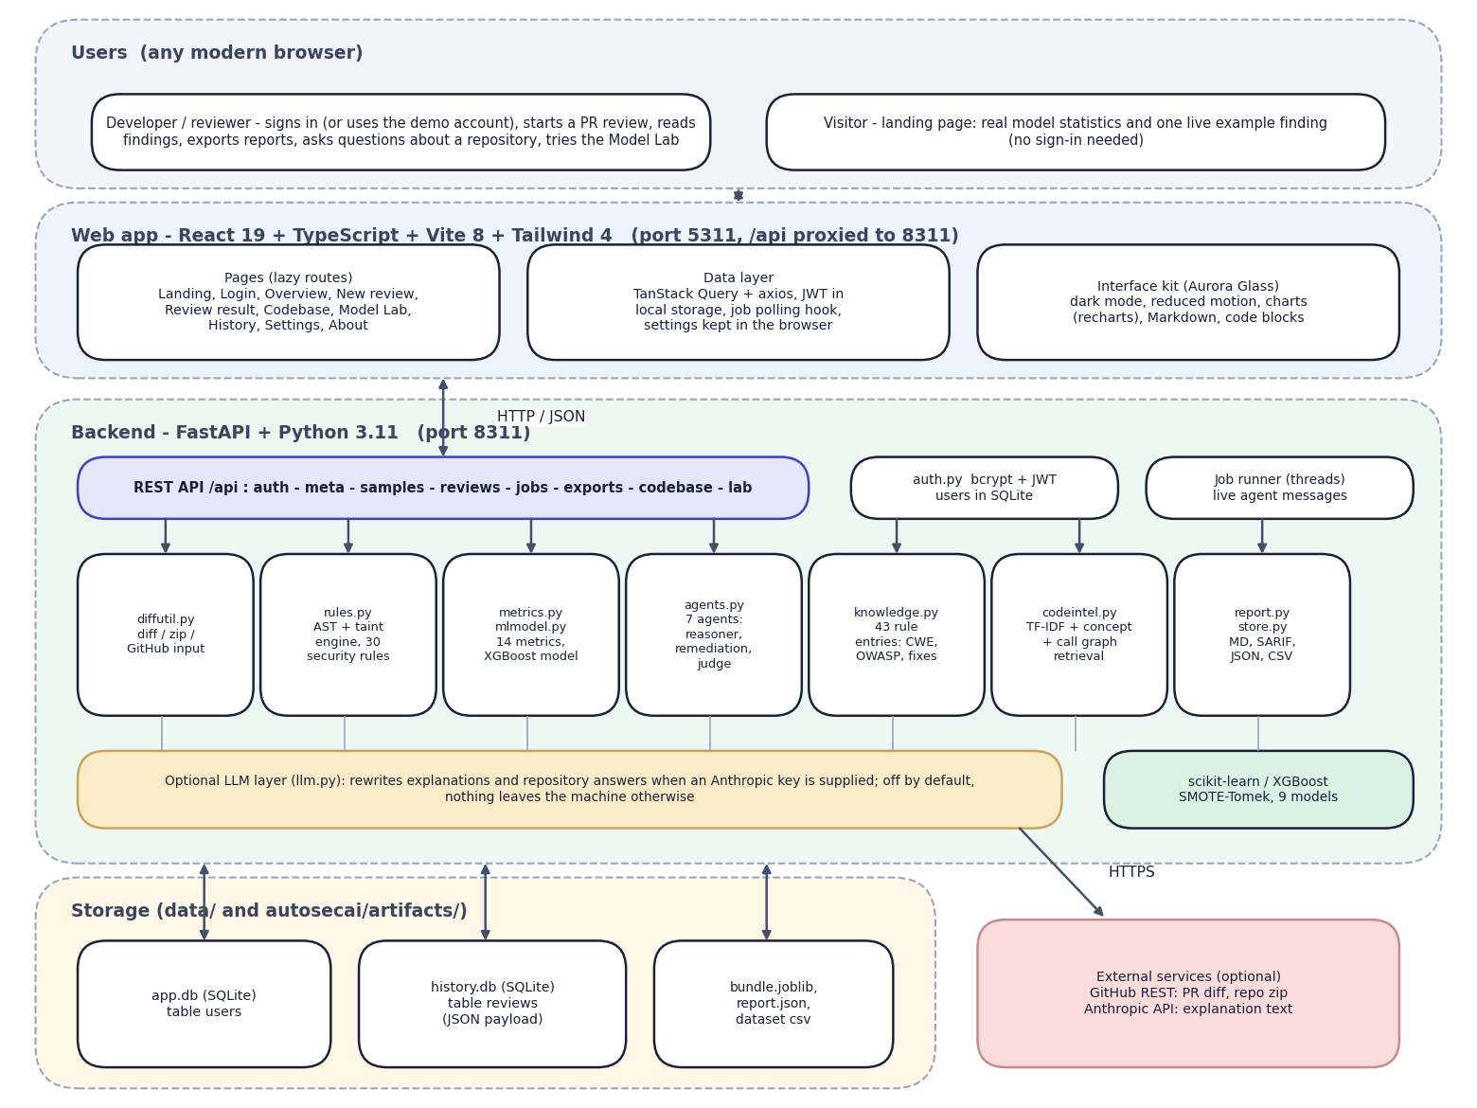

System architecture
Client: React 19 + TypeScript + Vite (port 5311), TanStack Query, recharts, dark mode.
API: FastAPI (port 8311): JWT sign-in, 25 route handlers, background jobs with live agent messages.
Engine: autosecai package: diff parsing, AST/taint rules, 14-metric model, 7 agents, exports.
Assistant: TF-IDF + concept scores + call graph retrieval over the repository.
Data: SQLite (users, reviews as JSON), model artefacts; GitHub and an LLM key are optional.
Notes:
The browser talks only to the Vite server, which proxies /api to FastAPI. The engine runs locally; GitHub and an optional Anthropic key are the only external calls.

Slide 5
Methodology: end-to-end workflow
Sign in + choose input
Ingest: diff, hunks, lines
Static analysis: AST + taint
ML risk: 14 metrics
Reason + remediate
Quality + judge: verdict
Export + history
Changed code first
Fixes are checked
Evidence kept
Findings are marked in or out of the diff, so the verdict is driven by what the pull request changes.
A patch is shown only if re-scanning the patched code no longer reports the finding.
Every agent writes a trace entry; exports include Markdown, SARIF 2.1.0, JSON and CSV.
Notes:
End-to-end workflow in seven steps. The central idea: static rules and a metric model look at the same changed functions, and every agent leaves an audit trail.

Slide 6
Dataset: a generated Python corpus
Data | Size | Use
Generated Python corpus (seed 7) | 6,000 functions, 501 vulnerable (8.35%) | Train and test the metric model
Split (stratified, seed 42) | 4,500 train / 1,500 test | Held-out scores
After SMOTE + Tomek (train only) | 8,232 rows | Balanced training
Built-in demo pull request | 1 file, +67 / -1 lines, 7 functions | Demo and measurement
Demo repository | 10 files, 24 code units | Codebase assistant
Base paper data (not used) | 21,759 C/C++ functions, 275 vulnerable | Not distributable here
Notes:
The corpus is generated, not collected: random benign logic plus injected vulnerable patterns of eight types, look-alike safe patterns and 1 percent label noise. It stands in for the base paper's C/C++ data, which is not available, so scores differ from the paper's.

Slide 7



Data preparation: metrics, selection, balancing
Metric extraction
Selection and scaling
Class balancing
Python's ast gives 14 metrics per function: M1 cyclomatic complexity ... M11 control dependency from the base paper, plus M12 risky API calls, M13 string-built sinks and M14 untrusted sources for taint-style flaws.
Seven selectors (Pearson, SVM, Lasso, chi-squared, two RFE variants, variance) vote; k is swept from 5 to 14 and k = 13 is chosen (validation F1 0.786). Min-Max scaling.
SMOTE (k = 5) then Tomek-link removal, implemented in-house: 4,500 training rows become 8,232 (16 Tomek removals). The test set is never touched.
Notes:
Preprocessing here means turning source code into metrics, choosing the useful ones and balancing the rare vulnerable class.

Slide 8
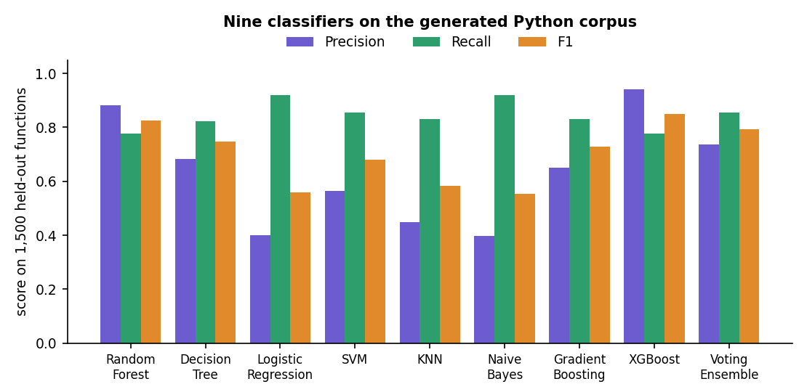

Models and pipeline components
Component | Detail
Risk model | XGBoost (200 trees, depth 5)
Compared | 8 other models, incl. Random Forest
Type classifier | Random Forest, 400 trees
Rule engine | 30 security + 12 quality rules
Explainer | 43-entry CWE / OWASP base
scikit-learn / XGBoost models trained here on the generated corpus; no deep network is used.
Notes:
Nine classifiers were trained as in the base paper. XGBoost has the best F1 (0.851); Random Forest, the paper's winner, scores 0.826 on this corpus.

Slide 9
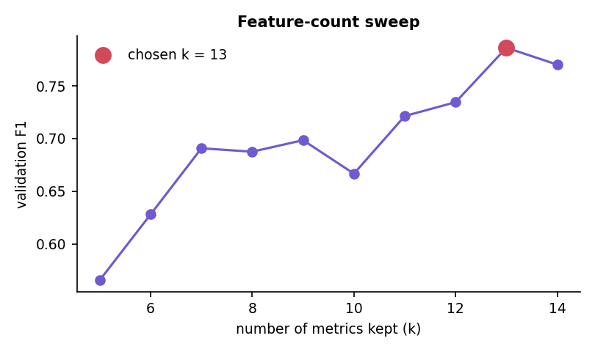

Training configuration
Setting | Value
Corpus / split seeds | 7 / 42
Split | 75 / 25 stratified
Selected metrics | top 13 of 14
Balancing | SMOTE k = 5 + Tomek links
Random Forest | 300 trees
XGBoost | 200 trees, depth 5, rate 0.1
Training time | 31.7 s, CPU only
Feature-count sweep: validation F1 rises from 0.566 at k = 5 to 0.786 at k = 13
Notes:
The base paper keeps the top five metrics. On this corpus validation F1 is 0.566 at k = 5 and 0.786 at k = 13 (test F1 0.645 against 0.826 for Random Forest), because the extra taint metrics matter.

Slide 10
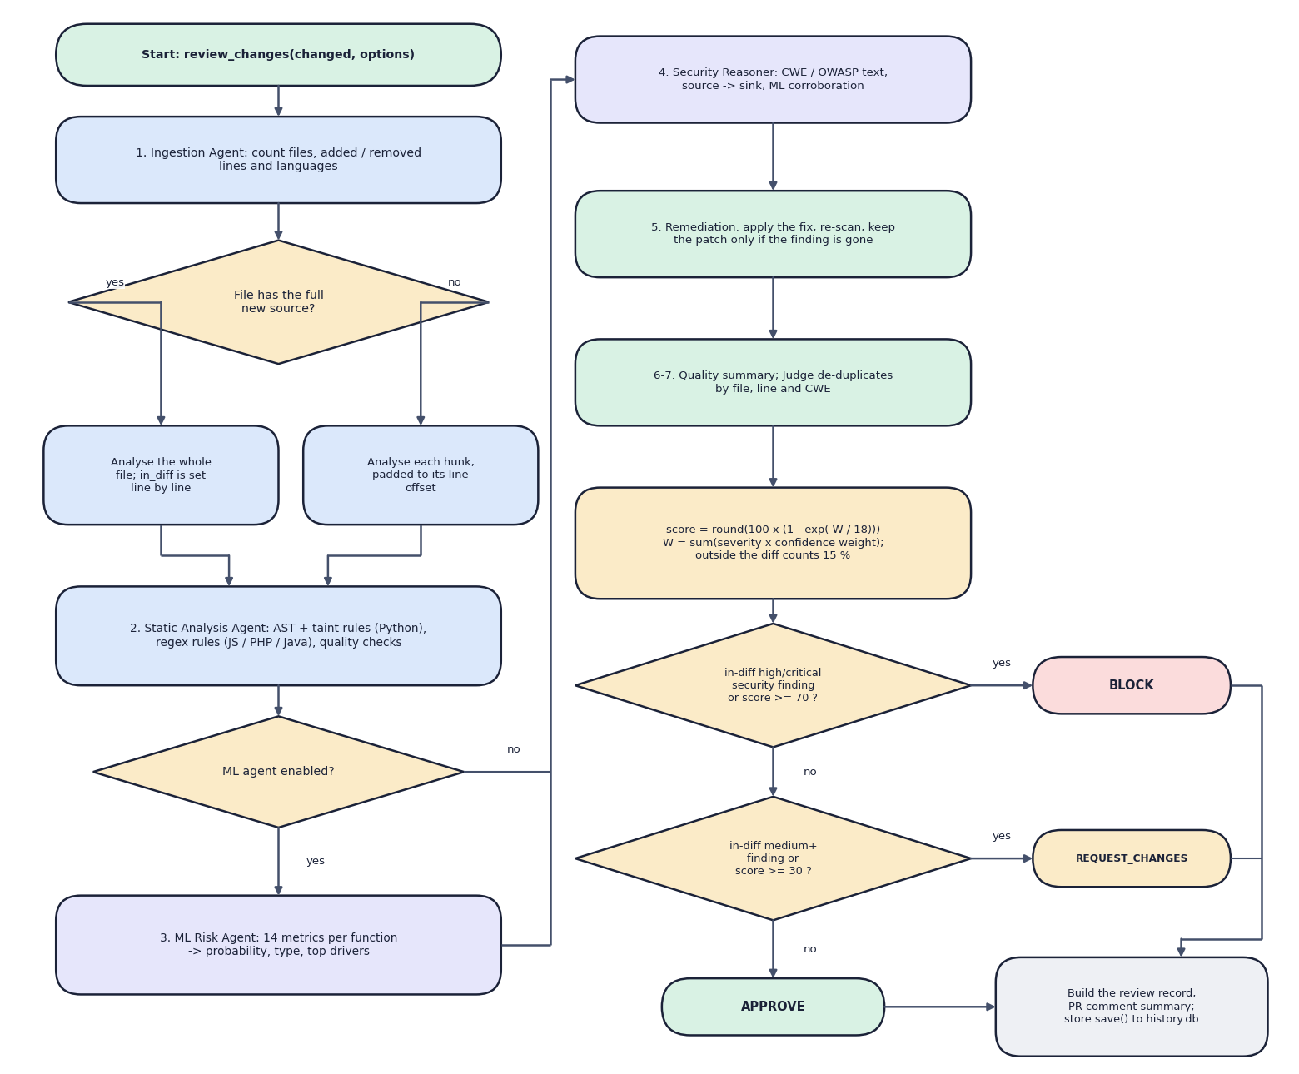

Decision logic
Verdict
BLOCK if a high or critical security finding in the changed lines is likely real, or the risk score is 70 or more; REQUEST_CHANGES at a medium finding or 30 or more; otherwise APPROVE.
Score
Risk = 100 x (1 - exp(-W / 18)), W = sum of severity x confidence weights; findings outside the diff count 15%.
Verified patches
Each fix is applied to a copy and re-scanned; it is kept only when the same rule no longer fires near that line.
Notes:
Decision logic of the judge agent: how findings become a score and a verdict, and when a patch is trusted.

Slide 11
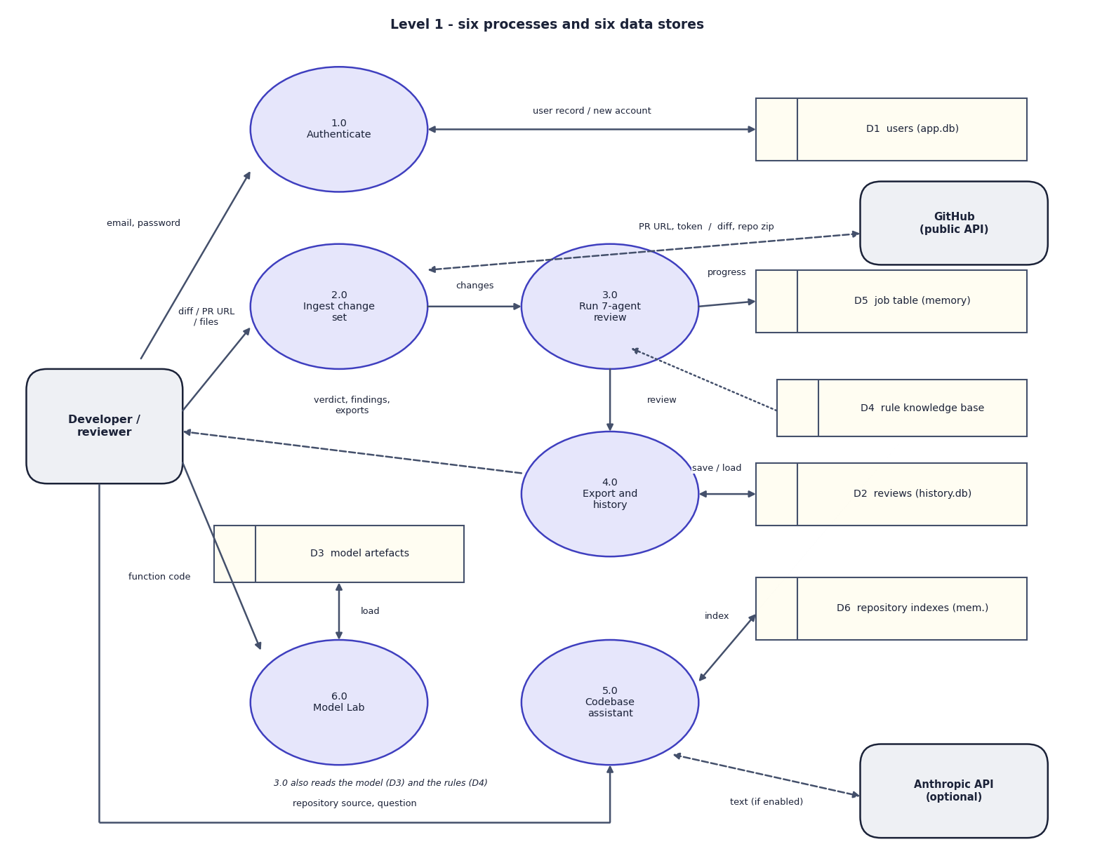
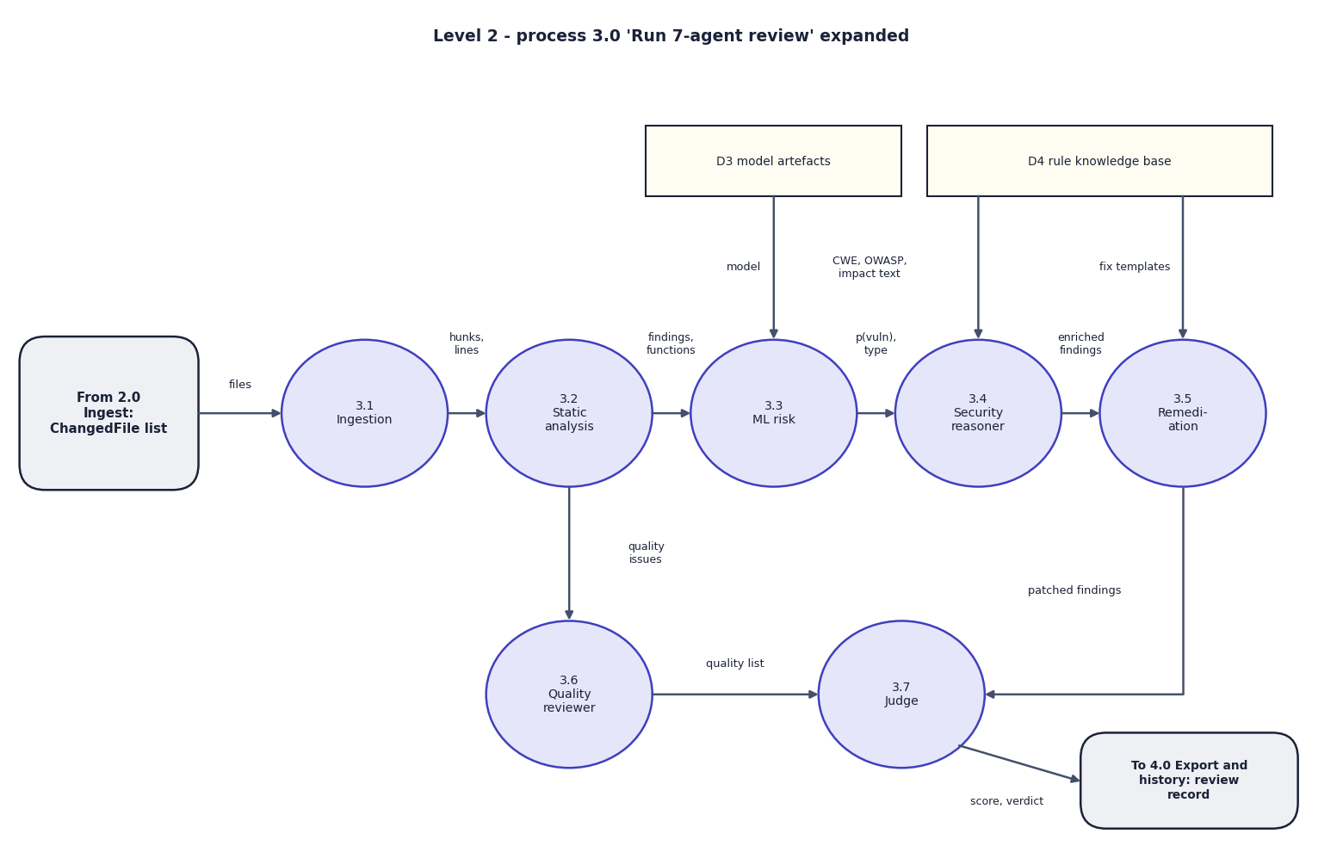

Data flow and modules
DFD level 1 (left) and level 2 expansion of the 7-agent review (right)
Module | Responsibility
diffutil + rules | parse diffs, zips, GitHub PRs; AST and taint rules; regex rules for JS, PHP, Java
metrics + mlmodel + agents | 14 metrics, risk model, seven agents, scoring and verdict
codeintel + report + store | repository retrieval, exports, SQLite history
Notes:
Level 1 shows six processes and six data stores; level 2 opens the review process into the seven agents.

Slide 12
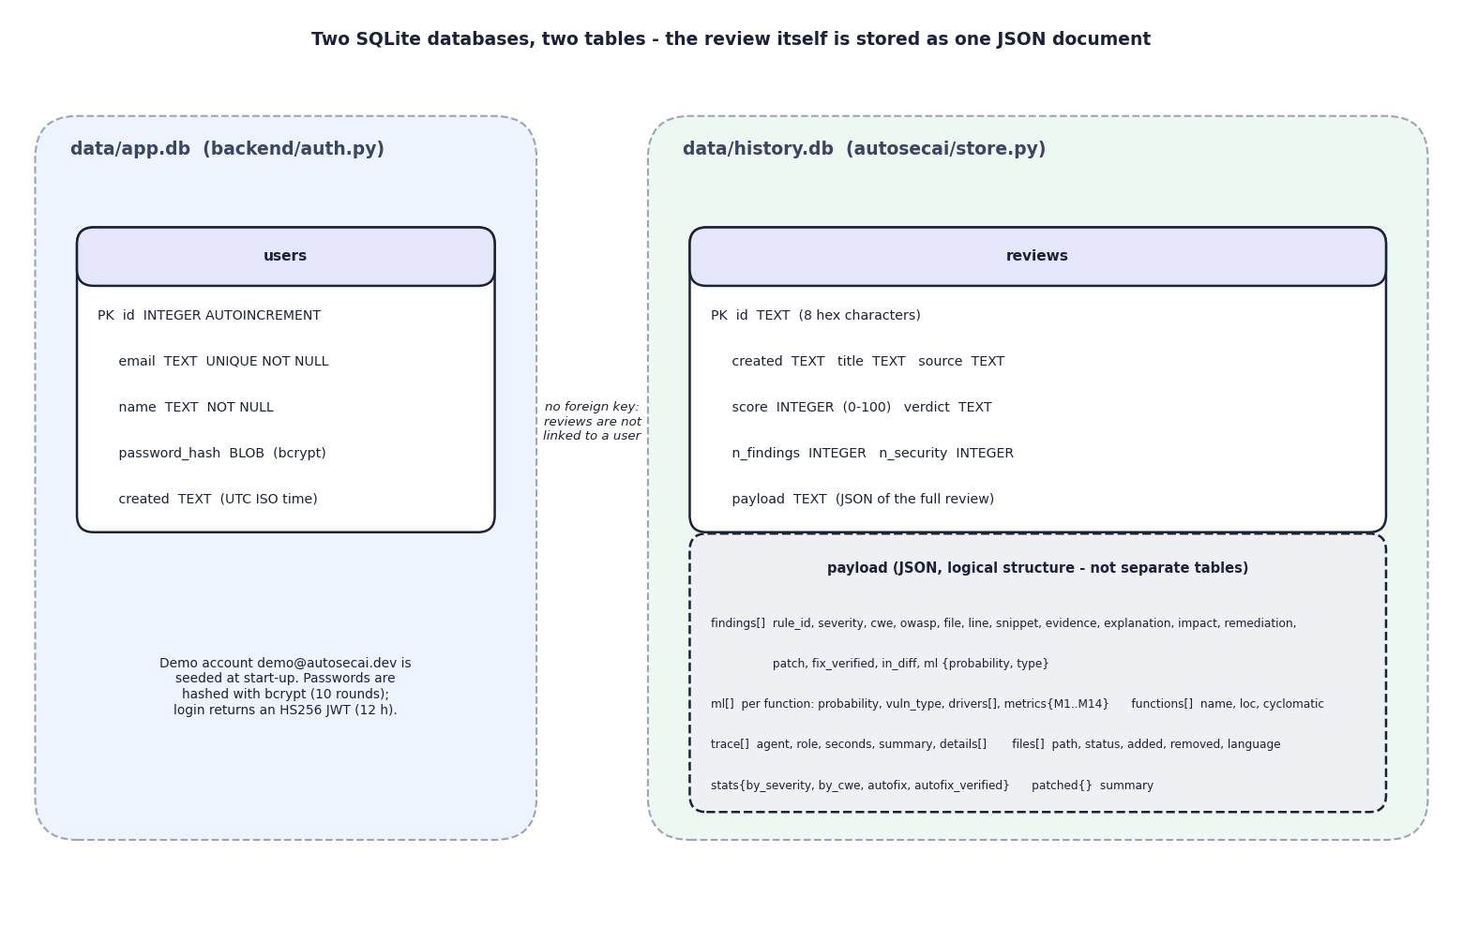
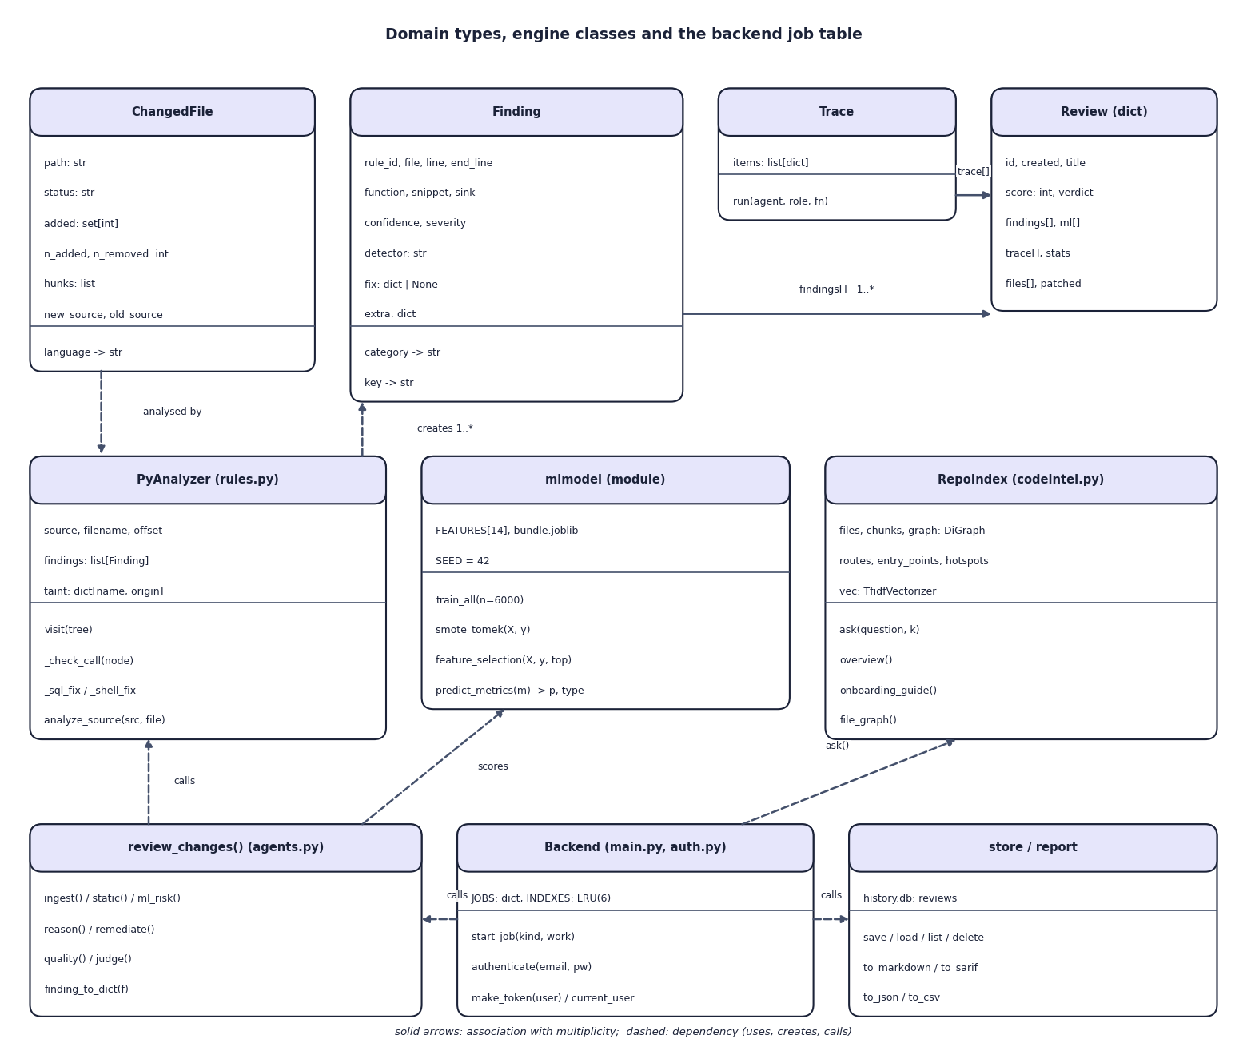

Database design and UML
ER diagram, 2 SQLite tables (left) and UML class diagram (right)
Table | Key fields | Notes
users (app.db) | id, email UNIQUE, name, password_hash (bcrypt), created | demo account seeded at start-up
reviews (history.db) | id, created, title, source, score, verdict, n_findings, n_security, payload | payload holds findings, ML rows, trace, files as JSON
Notes:
Two small SQLite databases. A review is stored as one JSON document, so there are no foreign keys; reviews are not linked to a user in this version.

Slide 13






Technology stack
Language
Analysis and ML
Frontend
Python 3.11, TypeScript
ast, scikit-learn, XGBoost, networkx, TF-IDF
React 19, Vite 8, Tailwind 4, TanStack Query, recharts, framer-motion
Backend
Exports
Testing
FastAPI, Pydantic, PyJWT, bcrypt, uvicorn, SQLite
Markdown, SARIF 2.1.0, JSON, CSV, patched files
pytest (17 tests), API smoke test, Playwright UI flows, strict TypeScript build
Notes:
Everything runs on one laptop with no GPU; an Anthropic key is optional.

Slide 14
Implementation progress
Component | Status
Diff, zip, folder and GitHub PR ingestion | Completed
AST + taint rule engine, 43 rule entries | Completed
14-metric model, 9 classifiers, type classifier | Completed
Seven agents, verified patches, verdict | Completed
Exports: Markdown, SARIF, JSON, CSV | Completed
Codebase assistant and Model Lab | Completed
React web app with sign-in, history, dark mode | Completed
Precision on real reviewed pull requests | Not done
25
API route handlers
43
rule knowledge-base entries
17/17
automated tests passing
Notes:
Every planned feature is implemented. The open item is measuring precision against manually reviewed real pull requests: no labelled set exists yet.

Slide 15
Preliminary results: held-out 1,500 functions
0.851
XGBoost F1 (Random Forest 0.826)
0.891
F1 when rules or ML flag (rules 0.800, ML 0.851)
0.375 s
median full review of the demo PR
Notes:
Scores are on a generated Python corpus, so they are not comparable with the base paper's. The rule engine and ML model were scored on the same 1,500 held-out functions; the rule engine and the corpus generator were written by the same team, so the rule scores are optimistic.

Slide 16
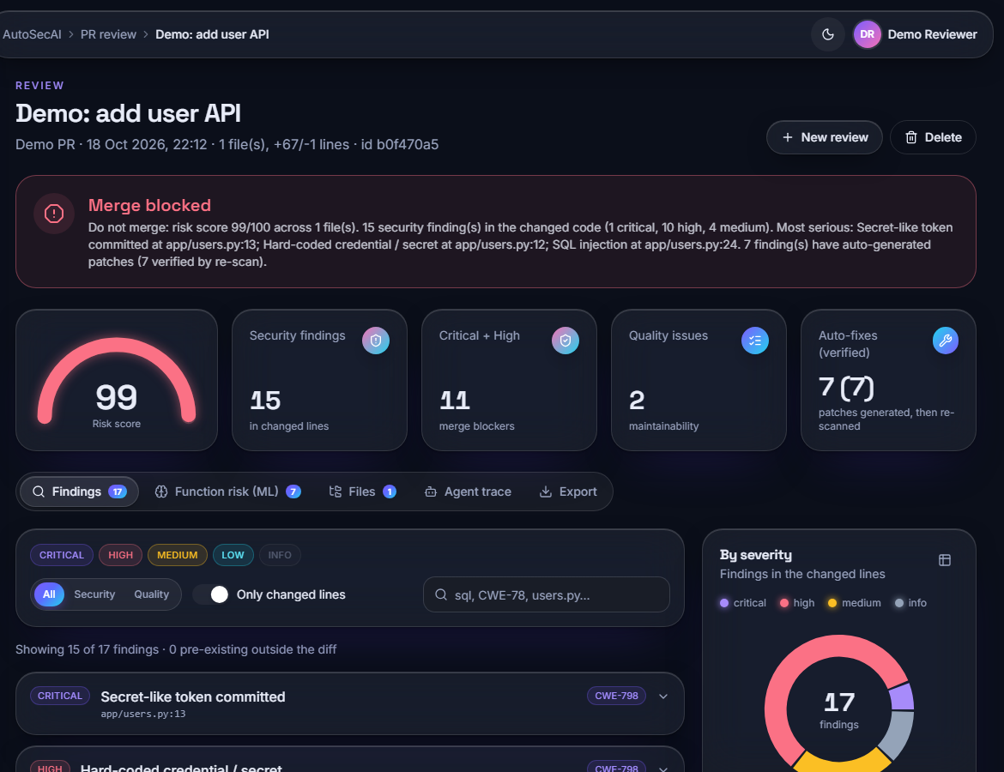
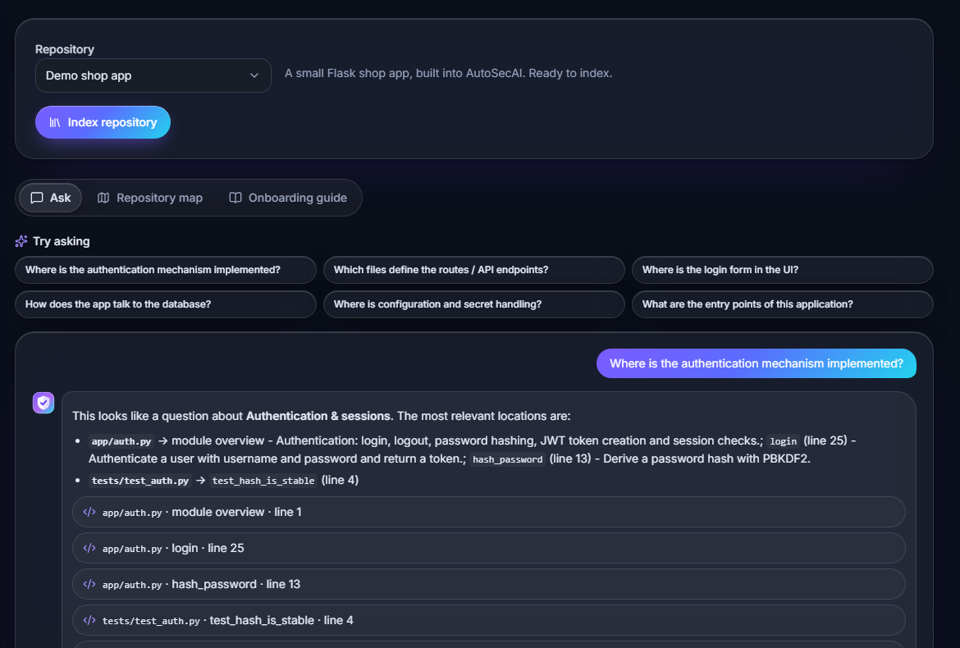


Output screens
Review result: BLOCK, risk 99, 15 security findings, 7 verified fixes
Codebase assistant: where is authentication implemented?
Notes:
Real captures of the running application with the built-in demo pull request and demo repository.

Slide 17
Testing and observations
Test group | Tests | Result
Engine: rules, taint, autofix, metrics, diff, ML, SMOTE-Tomek, codebase | 10 | Passed
API: auth, validation, review job, SARIF, codebase, lab | 7 | Passed
Live API smoke test | 16 | Passed
Browser UI flows (Playwright) | 22 | Passed
Production build (tsc + vite) | - | Passed
17 pytest tests pass in about 10 s; 16 of 16 API checks and 22 of 22 browser flows pass with zero console errors.
The demo pull request gets risk 99 and BLOCK with 17 findings; 7 of 7 patches verified by re-scan.
Rule engine F1 0.800, ML model 0.851, either 0.891 on 1,500 held-out functions.
Across five corpus seeds XGBoost F1 averages 0.842 (sd 0.006): the headline 0.851 is the best seed.
Not done: real-PR precision, comparison with other scanners, load and user testing.
Notes:
All counts come from runs made on 18 October 2026. The LLM text mode and a real GitHub PR fetch were not exercised.

Slide 18



Challenges and corrective actions
No labelled real data
Rare vulnerable class
Partial code in a diff
The base paper's C/C++ data is not available; a generated Python corpus with hard negatives and label noise is used and stated plainly.
Only 8.4% of functions are vulnerable; SMOTE-Tomek and a feature sweep were applied, and the ablation shows what each step buys.
Hunks are padded to their line offsets; whole-file fixes exist only when the full file is given.
Fixes that do not fix
Warning overload
Long reviews in a web page
Each patch is applied to a copy and re-scanned before it is shown.
Findings carry confidence, severity and an in-diff flag so changed lines drive the verdict.
Reviews run as background jobs; the UI polls and shows each agent's message as it finishes.
Notes:
Six challenges and how each was handled.

Slide 19
Next steps
Real-PR evaluation
User acceptance testing
Final report
Final presentation and demo
Collect manually reviewed pull requests and measure the precision of each agent against them (objective 6, not yet measured).
Try the optional LLM explanation mode with a key and compare it with the offline text.
Compare the findings with another open-source scanner on the same code.
Document every diagram, test and result in the report.
Notes:
What remains: a labelled real-pull-request evaluation and user feedback, then the report and the final demo.

Slide 20
Thank you
Questions and suggestions are welcome.
Notes:
Thank you. Questions are welcome.

