Slide 1

AutoSecAI: Autonomous Pull Request Analysis for Security, Vulnerability Detection, and Code Quality using Multi-Agent LLMs
Final Review
Team Details : Batch A11 (CSE, Section A)
Under the Esteemed Guidance of
P. KISHORE
[DESIGNATION], Department of CSE
23K91A0553 CHEPURI RISHIVARDHAN
23K91A0539 BODA SANDEEP
23K91A0562 DHARAVATH SEETHARAM
24K95A0501 NARISIMHA REDDY
DEPARTMENT OF COMPUTER SCIENCE AND ENGINEERING · Academic Year [ACADEMIC YEAR]
Notes:
Final review of AutoSecAI: an autonomous pull-request reviewer for security, vulnerability detection and code quality.

Slide 2
Table of Contents
Abstract
Base Paper & Literature Survey
Research Gap & Problem Statement
Objectives
Proposed System & Architecture
Methodology & Pipeline
Design & Implementation
Results, Testing & Comparison
Output Screens
Conclusion & Future Scope
References
Dept. of CSE | Batch A11 | Final Review
2

Slide 3
Abstract
Pull requests arrive faster than they can be reviewed by hand; security flaws such as SQL injection and XSS slip through, static analysers add many low-value warnings, and newcomers struggle to find their way around a large codebase.
AutoSecAI extracts the changed files, runs AST and taint static analysis, scores each changed function with the base paper's 14 source-code metrics, and uses seven cooperating agents to explain each finding, propose a patch that is verified by re-scanning, and issue a verdict.
A codebase assistant answers natural-language questions about a repository; results export as Markdown, SARIF, JSON and CSV through a React + FastAPI web application.
Measured: XGBoost F1 0.851 (precision 0.942, recall 0.776) on 1,500 held-out functions of a generated Python corpus; rule engine F1 0.800; either detector 0.891; a full demo review takes 0.375 s.
Keywords: pull request review, vulnerability detection, source-code metrics, multi-agent systems, code quality.
Dept. of CSE | Batch A11 | Final Review
3
Notes:
Abstract: problem, approach, application, and the headline measurements. The ML scores are on a generated corpus, not on real pull requests.

Slide 4
Base Paper
B. K. E. Abbasi and A. Shameli-Sendi, "Leveraging key source code metrics for predicting software vulnerabilities with machine learning," IEEE Access, vol. 14, pp. 52610-52625, 2026, doi: 10.1109/ACCESS.2026.3679930.
Task: predict vulnerable C/C++ functions, and their type, from 14 source-code metrics taken from a code property graph; 21,759 functions from 10 open-source projects, 275 vulnerable.
Method: seven feature-selection methods keep the five most useful metrics; SmoteTomek balances the classes; Min-Max scaling; nine ML models, tuned by grid search.
Reported results: Random Forest accuracy 0.96, precision 0.948, recall 0.974, F1 0.961; top metrics M5, M6, M1, M9, M11.
Our reading: the signal is computed offline and per function; no explanation, patch or pull-request context. The paper lists other languages than C and C++ as future work. We adopt the pipeline, reproduce it for Python and place it inside a pull-request review.
Dept. of CSE | Batch A11 | Final Review
4
Notes:
The base paper predicts vulnerable functions offline; AutoSecAI applies the same signal inside the pull-request workflow and adds explanation and remediation.

Slide 5
Literature Survey
Author / Year | Methodology | Dataset | Key Results | Limitations
Abbasi and Shameli-Sendi, 2026 (base) [1] | 14 code metrics, feature selection, SmoteTomek, 9 ML models | 21,759 C/C++ functions, 10 projects | Random Forest F1 0.961, accuracy 0.96 | C/C++ only; offline; no explanation
Zhang et al., 2026 [2] | Sphinx: structured data generation, checklist benchmark, checklist-reward training for LLM PR review | Pull-request review comments | Up to 40% higher checklist coverage | Review text, not security rules or fixes
CNN-LSTM hybrid, 2025 [3]; AI code security auditing, 2025 [4] | Deep hybrid detection; automated detection and remediation | Not retrieved | Not retrieved | Listed in batch survey only
Multi-modal + meta-learning, 2025 [5]; DcodeBERT, 2024 [6] | Code simplification and meta-learning; BERT-style detection and repair | Not retrieved | Not retrieved | Listed in batch survey only
Dept. of CSE | Batch A11 | Final Review
5
Notes:
[1] and [2] were read; [3] to [6] are listed in the batch survey but could not be retrieved, so no results are claimed for them.

Slide 6
Research Gap
Author / Paper | Research Gap
Base paper [1] | Predicts vulnerable functions offline from code metrics; no per-pull-request use, explanation, patch or repository context; C/C++ only
Sphinx [2] | Trains an LLM to write review comments; does not combine static security rules with a metric model or verify fixes
Static analysers | Report known patterns as raw warnings, many of low value, without impact, flow or a checked fix
Manual review | Slow, uneven on security, and blind to the wider codebase when judging a small diff
All of the above | No single reviewer joins rules, a metric model, explained findings, verified patches, a verdict and a repository assistant, with measured results
Dept. of CSE | Batch A11 | Final Review
6
Notes:
The batch survey states the gap: the signal is predicted offline, and it must be applied inside the live pull-request workflow together with agentic review that explains each finding.

Slide 7
Problem Statement
Manual pull-request review does not scale with the pace of modern development.
Security review depends on whether the reviewer happens to have security expertise.
Static analysers overwhelm developers with warnings that are mostly false positives.
Reviewers lack the context of a large codebase when judging a small diff.
Need: an autonomous reviewer that analyses each pull request for security and quality using codebase-aware multi-agent reasoning, and whose behaviour is measured.
Dept. of CSE | Batch A11 | Final Review
7

Slide 8
Objectives
Extract changed files and diff context automatically when a pull request is opened.
Compute source-code metrics for changed files and use them to rank vulnerability likelihood.
Perform AST-based static analysis to detect injection, access-control and validation flaws.
Deploy multiple agents covering security, code quality and maintainability concerns.
Retrieve related code from the repository so review comments reflect the wider codebase.
Post consolidated review comments and evaluate precision against manually reviewed pull requests (not yet measured: no labelled set).
Dept. of CSE | Batch A11 | Final Review
8

Slide 9
Proposed System
1. Sign in and choose the input - the built-in demo, a pasted diff, two file versions, a GitHub PR link, or files / zip / folder.
2. Ingestion Agent - changed files, hunks, line ranges and languages.
3. Static Analysis Agent - AST + taint rules for Python (30 security rules), regex rules for JS, PHP, Java, and quality checks.
4. ML Risk Agent - 14 metrics per changed function -> vulnerability probability, likely type, top drivers.
5. Security Reasoner and Remediation Agent - CWE / OWASP explanation, impact, flow; a patch kept only if a re-scan confirms it.
6. Quality Reviewer and Judge Agent - de-duplicate, risk score 0-100, verdict BLOCK / REQUEST_CHANGES / APPROVE.
7. Review, export (Markdown, SARIF, JSON, CSV), history; and a codebase assistant that answers where a feature lives.
Dept. of CSE | Batch A11 | Final Review
9

Slide 10
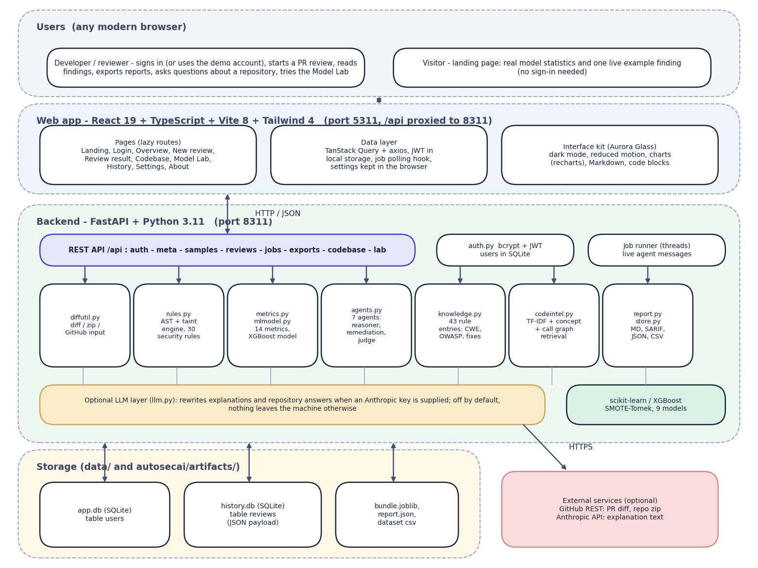

System Architecture
Layered architecture: browser, React app, FastAPI backend with the seven-agent engine, SQLite and model artefacts, optional GitHub and LLM calls
Dept. of CSE | Batch A11 | Final Review
10

Slide 11
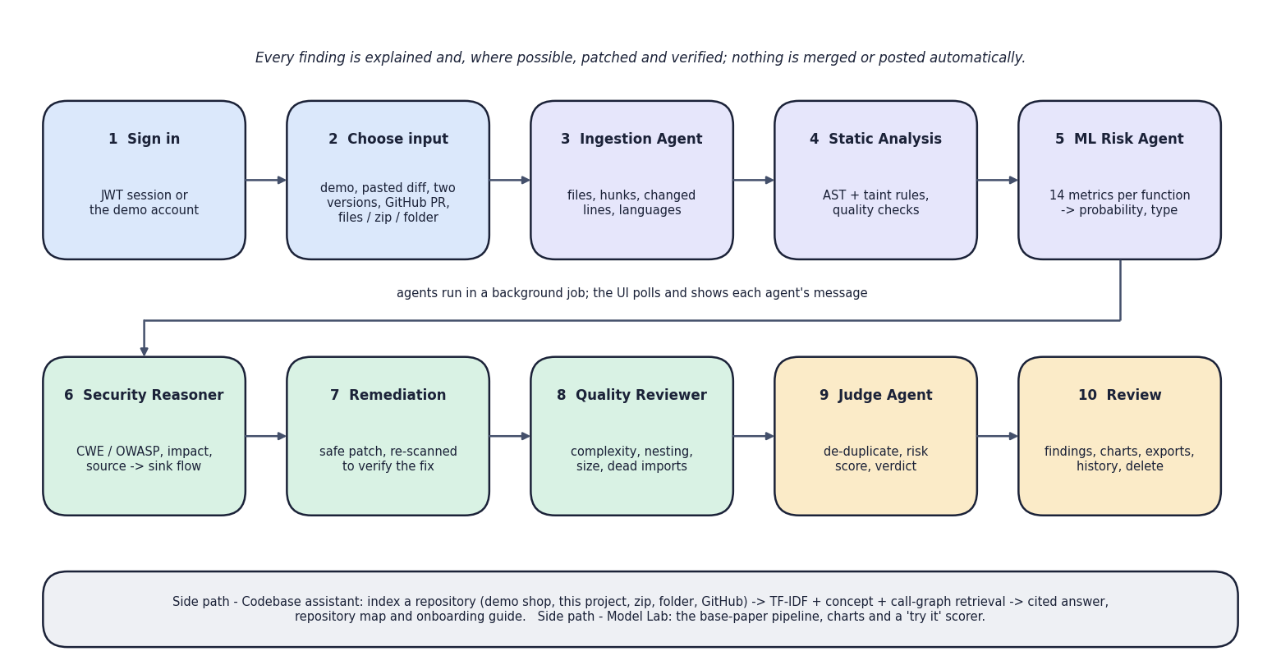

Methodology
End-to-end workflow: sign in, choose input, seven agents, review, export and history
Dept. of CSE | Batch A11 | Final Review
11

Slide 12
Dataset, Features & Models
Data: a generated Python corpus of 6,000 functions, 501 vulnerable (8.35%): benign filler, injected flaws of eight types, look-alike safe patterns and 1% label noise. The base paper's real C/C++ data is not available.
Split 75 / 25 stratified: 4,500 train, 1,500 test (125 vulnerable). SMOTE (k = 5) + Tomek links on the training part only: 8,232 rows.
Features: 14 AST metrics M1-M14 (M12-M14 added for taint-style flaws); seven selectors vote; k swept 5 to 14, k = 13 chosen; Min-Max scaling.
Models: Random Forest, Decision Tree, Logistic Regression, SVM, KNN, Naive Bayes, Gradient Boosting, XGBoost, soft-voting ensemble; a Random Forest classifies the vulnerability type.
Stored model: XGBoost (best F1). Training takes 31.7 s on a CPU.
Because the corpus is synthetic, scores show the pipeline works; they are not evidence about real pull requests.
Dept. of CSE | Batch A11 | Final Review
12
Notes:
The corpus is generated to resemble the base paper's imbalance; the metrics are measured from the real generated source code.

Slide 13
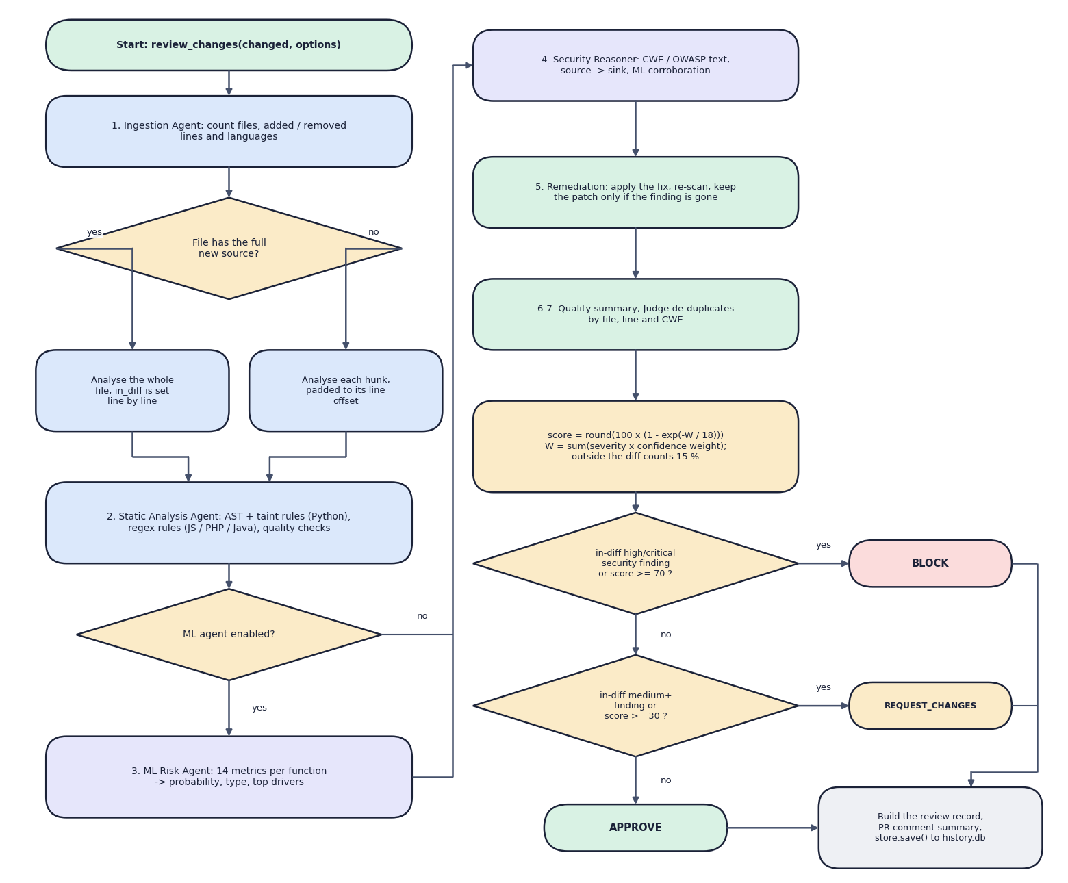

Decision Workflow
Core algorithm review_changes(): ingest, static analysis, ML risk, reasoner, remediation, quality, judge, score and verdict
Dept. of CSE | Batch A11 | Final Review
13

Slide 14
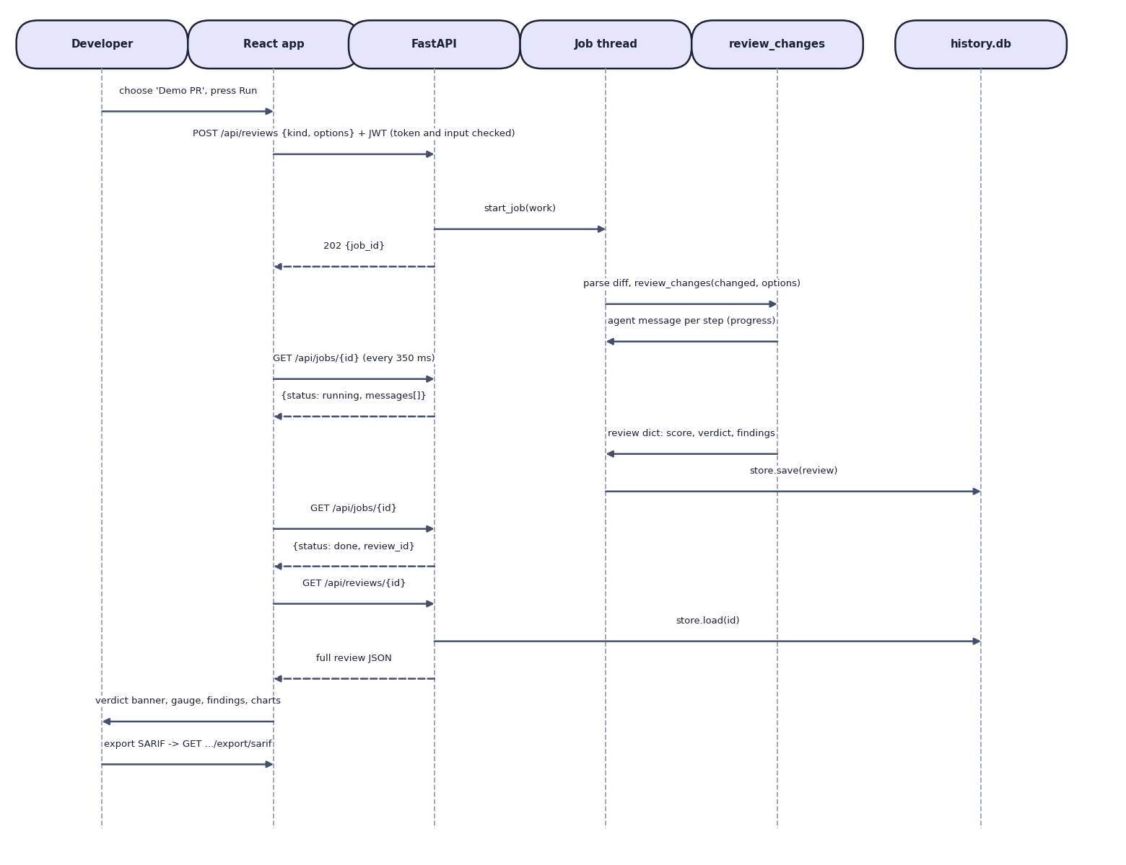

User–System Interaction
Sequence: start a review, poll the job with live agent messages, load the review, export a report
Dept. of CSE | Batch A11 | Final Review
14

Slide 15
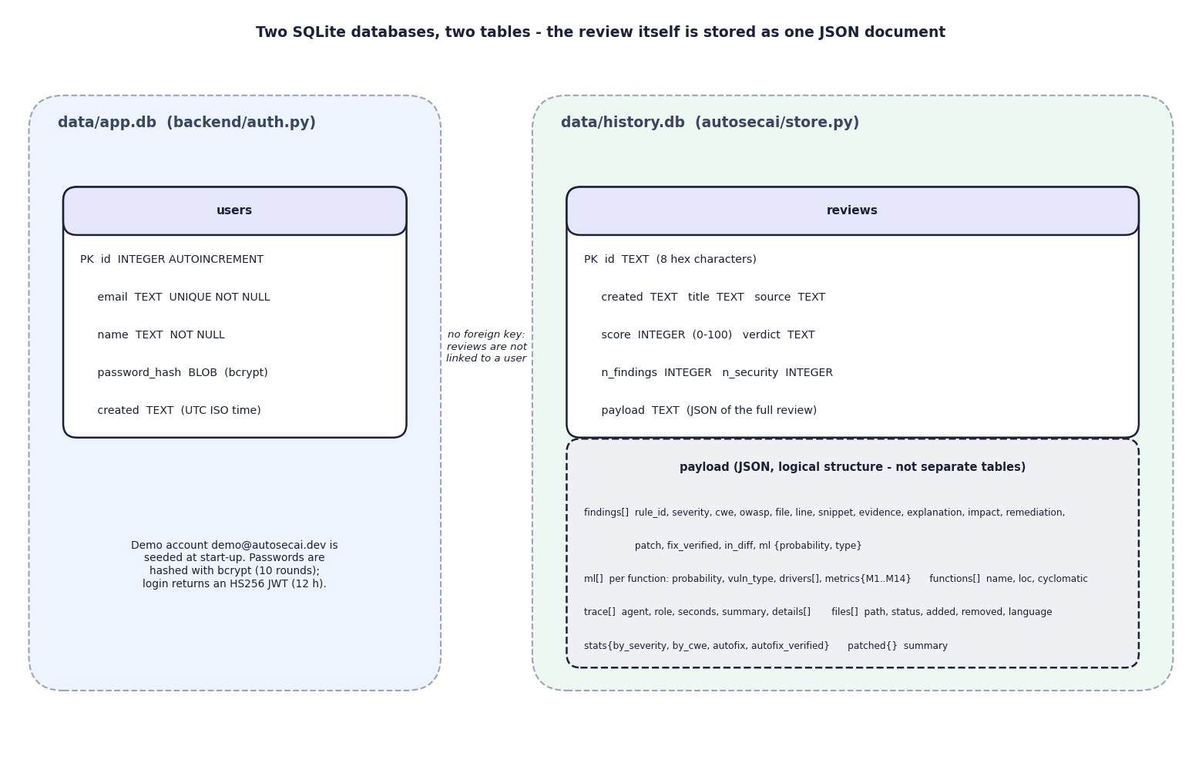

Database Design
Entity–relationship diagram: users (app.db) and reviews with a JSON payload (history.db)
Dept. of CSE | Batch A11 | Final Review
15

Slide 16
Implementation Highlights
Module | Implementation
Ingestion | Unified diffs, before/after versions, GitHub PR and repo zip, uploaded files, zip, local folder -> changed files with line ranges
Static analysis | Python AST visitor with taint tracking; 30 security rules mapped to CWE and OWASP; regex rules for JS, PHP, Java; 12 quality rules
ML risk | 14 metrics per function; XGBoost probability; Random Forest type; top drivers from the metric z-scores against safe code
Remediation | Parameterised SQL, list-form subprocess and other rewrites applied to a copy and re-scanned; kept only when the finding is gone
Judge | Score = 100 (1 - exp(-W / 18)); in-diff findings drive BLOCK, REQUEST_CHANGES or APPROVE
Codebase assistant | TF-IDF + concept scores + import / call graph with personalised PageRank; cited chunks, map and onboarding guide
Web app + API | React 19 + FastAPI, 25 routes, bcrypt + JWT, background jobs; 17 pytest tests
Dept. of CSE | Batch A11 | Final Review
16

Slide 17
Results – Model and Detector Performance
Measure | Result | Note
XGBoost (stored model) F1 | 0.851 | precision 0.942, recall 0.776, accuracy 0.977, AUC 0.937
Random Forest (base paper's choice) F1 | 0.826 | precision 0.882, recall 0.776, AUC 0.953
Other seven models, F1 range | 0.554 - 0.793 | Voting ensemble best of them; Naive Bayes lowest
Five corpus seeds, mean F1 | XGB 0.842, RF 0.814 | sd 0.006 / 0.010; headline is the best seed
Rule engine alone, F1 | 0.800 | precision 0.926, recall 0.704
Either rules or ML flags, F1 | 0.891 | precision 0.902, recall 0.880
Vulnerability-type accuracy | 0.651 | 8 types; deserialization F1 0.207, SQL injection 0.875
1,500 held-out functions (125 vulnerable) of a generated Python corpus; not comparable with real C/C++ code; rule scores are optimistic because the same team wrote the generator and the rules.
Dept. of CSE | Batch A11 | Final Review
17
Notes:
All numbers come from autosecai/artifacts/report.json and docs/measured_facts.json. Seed 7 reproduces the stored report exactly.

Slide 18
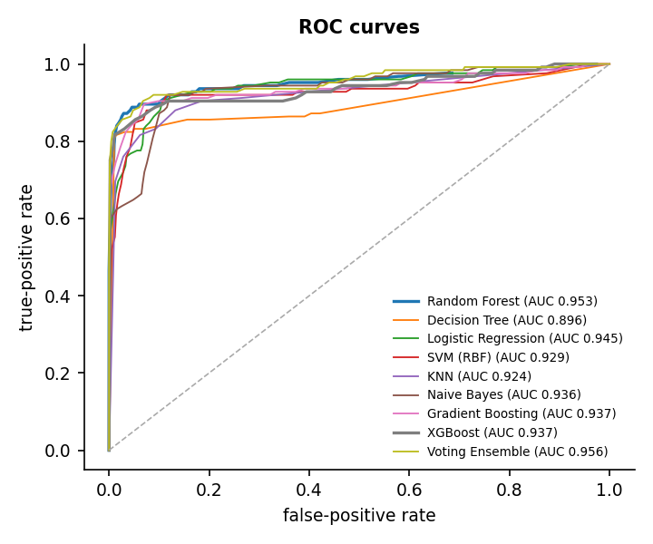
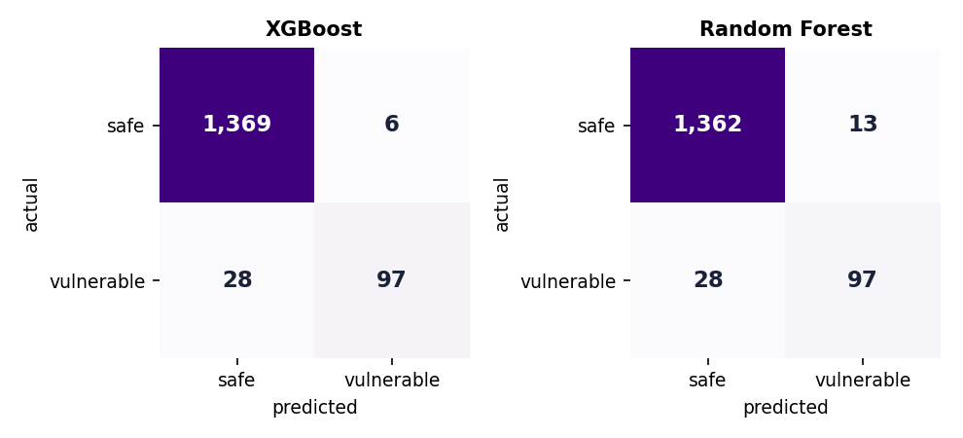


Confusion Matrix & ROC Curves
XGBoost: 6 false alarms, 28 missed, 97 caught of 125
ROC: AUC 0.937 XGBoost, 0.953 Random Forest
Dept. of CSE | Batch A11 | Final Review
18
Notes:
Rows are the truth. Recall is 0.776 for both models: about a fifth of the vulnerable functions are missed by the ML model alone, which is why the rule engine runs beside it.

Slide 19
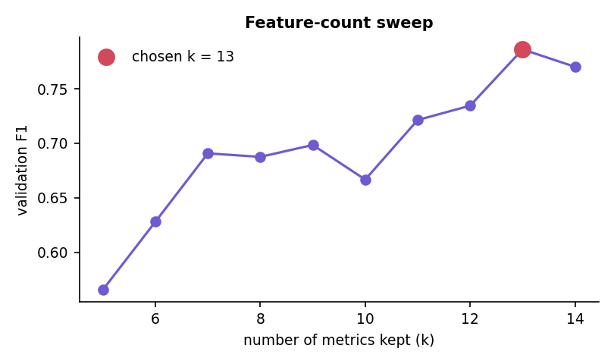
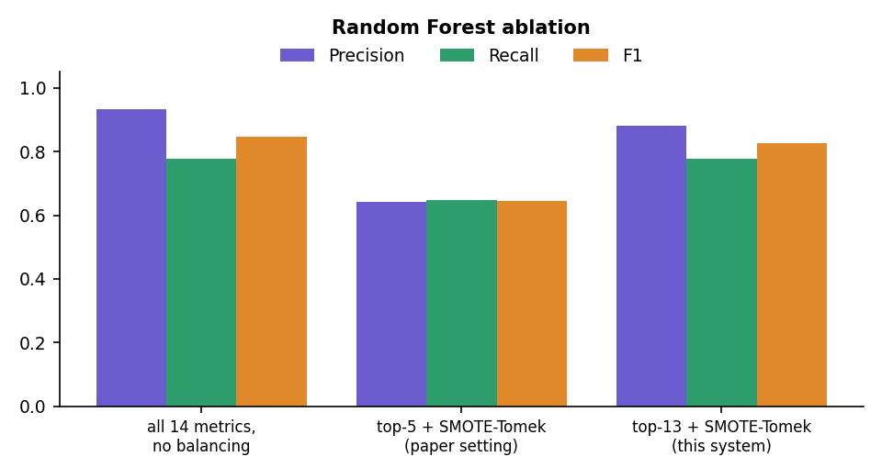


Parameter & Ablation Analysis
Feature count k: validation F1 0.566 at k = 5, 0.786 at k = 13
Random Forest: the paper's top-5 setting scores F1 0.645, all 14 metrics 0.847
Dept. of CSE | Batch A11 | Final Review
19
Notes:
The ablation changes the metric count and the balancing together, so their effects are confounded; the sweep shows the extra taint metrics matter. Balancing did not raise recall on this corpus.

Slide 20
Performance & Testing
Measurement | Result
Full review of the demo PR (20 runs) | median 0.375 s, p95 0.471 s; ML Risk Agent 0.3015 s, Remediation 0.0625 s, Static 0.008 s
Rule engine speed | 1.23 ms per function
HTTP latency (localhost) | health 1.2 ms, review list 3.2 ms, lab analyse 5.2 ms, login 60 ms (bcrypt), demo review job to done 436 ms
Codebase assistant | 8 of 12 questions put the right file first, 11 of 12 in the top 3; index 14 ms, answer 2 ms (small demo repo)
Automated tests | 17 pytest tests pass (10 engine, 7 API); 16 of 16 API smoke checks; 22 of 22 browser flows, 0 console errors
Build and layout | strict TypeScript + Vite build passes; no horizontal overflow at 360 and 768 px, light and dark
Not measured | precision on real reviewed PRs, other scanners, LLM text mode, real GitHub PR fetch, load, user study
Dept. of CSE | Batch A11 | Final Review
20
Notes:
Timings are on an i5-12500 with 15.7 GB RAM and no GPU, measured when the machine was idle.

Slide 21
Comparison with Base Paper (context only – different datasets)
System | Data | Method | Output | Reported / measured | Extras
Base paper [1] | 21,759 C/C++ functions, 10 real projects, 275 vulnerable | 14 metrics, selectors, SmoteTomek, 9 models | Vulnerable or not; type | Random Forest F1 0.961, accuracy 0.96 | Metric importance
Sphinx [2] | Pull-request review comments | LLM trained with checklist rewards | Review comments | Up to 40% higher checklist coverage | Benchmark
AutoSecAI | Generated Python corpus: 6,000 functions, 501 vulnerable | AST / taint rules + 14-metric XGBoost + 7 agents | Verdict, explained findings, verified patches | ML F1 0.851; rules 0.800; either 0.891 | Codebase assistant, exports, web app
Different language, data origin and class balance: the scores are not comparable and we do not claim to beat the paper's F1 of 0.961. The comparison is of approach.
Dept. of CSE | Batch A11 | Final Review
21

Slide 22
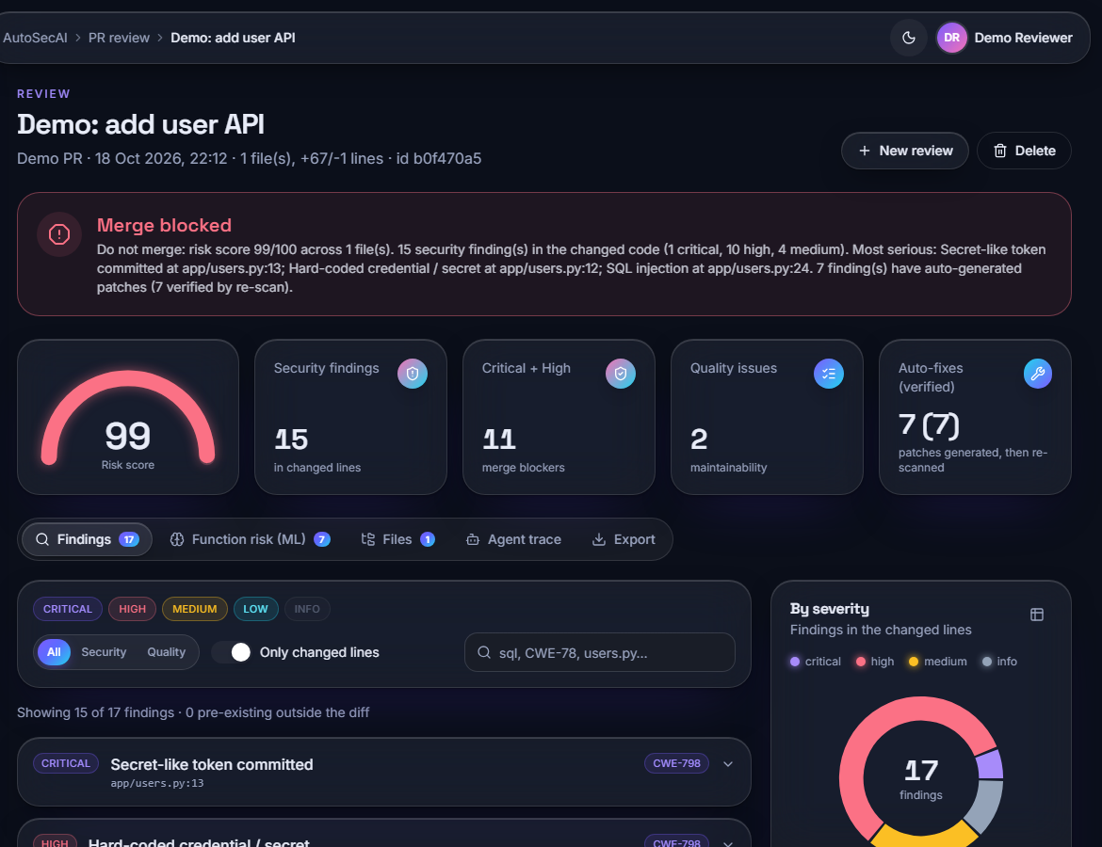
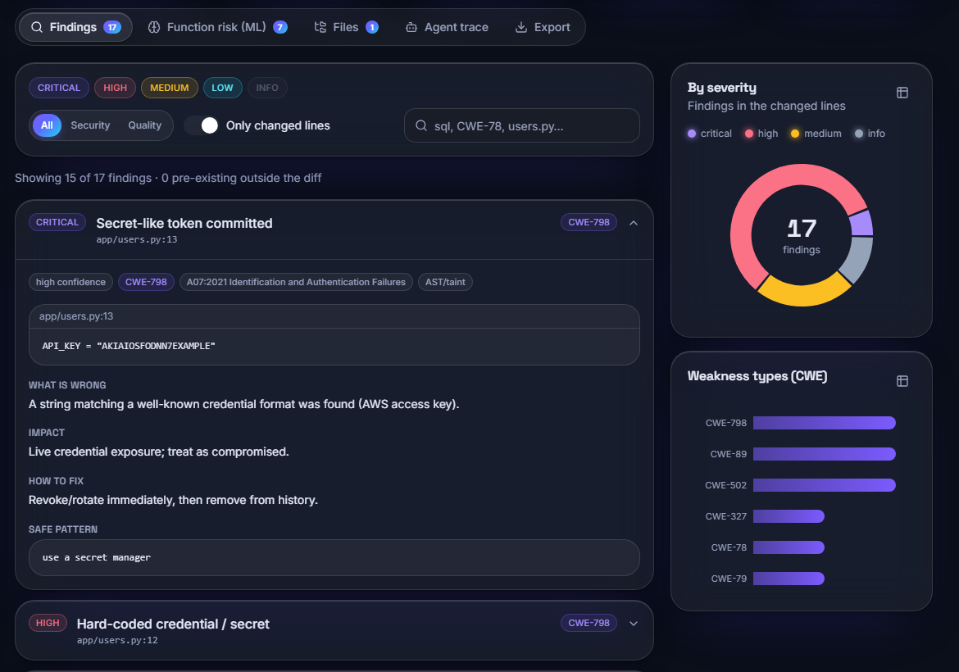


Output – Review Verdict and Findings
BLOCK: risk 99, 15 security findings, 7 verified auto-fixes
Findings with CWE, explanation, impact and fix
Dept. of CSE | Batch A11 | Final Review
22

Slide 23
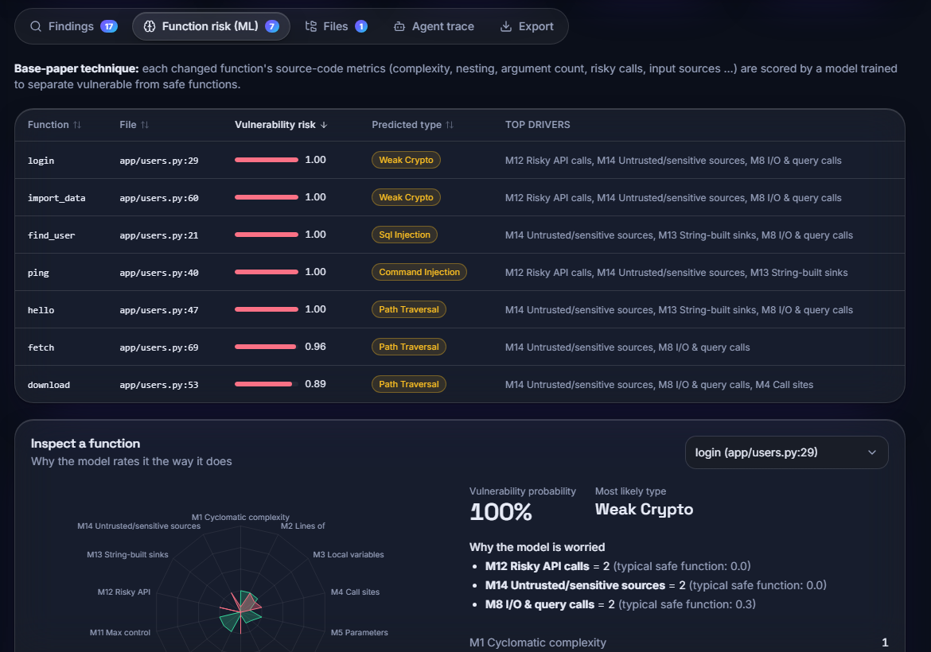
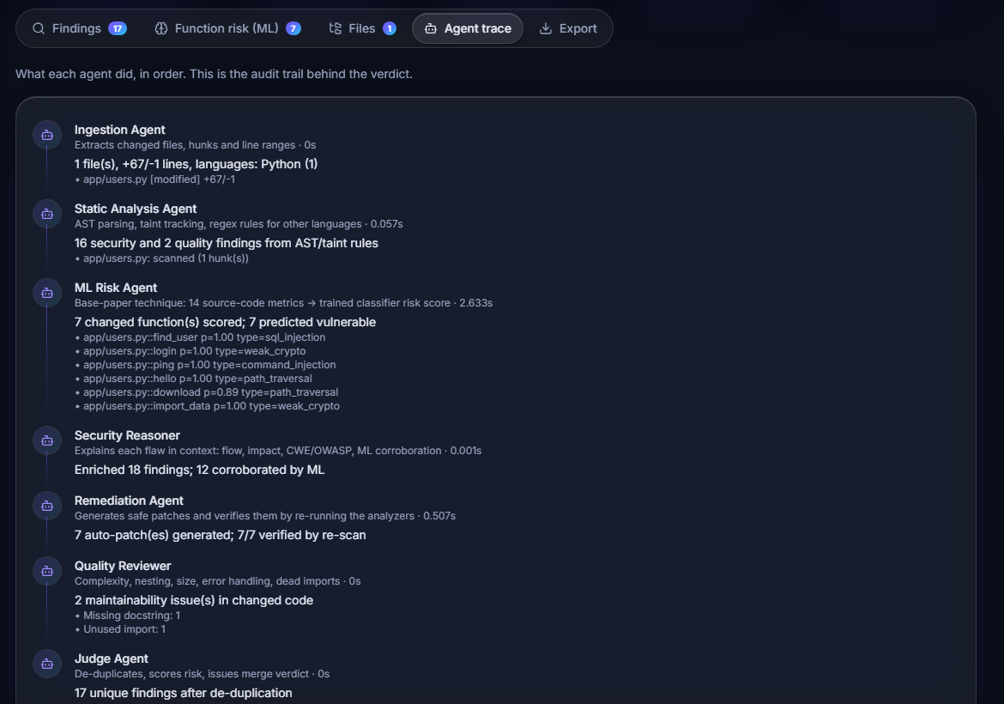


Output – Function Risk and Agent Trace
ML risk per changed function with the metrics that drive it
Audit trail: what each of the seven agents did
Dept. of CSE | Batch A11 | Final Review
23

Slide 24
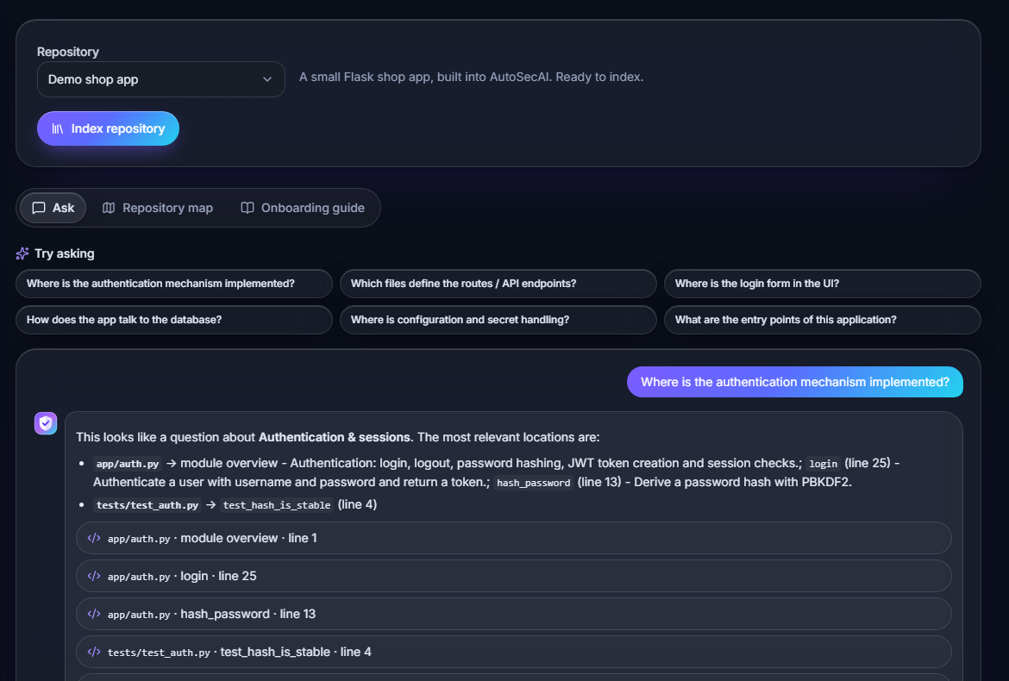
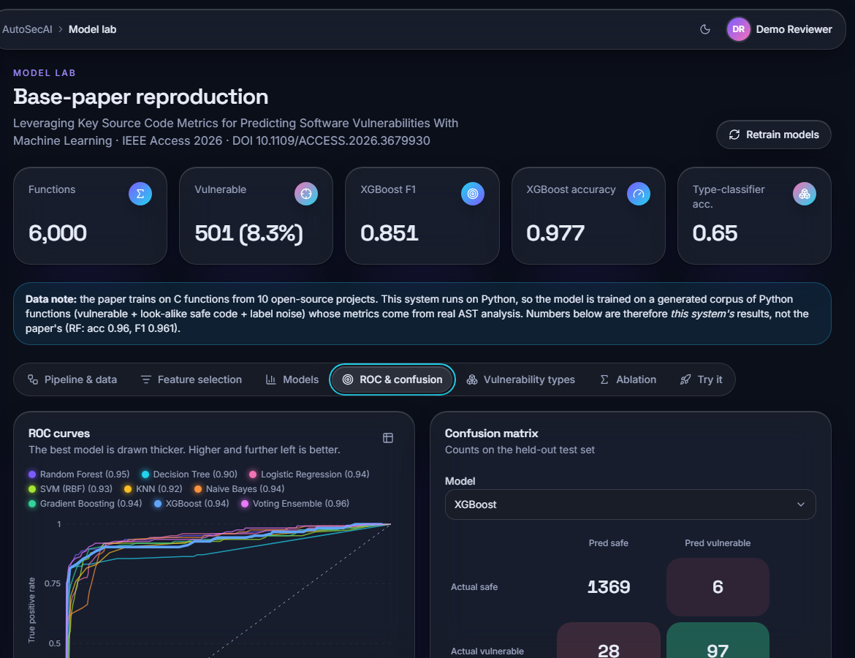


Output – Codebase Assistant and Model Lab
Where is the authentication mechanism implemented?
Model Lab: base-paper reproduction, ROC and confusion matrix
Dept. of CSE | Batch A11 | Final Review
24

Slide 25
Conclusion
Built AutoSecAI: a seven-agent pull-request reviewer that explains findings, offers verified patches and gives a verdict, plus a repository assistant and a web application.
Stored XGBoost model F1 0.851 on 1,500 held-out functions of a generated corpus (five-seed mean 0.842); rule engine 0.800; either detector 0.891.
A full demo review runs in 0.375 s; the demo PR scores 99/100 and BLOCK with 7 of 7 patches verified; 17 pytest tests, 16 API checks and 22 browser flows pass.
Limits: synthetic training data; Python-only deep analysis; no labelled real-PR benchmark; no comparison with other scanners; LLM text mode and real GitHub fetch untested; reviews are not scoped to a user.
Dept. of CSE | Batch A11 | Final Review
25

Slide 26
Future Scope
Collect manually reviewed pull requests and measure the precision and recall of each agent against them.
Train on real labelled vulnerable Python code; compare with Bandit, Semgrep or CodeQL on the same code.
Extend the AST and taint analysis beyond Python; post comments back to GitHub automatically.
Evaluate the optional LLM explanation mode; add a vector-embedding retriever to the codebase assistant.
Per-user review history, a hosted database, rate limiting, load testing and a user study.
Dept. of CSE | Batch A11 | Final Review
26

Slide 27
References
[1] B. K. E. Abbasi and A. Shameli-Sendi, "Leveraging key source code metrics for predicting software vulnerabilities with machine learning," IEEE Access, vol. 14, pp. 52610-52625, 2026, doi: 10.1109/ACCESS.2026.3679930.
[2] D. Zhang, S. Zhang, Z. Jin, J. Luo, S. Fu and E. Nallipogu, "Sphinx: Benchmarking and modeling for LLM-driven pull request review," arXiv:2601.04252, Jan. 2026.
[3] "Enhancing software security with CNN-LSTM hybrid model: Vulnerability detection," 2025 (listed in the batch literature survey; not independently retrieved).
[4] "Real-time AI code security auditing: Automated vulnerability detection and remediation through meta-experimental analysis," 2025 (listed in the batch literature survey; not independently retrieved).
[5] "Improving software security: A multi-modal framework for vulnerability detection using code simplification and meta-learning," 2025 (listed in the batch literature survey; not independently retrieved).
[6] "Advancing software security: DcodeBERT for automatic vulnerability detection and repair," 2024 (listed in the batch literature survey; not independently retrieved).
[7] H. Shahriar and M. Zulkernine, "Mitigating program security vulnerabilities: Approaches and challenges," ACM Comput. Surv., vol. 44, no. 3, pp. 1-46, Jun. 2012.
[8] Y. Shin and L. Williams, "Can traditional fault prediction models be used for vulnerability prediction?" Empirical Softw. Eng., vol. 18, no. 1, pp. 25-59, Feb. 2013.
[9] B. Chernis and R. Verma, "Machine learning methods for software vulnerability detection," in Proc. 4th ACM Int. Workshop Secur. Privacy Anal., Mar. 2018, pp. 31-39.
[10] F. Yamaguchi, M. Lottmann and K. Rieck, "Generalized vulnerability extrapolation using abstract syntax trees," in Proc. 28th Annu. Comput. Secur. Appl. Conf., Dec. 2012, pp. 359-368.
[11] R. Russell et al., "Automated vulnerability detection in source code using deep representation learning," in Proc. 17th IEEE Int. Conf. Mach. Learn. Appl. (ICMLA), Dec. 2018, pp. 757-762.
[12] Z. Li, D. Zou, S. Xu, X. Ou, H. Jin, S. Wang, Z. Deng and Y. Zhong, "VulDeePecker: A deep learning-based system for vulnerability detection," arXiv:1801.01681, 2018.
Dept. of CSE | Batch A11 | Final Review
27

Slide 28
THANK YOU
Questions & Suggestions
Dept. of CSE | Batch A11 | Final Review
28
Notes:
Thank you. Questions are welcome.

