Slide 1
ForgetSafe
REVIEW 2 · DESIGN, METHODOLOGY AND PROGRESS
Privacy-Preserving Machine Unlearning in Federated LLMs: A Certified Right-to-Be-Forgotten Framework
Presented by
Under the guidance of
G.SHASHANK 23K91A6761
B.SATHISH 23K91A6719
G.RAKESH 23K91A6759
B.AKHIL 23K91A6721
[GUIDE NAME], [DESIGNATION]
Department of Computer Science and Engineering (Data Science)
[COLLEGE NAME] · Batch A9 (CSE-DS, Section A) · [ACADEMIC YEAR]
Notes:
Review 2 covers the design, methodology and progress of ForgetSafe.

Slide 2
Contents
01
02
03
04
Recap
Architecture
Methodology
Dataset
05
06
07
08
Preprocessing
Model and training
Decision logic
Data flow, modules, database
09
10
11
12
Technology stack
Progress
Preliminary results and screens
Testing, challenges, next steps
Notes:
Twelve parts: recap, architecture, methodology, dataset, preprocessing, model and training, decision logic, data flow and database, technology, progress, results and screens, testing, challenges and next steps.

Slide 3


Recap: problem and proposed system
Problem
Proposed system
A client's influence stays in the federated model's parameters; retraining for every deletion request is impractical and heuristic unlearning gives no proof.
Subtract the client's tracked update, bound the release with differential privacy, verify, and record the request in a SHA-256 ledger: Python API plus React UI.
Training: 5 clients
Clip + noise + aggregate
Subtract client update
Verify: attack, utility
Certificate + ledger
Notes:
Recap of Review 1. The base paper recorded in the batch files is a sign-language survey whose review method is adopted; the technical neighbours are [2] to [4].

Slide 4
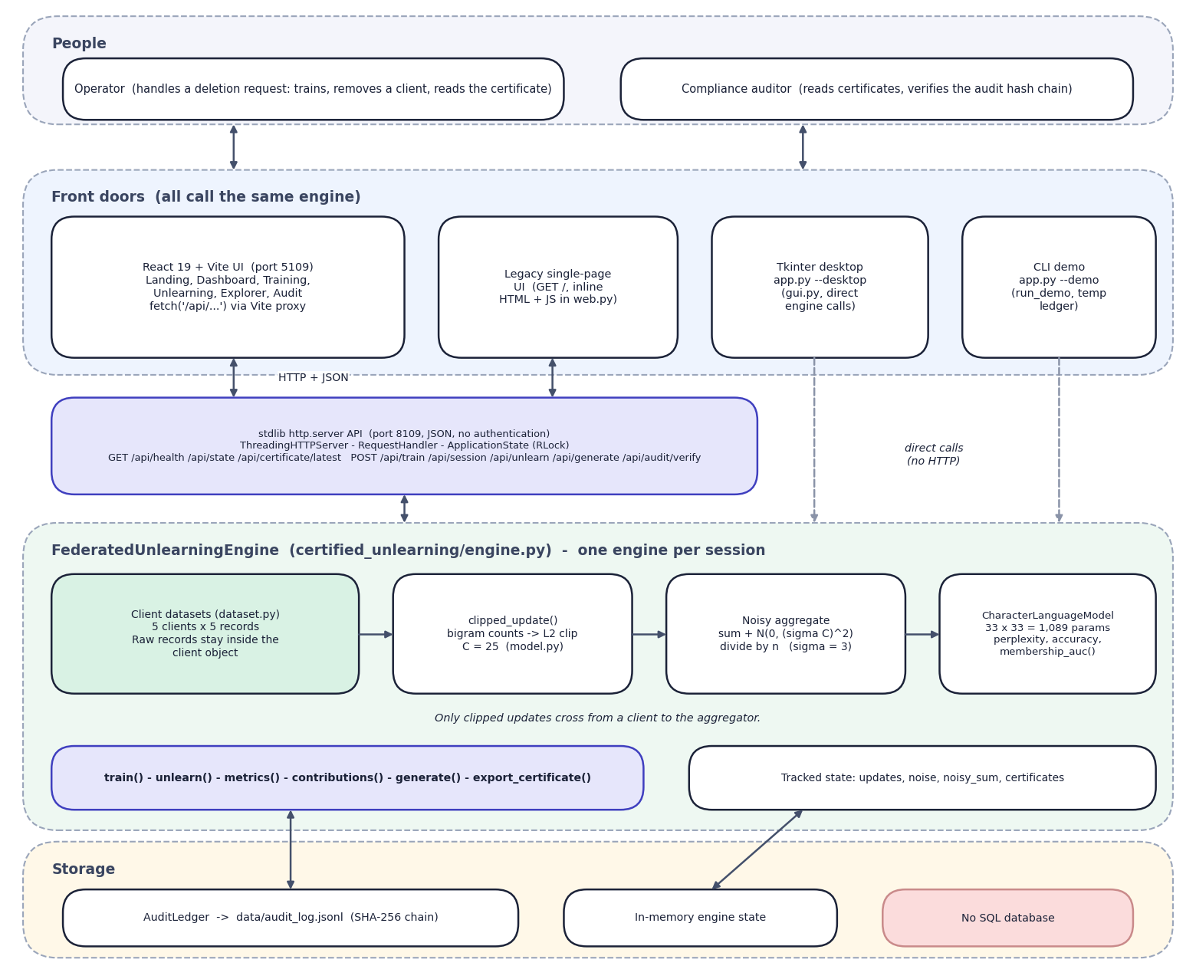
System architecture
Client: React 19 + Vite 8 (port 5109); the dev server proxies /api to the API.
API: Python standard-library http.server (port 8109), 9 routes (8 JSON endpoints and the legacy page); one shared engine behind a lock.
Engine: FederatedUnlearningEngine with train(), unlearn(), metrics() and generate().
Model: character-bigram LM (1,089 parameters) in the product; a 137,151-parameter GRU with LoRA-style adapters in the neural study.
Record: membership AUC, perplexity, reference recomputation and a SHA-256 hash-chained ledger (data/audit_log.jsonl).
Notes:
Everything runs on one machine with no third-party Python package. There is no SQL database: state is in memory plus the JSONL ledger.

Slide 5
Methodology: end-to-end workflow
Load 5 client corpora
Bigram update per client
L2-clip to C = 25
Sum + Gaussian noise
Unlearn: subtract update
Verify: AUC, utility
Certificate + ledger
Tracked updates
Verification stack
Reproducible
Clipped client updates are stored, so one can be subtracted later without touching raw records.
Membership AUC, public-set perplexity and accuracy, a retention floor of 70 %, and a retained-only recomputation.
Fixed seeds; four run_*.py scripts regenerate every experiments/*/metrics.json (product, synthetic corpus, neural, testing).
Notes:
Seven steps from the client corpora to the certificate. The recomputation re-uses the same stored noise, so it is exact by construction; an independent fresh-noise retrain comparison was added to the evaluation.

Slide 6
Dataset and input sources
Source (all synthetic) | Size | Use
Product corpus | 5 clients x 5 sentences (25 records); 5 public + 5 non-member | The app: training and removal
Synthetic-corpus study | 20 domains x 200 train / 200 held-out; 300 public | Real engine at realistic size
Neural-study corpus | 8 domains x 150 train / 150 held-out; 6,000 public | GRU + LoRA-style adapters
Bigram parameters | 33 symbols; 33 x 33 = 1,089 | Bigram count vector
External data | None: seeded grammars, offline | No licence issue
Notes:
Three synthetic data sources: the product's built-in corpus (certified_unlearning/dataset.py), a seeded 20-domain grammar corpus for the real engine, and a seeded 8-domain corpus for the neural study. In the product every raw update norm (25.2 to 28.2) exceeds C, so all five updates are clipped.

Slide 7



Data preparation and features
Text normalisation
Update vector
Clipping and noise
normalize_text(): lower-case; characters outside the 33-symbol alphabet become spaces; whitespace collapsed; ^ and $ mark the start and end of each record.
Counts of adjacent symbol pairs form a 1,089-dimensional vector per client. Raw L2 norms range 25.2 to 28.2.
Each vector is scaled to norm at most C. Product: C = 25 (scales 0.886 to 0.991). At realistic size raw norms are about 1,239, so C = 25 would shrink updates 50x: the studies use C = median raw norm. Noise std = sigma x C per coordinate.
Notes:
Preparation turns each client's sentences into one clipped update. In the product the noise standard deviation is 75 per coordinate while a clipped update has norm 25, so the noise dominates at the default setting. On 200-sentence clients the raw update norm is about 1,239 and the product's C = 25 scales every update by 0.02; the synthetic-corpus and neural studies therefore set C to the median raw norm.

Slide 8
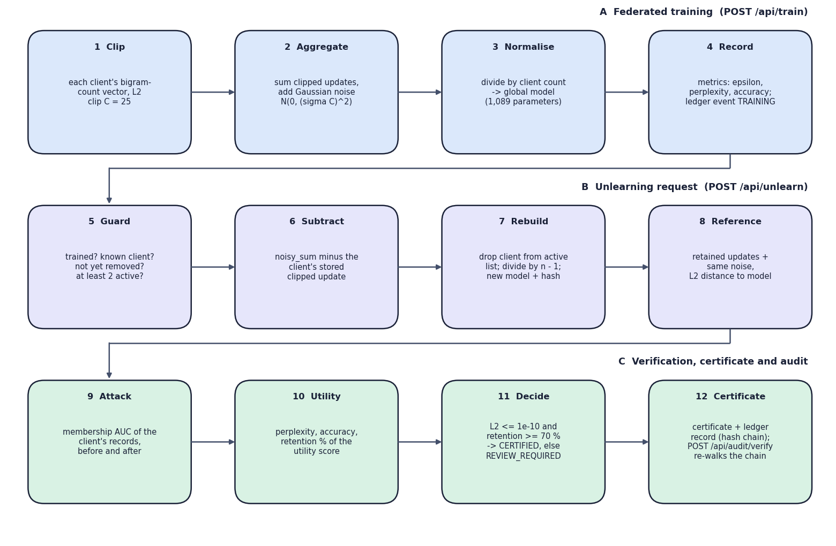
Model and aggregation
Component | Detail
Product model | Character-bigram LM, 1,089 parameters (33 x 33), pure Python
Neural study | GRU 137,151 parameters, frozen
Adapter per client | rank 64, 14,272 parameters
Release | (sum + noise) / n, same for both
Product: bigram parameter vector as the adapter update. Neural study: PyTorch GRU with LoRA-style adapters on synthetic text, CPU only.
Notes:
The product's model is a bigram language model whose parameter vector stands in for an adapter update. The neural study applies the same clip, noisy-sum and subtraction steps to the adapter parameters of a small GRU (137,151 parameters, rank-64 adapters of 14,272 parameters) trained on synthetic text; it ran in about four minutes on the CPU.

Slide 9
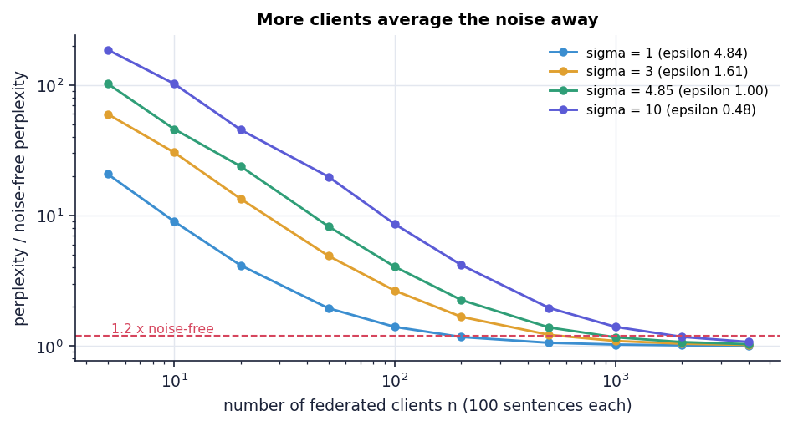
Training configuration
Setting | Value
Clients | 5 in the product; 5-20 and 8 in the studies
Clip norm C | 25 in the product; median raw norm in the studies
Noise multiplier sigma | 3 (std 75 per coordinate); sweeps 0 to 10
delta | 1e-5
Reported epsilon | 1.6149 at sigma 3
Seeds | 2026 (product); 5 to 50 seeds per study
Certified if | L2 <= 1e-10 and retention >= 70 %
Synthetic corpus: perplexity relative to the noise-free model against federation size; sigma 4.85 (epsilon 1.00) needs about 1,000 clients to come within 1.2x
Notes:
Epsilon = sqrt(2 ln(1.25/delta)) / sigma. The classical Gaussian bound is valid only for epsilon < 1, which needs sigma above 4.845; the product's default sigma = 3 is outside that range. Because the noise is added once to the sum and divided by n, a larger federation dilutes it: on the synthetic corpus (100 sentences per client, C = median norm) the perplexity falls to within 1.2x of the noise-free model from about 1,000 clients at sigma 4.85.

Slide 10
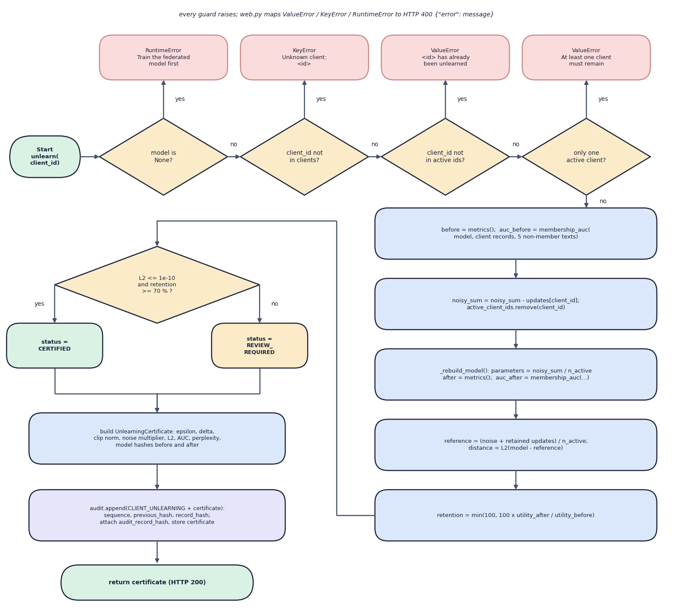
Decision logic
Certified or review
CERTIFIED if reference L2 is at most 1e-10 and retention is at least 70 %, else REVIEW_REQUIRED. In 250 requests all were CERTIFIED.
Refused requests
Before training, unknown client, repeat removal and removing the last client return HTTP 400 with a message.
Utility score
0.65 x accuracy + 0.35 / (1 + ln(1 + perplexity)); retention = after / before x 100, capped at 100.
Notes:
The flowchart follows FederatedUnlearningEngine.unlearn(). The retention threshold is a demonstration floor, not a legal criterion.

Slide 11
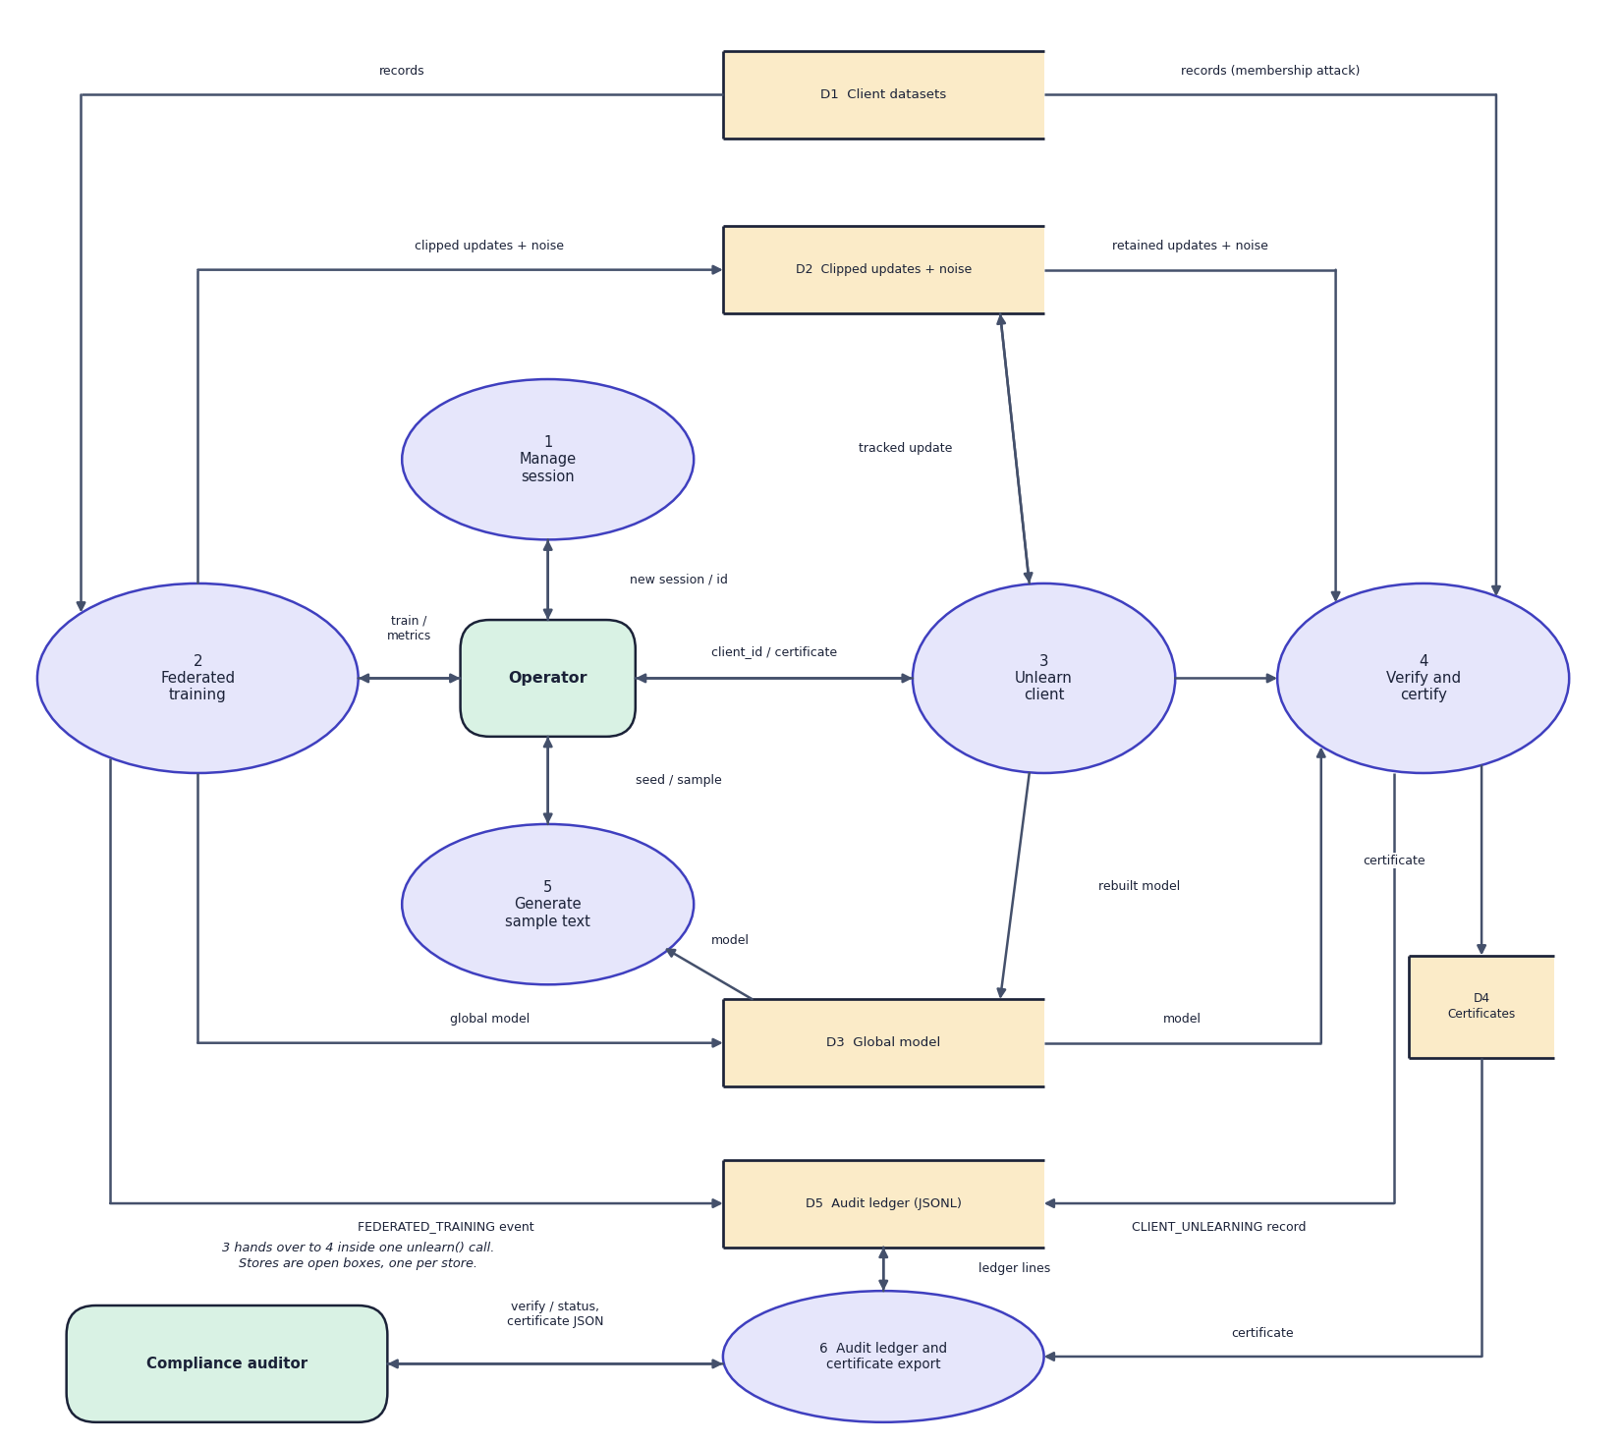
Data flow and modules
Module | Responsibility
engine.py | train(), unlearn(), certificate, metrics, reference recomputation
model.py, dataset.py | bigram update and clipping, perplexity, accuracy, membership AUC; corpora
audit.py, web.py | hash-chained ledger and verify(); JSON API and legacy page
DFD level 1: six processes, five stores
Notes:
Data flow of the training and unlearning requests and the modules that implement them.

Slide 12
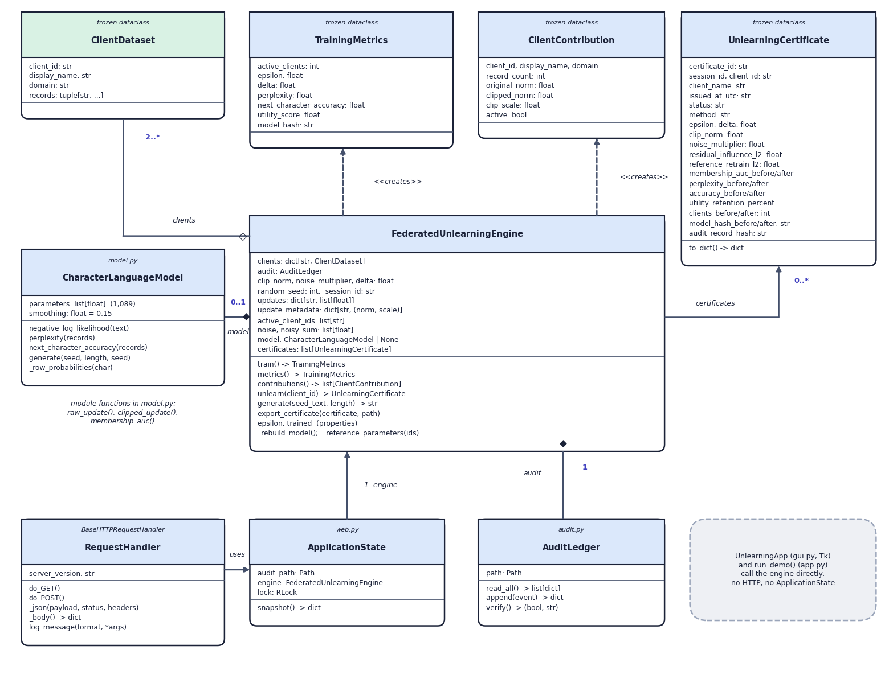
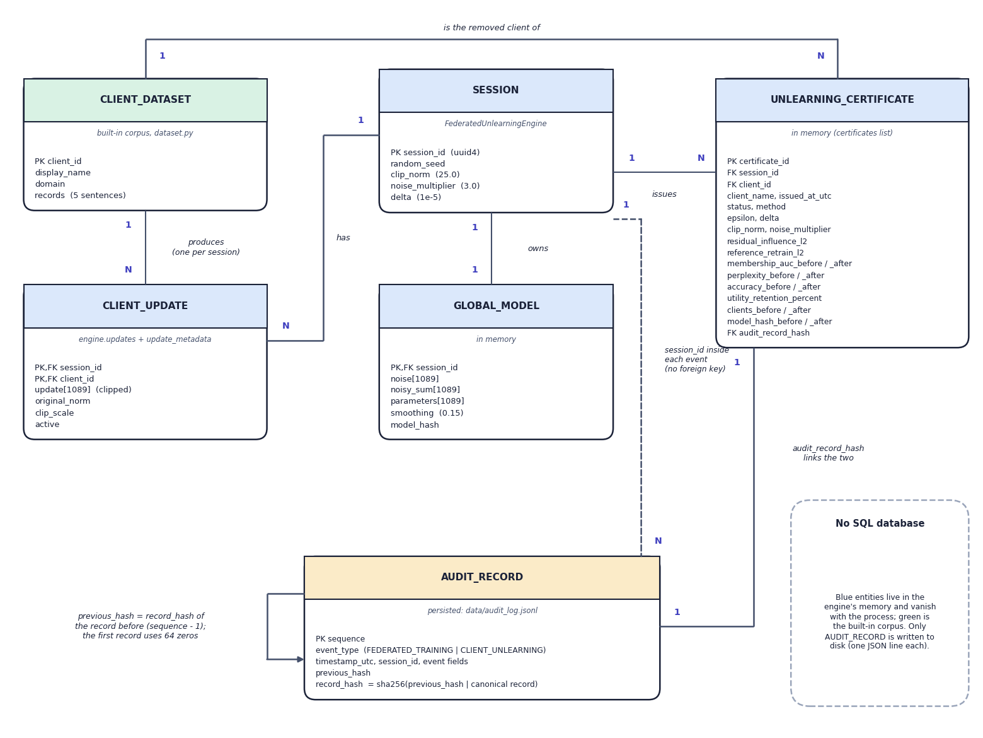
Data model and UML (no SQL database)
UML class diagram (left) and ER view of the data model (right); only the audit record is persisted
Notes:
ForgetSafe has no SQL database. Engine state lives in memory; certificates and training events are appended to data/audit_log.jsonl, which survives restarts and new sessions.

Slide 13






Technology stack
Language
Engine and maths
Backend
Python 3.11 (standard library only), JavaScript
dataclasses, hashlib, json, math, random.gauss; no NumPy
http.server ThreadingHTTPServer, JSON API, RLock-guarded engine
Frontend
Desktop and CLI
Storage and tests
React 19, Vite 8, react-router 7, Recharts 3, Framer Motion, GSAP
Tkinter GUI (--desktop) and terminal demo (--demo)
JSONL ledger; unittest (5 tests), smoke test (14 checks), Playwright captures
Notes:
Versions are the ones in frontend/package.json. There is no third-party Python dependency and no external AI service.

Slide 14
Implementation progress
Component | Status
Federated training with clipping and noise | Completed
Tracked-update unlearning and certificate | Completed
Membership attack and utility metrics | Completed
SHA-256 ledger with verification | Completed
React UI (landing + 5 screens), legacy UI, Tkinter, CLI | Completed
Product measurements: 11 experiments, 12 charts | Completed
Synthetic-corpus and neural-adapter studies | Completed
Load, security-probe and acceptance studies | Completed
Privacy accountant, signed ledger, authentication | Planned
9
API routes (8 JSON + legacy page)
5
unit tests pass
14/14
smoke-test checks pass
Notes:
All planned features and studies are done. The engineering items for the next stage are a privacy accountant, a signed ledger and authentication.

Slide 15
Preliminary results: attack AUC against noise
0.99 → 0.54
bigram attack AUC with no noise, before → after removal
0.78 → 0.53
neural adapters, client-level AUC (fresh retrain 0.53)
1,000
clients for epsilon < 1 with a useful model (synthetic corpus)
Notes:
At sigma 3 the attack is already near chance before removal (0.52 +/- 0.22), so there is little to remove. Without noise the attack is near-perfect and removal brings it to about 0.54. A fresh-noise retrain is as far from the unlearned model as two retrains are from each other: 875 versus 881 at sigma 3. At sigma 0.1 the useful model has AUC 0.86 before and 0.55 after. The neural adapter study (8 synthetic clients, GRU with 14,272-parameter adapters) shows the same: client-level AUC 0.78 before, 0.53 after removal, 0.53 for a fresh retrain; sigma 4.85 with 100-sentence clients needs about 1,000 clients for a useful model.

Slide 16
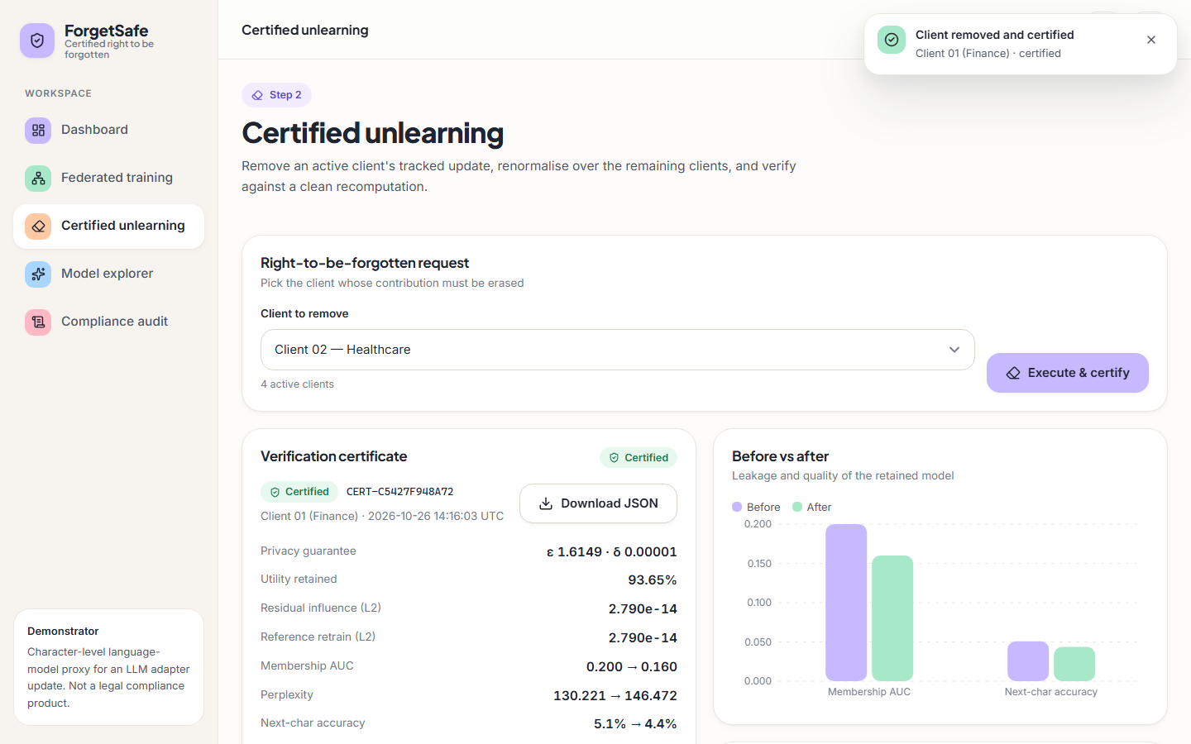
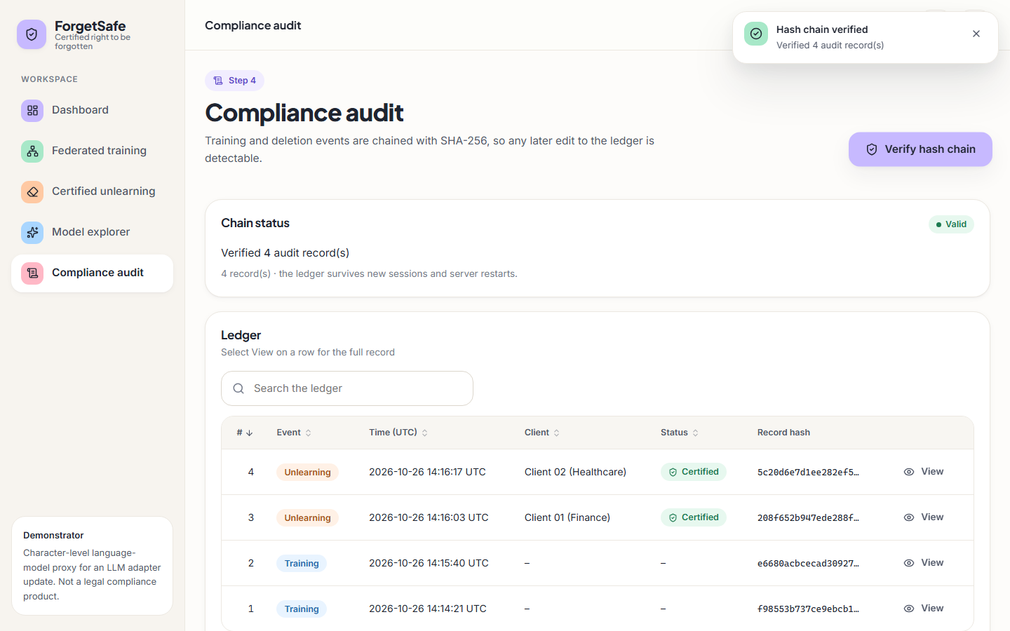
Output screens
Certificate for Client 01 (Finance): certified, 93.65 % utility retained, AUC 0.200 → 0.160
Compliance audit: 4 ledger records, hash chain verified valid
Notes:
Real captures of the running application (seed 2026, trained through the UI, Finance removed, then Healthcare). The ledger also holds two training events from earlier capture sessions.

Slide 17
Testing and observations
Test group | Count | Result
Unit tests (unittest) | 5 | 5 passed
Smoke test on the live API | 14 | 14 passed
Load, 1 to 64 concurrent clients | 4 scenarios | errors only from 16 clients up
Security probes | 58 | 35 handled, 15 noted, 8 defects
Scripted synthetic-user acceptance | 20 journeys | 20 passed all steps
Audit tamper attacks | 7 | 4 detected, 3 not
Audit chain catches edits, deletions and re-ordering (4 of 7 attacks); tail truncation, a full re-hash forgery and an appended forged record pass, and an emptied ledger verifies as valid.
Races: 32 simultaneous removals of one client gave 1 success and 31 refusals; 16 simultaneous trainings left a valid 16-record chain; a 2,000-request soak had 0 errors.
/api/state saturates near 86 requests/s because it re-reads the ledger; medians: train 36 ms, unlearn 58 ms.
8 security defects (no read timeout, POST open to cross-site requests, Host unchecked, connection bursts refused, no authentication) are listed with their fixes under next steps.
Acceptance is scripted (49 certificates checked, 0 console errors), not a human study.
Notes:
Load: 1, 2, 4, 8, 16, 32 and 64 concurrent clients on 127.0.0.1 against health, state, generate and a mixed train/unlearn workload. Security: 58 synthetic malicious or malformed requests, classified as handled, noteworthy or defect. Acceptance: 20 randomised Playwright journeys (desktop and 390 px phone, light and dark, some cancelling the first dialog). Latency measured on an i5-12500; the numbers shift between runs.

Slide 18



Challenges and corrective actions
Noise swamps the model
Certificate is an identity
Epsilon outside classical range
At sigma 3 perplexity is 142 +/- 28 against 32 for a uniform model; accuracy about 4 %.
The reference re-uses the stored noise (L2 about 1e-14). A fresh-noise retrain study: 875 versus 881.
Reported epsilon 1.61 exceeds 1; the bound needs sigma above 4.845. With 5 clients a useful model needs sigma 0.1 or less; with about 1,000 clients sigma 4.85 works.
Clip norm C = 25 is 50x too small
Ledger is tamper-evident only
API hardening
At 200 sentences per client raw norms are about 1,239; C = 25 scales them by 0.02. The studies set C to the median raw norm.
4 of 7 attacks detected; truncation, re-hash forgery and forged append are not; an emptied ledger verifies; one garbage line makes /api/state return 500.
8 defects in 58 probes: no read timeout, cross-site POST accepted, Host unchecked, connection bursts refused, no authentication.
Notes:
Six findings from the measurement suite and the testing studies, each backed by experiments/*/metrics.json and docs/REPORT_FACTS.md. The positive result that goes with them: epsilon below 1 and a useful model coexist once the federation is large (about 1,000 clients on the synthetic corpus).

Slide 19
Next steps
Honest certificate
Privacy accounting
Harden ledger and API
Report and demo
Put the fresh-noise retrain comparison in the certificate next to the same-noise recomputation, and re-draw the noise per release.
Add a privacy accountant and the exact analytic Gaussian bound [19] (it gives epsilon 1.27 at sigma 3, not 1.61); plan federations of about 1,000 clients for epsilon below 1.
Harden: sign or anchor ledger records, authenticate and CSRF-protect the API, add read timeouts, reject an emptied ledger and return a clean 400 for oversized bodies.
Complete the final report and demonstration; extend the adapter study to LoRA on a small pretrained language model with Flower.
Notes:
Engineering items for the final stage; each follows from a measured finding in the challenges slide. The exact analytic Gaussian value was computed for the report with the Balle and Wang calibration.

Slide 20
Thank you
Questions and suggestions are welcome.
Notes:
Thank you. Questions are welcome.

