Slide 1
HubOptima
REVIEW 2 · DESIGN, METHODOLOGY AND PROGRESS
Advanced Optimization in E-Commerce Logistics: Combining Matheuristics With Random Forests for Hub Location Efficiency
Presented by
Under the guidance of
CH.ARCHANA 23K91A6745
A.MEENAKSHI 23K91A6705
B.ARUN 23K91A6734
A.SAMPATH 23K91A6712
[GUIDE NAME], [DESIGNATION]
Department of Computer Science and Engineering (Data Science)
[COLLEGE NAME] · Batch A4 (CSE-DS, Section A) · [ACADEMIC YEAR]
Notes:
Review 2 covers design, methodology and progress of HubOptima.

Slide 2
Contents
01
02
03
04
Recap
Architecture
Methodology
Dataset
05
06
07
08
Data preparation
Forecaster and optimiser settings
Decision logic
Data flow, modules, data model
09
10
11
12
Technology stack
Progress
Preliminary results and screens
Testing, challenges, next steps
Notes:
Twelve parts, from a recap of Review 1 through design and methodology to progress, results, testing and next steps.

Slide 3


Recap: problem and proposed system
Problem
Proposed system
Hub networks are planned on a fixed demand with slow exact solvers or simple rules, so plans go stale as e-commerce demand moves between regions and seasons.
A Random Forest forecast feeds a capacitated hub-location model solved by a matheuristic, re-planned every month, behind a FastAPI + React application.
Order history, 90 regions
Random Forest forecast
Hub-location model
Matheuristic solve
KPIs, compare, re-plan
Notes:
Recap of Review 1: the problem and the proposed system as a five-step pipeline.

Slide 4
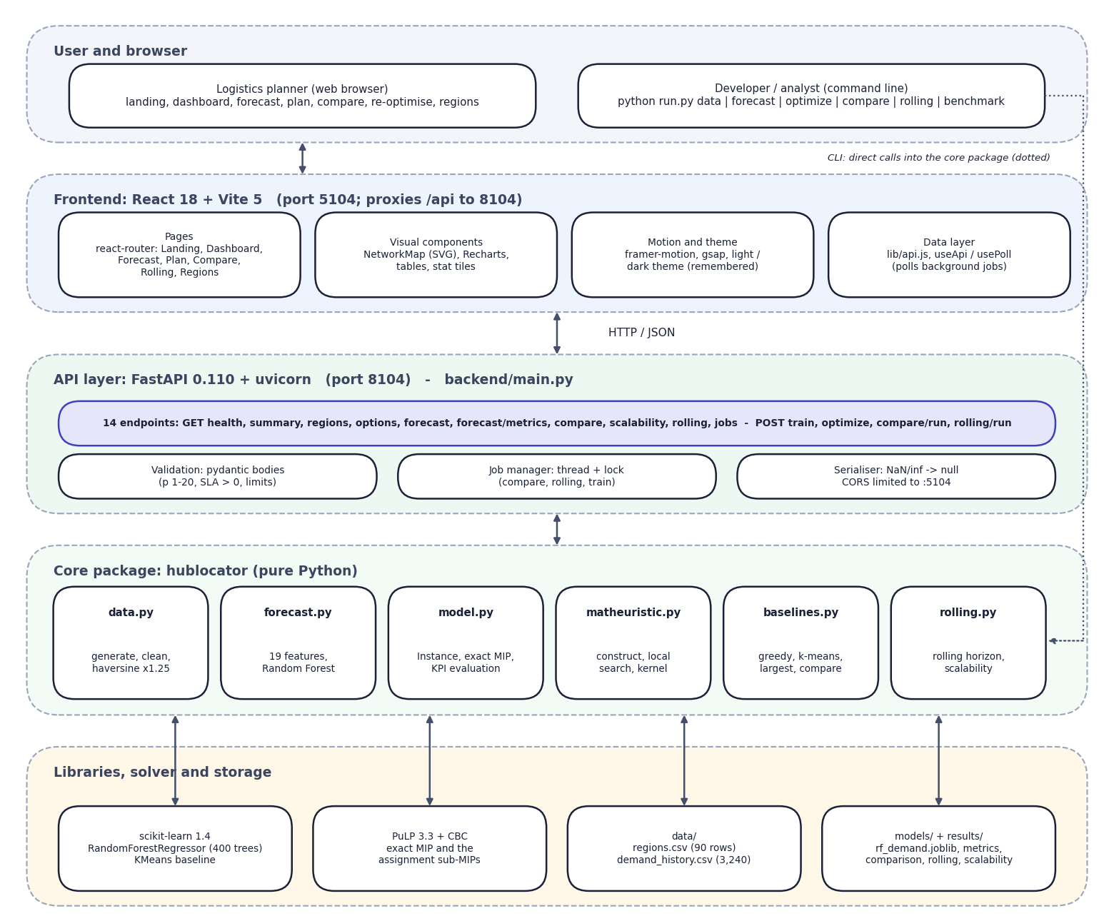

System architecture
Client: React 18 + Vite (port 5104): 7 pages, SVG network map, Recharts, light/dark theme.
API: FastAPI (port 8104), 14 endpoints, pydantic validation, background jobs in threads.
Core: hublocator package: data, forecast, model, matheuristic, baselines, rolling.
Solvers: scikit-learn Random Forest; PuLP with CBC for the MIPs.
Storage: CSV inputs, a joblib model and JSON results; no database.
Notes:
The browser talks only to the Vite server, which proxies /api to FastAPI. All science lives in the core package; the API only validates, runs jobs and serialises.

Slide 5
Methodology: end-to-end workflow
Load + clean data
19 features
Train Random Forest
Forecast next month
Build hub model
Matheuristic solve
Evaluate on realised demand
Plan, then judge
No look-ahead
Compare and adapt
Plans are built from the forecast and scored on the demand that actually occurred, so forecast error shows up as overloaded hubs.
For a past month the forecast uses only earlier data, and all rolling features are shifted by one month.
Five baselines run on the same instance; a rolling horizon re-forecasts and re-plans every month against a static plan.
Notes:
End-to-end workflow in seven steps. The key idea is to separate planning demand (forecast) from realised demand (what happened).

Slide 6
Dataset and input sources
Item | Facts | Use
Source | Synthetic, seed 42; no real data available | Training, planning
Regions | 90 = 30 cities + 60 satellite districts | Demand points and hub sites
History | 36 months, 2023-01 to 2025-12; 3,240 rows | Features, back-tests
Orders | 48.3 M in total; peak 2.38 M (Oct 2025) | Festival peak test
Split | Train 2023-04..2025-06 (2,430 rows); test 2025-07..12 (540) | Time-based evaluation
External data | None; generated by the project, no licence | Fully offline
Notes:
All data is synthetic and generated by a seeded script, so the same seed gives the same files. Festival peaks in Oct-Nov and a growth trend were built in; the model therefore learns a process the authors wrote down.

Slide 7



Data preparation and features
Cleaning
Features (19)
No leakage
De-duplicate (region, month); coerce orders to numbers; sort; interpolate gaps inside each region; derive year and month. The generated data has no gaps: the guards exist for real files.
Lags 1, 2, 3, 6, 12; rolling mean (3, 6) and std (3); trend; month, quarter, festival; promo and previous promo; population, tier, penetration; order value, return rate.
Every rolling window is computed on values shifted by one month; a past month is forecast only from earlier data; the split is by time, never random.
Notes:
Preprocessing is cleaning plus 19 engineered features; the shift(1) before every rolling window keeps the current month out of its own features.

Slide 8
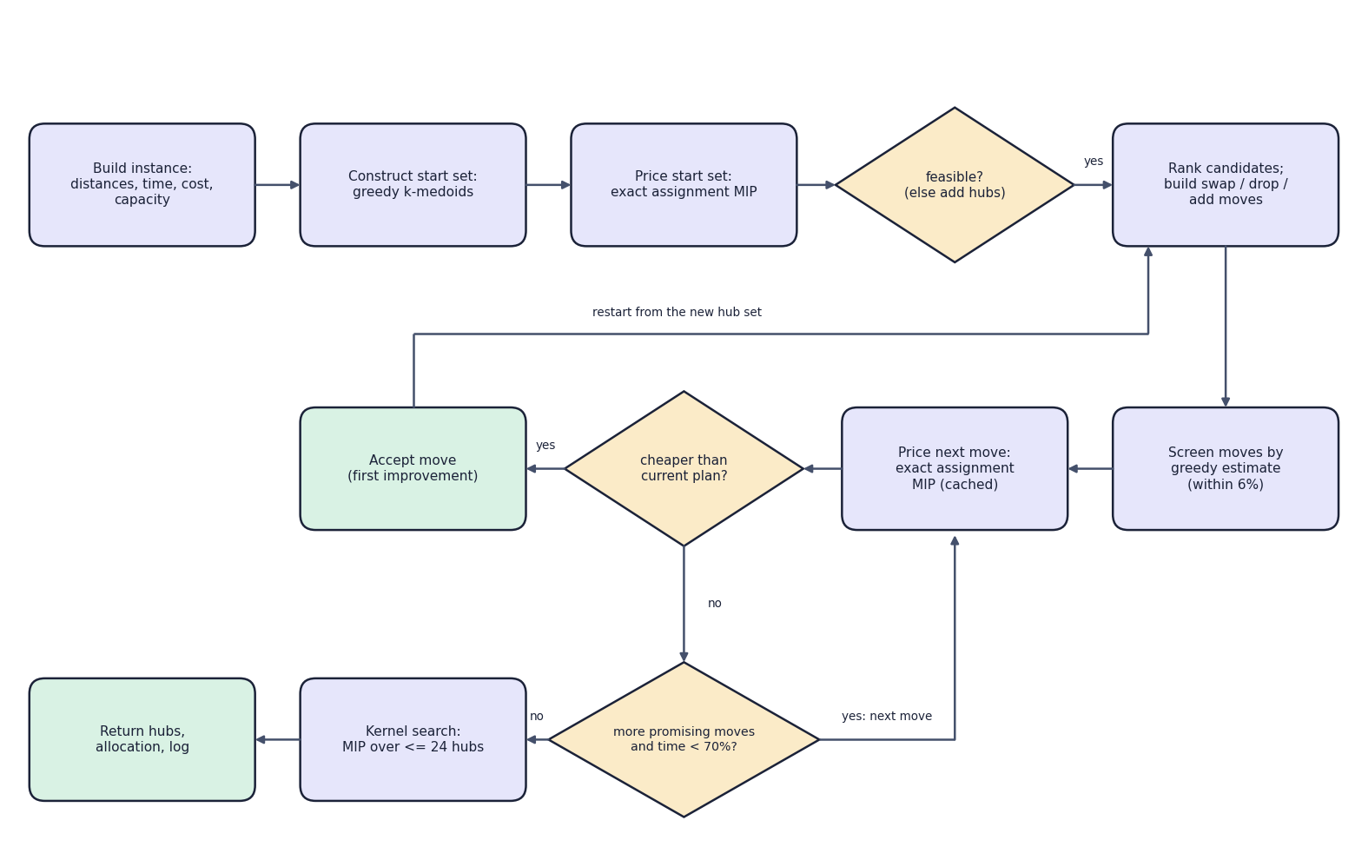

Model: forecaster and hub-location solver
Component | Detail
Random Forest | 400 trees, leaf 2, 60% features, seed 42
Hub MIP | 90 regions, p = 6, capacity 1.25
Matheuristic | construct, swap/drop/add, kernel (24)
Exact MIP | CBC via PuLP, time-limited
The 'model' is a Random Forest plus a mixed-integer model solved by CBC; no neural network is used.
Notes:
The flowchart is the real matheuristic. Fixing the hub set leaves a small assignment MIP that CBC solves exactly; the local search moves between hub sets.

Slide 9
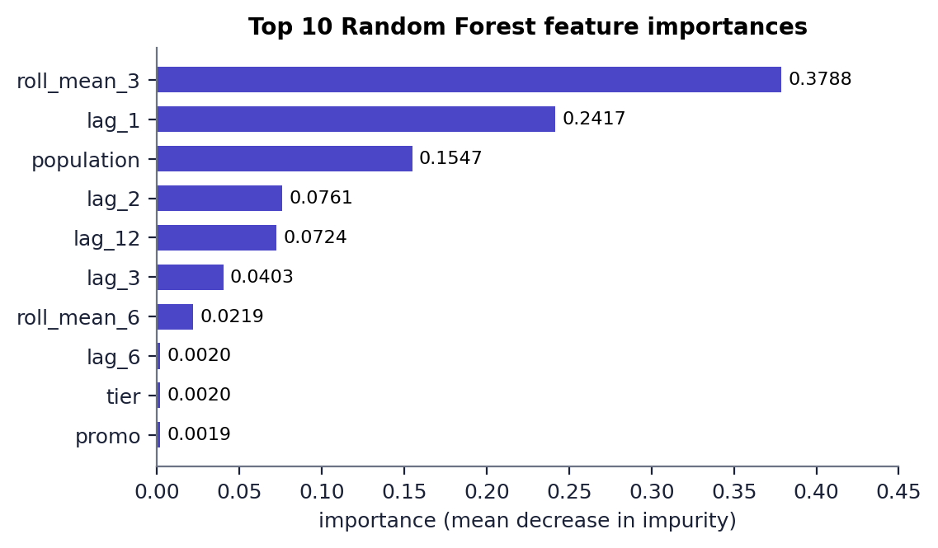

Training and solver configuration
Setting | Value
Forecaster | RandomForestRegressor, 400 trees, depth None
Tuning | None (one fixed setting, no CV)
Train / test | 2,430 rows / 540 rows (time split)
Fit time | 0.8 s
Plan defaults | p 6, capacity 1.25, SLA 48 h (soft)
MIP limit | 20 s per call (sub-MIP 5 s)
Hardware | i5-12500, 15.7 GB, Python 3.11.9
Top features: 3-month rolling mean (0.379), last month (0.242), population (0.155)
Notes:
Nothing is tuned: the hyper-parameters were set once. The importances show that the level of a region dominates; calendar features carry little weight.

Slide 10
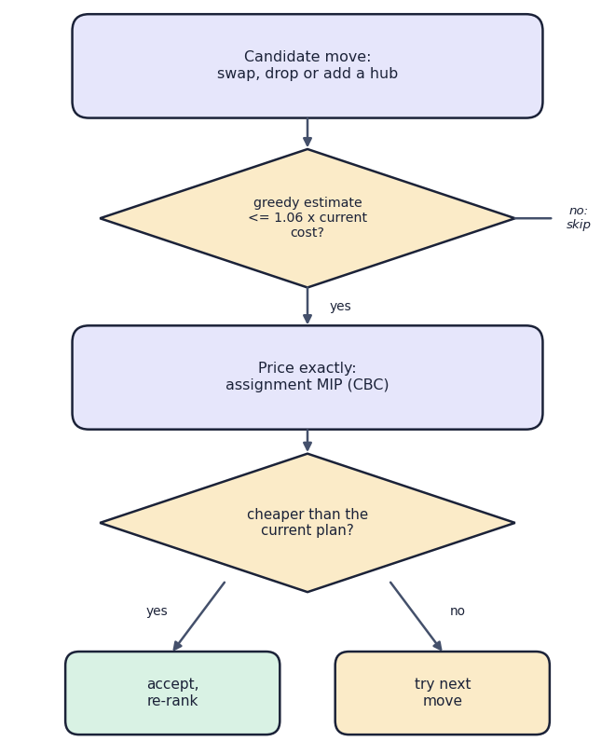

Decision logic
Accepting a move
A move is screened by a greedy estimate (within 6%), priced by an exact MIP and accepted only if cheaper.
Stopping
Stops when no promising move remains or 70% of the time is used; a kernel MIP over about 24 hubs then polishes the plan.
Infeasible plans
A start set that breaks capacity or a hard SLA gets more hubs; if still infeasible the API explains why.
Notes:
Decision logic: the search accepts only strictly better plans, restarts after each improvement and finishes with a restricted exact MIP.

Slide 11
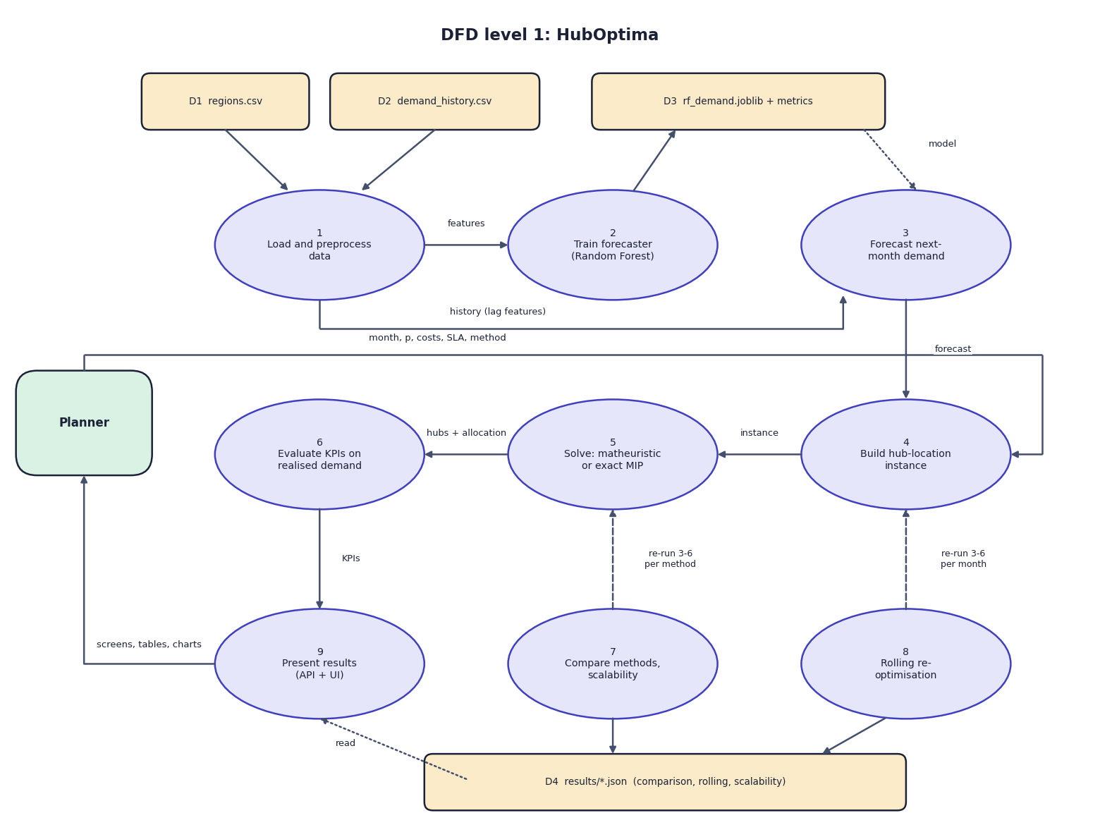
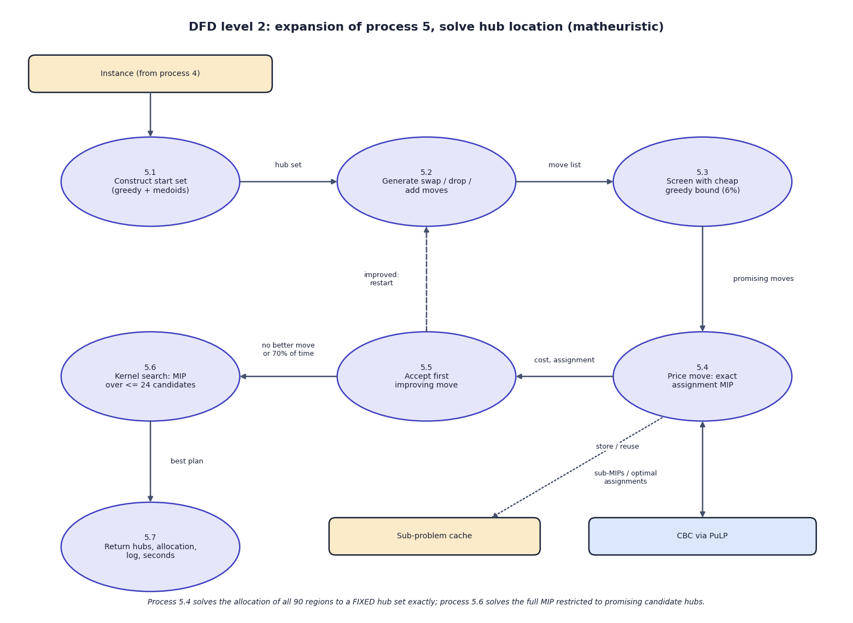

Data flow and modules
DFD level 1 (left) and level 2 expansion of 'Solve' (right)
Module | Responsibility
data.py, forecast.py | generate, clean, features, Random Forest, forecasts
model.py, matheuristic.py | Instance, exact MIP, KPI evaluation, matheuristic
baselines.py, rolling.py | greedy, k-means, largest markets; comparison; rolling horizon; scalability
Notes:
Level 1 shows nine processes and four data stores; level 2 opens the solve process.

Slide 12
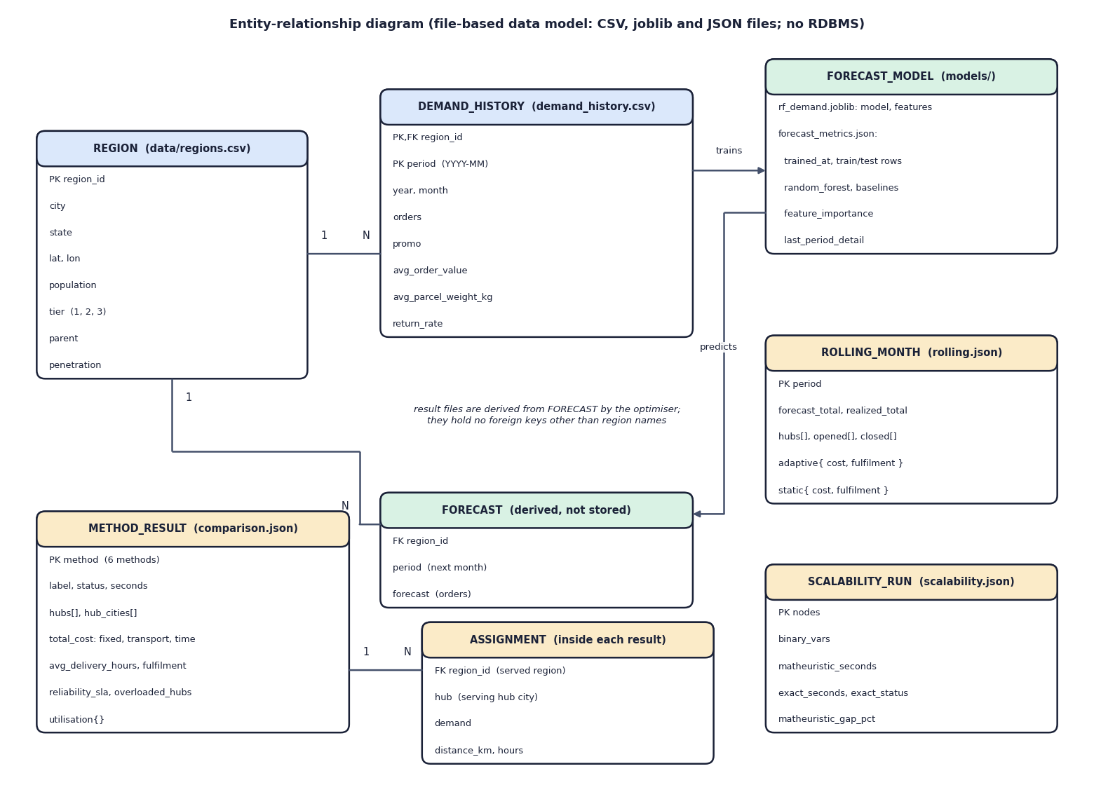
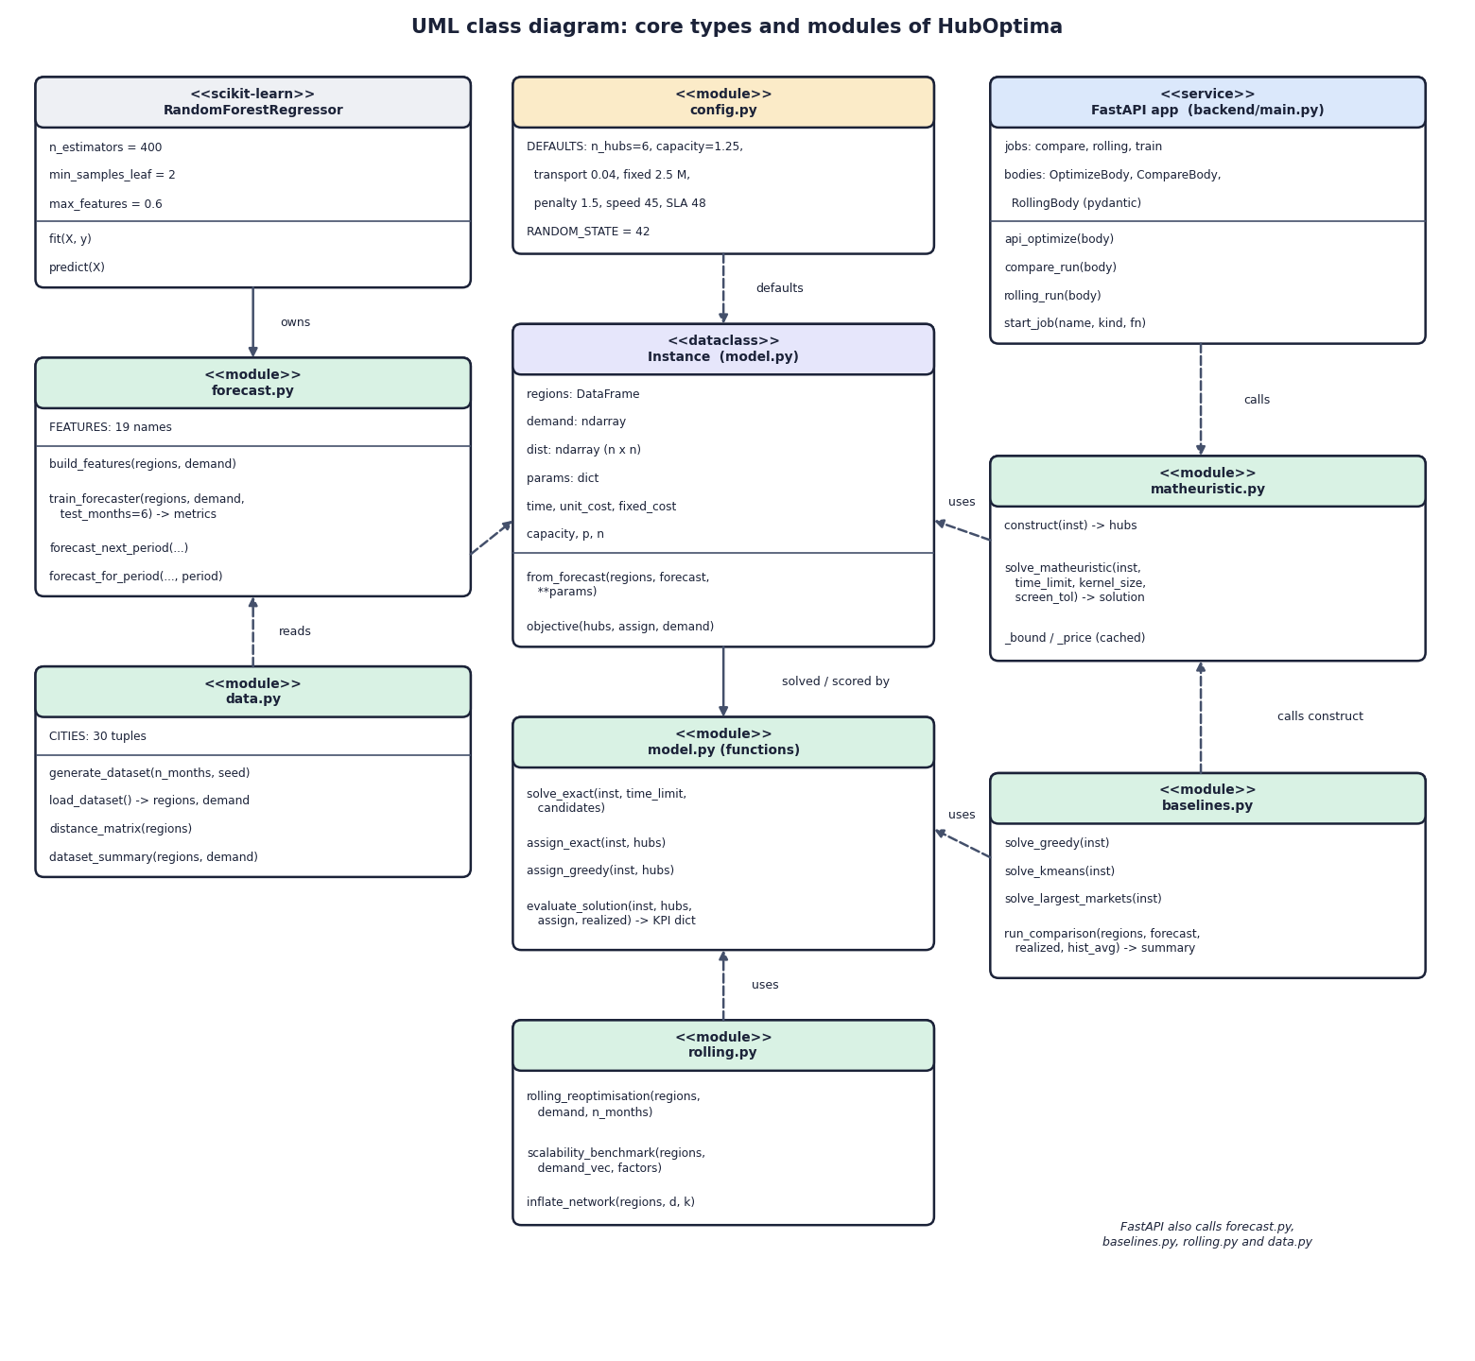

Data model and UML
File-based data model (left, no database) and UML class diagram (right)
File | Content | Size
regions.csv, demand_history.csv | 90 regions; region x month orders with promo, value, return rate | 90 / 3,240 rows
rf_demand.joblib, forecast_metrics.json | fitted forest + 19 features; metrics, importances | 38.5 MB / 12 KB
comparison / rolling / scalability .json | method KPIs and 90-row allocations; monthly adaptive vs static; benchmark runs | 118 KB / 6 KB / 1 KB
Notes:
There is no database: data and results are readable files, which suits the small data and keeps everything inspectable.

Slide 13






Technology stack
Language
Data and ML
Optimisation
Python 3.11, JavaScript (JSX)
pandas 2.2, NumPy 1.26, scikit-learn 1.4, joblib
PuLP 3.3 with the CBC solver
Backend
Frontend
Testing
FastAPI 0.110, uvicorn, pydantic; Flask 3 (classic UI)
React 18, Vite 5, recharts, framer-motion, gsap
tests.py (4), API smoke test (18), Playwright captures
Notes:
All components are open source and free; no GPU or commercial solver is needed.

Slide 14
Implementation progress
Component | Status
Data generation, cleaning and 19 features | Completed
Random Forest training and evaluation | Completed
Capacitated hub MIP and exact solver | Completed
Matheuristic (construct, local search, kernel) | Completed
Baselines, comparison and scalability benchmark | Completed
Rolling re-optimisation | Completed
FastAPI layer and React application | Completed
User acceptance testing with planners | Not done
14
API endpoints
7
web pages
4 + 18
tests and API checks passing
Notes:
Every planned feature is implemented. The one open item is user-acceptance testing with real logistics planners.

Slide 15
Preliminary results: forecast and plan, Oct 2025
7.67%
forecast MAPE (naive: 17.6-19.7%)
62.2 M
monthly cost, same as exact MIP
92.3%
simulated fulfilment (3 hubs overloaded)
Notes:
Results on synthetic data: the proposed plan equals the exact optimum and is the cheapest; the others cost 3.6% to 16.1% more. The peak was under-forecast by 13.2%, which overloads three hubs.

Slide 16
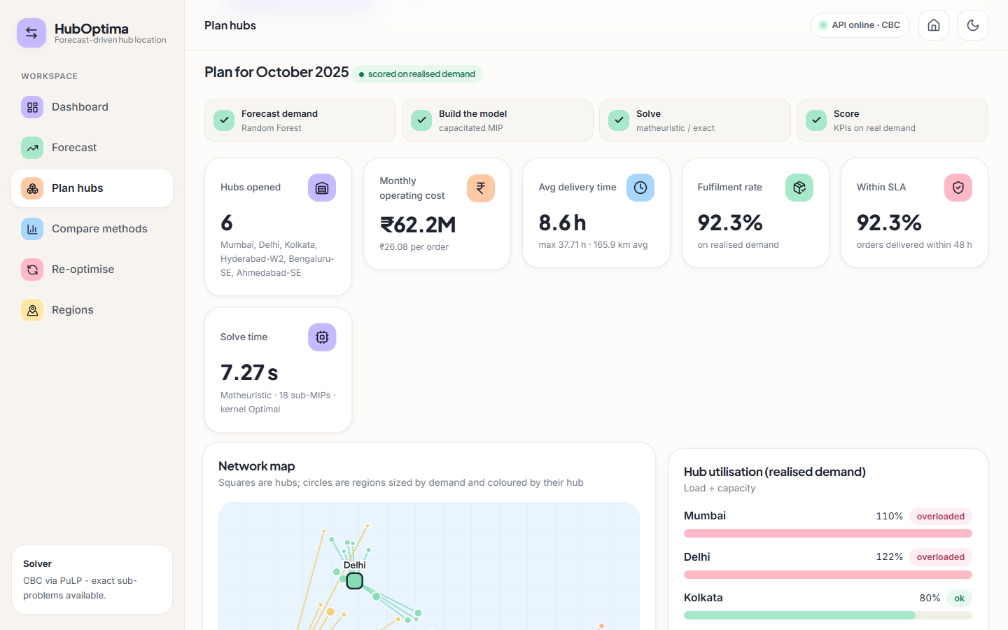
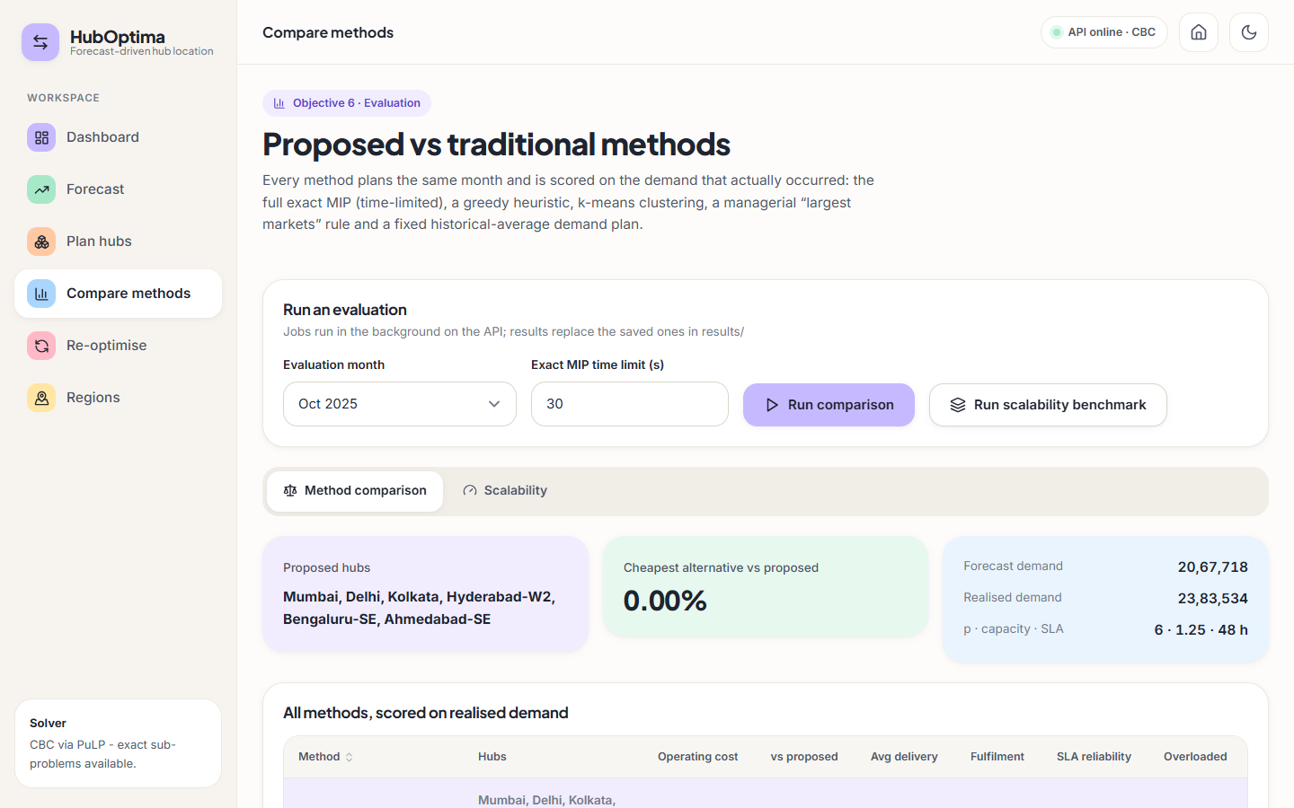


Output screens
Plan hubs: 6 hubs, INR 62.2 M, 92.3% fulfilment (Oct 2025)
Compare methods: six methods on realised demand
Notes:
Real captures of the running application with the project's data.

Slide 17
Testing and observations
Test group | Count | Result
Data, forecast, optimisation, web app (tests.py) | 4 | Passed
API smoke checks (endpoints, validation) | 18 | Passed
Browser walkthrough screens | 22 | Captured
Edge cases (n_hubs 0, unknown month, hard SLA) | 3 | Handled
Total automated | 22 | All passed
Matheuristic and exact MIP agree on the 90-region plan; the test requires them to be within 2%.
Planning takes about 3 s (4 hubs) to 12 s (6 hubs) end to end; read endpoints answer in 2-30 ms.
A 13.2% under-forecast of the peak overloads 3 of 6 hubs: found, reported, not hidden.
Not done: user-acceptance testing, load testing, authentication testing.
Notes:
Four unit tests, 18 API checks and a scripted browser walkthrough. The frontend has no automated unit tests.

Slide 18



Challenges and corrective actions
Synthetic data
Peak under-forecast
Forests cannot extrapolate
No real order history was available; stated in every result and limitation.
13.2% low in Oct 2025; plans overload 3 hubs. Next: a safety margin.
Oct 2025 exceeded every earlier month; likely cause of the miss.
Exact MIP slows down
Matheuristic gap
No authentication
270 nodes not solved in 67 s: the case for the matheuristic.
3.67% above the exact incumbent at 270 nodes; kernel size is a lever.
Local planning tool only; recorded as a limitation.
Notes:
Six challenges and how each was handled or recorded.

Slide 19
Next steps
User acceptance testing
Robust plan with a safety margin
Final report
Final presentation and demo
Collect feedback from logistics planners on the plan, compare and re-optimise screens (not yet done).
Add a safety margin or scenario objective so forecast error does not overload the biggest hubs.
Retrain the forecaster monthly inside the rolling horizon; test other learners.
Document every diagram, test and result in the report.
Notes:
What remains: real-user feedback and robustness, then the report and the final demo.

Slide 20
Thank you
Questions and suggestions are welcome.
Notes:
Thank you. Questions are welcome.

