Slide 1

Advanced Optimization in E-Commerce Logistics: Combining Matheuristics With Random Forests for Hub Location Efficiency
Final Review
Team Details : Batch A4
Under the Esteemed Guidance of
[GUIDE NAME]
[DESIGNATION], Department of CSE (Data Science)
23K91A6745 CH.ARCHANA
23K91A6705 A.MEENAKSHI
23K91A6734 B.ARUN
23K91A6712 A.SAMPATH
DEPARTMENT OF COMPUTER SCIENCE AND ENGINEERING (DATA SCIENCE) · Academic Year [ACADEMIC YEAR]
Notes:
Final review of HubOptima: forecast-driven hub location for e-commerce logistics.

Slide 2
Table of Contents
Abstract
Base Paper & Literature Survey
Research Gap & Problem Statement
Objectives
Proposed System & Architecture
Methodology & Model
Design & Implementation
Results, Testing & Comparison
Output Screens
Conclusion & Future Scope
References
Dept. of CSE (Data Science) | Batch A4 | Final Review
2

Slide 3
Abstract
E-commerce networks route parcels through hubs, so hub placement drives cost and delivery time. Classical models assume a fixed demand, and exact solvers slow down on large networks.
HubOptima forecasts regional demand with a Random Forest and feeds the forecast to a capacitated hub-location model solved by a matheuristic (greedy construction, MIP-priced local search, kernel search), re-planning every month.
Plans are scored on the demand that actually occurred; five traditional methods run on the same instance; a FastAPI + React application exposes everything.
Synthetic data (90 regions x 36 months): forecast MAPE 7.67% vs 17.6-19.7% for naive forecasters; Oct 2025 plan INR 62.2 M, equal to the exact MIP, 3.6-16.1% cheaper than the alternatives; re-planning 98.3% vs 83.7% fulfilment.
Limits: synthetic data, no robustness analysis, peak under-forecast by 13.2% overloads 3 of 6 hubs.
Keywords: hub location, matheuristic, Random Forest, demand forecasting, e-commerce logistics.
Dept. of CSE (Data Science) | Batch A4 | Final Review
3
Notes:
Abstract: problem, approach, evaluation and the honest limits.

Slide 4
Base Paper
K. Danach, A. Rammal, I. Moukadem, H. Harb, and A. Nasser, "Advanced optimization in e-commerce logistics: Combining matheuristics with random forests for hub location efficiency," IEEE Access, vol. 13, pp. 55915-55926, 2025, doi: 10.1109/ACCESS.2025.3550560.
Method: Random Forest demand forecast + matheuristic (relaxed MILP start, Variable Neighbourhood Search); forecasts re-optimise the hubs; validated on peak, spike and disruption scenarios.
Data: proprietary data of a global transport company, two years of demand, thousands of customer locations.
Reported: delivery-time compliance 92.3%, fulfilment 97.6%, robustness 0.87; +7.8% / +9.4% / +16%; cost reduction 15-20%; networks of 50-500 nodes.
Limitations (authors): sector-specific data, scalability not extensively tested, offline evaluation, other ML models not explored; RF gain given only as 'X %'.
Dept. of CSE (Data Science) | Batch A4 | Final Review
4
Notes:
The base paper is a framework paper evaluated on private data; its numbers are not reproduced here.

Slide 5
Literature Survey
Author / Year | Methodology | Dataset | Key Results | Limitations
Danach et al., 2025 [1] (base) | RF forecast + matheuristic (MILP, VNS) | Proprietary logistics data | 92.3% compliance, 97.6% fulfilment | Data not public; X % gain unstated
Zheng et al., 2024 [2] | Diversity-based hybrid PSO | Village drone delivery | 42.58% efficiency gain (abstract) | No forecasting; no optimality bound
Yang et al., 2023 [3] | Maximal-detour p-hub centre; MILP + Benders | Liner shipping | Faster exact solve | Fixed demand
Dehghan Chenary et al., 2024 [4] | Pareto clustering + metaheuristic | Australian Post | Better Pareto sets than MOPSO, NSGA-II | Demand given
Zhang et al., 2025 [5] | Two-stage adaptive robust (C&CG + Benders) | Not stated in abstract | Better out-of-sample than stochastic | Assumed uncertainty set
Danach et al., 2019 [9] | Lagrangian relaxation + hyper-heuristic | Not reviewed | Described in [1] | No forecasting
Dept. of CSE (Data Science) | Batch A4 | Final Review
5
Notes:
Only what the abstracts and the base paper state is summarised; full texts of [2]-[5] were not read.

Slide 6
Research Gap
Author / Paper | Research Gap
Base paper [1] | Data, code and matheuristic parameters unavailable; RF gain stated only as 'X %'; effect of forecast error on the plan not shown
Zheng et al. [2]; Dehghan Chenary et al. [4] | Metaheuristic search with demand taken as given; no forecast
Yang et al. [3]; Ernst and Krishnamoorthy [8] | Exact methods and decomposition for fixed demand; no adaptation
Zhang et al. [5] | Robust under an assumed uncertainty set, not learned from data
All reviewed work | No measured value of monthly re-planning; no exact-versus-matheuristic measurement as networks grow
Dept. of CSE (Data Science) | Batch A4 | Final Review
6
Notes:
The gap is forecast-driven, reproducible and measured hub planning, including the effect of forecast error and of re-planning.

Slide 7
Problem Statement
Poor hub placement increases transportation cost and delays deliveries.
Traditional hub location models assume fixed demand and ignore fluctuations.
Exact optimisation is too slow for large, changing logistics networks.
Forecasting and optimisation are done separately, which weakens hub decisions.
Problem: given order history, candidate hubs and cost and service parameters, choose hubs and an allocation that minimise cost within capacity and keep the plan good as demand changes.
Dept. of CSE (Data Science) | Batch A4 | Final Review
7

Slide 8
Objectives
Collect and preprocess historical e-commerce logistics data.
Predict regional demand using a Random Forest model.
Formulate hub location as an optimisation problem with cost, time and capacity constraints.
Solve the problem efficiently with a matheuristic approach.
Re-optimise hub configurations as demand changes.
Compare performance with traditional hub location methods.
Dept. of CSE (Data Science) | Batch A4 | Final Review
8

Slide 9
Proposed System
1. Data - 36 months of orders for 90 regions, cleaned and turned into 19 features.
2. Forecast - a Random Forest predicts next-month demand per region.
3. Model - a capacitated single-allocation MIP: fixed hub cost, transport cost, delivery-time penalty, capacity, p hubs.
4. Solve - matheuristic: greedy construction, MIP-priced local search, kernel search; exact MIP as reference.
5. Evaluate - plans scored on realised demand: cost, delivery time, fulfilment, utilisation.
6. Compare and adapt - five baselines, a scalability benchmark and monthly re-optimisation.
7. Use - FastAPI + React: forecast, plan with a map, compare, re-optimise.
Dept. of CSE (Data Science) | Batch A4 | Final Review
9

Slide 10
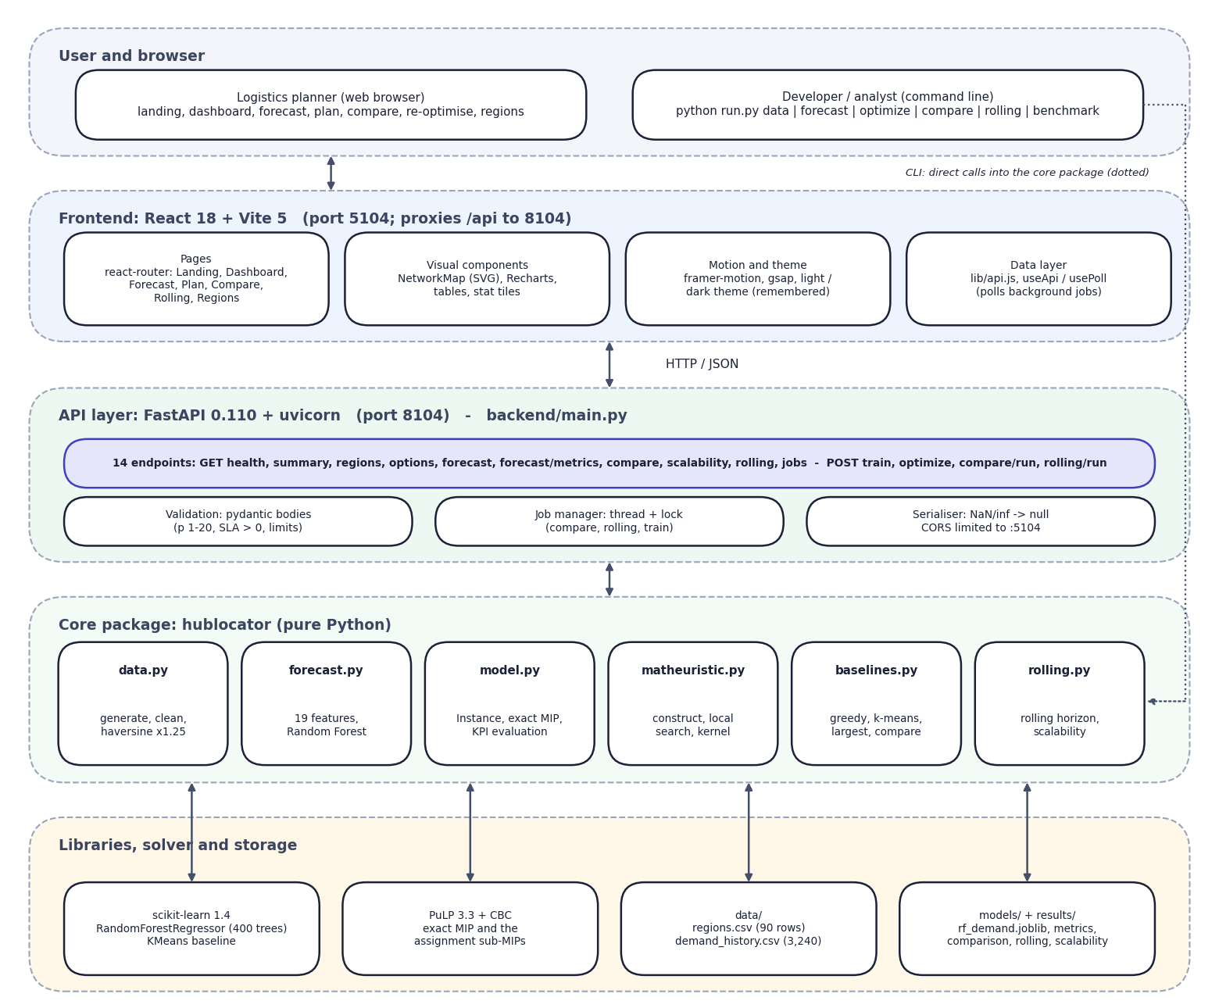

System Architecture
Layered architecture: browser/CLI, React frontend, FastAPI layer, hublocator core, libraries and files
Dept. of CSE (Data Science) | Batch A4 | Final Review
10

Slide 11
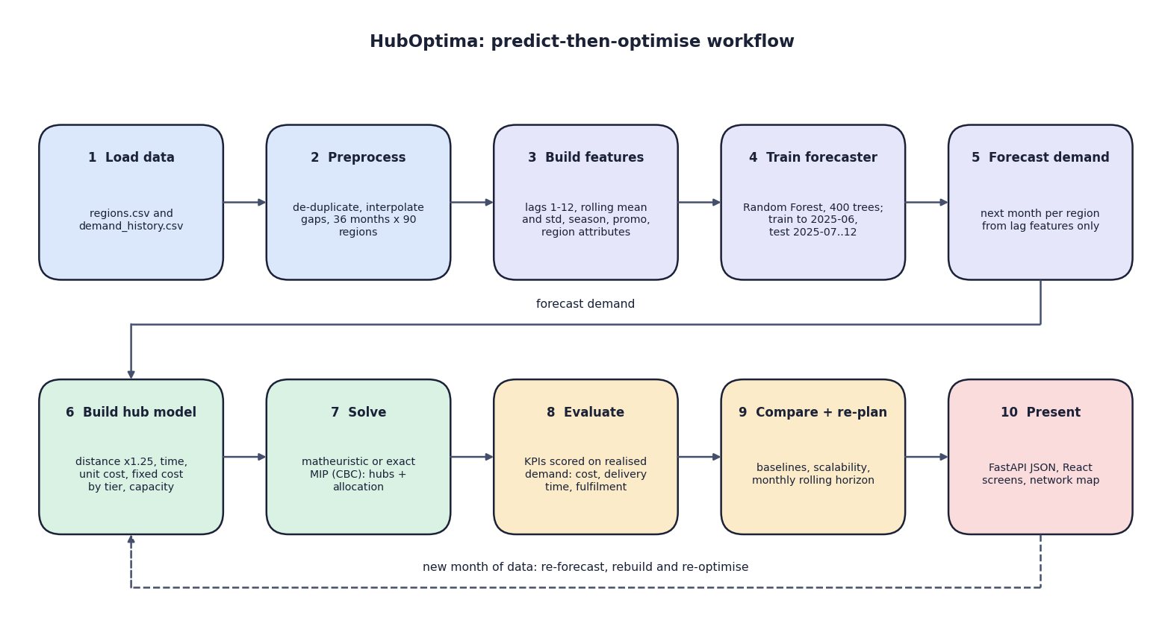

Methodology
Predict-then-optimise workflow: load, preprocess, features, train, forecast, model, solve, evaluate, compare and re-plan, present
Dept. of CSE (Data Science) | Batch A4 | Final Review
11

Slide 12
Dataset, Features & Model
Synthetic dataset (seed 42): 90 regions (30 cities + 60 satellite districts) x 36 months = 3,240 rows, 48.3 M orders; peak 2.38 M in Oct 2025; no real data.
Split by time: train 2023-04 to 2025-06 (2,430 rows), test 2025-07 to 2025-12 (540 rows).
19 features: lags 1-12, rolling mean/std, trend, calendar, promotion, region attributes, order value, return rate.
Random Forest: 400 trees, min leaf 2, 60% features, seed 42; fit 0.8 s; no tuning, no cross-validation.
Hub model: p = 6, capacity 1.25 x demand / p, transport INR 0.04/order-km, time penalty INR 1.5/order-h, fixed INR 2.5 M per hub (by tier), SLA 48 h soft.
Matheuristic: greedy/k-medoids start, swap/drop/add moves screened within 6%, exact assignment MIPs, kernel of 24 hubs.
Dept. of CSE (Data Science) | Batch A4 | Final Review
12
Notes:
All numbers are read from the project's own files; the dataset is synthetic, so absolute values are model outputs.

Slide 13
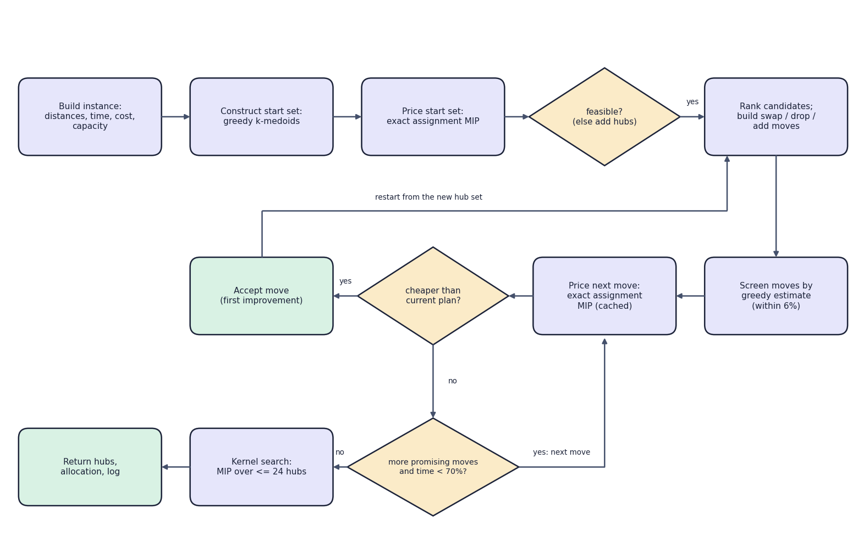

Decision Workflow
Core algorithm: construct, price, screen, price moves, accept first improvement, kernel search, return
Dept. of CSE (Data Science) | Batch A4 | Final Review
13

Slide 14
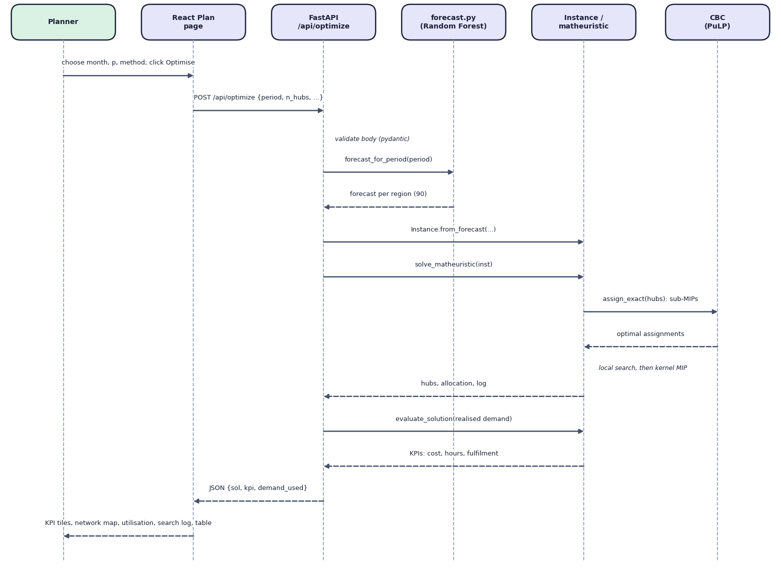

User–System Interaction
Sequence: planning hubs from the browser, through FastAPI, the forecaster and the matheuristic
Dept. of CSE (Data Science) | Batch A4 | Final Review
14

Slide 15
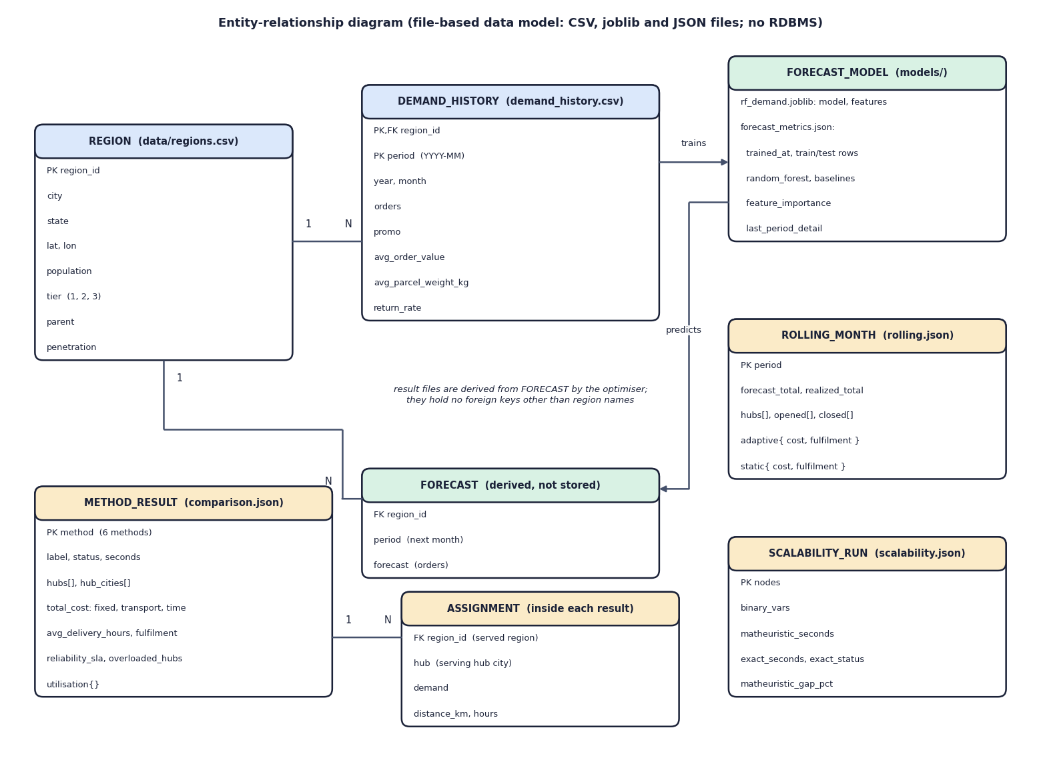

Database Design
Entity–relationship diagram of the file-based data model (CSV, joblib, JSON; no database)
Dept. of CSE (Data Science) | Batch A4 | Final Review
15

Slide 16
Implementation Highlights
Module | Implementation
data.py / forecast.py | seeded generation, cleaning, 19 shifted features; Random Forest with time split; forecast per region
model.py | Instance (distance x1.25, time, cost, capacity); exact MIP via PuLP/CBC; KPI evaluation on realised demand
matheuristic.py | greedy/k-medoids start; screened swap/drop/add priced by assignment MIPs; kernel search; cache of priced hub sets
baselines.py / rolling.py | greedy, k-means, largest markets, no-forecast; comparison; rolling horizon; scalability benchmark
backend/main.py | FastAPI, 14 endpoints, pydantic validation, background jobs in threads, NaN-safe JSON
frontend/ | React + Vite: 7 pages, SVG network map, Recharts, light/dark theme, job polling
Dept. of CSE (Data Science) | Batch A4 | Final Review
16

Slide 17
Results – Methods Compared (Oct 2025, p = 6)
Method | Operating cost (INR M per month) | Avg delivery / fulfilment
RF + matheuristic (proposed) | 62.2 (reference) | 8.56 h / 92.3%
RF + exact MIP | 62.2 (+0.0%) | 8.56 h / 92.3%
RF + greedy | 69.3 (+11.5%) | 9.47 h / 89.3%
RF + k-means | 64.4 (+3.6%) | 9.19 h / 91.8%
Largest-markets rule | 72.2 (+16.1%) | 8.96 h / 91.1%
Historical avg, no forecast | 67.2 (+8.1%) | 9.91 h / 66.0%
Synthetic data; planned on the forecast, scored on realised demand. Fulfilment is simulated from hub capacity; 3 of 6 hubs overloaded after a 13.2% under-forecast.
Dept. of CSE (Data Science) | Batch A4 | Final Review
17
Notes:
The matheuristic equals the exact MIP on this instance; the heuristics cost 3.6% to 16.1% more.

Slide 18
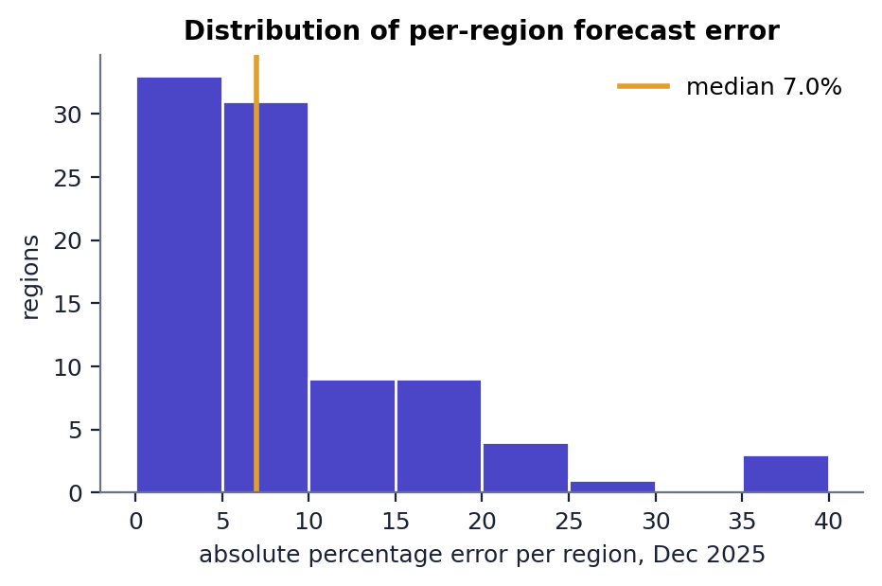
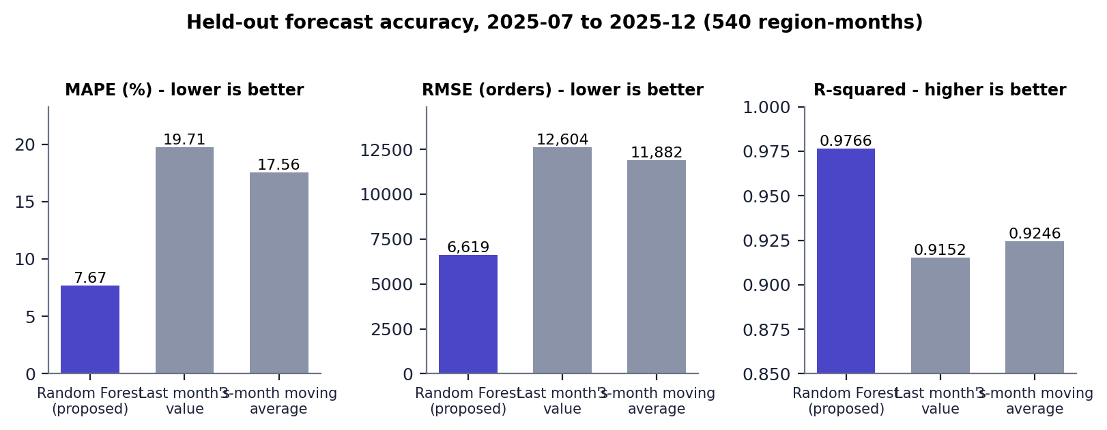


Forecast Accuracy & Error Distribution
Held-out accuracy: Random Forest vs naive forecasters (MAPE 7.67%)
Per-region error, Dec 2025: median 7.0%, 8 regions above 20%
Dept. of CSE (Data Science) | Batch A4 | Final Review
18
Notes:
This is the regression counterpart of a confusion matrix: error against two naive benchmarks and the spread of per-region error.

Slide 19
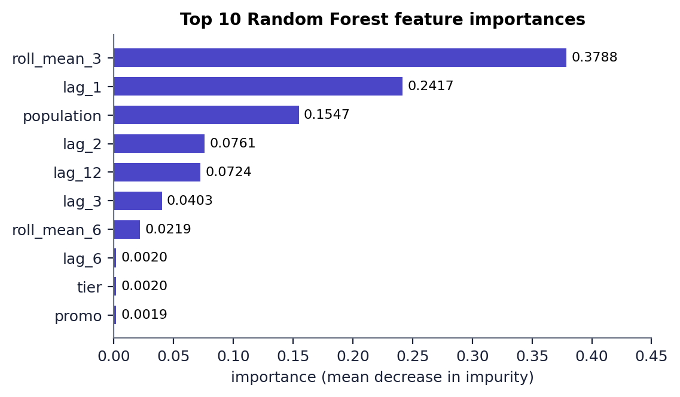
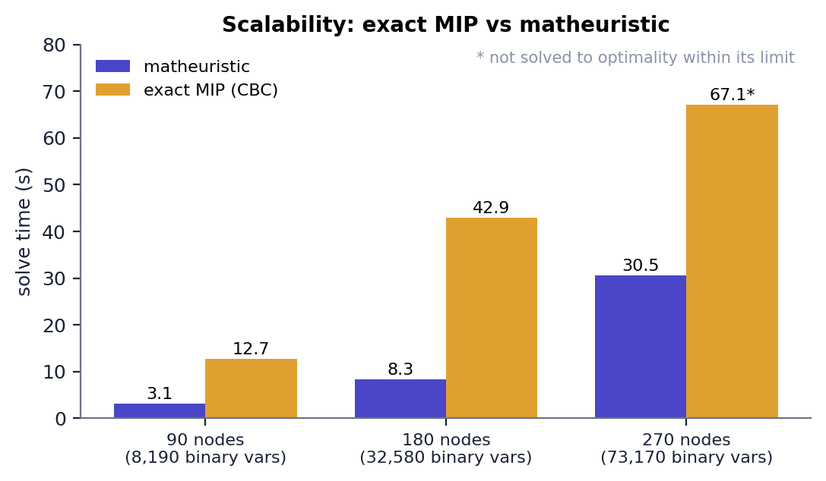


Feature Importance & Scalability
Top features: 3-month mean 0.379, last month 0.242, population 0.155
Exact MIP vs matheuristic: 270 nodes, exact not solved; matheuristic +3.67%
Dept. of CSE (Data Science) | Batch A4 | Final Review
19
Notes:
Feature importance shows the level of a region dominates; the scalability chart shows where the matheuristic helps.

Slide 20
Performance & Testing
Measurement | Result
Plan latency (median, end to end) | 3.4 s (4 hubs), 10.7-12.2 s (6 hubs, matheuristic), 15.3 s (6 hubs, exact)
Read endpoints | 2-30 ms; forecast endpoint 264 ms
Solver time (saved runs) | matheuristic 4.89 s, exact 7.99 s (90 nodes); 3.13 s vs 12.74 s; 8.31 s vs 42.94 s
Automated tests | tests.py 4 of 4 passed; API smoke test 18 of 18 passed
Re-optimisation | 98.3% vs 83.7% fulfilment, -4.9% cost, 1 hub change in 6 months
Not done | user acceptance, load and authentication testing
Dept. of CSE (Data Science) | Batch A4 | Final Review
20
Notes:
Measured on an i5-12500 with 15.7 GB RAM; run-to-run variation of several seconds comes from CBC and processor load.

Slide 21
Comparison with Base Paper (context only – different datasets)
Indicator | Base paper [1] | This project | Where measured | Comparable? | Reading
Delivery-time compliance | 92.3% | 92.3% (SLA reliability, Oct 2025 peak) | synthetic, simulated | No | different definition
Fulfilment | 97.6% | 92.3% (peak); 98.3% average with re-planning | synthetic, simulated | No | simulated vs observed
Cost vs alternatives | 15-20% lower | 3.6-16.1% lower; 0% vs exact MIP | synthetic, six methods | Direction only | baselines differ
Gain from adapting | +7.8% / +9.4% (abstract) | +14.6 points fulfilment vs a static plan | synthetic, Jul-Dec 2025 | Different comparison | control differs
Robustness | 0.87 | Not implemented | - | - | gap in this project
Scalability | 50-500 nodes | 90-270 nodes; +3.67% at 270 | synthetic benchmark | Smaller range | not tested beyond 270
Datasets and metric definitions differ, so this is context only: no head-to-head claim is made.
Dept. of CSE (Data Science) | Batch A4 | Final Review
21

Slide 22
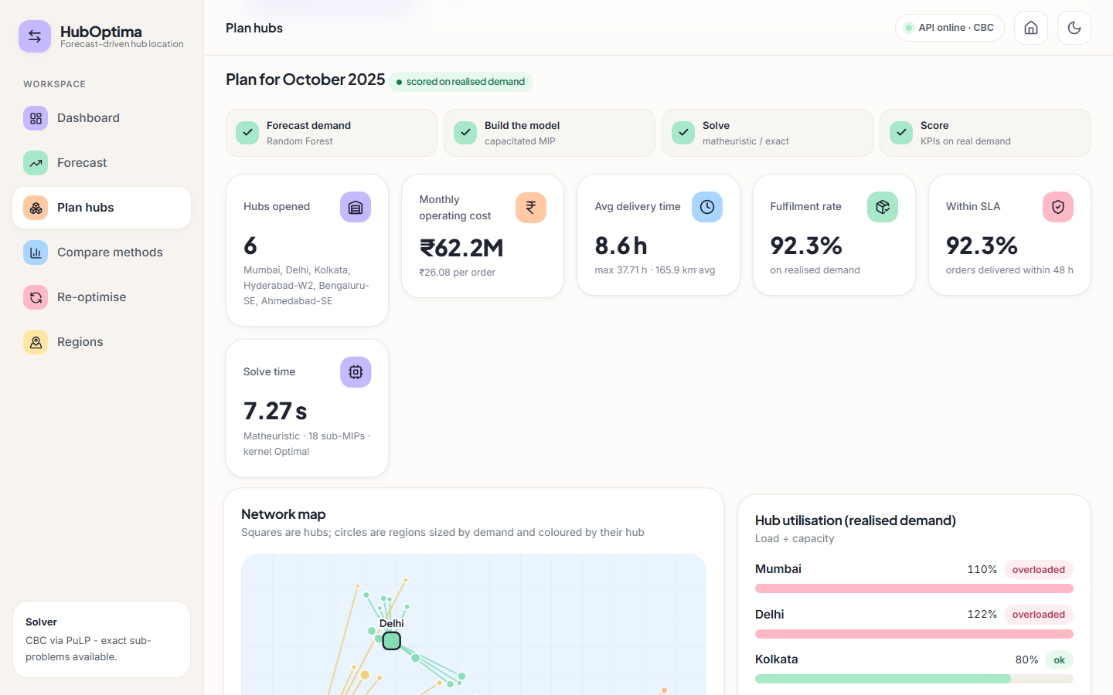
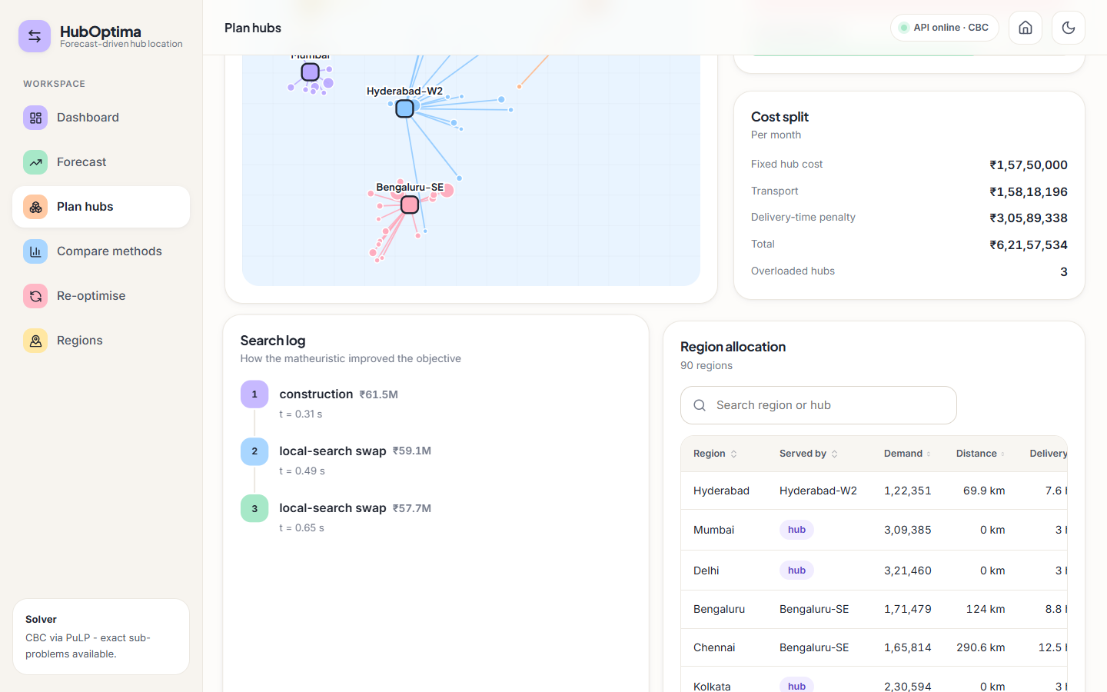


Output – Plan Hubs
Plan Oct 2025: 6 hubs, INR 62.2 M, 92.3% fulfilment
Search log and allocation of regions to hubs
Dept. of CSE (Data Science) | Batch A4 | Final Review
22

Slide 23
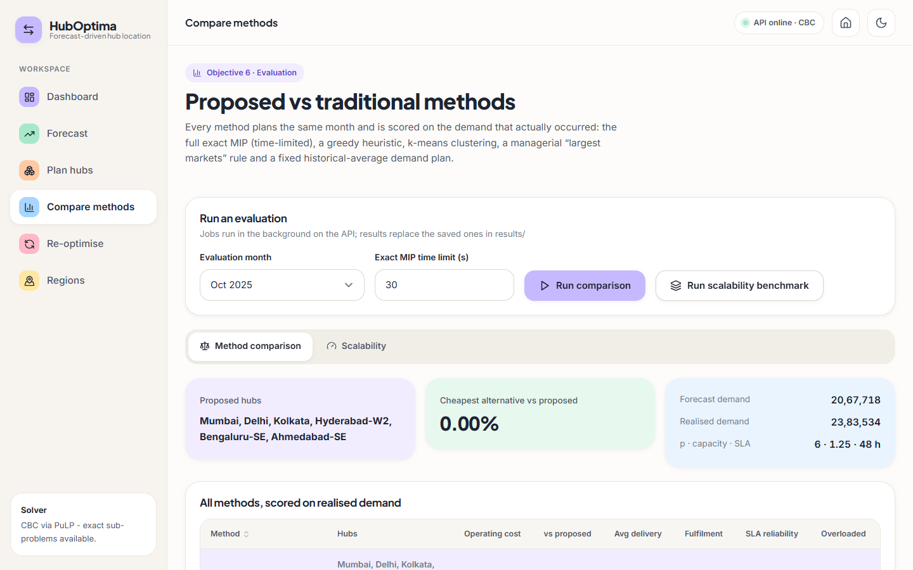
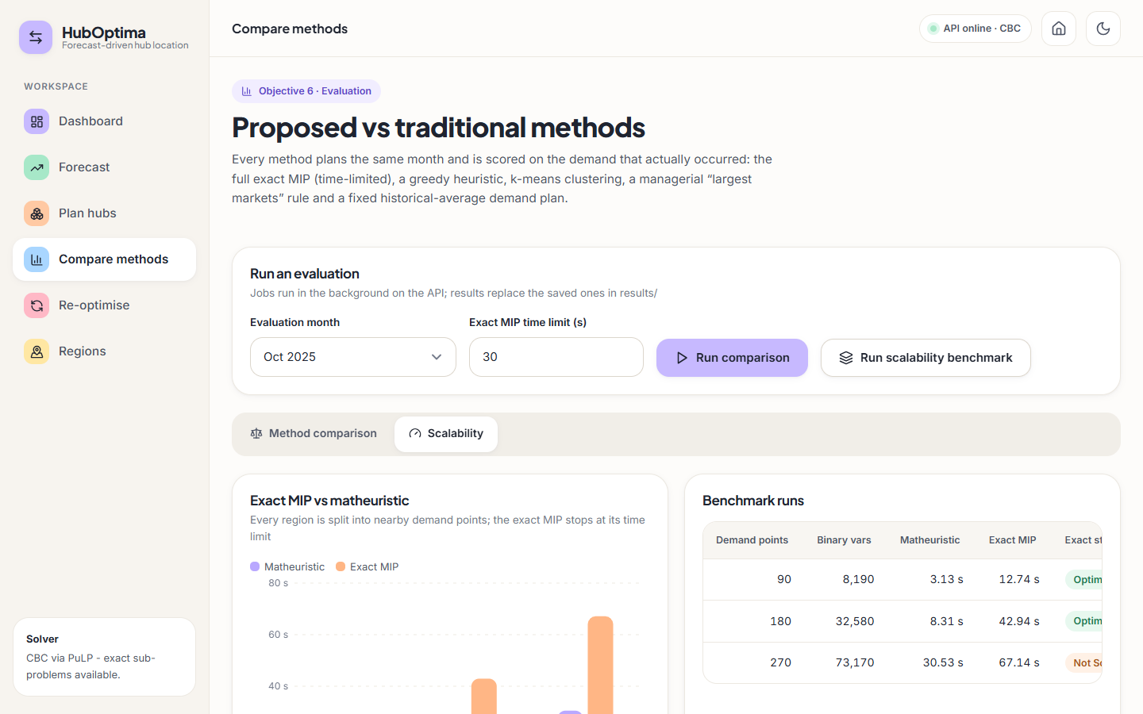


Output – Compare and Scalability
Six methods scored on realised demand
Exact MIP vs matheuristic at 90, 180, 270 nodes
Dept. of CSE (Data Science) | Batch A4 | Final Review
23

Slide 24
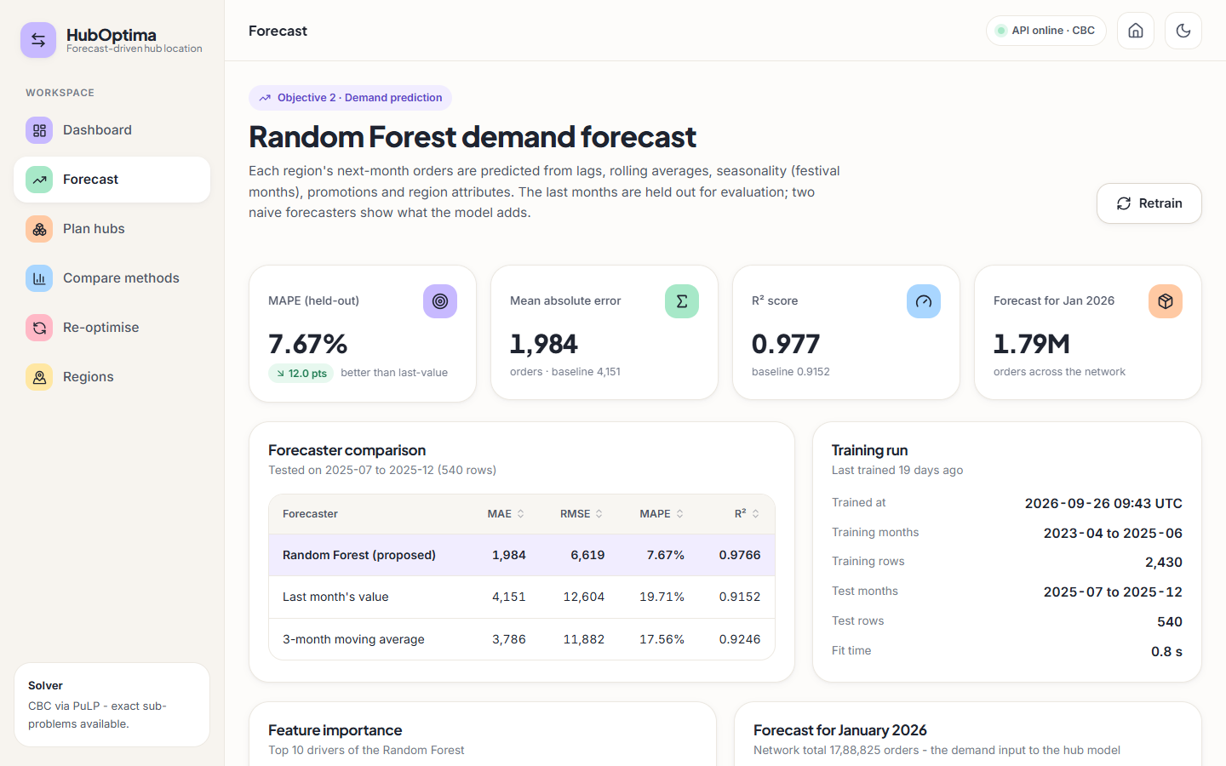
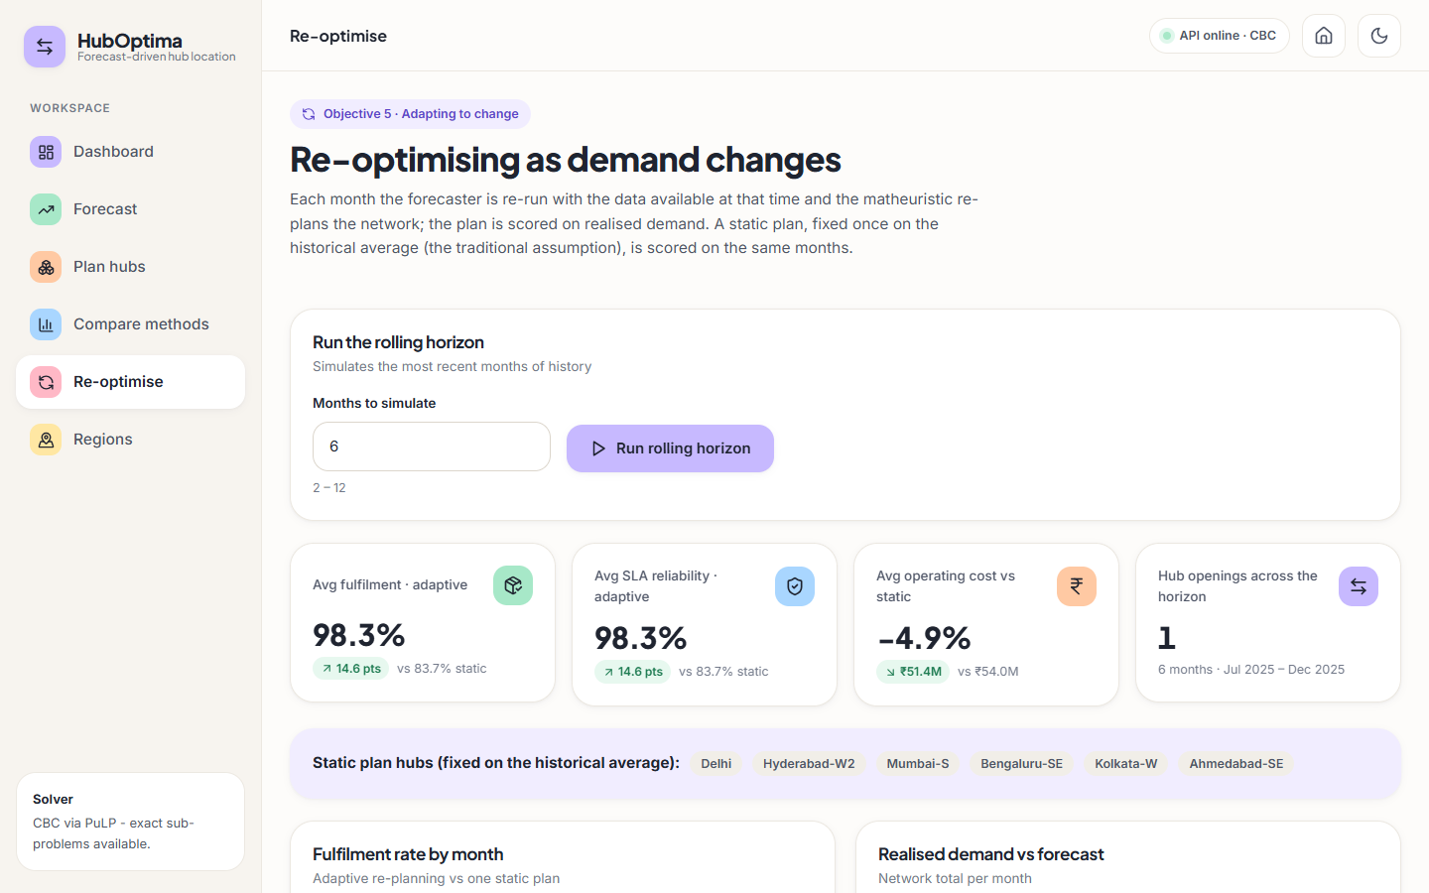


Output – Forecast and Re-optimisation
Forecast page: Random Forest vs naive forecasters
Re-optimise page: 98.3% vs 83.7% fulfilment
Dept. of CSE (Data Science) | Batch A4 | Final Review
24

Slide 25
Conclusion
Built HubOptima: forecast-driven hub location with a matheuristic, a comparison suite and a web application.
Forecast MAPE 7.67% (naive 17.6-19.7%); the matheuristic matches the exact MIP at 90 and 180 nodes and is cheapest of six methods on Oct 2025.
Re-planning each month: 98.3% vs 83.7% simulated fulfilment, 4.9% lower cost.
4 tests and 18 API checks pass; 22 screens captured with real data.
Limits: synthetic data; 13.2% peak under-forecast overloads 3 hubs; +3.67% at 270 nodes; no robustness analysis or user study.
Dept. of CSE (Data Science) | Batch A4 | Final Review
25

Slide 26
Future Scope
Pilot on real order data and gather feedback from logistics planners.
Robust plans: a safety margin or scenario objective against forecast error.
Retrain the forecaster monthly; try gradient boosting and LSTM; handle extrapolation beyond past peaks.
Add Variable Neighbourhood Search, multiple capacity levels and split allocation.
Database, sign-in and a job queue for multi-user deployment.
Dept. of CSE (Data Science) | Batch A4 | Final Review
26

Slide 27
References
[1] K. Danach, A. Rammal, I. Moukadem, H. Harb, and A. Nasser, "Advanced optimization in e-commerce logistics: Combining matheuristics with random forests for hub location efficiency," IEEE Access, vol. 13, pp. 55915-55926, 2025, doi: 10.1109/ACCESS.2025.3550560.
[2] L. Zheng, G. Xu, and W. Chen, "Using improved particle swarm optimization algorithm for location problem of drone logistics hub," Computers, Materials & Continua, vol. 78, no. 1, pp. 935-957, 2024, doi: 10.32604/cmc.2023.046006.
[3] L. Yang, J. Zheng, J. Wang, and X. Hu, "The maximal detour liner shipping hub location problem: Improving the applicability of the p-hub center problem," Transportation Research Part E: Logistics and Transportation Review, vol. 179, Art. no. 103330, Nov. 2023, doi: 10.1016/j.tre.2023.103330.
[4] M. Dehghan Chenary, A. Ferdowsi, and R. F. Hartl, "A Pareto-based clustering approach for solving a bi-objective mobile hub location problem with congestion," Logistics, vol. 8, no. 4, Art. no. 130, Dec. 2024, doi: 10.3390/logistics8040130.
[5] H. Zhang, J.-C. Wang, and Y. Gao, "Two-stage adaptive robust hub location problem under demand uncertainty," Naval Research Logistics, Dec. 2025, doi: 10.1002/nav.70043.
[6] M. E. O'Kelly, "The location of interacting hub facilities," Transportation Science, vol. 20, no. 2, pp. 92-106, 1986.
[7] J. F. Campbell, A. T. Ernst, and M. Krishnamoorthy, "Hub location problems," in Facility Location: Applications and Theory. Berlin, Germany: Springer, 2002, pp. 373-407.
[8] A. T. Ernst and M. Krishnamoorthy, "Efficient algorithms for the uncapacitated single allocation p-hub median problem," Location Science, vol. 4, no. 3, pp. 139-154, Oct. 1996.
[9] K. Danach, S. Gelareh, and R. Neamatian Monemi, "The capacitated single-allocation p-hub location routing problem: A Lagrangian relaxation and a hyper-heuristic approach," EURO Journal on Transportation and Logistics, vol. 8, no. 5, pp. 597-631, Dec. 2019.
[10] M. Kahalimoghadam, R. G. Thompson, and A. Rajabifard, "Determining the number and location of micro-consolidation centres as a solution to growing e-commerce demand," Journal of Transport Geography, vol. 117, Art. no. 103875, May 2024.
[11] L. Breiman, "Random forests," Machine Learning, vol. 45, no. 1, pp. 5-32, Oct. 2001.
[12] V. Maniezzo, M. A. Boschetti, and T. Stuetzle, Matheuristics: Algorithms and Implementations. Cham, Switzerland: Springer, 2021.
[13] F. Pedregosa et al., "Scikit-learn: Machine learning in Python," Journal of Machine Learning Research, vol. 12, pp. 2825-2830, 2011.
[14] S. Mitchell, M. O'Sullivan, and I. Dunning, "PuLP: A linear programming toolkit for Python," Dept. of Engineering Science, University of Auckland, 2011.
[15] J. Forrest and R. Lougee-Heimer, "CBC user guide," in Emerging Theory, Methods, and Applications, INFORMS TutORials in Operations Research, 2005, pp. 257-277.
[16] P. Hansen and N. Mladenovic, "Variable neighborhood search: Principles and applications," European Journal of Operational Research, vol. 130, no. 3, pp. 449-467, May 2001.
[17] E. Angelelli, R. Mansini, and M. G. Speranza, "Kernel search: A general heuristic for the multi-dimensional knapsack problem," Computers & Operations Research, vol. 37, no. 11, pp. 2017-2026, Nov. 2010.
[18] S. P. Lloyd, "Least squares quantization in PCM," IEEE Transactions on Information Theory, vol. 28, no. 2, pp. 129-137, Mar. 1982.
[19] R. J. Hyndman and G. Athanasopoulos, Forecasting: Principles and Practice, 3rd ed. Melbourne, Australia: OTexts, 2021.
[20] R. W. Sinnott, "Virtues of the haversine," Sky and Telescope, vol. 68, no. 2, p. 159, 1984.
Dept. of CSE (Data Science) | Batch A4 | Final Review
27

Slide 28
THANK YOU
Questions & Suggestions
Dept. of CSE (Data Science) | Batch A4 | Final Review
28
Notes:
Thank you. Questions are welcome.

