Slide 1
Secure Voting System with Aadhaar Verification through Blockchain
REVIEW 2 · DESIGN, METHODOLOGY AND PROGRESS
Design, methodology and progress: Aadhaar-verified, encrypted, hash-chained voting with an auditor view
Presented by
Under the guidance of
Mohammed Anwar-Ul-Haq 23K91A05F6
Mohammad Mosin 23K91A05F4
Manda Akshitha 23K91A05E4
Kothlapur Ganesh 24K95A0516
B Shruthi, [DESIGNATION]
Department of Computer Science and Engineering
TKR College of Engineering & Technology · Batch C1 (CSE-C) · [ACADEMIC YEAR]
Notes:
This review shows how AegisBallot is designed and built: the data, the cryptography and ledger design, what is implemented, the first measured results and the open items.

Slide 2
Contents
01
02
03
Recap and architecture
Methodology and data
Preprocessing and cryptographic design
04
05
06
System configuration and decision logic
Data flow, database and UML
Technology stack
07
08
09
Implementation progress and results
Output screens and testing
Challenges and next steps
Notes:
Agenda for the design and progress review.

Slide 3
Recap: problem and proposed system
!
Problem
i
Proposed system
B
Base paper link
Manual polling is slow and error-prone. A database ballot box can be edited without trace, and without identity binding duplicate or ineligible votes cannot be excluded reliably. Observers cannot recompute the result.
AegisBallot verifies a 12-digit Aadhaar number, issues a single-use token, encrypts the choice, commits it to a 3-validator hash-chained ledger and lets an auditor recompute the chain.
Shaikh et al. time a blockchain voting model on an Ethereum test chain with biometric authentication. AegisBallot keeps a registry plus ledger idea but uses an Aadhaar-style check and a local ledger. Results are not directly comparable.
Notes:
One-minute recap of Review 1: the integrity and identity problem, our approach, and how the base paper relates (shared goal, different chain, identity method and scope).

Slide 4
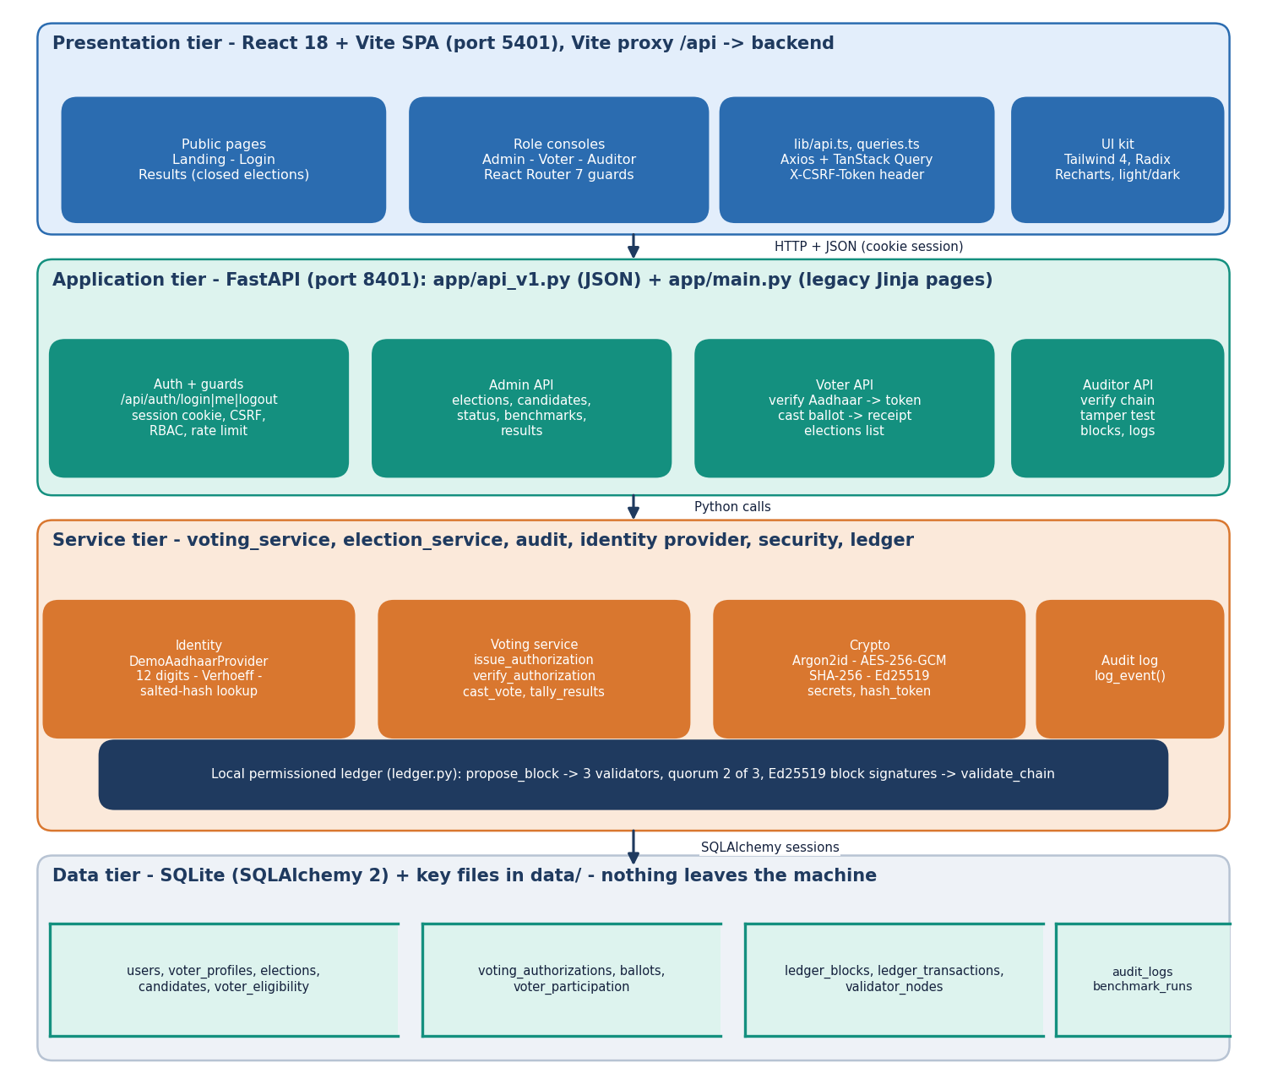
System architecture
Four tiers
Presentation: React 18 and Vite SPA (port 5401); public, voter, admin and auditor pages.
Application: FastAPI (port 8401), 21 JSON routes under /api, session cookie, CSRF header, RBAC, rate limits.
Services: identity provider, voting service, crypto, audit log and the ledger module.
Data: SQLite, 13 tables, plus key files in data/. Nothing is sent to an external service.
Notes:
The JSON routes are in app/api_v1.py; the original Jinja pages in app/main.py still work. The services are separate modules so each can be tested alone.

Slide 5
Methodology: end-to-end workflow
Sign in
Verify Aadhaar
One-time token
Encrypt + sign
Validators sign block
Receipt
Audit chain
One vote, four layers
Identity apart from ballot
Measured, not typed
Eligibility row, UNIQUE participation per (election, voter), single-use token, and a ledger check that nonce and transaction hash are new. Any one of them stops a second ballot.
The ballots table has no voter column and the token is stored only as a hash. Honest gap: voter_participation still stores voter id with ballot id, so secrecy is partial.
scripts/run_experiments.py and the product's own benchmark write every reported number to JSON; documents read them from there.
Notes:
The three design principles: layered one-vote enforcement, separation of identity from the ballot (with the honest gap stated), and numbers that come from scripts.

Slide 6
Data used: no external dataset
0
20
1,000
200 / 212
external datasets (no ML model)
seeded demo voters, Verhoeff-valid synthetic Aadhaar
synthetic voters per benchmark run
voters / ballots in the demo database
Data | Source | Size | Note
Voter registry | app/seed.py, generate_valid_aadhaar() | 20 voters + admin + auditor | salted SHA-256 hash and masked number stored
Elections | app/seed.py | 2 elections, 4 and 3 candidates | 8 seeded votes in the closed one
Benchmark voters | app.benchmarks.run_benchmark | 1,000 per run | Argon2id-hashed passwords, generated
Demo database | seed + benchmarks + smoke test | 200 voters, 8 elections, 213 blocks | used for the screenshots
All identities are generated; no real personal data and no UIDAI service are involved. Names in the seed file are common given names combined arbitrarily.
Notes:
Be frank: there is no dataset in the machine-learning sense. The 'data' is a synthetic identity registry and generated benchmark voters. Accuracy and F1 do not apply to this project.

Slide 7
Preprocessing: input validation and Aadhaar normalisation
Strip spaces / hyphens
12 digits?
Verhoeff checksum
Salted SHA-256
Registry lookup
Own account? eligible? not voted?
V
Verhoeff check digit
H
Hashed, never stored
The last digit of an Aadhaar number is a check digit of the Verhoeff dihedral-group scheme. It catches every single-digit error and adjacent transposition before any database work. Cost: 4.1 microseconds per number.
The registry stores sha256(salt + pepper + number) and a masked form (XXXX-XXXX-last four). The voter sees only the masked number. Failed attempts are audited and limited to 15 per minute per IP.
Notes:
Validation is cheap and happens first. Rejections at any stage return HTTP 400 or 403 and an audit entry. The registry is a synthetic local table; a real UIDAI adapter could replace the provider through the interface.

Slide 8
Cryptographic and ledger design (no ML model)
Component | Configuration | Role
Passwords | Argon2id (argon2-cffi defaults) | login verification
Aadhaar lookup | salted and peppered SHA-256 + Verhoeff | registry membership
Ballot secrecy | AES-256-GCM, 12-byte random nonce, one election key | encrypts the candidate id
Signatures | Ed25519: one system key for transactions, three validator keys for blocks | authenticity of tx and block
Ledger | SHA-256 hash chain, flat Merkle root, quorum 2 of 3 validators | tamper evidence
3 validators
2 of 3
1 tx / block
in-process Ed25519 keys on one server
approvals commit a block
one vote per block
Notes:
A local permissioned-ledger simulation. The three validators are keys in data/validators.json on the same machine, so the quorum demonstrates the rule but gives no distributed trust. The 'Merkle root' is a flat hash of the sorted transaction hashes, not a tree.

Slide 9
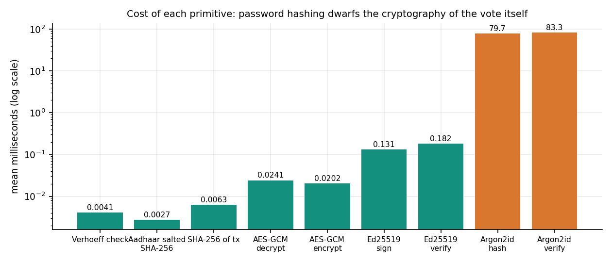
System configuration (no training step)
Setting | Value
One-time token | secrets.token_urlsafe(32); stored as SHA-256; expires after 10 minutes; one per election and voter
Rate limits | 10 logins and 15 verifications per 60 s per client IP (in memory)
Session | server-side store, cookie aegis_session HttpOnly, SameSite=lax; CSRF token in X-CSRF-Token on every POST; no Secure flag (plain HTTP)
Ledger | 3 validators, quorum 2, one transaction per block, genesis block at index 0
Machine | 3.11.9 on Windows 11, Intel i5-12500 (6 cores, 12 threads), 15.7 GB RAM; PC shared with other jobs
Argon2id hash 80 ms and verify 83 ms dominate; AES-GCM, SHA-256 and Ed25519 sign cost under 0.2 ms each. The cryptography of a vote is not the bottleneck.
Notes:
These are the fixed parameters read from the code. Micro-timings are means over thousands of calls on the shared PC (script run_experiments.py).

Slide 10
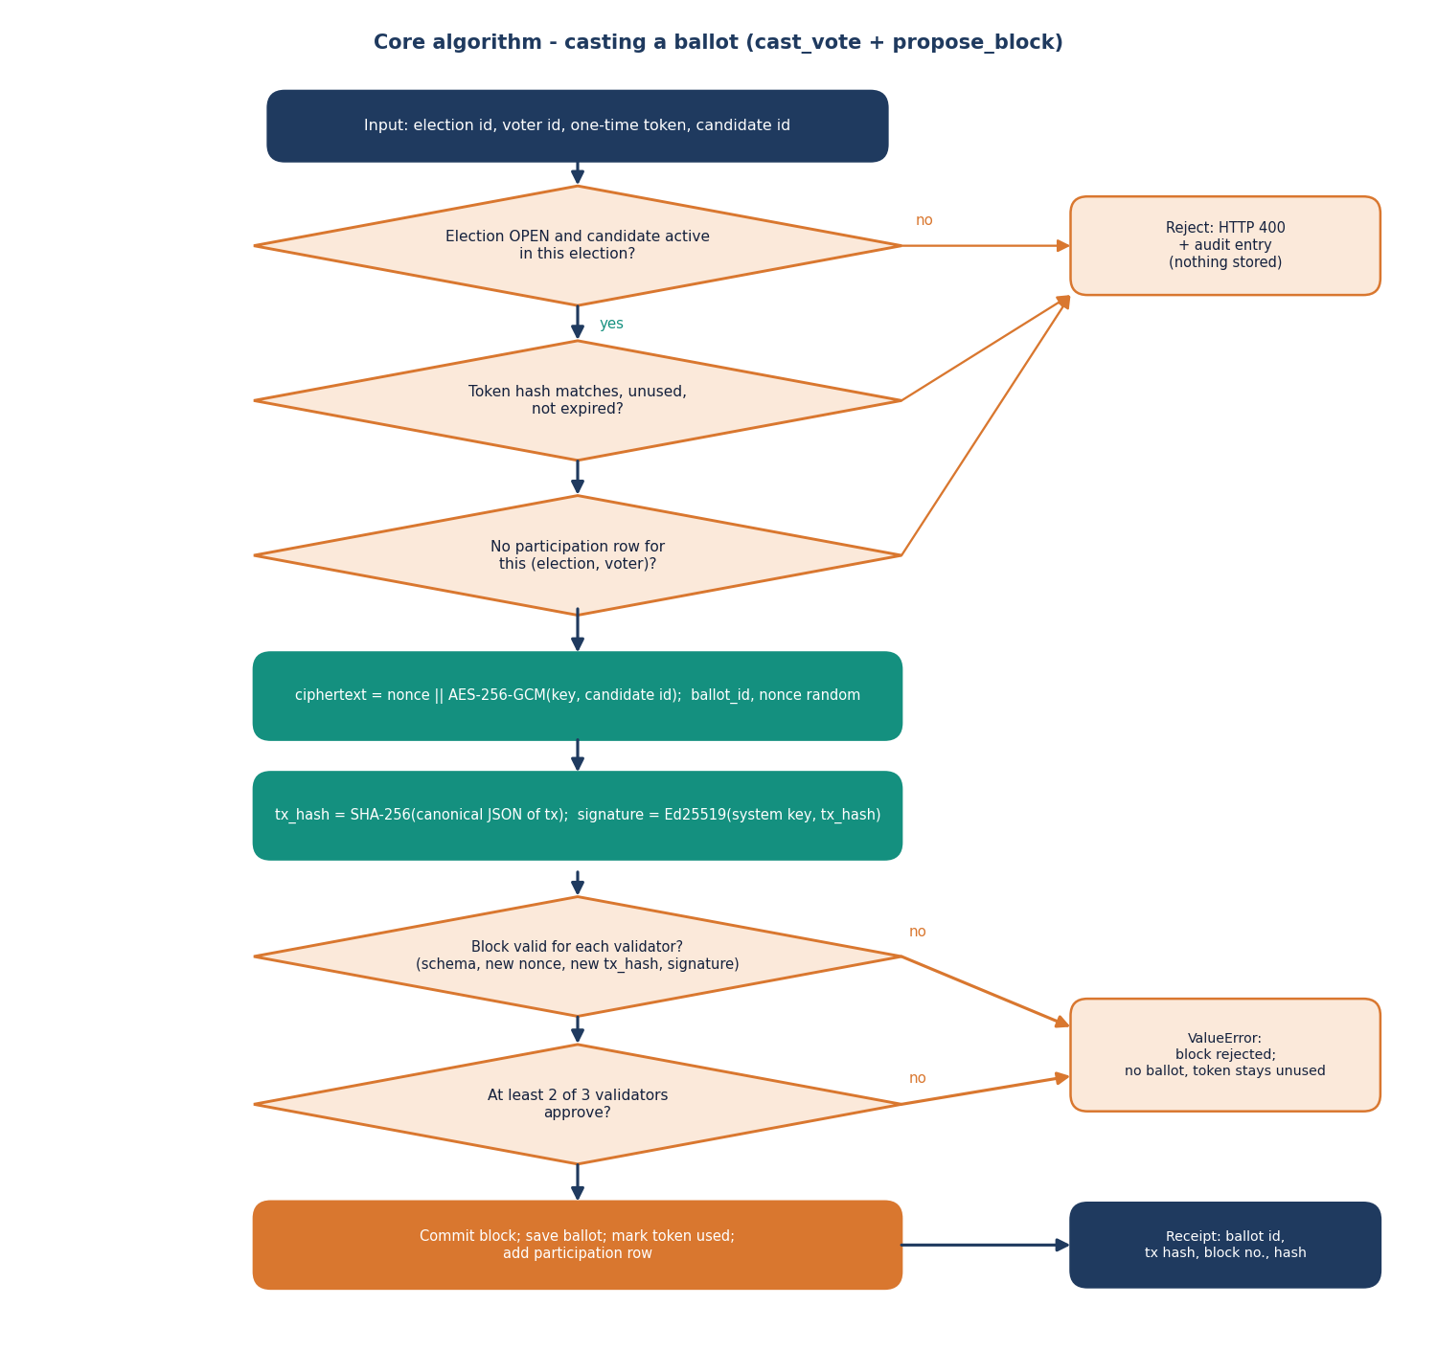
Decision logic: casting and auditing
cast_vote. Election OPEN and candidate active; token hash matches, unused, not expired; no participation row. Then encrypt, hash, sign.
propose_block. Each validator checks schema, new nonce, new transaction hash and signature, then signs the block hash. At least 2 of 3 approve, or a ValueError rejects the block and the token stays unused.
validate_chain. Recomputes the Merkle root, block hash and previous-hash link of every block; returns the first failing field.
Not covered. Validator signatures, transaction hashes against their fields, the ballots table and a dropped tip block (see testing).
Notes:
Left: the casting flowchart. Right: the three functions in app/services/voting_service.py and app/ledger/ledger.py. The last bullet is a finding from our own tamper study, shown later.

Slide 11
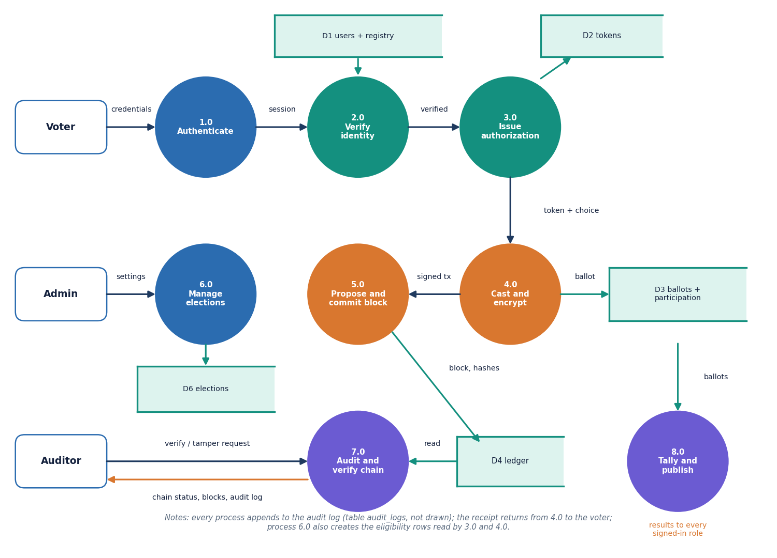
Data flow and modules
Module | Role
identity/provider, verhoeff | Aadhaar checks
services/voting_service | token, cast, tally
ledger/ledger | blocks, quorum, validate
security/crypto, auth | AES, Ed25519, Argon2id
security/sessions, rate_limit | cookie session, throttling
services/audit | audit log
api_v1 | 21 JSON routes
benchmarks/run_benchmark | latency and throughput
Notes:
Level-1 data flow: the login and Aadhaar check produce a token, the casting process hands a signed transaction to the ledger, and the auditor and tally processes read the stores.

Slide 12
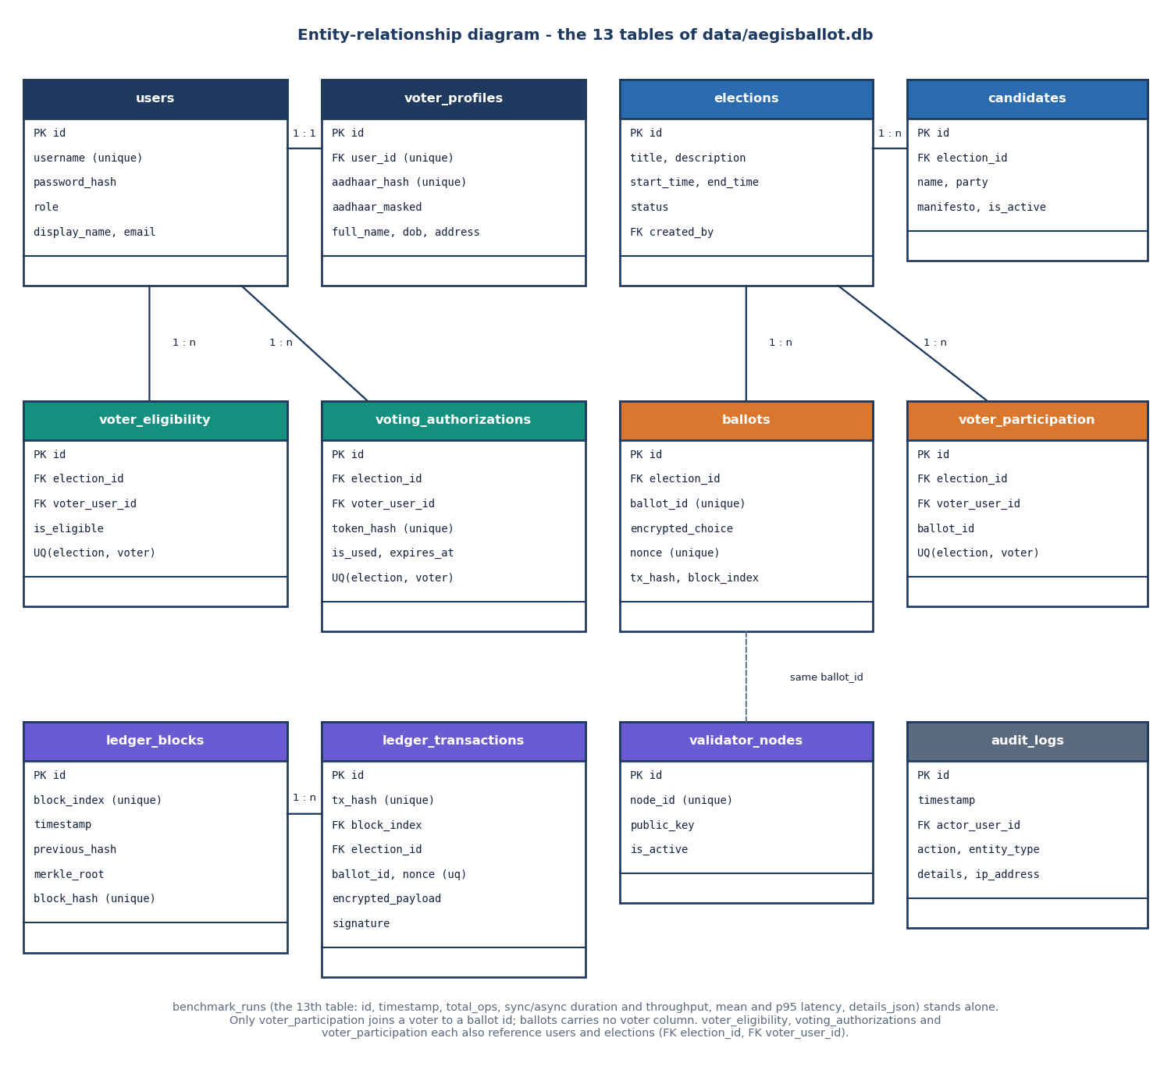
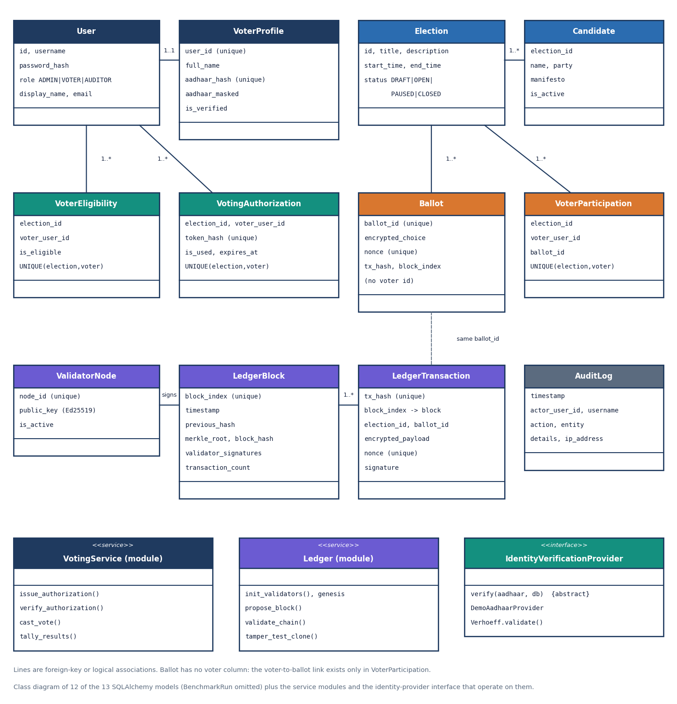
Database design and UML
13 tables. UNIQUE(election, voter) on eligibility, authorisation and participation lets the database refuse a second vote.
Notes:
Left: ER diagram of the 13 tables. Right: the models as classes with the voting and ledger modules. Ballots carry no voter column; voter_participation is the only voter-to-ballot link.

Slide 13
Technology stack
Layer | Technology
Backend | Python 3.11.9, FastAPI 0.110.0, Uvicorn, Pydantic, SQLAlchemy 2.0.30, SQLite
Cryptography | cryptography 42.0.7 (AES-GCM, Ed25519), argon2-cffi 23.1.0 (Argon2id), hashlib SHA-256
Reports | reportlab (PDF generation), Jinja2 (original pages)
Front end | React 18.3, Vite 8, TypeScript 5.9, Tailwind CSS 4, Radix UI, TanStack Query 5, React Router 7, Recharts 3, Framer Motion, GSAP
Testing | pytest (17 tests), FastAPI TestClient, httpx, an HTTP matrix in run_experiments.py, Playwright for screenshots
Run | run.bat creates the virtual environment, seeds the database and starts both servers (ports 8401 and 5401)
Notes:
Everything is open source. The versions are those measured: Python 3.11.9, FastAPI 0.110.0, SQLAlchemy 2.0.30.

Slide 14
Implementation progress
Component | Status | Evidence
Identity check (format, Verhoeff, registry, own id) | Done | 25 of 25 HTTP checks incl. identity cases
Token, encrypted ballot, one-vote layers | Done | duplicate / replay / expired cases rejected
Ledger: blocks, 3 validators, quorum, validate_chain | Done, gaps | 7 of 13 tamper cases detected
Admin, voter and auditor consoles | Done | 21 JSON routes; 23 screenshots
Audit log, rate limiting, CSRF, RBAC | Done | 401 / 403 / 429 verified
TLS / Secure cookies | Not done | plain HTTP, no Secure flag
Real UIDAI integration, distributed validators | Not done | synthetic registry; one-machine ledger
Notes:
State of the code base. The honest gaps: TLS, a real identity provider, distributed validators, and signature checks inside validate_chain.

Slide 15
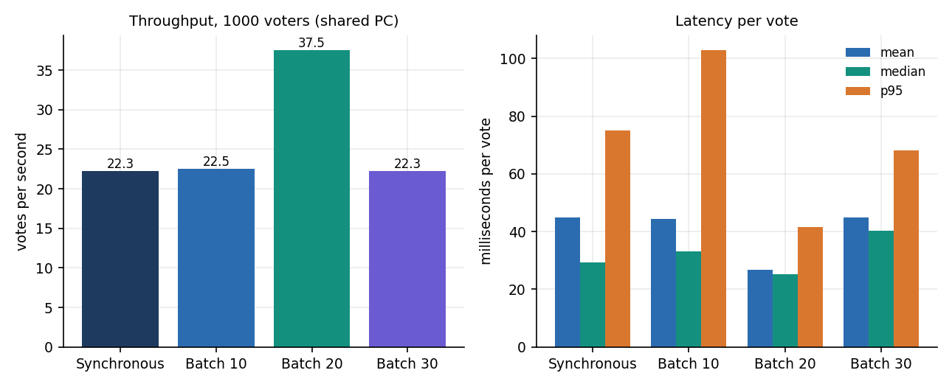
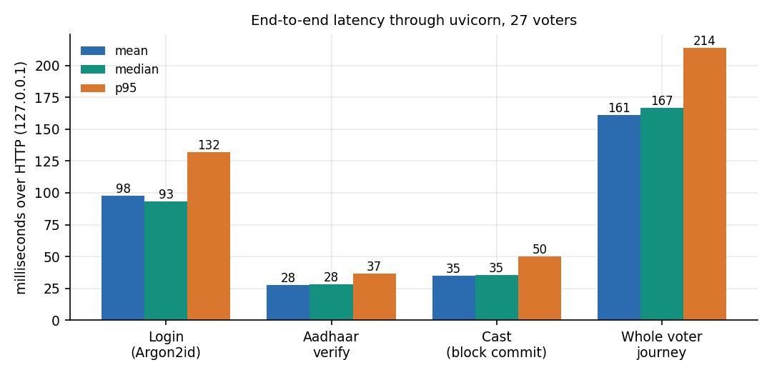
Preliminary results
1,000 / 1,000
45 ms
161 ms
7 of 13
votes succeeded in the benchmark, 0 failures
mean per vote on the shared PC (16-17 ms idle)
whole voter journey over HTTP (mean, 27 voters)
tamper cases caught by validate_chain
The 'async' batches in the benchmark run sequentially, so batch sizes differ only by noise; the base paper's 2-4 s per transaction (read from its charts) is on another chain and machine, so only the order of magnitude is comparable.
Notes:
Benchmark: 1000 synthetic voters, all votes succeeded; mean 44.9 ms, p95 75.0 ms on a shared PC; earlier idle-PC runs gave 16.1 to 17.3 ms. HTTP journey login + verify + cast averaged 161 ms, dominated by Argon2id login (98 ms).

Slide 16
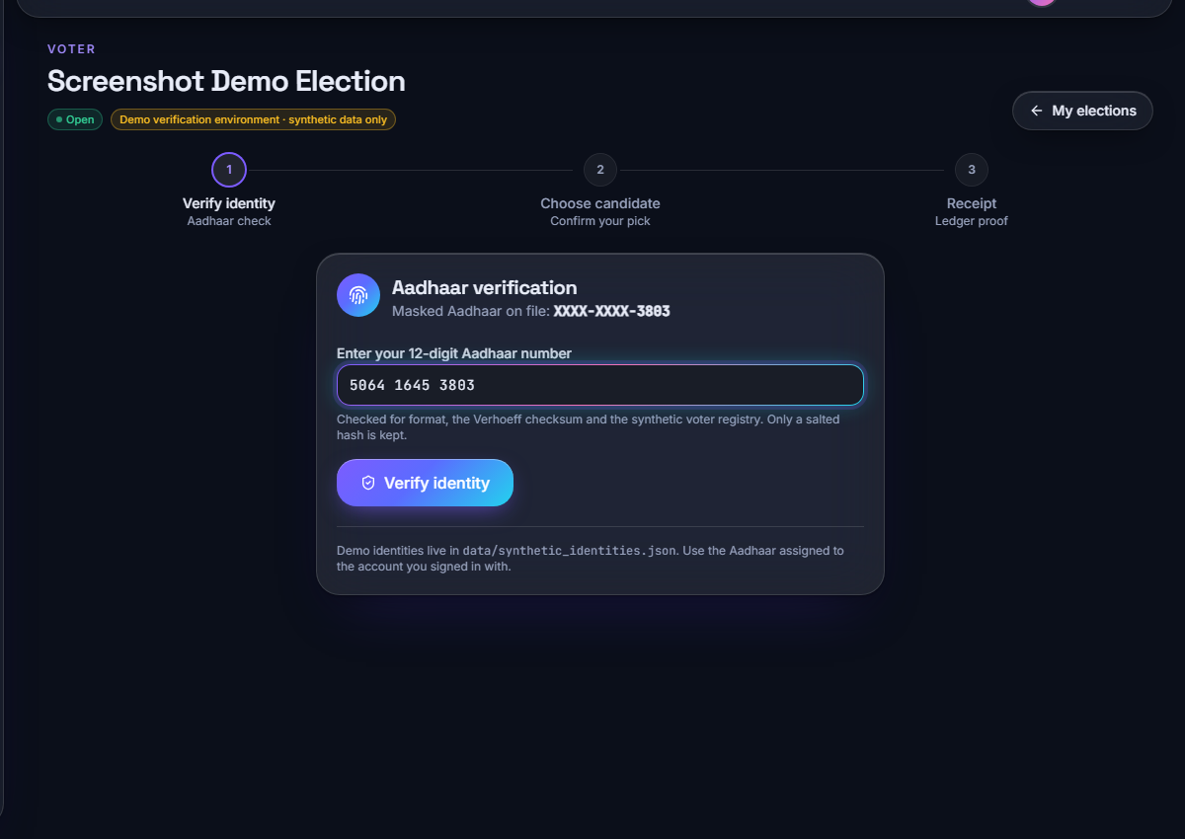
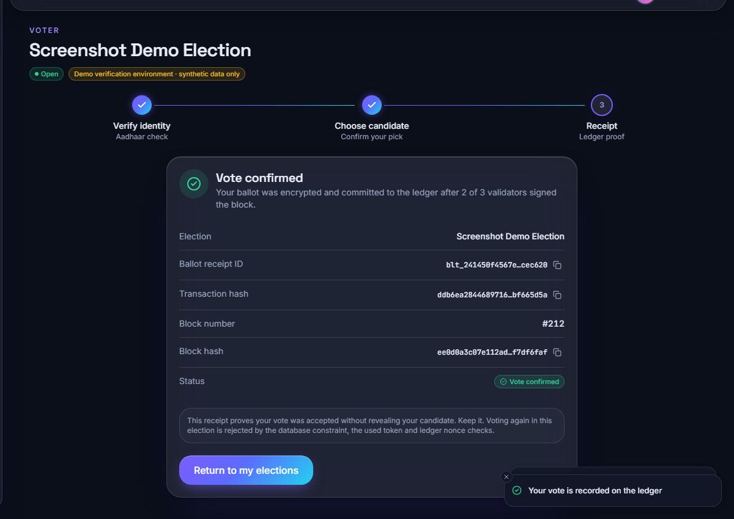
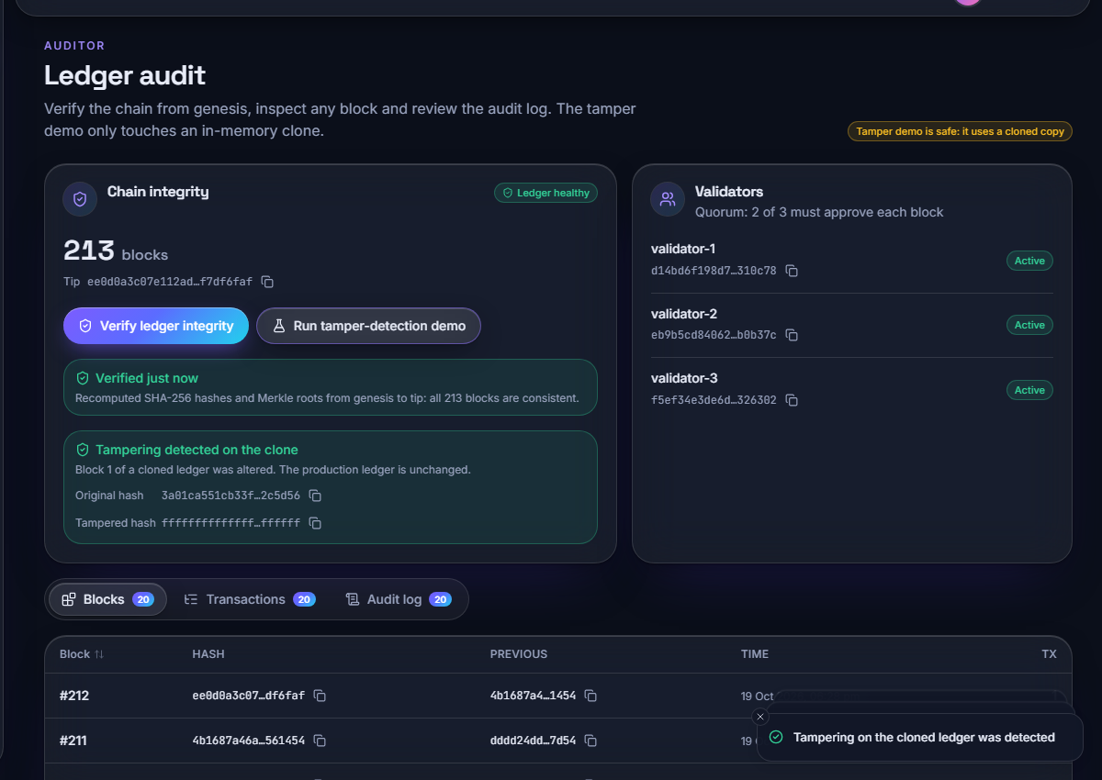
Output screens
1 Aadhaar check: masked number, format, Verhoeff, registry
2 Receipt: ballot id, transaction hash, block number
3 Auditor: chain integrity check and tamper demo
Real captures of the running React application (1440 x 900) against the demo database: 200 voters, 8 elections, 212 ballots, 213 blocks.
The voter flow is three steps: verify identity, choose a candidate, keep the receipt. The same receipt values appear in the auditor's block view.
The banner 'Demo verification environment - synthetic data only' is shown on every voter page.
Notes:
Real screenshots of the running React application with the demo database (200 voters, 8 elections, 212 ballots, 213 blocks): identity check, receipt and the auditor console. More screens follow in the final deck.

Slide 17
Initial testing and observations
17 / 17
25 / 25
HTTP 429
13 / 13
pytest tests passed
HTTP security and functional checks
login throttled after 10 attempts per 60 s
tamper cases caught by a stricter audit
Observation | Action
validate_chain misses edits to the ballots table (the tally source), edits with all hashes recomputed, forged signatures and a dropped tip block | Documented; stricter audit built for the study only; fix listed as next step
The 'tamper test' button simulates detection on an in-memory copy | Stated plainly; the unit test tampers the real database
Admin can read a live tally of an open election; voter_participation links voter to ballot | Listed as privacy limitations
Notes:
Tests ran on scratch databases so the demo data stayed untouched. The tamper study applied 13 kinds of edit to a 361-block chain and rolled each back.

Slide 18
Challenges and corrective actions
Challenge | Corrective action
No access to UIDAI; real Aadhaar data must not be used | Synthetic registry with valid Verhoeff check digits behind an interface that a real adapter can replace
Keeping identity apart from the ballot | Token hashed at rest, ballots table without voter id; remaining link in voter_participation measured and disclosed
Ledger checks weaker than the claim 'immutable' | Tamper study run; gaps reported; stricter audit prototyped in the experiment script
Benchmark noise on a shared PC | Idle runs (16-17 ms) and loaded run (45 ms) both reported
Base paper's setting differs (Ethereum, biometrics, C#) | Only order-of-magnitude comparison, differences stated
Notes:
Each challenge was met by a concrete design choice or by measuring it and saying so in the report.

Slide 19
Next steps
1
Harden the audit
2
Improve privacy
3
Secure transport
4
Evaluate further
Verify validator signatures, recompute transaction hashes and cross-check ballots against the ledger inside validate_chain.
Per-election keys, break the voter-to-ballot link, and keep tallies sealed until the election closes.
TLS with Secure cookies, persistent sessions and a shared rate-limit store.
Concurrent voting test, real multi-node validators, penetration test and a small usability study.
Notes:
Plan to the final review. The first two items address the gaps found by our own tamper study and design review.

Slide 20
Thank you
Questions and suggestions are welcome.
Notes:
Likely questions: is the Aadhaar check real (no, synthetic registry); is it decentralised (no, three validators on one machine); can the administrator change a vote (some edits are detected, some are not; see the tamper study).

