Slide 1

SECURE VOTING SYSTEM WITH AADHAR VERIFICATION THROUGH BLOCKCHAIN
Final Review · AegisBallot
Team Details : Batch C1
Under the Esteemed Guidance of
B Shruthi
[DESIGNATION], Department of CSE
23K91A05F6 Mohammed Anwar-Ul-Haq
23K91A05F4 Mohammad Mosin
23K91A05E4 Manda Akshitha
24K95A0516 Kothlapur Ganesh
DEPARTMENT OF COMPUTER SCIENCE AND ENGINEERING · TKR College of Engineering & Technology · Academic Year [ACADEMIC YEAR]
Notes:
Introduce the team and the project: AegisBallot, a local e-voting application with Aadhaar-style verification, encrypted ballots and an auditable ledger.

Slide 2
Table of Contents
Abstract
Base Paper & Literature Survey
Research Gap, Problem Statement & Objectives
Proposed System & Architecture
Methodology & Identity Verification
Ballot, Token & Ledger Design
Interaction, Database & Implementation
Results: Benchmark, Tamper Matrix, Parameters
Performance & Testing
Comparison with Base Paper
Output Screens
Conclusion, Future Scope & References
Dept. of CSE | Batch C1 | Final Review
2
Notes:
The agenda follows the report: problem, design, method, results, comparison, screens, conclusion.

Slide 3
Abstract
Manual polling is slow and error-prone; conventional e-voting keeps ballots in a database an administrator could alter, and without identity binding duplicate votes cannot be excluded reliably.
AegisBallot: a voter verifies a synthetic Aadhaar number (12 digits, Verhoeff checksum, salted-hash registry), receives a 10-minute single-use token, casts an AES-256-GCM encrypted ballot, and the Ed25519-signed transaction is committed to a hash-chained ledger by 2 of 3 validators.
Admin, voter and auditor roles on FastAPI + React; 17 of 17 tests and 25 of 25 HTTP security checks pass.
Benchmark of 1,000 synthetic voters: 1000 of 1000 votes succeed; mean 44.9 ms per vote on a shared PC (16-17 ms on an idle PC); a full voter journey over HTTP takes 161 ms.
The product's integrity check catches 7 of 13 tamper cases; a stricter audit written for the study catches 13 of 13.
Not done: real UIDAI link, networked validators, TLS, concurrent-vote tests, a user study.
Dept. of CSE | Batch C1 | Final Review
3
Notes:
Read the problem, then the system in one breath. Give each number with its protocol and end on the honest limits.

Slide 4
Base Paper
A. Shaikh, N. Adhikari, A. Nazir, A. S. Shah, S. Baig and H. Al Shihi, "Blockchain-enhanced electoral integrity: a robust model for secure digital voting systems in Oman," F1000Research, vol. 14, art. 223, 2025, doi: 10.12688/f1000research.160087.3.
Aspect | Base paper: Blockchain-enhanced electoral integrity - a robust model for secure digital voting in Oman
Method | Four tiers: MySQL + Ethereum nodes (Geth test chain, Nethereum) + C# web tier + client devices. Smart contracts register voters and candidates, cast and count votes; biometric authentication blocks duplicates (simulation)
Data | 1000 synthetic voters (synthetic SSNs, names, addresses); voter registration and vote-casting transactions
Reported results | Synchronous and asynchronous batches of 10, 20, 30, 50; about 2 s per registration and 3-4 s per vote (read by eye from its Figures 6 and 9; no tabulated values)
Security | Discusses Sybil, 51%, smart-contract and DoS threats; proposes PBFT among approved validators; no attack experiments
Stated limits | Layer-1 throughput (Ethereum about 119 tx/s as quoted), synthetic data, no pilot, public-trust studies needed
Dept. of CSE | Batch C1 | Final Review
4
Notes:
Shaikh et al., F1000Research 2025. We keep the idea of a ledger-backed vote and add national-ID-style identity, an admin and auditor workflow, and a tamper study; we do not use Ethereum.

Slide 5
Literature Survey
Work | Year | Approach | Data / finding / limitation
Shaikh et al. [1] (base) | 2025 | Ethereum (Geth test chain) smart contracts; biometric voter authentication; C# clients | 1000 synthetic voters; ~2 s / ~3-4 s per registration / vote tx (read from figures)
Chouhan & Sharma [2] | 2025 | Aadhaar / licence hashed with BLAKE2b-512, fingerprint and picture-rotation factors, hash chain | Concept and demo blocks; no throughput or tamper evaluation
Ray, Ojha & Rhmann [4] | 2024 | Study of a blockchain-powered electronic voting system | Abstract only available; no numbers used here
Krishan, Raj & Raj [5] | 2026 | Permissioned ledger, smart contracts, hashing for anonymity, real-time tally | Short preprint; scalability acknowledged as open, claims unverified
Aswini [6] | 2025 | Review of trust and security challenges; hybrid ZKP / homomorphic / sharding designs | Review, no implementation; lists malware, insiders, verifiability as limits
Bramasto et al. [7] | 2024 | DApp on the Vexanium blockchain (PHP 8.2, Apache, PostgreSQL) | Black-box tests passed; only smart contracts, no Ricardian contract or hardening
Jafar et al. [8] | 2021 | Systematic review of blockchain e-voting proposals | Privacy protection and transaction speed are the most reported issues
Springall et al. [10] | 2014 | Security analysis of Estonia's internet voting in real use | Found real attack paths against a deployed system with national ID
Dept. of CSE | Batch C1 | Final Review
5
Notes:
Representative blockchain-voting work. Entries whose full text could not be read are used only for what their abstracts say.

Slide 6
Research Gap
Surveyed work establishes blockchain models for electoral integrity
Base paper authenticates by biometrics on a test chain; no national-ID check, no admin workflow
Aadhaar-based proposals show concepts but report no performance or tamper tests
Few student-deployable systems join identity, ledger, admin and audit in one app
Ledger checks are rarely tested against edits to the tally source or forged signatures
Ethereum's ~119 tx/s (as quoted by the base paper) limits national-scale use
Dept. of CSE | Batch C1 | Final Review
6
Notes:
Six gaps from the survey. We address identity, administration and audit directly and measure what the ledger check does and does not catch.

Slide 7
Problem Statement
Manual voting is slow, needs heavy infrastructure and delays results
Conventional digital voting keeps ballots in a database an administrator could alter
Without identity binding, duplicate or ineligible voting cannot be prevented reliably
Voters and observers cannot independently verify that results were not manipulated
Need: verify identity, record each ballot immutably, produce an auditable result
Input
Output
Record
Login, a 12-digit Aadhaar number and a candidate choice from an eligible voter
An encrypted ballot on a hash-chained ledger, a receipt, a tally and an auditable trail
Audit log of every action; chain, blocks and benchmarks open to the auditor
Dept. of CSE | Batch C1 | Final Review
7
Notes:
The statement has three parts: verify identity, record the ballot immutably, and keep the result checkable.

Slide 8
Objectives
1. Voter registration and authentication with Aadhaar-based identity verification
2. One voter, one vote: identity binding plus duplicate checks
3. Record every ballot immutably with blockchain and cryptographic hashing
4. Admin portal for elections, candidates and polling windows
5. Results on close with a complete chronological audit trail
6. RBAC, input validation, TLS; evaluate integrity and performance
Dept. of CSE | Batch C1 | Final Review
8
Notes:
The six objectives of the proposal. The conclusion states the real status of each; objective 6 (TLS) was not met.

Slide 9
Proposed System
Sign in
Verify Aadhaar
One-time token
Encrypt + sign
Ledger block
Receipt + audit
Verify Aadhaar locally: 12 digits, Verhoeff checksum, salted-hash registry lookup
Issue a one-time token (hashed, 10 min) that separates identity from the ballot
Encrypt the choice with AES-256-GCM; sign the transaction with Ed25519
Commit each ballot to a hash-chained ledger approved by 2 of 3 validators
Give admin, voter and auditor roles with CSRF, rate limiting and an audit log
A local demonstration: no UIDAI call, no public chain; the interface labels it a demo verification environment.
Dept. of CSE | Batch C1 | Final Review
9
Notes:
The proposed system as one line of boxes and the five design rules behind it.

Slide 10
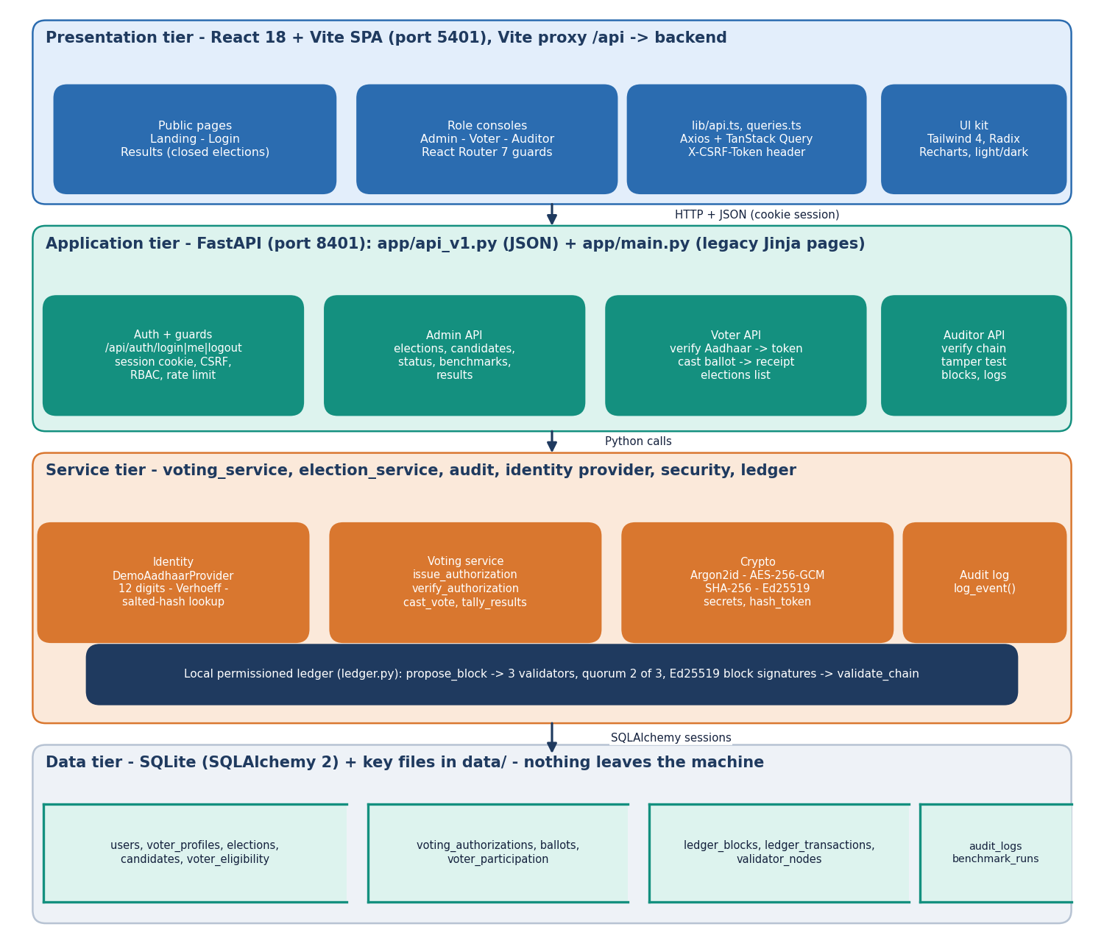
System Architecture
Web app: React + Vite on port 5401
API: FastAPI on port 8401, 21 JSON routes
Services: identity, voting, crypto, audit, ledger
Storage: SQLite, 13 tables, plus key files in data/
Everything runs on one machine; nothing is sent to an outside service
Dept. of CSE | Batch C1 | Final Review
10
Notes:
Tiers and storage; the ledger is a module inside the application, not a separate network.

Slide 11
Methodology
Login
Aadhaar check
Token
Encrypt
Sign + propose
2-of-3 commit
Audit
One vote per voter is enforced four ways: eligibility row, unique participation row, single-use token, and ledger nonce / transaction-hash uniqueness.
Identity and ballot are separated: the ballot row has no voter id; the token is stored only as a SHA-256 hash.
Controls: Argon2id passwords, server-side session, CSRF header, role checks, rate limits (10 logins and 15 verifications per minute per IP), audit log.
Evaluation: 17 unit tests, 25 HTTP checks, a 13-case tamper study, a 1,000-voter benchmark and latency measurements.
Every number comes from scripts/run_experiments.py, the product's own benchmark or the test run.
Dept. of CSE | Batch C1 | Final Review
11
Notes:
Workflow, the four-layer one-vote rule and how the system was evaluated.

Slide 12
Identity Verification: Verhoeff Check and Registry
0
Steps: strip spaces and dashes; exactly 12 digits; Verhoeff checksum (dihedral-group check over the digits); SHA-256 of salt + pepper + number looked up in voter_profiles.
The number must belong to the signed-in account (403 otherwise), the voter must be eligible and not yet have voted.
Only a salted hash and a masked form (XXXX-XXXX-1234) are stored.
Provider interface: DemoAadhaarProvider can be replaced by a real adapter. UIDAI is not contacted; numbers are generated with a valid check digit.
Component | Choice
Passwords | Argon2id
Ballot | AES-256-GCM, 12-byte nonce
Signatures | Ed25519 (system + 3 validators)
Hashing | SHA-256 chain
Quorum | 2 of 3 validators
external datasets: all identities are synthetic
20
seeded voters (voter1-20) + admin + auditor
0.007 ms
Verhoeff check + salted hash per Aadhaar
Dept. of CSE | Batch C1 | Final Review
12
Notes:
Be frank: the registry is synthetic and local. The Verhoeff check catches typing errors, not forged numbers.

Slide 13
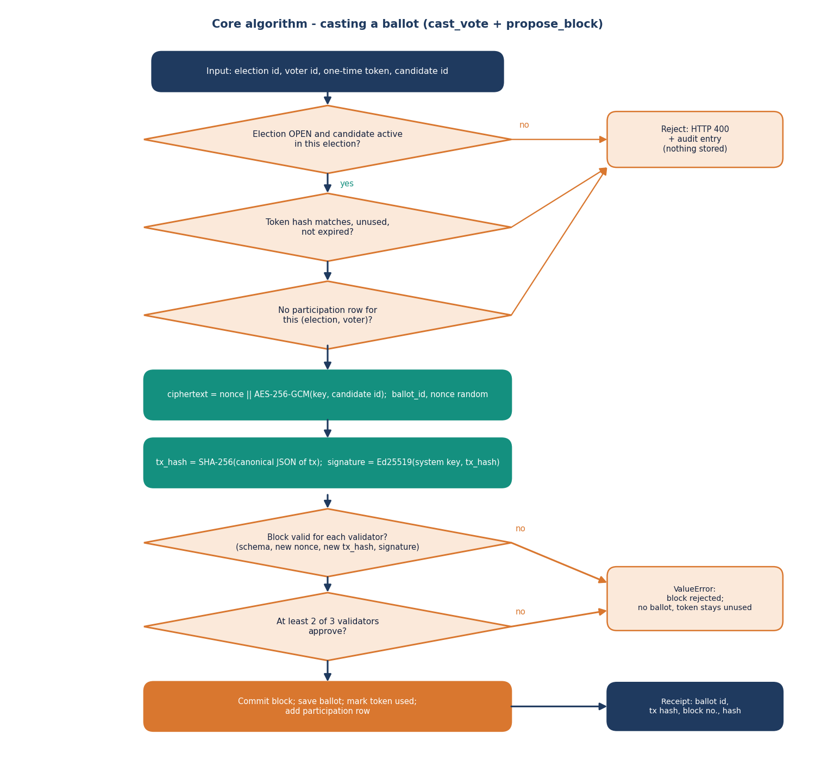
Ballot, Token & Ledger Design
Token: 256-bit random, only its SHA-256 stored, valid 10 minutes, one per voter and election.
Ballot: candidate id encrypted with AES-256-GCM; transaction hash = SHA-256 of the canonical JSON; Ed25519 signature.
Block: index, timestamp, previous hash, flat hash of the sorted transaction hashes, block hash, validator signatures; one transaction per block.
Validators: three Ed25519 keys held in the same process; each re-checks schema, nonce and hash uniqueness; two approvals commit.
This simulates a permissioned ledger on one machine; it is not Ethereum and not distributed.
Dept. of CSE | Batch C1 | Final Review
13
Notes:
The core algorithm: cast_vote followed by propose_block. Say plainly that the validators are simulated on one server.

Slide 14
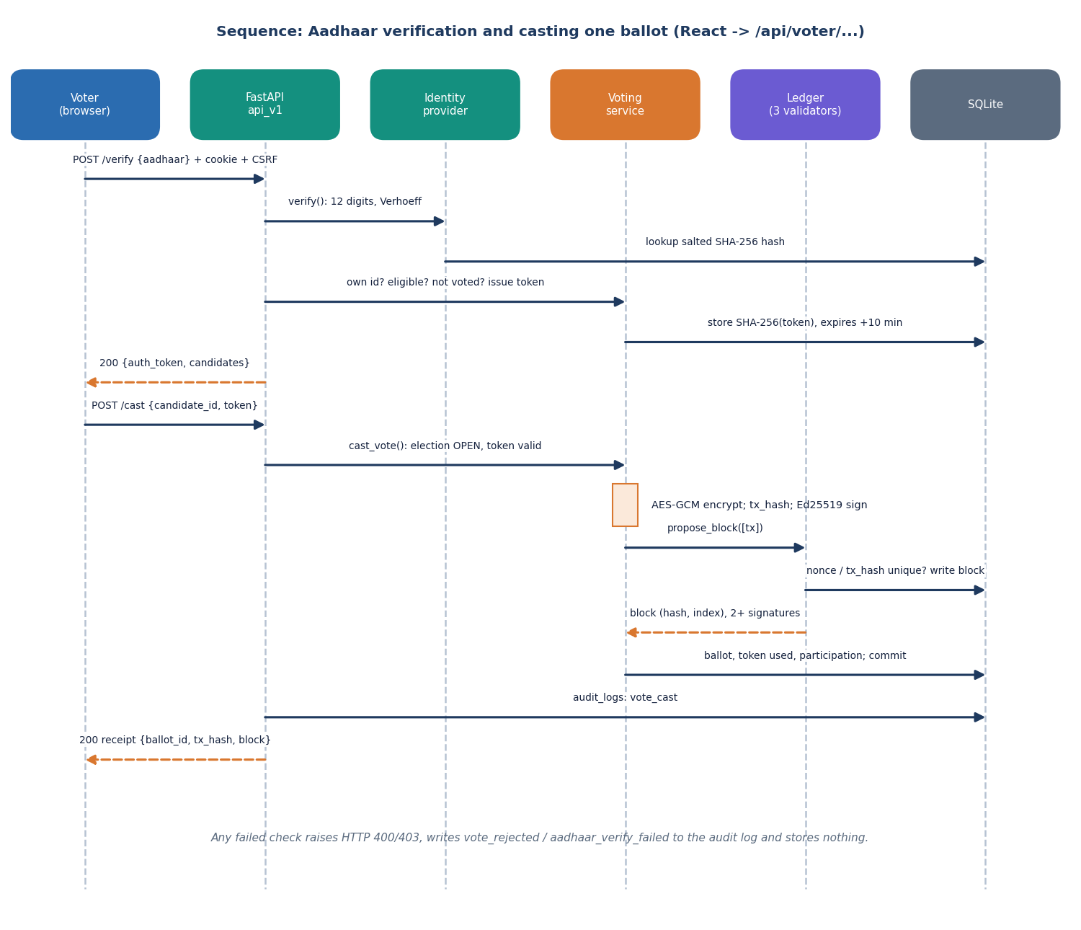
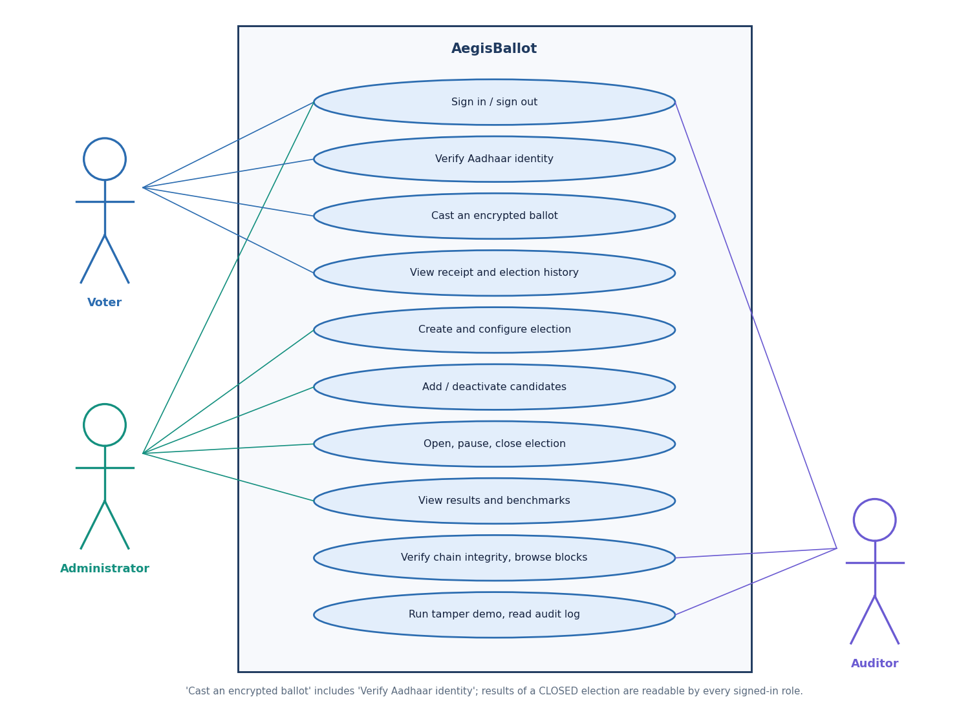
User – System Interaction
Dept. of CSE | Batch C1 | Final Review
14
Notes:
Sequence of verification and casting, and the use cases of voter, administrator and auditor.

Slide 15
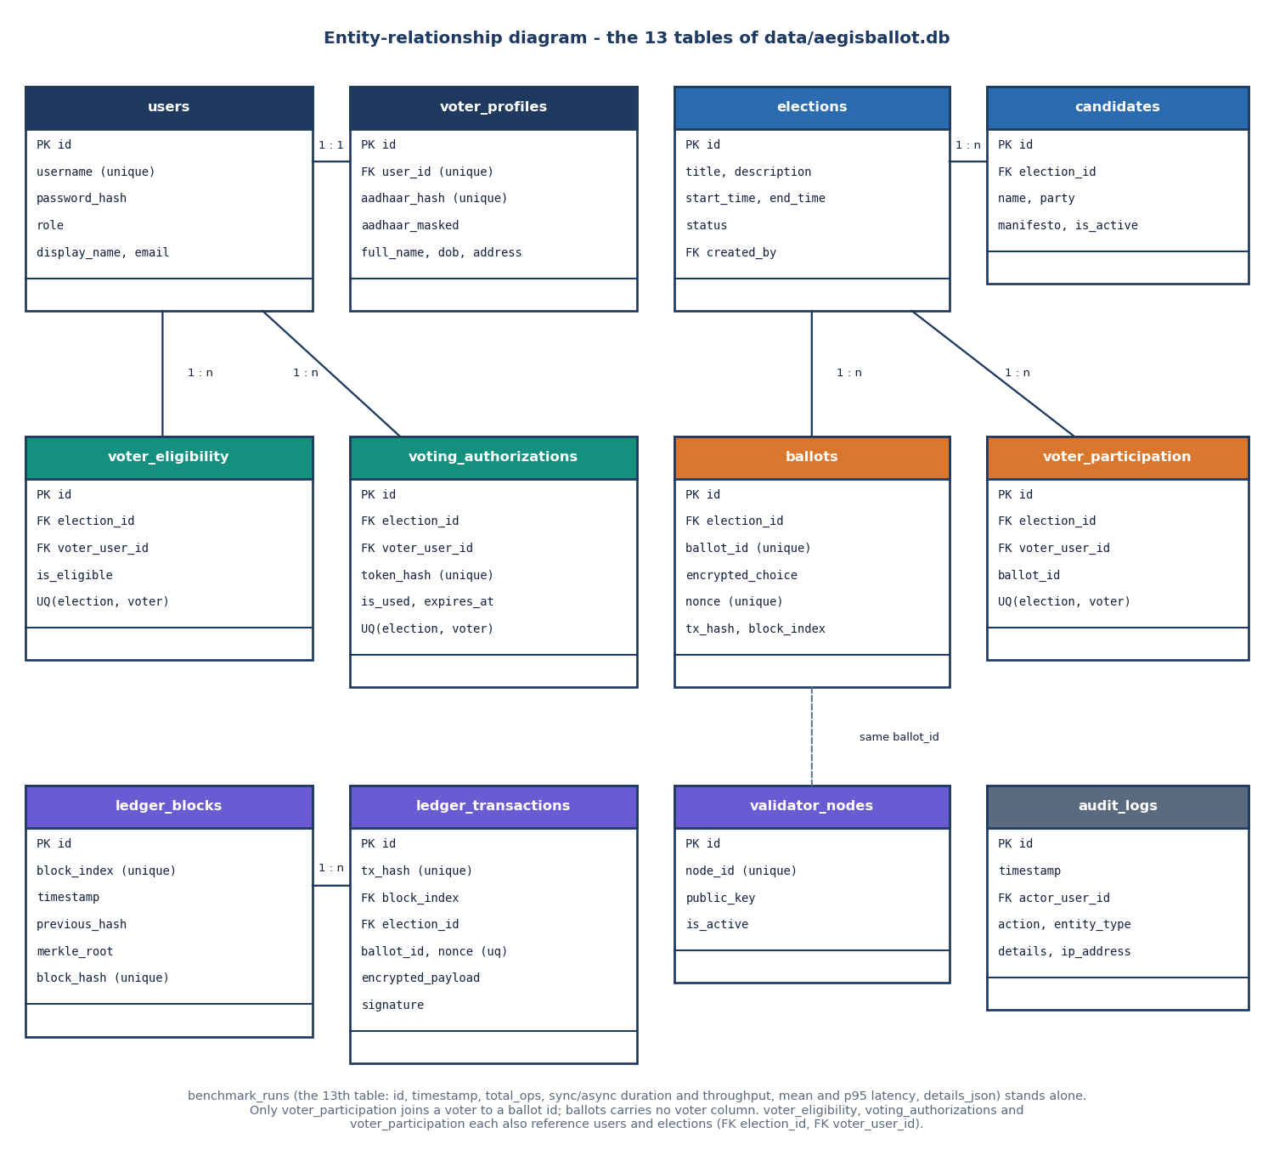
Database Design
Table | Role
users, voter_profiles | accounts; salted Aadhaar hash
elections, candidates | election set-up
voter_eligibility | who may vote, unique per pair
voting_authorizations | hashed single-use tokens
ballots | ciphertext, no voter id
voter_participation | voter + ballot id, unique per pair
ledger_blocks / _transactions | the chain
validator_nodes, audit_logs | public keys; action log
voter_participation joins a voter to a ballot id, so ballot secrecy is partial (stated as a limitation).
Dept. of CSE | Batch C1 | Final Review
15
Notes:
Thirteen tables in SQLite. The unique constraints are what the database itself uses to refuse a second vote.

Slide 16
Implementation Highlights
21
17 + 25
12
5,281
JSON API routes
unit tests + HTTP checks
React pages (3 role consoles)
lines of frontend TypeScript
Backend: FastAPI + SQLAlchemy 2 (about 2,091 lines); React 18, TanStack Query, Tailwind 4 frontend; one run.bat starts both servers.
Input checks: Pydantic models, Aadhaar format and checksum, election window and status, candidate must belong to the election.
Auditor tools: integrity check, block explorer, tamper demonstration on a cloned ledger, audit log viewer; admin benchmark page.
Known gaps: sessions and rate limits are in memory, no TLS or Secure cookie flag, keys stored as files in data/.
Dept. of CSE | Batch C1 | Final Review
16
Notes:
Highlights and the configuration gaps that a real deployment would have to close.

Slide 17
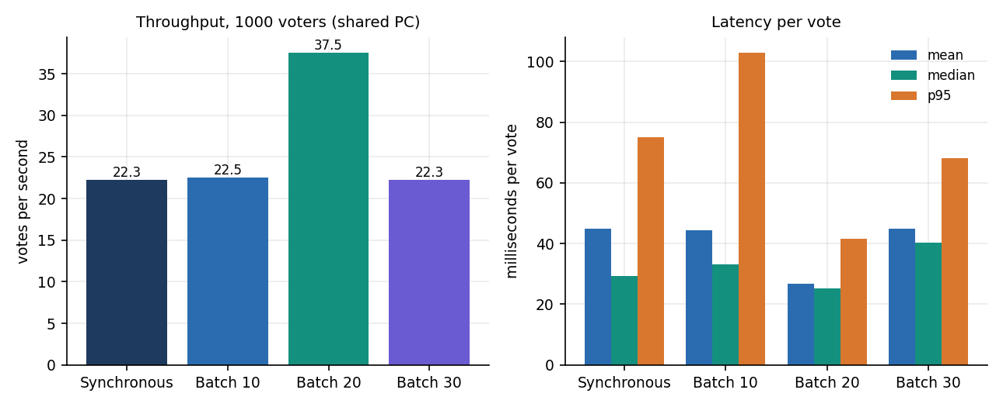
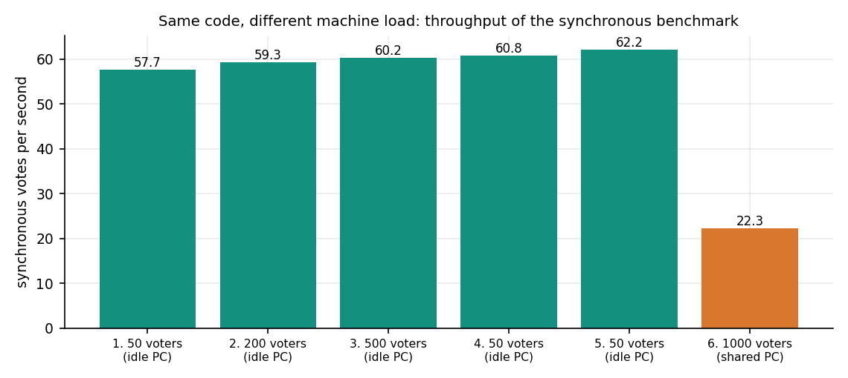
Results – Benchmark of 1,000 Synthetic Voters
1000 / 1000
44.9 ms
22.3 ops/s
16-17 ms
votes succeeded, 0 failures
mean per vote (shared PC)
synchronous throughput
mean per vote on idle PC (58-62 ops/s)
Median 29.4 ms, p95 75.0 ms, max 655 ms. The PC was shared with other jobs; earlier idle runs (50, 200, 500 voters) were about 60 ops/s.
'Batches' of 10, 20, 30 run sequentially in the benchmark code, so differences between them are machine noise, not an effect of batching.
Dept. of CSE | Batch C1 | Final Review
17
Notes:
The base paper used 1000 synthetic voters too. Stress that the batch bars differ only by load on the PC: the code is sequential.

Slide 18
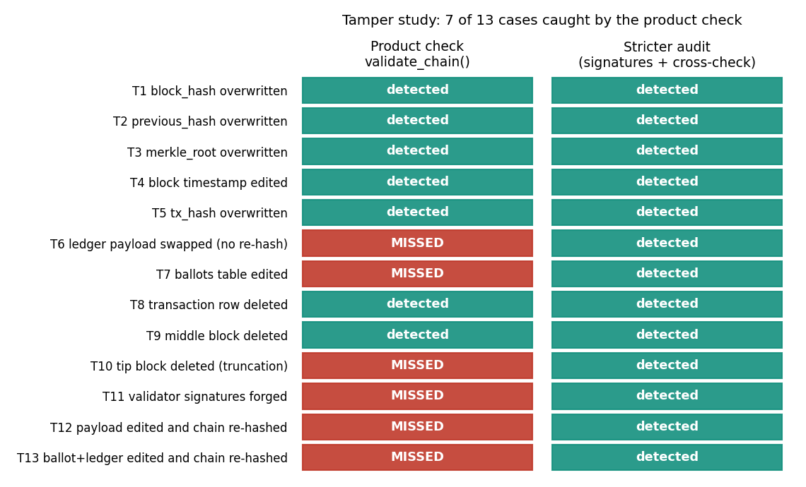
Tamper-Detection Matrix (13 cases)
Product check (validate_chain): 7 of 13 cases detected; stricter audit written for the study: 13 of 13.
Missed by the product: edited ledger payload, edited ballots table (the tally source, tally changes), edit with all hashes recomputed, forged validator signatures, dropped tip block.
The stricter audit verifies signatures, recomputes transaction hashes and cross-checks ballots against the ledger.
Keys sit on the same server, so a writer of the files could forge signatures too.
Each case was applied inside a transaction and rolled back; chain of 361 blocks.
Dept. of CSE | Batch C1 | Final Review
18
Notes:
This replaces the confusion matrix: it shows which tampering is detected. It is the most important finding of the evaluation.

Slide 19
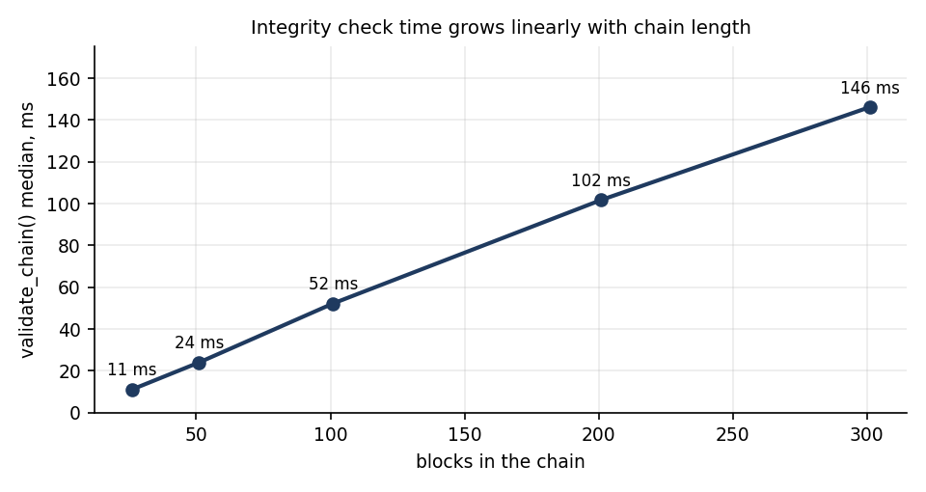
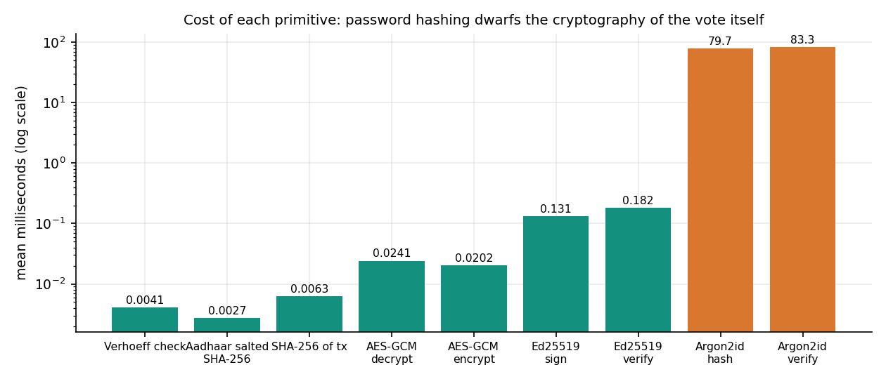
Parameter Analysis – Chain Height, Batch Size, Primitives
validate_chain grows linearly: 11 ms at 26 blocks, 146 ms at 301 blocks (about 0.5 ms per block).
Batch size 10 / 20 / 30: 22.5 / 37.5 / 22.3 ops/s on the loaded PC; batches run sequentially, so this is noise.
Primitives: AES-GCM 0.020 ms, Ed25519 sign 0.13 ms, Argon2id verify 83 ms: password hashing dominates login, not the ballot cryptography.
Dept. of CSE | Batch C1 | Final Review
19
Notes:
Parameter analysis for a systems project: how cost changes with chain length and which primitive dominates. Batch size has no real effect.

Slide 20
Performance & Testing
98 ms
28 ms
35 ms
161 ms
login over HTTP (Argon2id)
Aadhaar verification
cast ballot (block commit)
whole voter journey (27 voters)
Test layer | What it covers | Result
Unit tests (pytest) | Aadhaar format and checksum, duplicate vote, RBAC, tamper, nonce replay, token expiry, identity separation, audit log | 17 of 17 passed in 5.4 s
HTTP matrix | 401 / 403 / 400 / 404 / 429 paths: RBAC, CSRF, wrong or forged Aadhaar, replay, rate limit, injection-style login | 25 of 25 as expected
Per-vote stages (in-process) | authorise, encrypt + sign, propose block, persist | 11.0 + 0.5 + 16.8 + 9.5 ms
Not tested | concurrent voters, penetration test, user study, TLS, real UIDAI | gap
Intel Core i5-12500, 15.7 GB, Windows 11; the PC was shared with other jobs. Tests ran against scratch databases, never the demo database.
Dept. of CSE | Batch C1 | Final Review
20
Notes:
Everything passed, but the tests did not cover concurrency or a penetration test; say so.

Slide 21
Comparison with Base Paper (context only – different chain and scope)
Aspect | Base paper [1] | AegisBallot
Ledger | Ethereum (Geth test chain), smart contracts, Nethereum | Local permissioned ledger, 3 in-process validators, 2-of-3, SQLite
Identity | Biometric authentication (simulated) | Aadhaar-style 12 digits, Verhoeff + salted-hash registry (synthetic)
Stack / hardware | C# .NET Core 7, MySQL; i7-12700, 16 GB, Windows 10 | Python FastAPI, React, SQLite; i5-12500, 15.7 GB, shared PC
Test data | 1000 synthetic voters; batches 10, 20, 30, 50 | 1,000 synthetic voters; sequential batches 10, 20, 30
Time per transaction | about 2 s registration, 3-4 s vote (read by eye from Figs 6, 9) | cast 27-45 ms in-process (loaded PC), 35 ms over HTTP
Security evaluation | Threat discussion; no attack experiments | 25 HTTP checks + 13-case tamper study; not decentralised
Different chain, hardware, definition of a transaction and guarantees: the times are an order of magnitude only. No superiority over the base paper is claimed; a local ledger does not offer its decentralisation.
Dept. of CSE | Batch C1 | Final Review
21
Notes:
State plainly that a single-machine ledger is not comparable with an Ethereum test chain; the millisecond numbers show only that the local design is light.

Slide 22
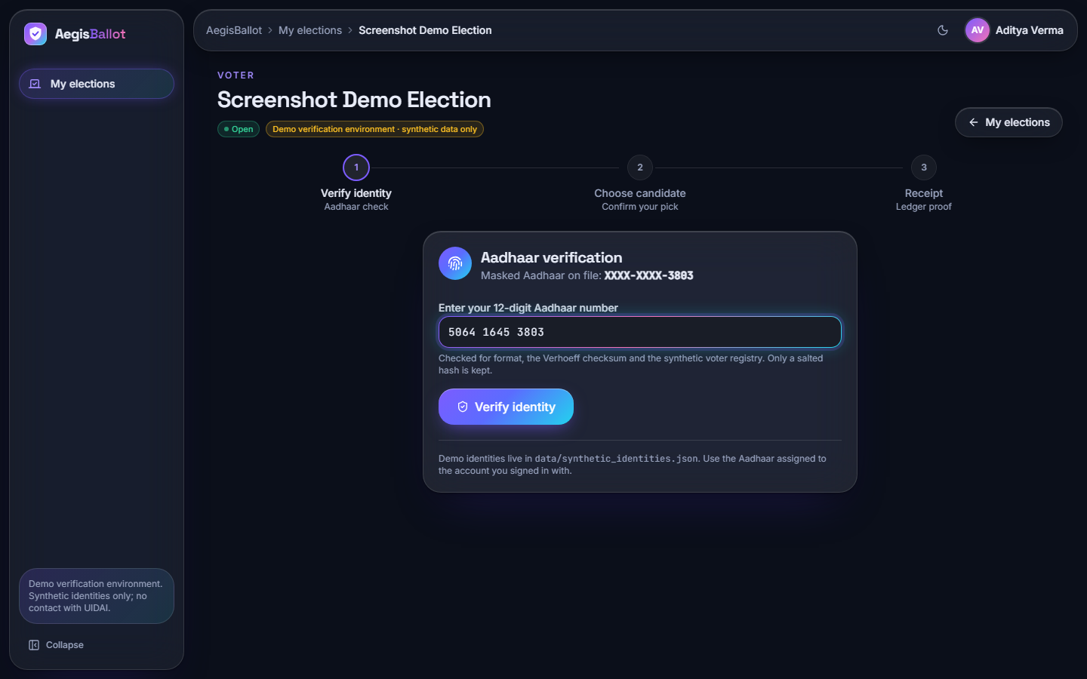
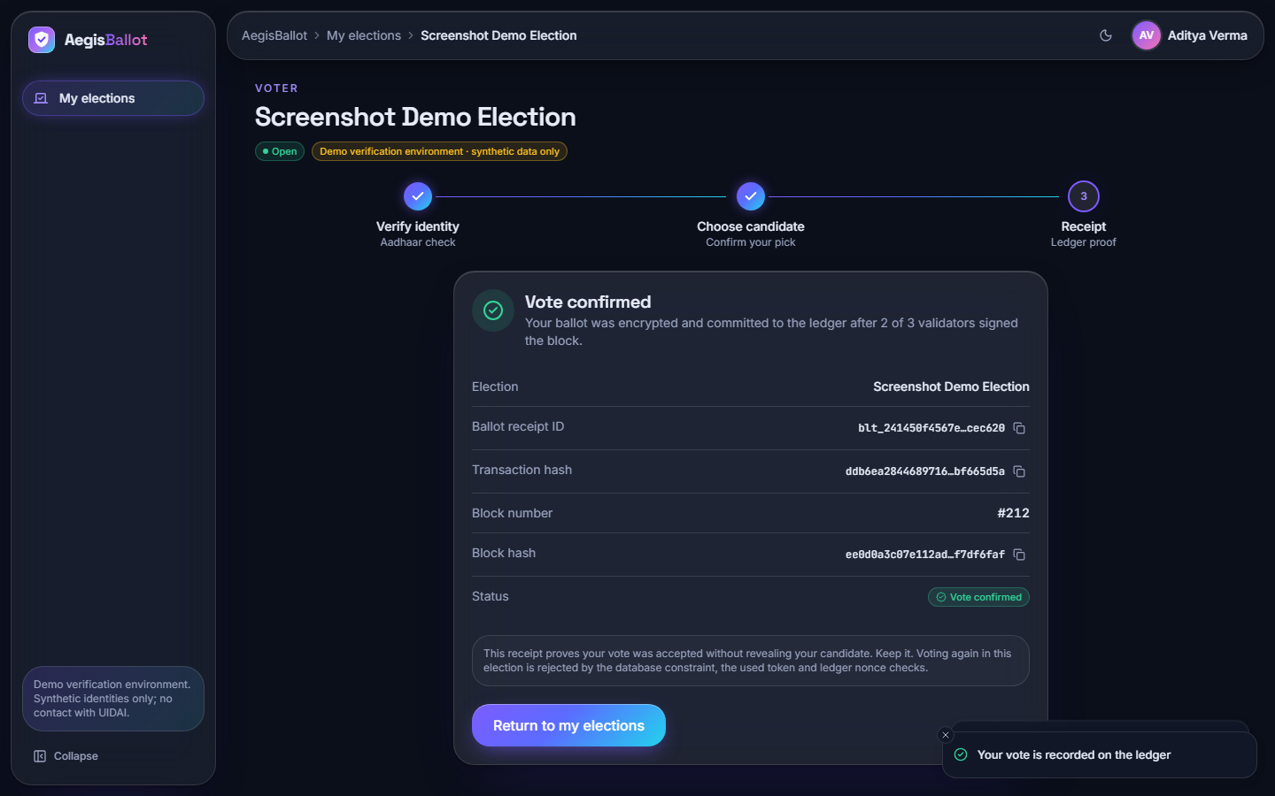
Output – Voter Flow: Aadhaar Verification and Receipt
Left: the voter enters a 12-digit number against the masked Aadhaar of the account; a token is issued for ten minutes. Right: after the vote the receipt shows ballot id, transaction hash, block number and block hash, never the choice.
Dept. of CSE | Batch C1 | Final Review
22
Notes:
Real screenshots of the running app with 200 voters, 8 elections and 212 ballots in the database.

Slide 23
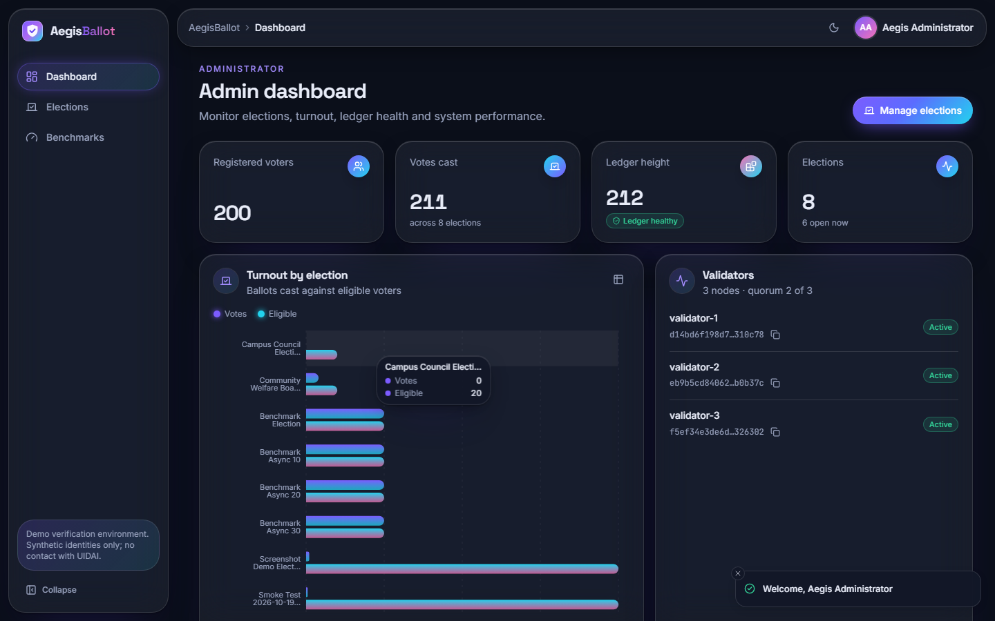
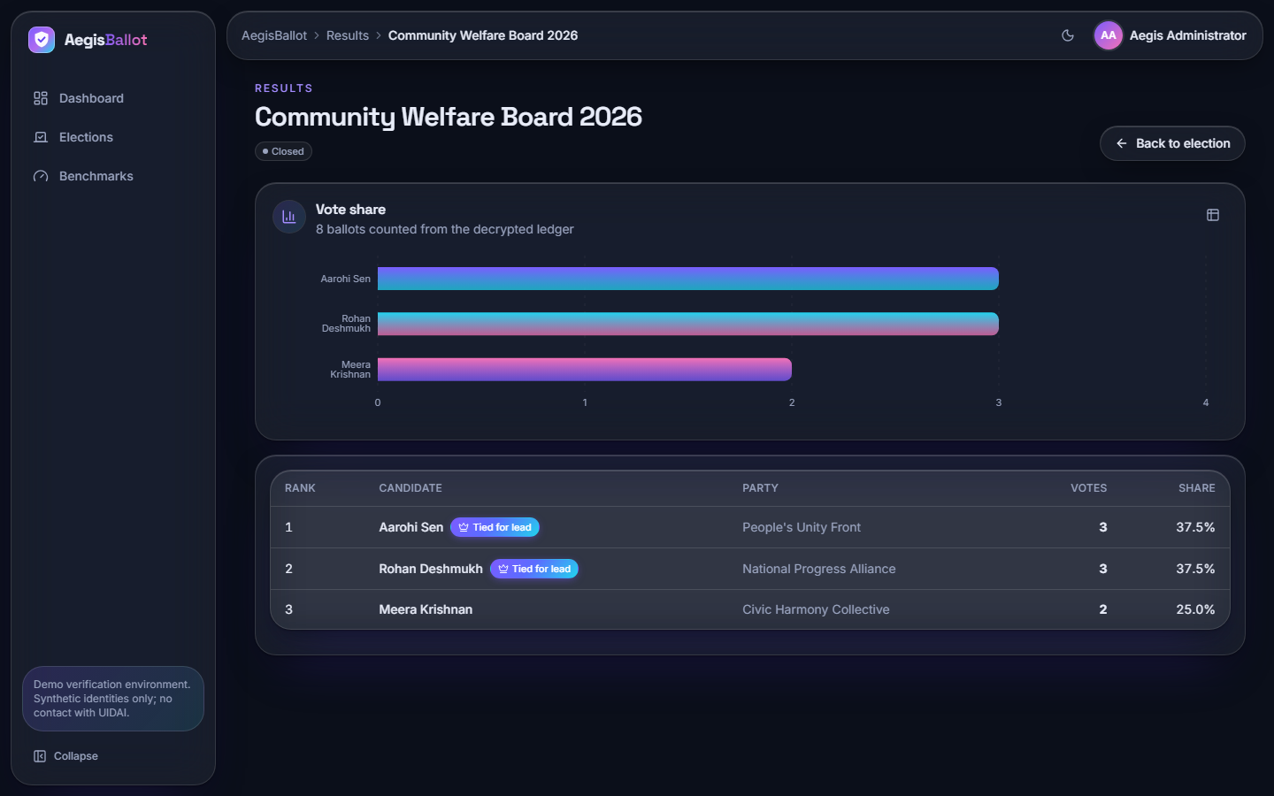
Output – Administrator Dashboard and Results
Left: dashboard with voters, votes cast, ledger height, validators and turnout per election. Right: results of a closed election, counted from the 8 decrypted ballots.
Dept. of CSE | Batch C1 | Final Review
23
Notes:
The tally is read from the ballots table; the tamper study shows the ledger check does not cover that table.

Slide 24
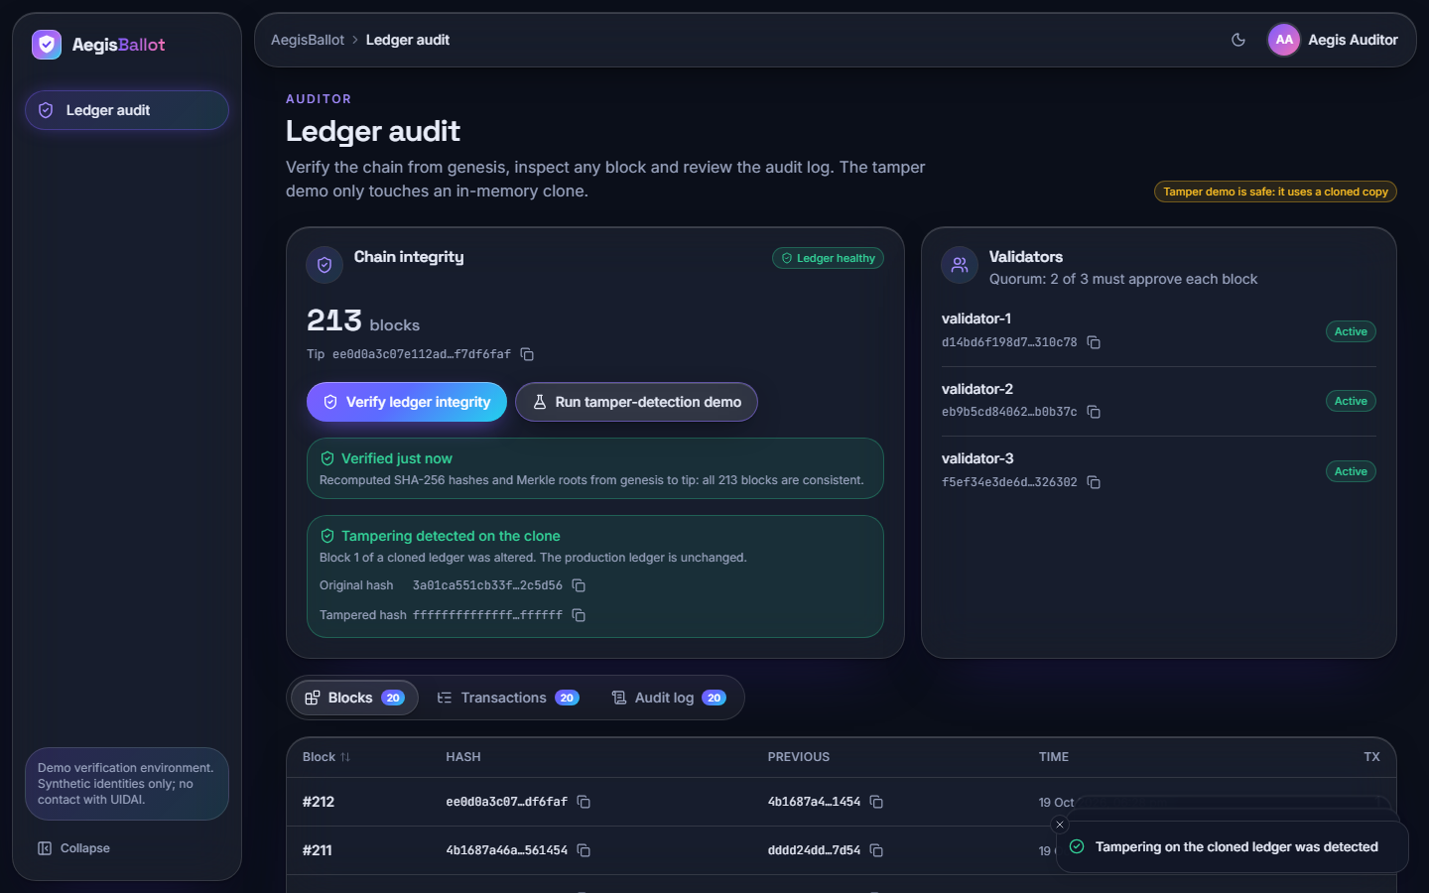
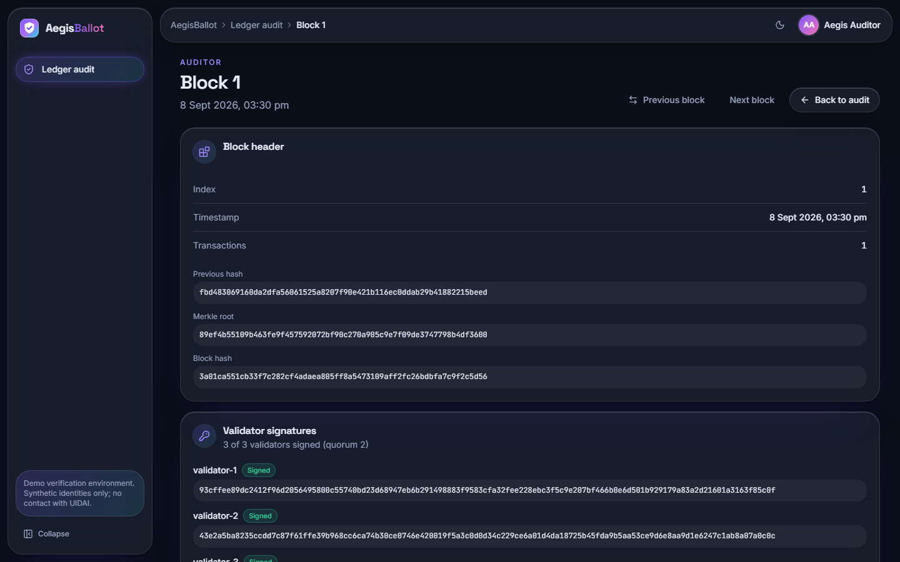
Output – Auditor Ledger View and Block Detail
Left: chain integrity, validators, integrity check and tamper demonstration. Right: one block with previous hash, Merkle root, block hash and the three validator signatures.
Dept. of CSE | Batch C1 | Final Review
24
Notes:
The auditor can recompute the chain and inspect every block; the tamper demonstration works on a cloned ledger.

Slide 25
Conclusion
Delivered: a working local e-voting platform from Aadhaar verification to encrypted ballot, ledger block, receipt, results and auditor view; 17 of 17 tests and 25 of 25 HTTP checks pass.
Measured: 44.9 ms mean per vote at 1,000 voters (shared PC), 161 ms per voter journey over HTTP; the integrity check detects 7 of 13 tamper cases.
Objectives: objective 2 achieved; 1, 3, 4, 5 and 6 achieved in part or with caveats (identity on a synthetic registry, 7 of 13 tamper cases caught, windows not enforced, TLS not configured).
Limits: synthetic registry, single-machine ledger, partial ballot secrecy, no TLS, no concurrency test, no user study.
Position: a local demonstration, not a national-election system.
Dept. of CSE | Batch C1 | Final Review
25
Notes:
Be explicit about which objectives were met and what was never measured.

Slide 26
Future Scope
Make validate_chain verify validator signatures, recompute transaction hashes and cross-check the ballots table; use a real Merkle tree.
Separate voter and ballot records so ballots are unlinkable; per-election keys; threshold or homomorphic tallying.
TLS with Secure cookies, persistent sessions, shared rate limiting; OTP or biometric second factor; a real identity-provider adapter.
Validators on separate machines with a network consensus (e.g. PBFT or Raft); PostgreSQL; concurrent-vote and load testing.
Penetration test, usability and accessibility study with real users, and a Layer-2 comparison with the base paper's approach.
Dept. of CSE | Batch C1 | Final Review
26
Notes:
Concrete next steps, ordered by value: close the audit gaps first.

Slide 27
References
[1] A. Shaikh, N. Adhikari, A. Nazir, A. S. Shah, S. Baig and H. Al Shihi, "Blockchain-enhanced electoral integrity: a robust model for secure digital voting systems in Oman," F1000Research, vol. 14, art. 223, version 3, Sep. 2025, doi: 10.12688/f1000research.160087.3.
[2] S. Chouhan and G. Sharma, "A new era of elections: leveraging blockchain for fair and transparent voting," arXiv:2502.16127, Feb. 2025.
[4] M. Ray, V. Ojha and W. Rhmann, "Electronic voting system powered by blockchain technology: a study," SSRN Electronic Journal, 2024, doi: 10.2139/ssrn.4483852. [SSRN lists the posting as May 2023 (ICCS 2023); the batch records 2024.]
[6] T. Aswini, "Blockchain in electronic voting systems: trust and security challenges," Sci. J. Artif. Intell. Blockchain Technol., vol. 2, no. 4, pp. 69-77, Oct.-Dec. 2025, doi: 10.63345/sjaibt.v2.i4.108.
[7] S. Bramasto, S. F. Savitri and E. R. Djuwitaningrum, "Electronic voting (e-voting) sebagai aplikasi terdesentralisasi pada Vexanium blockchain," Faktor Exacta, vol. 17, no. 2, pp. 96-107, Jun. 2024, doi: 10.30998/faktorexacta.v17i2.19405.
[8] U. Jafar, M. J. Ab Aziz and Z. Shukur, "Blockchain for electronic voting system - review and open research challenges," Sensors, vol. 21, no. 17, art. 5874, 2021.
[10] D. Springall et al., "Security analysis of the Estonian internet voting system," in Proc. ACM SIGSAC Conf. Comput. Commun. Secur. (CCS), 2014, pp. 703-715.
[15] S. Nakamoto, "Bitcoin: a peer-to-peer electronic cash system," 2008. [Online]. Available: https://bitcoin.org/bitcoin.pdf
[16] V. Buterin, "A next-generation smart contract and decentralized application platform (Ethereum white paper)," 2014.
[18] M. Castro and B. Liskov, "Practical Byzantine fault tolerance," in Proc. 3rd Symp. Operating Syst. Design Implement. (OSDI), 1999, pp. 173-186.
[20] National Institute of Standards and Technology, "Secure hash standard (SHS)," FIPS PUB 180-4, Aug. 2015.
[21] M. Dworkin, "Recommendation for block cipher modes of operation: Galois/Counter Mode (GCM) and GMAC," NIST Special Publication 800-38D, Nov. 2007.
[22] S. Josefsson and I. Liusvaara, "Edwards-curve digital signature algorithm (EdDSA)," IETF RFC 8032, Jan. 2017.
[23] A. Biryukov, D. Dinu and D. Khovratovich, "Argon2: new generation of memory-hard functions for password hashing and other applications," in Proc. IEEE Eur. Symp. Secur. Privacy (EuroS&P), 2016, pp. 292-302.
Dept. of CSE | Batch C1 | Final Review
27
Notes:
Selected references with their report numbers; the complete numbered list is in the report.

Slide 28
THANK YOU
Questions & Suggestions
Dept. of CSE | Batch C1 | Final Review
28
Notes:
Invite questions.

