Slide 1


AI HEALTH INSURANCE ASSISTANCE USING LLM + RAG
NAME REG.NO
1 G.PRANATHI 23K91A6764
2 CH.AISHWARYA 23K91A6747
3 BHAVANSH MANE 23K91A6728
4 B.DEEKSHITH 24K95A6701
Guide Name:
GUIDE NAME
CSE (DATA SCIENCE)
BATCH : A1

Slide 2
CONTEXT
Introduction
Abstract
Existing system
Limitation of Existing system
Proposed System
System Architecture
Methodology
System Requirements
Conclusion
CSE (DATA SCIENCE)

Slide 3
INTRODUCTION
Health insurance is essential for managing medical costs, but policy documents are long and written in dense legal and technical language.
Policyholders often cannot tell what is covered, what is excluded and which conditions apply until a claim is rejected.
Understanding a policy or filing a claim usually depends on agents, call centres or other expert intermediaries.
Large Language Models can explain complex text simply, but on their own they may produce answers the policy does not support.
Retrieval-Augmented Generation grounds every LLM answer in the relevant clauses retrieved from the user's own policy document.
This project builds an AI health insurance assistant that combines RAG and an LLM to explain policies and guide users through claims.
CSE (DATA SCIENCE)

Slide 4
ABSTRACT
Health insurance policies are long, technical documents, so users struggle to understand coverage, exclusions, deductibles and claim procedures.
The project builds an AI health insurance assistant that combines Retrieval-Augmented Generation (RAG) with a Large Language Model (LLM).
Uploaded policy documents are parsed to extract key attributes such as policy number, coverage limits, deductibles, exclusions and benefit rules.
A conversational chatbot answers policy-specific questions in plain language, grounded in and citing the retrieved policy clauses.
The assistant also guides claims with eligibility pre-checks, evidence checklists and step-by-step procedures, and supports plan comparison.
CSE (DATA SCIENCE)

Slide 5
Existing system
Insurers publish policy wordings as long PDF documents that users must read and interpret on their own.
Customer queries are handled by agents, call centres and FAQ pages that give generic rather than policy-specific answers.
Comparison websites compare premiums and headline benefits but do not explain exclusions or claim conditions.
General-purpose chatbots answer from broad training data rather than the user's actual policy document.
CSE (DATA SCIENCE)

Slide 6
Limitations of Existing system
Policy wording is technical and lengthy, so key exclusions and conditions are easily missed.
Answers from agents and helplines are slow, inconsistent and depend on human availability.
Generic chatbots can hallucinate coverage details because their answers are not grounded in the policy.
No single tool automatically extracts key attributes such as deductibles, limits and waiting periods.
Claim filing offers no guided pre-checks for eligibility or required documents.
Users receive answers without references to the clauses that support them.
CSE (DATA SCIENCE)

Slide 7
Proposed System
An AI assistant reads uploaded health insurance documents and extracts policy number, coverage limits, deductibles, exclusions and benefit rules.
Policy text is split into chunks, embedded and stored in a vector database for semantic retrieval.
For each question, RAG retrieves the most relevant clauses and the LLM generates a plain-language answer citing them.
Claim guidance provides eligibility pre-checks, evidence checklists and step-by-step procedural instructions.
Summaries highlight risks, exceptions, cost and coverage trade-offs and recommended next actions.
CSE (DATA SCIENCE)

Slide 8
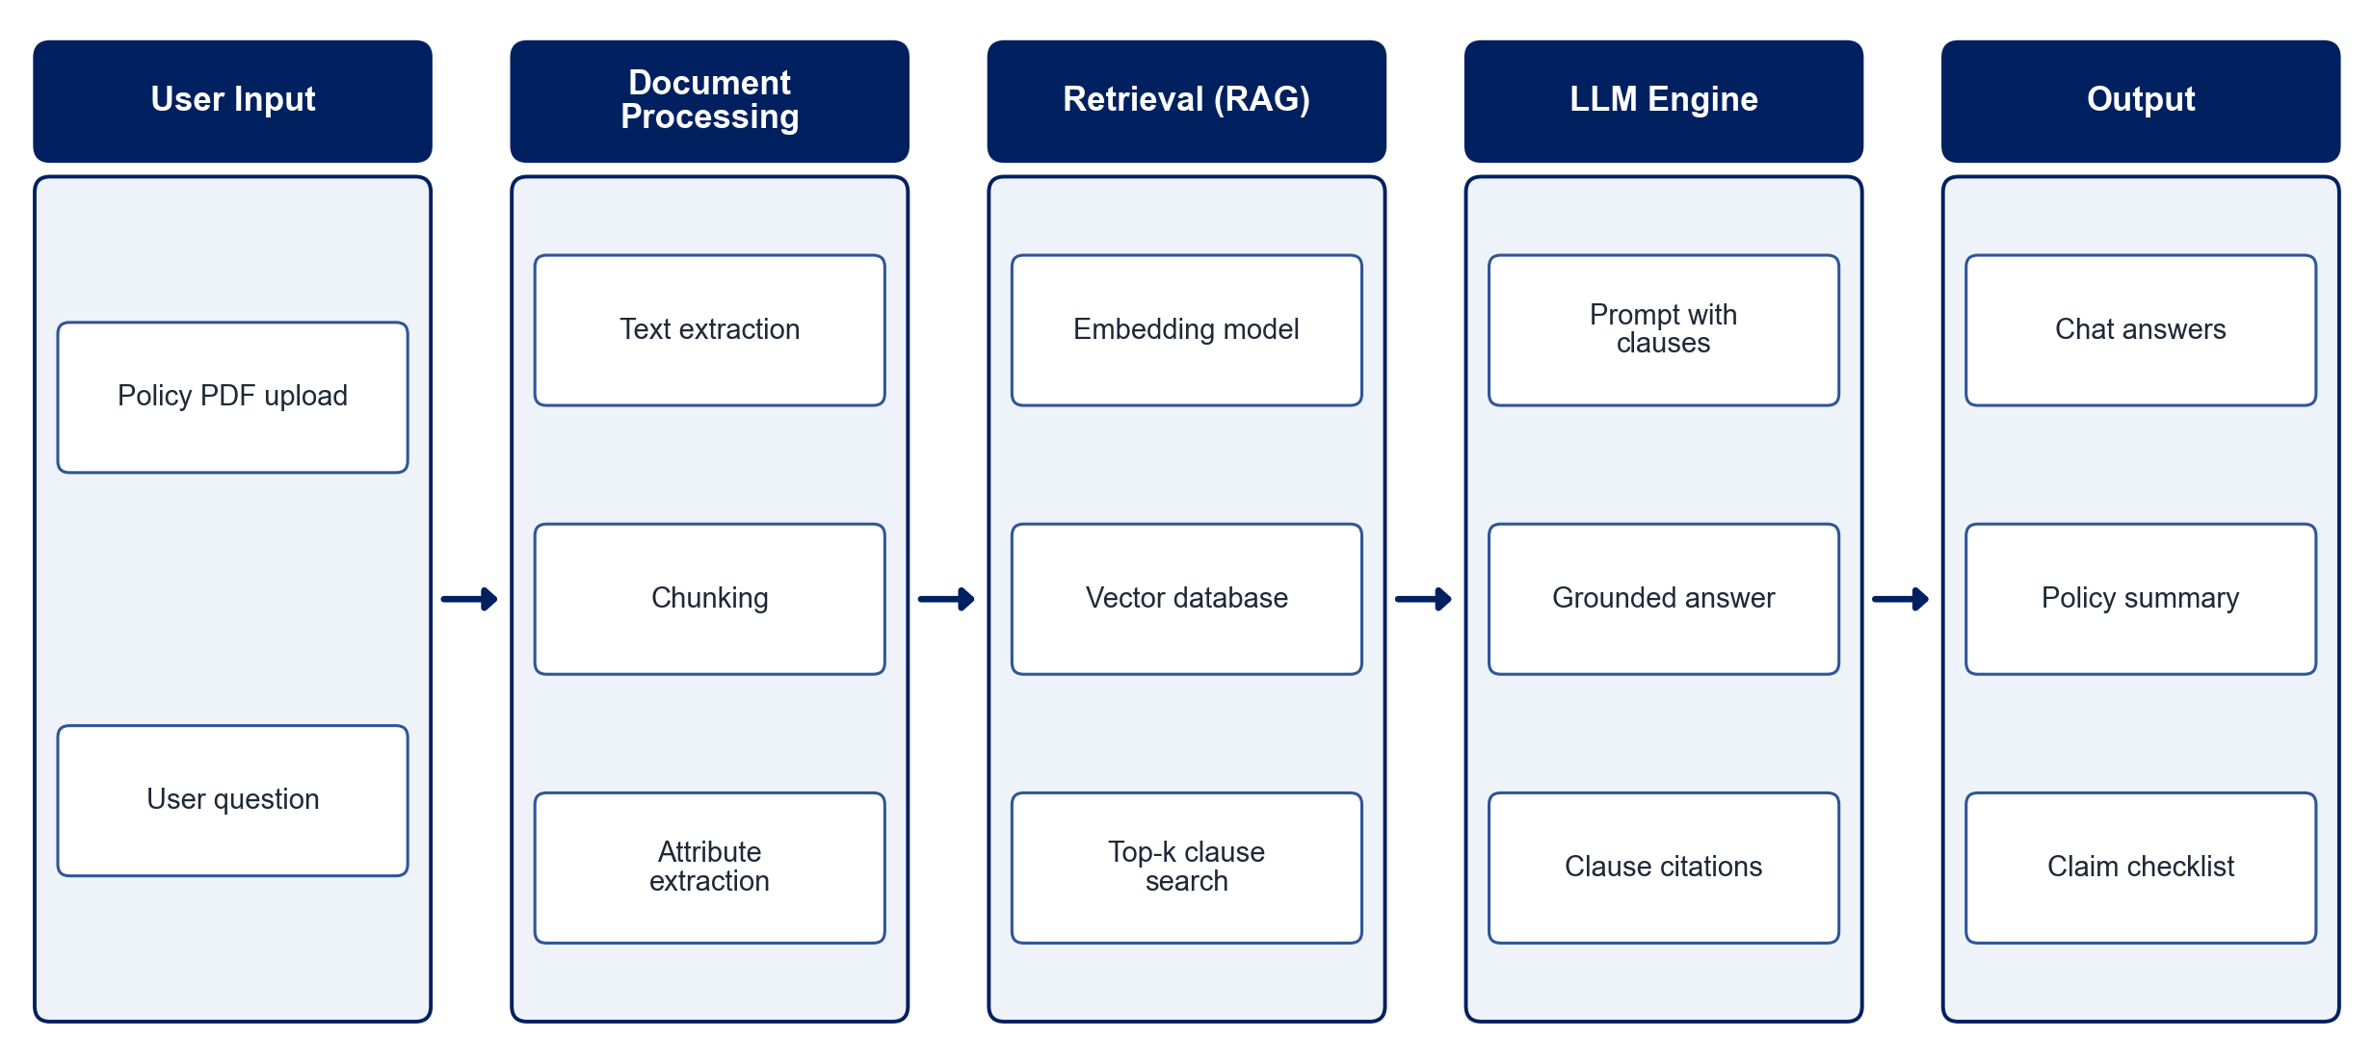
PROPOSED SYSTEM ARCHITECTURE
        Fig:- 1.1. System Architecture
CSE (DATA SCIENCE)

Slide 9
METHODOLOGY
Data Collection: Gather sample health insurance policy documents, brochures and claim-procedure guides.
Preprocessing: Extract text from PDFs, clean it and split it into overlapping clause-level chunks.
Attribute Extraction: Identify policy number, sum insured, deductibles, exclusions, waiting periods and benefit rules.
Embedding & Indexing: Convert chunks into vector embeddings and store them in a vector database.
Retrieval: Retrieve the top-matching clauses for each user query by semantic similarity.
Answer Generation: Pass the query and retrieved clauses to the LLM to produce a grounded answer with clause references.
Claim Guidance: Generate eligibility pre-checks, document checklists and step-by-step claim instructions.
Evaluation: Measure answer relevance, faithfulness to the policy and response time on test questions.
CSE (DATA SCIENCE)

Slide 10
SYSTEM REQUIREMENTS
Hardware Requirements
Processor: Intel Core i5 or equivalent
RAM: 8 GB or higher
Storage: 20 GB free space
Network: Stable internet connection for LLM API access
Software Requirements
Operating System: Windows 10/11 or Linux
Language: Python
Frameworks: LangChain, FastAPI / Flask
LLM: OpenAI GPT / Gemini API
Vector Store: FAISS / ChromaDB
PDF Processing: PyMuPDF / pdfplumber
Interface: Streamlit / React
CSE (DATA SCIENCE)

Slide 11
Conclusion
The assistant turns lengthy, technical health insurance documents into clear, policy-specific answers.
Grounding LLM responses in retrieved clauses improves reliability and lets users verify every answer.
Claim guidance and plan comparison reduce dependence on intermediaries and shorten decision cycles.
The system lays a foundation for benefit notifications, provider-portal integration and personalised recommendations.
CSE (DATA SCIENCE)

