Slide 1


AI POWERED INTELLIGENT HOSPITAL PATIENT FLOW MANAGEMENT SYSTEM
NAME REG.NO
1 A.RAMU 23K91A6715
2 B.RUSHI 23K91A6720
3 B.RAJ KUMAR 23K91A6725
4 A.PRABHAS 23K91A6703
Guide Name:
GUIDE NAME
CSE (DATA SCIENCE)
BATCH : A10

Slide 2
CONTEXT
Introduction
Abstract
Existing system
Limitation of Existing system
Proposed System
System Architecture
Methodology
System Requirements
Conclusion
CSE (DATA SCIENCE)

Slide 3
INTRODUCTION
Hospitals manage large numbers of patients every day across many departments.
Registration, billing and appointments are digital, but activities inside the hospital are still largely manual.
Nurses call names in waiting areas, lab staff manage queues by hand and bed availability is checked by phone.
Patients move between OPD, laboratory, pharmacy, wards and ICU, so poor coordination causes delays.
AI can predict waiting times, prioritise emergencies and support resource allocation.
This project builds an AI-powered system that manages and optimises patient flow across the hospital.
CSE (DATA SCIENCE)

Slide 4
ABSTRACT
Hospitals handle large patient volumes, yet queues, lab tests and bed or ICU availability are still managed manually.
Manual coordination increases waiting time, creates confusion and reduces operational efficiency.
The project automates the patient journey with digital tokens, movement tracking, lab test scheduling and real-time bed and ICU monitoring.
Separate dashboards serve doctors, nurses, laboratory staff and administrators.
AI predicts patient waiting time, prioritises emergency cases and assists bed and ICU allocation.
CSE (DATA SCIENCE)

Slide 5
Existing system
Hospital Management Systems handle registration, billing and appointments.
Waiting areas rely on manual name calling or simple token displays.
Laboratory queues and test scheduling are managed manually by staff.
Bed and ICU availability is confirmed through phone calls and registers.
CSE (DATA SCIENCE)

Slide 6
Limitations of Existing system
Manual queue handling causes long and unpredictable waiting times.
Departments lack real-time information about patient location and status.
Bed and ICU availability is not visible instantly, which delays admissions.
Emergency cases are not prioritised automatically.
Staff workload increases because coordination is manual.
CSE (DATA SCIENCE)

Slide 7
Proposed System
Digital tokens are generated at registration, and patients are tracked across departments.
Laboratory tests are scheduled automatically to reduce queues.
Bed and ICU availability is monitored and updated in real time.
Role-based dashboards serve doctors, nurses, laboratory staff and administrators.
AI models predict waiting time, prioritise emergencies and recommend bed and ICU allocation.
CSE (DATA SCIENCE)

Slide 8
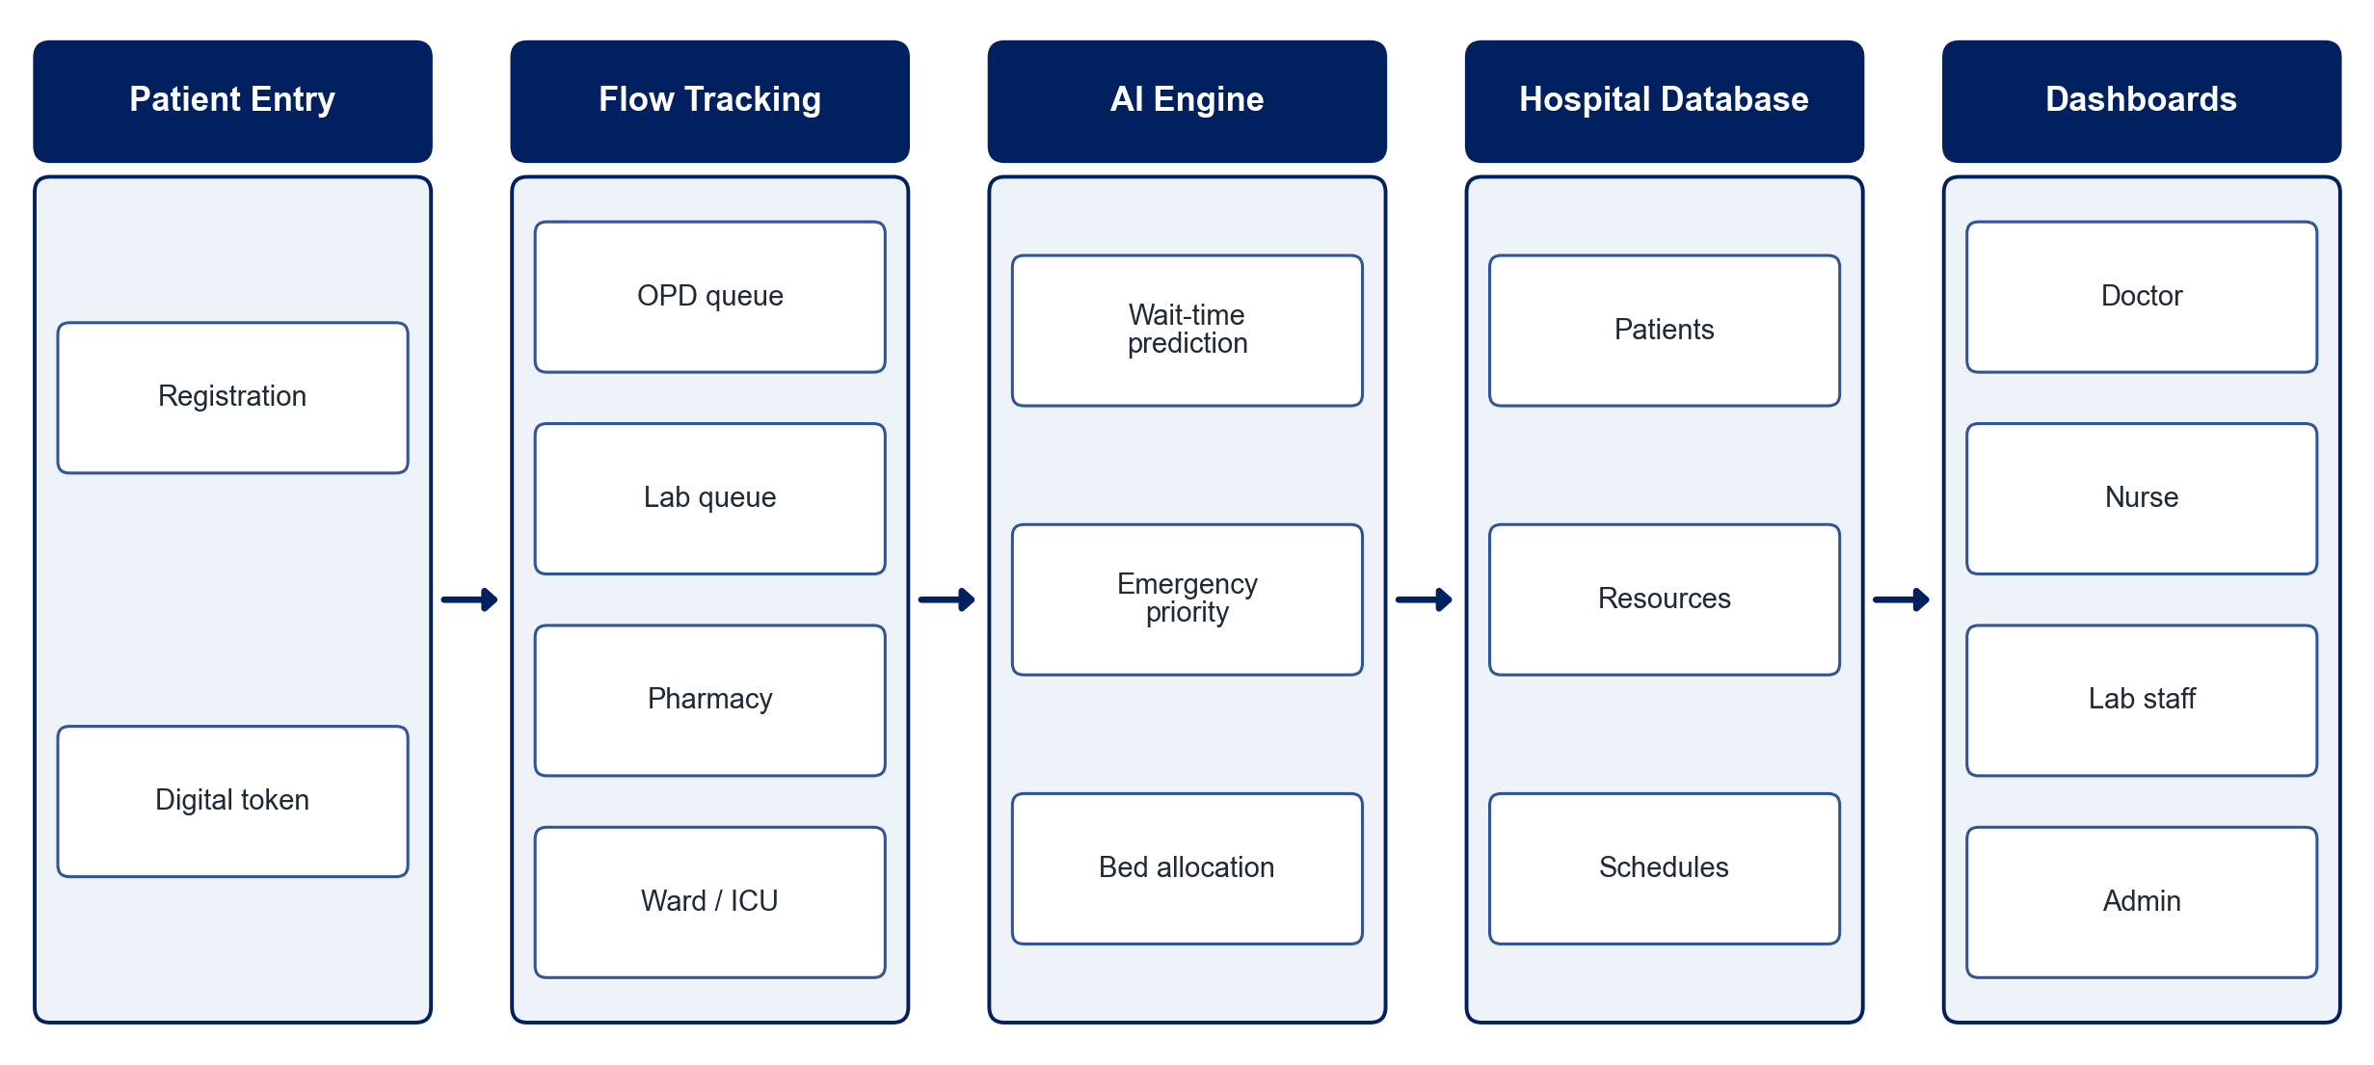
PROPOSED SYSTEM ARCHITECTURE
        Fig:- 1.1. System Architecture
CSE (DATA SCIENCE)

Slide 9
METHODOLOGY
Requirement Analysis: Map the patient journey across OPD, laboratory, pharmacy, wards and ICU.
Token System: Generate digital tokens at registration and display queue status.
Patient Tracking: Update patient status as they move between departments.
Lab Scheduling: Schedule laboratory tests automatically based on queue load.
Resource Monitoring: Track bed and ICU availability in real time.
AI Models: Train models to predict waiting time and classify emergency priority.
Dashboards: Build role-based dashboards for doctors, nurses, lab staff and administrators.
Testing: Evaluate waiting-time reduction and prediction accuracy on sample hospital data.
CSE (DATA SCIENCE)

Slide 10
SYSTEM REQUIREMENTS
Hardware Requirements
Processor: Intel Core i5 or equivalent
RAM: 8 GB or higher
Storage: 20 GB free space
Display: Screen for token and queue display
Software Requirements
Languages: Python, JavaScript
Backend: Django / Flask
Frontend: React
Database: MySQL / PostgreSQL
Machine Learning: scikit-learn, pandas
Tools: VS Code, Git
CSE (DATA SCIENCE)

Slide 11
Conclusion
The system automates the patient journey from registration to discharge.
Real-time tracking and dashboards improve coordination between departments.
AI-based prediction and prioritisation reduce waiting time and support critical cases.
Hospitals gain lower staff workload, better resource use and faster care.
CSE (DATA SCIENCE)

