Slide 1


AI-ENABLED DIGITAL EXAMINATION SEATING MANAGEMENT SYSTEM
NAME REG.NO
1 A.SANJAY 23K91A6702
2 CH.NAVEEN 23K91A6743
3 D.KOTESH 24K95A6705
4 STUDENT NAME A.AKSHITH
Guide Name:
GUIDE NAME
CSE (DATA SCIENCE)
BATCH : A13

Slide 2
CONTEXT
Introduction
Abstract
Existing system
Limitation of Existing system
Proposed System
System Architecture
Methodology
System Requirements
Conclusion
CSE (DATA SCIENCE)

Slide 3
INTRODUCTION
Seating arrangement is a critical administrative task before every examination.
Many institutions still prepare seating manually or with spreadsheets.
Allocation must satisfy room capacity, subject combinations, department distribution and roll-number order.
Predictable seating makes malpractice easier.
AI and optimisation can generate fair, randomised and constraint-satisfying plans quickly.
This project builds an AI-enabled digital examination seating management system.
CSE (DATA SCIENCE)

Slide 4
ABSTRACT
Exam seating is prepared manually or with spreadsheets before every examination cycle, which is slow and error-prone.
Predictable seating patterns fail to prevent malpractice and struggle with room capacity, subject clashes and roll-number rules.
The project automates seat allocation with AI and optimisation to produce fair, randomised, constraint-satisfying plans in seconds.
Anti-cheating rules ensure that students of the same course or with adjacent roll numbers are not seated together.
A central dashboard supports data upload, hall configuration, chart export, attendance tracking, seat lookup and reports.
CSE (DATA SCIENCE)

Slide 5
Existing system
Seating plans prepared manually by the examination cell.
Spreadsheet templates that sort students by roll number.
Basic seating software that assigns seats sequentially by hall capacity.
Printed seating charts displayed on notice boards.
CSE (DATA SCIENCE)

Slide 6
Limitations of Existing system
Manual allocation is time-consuming and error-prone.
Sequential patterns are predictable and allow malpractice.
Constraints such as subject clashes and spacing are hard to satisfy manually.
Any change requires redoing the whole plan.
Students cannot look up their seats digitally.
CSE (DATA SCIENCE)

Slide 7
Proposed System
Administrators upload student data and configure examination halls on a central dashboard.
An optimisation algorithm allocates seats while respecting capacity, subject combinations and roll-number rules.
Anti-cheating spacing keeps students of the same course or adjacent roll numbers apart.
Randomisation makes seating unpredictable while keeping it fair.
Seating charts are exported, printed or displayed, with attendance tracking, seat lookup and automated reports.
CSE (DATA SCIENCE)

Slide 8
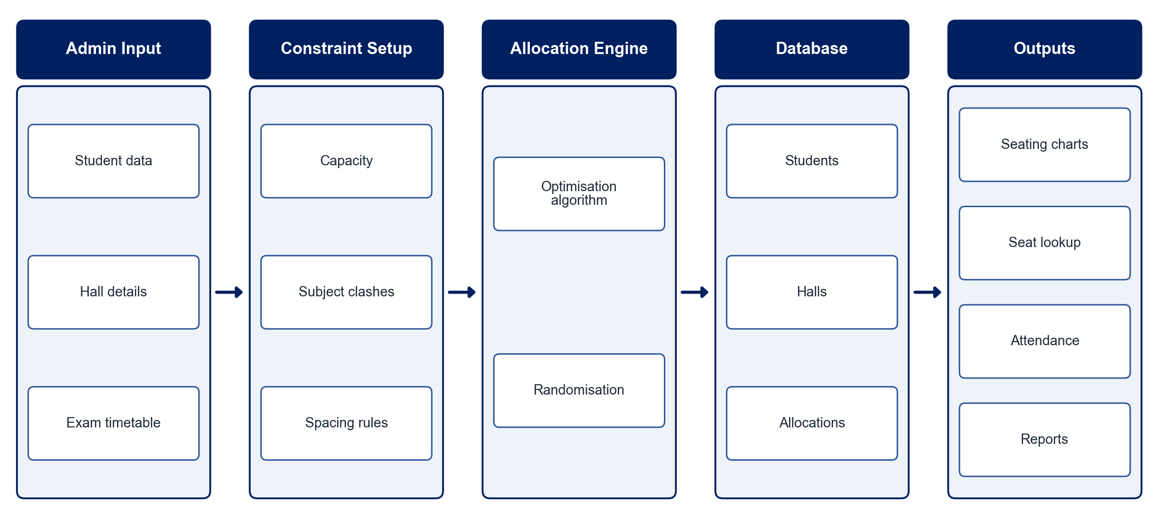
PROPOSED SYSTEM ARCHITECTURE
        Fig:- 1.1. System Architecture
CSE (DATA SCIENCE)

Slide 9
METHODOLOGY
Data Input: Upload student lists, course details, hall capacities and exam schedules.
Constraint Definition: Encode capacity, subject-combination, department and roll-number spacing rules.
Seat Allocation: Use constraint optimisation to assign seats that satisfy all rules.
Randomisation: Shuffle valid allocations so that seating is unpredictable.
Validation: Check the plan for clashes, overflow and adjacency violations.
Output Generation: Produce hall-wise seating charts for export, printing or display.
Student Services: Provide real-time seat lookup and attendance tracking.
Reporting: Generate automated hall-wise and exam-wise reports.
CSE (DATA SCIENCE)

Slide 10
SYSTEM REQUIREMENTS
Hardware Requirements
Processor: Intel Core i3/i5 or equivalent
RAM: 8 GB
Storage: 10 GB free space
Printer: For seating charts (optional)
Software Requirements
Language: Python
Optimisation: Google OR-Tools / PuLP
Backend: Django / Flask
Frontend: React / HTML-CSS
Database: MySQL / PostgreSQL
Reports: ReportLab / openpyxl
CSE (DATA SCIENCE)

Slide 11
Conclusion
The system produces fair, constraint-satisfying seating plans in seconds.
Anti-cheating spacing and randomisation strengthen examination integrity.
Administrative workload and human error are significantly reduced.
The solution scales to institutions of different sizes.
CSE (DATA SCIENCE)

