Slide 1


AUTOMATED PLASTIC WASTE DETECTION IN OCEANS USING ARTIFICIAL INTELLIGENCE
NAME REG.NO
1 B.AKHILA 23K91A6735
2 G.MANISHA 23K91A6756
3 B.PRANAY 24K95A6702
4 B.PRAVEEN 24K95A6703
Guide Name:
MRS. N. SRAVANTHI
(ASSISTANT PROFESSOR)
CSE (DATA SCIENCE)
BATCH : A14

Slide 2
CONTEXT
Introduction
Abstract
Existing system
Limitation of Existing system
Proposed System
System Architecture
Methodology
System Requirements
Conclusion
CSE (DATA SCIENCE)

Slide 3
INTRODUCTION
Millions of tonnes of plastic waste enter the oceans every year.
Plastic debris harms marine life, damages ecosystems and returns to humans through the food chain.
Monitoring relies on manual inspection and marine surveys, which are slow, costly and cover small areas.
Deep learning and computer vision can detect objects in images automatically and at scale.
Object detection models such as YOLO locate each plastic item with a bounding box and confidence score.
This project builds an AI system that automatically detects and localises plastic waste in ocean images.
CSE (DATA SCIENCE)

Slide 4
ABSTRACT
Marine plastic pollution threatens ocean ecosystems, biodiversity and marine life.
Manual inspection and marine surveys are slow, expensive, labour-intensive and limited in coverage.
The project uses AI, deep learning and computer vision to detect plastic waste in underwater and surface-water images.
Object detection locates each plastic item with a bounding box and confidence score, rather than only classifying the image.
A prototype lets users upload ocean images and view detections, forming a base for video, drone and robotic cleaning applications.
CSE (DATA SCIENCE)

Slide 5
Existing system
Manual beach and ocean surveys by volunteers and researchers.
Visual inspection of photographs and videos by experts.
Image classification models that only report whether plastic is present.
Robotic cleaning systems that use onboard detection to collect floating waste.
CSE (DATA SCIENCE)

Slide 6
Limitations of Existing system
Manual surveys are time-consuming, expensive and labour-intensive.
Coverage is limited to small, accessible areas.
Classification models do not locate individual plastic objects.
Detection accuracy drops with water reflections, turbidity and lighting changes.
Results are not available in real time.
CSE (DATA SCIENCE)

Slide 7
Proposed System
Underwater and surface-water images are preprocessed to improve quality.
A deep-learning object detector such as YOLO locates plastic items in each image.
Each detection is shown with a bounding box and confidence score.
A simple interface lets users upload images and view the results.
The system provides a base for video, drone and underwater robotic applications.
CSE (DATA SCIENCE)

Slide 8
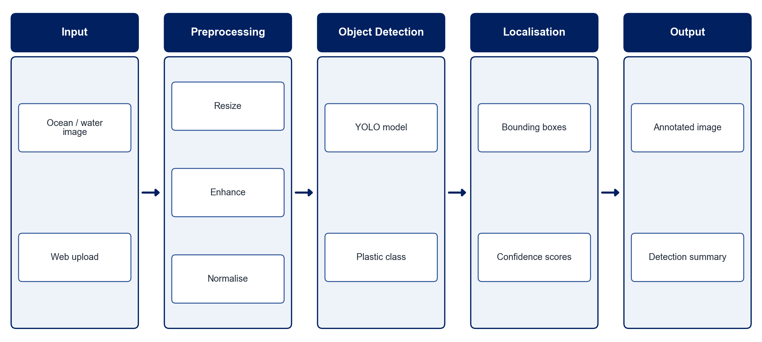
PROPOSED SYSTEM ARCHITECTURE
        Fig:- 1.1. System Architecture
CSE (DATA SCIENCE)

Slide 9
METHODOLOGY
Data Collection: Use public marine debris datasets of underwater and surface-water images.
Annotation: Label plastic objects in each image with bounding boxes.
Preprocessing: Resize, enhance contrast and normalise images, and augment for lighting and turbidity.
Model Training: Train a YOLO object detection model to detect plastic waste.
Localisation: Output bounding boxes and confidence scores for each detected object.
Evaluation: Measure precision, recall, mAP and inference time.
Prototype: Build an interface to upload images and view annotated results.
Future Extension: Extend detection to video streams, drones and underwater robots.
CSE (DATA SCIENCE)

Slide 10
SYSTEM REQUIREMENTS
Hardware Requirements
Processor: Intel Core i5 or equivalent
RAM: 8 GB or higher
GPU: NVIDIA GPU or Google Colab for training
Storage: 20 GB free space
Software Requirements
Language: Python
Object Detection: Ultralytics YOLO (PyTorch)
Image Processing: OpenCV
Annotation: LabelImg / Roboflow
Interface: Streamlit / Flask
Tools: Jupyter Notebook, VS Code
CSE (DATA SCIENCE)

Slide 11
Conclusion
The system detects and localises plastic waste in ocean images automatically.
Bounding boxes and confidence scores make results clear and easy to verify.
Automation reduces the time and effort of manual marine monitoring.
It lays a foundation for real-time video, drone and robotic ocean-cleaning applications.
CSE (DATA SCIENCE)

