Slide 1


VISIONFORGE AI: AN EXPLAINABLE VISION-LANGUAGE FRAMEWORK FOR INDUSTRIAL DEFECT DETECTION, ROOT CAUSE ANALYSIS, AND AUTOMATED INSPECTION REPORTING
NAME REG.NO
1 G.SRIVARDHAN 23K91A6755
2 B.TRIVED 23K91A6733
3 G.RAKESH 23K91A6752
4 B.INDRANEEL VARMA 23K91A6729
Guide Name:
MR. K. SATHYANARAYANA
(ASSISTANT PROFESSOR)
CSE (DATA SCIENCE)
BATCH : A15

Slide 2
CONTEXT
Introduction
Abstract
Existing system
Limitation of Existing system
Proposed System
System Architecture
Methodology
System Requirements
Conclusion
CSE (DATA SCIENCE)

Slide 3
INTRODUCTION
Product quality is critical in manufacturing, and defects cause losses, recalls and safety risks.
Manual visual inspection is slow, tiring and inconsistent.
Deep learning can detect defects in images of PCBs, steel surfaces and other components.
Most AI models only classify defects without explaining their decisions.
Operators also need root causes and corrective actions, not just a defect label.
This project builds VisionForge AI, an explainable inspection system with root-cause analysis and automated reporting.
CSE (DATA SCIENCE)

Slide 4
ABSTRACT
VisionForge AI is a software-based inspection system that automates defect detection in industrial products such as PCBs and steel surfaces.
Deep-learning computer vision detects and classifies defects in product images.
Explainable AI highlights the image regions that led to each detection.
The system generates a human-readable explanation and suggests possible root causes.
A web dashboard supports image upload, heatmap analysis and automatic inspection reports with defect type, confidence and corrective actions.
CSE (DATA SCIENCE)

Slide 5
Existing system
Manual visual inspection by quality-control staff.
Rule-based machine vision using fixed thresholds and templates.
CNN-based defect classifiers trained on industrial datasets.
Vision-language models that improve detection accuracy using text knowledge.
CSE (DATA SCIENCE)

Slide 6
Limitations of Existing system
Manual inspection is slow, subjective and error-prone.
Rule-based vision fails on new defect types and lighting changes.
Deep models act as black boxes without explanations.
Detections are not linked to root causes or corrective actions.
Inspection reports are prepared manually.
CSE (DATA SCIENCE)

Slide 7
Proposed System
Deep-learning models detect and classify defects in images of PCBs, steel surfaces and other components.
Explainable AI such as Grad-CAM highlights the regions behind each detection.
A language layer generates human-readable explanations and suggests possible root causes.
Inspection reports include defect type, confidence score, explanation, causes and corrective actions.
The fully software-based system uses public industrial datasets, keeping it low-cost.
CSE (DATA SCIENCE)

Slide 8
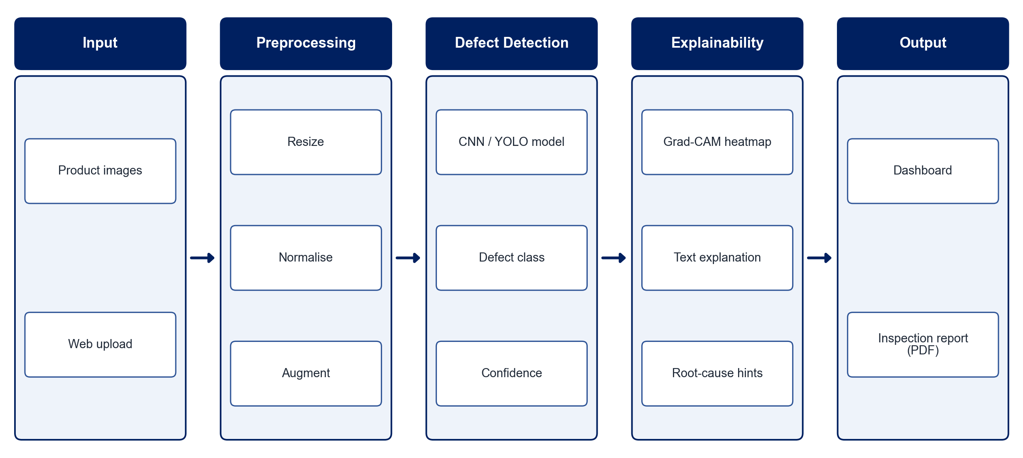
PROPOSED SYSTEM ARCHITECTURE
        Fig:- 1.1. System Architecture
CSE (DATA SCIENCE)

Slide 9
METHODOLOGY
Dataset Collection: Use public datasets such as PCB defect and NEU steel surface datasets.
Preprocessing: Resize, normalise and augment images.
Model Training: Train a deep-learning detector or classifier for the defect types.
Explainability: Generate Grad-CAM heatmaps showing the influential regions.
Explanation & Root Cause: Map defect types and regions to explanations and likely causes.
Report Generation: Create inspection reports with type, confidence, explanation and corrective actions.
Dashboard: Build a web interface for upload, results, heatmaps and reports.
Evaluation: Measure accuracy, precision, recall and mAP.
CSE (DATA SCIENCE)

Slide 10
SYSTEM REQUIREMENTS
Hardware Requirements
Processor: Intel Core i5 or equivalent
RAM: 8 GB or higher
GPU: NVIDIA GPU or Google Colab for training
Storage: 20 GB free space
Software Requirements
Language: Python
Deep Learning: PyTorch / TensorFlow, Ultralytics YOLO
Explainability: Grad-CAM
Image Processing: OpenCV
Web App: Flask / Streamlit
Reports: ReportLab
CSE (DATA SCIENCE)

Slide 11
Conclusion
VisionForge AI automates industrial inspection with accurate deep-learning defect detection.
Explainable heatmaps and text explanations make every decision transparent.
Root-cause suggestions and automated reports support faster corrective action.
The software-only design keeps the solution affordable and easy to deploy.
CSE (DATA SCIENCE)

