Slide 1


AI-DRIVEN COMPLEX EMOTION RECOGNITION USING FACIAL EXPRESSION IMAGES
NAME REG.NO
1 B.SHIRISHA 23K91A6730
2 B.ASHRITH 23K91A6731
3 B.MURALI 23K91A6724
4 B.GOUTHAM 23K91A6727
Guide Name:
GUIDE NAME
CSE (DATA SCIENCE)
BATCH : A16

Slide 2
CONTEXT
Introduction
Abstract
Existing system
Limitation of Existing system
Proposed System
System Architecture
Methodology
System Requirements
Conclusion
CSE (DATA SCIENCE)

Slide 3
INTRODUCTION
Emotions shape human communication, and facial expressions are a major cue to emotional state.
Facial emotion recognition is used in healthcare, driver safety, education and human-computer interaction.
Most systems classify one basic emotion such as happiness, sadness, anger, fear, disgust or surprise.
Real expressions often combine emotions, which single-label models cannot capture.
Complex-emotion samples are scarce, which makes such models hard to train.
This project uses GAN-generated faces and multi-label CNN classification to recognise complex emotions.
CSE (DATA SCIENCE)

Slide 4
ABSTRACT
Facial expressions reveal emotional state, but most recognition systems detect only single basic emotions.
Real people often show complex emotions, such as happiness with surprise or sadness with fear.
The project uses Conditioned Emotion GANs (cEmoGANs) to generate identity-preserving facial images with mixed expressions.
The generated images enlarge the scarce complex-emotion dataset.
A CNN-based multi-label classifier then recognises multiple emotions in a single face.
CSE (DATA SCIENCE)

Slide 5
Existing system
CNN models trained on datasets such as FER-2013 classify seven basic emotions.
Single-label classifiers assign exactly one emotion per image.
Data augmentation uses flips, crops and rotations.
Some GANs edit expressions but distort facial identity.
CSE (DATA SCIENCE)

Slide 6
Limitations of Existing system
Systems cannot recognise mixed or complex emotions.
Complex-emotion datasets are small and imbalanced.
Basic augmentation does not create new expressions.
Expression-editing GANs lose identity and add distortions.
Accuracy drops on real-world expressions.
CSE (DATA SCIENCE)

Slide 7
Proposed System
cEmoGANs generate facial images with specified complex emotions.
The generator preserves identity while changing only the expression.
Generated images enlarge and diversify the training dataset.
A CNN multi-label classifier predicts every emotion present in a face.
The system recognises both basic and complex emotions more accurately.
CSE (DATA SCIENCE)

Slide 8
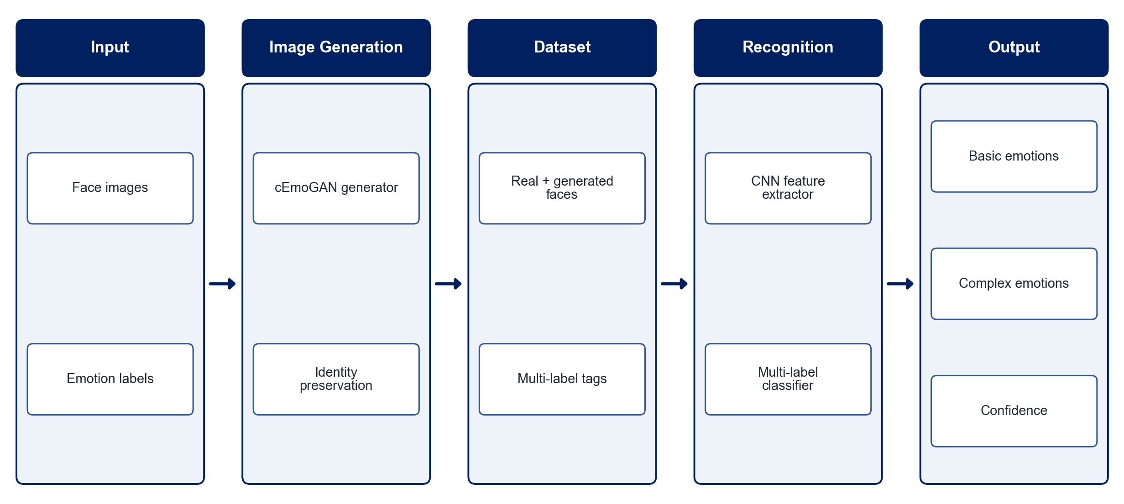
PROPOSED SYSTEM ARCHITECTURE
        Fig:- 1.1. System Architecture
CSE (DATA SCIENCE)

Slide 9
METHODOLOGY
Data Collection: Use facial expression datasets with basic and compound emotion labels.
Preprocessing: Detect, align, crop and normalise faces.
cEmoGAN Training: Train a conditioned GAN to generate faces with target complex emotions.
Identity Check: Verify that generated faces preserve identity and have low distortion.
Dataset Expansion: Combine real and generated images with multi-label annotations.
Classifier Training: Train a CNN with sigmoid outputs for multi-label emotion recognition.
Evaluation: Measure accuracy, F1-score and Hamming loss.
Deployment: Provide an interface to upload a face and view the detected emotions.
CSE (DATA SCIENCE)

Slide 10
SYSTEM REQUIREMENTS
Hardware Requirements
Processor: Intel Core i5 or equivalent
RAM: 16 GB recommended
GPU: NVIDIA GPU or Google Colab for GAN training
Storage: 30 GB free space
Software Requirements
Language: Python
Deep Learning: PyTorch / TensorFlow
Face Processing: OpenCV, dlib / MediaPipe
Libraries: NumPy, scikit-learn
Interface: Streamlit / Flask
Tools: Jupyter Notebook
CSE (DATA SCIENCE)

Slide 11
Conclusion
The system recognises complex, mixed emotions that single-label models miss.
cEmoGAN-generated faces address the shortage of complex-emotion data.
Identity preservation keeps generated images realistic and useful for training.
The approach supports mental-health monitoring, driver safety, smart classrooms and virtual assistants.
CSE (DATA SCIENCE)

