Slide 1


CROPSIGHT: SMART CROP DELIVERY WITH AI-BASED PRICE AND QUALITY INTELLIGENCE
NAME REG.NO
1 G.PRANAVI 23K91A6765
2 G.SIRI CHANDANA 23K91A6763
3 A.NIKHIL 23K91A6715
4 G.VISHNU VARDHAN 23K91A6754
Guide Name:
K. MOUNIKA
CSE (DATA SCIENCE)
BATCH : A17

Slide 2
CONTEXT
Introduction
Abstract
Existing system
Limitation of Existing system
Proposed System
System Architecture
Methodology
System Requirements
Conclusion
CSE (DATA SCIENCE)

Slide 3
INTRODUCTION
Agriculture supports millions of farmers, but their income depends on unpredictable market prices.
Crop quality is often judged manually and inconsistently, which affects pricing.
Post-harvest losses occur during storage and transport because conditions are not monitored.
Farmers have limited access to buyers and to real-time decision support.
AI, ML and IoT can grade quality, forecast prices and monitor the supply chain.
This project builds CropSight, a platform for AI-based crop quality, price intelligence and smart delivery.
CSE (DATA SCIENCE)

Slide 4
ABSTRACT
Farmers face fluctuating prices, inconsistent quality assessment, supply-chain inefficiencies and little real-time decision support.
CropSight integrates AI, ML and IoT to assess crop quality, predict prices and streamline delivery.
Deep learning grades crop quality from images using size, colour, texture and defects.
ML predicts prices from market trends, weather, demand and regional variations, while IoT sensors monitor storage and transport.
A smart delivery module and marketplace recommend routes, buyers and the best time to sell, with explainable AI for transparency.
CSE (DATA SCIENCE)

Slide 5
Existing system
Crop quality is graded manually by traders at markets.
Farmers sell through middlemen at mandi prices.
Government portals such as e-NAM publish prices without forecasts.
Storage and transport conditions are rarely monitored.
CSE (DATA SCIENCE)

Slide 6
Limitations of Existing system
Manual grading is subjective and inconsistent.
Farmers lack price forecasts to decide when to sell.
Middlemen reduce farmers' share of the final price.
Unmonitored storage and transport cause post-harvest losses.
Grading and pricing decisions are not transparent.
CSE (DATA SCIENCE)

Slide 7
Proposed System
Deep learning grades crop quality from images using size, colour, texture and defects.
ML models forecast prices from market trends, weather, demand and regional variations.
IoT sensors monitor temperature and humidity during storage and transport.
Explainable AI shows why a grade or price was predicted.
A digital marketplace recommends buyers, delivery routes and the best time to sell.
CSE (DATA SCIENCE)

Slide 8
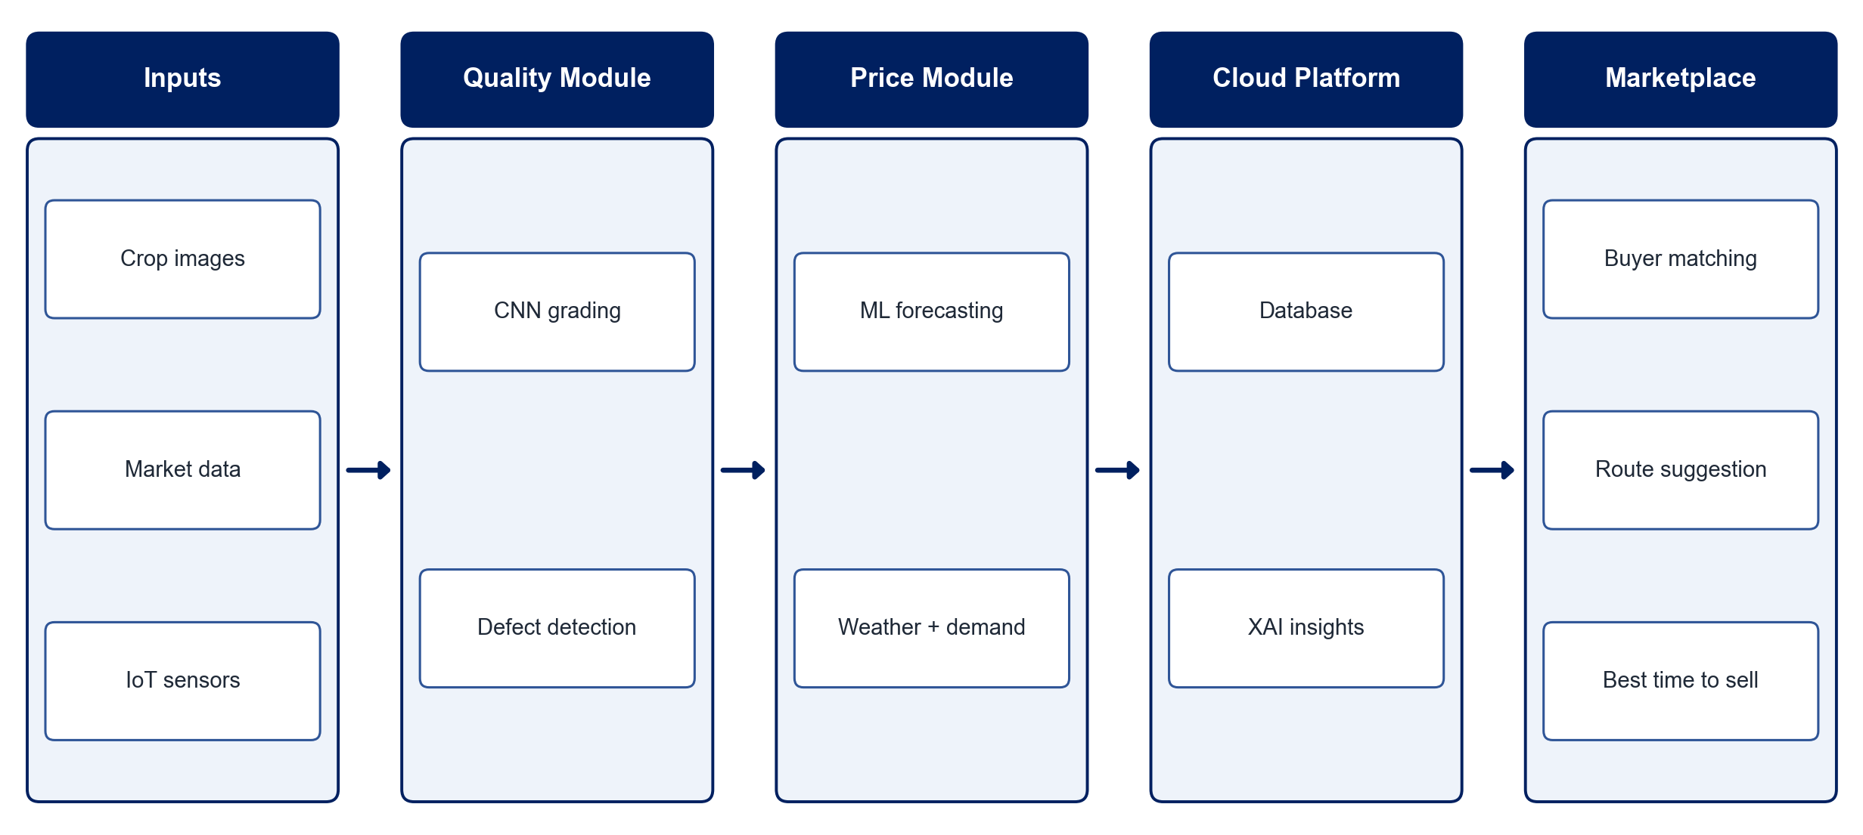
PROPOSED SYSTEM ARCHITECTURE
        Fig:- 1.1. System Architecture
CSE (DATA SCIENCE)

Slide 9
METHODOLOGY
Data Collection: Gather crop images, historical market prices, weather and demand data.
Quality Grading: Train a CNN to grade crops by size, colour, texture and defects.
Price Forecasting: Train ML models on market trends, weather and regional prices.
IoT Monitoring: Stream temperature and humidity from storage and transport sensors to the cloud.
Explainability: Apply XAI techniques to explain grades and price predictions.
Delivery Recommendation: Suggest buyers, routes and the best selling time.
Marketplace: Connect farmers, distributors and buyers on a web or mobile platform.
Evaluation: Measure grading accuracy and price-forecast error (MAE, RMSE).
CSE (DATA SCIENCE)

Slide 10
SYSTEM REQUIREMENTS
Hardware Requirements
Processor: Intel Core i5 or equivalent
RAM: 8 GB or higher
IoT: ESP32 / Arduino with DHT11 / DHT22 sensors
Camera: Smartphone camera for crop images
Storage: 20 GB free space
Software Requirements
Language: Python
Deep Learning: TensorFlow / PyTorch
Machine Learning: scikit-learn, XGBoost
Explainability: SHAP, Grad-CAM
Cloud: Firebase / ThingSpeak
App: Flask / Streamlit
CSE (DATA SCIENCE)

Slide 11
Conclusion
CropSight gives farmers objective quality grades and price forecasts.
IoT monitoring reduces post-harvest losses during storage and transport.
Explainable AI builds trust in grading and pricing decisions.
The marketplace improves supply-chain efficiency and helps farmers earn fair prices.
CSE (DATA SCIENCE)

