Slide 1


ATTENDANCE MAGIC: A SMART GEO-FENCED ATTENDANCE SYSTEM WITH LIVE CHALLENGE VERIFICATION
NAME REG.NO
1 A.GREESHMA 23K91A6706
2 B.VINAY 23K91A6740
3 G.SRIRAM 23K91A6757
4 B.SAI KUMAR 24K95A6704
Guide Name:
GUIDE NAME
CSE (DATA SCIENCE)
BATCH : A2

Slide 2
CONTEXT
Introduction
Abstract
Existing system
Limitation of Existing system
Proposed System
System Architecture
Methodology
System Requirements
Conclusion
CSE (DATA SCIENCE)

Slide 3
INTRODUCTION
Attendance is a daily requirement in educational institutions and affects academic eligibility and records.
Manual roll calls and sign-in sheets consume class time and are prone to errors and proxy attendance.
Digital options such as QR codes and shared links are easy to forward to absent students.
Face recognition can confirm identity, but a static photo or video can still be used to spoof it.
Combining location verification, liveness detection and face matching makes proxy attendance significantly harder.
This project builds Attendance Magic, a geo-fenced attendance system with live facial challenge verification.
CSE (DATA SCIENCE)

Slide 4
ABSTRACT
Attendance Magic is a secure, AI-assisted attendance system that reduces proxy attendance, manual errors and the time spent recording attendance.
Faculty create time-bound attendance sessions with configurable geographic boundaries, and students join through a unique session link.
Security combines JWT authentication, GPS location verification, session expiry, device identification and roll-number restrictions.
After location checks, students complete a random live facial challenge verified with MediaPipe landmarks and InsightFace embeddings.
Each captured face is compared with faces already recorded in the session, and records can be viewed and exported to Excel.
CSE (DATA SCIENCE)

Slide 5
Existing system
Manual roll calls and paper attendance registers maintained by faculty.
Biometric fingerprint devices installed in classrooms or at entrances.
QR-code or link-based attendance through learning management systems.
Face recognition attendance using CNN models on a classroom camera feed.
CSE (DATA SCIENCE)

Slide 6
Limitations of Existing system
Manual methods waste class time and allow proxy attendance.
QR codes and attendance links can be shared with students who are not present.
Fingerprint devices need dedicated hardware, are shared contact points and create queues.
Face recognition without a liveness check can be fooled by photos or videos.
Existing systems do not verify that the student is physically within the classroom area.
One person can mark attendance for several identities if duplicate faces are not checked.
CSE (DATA SCIENCE)

Slide 7
Proposed System
Faculty create time-bound attendance sessions with a configurable geo-fence and share a unique session link.
Students are authenticated with JWT and verified by GPS location, device identity and roll-number restrictions.
A random live facial challenge, such as turning the head, is verified in real time using MediaPipe landmarks.
InsightFace embeddings compare the captured face with faces already recorded in the session to block duplicate identities.
Faculty view attendance summaries and lists and export records to Excel.
CSE (DATA SCIENCE)

Slide 8
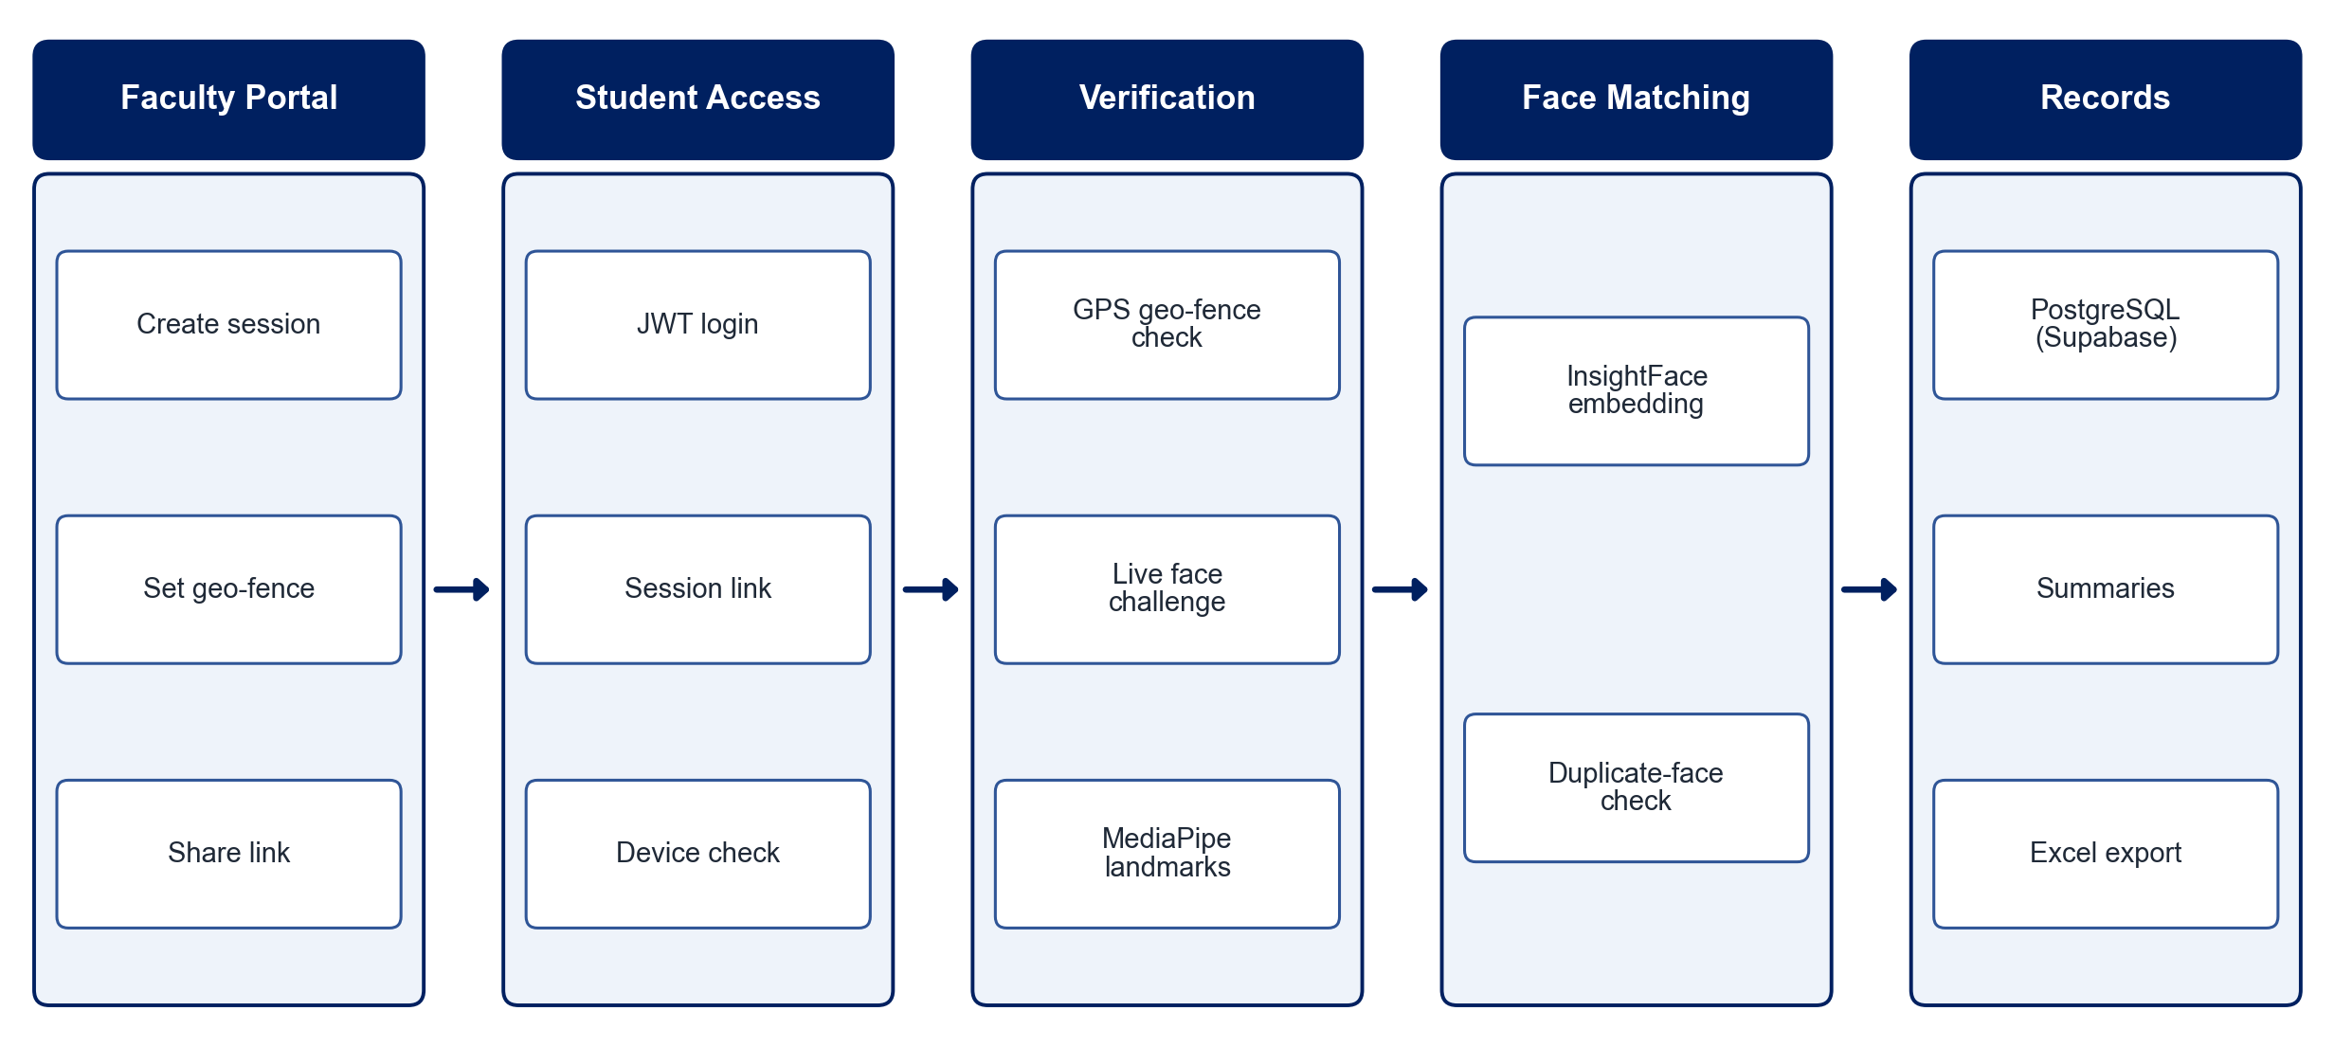
PROPOSED SYSTEM ARCHITECTURE
        Fig:- 1.1. System Architecture
CSE (DATA SCIENCE)

Slide 9
METHODOLOGY
Requirement Analysis: Define session rules, geo-fence radius, user roles and proxy-prevention checks.
Session Management: Faculty create time-bound sessions with location boundaries and unique links.
Authentication: Authenticate students with JWT and apply device and roll-number restrictions.
Location Verification: Compare the student's GPS coordinates with the session geo-fence.
Liveness Challenge: Issue a random head-movement challenge and verify it with MediaPipe facial landmarks.
Face Matching: Generate InsightFace embeddings and check similarity against faces already captured in the session.
Record Storage: Save verified attendance with timestamps in PostgreSQL on Supabase.
Testing: Evaluate proxy-prevention checks, verification accuracy and response time.
CSE (DATA SCIENCE)

Slide 10
SYSTEM REQUIREMENTS
Hardware Requirements
Processor: Intel Core i5 or equivalent
RAM: 8 GB or higher
Camera: Smartphone or laptop front camera
GPS: Location-enabled smartphone
Storage: 10 GB free space
Software Requirements
Frontend: React, Tailwind CSS
Backend: Django REST Framework with JWT
Face AI: MediaPipe, InsightFace
Database: PostgreSQL on Supabase
Languages: Python, JavaScript
Tools: VS Code, Git
CSE (DATA SCIENCE)

Slide 11
Conclusion
Attendance Magic replaces manual attendance with a fast, secure digital workflow.
Layered checks of geo-fencing, device identity, live facial challenge and duplicate-face matching make proxy attendance significantly harder.
Faculty save time through automatic records, summaries and Excel export.
The system scales across classes and institutions and improves the reliability of attendance records.
CSE (DATA SCIENCE)

