Slide 1


A DYNAMIC PHISHING URL DETECTION SYSTEM INTEGRATING ADVANCED MACHINE LEARNING AND CROWDSOURCED THREAT INTELLIGENCE
NAME REG.NO
1 D.ANISH MEGHAN 23K91A6750
2 B.AKSHAYA 23K91A6737
3 B.TANUJA 23K91A6736
4 CH.SAI CHETHAN 23K91A6742
Guide Name:
MR. G. RAVI
CSE (DATA SCIENCE)
BATCH : A3

Slide 2
CONTEXT
Introduction
Abstract
Existing system
Limitation of Existing system
Proposed System
System Architecture
Methodology
System Requirements
Conclusion
CSE (DATA SCIENCE)

Slide 3
INTRODUCTION
Phishing is one of the most common cyberattacks against individuals and organisations.
Attackers build deceptive websites that imitate banks, shopping sites and online services to steal credentials.
New phishing domains appear every day, and many stay active for only a few hours.
Blacklist-based protection works only after a URL has been reported and added to a list.
Machine learning can recognise phishing URLs from their characteristics even when they have never been seen before.
This project combines ML-based URL classification with crowdsourced threat intelligence for dynamic phishing detection.
CSE (DATA SCIENCE)

Slide 4
ABSTRACT
Phishing websites steal usernames, passwords, banking credentials and personal data by imitating trusted sites.
Blacklists and manually updated databases fail to catch newly created, zero-day phishing URLs.
The project classifies URLs with machine learning using lexical, structural and domain-based features.
Crowdsourced threat intelligence from trusted security communities keeps the system updated with newly reported phishing URLs.
Random Forest, XGBoost and Logistic Regression are compared on accuracy, precision, recall and F1-score.
CSE (DATA SCIENCE)

Slide 5
Existing system
Browsers and email filters check URLs against blacklists such as Google Safe Browsing and PhishTank.
Rule-based filters flag URLs using fixed patterns such as IP addresses or suspicious keywords.
Some systems use ML classifiers trained once on a fixed phishing dataset.
Users can report phishing sites, but these reports are processed manually.
CSE (DATA SCIENCE)

Slide 6
Limitations of Existing system
Blacklists cannot detect zero-day phishing URLs that have not yet been reported.
Manually updated databases lag behind fast-changing phishing campaigns.
Fixed rules are easily bypassed by small changes in URL structure.
Models trained once degrade as attack patterns evolve.
High false-positive rates block legitimate websites and reduce user trust.
CSE (DATA SCIENCE)

Slide 7
Proposed System
URLs are analysed using lexical, structural and domain-based features such as length, special characters, subdomains and domain age.
ML models including Random Forest, XGBoost and Logistic Regression classify URLs as phishing or legitimate.
Crowdsourced threat intelligence from trusted cybersecurity communities adds newly reported phishing URLs.
The model is refined continuously with new threat data to adapt to evolving attack patterns.
Real-time classification gives users an immediate verdict with a confidence score.
CSE (DATA SCIENCE)

Slide 8
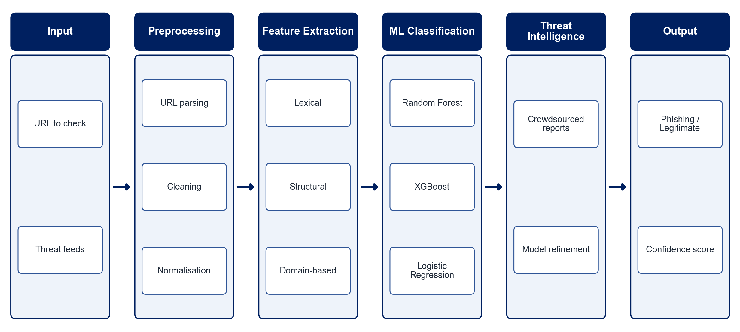
PROPOSED SYSTEM ARCHITECTURE
        Fig:- 1.1. System Architecture
CSE (DATA SCIENCE)

Slide 9
METHODOLOGY
Data Collection: Gather labelled phishing and legitimate URLs from public datasets and threat-sharing platforms.
Preprocessing: Parse, clean and normalise URLs and remove duplicates.
Feature Extraction: Compute lexical, structural and domain-based features for each URL.
Model Training: Train Random Forest, XGBoost and Logistic Regression classifiers.
Model Selection: Compare models on accuracy, precision, recall and F1-score and select the best.
Threat Intelligence Integration: Ingest crowdsourced threat feeds to flag newly reported phishing URLs.
Continuous Refinement: Retrain the model periodically with newly verified threat data.
Deployment: Provide a web interface for real-time URL checking.
CSE (DATA SCIENCE)

Slide 10
SYSTEM REQUIREMENTS
Hardware Requirements
Processor: Intel Core i5 or equivalent
RAM: 8 GB or higher
Storage: 20 GB free space
Network: Internet access for threat-feed updates
Software Requirements
Language: Python
ML Libraries: scikit-learn, XGBoost, pandas, NumPy
URL Features: tldextract, python-whois
Backend: Flask / FastAPI
Interface: Streamlit / HTML-CSS
Tools: Jupyter Notebook, VS Code
CSE (DATA SCIENCE)

Slide 11
Conclusion
The system detects phishing URLs from their characteristics, including zero-day URLs absent from blacklists.
Crowdsourced threat intelligence keeps detection current as attack patterns change.
Comparing several ML models ensures the best-performing classifier is used.
The approach offers faster, more adaptive and more accurate protection for users and organisations.
CSE (DATA SCIENCE)

