Slide 1


ADVANCED OPTIMIZATION IN E-COMMERCE LOGISTICS: COMBINING MATHEURISTICS WITH RANDOM FORESTS FOR HUB LOCATION EFFICIENCY
NAME REG.NO
1 CH.ARCHANA 23K91A6745
2 A.MEENAKSHI 23K91A6705
3 B.ARUN 23K91A6734
4 A.SAMPATH 23K91A6712
Guide Name:
GUIDE NAME
CSE (DATA SCIENCE)
BATCH : A4

Slide 2
CONTEXT
Introduction
Abstract
Existing system
Limitation of Existing system
Proposed System
System Architecture
Methodology
System Requirements
Conclusion
CSE (DATA SCIENCE)

Slide 3
INTRODUCTION
E-commerce has raised customer expectations for fast and reliable delivery.
Logistics networks route orders through hubs, so hub placement strongly affects cost and delivery time.
The Hub Location Problem is a classic optimisation problem, but real demand fluctuates across regions and seasons.
Traditional optimisation models assume fixed demand and cannot adapt when demand patterns change.
Machine learning can forecast demand from historical data, and matheuristics can solve large optimisation problems efficiently.
This project combines Random Forest demand prediction with matheuristic optimisation for efficient e-commerce hub location.
CSE (DATA SCIENCE)

Slide 4
ABSTRACT
Rapid e-commerce growth demands fast, reliable and low-cost logistics networks.
Choosing hub locations that minimise transport cost while ensuring timely delivery is a critical supply-chain problem.
The project predicts future demand from historical logistics data using a Random Forest model.
The predictions feed a matheuristic optimisation model that selects hubs considering transport cost, delivery time, hub capacity and network constraints.
The integrated model is evaluated against traditional hub location methods on delivery time, fulfilment rate, reliability and operating cost.
CSE (DATA SCIENCE)

Slide 5
Existing system
Hub locations are chosen using exact mathematical models such as mixed-integer programming with fixed demand.
Heuristics such as greedy and genetic algorithms search for good hub configurations.
Planning decisions are often based on managerial judgement and historical averages.
Demand forecasting and network optimisation are performed as separate, disconnected steps.
CSE (DATA SCIENCE)

Slide 6
Limitations of Existing system
Exact models become computationally expensive for large logistics networks.
Fixed-demand assumptions do not reflect fluctuating e-commerce orders.
Hub configurations are not updated when demand or operating conditions change.
Separating forecasting from optimisation leads to sub-optimal hub decisions.
Pure heuristics do not guarantee solution quality.
CSE (DATA SCIENCE)

Slide 7
Proposed System
A Random Forest model predicts future demand for each region from historical logistics data.
Predicted demand is fed into a matheuristic optimisation model for hub selection.
The optimiser considers transportation cost, delivery time, hub capacity and network constraints.
Hub configurations are re-optimised as demand patterns and business requirements change.
Results are compared with traditional hub location methods on cost, delivery time and fulfilment rate.
CSE (DATA SCIENCE)

Slide 8
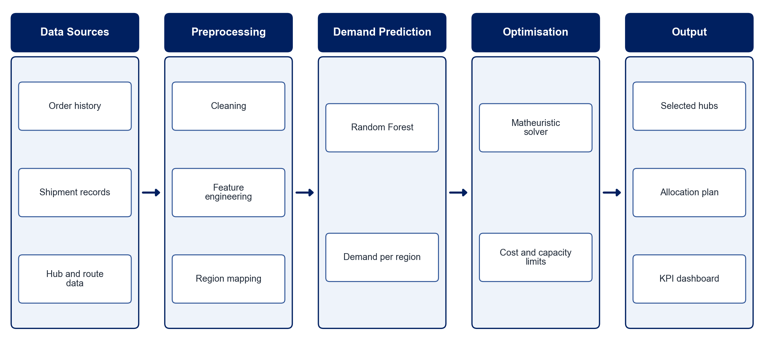
PROPOSED SYSTEM ARCHITECTURE
        Fig:- 1.1. System Architecture
CSE (DATA SCIENCE)

Slide 9
METHODOLOGY
Data Collection: Gather historical order, shipment, route and hub data.
Preprocessing: Clean the data and engineer features such as region, season and order volume.
Demand Prediction: Train a Random Forest model to forecast demand per region.
Model Formulation: Formulate the hub location problem with cost, delivery-time and capacity constraints.
Matheuristic Optimisation: Combine mathematical programming with heuristic search to select hubs.
Dynamic Re-optimisation: Update hub configurations when predicted demand changes.
Evaluation: Compare with traditional methods on delivery time, fulfilment rate, reliability and cost.
Visualisation: Present hub locations and KPIs on a map-based dashboard.
CSE (DATA SCIENCE)

Slide 10
SYSTEM REQUIREMENTS
Hardware Requirements
Processor: Intel Core i5 or equivalent
RAM: 8 GB or higher
Storage: 20 GB free space
Software Requirements
Language: Python
Machine Learning: scikit-learn, pandas, NumPy
Optimisation: PuLP / Google OR-Tools
Visualisation: Matplotlib, Folium
Interface: Streamlit
Tools: Jupyter Notebook, VS Code
CSE (DATA SCIENCE)

Slide 11
Conclusion
Combining ML demand prediction with matheuristic optimisation produces hub decisions that adapt to changing demand.
The approach lowers transportation cost while improving delivery-time performance and fulfilment rate.
Dynamic re-optimisation improves network reliability as business conditions change.
The framework offers a practical, data-driven tool for e-commerce logistics planning.
CSE (DATA SCIENCE)

