Slide 1


JEPA-LLM TUNING FRAMEWORK FOR COMBATING GST AND SALES TAX INPUT TAX CREDIT FRAUD PATTERN DETECTION
NAME REG.NO
1 B.ASHRITHA 23K91A6732
2 B.DIVYA 23K91A6739
3 A.KISHORE 23K91A6716
4 A.YAGNESH 23K91A6711
Guide Name:
DR. N. CH. RAVI
CSE (DATA SCIENCE)
BATCH : A5

Slide 2
CONTEXT
Introduction
Abstract
Existing system
Limitation of Existing system
Proposed System
System Architecture
Methodology
System Requirements
Conclusion
CSE (DATA SCIENCE)

Slide 3
INTRODUCTION
GST lets businesses claim Input Tax Credit on taxes paid for purchases, which makes the system a target for fraud.
Fraudsters generate fake invoices, run circular trading loops and use shell companies to claim credit without genuine transactions.
Such fraud causes large revenue losses and weakens trust in the tax system.
Fraud patterns are spread across invoices, taxpayers and filing cycles, so they are hard to see in individual records.
Confirmed fraud labels are scarce, which limits purely supervised machine learning.
This project combines self-supervised JEPA representation learning with an LLM to detect and explain ITC fraud patterns.
CSE (DATA SCIENCE)

Slide 4
ABSTRACT
Input Tax Credit fraud in GST and Sales Tax, through fake invoices, circular trading and shell companies, causes major revenue leakage.
Manual audits and rule-based checks are slow and reactive, and miss fraud hidden across invoices, taxpayers and filing cycles.
The project uses a Joint Embedding Predictive Architecture (JEPA) to learn normal GST behaviour from largely unlabelled data.
Invoice-level, taxpayer-behaviour and network-level features are combined, and deviations from learned patterns are scored as suspicious.
A tuned LLM explains each flagged claim in natural language to support tax officers' investigations.
CSE (DATA SCIENCE)

Slide 5
Existing system
Tax authorities rely on manual audits and investigations after fraud is suspected.
Rule-based checks flag mismatches between GST returns and invoice data.
Supervised ML models classify fraud using labelled historical cases.
Forensic accounting and network analysis are applied case by case by investigators.
CSE (DATA SCIENCE)

Slide 6
Limitations of Existing system
Manual audits are slow and detect fraud only after revenue is lost.
Fixed rules are easily evaded as fraudsters change tactics.
Supervised models need labelled fraud cases, which are scarce.
Checks on individual transactions miss circular trading and shell-company networks.
Most systems give fraud scores without explaining why a claim is suspicious.
CSE (DATA SCIENCE)

Slide 7
Proposed System
A JEPA module learns compact predictive embeddings of normal GST behaviour from unlabelled invoices, returns and transaction flows.
Invoice-level, taxpayer-behaviour and buyer-seller network features are combined in a multi-layer fraud assessment.
Deviations from learned behaviour are converted into fraud risk scores for taxpayers and invoice chains.
Target patterns include fake invoices, circular trading, shell entities and abnormal spikes in ITC claims.
A tuned LLM generates natural-language explanations of why each claim was flagged.
CSE (DATA SCIENCE)

Slide 8
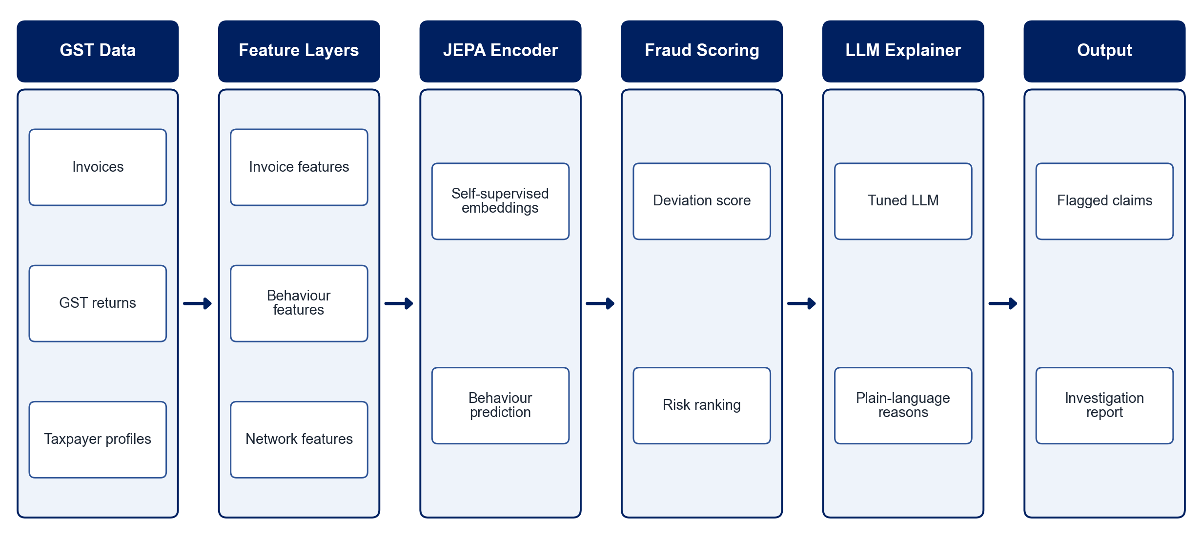
PROPOSED SYSTEM ARCHITECTURE
        Fig:- 1.1. System Architecture
CSE (DATA SCIENCE)

Slide 9
METHODOLOGY
Data Preparation: Build a GST dataset of invoices, returns, taxpayer profiles and transaction links, using synthetic data where needed.
Feature Engineering: Derive invoice, taxpayer-behaviour and network-level features.
Graph Construction: Model buyer-seller relationships to expose circular trading and shell clusters.
JEPA Training: Train the JEPA encoder self-supervised to predict embeddings of normal behaviour.
Fraud Scoring: Score deviations from learned behaviour and rank suspicious taxpayers and invoices.
LLM Tuning: Tune an LLM to generate explanations of flagged patterns.
Evaluation: Measure precision, recall and F1-score on labelled cases and review explanation quality.
Dashboard: Present risk scores, fraud networks and explanations to tax officers.
CSE (DATA SCIENCE)

Slide 10
SYSTEM REQUIREMENTS
Hardware Requirements
Processor: Intel Core i5/i7 or equivalent
RAM: 16 GB recommended
GPU: NVIDIA GPU or Google Colab for training
Storage: 50 GB free space
Software Requirements
Language: Python
Deep Learning: PyTorch
Graph Analysis: NetworkX / PyTorch Geometric
LLM: Hugging Face Transformers with LoRA
Data Handling: pandas, NumPy
Interface: Streamlit dashboard
CSE (DATA SCIENCE)

Slide 11
Conclusion
The framework detects GST ITC fraud by learning normal behaviour instead of relying only on labelled fraud cases.
Combining invoice, taxpayer and network features exposes fraud rings such as circular trading and shell companies.
LLM explanations make every flag transparent and easier for officers to investigate.
The system supports faster, proactive and more explainable tax fraud detection.
CSE (DATA SCIENCE)

