Slide 1


LEGAL CONTRACT COMPLEXITY & PREDATORY CLAUSE DETECTOR
NAME REG.NO
1 CH.PRANATHI 23K91A6744
2 G.PRANAVI 23K91A6762
3 G.CHARAN JOSEPH 23K91A6753
4 G.BHAGWATH 23K91A6760
Guide Name:
GUIDE NAME
CSE (DATA SCIENCE)
BATCH : A6

Slide 2
CONTEXT
Introduction
Abstract
Existing system
Limitation of Existing system
Proposed System
System Architecture
Methodology
System Requirements
Conclusion
CSE (DATA SCIENCE)

Slide 3
INTRODUCTION
Individuals, freelancers, gig workers and small businesses increasingly sign digital contracts without legal support.
Contracts can contain unfair termination terms, hidden liabilities or one-sided arbitration clauses.
Non-experts struggle to recognise such clauses, which creates information asymmetry against the weaker party.
Professional legal review is expensive and not always accessible.
Large Language Models with retrieval can read contracts and explain risks in plain language.
This project builds a jurisdiction-aware contract complexity and predatory clause detector for Indian contracts.
CSE (DATA SCIENCE)

Slide 4
ABSTRACT
Contracts signed by individuals, freelancers and small businesses often contain complex, ambiguous or predatory clauses.
The project automatically assesses contract complexity and flags predatory clauses, with a focus on Indian law.
A RAG architecture combines the Claude API with pgvector semantic search over clause embeddings.
A Neo4j graph models relationships between clause types, legal concepts and precedents to detect risky clause combinations.
The system is evaluated on the CUAD dataset, measuring clause classification and predatory-flag detection separately.
CSE (DATA SCIENCE)

Slide 5
Existing system
Contracts are reviewed manually by lawyers or read by signatories without expert help.
Commercial contract analysis tools target enterprise use and US or EU law.
Research systems classify clause types using datasets such as CUAD.
General chatbots can summarise contracts but are not grounded in legal context.
CSE (DATA SCIENCE)

Slide 6
Limitations of Existing system
Professional legal review is costly and slow for individuals and small businesses.
Existing tools rarely consider Indian contract law.
Clauses are analysed in isolation, missing risky combinations of clauses.
Clause classification and predatory-clause detection are often conflated in evaluation.
General LLM summaries may be inaccurate and lack clause-level references.
CSE (DATA SCIENCE)

Slide 7
Proposed System
Users upload contracts and receive clause-level annotations, a complexity score and a plain-language risk summary.
Clauses are embedded and stored in PostgreSQL with pgvector for semantic similarity search.
A RAG pipeline with the Claude API reasons over retrieved clauses and legal context.
A Neo4j graph models clause types, legal concepts and precedent patterns to detect risky clause combinations.
A FastAPI backend and Next.js frontend deliver fast, API-based inference without a local GPU.
CSE (DATA SCIENCE)

Slide 8
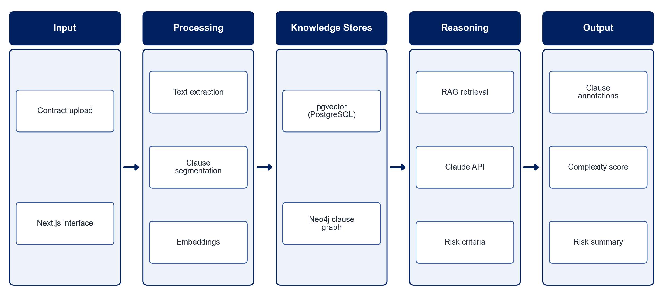
PROPOSED SYSTEM ARCHITECTURE
        Fig:- 1.1. System Architecture
CSE (DATA SCIENCE)

Slide 9
METHODOLOGY
Dataset Preparation: Use the CUAD dataset of expert-annotated contracts and curate Indian-law risk criteria.
Clause Segmentation: Extract text from contracts and split it into individual clauses.
Embedding & Storage: Embed clauses and store them in PostgreSQL with pgvector.
Knowledge Graph: Model clause types, legal concepts and precedent patterns in Neo4j.
RAG Reasoning: Retrieve similar clauses and legal context and analyse them with the Claude API.
Risk Scoring: Flag predatory clauses and compute an overall contract complexity score.
Evaluation: Evaluate clause-type classification on CUAD labels and predatory flags on curated criteria, separately.
Interface: Provide contract upload, clause annotations and a plain-language summary in Next.js.
CSE (DATA SCIENCE)

Slide 10
SYSTEM REQUIREMENTS
Hardware Requirements
Processor: Intel Core i5 or equivalent
RAM: 8 GB or higher
Storage: 20 GB free space
GPU: Not required (CPU-only, API-based inference)
Network: Internet access for the Claude API
Software Requirements
Backend: FastAPI (Python)
Frontend: Next.js
LLM: Claude API
Vector Search: PostgreSQL with pgvector
Graph Database: Neo4j
Dataset: CUAD
CSE (DATA SCIENCE)

Slide 11
Conclusion
The system makes contract risks visible to individuals and small businesses before they sign.
RAG with pgvector grounds the analysis in relevant clauses, while Neo4j exposes risky clause combinations.
Evaluating classification and predatory detection separately gives honest, task-specific metrics.
The project contributes a jurisdiction-aware approach for Indian contracts that is underrepresented in current research.
CSE (DATA SCIENCE)

