Slide 1


SHEGUARD: AI POWERED WOMEN’S SAFETY PLATFORM
NAME REG.NO
1 CH.AARTHI 23K91A6741
2 D.PRANATHI 23K91A6748
3 BALA VIGNESH 23K91A6717
4 A.VISHAL 23K91A6704
Guide Name:
GUIDE NAME
CSE (DATA SCIENCE)
BATCH : A7

Slide 2
CONTEXT
Introduction
Abstract
Existing system
Limitation of Existing system
Proposed System
System Architecture
Methodology
System Requirements
Conclusion
CSE (DATA SCIENCE)

Slide 3
INTRODUCTION
Women's safety in public places remains a major social concern.
Harassment and assault can occur on isolated streets as well as in crowded places.
Many safety apps provide an SOS button, but using it takes time and access to the phone.
In a real emergency the user may be frightened or unable to perform several actions.
Combining prevention, quick activation, live communication and evidence storage can reduce response time.
This project builds SHEGUARD, an AI-powered women's safety platform covering the full emergency lifecycle.
CSE (DATA SCIENCE)

Slide 4
ABSTRACT
Women face harassment, stalking and assault in both isolated and crowded public places.
Most safety apps depend on the user manually opening the app and pressing an SOS button during an emergency.
SHEGUARD supports users before, during and after an emergency through Safe Route guidance, SafePhrase activation and Smart SOS.
An emergency shares live location with trusted guardians and preserves timestamps, location, audio and image evidence.
The platform uses Flutter, the Gemini API and Supabase, with role-based access and Row Level Security.
CSE (DATA SCIENCE)

Slide 5
Existing system
SOS and panic-button apps send alerts to emergency contacts.
Government helplines and apps connect users to the police.
IoT wearables with GPS and GSM send location alerts when triggered.
Map apps suggest the fastest route without considering safety.
CSE (DATA SCIENCE)

Slide 6
Limitations of Existing system
SOS must be triggered manually, which is difficult during an emergency.
Most apps focus only on sending an alert, not on prevention or follow-up.
Routes are chosen for speed, not safety.
Evidence such as audio, images and timestamps is rarely preserved securely.
Guardians receive one-time alerts instead of live location updates.
CSE (DATA SCIENCE)

Slide 7
Proposed System
Safe Route guidance helps users choose safer travel routes using available safety information.
SafePhrase voice activation and Smart SOS trigger an emergency with minimal actions.
An emergency session shares live location with trusted guardians in real time.
Timestamps, location details and audio or image evidence are stored securely.
Gemini-based AI assistance and community safety reports support users, with data protected by Row Level Security.
CSE (DATA SCIENCE)

Slide 8
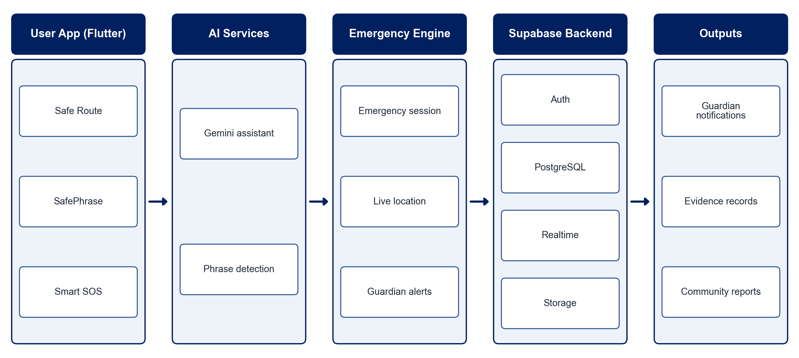
PROPOSED SYSTEM ARCHITECTURE
        Fig:- 1.1. System Architecture
CSE (DATA SCIENCE)

Slide 9
METHODOLOGY
Requirement Analysis: Identify safety needs before, during and after an emergency.
Safe Route Module: Rate routes using available safety information and recommend safer paths.
Emergency Activation: Implement the SafePhrase voice trigger and one-tap Smart SOS.
Emergency Session: Create a session that shares live location with trusted guardians.
Evidence Preservation: Capture timestamps, location, audio and images and store them securely.
AI Assistance: Integrate the Gemini API for safety guidance and support.
Security: Apply role-based access and Supabase Row Level Security to sensitive data.
Testing: Test activation speed, alert delivery and location accuracy.
CSE (DATA SCIENCE)

Slide 10
SYSTEM REQUIREMENTS
Hardware Requirements
Smartphone: Android / iOS with GPS, microphone and camera
Development Machine: Intel Core i5, 8 GB RAM
Storage: 20 GB free space
Network: Mobile data or Wi-Fi
Software Requirements
App Framework: Flutter (Dart)
AI: Gemini API
Backend: Supabase (Auth, PostgreSQL, Realtime, Storage)
Maps: Google Maps API
Tools: Android Studio, VS Code
CSE (DATA SCIENCE)

Slide 11
Conclusion
SHEGUARD reduces the number of actions needed to get help during an emergency.
Safe Route guidance adds prevention, while live location keeps guardians informed.
Securely preserved evidence supports follow-up after an incident.
The platform provides a practical, user-centred foundation for women's safety beyond a simple SOS button.
CSE (DATA SCIENCE)

