Slide 1


JEPA LLM TUNING FRAMEWORK MODEL FOR SELF SUPERVISED MEDICAL IMAGE SEGMENTATION AND DNA FINGER PRINTING ANALYSIS
NAME REG.NO
1 C.MANASA 23K91A6746
2 B.SRUTHI 23K91A6723
3 B.MANASVI 23K91A6738
4 B.SATHWIK 23K91A6726
Guide Name:
GUIDE NAME
CSE (DATA SCIENCE)
BATCH : A8

Slide 2
CONTEXT
Introduction
Abstract
Existing system
Limitation of Existing system
Proposed System
System Architecture
Methodology
System Requirements
Conclusion
CSE (DATA SCIENCE)

Slide 3
INTRODUCTION
Medical image segmentation and DNA fingerprinting are key tasks in diagnosis and forensic analysis.
Both tasks need large amounts of expert-labelled data, which is expensive and scarce.
Generative self-supervised methods reconstruct pixels or tokens and spend effort on low-level noise.
JEPA learns by predicting the representations of hidden regions in an abstract embedding space.
LLMs can turn model outputs into structured, human-readable clinical and forensic reports.
This project builds a JEPA-LLM framework for self-supervised medical image segmentation and DNA fingerprint analysis.
CSE (DATA SCIENCE)

Slide 4
ABSTRACT
The project proposes a unified framework that combines Joint Embedding Predictive Architecture (JEPA) with LLM fine-tuning for two biomedical tasks.
The tasks are self-supervised medical image segmentation and DNA fingerprinting analysis.
JEPA predicts target representations in a joint embedding space instead of reconstructing pixels or nucleotides.
A lightweight alignment bridge connects JEPA embeddings to an LLM fine-tuned with LoRA to produce structured clinical and forensic text.
The approach reduces the need for dense annotations and improves sample efficiency.
CSE (DATA SCIENCE)

Slide 5
Existing system
Supervised U-Net models segment medical images using dense pixel-level labels.
Masked autoencoders and contrastive learning pre-train models through reconstruction or augmentation.
DNA fingerprinting uses STR profiling with rule-based allele matching.
Genomic foundation models learn through masked language modelling or next-token prediction.
CSE (DATA SCIENCE)

Slide 6
Limitations of Existing system
Dense pixel-level and sequence-level labels are costly and require experts.
Reconstruction-based pre-training wastes capacity on pixel and token noise.
Imaging and genomic analysis are handled by separate, unrelated pipelines.
Model outputs are not translated into structured, readable reports.
Performance drops when labelled samples are scarce.
CSE (DATA SCIENCE)

Slide 7
Proposed System
A JEPA core uses context and target encoders to predict representations of masked image patches and DNA sequence windows.
A multi-scale cross-attention predictor captures both anatomical structures and repeat patterns such as STRs and VNTRs.
Dual-domain tokenisation uses ViT patches for images and k-mer tokens for DNA sequences.
A Q-Former or Perceiver bridge connects JEPA embeddings to an LLM fine-tuned with LoRA.
The LLM generates structured outputs, such as segmented-region descriptions and STR match summaries, from few labels.
CSE (DATA SCIENCE)

Slide 8
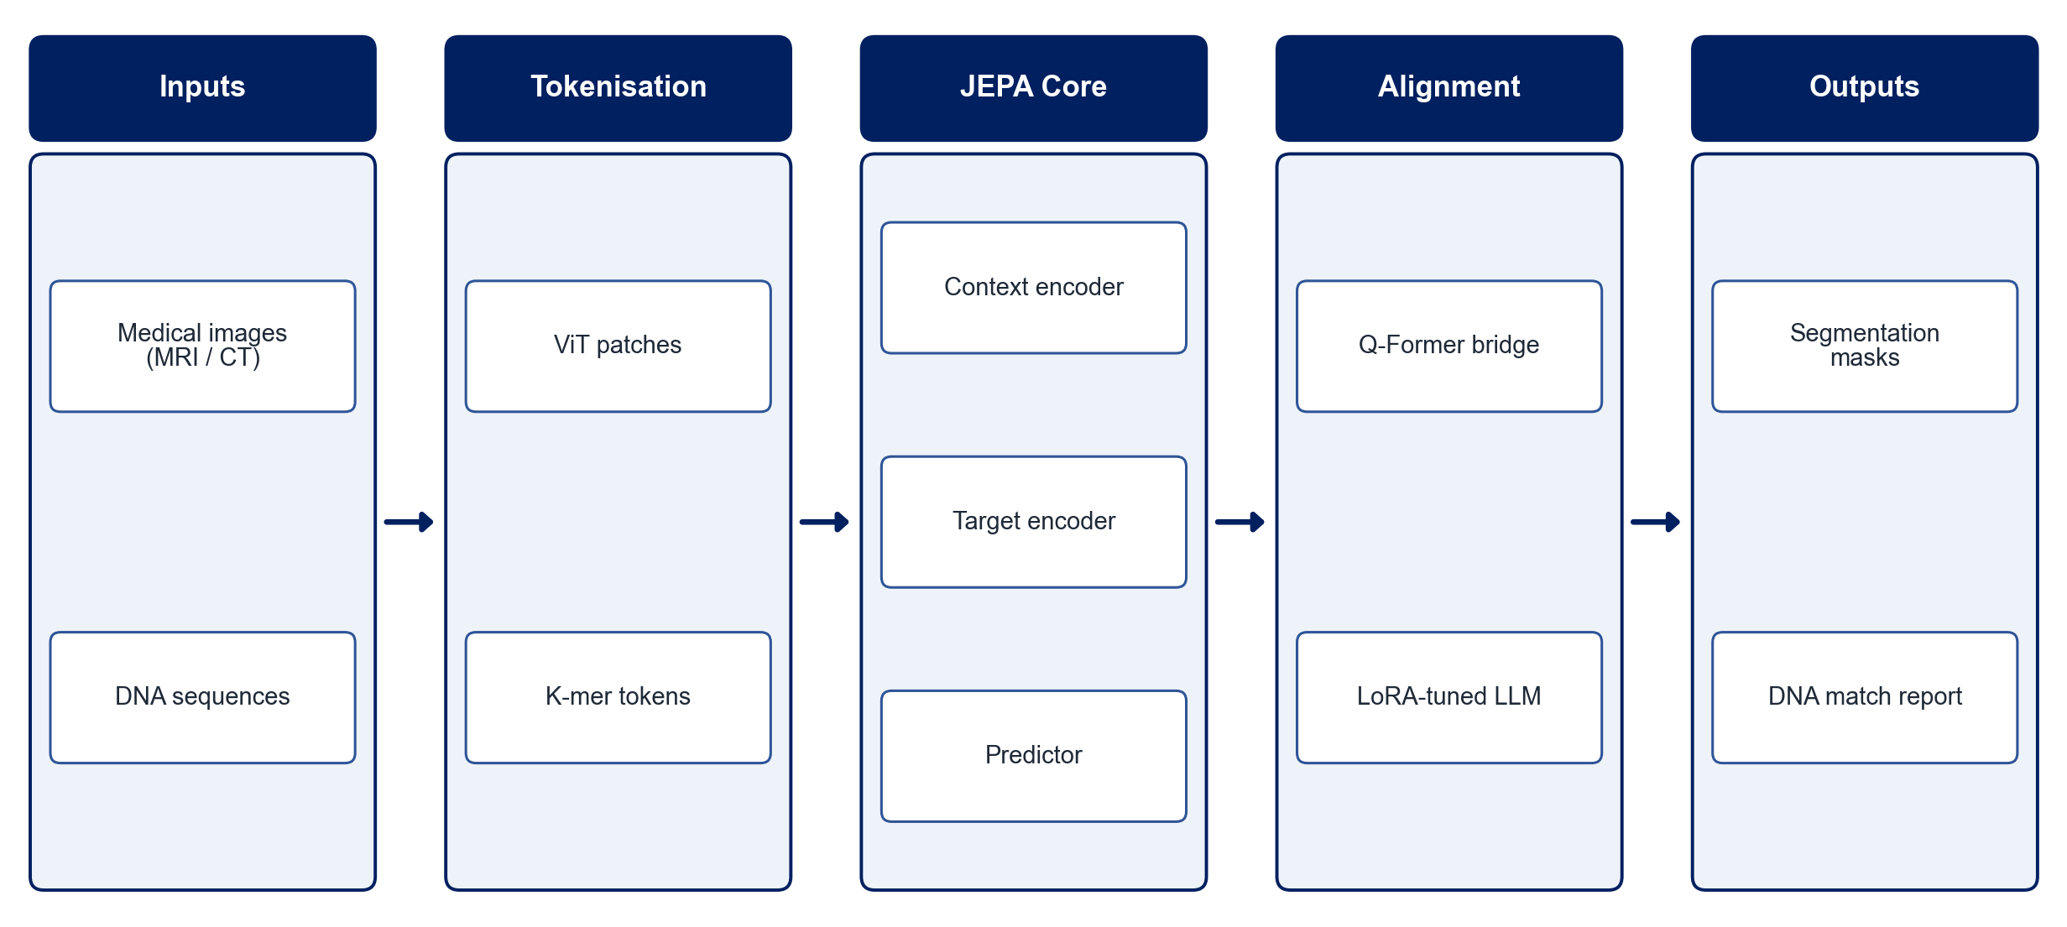
PROPOSED SYSTEM ARCHITECTURE
        Fig:- 1.1. System Architecture
CSE (DATA SCIENCE)

Slide 9
METHODOLOGY
Data Collection: Use public medical imaging datasets and DNA sequence or STR datasets.
Tokenisation: Convert images into ViT patches and DNA sequences into k-mer tokens.
JEPA Pre-training: Train context and target encoders to predict the representations of masked regions.
Downstream Fine-tuning: Fine-tune segmentation and DNA fingerprinting heads with few labels.
LLM Alignment: Connect JEPA embeddings to an LLM through a Q-Former bridge and tune it with LoRA.
Report Generation: Generate structured segmentation descriptions and STR match summaries.
Evaluation: Measure Dice score and IoU for segmentation and match accuracy for DNA fingerprinting.
Comparison: Compare against supervised and reconstruction-based baselines.
CSE (DATA SCIENCE)

Slide 10
SYSTEM REQUIREMENTS
Hardware Requirements
Processor: Intel Core i7 or equivalent
RAM: 16 GB or higher
GPU: NVIDIA GPU (8 GB+) or Google Colab
Storage: 100 GB free space
Software Requirements
Language: Python
Deep Learning: PyTorch
Models: ViT, Hugging Face Transformers, PEFT (LoRA)
Medical Imaging: MONAI, SimpleITK
Genomics: Biopython
Interface: Streamlit / Gradio
CSE (DATA SCIENCE)

Slide 11
Conclusion
JEPA-based pre-training learns meaningful representations without reconstructing pixels or nucleotides.
One framework serves both medical image segmentation and DNA fingerprinting.
LLM alignment converts model outputs into structured, readable clinical and forensic reports.
The approach reduces dependence on expensive labelled data in specialised biomedicine.
CSE (DATA SCIENCE)

