Slide 1


PRIVACY-PRESERVING MACHINE UNLEARNING IN FEDERATED LLMS: A CERTIFIED RIGHT-TO-BE-FORGOTTEN FRAMEWORK
NAME REG.NO
1 G.SHASHANK 23K91A6761
2 B.SATHISH 23K91A6719
3 G.RAKESH 23K91A6759
4 B.AKHIL 23K91A6721
Guide Name:
GUIDE NAME
CSE (DATA SCIENCE)
BATCH : A9

Slide 2
CONTEXT
Introduction
Abstract
Existing system
Limitation of Existing system
Proposed System
System Architecture
Methodology
System Requirements
Conclusion
CSE (DATA SCIENCE)

Slide 3
INTRODUCTION
Large Language Models are increasingly trained with federated learning so that private data stays on client devices.
Even without sharing raw data, each client's contribution becomes embedded in the global model parameters.
Data protection laws such as the GDPR give users the right to have their data forgotten on request.
Retraining a large federated model from scratch for every deletion request is computationally impractical.
Machine unlearning removes the influence of specific data, but most methods cannot prove that forgetting actually happened.
This project builds a certified, privacy-preserving unlearning framework for federated LLMs with verifiable compliance.
CSE (DATA SCIENCE)

Slide 4
ABSTRACT
Federated LLMs are trained across many clients whose private data never leaves their devices, yet each client's influence remains in the model parameters.
Regulations such as the GDPR's Right to Be Forgotten require that a user's data can be removed on request.
Existing deletion methods rely on heuristic retraining or approximate weight changes and give no formal guarantee of forgetting.
The project proposes certified unlearning that combines differential-privacy bounds with parameter-level updates to erase a client's contribution without full retraining.
A verification and audit mechanism proves each unlearning request to regulators and users while preserving model utility.
CSE (DATA SCIENCE)

Slide 5
Existing system
Full retraining of the model without the deleted client's data.
Approximate unlearning through gradient ascent or heuristic weight adjustment.
SISA-style sharded training that retrains only the affected shards.
Differential privacy during training to limit the influence of individual data.
CSE (DATA SCIENCE)

Slide 6
Limitations of Existing system
Full retraining is too expensive for large federated LLMs.
Heuristic methods provide no formal guarantee that data is forgotten.
Unlearning is not verifiable or auditable for regulators.
Aggressive unlearning degrades overall model utility.
Most methods target centralised models, not federated LLM pipelines.
CSE (DATA SCIENCE)

Slide 7
Proposed System
Clients submit unlearning requests that trigger removal of their data contribution from the federated global model.
Parameter-level update techniques erase targeted contributions without retraining from scratch.
Differential-privacy bounds give a provable, quantifiable guarantee that remaining influence is below a threshold.
A verification and audit module records and demonstrates each unlearning request for compliance.
The framework runs inside the federated training pipeline with low overhead while preserving model utility.
CSE (DATA SCIENCE)

Slide 8
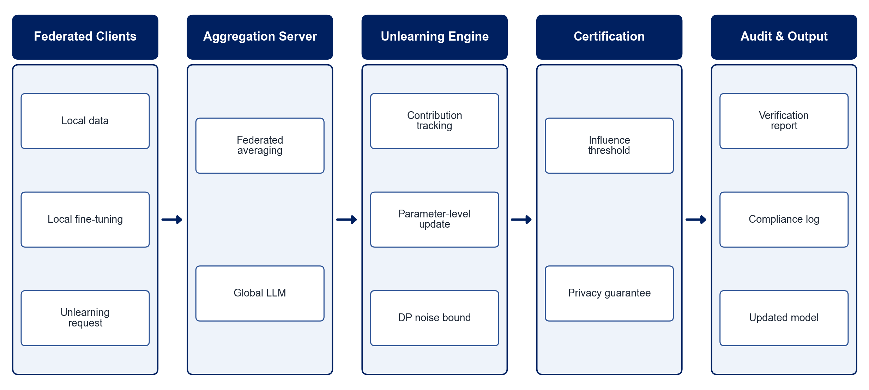
PROPOSED SYSTEM ARCHITECTURE
        Fig:- 1.1. System Architecture
CSE (DATA SCIENCE)

Slide 9
METHODOLOGY
Federated Setup: Fine-tune a small LLM across simulated clients using federated averaging.
Contribution Tracking: Record each client's updates so they can be removed later.
Unlearning Request: Accept a client's deletion request and identify its contribution.
Parameter-level Unlearning: Remove the client's influence with targeted parameter updates instead of full retraining.
Certification: Apply differential-privacy bounds to certify that remaining influence is below a threshold.
Verification: Test forgetting with membership-inference attacks and compare with a retrained model.
Utility Evaluation: Measure perplexity and task accuracy on the retained data.
Audit Logging: Generate verifiable compliance records for each request.
CSE (DATA SCIENCE)

Slide 10
SYSTEM REQUIREMENTS
Hardware Requirements
Processor: Intel Core i7 or equivalent
RAM: 16 GB or higher
GPU: NVIDIA GPU (8 GB+) or Google Colab
Storage: 50 GB free space
Software Requirements
Language: Python
Deep Learning: PyTorch
Federated Learning: Flower (flwr)
LLMs: Hugging Face Transformers, PEFT (LoRA)
Privacy: Opacus (differential privacy)
Interface: Streamlit audit dashboard
CSE (DATA SCIENCE)

Slide 11
Conclusion
The framework lets federated LLMs honour data-deletion requests without retraining from scratch.
Differential-privacy bounds make forgetting provable rather than approximate.
Audit records demonstrate compliance with regulations such as the GDPR.
Model utility is preserved, making certified unlearning practical for real federated deployments.
CSE (DATA SCIENCE)

