Slide 1


AI POWERED GOVERNMENT DECISION SUPPORT SYSTEM FOR SMART GOVERNANCE
NAME REG.NO
1 MALLAVARAPU AMULYA 23K91A67A8
2 KORAY PRAMOD KUMAR 23K91A6794
3 KAGE KRISHNACHAITANYA KUMAR 23K91A6775
4 MOHAMMAD FAZAL 23K91A67B6
Guide Name:
MR.M.AROKIA MUTHU
CSE (DATA SCIENCE)
BATCH : B1

Slide 2
CONTEXT
Introduction
Abstract
Existing system
Limitation of Existing system
Proposed System
System Architecture
Methodology
System Requirements
Conclusion
CSE (DATA SCIENCE)

Slide 3
INTRODUCTION
Digital governance has made it easy for citizens to report civic problems.
Complaint volumes about roads, water, streetlights, garbage and drainage are growing rapidly.
Officers manually read, prioritise and route complaints to departments.
Manual handling delays resolution and wastes resources.
NLP and explainable AI can analyse complaints and recommend actions transparently.
This project builds an AI-powered, human-in-the-loop decision support system for smart governance.
CSE (DATA SCIENCE)

Slide 4
ABSTRACT
Citizen complaints about roads, water leakage, streetlights, garbage, drainage and sanitation are rising with digital governance.
Grievance portals register and track complaints, but officers still analyse, prioritise and route them manually.
The project uses AI, NLP and Explainable AI to classify complaints, predict priority, recommend the department and estimate resolution time.
A Human-in-the-Loop approach lets officers review explainable recommendations and make the final decision.
The platform serves citizens, officers, field staff and administrators with tracking, work assignment and real-time analytics.
CSE (DATA SCIENCE)

Slide 5
Existing system
Grievance portals and apps for complaint registration and tracking.
Officers manually categorise complaints and assign departments.
Priority is decided by officer judgement or first-come order.
Reports are compiled manually from complaint records.
CSE (DATA SCIENCE)

Slide 6
Limitations of Existing system
Manual classification and routing delay resolution.
Urgent issues are not prioritised consistently.
Resolution times are not estimated for planning.
Recommendations, where present, lack explanations.
There is little real-time analytics for monitoring performance.
CSE (DATA SCIENCE)

Slide 7
Proposed System
NLP models classify complaints by category and extract key details.
ML predicts priority and estimates resolution time.
The system recommends the responsible department for each complaint.
Explainable AI shows the reasons behind every recommendation, and officers make the final decision.
Role-based modules support citizens, officers, field staff and administrators with real-time analytics.
CSE (DATA SCIENCE)

Slide 8
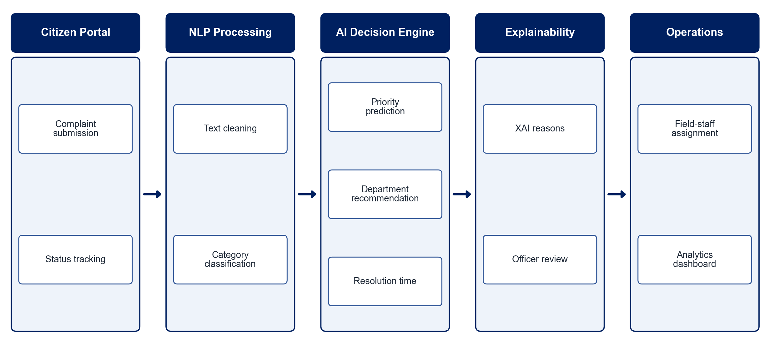
PROPOSED SYSTEM ARCHITECTURE
        Fig:- 1.1. System Architecture
CSE (DATA SCIENCE)

Slide 9
METHODOLOGY
Data Collection: Gather civic complaint text with categories, departments and resolution times.
Preprocessing: Clean and normalise complaint text, including informal language.
Classification: Train NLP models to classify complaint categories.
Priority Prediction: Predict urgency from complaint content and context.
Department Recommendation: Map each complaint to the responsible department.
Resolution Estimation: Predict the expected resolution time.
Explainability & Review: Show XAI explanations and let officers approve or override.
Dashboard: Provide assignment tracking and real-time analytics for administrators.
CSE (DATA SCIENCE)

Slide 10
SYSTEM REQUIREMENTS
Hardware Requirements
Processor: Intel Core i5 or equivalent
RAM: 8 GB or higher
Storage: 20 GB free space
Network: Internet access for the web portal
Software Requirements
Language: Python
NLP: Hugging Face Transformers, scikit-learn
Explainability: SHAP / LIME
Backend: Django / FastAPI
Frontend: React
Database: PostgreSQL / MySQL
CSE (DATA SCIENCE)

Slide 11
Conclusion
The system automates complaint analysis, prioritisation and routing.
Explainable, human-in-the-loop recommendations keep officers in control.
Resolution-time estimates and analytics support better resource planning.
The platform improves governance efficiency, transparency and citizen satisfaction.
CSE (DATA SCIENCE)

