Slide 1


HYBRID CHAOTIC LIGHTWEIGHT IMAGE ENCRYPTION FOR SECURE UAV TRANSMISSION: WAVELET AND XOR-DIFFUSION APPROACH
NAME REG.NO
1 NALLA NIKHILESHWAR REDDY 23K91A67C5
2 KASTURI SRIMUKHI 24K95A6707
3 GUNJULURI SHAILAJA 23K91A6771
4 MOKKA PHANEENDHAR GOUD 23K91A67B8
Guide Name:
DR.M.SANDHYA RANI
CSE (DATA SCIENCE)
BATCH : B10

Slide 2
CONTEXT
Introduction
Abstract
Existing system
Limitation of Existing system
Proposed System
System Architecture
Methodology
System Requirements
Conclusion
CSE (DATA SCIENCE)

Slide 3
INTRODUCTION
UAVs capture and transmit sensitive images for surveillance, mapping, agriculture and defence.
Images sent over wireless channels can be intercepted, altered or accessed without authorisation.
Image data has high redundancy and strong pixel correlation, which weakens conventional ciphers.
Standard ciphers such as AES are secure but can be too slow for real-time transmission on limited hardware.
Chaotic maps generate highly random, key-sensitive sequences that suit lightweight image encryption.
This project builds a hybrid chaotic, lightweight image encryption scheme using DWT and XOR diffusion for secure UAV transmission.
CSE (DATA SCIENCE)

Slide 4
ABSTRACT
UAV images sent over wireless links are vulnerable to interception, modification, statistical attacks and differential attacks.
Strong encryption methods are often too computationally heavy for real-time image transmission.
The project decomposes images with the Discrete Wavelet Transform and generates unpredictable keys with a chaotic map.
XOR-based diffusion encrypts pixels, reducing correlation and resisting brute-force, statistical and differential attacks.
Security and speed are evaluated with entropy, histograms, correlation, NPCR, UACI, PSNR, MSE, key sensitivity and encryption time.
CSE (DATA SCIENCE)

Slide 5
Existing system
Standard block ciphers such as AES and DES applied to image data.
Single chaotic-map encryption schemes such as logistic-map ciphers.
Multi-chaos image encryption for IoT devices.
Transform-domain encryption using DCT or DWT.
CSE (DATA SCIENCE)

Slide 6
Limitations of Existing system
Standard ciphers are computationally heavy for real-time UAV links.
Single chaotic maps have small key spaces and known weaknesses.
Some schemes leave residual pixel correlation.
Many methods are not evaluated for encryption speed.
Frequency-domain and chaotic methods are rarely combined.
CSE (DATA SCIENCE)

Slide 7
Proposed System
The input image is decomposed into frequency sub-bands using the Discrete Wavelet Transform.
A chaotic map generates unpredictable keys that are highly sensitive to initial conditions.
XOR-based diffusion encrypts pixels to reduce correlation.
The scheme is purely software-based and lightweight enough for real-time transmission.
Security is verified using entropy, histogram, correlation, NPCR, UACI, PSNR, MSE and key sensitivity.
CSE (DATA SCIENCE)

Slide 8
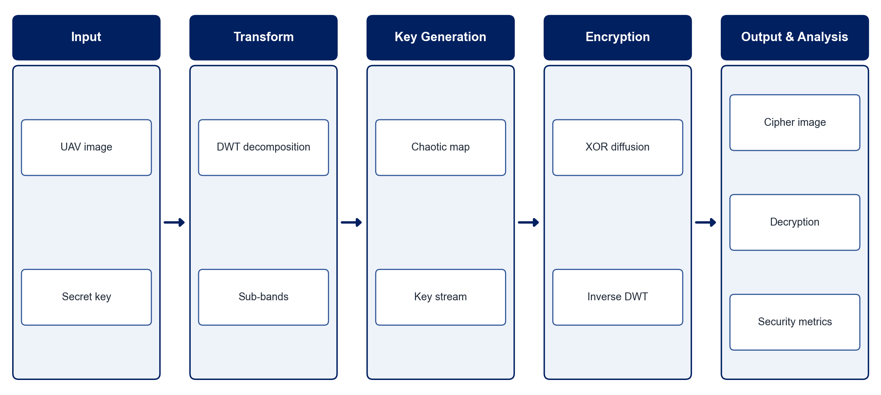
PROPOSED SYSTEM ARCHITECTURE
        Fig:- 1.1. System Architecture
CSE (DATA SCIENCE)

Slide 9
METHODOLOGY
Image Acquisition: Collect standard test images and UAV aerial images.
Preprocessing: Convert images to a fixed size and format.
DWT Decomposition: Decompose images into approximation and detail sub-bands.
Chaotic Key Generation: Generate key streams using a chaotic map with secret initial conditions.
XOR Diffusion: Encrypt pixel values by XOR with the chaotic key stream.
Decryption: Reverse the process to recover the original image.
Security Analysis: Measure entropy, histogram, correlation, NPCR, UACI and key sensitivity.
Performance Analysis: Measure PSNR, MSE and encryption and decryption time.
CSE (DATA SCIENCE)

Slide 10
SYSTEM REQUIREMENTS
Hardware Requirements
Processor: Intel Core i5 or equivalent
RAM: 8 GB or higher
Storage: 10 GB free space
Software Requirements
Language: Python
Libraries: NumPy, OpenCV, PyWavelets
Analysis: Matplotlib, scikit-image
Interface: Tkinter / Streamlit
Tools: Jupyter Notebook, VS Code
CSE (DATA SCIENCE)

Slide 11
Conclusion
The scheme secures UAV images with lightweight, software-only encryption.
DWT and chaotic keys provide a large key space and strong key sensitivity.
XOR diffusion lowers pixel correlation and resists statistical and differential attacks.
Low encryption time makes the scheme suitable for real-time transmission.
CSE (DATA SCIENCE)

