Slide 1


SMART DIET PLANNER: AN AI-POWERED WEB APPLICATION FOR PERSONALIZED NUTRITION MANAGEMENT
NAME REG.NO
1 NAGAPURI VINAY KUMAR 23K91A67C2
2 MANCHALA AKSHITH VARMA 23K91A67B1
3 KARNATI PRAVEEN REDDY 23K91A6782
4 KORRA RAHUL 23K91A6795
Guide Name:
MRS.T.ANUSHA
CSE (DATA SCIENCE)
BATCH : B11

Slide 2
CONTEXT
Introduction
Abstract
Existing system
Limitation of Existing system
Proposed System
System Architecture
Methodology
System Requirements
Conclusion
CSE (DATA SCIENCE)

Slide 3
INTRODUCTION
Healthy eating is essential for preventing lifestyle diseases.
Busy routines and irregular eating habits make balanced nutrition difficult.
Online diet information is abundant but generic and often conflicting.
Nutritional needs vary with age, body measurements, activity, health conditions and goals.
AI can combine these factors to generate personalised meal plans.
This project builds the Smart Diet Planner, an AI-powered web application for personalised nutrition management.
CSE (DATA SCIENCE)

Slide 4
ABSTRACT
Busy lifestyles and conflicting online information make healthy eating difficult.
Most people find it hard to choose meals suited to their age, health condition and fitness goals.
The Smart Diet Planner uses AI to generate meal plans from age, gender, height, weight, activity level, preferences and goals.
Users calculate daily calorie needs, track nutritional intake and monitor progress.
Recommendations take dietary restrictions, food allergies and medical conditions into account.
CSE (DATA SCIENCE)

Slide 5
Existing system
Printed diet charts that give the same plan to everyone.
Calorie-counting apps that track intake without planning meals.
Consultations with dietitians, which are costly and not always accessible.
Generic online meal plans and fitness blogs.
CSE (DATA SCIENCE)

Slide 6
Limitations of Existing system
Diet charts ignore individual needs and goals.
Calorie trackers do not recommend balanced meals.
Allergies and medical conditions are often ignored.
Professional nutrition advice is costly.
Users struggle to track progress and stay consistent.
CSE (DATA SCIENCE)

Slide 7
Proposed System
Users create profiles with age, gender, height, weight, activity level, preferences and goals.
The system calculates BMI, BMR and daily calorie requirements.
AI generates balanced meal plans for weight loss, weight gain or maintenance.
Recommendations respect dietary restrictions, allergies and medical conditions.
Users track intake and progress through dashboards.
CSE (DATA SCIENCE)

Slide 8
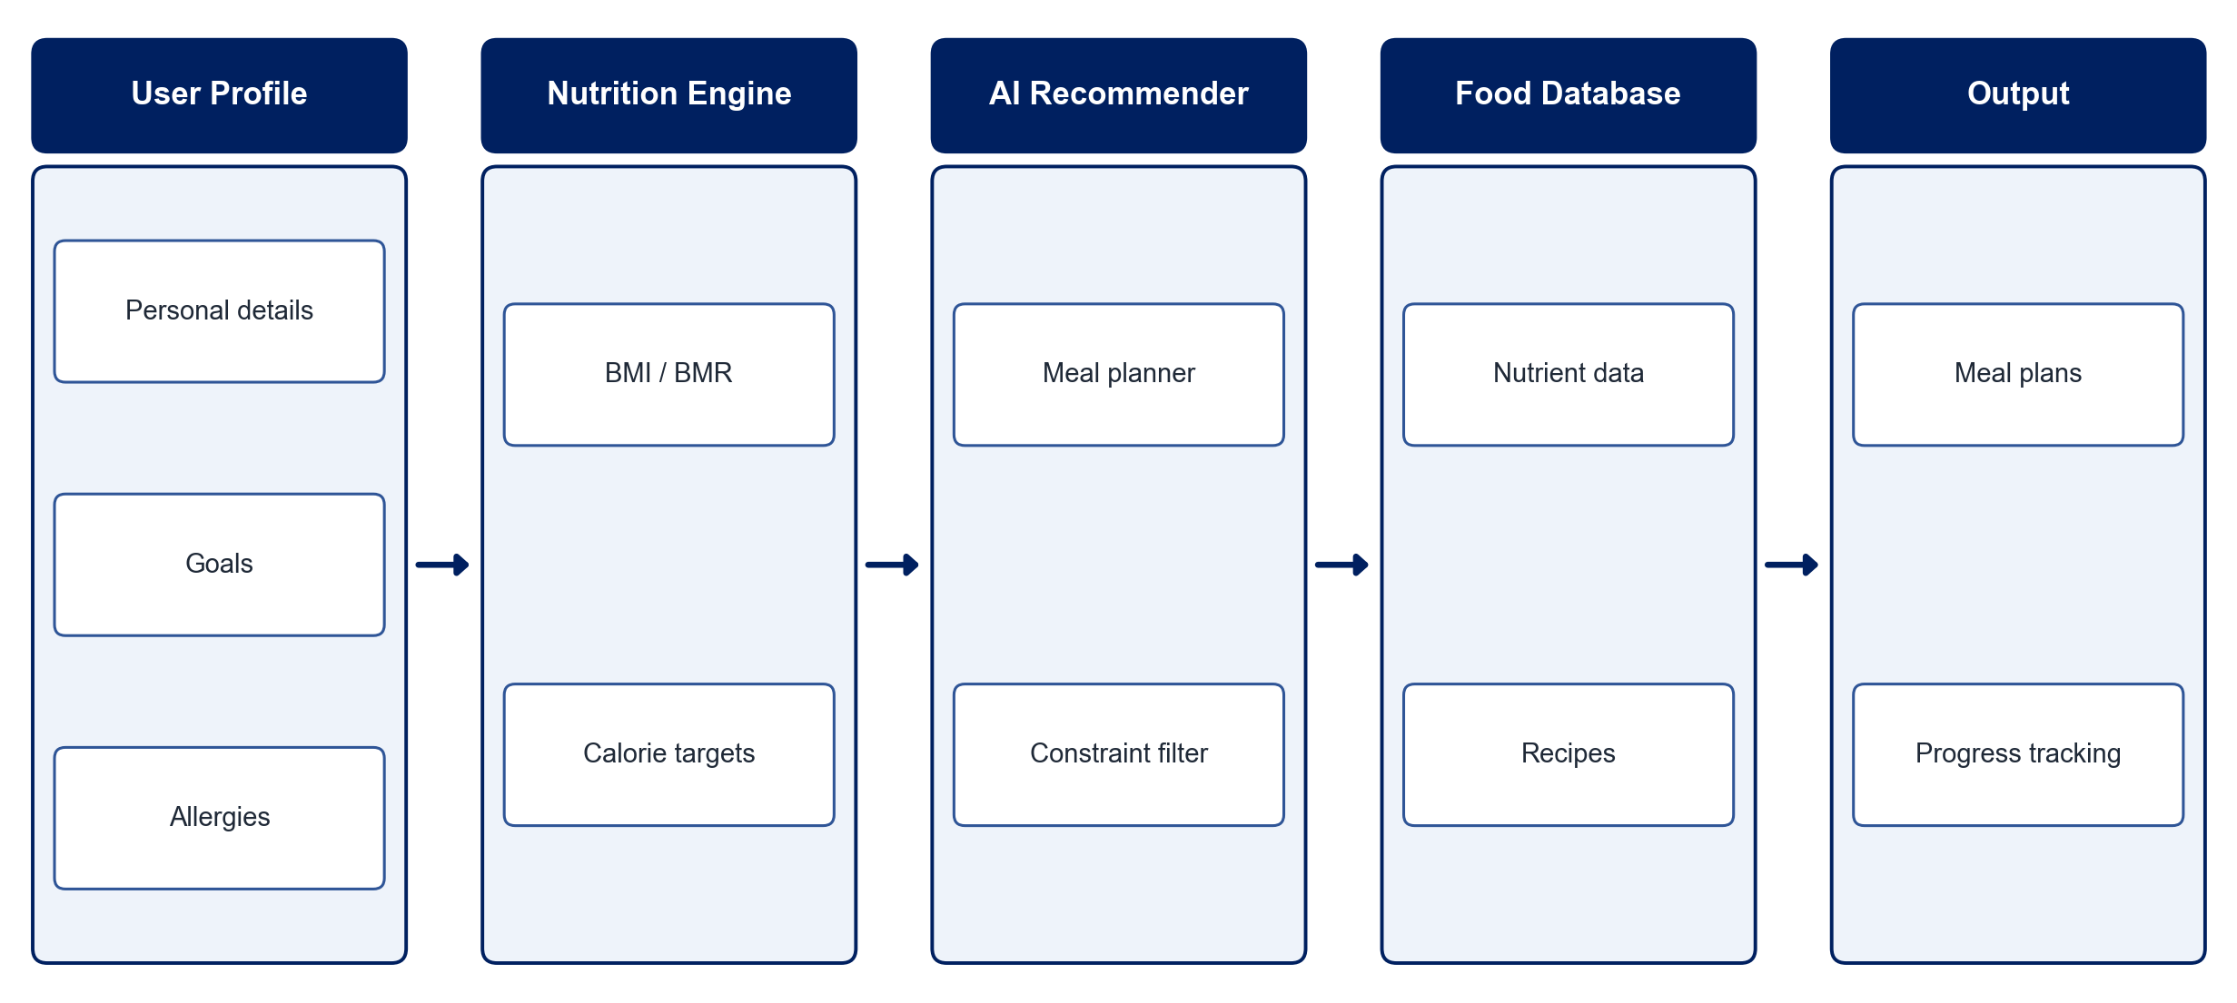
PROPOSED SYSTEM ARCHITECTURE
        Fig:- 1.1. System Architecture
CSE (DATA SCIENCE)

Slide 9
METHODOLOGY
Requirement Analysis: Define user profile fields, goals and health constraints.
Food Dataset: Build a food and nutrient database with calories and macronutrients.
Calorie Calculation: Compute BMI, BMR and daily calorie needs from profile data.
Recommendation Model: Generate meal plans using ML and rule-based filtering on nutrients and preferences.
Constraint Handling: Exclude foods that conflict with allergies, restrictions or conditions.
Progress Tracking: Record intake and weight to adapt recommendations.
Web Application: Build profile, planner and dashboard pages.
Testing: Evaluate plans against nutritional targets and user feedback.
CSE (DATA SCIENCE)

Slide 10
SYSTEM REQUIREMENTS
Hardware Requirements
Processor: Intel Core i5 or equivalent
RAM: 8 GB or higher
Storage: 10 GB free space
Software Requirements
Language: Python
Machine Learning: scikit-learn, pandas
Backend: Flask / Django
Frontend: HTML, CSS, JavaScript / React
Database: MySQL / SQLite
Dataset: USDA / Indian food nutrient data
CSE (DATA SCIENCE)

Slide 11
Conclusion
The Smart Diet Planner turns personal data into balanced, personalised meal plans.
Allergies, restrictions and medical conditions are respected automatically.
Progress tracking helps users build healthy habits over time.
AI makes nutrition planning simple, accurate and accessible for everyone.
CSE (DATA SCIENCE)

