Slide 1


PULMONARY DISEASE DETECTION USING DEEP LEARNING TECHNIQUES
NAME REG.NO
1 MALKAJGIRI RAKSHITHA 23K91A67A6
2 KATTA SOWMYA 23K91A6786
3 GOURABATHUNI SAI VAISHNAVI 23K91A6766
4 MUDUSU GOUTHAM 23K91A67B9
Guide Name:
MRS M. PRAVARSHA REDDY
CSE (DATA SCIENCE)
BATCH : B12

Slide 2
CONTEXT
Introduction
Abstract
Existing system
Limitation of Existing system
Proposed System
System Architecture
Methodology
System Requirements
Conclusion
CSE (DATA SCIENCE)

Slide 3
INTRODUCTION
Pulmonary diseases such as pneumonia, tuberculosis and lung cancer cause major illness and death worldwide.
Chest X-rays and CT scans are the main imaging tools for diagnosis.
Reading scans requires expert radiologists, who are scarce in many regions.
Deep learning can classify lung diseases from medical images with high accuracy.
Explainable AI and clear reports help clinicians and patients trust and understand results.
This project builds an explainable deep-learning system for multi-disease pulmonary screening.
CSE (DATA SCIENCE)

Slide 4
ABSTRACT
Pulmonary diseases are a major cause of illness and death, so early and accurate detection is essential.
The project detects multiple pulmonary diseases from chest X-ray and CT images using deep learning.
Preprocessing, U-Net lung segmentation and an EfficientNetB0 transfer-learning model classify pneumonia, TB, COVID-19, pneumothorax, effusion, oedema, lung cancer and normal cases.
Grad-CAM highlights the influential regions, with confidence and severity information.
An AI assistant explains results, and the multilingual web app generates secure PDF reports.
CSE (DATA SCIENCE)

Slide 5
Existing system
Manual interpretation of chest X-rays and CT scans by radiologists.
CNN models that detect a single disease such as pneumonia or COVID-19.
Multi-class CT classifiers with explainable heatmaps.
Hospital PACS systems that store images without automated screening.
CSE (DATA SCIENCE)

Slide 6
Limitations of Existing system
Manual reading is slow and depends on scarce specialists.
Many models detect only one disease.
Predictions often lack explanations and severity information.
Reports are technical and available only in English.
Patient data security is often overlooked in prototypes.
CSE (DATA SCIENCE)

Slide 7
Proposed System
Images are preprocessed with resizing, normalisation, contrast enhancement and noise reduction.
U-Net segmentation isolates the lung region.
EfficientNetB0 transfer learning classifies eight pulmonary conditions and normal cases.
Grad-CAM heatmaps, confidence scores and severity information explain each prediction.
An AI assistant and multilingual PDF reports support users, with secure, encrypted storage.
CSE (DATA SCIENCE)

Slide 8
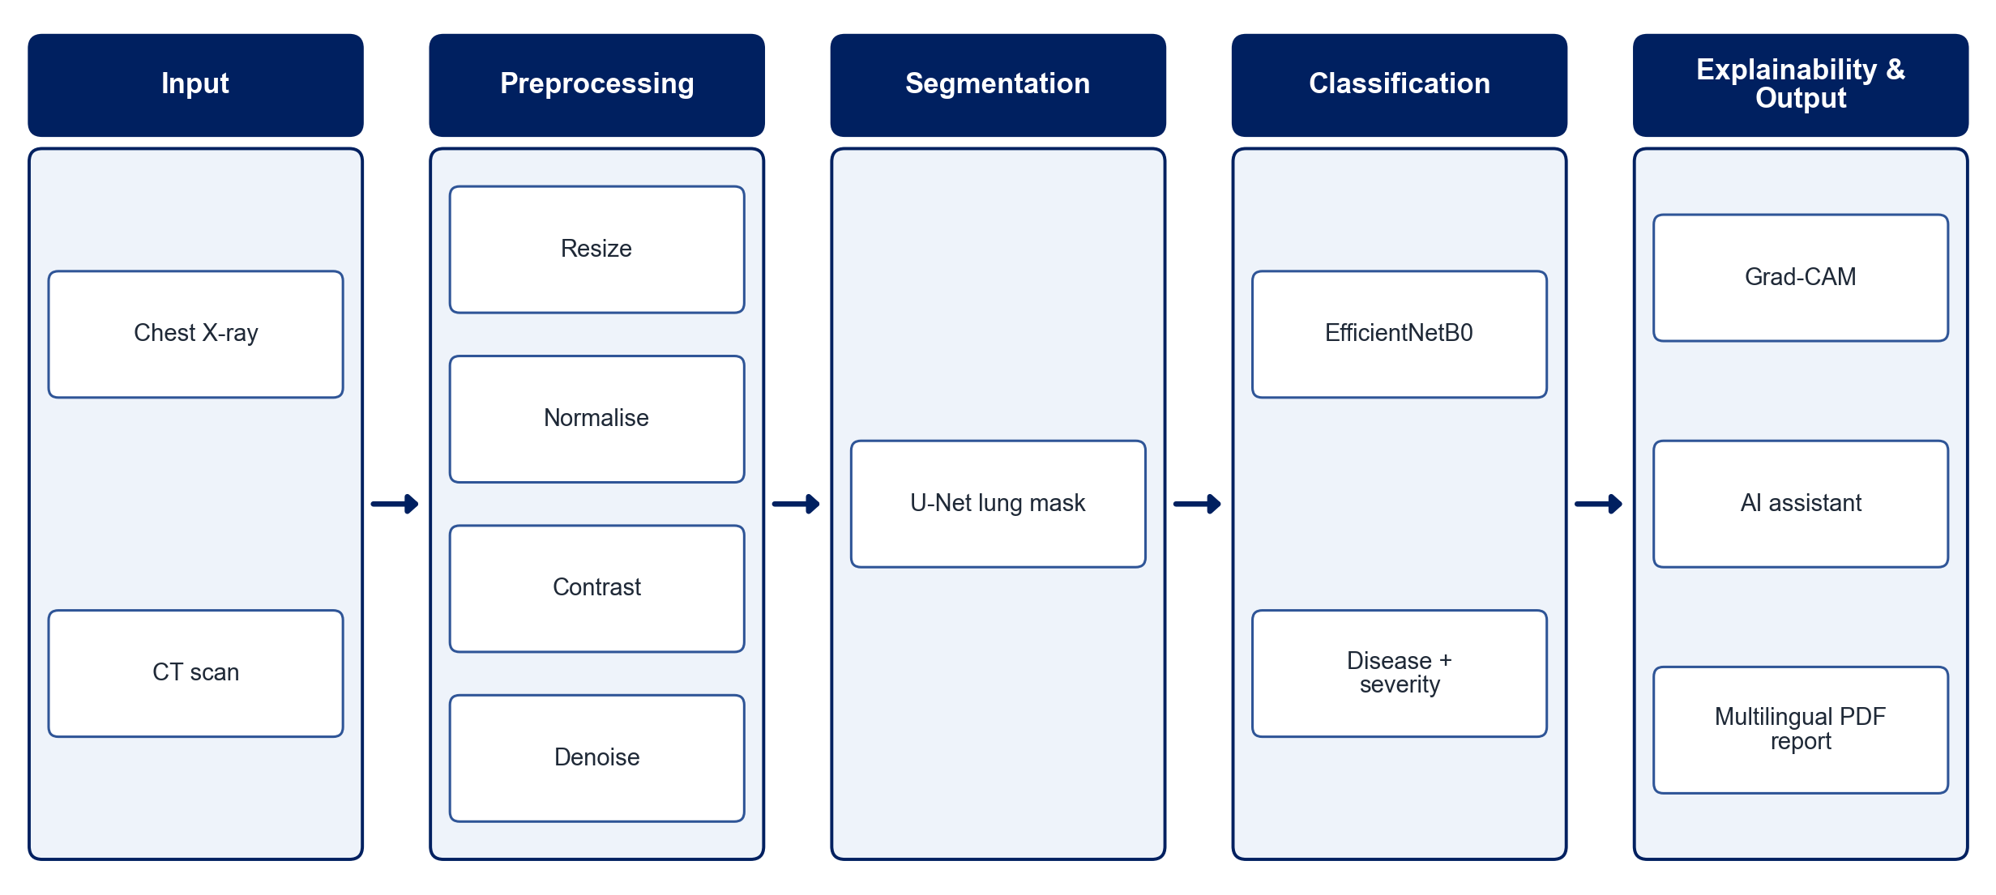
PROPOSED SYSTEM ARCHITECTURE
        Fig:- 1.1. System Architecture
CSE (DATA SCIENCE)

Slide 9
METHODOLOGY
Data Collection: Use public chest X-ray and CT datasets covering pneumonia, TB, COVID-19 and other conditions.
Preprocessing: Resize, normalise, enhance contrast and reduce noise.
Lung Segmentation: Train a U-Net to isolate the lung regions.
Classification: Fine-tune EfficientNetB0 for multi-class disease classification.
Explainability: Generate Grad-CAM heatmaps for each prediction.
Severity & Confidence: Estimate severity and report prediction confidence.
Web Application: Provide upload, a multilingual AI assistant, PDF reports and secure history.
Evaluation: Measure accuracy, precision, recall, F1-score and AUC.
CSE (DATA SCIENCE)

Slide 10
SYSTEM REQUIREMENTS
Hardware Requirements
Processor: Intel Core i5 or equivalent
RAM: 16 GB recommended
GPU: NVIDIA GPU or Google Colab for training
Storage: 50 GB free space
Software Requirements
Language: Python
Deep Learning: TensorFlow / Keras, PyTorch
Image Processing: OpenCV
Explainability: Grad-CAM
Web App: Flask / Django
Reports & Security: ReportLab, encryption, cloud storage
CSE (DATA SCIENCE)

Slide 11
Conclusion
The system screens for multiple pulmonary diseases from X-ray and CT images.
Segmentation and Grad-CAM make predictions accurate and explainable.
Multilingual reports and an AI assistant improve accessibility for diverse users.
It supports clinicians as a preliminary screening tool, not a replacement for professional diagnosis.
CSE (DATA SCIENCE)

