Slide 1


API SECURITY PLATFORM FOR PAYMENT APPLICATIONS
NAME REG.NO
1 KAPARTHI SRIPAD 23K91A6780
2 NUTHANAGANTI DIVYAJYOTHI 23K91A67C8
3 NAGUNOORI SIDHARTHA 24K95A6710
4 KODURU SATHISH 23K91A6792
Guide Name:
MRS.T.JYOTHI
CSE (DATA SCIENCE)
BATCH : B13

Slide 2
CONTEXT
Introduction
Abstract
Existing system
Limitation of Existing system
Proposed System
System Architecture
Methodology
System Requirements
Conclusion
CSE (DATA SCIENCE)

Slide 3
INTRODUCTION
APIs are the backbone of UPI and digital payment applications.
As online payments grow, APIs have become a common target for cyberattacks.
The OWASP API Security Top 10 lists the most critical API risks, such as broken object-level authorisation.
Existing security testing tools require expertise, manual effort and expensive licences.
Many vulnerabilities therefore remain undetected until after deployment.
This project builds a simple, automated API security testing tool for payment applications.
CSE (DATA SCIENCE)

Slide 4
ABSTRACT
APIs connect users, banks and payment services in UPI and digital payment apps, which makes them frequent attack targets.
Popular security tools need skilled professionals, manual effort and expensive licences.
The project builds an automated tool that scans REST APIs against the OWASP API Security Top 10.
It detects broken authentication, BOLA / IDOR, excessive data exposure, rate-limiting weaknesses and injection issues.
It generates a detailed report with an API security score and recommendations before deployment.
CSE (DATA SCIENCE)

Slide 5
Existing system
Manual penetration testing by security professionals.
Commercial scanners such as Burp Suite Pro and enterprise API security platforms.
Open-source tools such as OWASP ZAP and Postman test scripts.
Research frameworks that use LLMs to generate API security tests.
CSE (DATA SCIENCE)

Slide 6
Limitations of Existing system
Manual testing is slow and requires skilled professionals.
Commercial tools are expensive for small teams and students.
General scanners do not focus on payment API risks.
Results are hard for developers to interpret without a clear score.
Vulnerabilities such as BOLA / IDOR often go undetected before deployment.
CSE (DATA SCIENCE)

Slide 7
Proposed System
The tool imports REST API endpoints from specifications or collections.
Automated tests check for broken authentication, BOLA / IDOR, excessive data exposure, rate limiting and injection.
Tests follow the OWASP API Security Top 10.
Each API receives a security score based on findings and their severity.
A detailed report gives developers clear recommendations before deployment.
CSE (DATA SCIENCE)

Slide 8
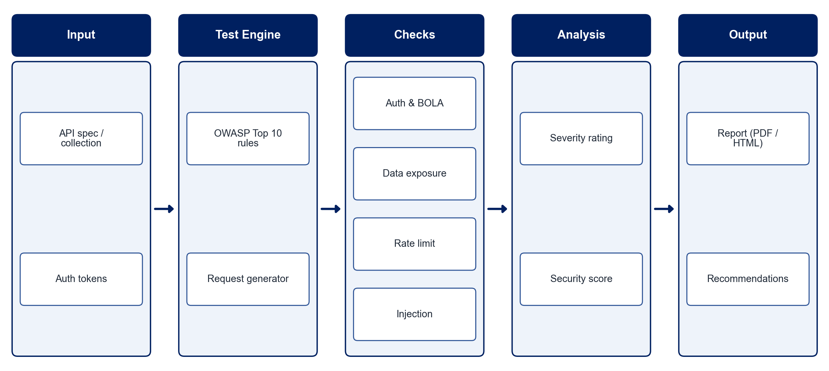
PROPOSED SYSTEM ARCHITECTURE
        Fig:- 1.1. System Architecture
CSE (DATA SCIENCE)

Slide 9
METHODOLOGY
Requirement Analysis: Map OWASP API Security Top 10 risks to payment API scenarios.
Endpoint Discovery: Import endpoints from OpenAPI specifications or Postman collections.
Test Generation: Generate test requests for each vulnerability category.
Authentication Tests: Check weak tokens, missing authentication and session issues.
Authorisation Tests: Detect BOLA / IDOR by manipulating object identifiers.
Exposure & Rate Tests: Detect excessive data exposure, missing rate limits and injection.
Scoring & Reporting: Compute a security score and generate recommendations.
Validation: Test the tool on deliberately vulnerable APIs such as VAmPI and OWASP crAPI.
CSE (DATA SCIENCE)

Slide 10
SYSTEM REQUIREMENTS
Hardware Requirements
Processor: Intel Core i5 or equivalent
RAM: 8 GB or higher
Storage: 10 GB free space
Network: Local / test network for API scanning
Software Requirements
Language: Python
HTTP Testing: Requests, httpx
API Specs: OpenAPI / Swagger parser
Test Targets: VAmPI, OWASP crAPI
Interface: Flask / Streamlit dashboard
Reports: ReportLab / Jinja2
CSE (DATA SCIENCE)

Slide 11
Conclusion
The tool automates API security testing for payment applications.
OWASP-guided checks detect critical vulnerabilities before deployment.
A security score and clear recommendations make results actionable for developers.
It offers a simple, low-cost alternative to expensive professional tools.
CSE (DATA SCIENCE)

