Slide 1


AQUAVISION: AI-POWERED SMART WATER DISTRIBUTION AND QUALITY INTELLIGENCE PLATFORM
NAME REG.NO
1 MEDIPALLY KAVYA 23K91A67B3
2 KETHAVATH SUMATHI 23K91A6788
3 KETHIREDDY MANOJ REDDY 23K91A6789
4 NALLAGATLA NITHIN 23K91A67C6
Guide Name:
MRS K.MOUNIKA
CSE (DATA SCIENCE)
BATCH : B14

Slide 2
CONTEXT
Introduction
Abstract
Existing system
Limitation of Existing system
Proposed System
System Architecture
Methodology
System Requirements
Conclusion
CSE (DATA SCIENCE)

Slide 3
INTRODUCTION
Safe drinking water is essential for public health.
Rapid urbanisation and ageing pipelines strain water distribution networks.
Leakages and unequal distribution waste water and leave some areas short.
Water quality is often tested manually and infrequently.
Machine learning can predict quality and demand and detect leaks and anomalies from data.
This project builds AquaVision, an AI-powered smart water distribution and quality intelligence platform.
CSE (DATA SCIENCE)

Slide 4
ABSTRACT
Safe drinking water and efficient distribution are challenged by urbanisation, population growth, ageing pipelines and climate change.
Existing ML approaches mostly predict water quality and overlook distribution, demand, leakage and anomaly detection.
AquaVision combines AI, ML, predictive analytics and interactive visualisation for water resource management.
It uses public water-quality data, distribution records, weather and consumption patterns, avoiding expensive IoT infrastructure.
An ensemble of Random Forest, XGBoost, Gradient Boosting and Decision Tree predicts quality and demand, while other models detect leaks and anomalies.
CSE (DATA SCIENCE)

Slide 5
Existing system
Manual laboratory testing of water samples.
IoT sensor networks for real-time water quality monitoring.
ML models that predict water potability from quality parameters.
Distribution managed with fixed schedules and manual inspection.
CSE (DATA SCIENCE)

Slide 6
Limitations of Existing system
Manual testing is slow and infrequent.
IoT sensor networks are expensive to deploy widely.
ML studies focus only on quality, not distribution.
Leakages and abnormal consumption are detected late.
There is no integrated decision support for water managers.
CSE (DATA SCIENCE)

Slide 7
Proposed System
Public water-quality datasets, distribution records, weather and consumption data are combined.
An ensemble of Random Forest, XGBoost, Gradient Boosting and Decision Tree predicts water quality.
Demand forecasting models predict future water needs.
Additional models detect distribution imbalances, leakages and abnormal consumption.
An interactive dashboard supports decisions without heavy IoT infrastructure.
CSE (DATA SCIENCE)

Slide 8
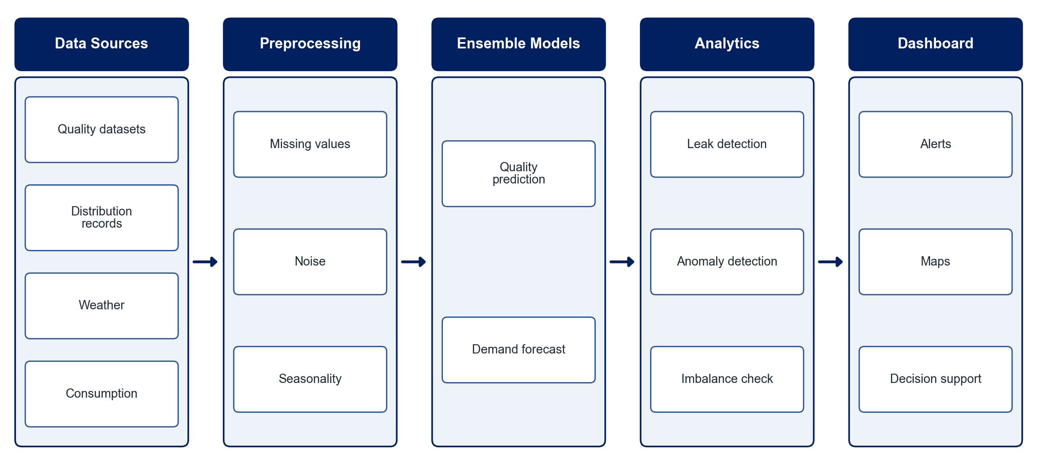
PROPOSED SYSTEM ARCHITECTURE
        Fig:- 1.1. System Architecture
CSE (DATA SCIENCE)

Slide 9
METHODOLOGY
Data Collection: Gather public water-quality, distribution, weather and consumption data.
Preprocessing: Handle missing values, noise and seasonal variation.
Feature Engineering: Derive quality, usage and temporal features.
Quality Prediction: Train an ensemble of Random Forest, XGBoost, Gradient Boosting and Decision Tree.
Demand Forecasting: Predict future water demand by area and season.
Leak & Anomaly Detection: Identify pipeline leakage and abnormal consumption patterns.
Dashboard: Visualise predictions, alerts and recommendations.
Evaluation: Measure accuracy, F1-score, RMSE and detection rate.
CSE (DATA SCIENCE)

Slide 10
SYSTEM REQUIREMENTS
Hardware Requirements
Processor: Intel Core i5 or equivalent
RAM: 8 GB or higher
Storage: 20 GB free space
Software Requirements
Language: Python
Machine Learning: scikit-learn, XGBoost, pandas
Time Series: Prophet / statsmodels
Dashboard: Dash / Streamlit, Plotly
Database: SQLite / PostgreSQL
Tools: Jupyter Notebook
CSE (DATA SCIENCE)

Slide 11
Conclusion
AquaVision predicts water quality and demand from available data.
Leak and anomaly detection reduce water loss and improve reliability.
A software-driven approach keeps the platform affordable for urban and rural areas.
The dashboard supports data-driven, sustainable water management.
CSE (DATA SCIENCE)

