Slide 1


AI-DRIVEN DISTRIBUTED OP BOOKING SYSTEM WITH INTELLIGENT DISEASE SEVERITY ANALYSIS AND DYNAMIC QUEUE POSITION SYSTEM
NAME REG.NO
1 G. PRAVEEN KUMAR 23K91A6768
2 K. AKSHAYA 23K91A6784
3 G. AKSHAYA 23K91A6767
4 N. DHEERAJ KUMAR 23K91A67C4
Guide Name:
MRS J.ASHWINI REDDY
CSE (DATA SCIENCE)
BATCH : B15

Slide 2
CONTEXT
Introduction
Abstract
Existing system
Limitation of Existing system
Proposed System
System Architecture
Methodology
System Requirements
Conclusion
CSE (DATA SCIENCE)

Slide 3
INTRODUCTION
Outpatient departments handle the largest share of hospital visits.
Patients often wait hours in queues just to register for an OP appointment.
Limited daily slots mean many patients cannot see a doctor the same day.
Critical cases wait in the same queue as mild ones.
AI can assess symptom severity and match patients to suitable hospitals.
This project builds a distributed, AI-driven OP booking system with severity analysis and dynamic queues.
CSE (DATA SCIENCE)

Slide 4
ABSTRACT
Patients spend hours in OP registration queues, and limited daily slots mean many cannot see a doctor the same day.
The project lets patients book OP appointments online at hospitals in their district, with daily limits and emergency quotas.
AI analyses symptoms to classify severity as mild, moderate, severe or critical.
Severity, location, specialty and availability drive dynamic hospital recommendation.
Secure inter-hospital referrals and a dynamic queue module update positions and waiting times in real time.
CSE (DATA SCIENCE)

Slide 5
Existing system
Walk-in OP registration at hospital counters.
Online appointment portals for individual hospitals.
First-come, first-served token systems.
Referrals between hospitals through paper letters and phone calls.
CSE (DATA SCIENCE)

Slide 6
Limitations of Existing system
Long physical queues and overcrowding at registration.
Slots run out, forcing patients to return another day.
Critical cases are not prioritised.
Patients do not know which hospital suits their condition.
Referrals and record sharing between hospitals are slow.
CSE (DATA SCIENCE)

Slide 7
Proposed System
Patients book OP appointments online at hospitals within their district.
Hospitals configure daily OP limits and emergency quotas, with automatic next-day scheduling.
AI classifies symptom severity as mild, moderate, severe or critical.
Hospitals are recommended by severity, location, specialty and availability.
Secure inter-hospital referrals and dynamic queue positions with estimated waiting times.
CSE (DATA SCIENCE)

Slide 8
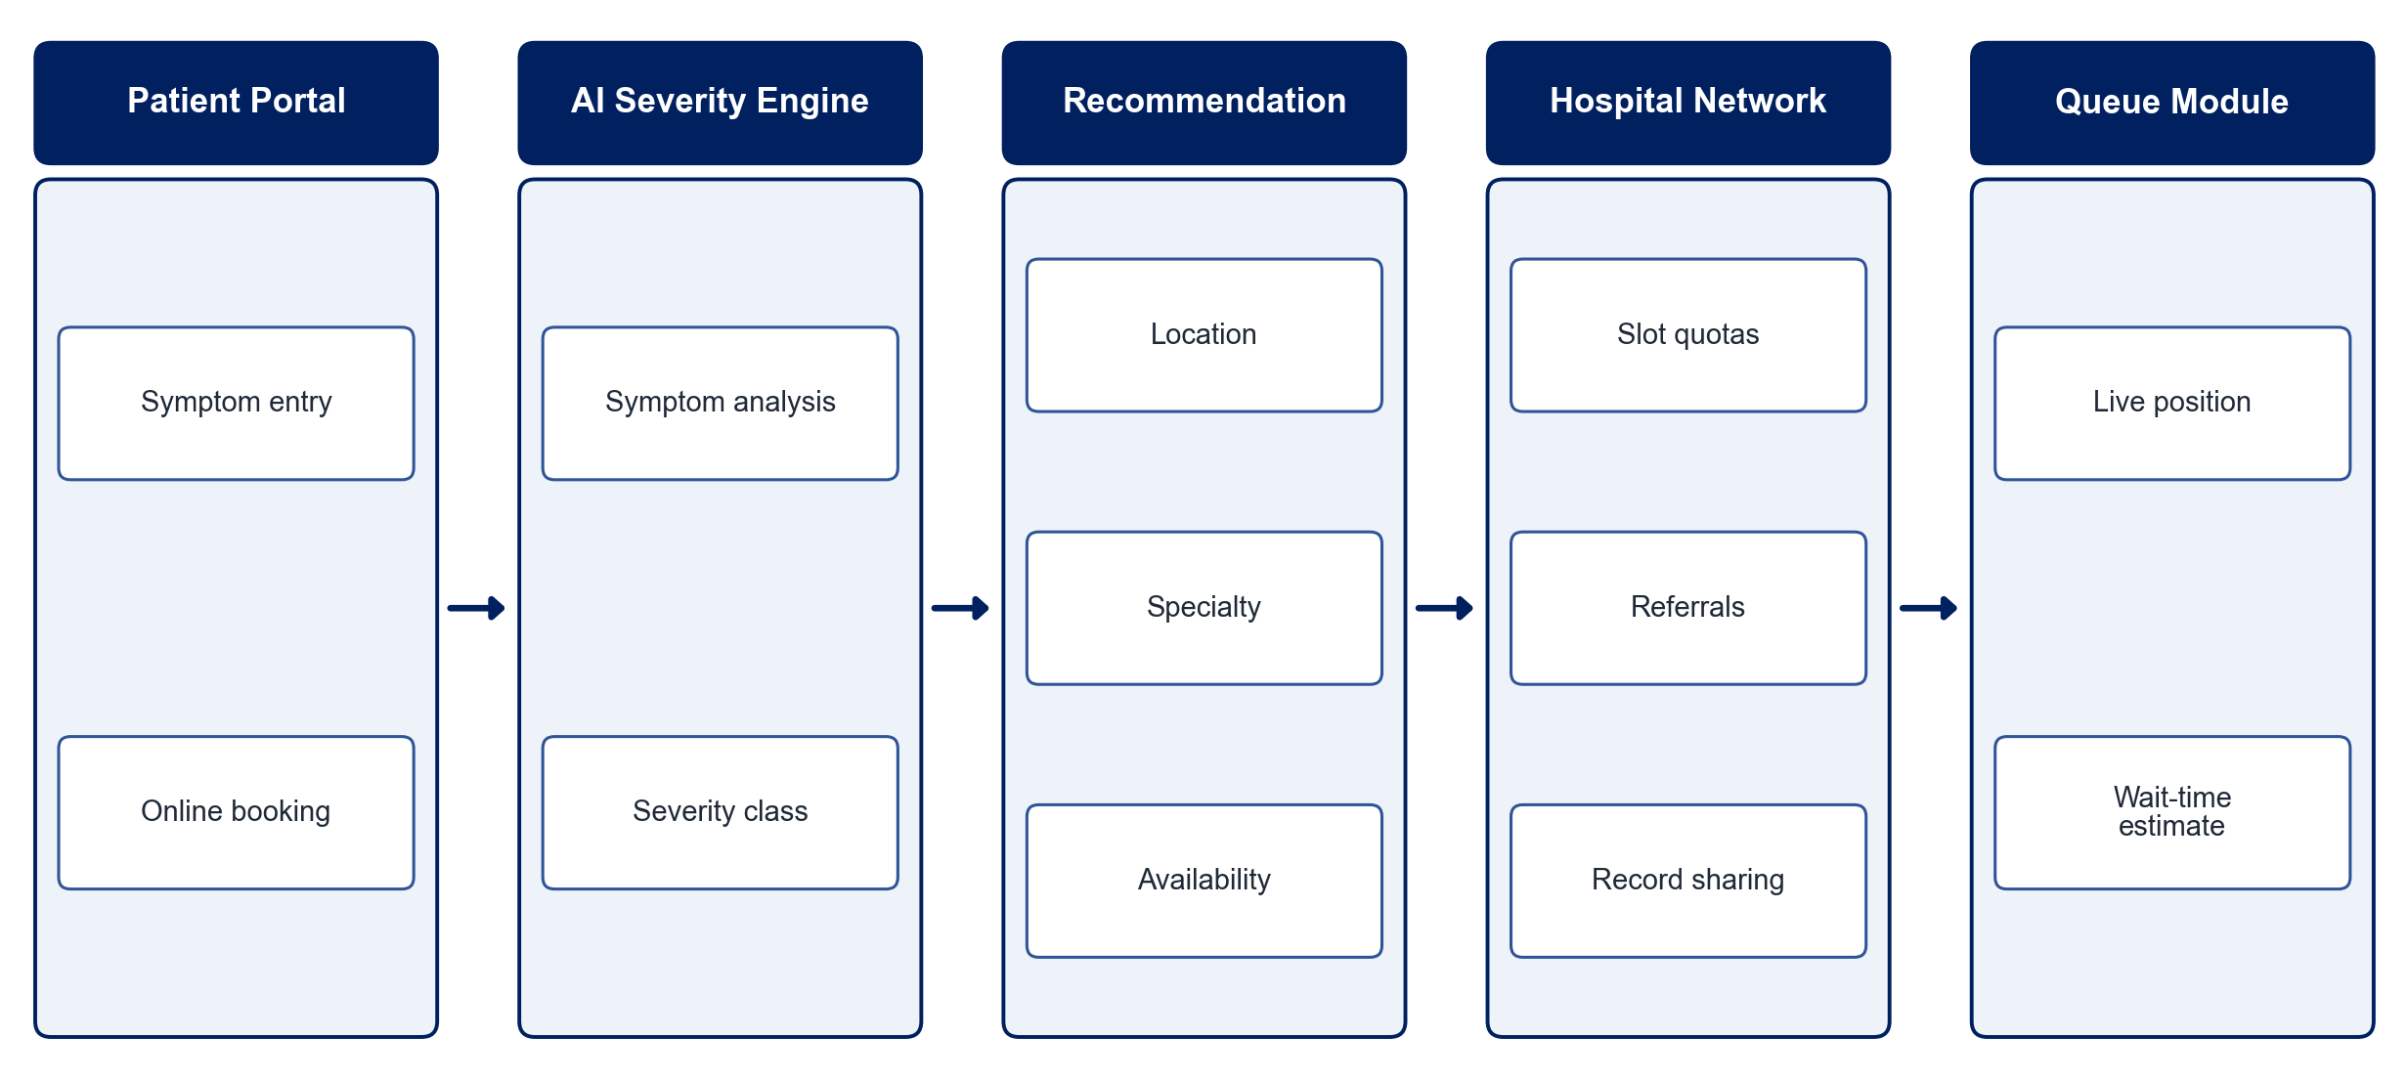
PROPOSED SYSTEM ARCHITECTURE
        Fig:- 1.1. System Architecture
CSE (DATA SCIENCE)

Slide 9
METHODOLOGY
Requirement Analysis: Define booking rules, daily limits, emergency quotas and user roles.
Symptom Dataset: Prepare symptom-severity data for model training.
Severity Model: Train ML / NLP models to classify severity into four levels.
Hospital Recommendation: Rank hospitals by severity, distance, specialty and availability.
Booking Engine: Enforce slot limits and schedule overflow to the next available day.
Queue Management: Update queue positions and estimate waiting times dynamically.
Inter-hospital Collaboration: Enable secure referrals and medical record sharing.
Testing: Evaluate severity accuracy and waiting-time reduction.
CSE (DATA SCIENCE)

Slide 10
SYSTEM REQUIREMENTS
Hardware Requirements
Processor: Intel Core i5 or equivalent
RAM: 8 GB or higher
Storage: 20 GB free space
Smartphone: For patient-side booking
Software Requirements
Languages: Python, JavaScript
Machine Learning: scikit-learn, NLP libraries
Backend: Django / Node.js
Frontend: React
Database: PostgreSQL / MongoDB
Maps: Google Maps API
CSE (DATA SCIENCE)

Slide 11
Conclusion
Online distributed booking removes long OP registration queues.
Severity-based prioritisation ensures critical patients are seen first.
Hospital recommendation directs patients to the right facility.
Secure referrals and live queues improve coordination and reduce waiting time.
CSE (DATA SCIENCE)

