Slide 1


AUTOMATIC DETECTION OF HYPERTENSIVE RETINOPATHY USING HAAR WAVELET TRANSFORM AND LENET CNN
NAME REG.NO
1 L. PRATHIMA 23K91A67A1
2 L. SAI PRANEETH 23K91A6799
3 G. YOGISHWAR 23K91A6769
4 L. SRI RAM 23K91A67A0
Guide Name:
MRS. S.VENKATA RAMANA
CSE (DATA SCIENCE)
BATCH : B16

Slide 2
CONTEXT
Introduction
Abstract
Existing system
Limitation of Existing system
Proposed System
System Architecture
Methodology
System Requirements
Conclusion
CSE (DATA SCIENCE)

Slide 3
INTRODUCTION
High blood pressure damages the small blood vessels of the retina, causing hypertensive retinopathy.
The condition progresses silently in its early stages, so regular screening is essential to prevent vision loss.
Manual screening of fundus images is time-consuming and needs experienced ophthalmologists.
Retinal blood vessels reflect systemic vascular health, linking retinal changes to heart disease risk.
Deep learning with wavelet features can classify fundus images automatically.
This project combines hypertensive retinopathy detection with heart disease risk prediction for an overall health assessment.
CSE (DATA SCIENCE)

Slide 4
ABSTRACT
Hypertensive retinopathy is retinal damage caused by high blood pressure; it progresses silently, and manual screening needs experienced ophthalmologists.
The project detects hypertensive retinopathy from retinal fundus images using Haar Wavelet Transform features and a LeNet CNN.
Fundus images are preprocessed and resized to a uniform size before training and evaluation.
Because retinal vessels reflect systemic vascular health, heart disease risk is also predicted from age, blood pressure, cholesterol and other clinical factors.
A web app gives three outputs: retinopathy prediction, heart disease risk and a combined risk stage for early diagnosis.
CSE (DATA SCIENCE)

Slide 5
Existing system
Manual fundus examination by ophthalmologists.
Deep-learning models for retinal screening, mostly focused on diabetic retinopathy.
Separate ML models for heart disease risk prediction.
Blood pressure checks without any retinal assessment.
CSE (DATA SCIENCE)

Slide 6
Limitations of Existing system
Manual screening is slow and specialist-dependent.
Most automated retinal models target diabetic retinopathy, not hypertensive retinopathy.
Retinal and cardiovascular risks are assessed separately.
Low contrast in fundus images reduces accuracy.
There is no combined risk stage for overall health.
CSE (DATA SCIENCE)

Slide 7
Proposed System
Fundus images are preprocessed and resized to a uniform size.
The Haar Wavelet Transform extracts enhanced vessel and lesion features.
A LeNet CNN classifies hypertensive retinopathy from the wavelet features.
An ML model predicts heart disease risk from clinical parameters.
A web app combines both outputs into an overall risk stage.
CSE (DATA SCIENCE)

Slide 8
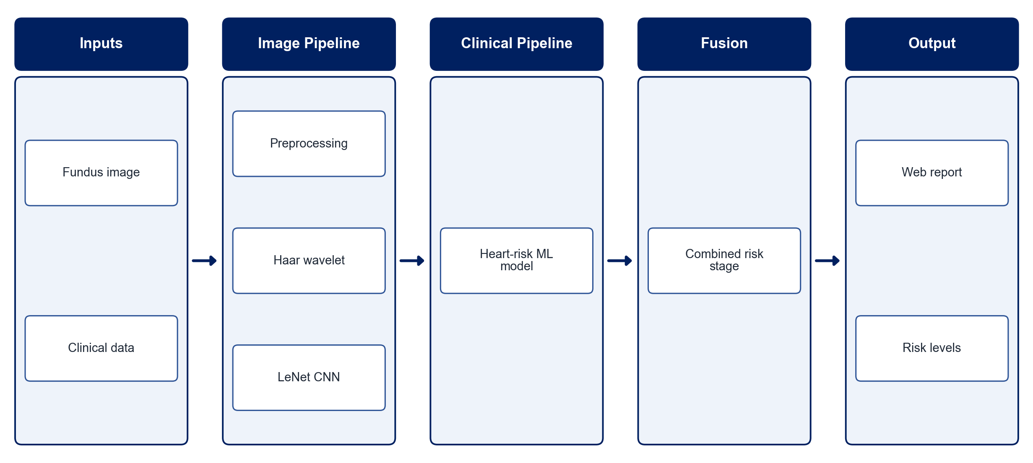
PROPOSED SYSTEM ARCHITECTURE
        Fig:- 1.1. System Architecture
CSE (DATA SCIENCE)

Slide 9
METHODOLOGY
Data Collection: Use public fundus datasets with hypertensive retinopathy labels and a heart disease clinical dataset.
Preprocessing: Resize, normalise and enhance the fundus images.
Feature Extraction: Apply the Haar Wavelet Transform to capture vessel and lesion detail.
Image Classification: Train a LeNet CNN on the wavelet features to detect hypertensive retinopathy.
Heart Risk Model: Train an ML classifier on age, blood pressure, cholesterol and other factors.
Risk Fusion: Combine both predictions into an overall risk stage.
Web Application: Build upload and data-entry pages with result display.
Evaluation: Measure accuracy, precision, recall, F1-score and AUC.
CSE (DATA SCIENCE)

Slide 10
SYSTEM REQUIREMENTS
Hardware Requirements
Processor: Intel Core i5 or equivalent
RAM: 8 GB or higher
GPU: Optional (Google Colab)
Storage: 20 GB free space
Software Requirements
Language: Python
Deep Learning: TensorFlow / Keras
Wavelets: PyWavelets
Image Processing: OpenCV
Machine Learning: scikit-learn
Web App: Flask / Streamlit
CSE (DATA SCIENCE)

Slide 11
Conclusion
The system screens fundus images for hypertensive retinopathy automatically.
Haar wavelet features with a lightweight LeNet CNN keep the model accurate and efficient.
Adding heart disease risk links retinal findings to overall cardiovascular health.
The combined risk stage supports early diagnosis and timely medical decisions.
CSE (DATA SCIENCE)

