Slide 1


NEXTGEN CALL INTELLIGENCE WITH ARTIFICIAL INTELLIGENCE
NAME REG.NO
1 KOPPU RISHIVARDHAN GOUD 23K91A6793
2 MALGI REDDY DIVYA SRI 23K91A67A5
3 KANDIKONDA SIDDHARTH 23K91A6779
4 MOHAMMED FAIZAN UDDIN 23K91A67B7
Guide Name:
DR.G.RAVI
CSE (DATA SCIENCE)
BATCH : B17

Slide 2
CONTEXT
Introduction
Abstract
Existing system
Limitation of Existing system
Proposed System
System Architecture
Methodology
System Requirements
Conclusion
CSE (DATA SCIENCE)

Slide 3
INTRODUCTION
Customer-service calls are a key support channel in banking, telecom, healthcare and e-commerce.
Organisations record thousands of calls but review only a small sample manually.
Manual monitoring is slow, inconsistent and delays decisions.
Speech recognition and NLP can convert calls to text and analyse them automatically.
Sentiment and intent analysis reveal customer satisfaction and recurring issues.
This project builds NextGen Call Intelligence, an AI system that analyses calls and delivers real-time insights.
CSE (DATA SCIENCE)

Slide 4
ABSTRACT
Traditional call monitoring requires heavy manual effort and gives little real-time insight.
NextGen Call Intelligence analyses voice conversations automatically using speech-to-text, NLP, ML and sentiment analysis.
It converts calls into text, identifies customer emotion and intent, extracts keywords and classifies call topics.
It generates concise call summaries, evaluates agent performance and detects customer issues.
Interactive dashboards provide real-time analytics for support, banking, healthcare, telecom and e-commerce.
CSE (DATA SCIENCE)

Slide 5
Existing system
Supervisors manually listen to a sample of recorded calls.
Contact-centre software records calls and tracks basic metrics such as duration.
Post-call surveys measure customer satisfaction.
Commercial speech analytics platforms serve large enterprises.
CSE (DATA SCIENCE)

Slide 6
Limitations of Existing system
Only a small fraction of calls is reviewed.
Manual review is slow, subjective and costly.
Basic metrics do not capture emotion, intent or issues.
Insights arrive too late for timely action.
Commercial analytics platforms are expensive.
CSE (DATA SCIENCE)

Slide 7
Proposed System
Speech-to-text converts voice calls into transcripts.
NLP identifies intent, extracts keywords and classifies call topics.
Sentiment analysis detects customer emotions during the call.
The system generates concise call summaries and evaluates agent performance.
Interactive dashboards present real-time call analytics.
CSE (DATA SCIENCE)

Slide 8
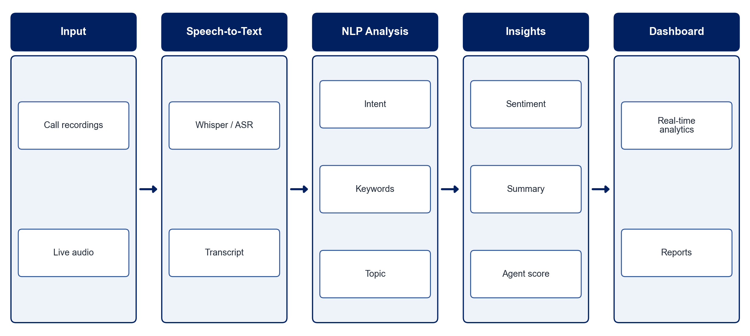
PROPOSED SYSTEM ARCHITECTURE
        Fig:- 1.1. System Architecture
CSE (DATA SCIENCE)

Slide 9
METHODOLOGY
Data Collection: Gather sample customer-service call recordings and transcripts.
Speech-to-Text: Convert audio to text using an ASR model such as Whisper.
Preprocessing: Clean transcripts and separate the speakers.
Intent & Topic Classification: Train NLP models to classify intent and topic.
Sentiment Analysis: Detect customer emotion through the call.
Summarisation: Generate concise call summaries.
Agent Evaluation: Score agents on resolution, tone and compliance.
Dashboard & Evaluation: Visualise analytics and measure transcription and classification accuracy.
CSE (DATA SCIENCE)

Slide 10
SYSTEM REQUIREMENTS
Hardware Requirements
Processor: Intel Core i5 or equivalent
RAM: 8 GB or higher
GPU: Optional, for faster speech recognition
Storage: 20 GB free space
Audio: Call recordings / microphone
Software Requirements
Language: Python
Speech: OpenAI Whisper / Vosk
NLP: Hugging Face Transformers, spaCy
Machine Learning: scikit-learn
Dashboard: Streamlit / Dash
Database: MongoDB / PostgreSQL
CSE (DATA SCIENCE)

Slide 11
Conclusion
The system analyses every call automatically instead of a small manual sample.
Sentiment, intent and topic analysis reveal customer needs and issues.
Summaries and agent scores save time and improve service quality.
Real-time dashboards turn call management into data-driven decision-making.
CSE (DATA SCIENCE)

