Slide 1


IOT-DRIVEN MOBILE NETWORK DETECTION AND COMPLAINT AUTOMATION SYSTEM
NAME REG.NO
1 MAIDAM RISHI KUMAR 23K91A67A4
2 KATKAM SAITEJA 23K91A6785
3 KAMBHAMPATI VASUDEVARA 23K91A6777
4 MULAKA VENKATA SASHANKAR REDDY 23K91A67C0
Guide Name:
MRS.M.SAROJINI RANI
CSE (DATA SCIENCE)
BATCH : B2

Slide 2
CONTEXT
Introduction
Abstract
Existing system
Limitation of Existing system
Proposed System
System Architecture
Methodology
System Requirements
Conclusion
CSE (DATA SCIENCE)

Slide 3
INTRODUCTION
Mobile connectivity is essential for communication, education, digital payments and emergency services.
Weak signals, call drops and slow internet remain common, especially in rural and underserved regions.
An ESP32-based IoT device continuously collects network signal information such as RSSI, with GPS used for location tagging.
Measurements are sent through MQTT / HTTP to a Python AI service that classifies weak and strong zones and suggests better-signal locations.
Spring Boot automates complaint registration, stores complaint history in PostgreSQL and manages complaint status.
The objective is to move from manual, reactive reporting to continuous monitoring and automated network issue management.
CSE (DATA SCIENCE)

Slide 4
ABSTRACT
Mobile connectivity is essential, yet weak signals, call drops and unresolved complaints persist in rural and semi-urban regions.
Traditional approaches depend on users noticing a problem and registering a complaint manually, which delays resolution.
The project uses ESP32 / Raspberry Pi modules, GSM sensors and smartphone APIs to verify 2G-5G signals and classify zones using GPS.
ML models such as Gaussian Process Regression and Random Forest classify signal zones, and complaints are auto-registered via SMS gateways or REST APIs.
Offline-first operation and a complaint lifecycle dashboard provide resilience and transparency from detection to resolution.
CSE (DATA SCIENCE)

Slide 5
Existing system
Users notice poor signal themselves and report it through customer-care calls, apps or portals.
Operators run periodic drive tests to measure coverage.
ML studies predict signal strength using models such as Gaussian Process Regression and Random Forest.
Complaints are tracked separately from actual network measurements.
CSE (DATA SCIENCE)

Slide 6
Limitations of Existing system
No continuous, real-time network quality monitoring.
Users must manually identify and report weak or dead zones.
Complaint information may be incomplete or inaccurate.
No automatic weak / strong signal-zone classification.
No location-aware recommendation of nearby better-signal areas.
Limited end-to-end visibility of complaint status and coverage conditions.
CSE (DATA SCIENCE)

Slide 7
Proposed System
ESP32 acts as the IoT sensing node, collecting RSSI and related measurements through built-in Wi-Fi / Bluetooth.
An optional GPS module such as NEO-6M adds geographic coordinates to each observation.
A Python FastAPI AI microservice classifies signal zones and suggests relocation.
A Spring Boot backend automatically raises complaints for weak or dead zones and manages their lifecycle in PostgreSQL.
A React dashboard shows coverage heatmaps, complaint status and recommended locations, with offline-first operation.
CSE (DATA SCIENCE)

Slide 8
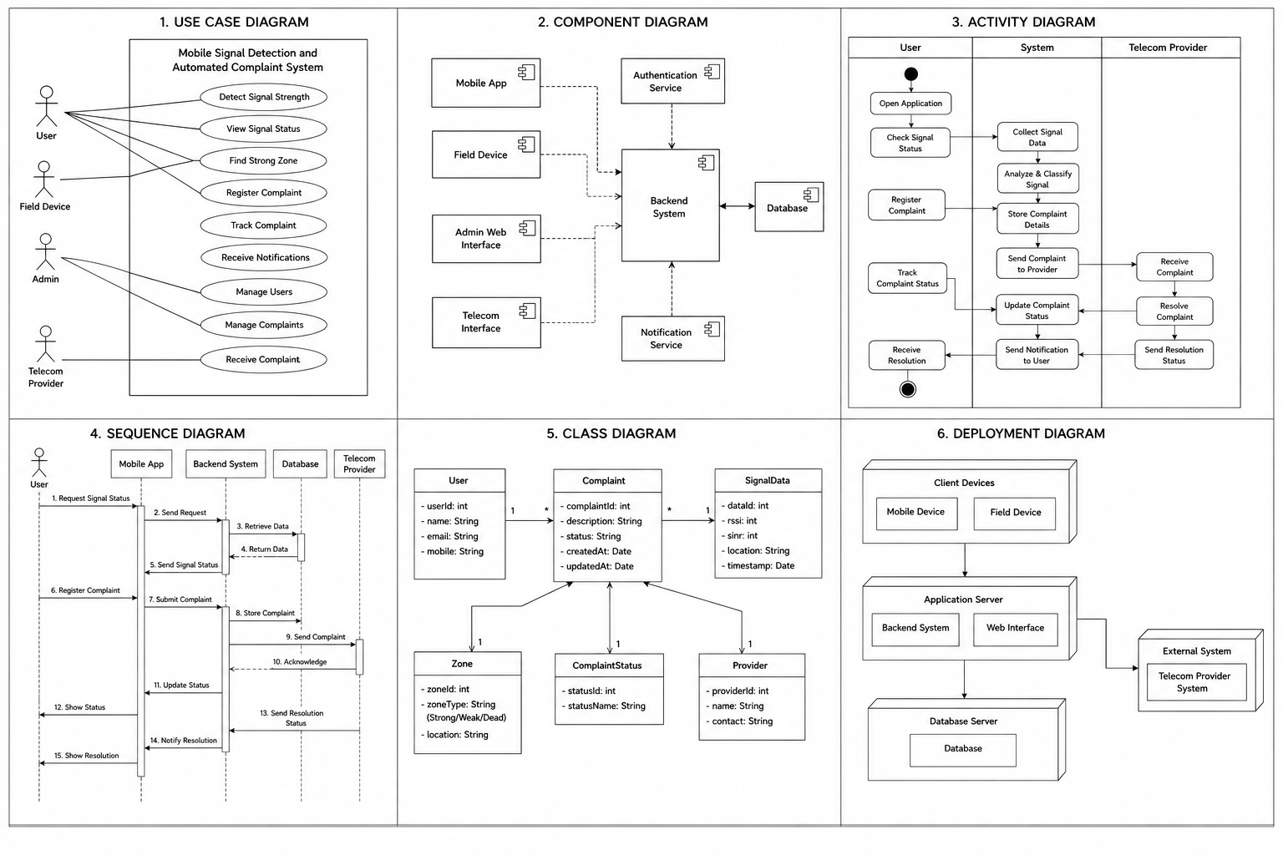
PROPOSED SYSTEM ARCHITECTURE
        Fig:- 1.1. System Architecture
CSE (DATA SCIENCE)

Slide 9
METHODOLOGY
Problem Identification: Identify weak signal zones and automate the complaint registration process.
Data Collection: Collect RSSI, SINR, latency and GPS data using ESP32 and Android APIs.
AI Classification: Use ML to classify signal zones as Strong, Weak or Dead and recommend nearby strong areas.
Backend System: Manage complaints from registration to resolution and store data securely.
Mobile Application: Display signal strength, provide location guidance and track complaints.
Cloud Deployment: Deploy the system using Supabase / AWS with Docker for scalability.
Integration Workflow: Connect IoT / Android, AI, backend, database and mobile app for seamless operation.
Testing: Validate the system through unit, integration, field and user acceptance testing.
CSE (DATA SCIENCE)

Slide 10
SYSTEM REQUIREMENTS
Hardware Requirements
Development Machine: Intel i5, 8 GB RAM or more, 50 GB free space, Windows 10/11
IoT Hardware: ESP32 for signal data, GPS module for location
Power Supply: USB or battery
Smartphone: Android 10 or higher
SIM: 4G / 5G SIM for real-time signal testing
Software Requirements
AI Service: Python + FastAPI
Backend: Java + Spring Boot
Machine Learning: PyTorch / TensorFlow
Database: PostgreSQL / Supabase, SQLite (offline storage)
Mobile: Android Studio, Google Maps SDK
Deployment: Docker
CSE (DATA SCIENCE)

Slide 11
Conclusion
The system provides an end-to-end approach to mobile connectivity problems, from detection to complaint resolution.
ESP32 enables low-cost signal data collection, while GPS adds geographic context.
AI services turn measurements into signal-zone classifications and relocation recommendations, and Spring Boot automates the complaint lifecycle.
Future scope includes multi-operator measurements, predictive dead-zone detection and real-time telecom integration.
CSE (DATA SCIENCE)

