Slide 1


AI-DRIVEN LEARNING AND EARNING ECOSYSTEM FOR KNOWLEDGE ENGINEERS
NAME REG.NO
1 MANDADI PRANATHI REDDY 23K91A67B2
2 MULKALAPALLI SANTHOSH 23K91A67C1
3 MADANU SATHWIKA 23K91A67A3
4 NANDIKONDA ANISH REDDY 23K91A67C7
Guide Name:
MRS. M. PRAVARSHA REDDY
CSE (DATA SCIENCE)
BATCH : B3

Slide 2
CONTEXT
Introduction
Abstract
Existing system
Limitation of Existing system
Proposed System
System Architecture
Methodology
System Requirements
Conclusion
CSE (DATA SCIENCE)

Slide 3
INTRODUCTION
Educational resources are scattered across multiple platforms, making them difficult to organise and access.
Students are often uncertain when choosing career paths because they lack personalised guidance.
Opportunities for peer-to-peer mentorship and structured knowledge sharing are limited.
Placement preparation is often generic and gives little individualised feedback.
Existing systems rarely let students earn from their academic knowledge and skills.
This project builds an AI-powered ecosystem where engineering students learn, earn, get mentored and prepare for placements in one place.
CSE (DATA SCIENCE)

Slide 4
ABSTRACT
Engineering students struggle to find learning resources, career guidance, mentorship and placement preparation in a single platform.
Existing platforms each focus on one service, and students have few ways to earn from their knowledge.
The project provides a Learn and Earn Marketplace where students share, access and sell notes, project reports, coding templates and courses.
A Peer Mentorship System connects students with seniors and peers for academic, coding, project, internship and placement guidance.
AI recommends career paths and personalised learning roadmaps and offers mock interviews with feedback on technical knowledge and communication.
CSE (DATA SCIENCE)

Slide 5
Existing system
Online learning platforms such as NPTEL, Coursera and YouTube provide courses.
Separate mentoring platforms and senior networks offer guidance informally.
Mock interview and coding platforms support placement preparation.
Notes and study materials are shared through messaging groups and drives.
CSE (DATA SCIENCE)

Slide 6
Limitations of Existing system
Fragmented learning resources: notes, courses, mentorship and placement material sit on different platforms.
Lack of personalised career guidance based on interests, skills and goals.
Limited peer-to-peer knowledge sharing and few ways to earn from contributions.
Generic placement preparation with little personalised feedback.
No integrated student ecosystem, leading to a disconnected experience and reduced collaboration.
CSE (DATA SCIENCE)

Slide 7
Proposed System
Learn & Earn Marketplace: students share, access and monetise notes, study materials, project reports, coding templates and courses.
Peer Mentorship System: connects students with experienced peers for academic, coding, project, internship and placement guidance.
AI Career Guidance: recommends career domains and personalised learning roadmaps from interests, skills and goals.
AI Interview Assistance: mock interviews with feedback on technical knowledge, communication and overall performance.
Personalised Ecosystem: portfolios, progress dashboards, community discussions and gamification.
CSE (DATA SCIENCE)

Slide 8
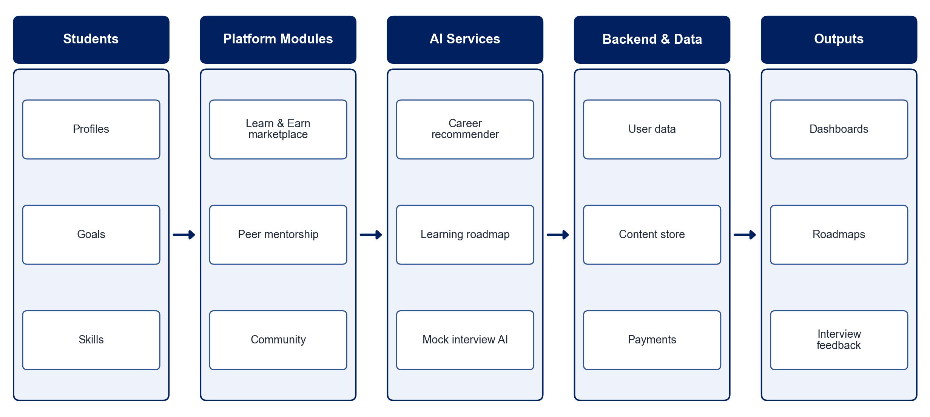
PROPOSED SYSTEM ARCHITECTURE
        Fig:- 1.1. System Architecture
CSE (DATA SCIENCE)

Slide 9
METHODOLOGY
Requirement Analysis: Identify student needs across learning, mentoring, earning and placements.
Marketplace Module: Build resource upload, search, purchase and rating features.
Mentorship Module: Match students with mentors by domain and schedule sessions.
Career Recommendation: Recommend career paths from interests, skills and progress using ML.
Learning Roadmaps: Model topics and prerequisites as a graph to generate personalised roadmaps.
Interview Assistant: Conduct AI mock interviews and score technical and communication skills.
Dashboards: Track progress, earnings and activity with gamification.
Testing: Evaluate usability, recommendation quality and engagement with students.
CSE (DATA SCIENCE)

Slide 10
SYSTEM REQUIREMENTS
Hardware Requirements
Processor: Intel Core i5 or equivalent
RAM: 8 GB or higher
Storage: 20 GB free space
Network: Internet access for cloud services
Software Requirements
Frontend: React.js
Backend: Node.js / Django
Database: MongoDB / PostgreSQL
AI: Python, scikit-learn, Gemini / OpenAI API
Payments: Razorpay (test mode)
Tools: VS Code, Git
CSE (DATA SCIENCE)

Slide 11
Conclusion
The platform brings learning, mentorship, career guidance and placement preparation into one ecosystem.
The Learn & Earn marketplace rewards students for sharing knowledge.
AI recommendations and mock interviews personalise each student's path to placement readiness.
The ecosystem improves collaboration, engagement, employability and informed career decisions.
CSE (DATA SCIENCE)

