Slide 1


UPI GUARDIAN: AI-BASED ADAPTIVE FRAUD PREVENTION FRAMEWORK
NAME REG.NO
1 GURJAPALLI SRI HARSHINI 23K91A6772
2 MALLARAPU BHANUCHANDAR 23K91A67A7
3 KALUSANI ABHISHEK REDDY 23K91A6776
4 NAGULA KALYAN RAM 23K91A67C3
Guide Name:
MRS. K. UMA BHARATHI
CSE (DATA SCIENCE)
BATCH : B4

Slide 2
CONTEXT
Introduction
Abstract
Existing system
Limitation of Existing system
Proposed System
System Architecture
Methodology
System Requirements
Conclusion
CSE (DATA SCIENCE)

Slide 3
INTRODUCTION
UPI is India's most widely used digital payment method, handling billions of transactions every month.
Its speed and convenience also attract fraud through phishing links, fake collect requests, QR code scams and social engineering.
Many victims are tricked into approving the payment themselves, so detection after the fact is too late.
AI can assess the risk of a payment before it completes using behaviour, history and message signals.
Clear explanations and voice guidance in local languages help users make safer decisions.
This project builds UPI Guardian, an adaptive AI framework that prevents fraud before money leaves the account.
CSE (DATA SCIENCE)

Slide 4
ABSTRACT
UPI has made digital payments fast and convenient but has also increased phishing, fake payment requests, QR code scams and social engineering.
Existing AI fraud detection flags suspicious transactions but cannot always stop users from sending money to fraudsters.
UPI Guardian performs AI risk analysis using transaction behaviour, payment history, receiver trust score and suspicious SMS indicators.
High-risk payments trigger Smart Payment Intent Verification, Delayed Protection Mode and explainable risk analysis.
Personalised multilingual voice assistance in English, Hindi and Telugu improves accessibility.
CSE (DATA SCIENCE)

Slide 5
Existing system
Banks and UPI apps apply rule-based limits and blacklists of known fraud accounts.
ML models detect fraudulent transactions from historical transaction data.
Users receive generic warnings and SMS alerts after transactions.
Complaints are registered through bank helplines and cybercrime portals after fraud occurs.
CSE (DATA SCIENCE)

Slide 6
Limitations of Existing system
Detection happens after money is transferred, when recovery is difficult.
Social-engineering scams bypass rules because users approve the payment themselves.
Warnings are generic and not tailored to the risk of the specific transaction.
Suspicious SMS and payment requests are not analysed together with transactions.
Warnings are usually in English only, excluding many users.
CSE (DATA SCIENCE)

Slide 7
Proposed System
AI risk analysis scores each payment using transaction behaviour, payment history, receiver trust score and suspicious SMS indicators.
Smart Payment Intent Verification asks users to confirm the purpose of high-risk payments.
Delayed Protection Mode briefly holds high-risk transfers so users can reconsider.
Explainable AI tells users why a payment was flagged.
Personalised multilingual voice assistance in English, Hindi and Telugu guides users.
CSE (DATA SCIENCE)

Slide 8
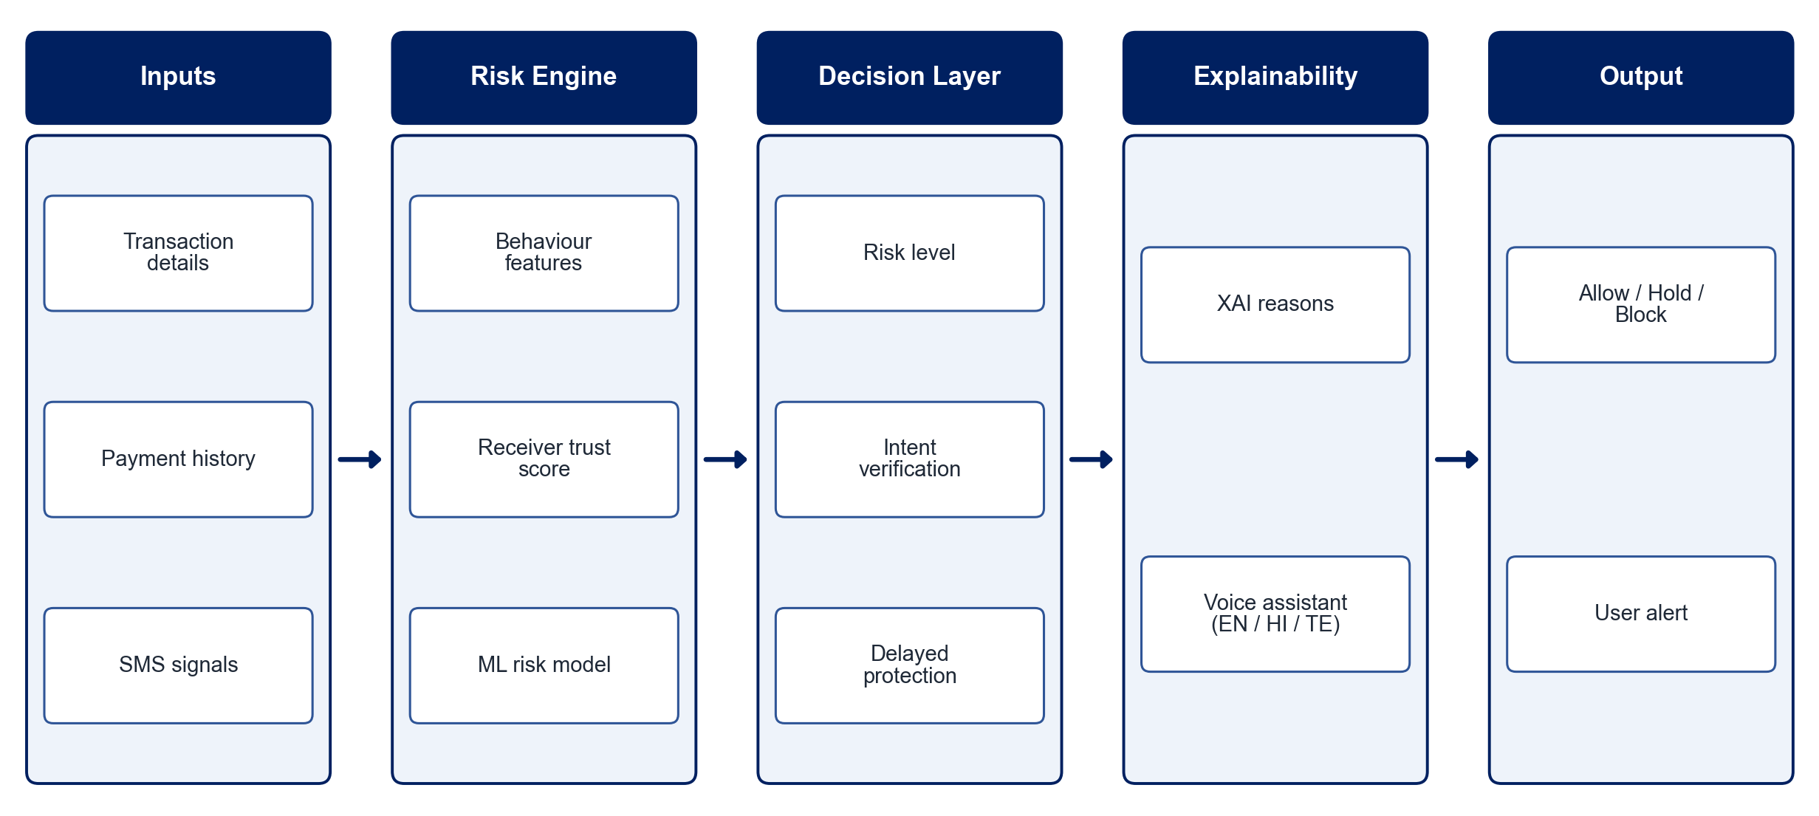
PROPOSED SYSTEM ARCHITECTURE
        Fig:- 1.1. System Architecture
CSE (DATA SCIENCE)

Slide 9
METHODOLOGY
Data Collection: Use public and synthetic UPI transaction datasets with fraud labels.
Feature Engineering: Derive behaviour, history, receiver-trust and SMS-based features.
Risk Model: Train ML models to score transaction risk and handle class imbalance.
Trust Scoring: Compute receiver trust scores from history and fraud reports.
SMS Analysis: Detect suspicious messages using NLP.
Protection Actions: Trigger intent verification and delayed protection for high-risk payments.
Explainability & Voice: Explain risk with XAI and deliver guidance in English, Hindi and Telugu.
Evaluation: Measure precision, recall, F1-score and false-alarm rate.
CSE (DATA SCIENCE)

Slide 10
SYSTEM REQUIREMENTS
Hardware Requirements
Processor: Intel Core i5 or equivalent
RAM: 8 GB or higher
Storage: 20 GB free space
Smartphone: Android device for app testing
Software Requirements
Language: Python
Machine Learning: scikit-learn, XGBoost
NLP: Hugging Face Transformers
Explainability: SHAP
Voice: Google Text-to-Speech (gTTS)
Backend: Flask / FastAPI
App: Flutter / React Native
CSE (DATA SCIENCE)

Slide 11
Conclusion
UPI Guardian shifts fraud protection from detection after payment to prevention before payment.
Combining transaction, trust and SMS signals improves risk assessment.
Intent verification and delayed protection give users a chance to stop scams.
Explainable, multilingual guidance makes digital payments safer and more accessible.
CSE (DATA SCIENCE)

