Slide 1


AI-POWERED REAL-TIME INDIAN SIGN LANGUAGE RECOGNITION AND BIDIRECTIONAL COMMUNICATION SYSTEM WITH LIVE SUBTITLE GENERATION
NAME REG.NO
1 MAMIDALA SAI PRANATHI 23K91A67B0
2 JOOKANTI SRAVANTHI 24K95A6706
3 KUTHADI SANDEEP 23K91A6798
4 MOHAMMAD ABDUL SHAAZ MOHAMMAD 23K91A67B5
Guide Name:
MRS.K.KIRANMAYEE
CSE (DATA SCIENCE)
BATCH : B5

Slide 2
CONTEXT
Introduction
Abstract
Existing system
Limitation of Existing system
Proposed System
System Architecture
Methodology
System Requirements
Conclusion
CSE (DATA SCIENCE)

Slide 3
INTRODUCTION
Communication barriers between hearing-impaired individuals and the general public remain a significant daily challenge.
Manual interpretation of Indian Sign Language (ISL) requires trained interpreters, who are not always available.
Existing recognition systems often lack real-time performance, bidirectional communication and support for ISL.
AI, deep learning and computer vision enable accurate real-time ISL recognition and speech-to-text conversion.
This project develops an AI-powered real-time ISL recognition and bidirectional communication system with live subtitles.
It translates ISL into text and speech and converts spoken language into live subtitles for inclusive communication.
CSE (DATA SCIENCE)

Slide 4
ABSTRACT
Communication between hearing-impaired people and the general public is a daily challenge, and ISL interpreters are rarely available.
Existing ISL systems mostly support one-way translation, struggle with continuous sentences and poor lighting, and lack live subtitles.
Live gestures are captured by camera, MediaPipe detects hand landmarks, and a CNN, LSTM or Transformer model classifies each sign with a confidence score.
Recognised signs form sentences that are converted to text and speech, while speech is converted to live subtitles using VOSK or Whisper.
The system runs offline with low latency and supports edge devices such as Raspberry Pi and Jetson Nano.
CSE (DATA SCIENCE)

Slide 5
Existing system
Existing systems use AI and deep learning for Indian Sign Language recognition.
They recognise hand gestures and convert them into text or speech.
Commonly used models include CNN, LSTM, MediaPipe and YOLO.
They provide good accuracy but mostly support one-way communication.
CSE (DATA SCIENCE)

Slide 6
Limitations of Existing system
Supports only one-way communication.
Limited recognition of continuous sign language sentences.
Accuracy decreases in complex backgrounds and poor lighting.
Lacks real-time live subtitle generation.
Limited support for ISL variations.
High computational requirements in many existing models.
CSE (DATA SCIENCE)

Slide 7
Proposed System
An AI-powered real-time ISL recognition system built with deep learning and computer vision.
ISL gestures are converted into text and speech instantly.
Spoken language is translated into live subtitles for bidirectional communication.
MediaPipe hand landmarks feed a CNN, LSTM or Transformer model that outputs confidence scores.
The system provides fast, accurate and user-friendly communication with offline, low-latency operation.
CSE (DATA SCIENCE)

Slide 8
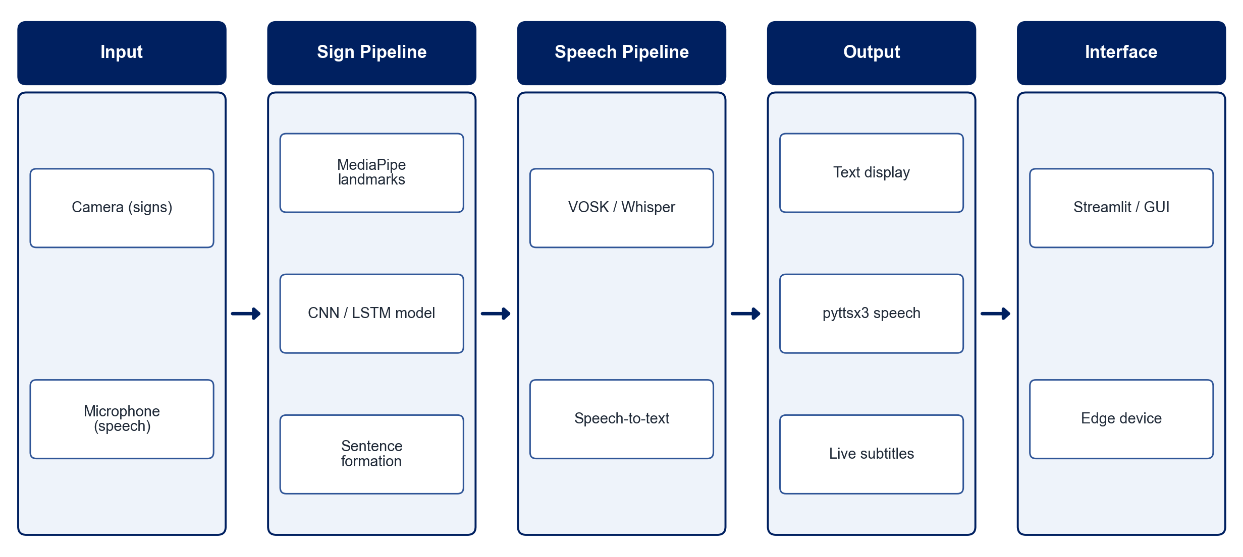
PROPOSED SYSTEM ARCHITECTURE
        Fig:- 1.1. System Architecture
CSE (DATA SCIENCE)

Slide 9
METHODOLOGY
Data Collection: Collect and prepare Indian Sign Language gesture datasets.
Preprocessing: Detect hand landmarks using MediaPipe and normalise the extracted features.
Model Training: Train a deep learning model (CNN / LSTM / Transformer) for gesture recognition.
Real-Time Recognition: Capture live gestures through a camera and classify them with confidence scores.
Text & Speech Output: Convert recognised signs into continuous text and speech.
Speech-to-Text: Capture spoken language through a microphone and convert it into live subtitles.
System Integration: Integrate all modules into a single real-time bidirectional communication system.
Deployment & Testing: Optimise for offline / edge deployment and evaluate accuracy, latency and reliability.
CSE (DATA SCIENCE)

Slide 10
SYSTEM REQUIREMENTS
Hardware Requirements
Processor: Intel Core i5 or equivalent
RAM: 8 GB or higher
Camera: HD webcam
Microphone: Built-in / external
Storage: 10 GB+ free space
Optional: Raspberry Pi / Jetson Nano for edge deployment
Software Requirements
Operating System: Windows / Linux
Language: Python
Libraries: OpenCV, MediaPipe, NumPy, TensorFlow / PyTorch
Speech Processing: VOSK / Whisper, pyttsx3
Interface: Streamlit / custom GUI
Database: SQLite (optional)
CSE (DATA SCIENCE)

Slide 11
Conclusion
The system enables real-time bidirectional communication by converting ISL gestures into text and speech and spoken language into live subtitles.
It provides an accessible, reliable and user-friendly way to promote inclusion in education, healthcare, workplaces and public places.
It reduces communication barriers through fast, seamless interaction between hearing-impaired and hearing individuals.
AI-based recognition, confidence scoring and edge deployment improve accuracy, reliability and real-time performance.
CSE (DATA SCIENCE)

