Slide 1


AI-ENHANCED PATIENT-CENTRIC UNIFIED HEALTH DATA INTEROPERABILITY SYSTEM
NAME REG.NO
1 KODIDUTI SRUTHI 23K91A6791
2 K AKSHEYAA 23K91A6774
3 MALLELA NAVYA 23K91A67A9
4 KETHAVATH YUVARAJ 24K95A6709
Guide Name:
DR. N. KIRANMAI
CSE (DATA SCIENCE)
BATCH : B6

Slide 2
CONTEXT
Introduction
Abstract
Existing system
Limitation of Existing system
Proposed System
System Architecture
Methodology
System Requirements
Conclusion
CSE (DATA SCIENCE)

Slide 3
INTRODUCTION
Healthcare generates large volumes of patient data across diagnosis, treatment, laboratory tests and medication.
This data is stored in separate hospital systems that do not share it easily.
When patients visit a new hospital, their previous history is often unavailable.
Fragmented records cause repeated tests, delayed decisions and poor continuity of care.
Standards such as HL7 FHIR make secure, structured exchange between hospitals possible.
This project builds a patient-centric unified health record system with FHIR interoperability and an AI health assistant.
CSE (DATA SCIENCE)

Slide 4
ABSTRACT
Patient data from diagnosis, treatment, lab tests and medication is stored separately across hospitals.
Doctors cannot easily see a patient's complete history, which leads to repeated tests and delayed decisions.
The project lets hospitals exchange standardised records using HL7 FHIR, with a Master Patient Index locating where records exist.
Authorised retrieval uses secure FHIR REST APIs with authentication and patient consent, and records sync to a unified patient platform.
An AI Health Assistant uses Random Forest to predict health risks, explain reports, summarise treatment and send reminders.
CSE (DATA SCIENCE)

Slide 5
Existing system
Each hospital maintains its own electronic health record system.
Patients carry paper reports and prescriptions between hospitals.
Some regions use health information exchanges for data sharing.
Personal health apps store records that patients upload manually.
CSE (DATA SCIENCE)

Slide 6
Limitations of Existing system
Medical records are fragmented across institutions.
Doctors lack a complete patient history at a new hospital.
Repeated diagnostic tests waste time and money.
Patients cannot access their complete records in one place.
Existing exchange focuses on sharing, not on a unified patient-centric record or insights.
CSE (DATA SCIENCE)

Slide 7
Proposed System
Hospitals exchange standardised patient records using HL7 FHIR.
A Master Patient Index identifies the hospitals that hold a patient's records.
Secure FHIR REST APIs retrieve records with authentication and patient consent.
After treatment, hospitals sync a FHIR summary to a unified platform while keeping ownership of the originals.
A Random Forest AI assistant predicts health risks, explains reports, summarises treatment and sends reminders.
CSE (DATA SCIENCE)

Slide 8
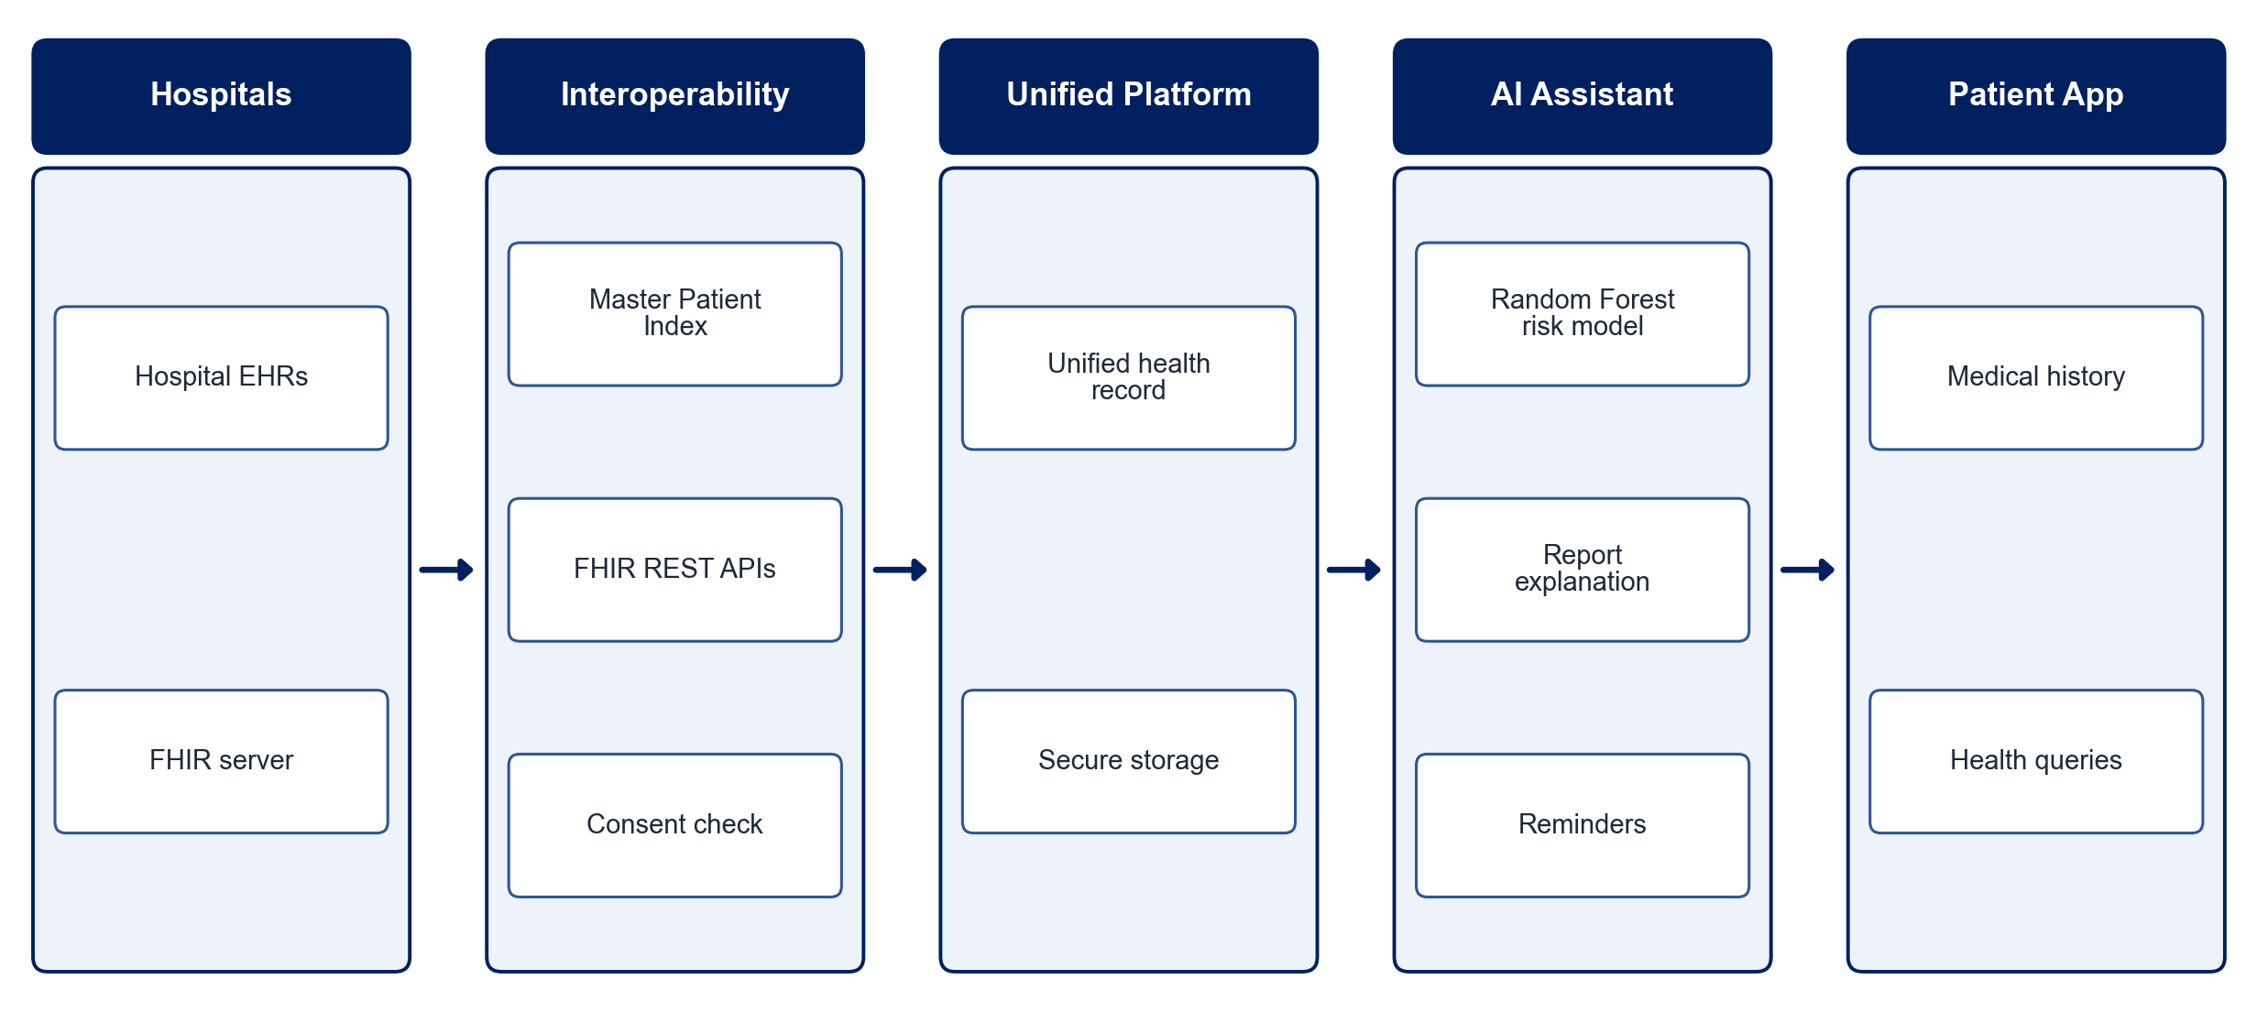
PROPOSED SYSTEM ARCHITECTURE
        Fig:- 1.1. System Architecture
CSE (DATA SCIENCE)

Slide 9
METHODOLOGY
Requirement Analysis: Define record types, consent rules and roles for hospitals and patients.
FHIR Modelling: Represent patient data as FHIR resources such as Patient, Observation and MedicationRequest.
Master Patient Index: Match and link patient identities across hospitals.
Secure Exchange: Implement authenticated FHIR REST APIs with consent verification.
Record Synchronisation: Sync treatment summaries to the unified platform.
AI Assistant: Train a Random Forest model for risk prediction and generate report explanations.
Patient App: Build a mobile app for history access, reminders and queries.
Testing: Validate interoperability, security and prediction accuracy.
CSE (DATA SCIENCE)

Slide 10
SYSTEM REQUIREMENTS
Hardware Requirements
Processor: Intel Core i5 or equivalent
RAM: 8 GB or higher
Storage: 50 GB free space
Smartphone: Android device for the patient app
Software Requirements
Standards: HL7 FHIR (HAPI FHIR server)
Backend: Python (FastAPI) / Java (Spring Boot)
Machine Learning: scikit-learn (Random Forest)
Database: PostgreSQL
Security: OAuth 2.0 / JWT
App: Flutter / React Native
CSE (DATA SCIENCE)

Slide 11
Conclusion
The system gives doctors and patients a complete, unified view of medical history.
FHIR-based exchange with consent keeps sharing secure and standardised.
Hospitals retain ownership of original records while patients gain access to them.
The AI assistant turns unified records into risk predictions and personalised guidance.
CSE (DATA SCIENCE)

