Slide 1


AI-DRIVEN INTELLIGENT HOSPITAL RESOURCE PREDICTION, OPTIMIZATION AND DECISION SUPPORT SYSTEM
NAME REG.NO
1 KOTHA ROHITH 23K91A6796
2 GUMMULA VIKRAM REDDY 23K91A6770
3 JANGILI MARUTHI 23K91A6773
4 KATRIYAL VAMSHI 24K95A6708
Guide Name:
MR.J.ANIL KUMAR
CSE (DATA SCIENCE)
BATCH : B7

Slide 2
CONTEXT
Introduction
Abstract
Existing system
Limitation of Existing system
Proposed System
System Architecture
Methodology
System Requirements
Conclusion
CSE (DATA SCIENCE)

Slide 3
INTRODUCTION
Hospitals must serve growing numbers of patients with limited beds, staff and equipment.
Poor forecasting of admissions and length of stay leads to overcrowding and delayed care.
Staff often make critical resource decisions under time pressure with incomplete information.
Machine learning can predict length of stay and resource demand from EHR data.
Explainable AI makes predictions understandable, so clinicians can trust and act on them.
This project builds an AI-driven, explainable system for hospital resource prediction and decision support.
CSE (DATA SCIENCE)

Slide 4
ABSTRACT
Hospitals face rising patient numbers, limited resources and pressure to make quick, accurate decisions.
Delays in predicting admissions, length of stay, bed occupancy and resource needs cause overcrowding and higher costs.
The project analyses electronic health records to predict length of stay, bed occupancy, ICU requirements and resource utilisation.
Predictions drive recommendations for the optimal allocation of beds, staff and critical equipment.
Explainable AI makes each prediction transparent so that doctors and administrators can trust it.
CSE (DATA SCIENCE)

Slide 5
Existing system
Bed and resource planning based on manual census and experience.
Hospital information systems that record occupancy but do not forecast it.
Statistical models that estimate average length of stay.
ML studies that predict length of stay without supporting allocation decisions.
CSE (DATA SCIENCE)

Slide 6
Limitations of Existing system
Resource needs are not forecast, which causes overcrowding.
Length of stay is estimated manually and inconsistently.
Predictions, where available, are black boxes.
There are no recommendations for allocating beds, staff and equipment.
Decisions are reactive rather than proactive.
CSE (DATA SCIENCE)

Slide 7
Proposed System
ML models predict length of stay, bed occupancy and ICU requirements from EHR data.
Resource utilisation forecasts cover beds, staff and critical equipment.
An optimisation layer recommends the allocation of beds, staff and equipment.
Explainable AI such as SHAP shows the factors behind each prediction.
A dashboard supports administrators and doctors in making timely decisions.
CSE (DATA SCIENCE)

Slide 8
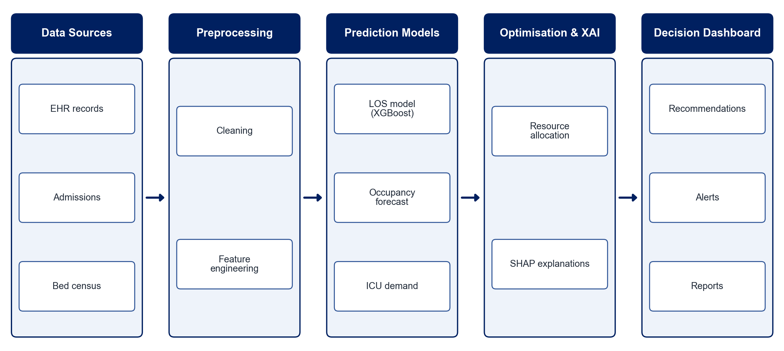
PROPOSED SYSTEM ARCHITECTURE
        Fig:- 1.1. System Architecture
CSE (DATA SCIENCE)

Slide 9
METHODOLOGY
Data Collection: Use EHR datasets such as MIMIC with admission and stay details.
Preprocessing: Handle missing values and engineer clinical and admission features.
LOS Prediction: Train XGBoost and other classifiers to predict length of stay.
Demand Forecasting: Forecast bed occupancy and ICU requirements over time.
Resource Optimisation: Recommend the allocation of beds, staff and equipment.
Explainability: Apply SHAP to explain each prediction.
Dashboard: Present forecasts, recommendations and explanations to decision-makers.
Evaluation: Measure accuracy, AUC, F1-score and forecast error.
CSE (DATA SCIENCE)

Slide 10
SYSTEM REQUIREMENTS
Hardware Requirements
Processor: Intel Core i5 or equivalent
RAM: 8 GB or higher
Storage: 20 GB free space
Software Requirements
Language: Python
Machine Learning: scikit-learn, XGBoost
Explainability: SHAP
Optimisation: PuLP / OR-Tools
Dashboard: Streamlit / Dash
Database: PostgreSQL
CSE (DATA SCIENCE)

Slide 11
Conclusion
The system forecasts length of stay, bed occupancy and ICU demand before shortages occur.
Allocation recommendations help hospitals use beds, staff and equipment efficiently.
Explainable predictions build clinician trust and support informed decisions.
The system empowers staff to deliver timely, patient-centred care.
CSE (DATA SCIENCE)

