Slide 1


ENHANCED AI-BASED HUMAN ACTIVITY RECOGNITION WITH FALL DETECTION AND EMERGENCY ALERT SYSTEM
NAME REG.NO
1 KUNTA NANDINI REDDY 23K91A6797
2 KETHAVATH MALLISHWARI 23K91A6787
3 KARATLAPELLY VIVEK 23K91A6781
4 MEDUDHULA SAGAR 23K91A67B4
Guide Name:
MR.M.AROKIA MUTHU
CSE (DATA SCIENCE)
BATCH : B8

Slide 2
CONTEXT
Introduction
Abstract
Existing system
Limitation of Existing system
Proposed System
System Architecture
Methodology
System Requirements
Conclusion
CSE (DATA SCIENCE)

Slide 3
INTRODUCTION
Human Activity Recognition automatically identifies human activities from sensor or video data.
It supports elderly care, healthcare monitoring, smart homes and human-computer interaction.
Falls are a leading cause of injury among elderly people living alone.
Existing HAR systems are trained on small, controlled datasets and perform poorly in real homes.
Most systems recognise activities but do not respond to emergencies.
This project combines robust vision-based HAR with real-time fall detection and emergency alerts.
CSE (DATA SCIENCE)

Slide 4
ABSTRACT
Human Activity Recognition supports healthcare, elderly care, smart homes and surveillance.
Existing HAR systems rely on small datasets and controlled settings and lack fall detection and emergency response.
The project recognises activities such as walking, standing, sitting, drinking water and picking up objects from video.
Deep learning on a larger, more diverse dataset improves robustness in low light and partial occlusion.
A fall detection module detects falls in real time and sends alerts through SMS, email, notifications or alarms.
CSE (DATA SCIENCE)

Slide 5
Existing system
Wearable sensor-based HAR using accelerometers and gyroscopes.
Vision-based HAR using CNN and LSTM models on video datasets.
Standalone fall-detection devices and panic buttons.
WiFi-based and multimodal HAR in research settings.
CSE (DATA SCIENCE)

Slide 6
Limitations of Existing system
Small datasets and controlled environments limit real-world accuracy.
Accuracy drops in low light and with occlusion.
Activity recognition and fall detection are separate systems.
There is no automatic emergency alerting.
Wearables must be worn and charged constantly.
CSE (DATA SCIENCE)

Slide 7
Proposed System
A deep-learning model recognises walking, standing, sitting, drinking water and picking up objects from video.
Training on a larger, diverse dataset improves robustness in low light and occlusion.
A fall detection module identifies accidental falls in real time.
Emergency alerts are sent through SMS, email, mobile notifications or alarms.
The system provides continuous, camera-based monitoring for elderly care and smart homes.
CSE (DATA SCIENCE)

Slide 8
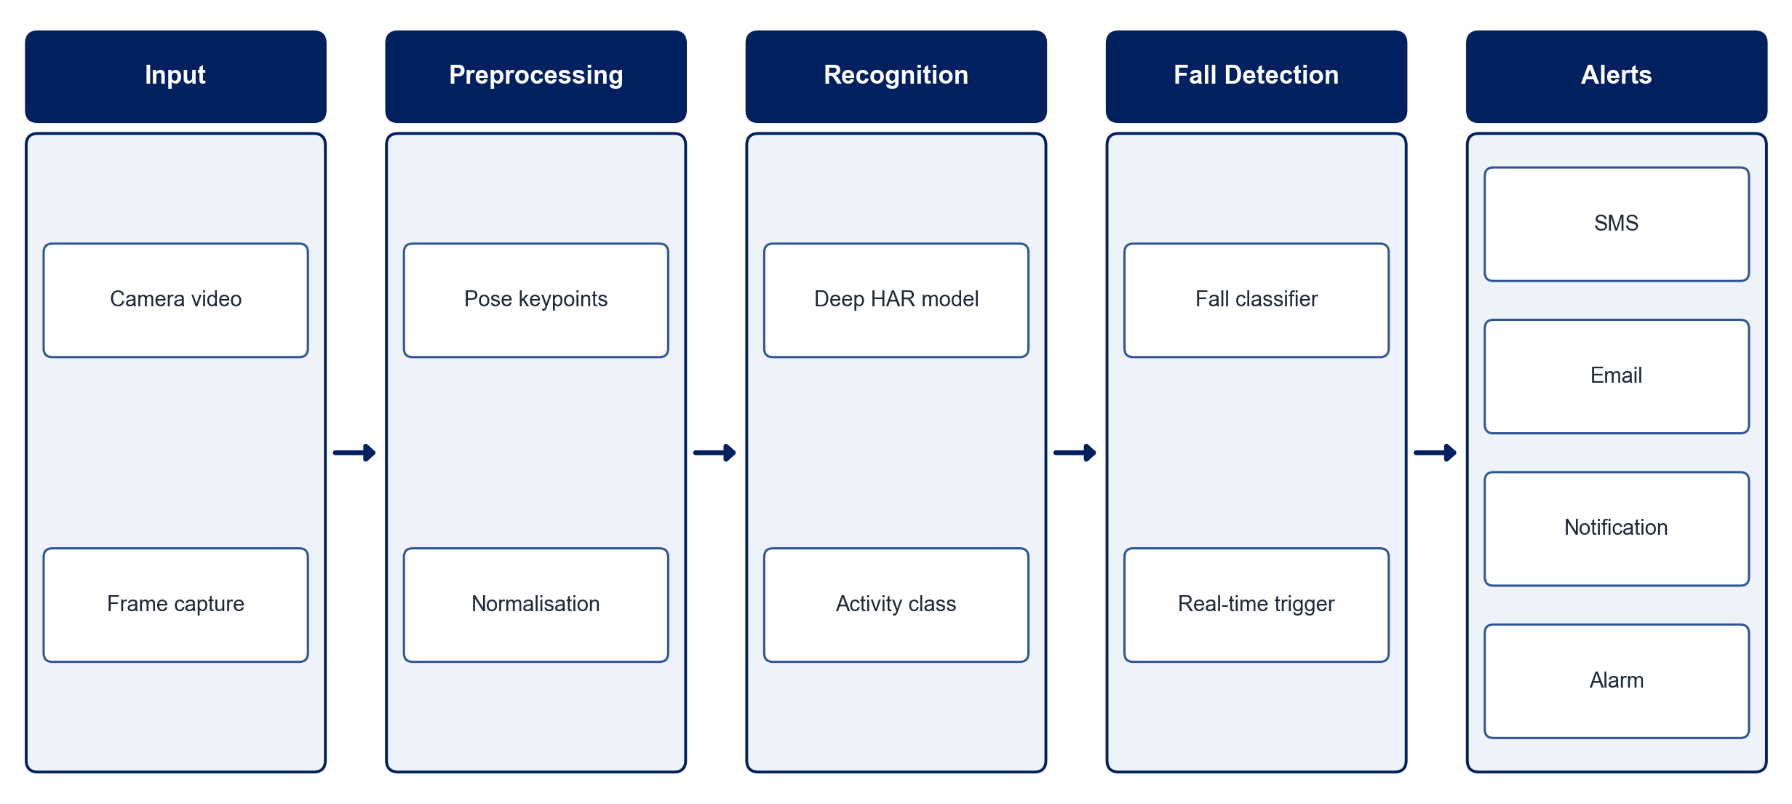
PROPOSED SYSTEM ARCHITECTURE
        Fig:- 1.1. System Architecture
CSE (DATA SCIENCE)

Slide 9
METHODOLOGY
Data Collection: Use a large, diverse HAR video dataset that includes fall samples.
Preprocessing: Extract frames and pose keypoints and normalise them.
Augmentation: Simulate low light and partial occlusion to improve robustness.
HAR Model: Train a CNN-LSTM or 3D-CNN model for activity recognition.
Fall Detection: Train a fall classifier using pose and motion features.
Real-time Inference: Run recognition and fall detection on a live camera feed.
Alert System: Send SMS, email, notifications or alarms when a fall is detected.
Evaluation: Measure accuracy, precision, recall and detection latency.
CSE (DATA SCIENCE)

Slide 10
SYSTEM REQUIREMENTS
Hardware Requirements
Processor: Intel Core i5 or equivalent
RAM: 8 GB or higher
GPU: NVIDIA GPU or Google Colab for training
Camera: HD webcam / IP camera
Storage: 30 GB free space
Software Requirements
Language: Python
Deep Learning: TensorFlow / PyTorch
Vision: OpenCV, MediaPipe Pose
Alerts: Twilio SMS, SMTP email, Firebase notifications
Interface: Streamlit / Flask
CSE (DATA SCIENCE)

Slide 11
Conclusion
The system recognises daily activities robustly in real-world conditions.
Real-time fall detection with automatic alerts enables immediate help.
Training on diverse data improves performance in low light and occlusion.
It offers a practical, scalable solution for elderly care and smart homes.
CSE (DATA SCIENCE)

