Slide 1


TALENTTRACK: AI-POWERED PLACEMENT READINESS PLATFORM WITH INTEGRATED CODING EVALUATION
NAME REG.NO
1 KODAVATH VAMSHI 23K91A6790
2 KARTIKEY SHUKLA 23K91A6783
3 ODETI THIRUPATHI 23K91A67C9
4 M BHAVANI PRASAD 23K91A67A2
Guide Name:
MRS.CH.GAYATHRI
CSE (DATA SCIENCE)
BATCH : B9

Slide 2
CONTEXT
Introduction
Abstract
Existing system
Limitation of Existing system
Proposed System
System Architecture
Methodology
System Requirements
Conclusion
CSE (DATA SCIENCE)

Slide 3
INTRODUCTION
Campus recruitment is a key step from academics to professional careers.
Placement cells mainly organise drives and do not track student readiness continuously.
Students practise aptitude, coding and interviews on scattered external platforms.
Recruiters shortlist manually from large applicant pools.
AI can analyse resumes, guide students and evaluate skills automatically.
This project builds TalentTrack, an AI-powered placement readiness platform with integrated coding evaluation.
CSE (DATA SCIENCE)

Slide 4
ABSTRACT
Campus placement systems focus on running drives and lack continuous skill assessment, tracking and personalised guidance.
TalentTrack is a MERN-stack platform where students, placement officers and recruiters take part in placements.
Aptitude, coding and technical modules with automated evaluation, leaderboards and contests build student skills.
Students advance through evaluation levels and expert-led mock interviews, supported by AI resume analysis and a chatbot.
Recruiters create drives and shortlist by skill, while officers monitor progress through analytics dashboards.
CSE (DATA SCIENCE)

Slide 5
Existing system
Placement cells manage drives using spreadsheets and emails.
Students use separate platforms such as LeetCode and HackerRank for practice.
AI mock interview tools provide interview practice independently.
Recruiters shortlist candidates based on CGPA and resumes.
CSE (DATA SCIENCE)

Slide 6
Limitations of Existing system
There is no continuous assessment of student skills.
Practice happens on scattered platforms without institutional tracking.
Students receive little personalised guidance.
Shortlisting ignores actual skill performance.
Placement officers lack analytics on student readiness.
CSE (DATA SCIENCE)

Slide 7
Proposed System
Aptitude, coding and technical practice modules with automated evaluation.
Leaderboards and regular coding contests to build skills.
Level-based progression with expert-led mock interviews before a student becomes placement-ready.
AI resume analysis and an intelligent chatbot for placement queries.
Recruiter drive creation, eligibility criteria and skill-based shortlisting, with analytics dashboards.
CSE (DATA SCIENCE)

Slide 8
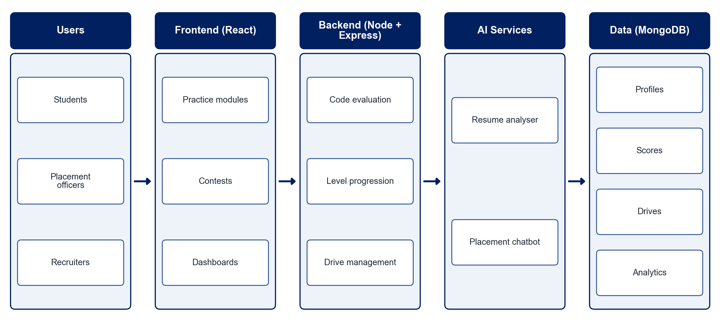
PROPOSED SYSTEM ARCHITECTURE
        Fig:- 1.1. System Architecture
CSE (DATA SCIENCE)

Slide 9
METHODOLOGY
Requirement Analysis: Define roles and workflows for students, officers and recruiters.
Practice Modules: Build aptitude, coding and technical question banks.
Code Evaluation: Integrate an online judge to run and score code submissions.
Level Progression: Promote students through evaluation levels and mock interviews.
AI Resume Analysis: Score resumes and suggest improvements using NLP.
Chatbot: Answer placement queries and give personalised guidance.
Recruiter Module: Create drives, set eligibility and shortlist by performance.
Analytics & Testing: Build dashboards and test the platform with users.
CSE (DATA SCIENCE)

Slide 10
SYSTEM REQUIREMENTS
Hardware Requirements
Processor: Intel Core i5 or equivalent
RAM: 8 GB or higher
Storage: 20 GB free space
Network: Internet access for cloud deployment
Software Requirements
Frontend: React.js
Backend: Node.js, Express.js
Database: MongoDB
Code Execution: Judge0 API
AI: Gemini / OpenAI API for resume analysis and chatbot
Tools: VS Code, Git, Postman
CSE (DATA SCIENCE)

Slide 11
Conclusion
TalentTrack brings practice, assessment, mock interviews and recruitment into one platform.
Continuous evaluation and level progression build real placement readiness.
AI resume analysis and chatbot guidance improve employability.
Skill-based shortlisting and analytics make recruitment transparent and data-driven.
CSE (DATA SCIENCE)

