Slide 1
DDoS Attack Detection and Mitigation
REVIEW 2 · DESIGN, METHODOLOGY AND PROGRESS
Design, methodology and progress: Random Forest detection, distributed-risk severity and self-recovering quarantine
Presented by
Under the guidance of
Mallela Pallavi 23K91A05E3
Kattoju Durgabhavani 24K95A0514
Nimmala Rakshitha 23K91A05H3
Prodhatoor Shashi Preetham 23K91A05K0
V Meenakshi, [DESIGNATION]
Department of Computer Science and Engineering
[COLLEGE NAME] · Batch C15 (CSE-C) · [ACADEMIC YEAR]
Notes:
This review shows how SentinelFlow is designed and built, what is implemented, the first measured results and the open items. Introduce the four team members and the guide. The headline for this review is honest: the pipeline works, the shipped model was trained on a synthetic fallback, and we re-checked it on real CICIDS2017 flows.

Slide 2
Contents
01
02
03
Recap and architecture
Methodology and data
Preprocessing and model
04
05
06
Training and decision logic
Data flow, database and UML
Technology stack
07
08
09
Progress and preliminary results
Output screens and testing
Challenges and next steps
Notes:
Agenda for the design and progress review.

Slide 3
Recap: problem and proposed system
!
Problem
i
Proposed system
B
Base paper link [1]
A DDoS attack floods a service from many sources. Detection without action leaves the service down, and blocking legitimate users through false positives is itself a denial of service. Signature rules miss new patterns.
SentinelFlow turns rolling traffic windows into ten features, classifies them with a Random Forest, scores distributed risk and severity with listed factors, quarantines the worst sources temporarily and lets them recover, and shows everything on a React console.
Trigui et al. (IEEE Access, 2026) build an RF + Banzhaf feature-selection ensemble for SDN DDoS detection and report 100 % offline; mitigation and live testing are future work. SentinelFlow implements the closed loop; it does not implement Banzhaf selection or voting ensembles.
Notes:
Recap of Review 1. We say plainly what is borrowed (a tree-based detector on flow features) and what is added (the live detection to mitigation loop).

Slide 4
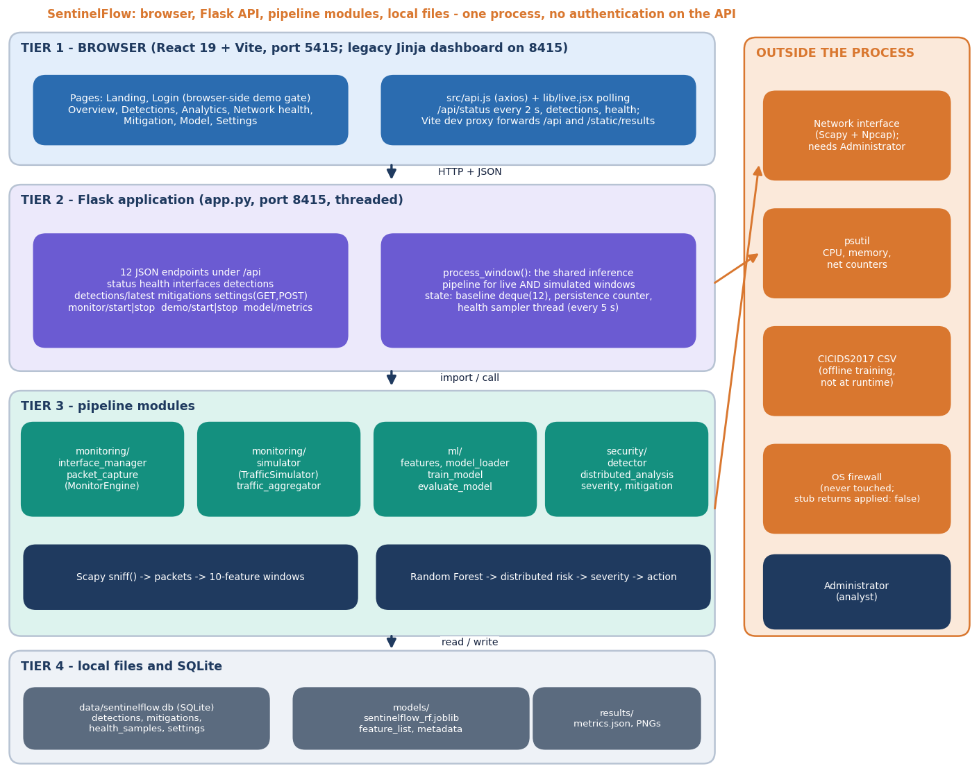
System architecture
Four tiers, one process
Console: React 19 + Vite on port 5415, nine pages (landing, login, overview, detections, analytics, network health, mitigation, model, settings).
API: Flask on port 8415, twelve JSON endpoints; invalid input returns HTTP 400 with a message.
Pipeline: monitoring, ml and security packages share one per-window function, process_window().
State: SQLite plus joblib and JSON files. The REST API has no authentication and binds to 127.0.0.1.
Notes:
The same process_window() function handles live and simulated windows, so Simulation Mode exercises the real classifier, severity and mitigation code.

Slide 5
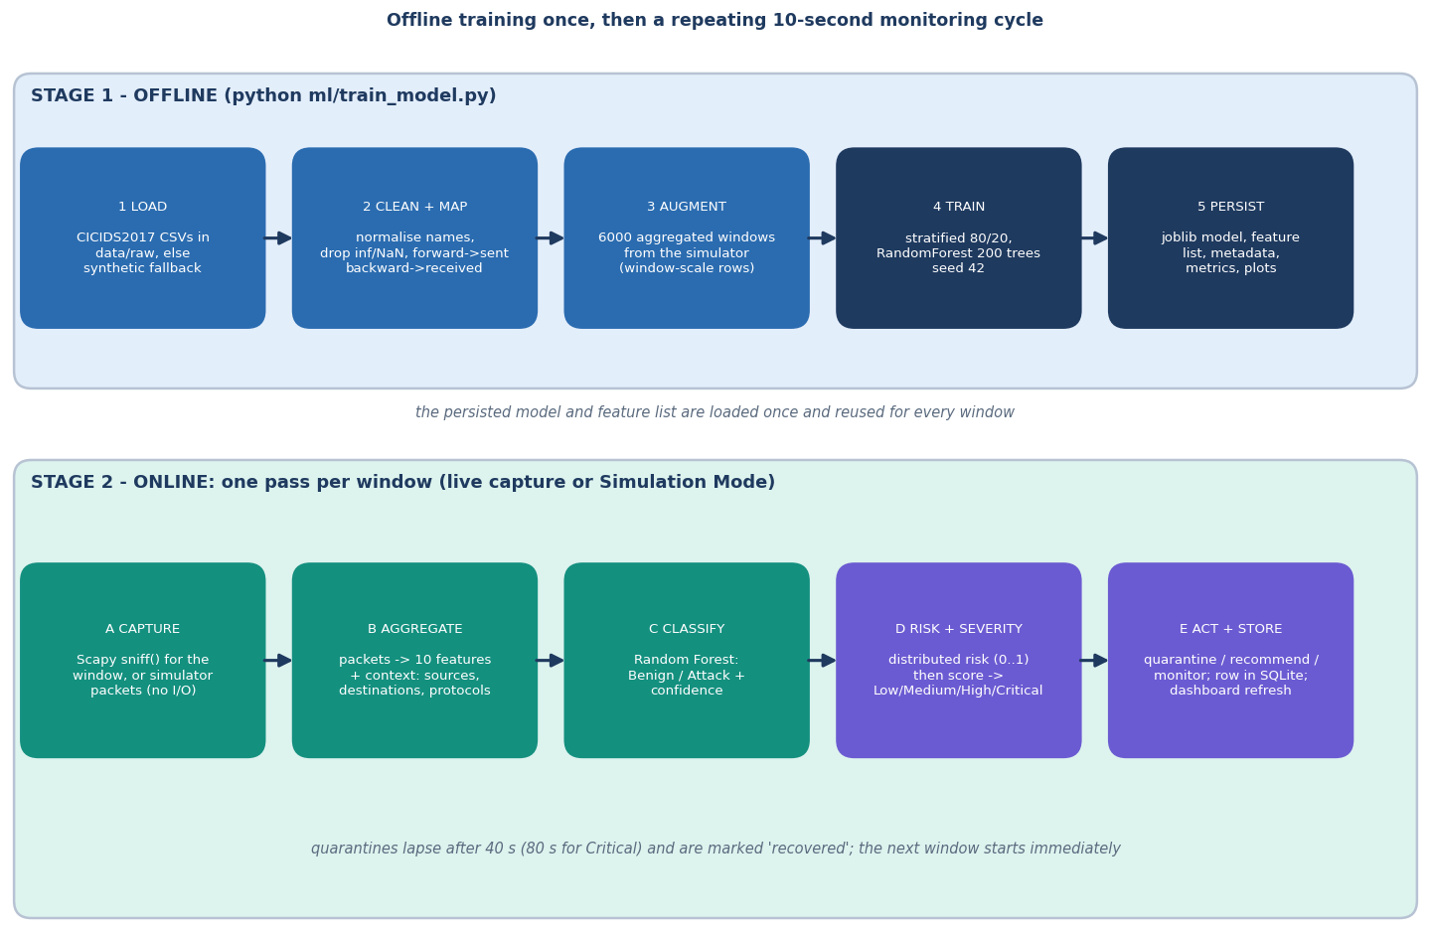
Methodology: train offline, then one pass per window
Train
CICIDS2017 CSVs (or a synthetic fallback), mapped to ten features, plus 6,000 aggregated simulator windows; 200-tree Random Forest.
Monitor
Window of packets, ten features, RF label and confidence, distributed risk, severity, action.
Evaluate
Accuracy, precision, recall, F1, false-positive rate; real flows, synthetic split and window pipeline at 2, 5 and 10 s.
High-level workflow of ml/train_model.py and the monitoring cycle.
Notes:
Offline training happens once; every window then costs a feature aggregation, one forest prediction and a few rule evaluations.

Slide 6
Data: synthetic training set and real CICIDS2017 check
24,000
6,000
225,745
97.7k / 128.0k
rows in the shipped training run (19,200 train, 4,800 test)
of them aggregated simulator windows (3,000 benign, 3,000 attack)
real CICIDS2017 flows used for the check (Friday DDoS day)
benign / DDoS flows in the real file
 | Shipped model's training data | Real-data check (this review)
Source | Synthetic flows in CICIDS2017 column layout (CICIDS2017 was unreachable at build time) + simulator windows | CICIDS2017 Friday-Afternoon-DDos CSV, Hugging Face mirror c01dsnap/CIC-IDS2017; licence 'other'; Sharafaldin et al. [8]
Labels | Benign / Attack by construction (12,000 each) | BENIGN 97,718, DDoS 128,027 as labelled by the dataset authors
Features | Ten: sent / received packets, bytes, packets per s, bytes per s, average sizes | Same ten, mapped by the product's own ml/preprocessing.py (forward = sent, backward = received)
Split | Stratified 80/20, seed 42 | Shipped model scored on all flows; retrained forest on stratified 80/20 over 5 seeds and on a 70/30 block split
Caveat | 99.71 % is measured on the synthetic split | One attack type; known label problems in CICIDS2017 [9]; file not committed to the repository
Notes:
The product's own training script falls back to synthetic data when CICIDS2017 cannot be downloaded, and records that in metrics.json. For this review the real file was downloaded separately and the shipped model and a retrained model were tested on it.

Slide 7
Preprocessing and feature schema
Raw flows / packets
Clean: drop inf, NaN
Map to 10 features
Add window rows
Stratified 80/20
Random Forest
10
10 s
features: sent and received packets, bytes, rates and average sizes
default window; the model was calibrated on 10 s windows
Flows: forward packets and bytes become 'sent', backward become 'received'; rates are counts over the flow duration; averages are bytes over packets (0 when there are none).
Windows: packets whose destination is a local address are 'received', those from a local address are 'sent'; the same schema keeps training and inference identical.
Every prediction validates names, order, NaN / infinity and negative values before the forest sees them.
Known limit: a flow and a 10-second window differ in scale, so 6,000 simulator windows are added to training; a forest trained on flows alone called every simulated window benign.
Notes:
ml/preprocessing.py and monitoring/traffic_aggregator.py. The flow-to-window scale gap was measured: the forest retrained on real flows only had zero attack recall on simulator windows.

Slide 8
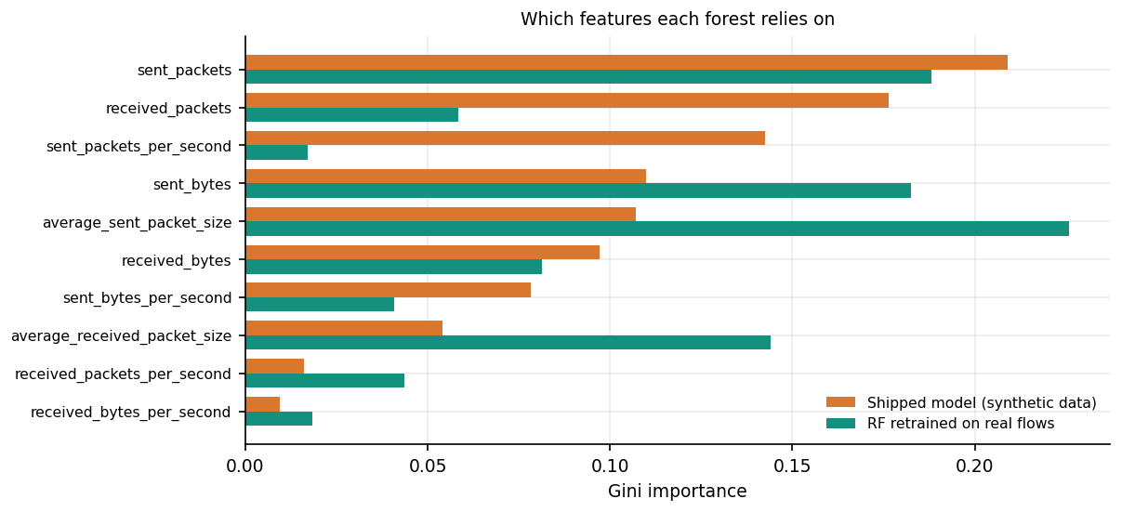
Model: 200-tree Random Forest on ten features
Why a Random Forest: handles non-linear count and size features, trains in seconds, no feature scaling, and gives importances to explain.
On real flows the same forest scores 99.94 % (5 seeds); a decision tree and gradient boosting are equal within 0.01 points; Gaussian Naive Bayes reaches 72.9 %.
Size: shipped model 2.74 MB, loads in 0.113 s.
Gini importance of the shipped forest (synthetic data) and of a forest retrained on real flows: the real forest relies on average packet sizes and sent bytes.
Notes:
The base paper compares seven classifiers and four ensembles; we compare five single classifiers on the same real split, and the tree-based ones are indistinguishable.

Slide 9
Training and evaluation configuration
Setting | Value
Classifier | scikit-learn RandomForestClassifier: 200 trees, no depth limit, class_weight balanced, seed 42, n_jobs = -1
Shipped training run | 19,200 train / 4,800 test rows (stratified 80/20), trained in 22.2 s; artefacts in models/ and results/
Real-data experiments | RF retrained with the same settings on real flows: 5 seeds (42, 1, 2, 3, 4) and a 70/30 block split; baselines DT, HistGradientBoosting, GaussianNB, logistic regression
Window pipeline test | 4,000 simulator windows per length (2, 5, 10 s; 35 % attack), rolling baseline of 12 windows, persistence, severity as in app.py
Latency run | 600 windows; single-window inference; REST calls over 127.0.0.1
Machine | Core i5-12500, 15.7 GB RAM, no GPU, Windows 11; Python 3.11.9, scikit-learn 1.9.1; other jobs kept the CPU at 100 % during timing
Hyper-parameters are those of ml/train_model.py; no tuning was done for this review.
Notes:
Everything in the result slides was produced by scripts/run_experiments.py and scripts/measure_api.py; the shipped artefacts were never overwritten.

Slide 10
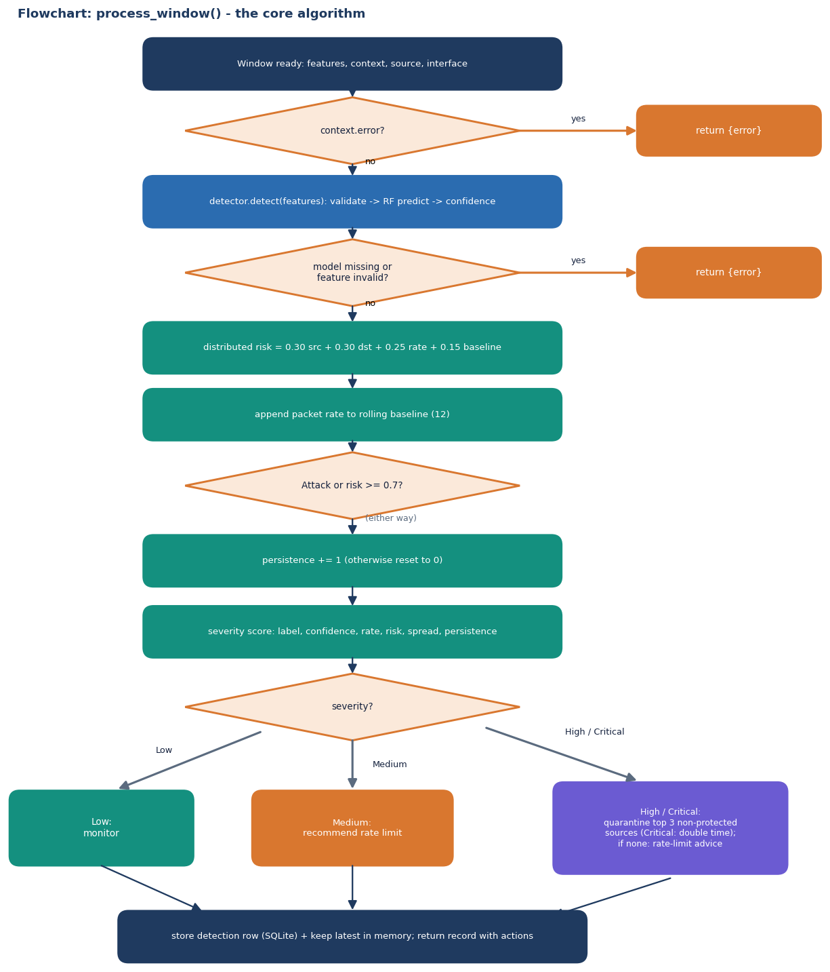
Decision logic: risk, severity and mitigation
Step | Rule (from the code)
Distributed risk | 0.30 min(src/30,1) + 0.30 min(dst/15,1) + 0.25 min(rate/1500,1) + 0.15 baseline deviation; Medium from 0.4, High from 0.7
Persistence | consecutive windows with Attack or risk >= 0.7
Severity score | Attack +30; confidence >= 0.9 +15; rate >= 3,000 pkt/s +20; risk >= 0.7 +20; wide spread +8; persistence >= 3 +10; benign capped at 45
Levels | Medium >= 28, High >= 50, Critical >= 70
Action | Low: monitor. Medium: recommend rate limit. High / Critical: quarantine the top 3 non-protected sources for 40 s (80 s for Critical), then recover
Notes:
This mirrors security/distributed_analysis.py, severity.py and mitigation.py. Local and loopback addresses are never quarantined; the operating-system firewall is never touched.

Slide 11
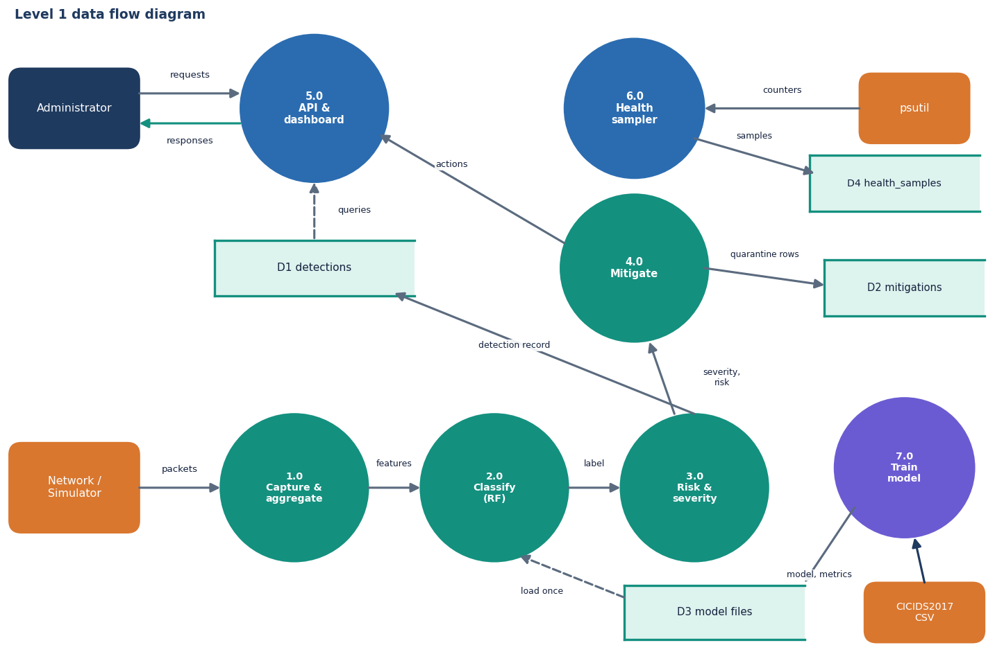
Data flow and modules
Module | Role
monitoring/ | capture, simulator, aggregator
ml/ | features, preprocessing, training
security/ | detector, risk, severity, mitigation
database/db.py | SQLite, four tables
app.py | 12 endpoints, process_window
frontend/src | React pages and polling
tests/ | 95 pytest tests
scripts/ | smoke, experiments, API probes
Level-1 data flow diagram: seven processes, four stores.
Notes:
Level 1: capture and aggregate, classify, risk and severity, mitigate; the API, health sampler and training run alongside.

Slide 12
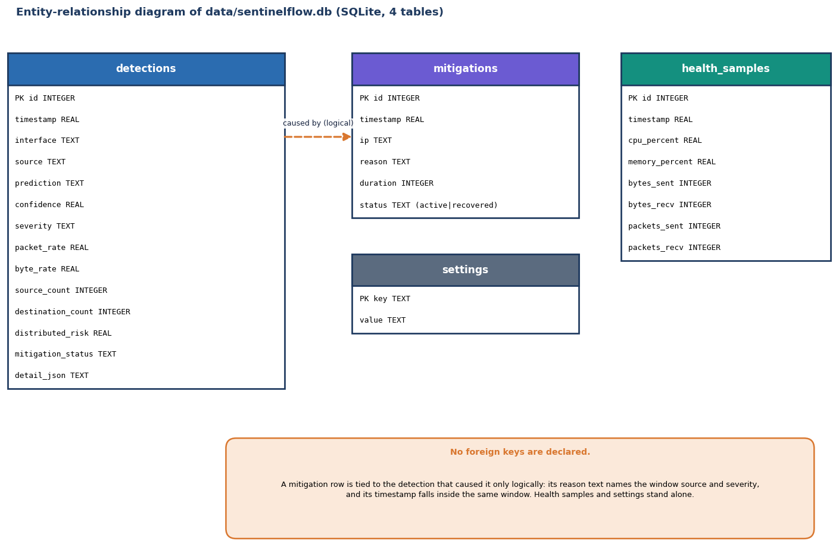
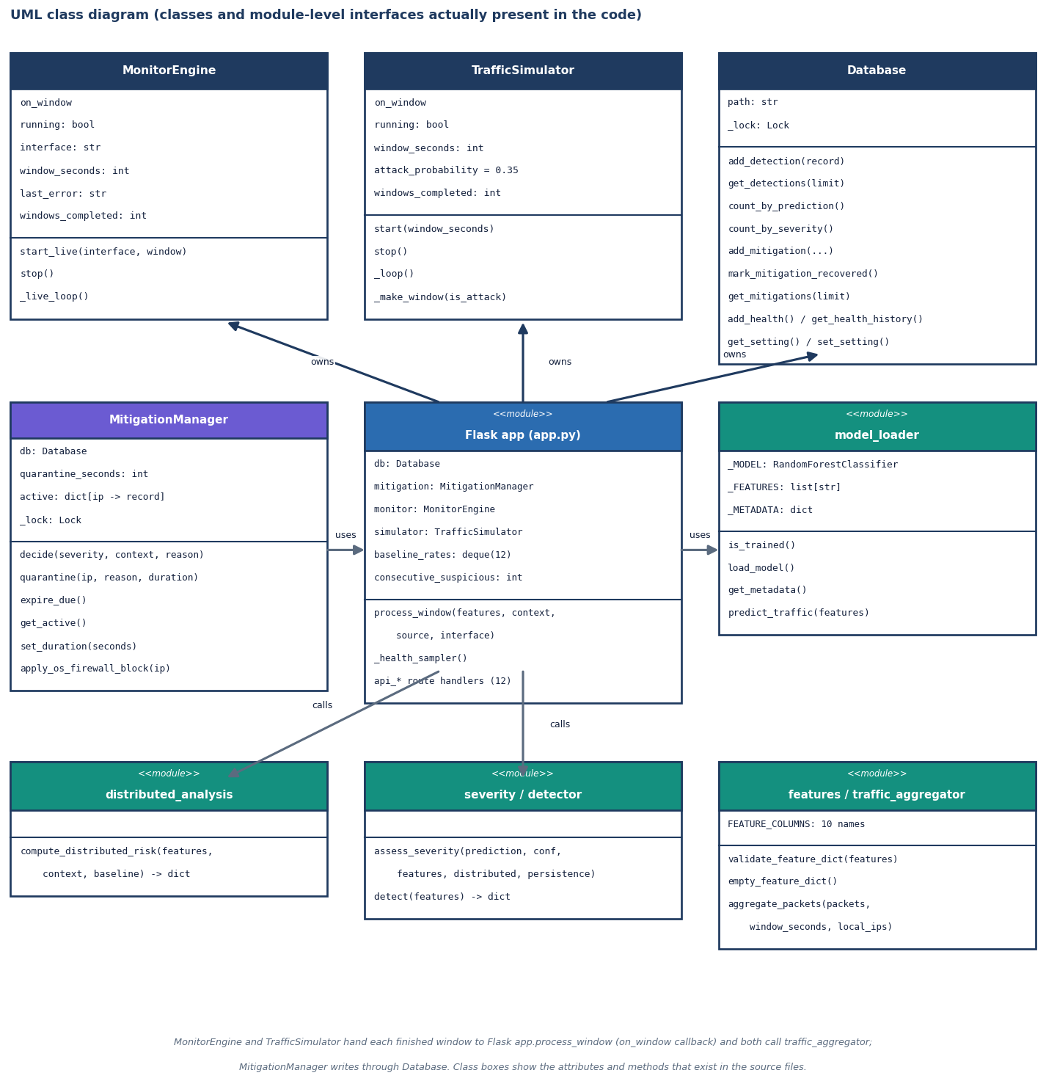
Database and UML
SQLite database: detections, mitigations, health_samples and settings; no foreign keys are declared.
Classes and module interfaces present in the code.
Notes:
Honest point: the settings table exists but the API keeps settings in memory, and a quarantine row is linked to its detection only by reason text and time.

Slide 13
Technology stack
Layer | Technology
Language and API | Python 3.11.9, Flask 3.1.3 (threaded), python-dotenv; ports 8415 and 5415 from .env
Machine learning | scikit-learn 1.9.1 (RandomForest), pandas 3.1.0, NumPy 2.4.6, joblib 1.6.0, matplotlib 3.11.2 for result plots
Traffic and host | Scapy 2.8.0 (sniff, needs Npcap on Windows), psutil 7.2.2 (CPU, memory, network counters)
Storage | SQLite (standard library) with a lock; model and metrics as joblib, JSON and PNG files
Front end | React 19, Vite 8, Tailwind 4, Recharts 3, React Router 7, axios, Framer Motion, three.js backdrop
Testing and run | pytest 9.1.1 (95 tests), smoke script, API probe script; run.bat or Docker (dashboard, inference, simulation)
Notes:
Versions are those installed on the development machine. The model file was saved with scikit-learn 1.9.0 and loads under 1.9.1 with a warning.

Slide 14
Implementation progress
Component | Status | Evidence
Aggregator, Random Forest, distributed risk, severity, mitigation with expiry | Done | 95/95 pytest tests cover each module
Flask API (12 endpoints), SQLite storage, React console (9 pages) | Done | 25/25 smoke checks; 25/25 malformed-input probes handled
Simulation Mode through the identical pipeline | Done | first detection 4.6 s after Start at 2 s windows
Live Scapy capture | Implemented, not verified live | Npcap not installed here; error path verified (capture_error reported, mode returns to stopped)
Training on real CICIDS2017 | Partly | script supports it; shipped model used the synthetic fallback; real-data check run separately
Enforcement beyond the application (firewall, rate limiting) | Not done | apply_os_firewall_block is a stub; rate limiting is only recommended
Authentication, multi-attack classes, real testbed | Not done | API is localhost-only; binary labels; no SDN deployment
Notes:
State of the code base. The last three rows are the honest gaps against the batch objectives.

Slide 15
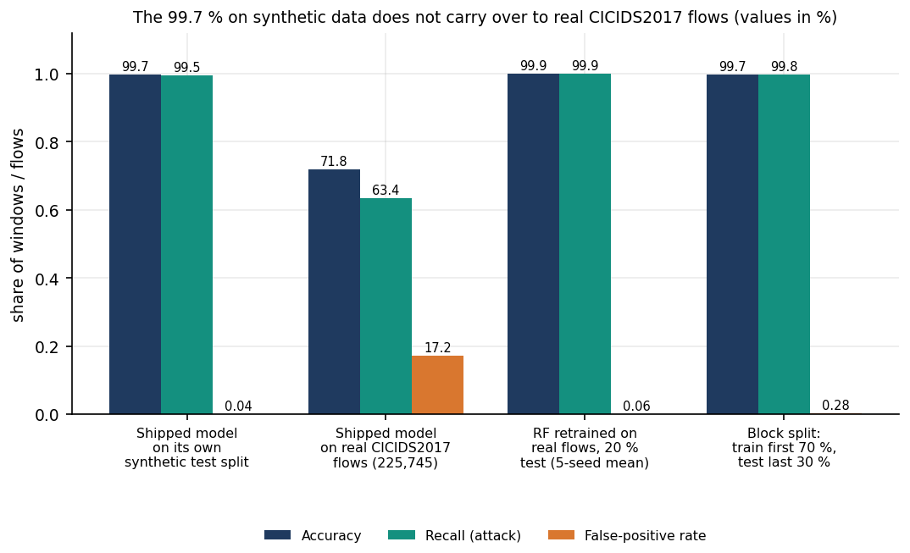
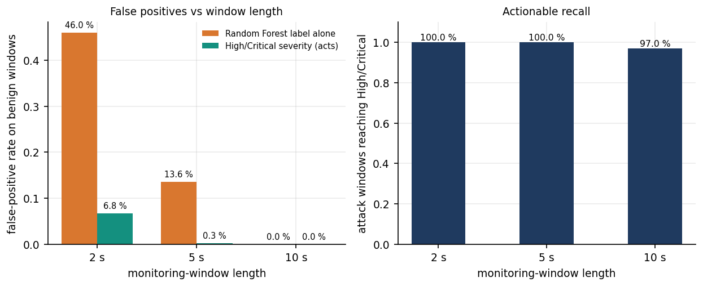
Preliminary results
99.71%
71.8%
99.94%
0.27%
shipped model on its own synthetic split (4,800 rows)
same model on 225,745 real CICIDS2017 flows (recall 63.4 %)
forest retrained on real flows, 5-seed mean (FPR 0.06 %)
false positives at 5 s windows with severity (RF label alone 13.6 %)
The synthetic score does not transfer to real flows; retraining with the same features fixes that on this attack type. Window length matters: the model was calibrated on 10 s windows. The base paper's 100 % is on different datasets and is not directly comparable. Recall at High/Critical: 100 % at 2 s, 100 % at 5 s, 97.0 % at 10 s.
Notes:
Be explicit: 99.71 percent is a synthetic-data number. On real flows the shipped model has a 17.2 percent false-positive rate. The severity layer keeps most benign windows below High; at 10 s windows 44 weaker attack windows stay at Medium.

Slide 16
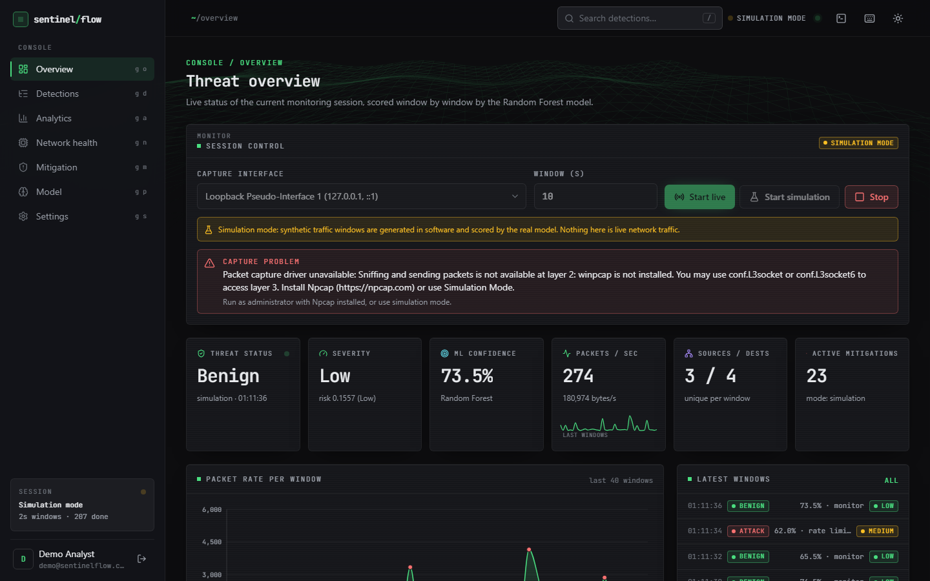
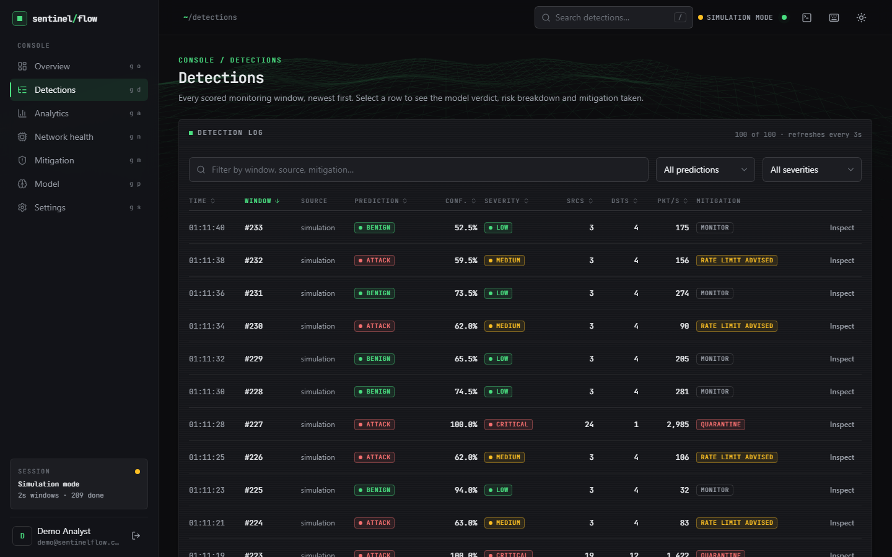
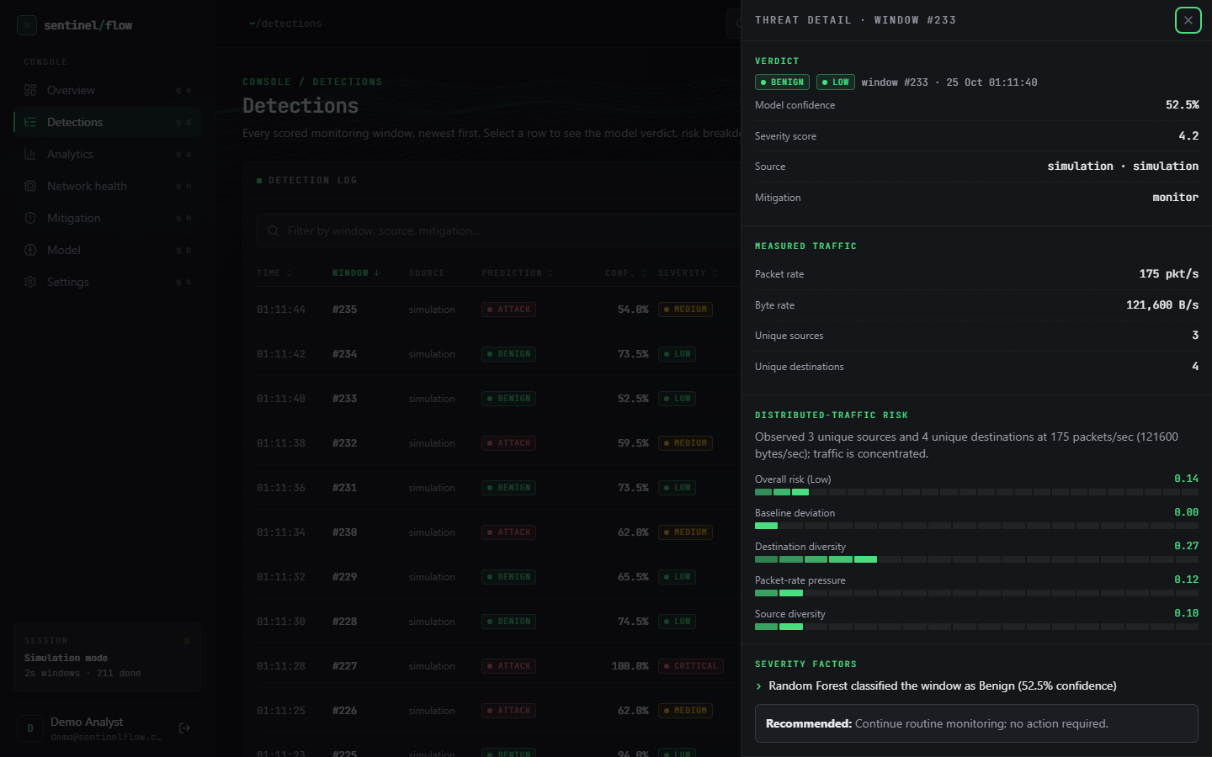
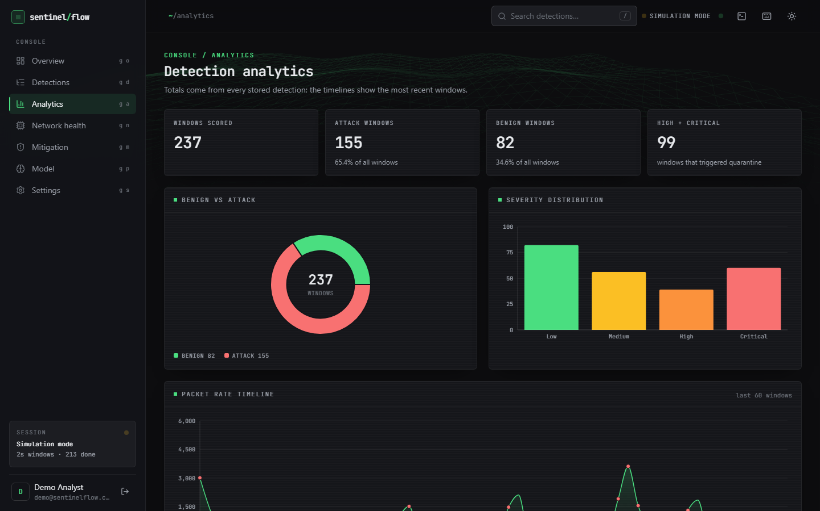
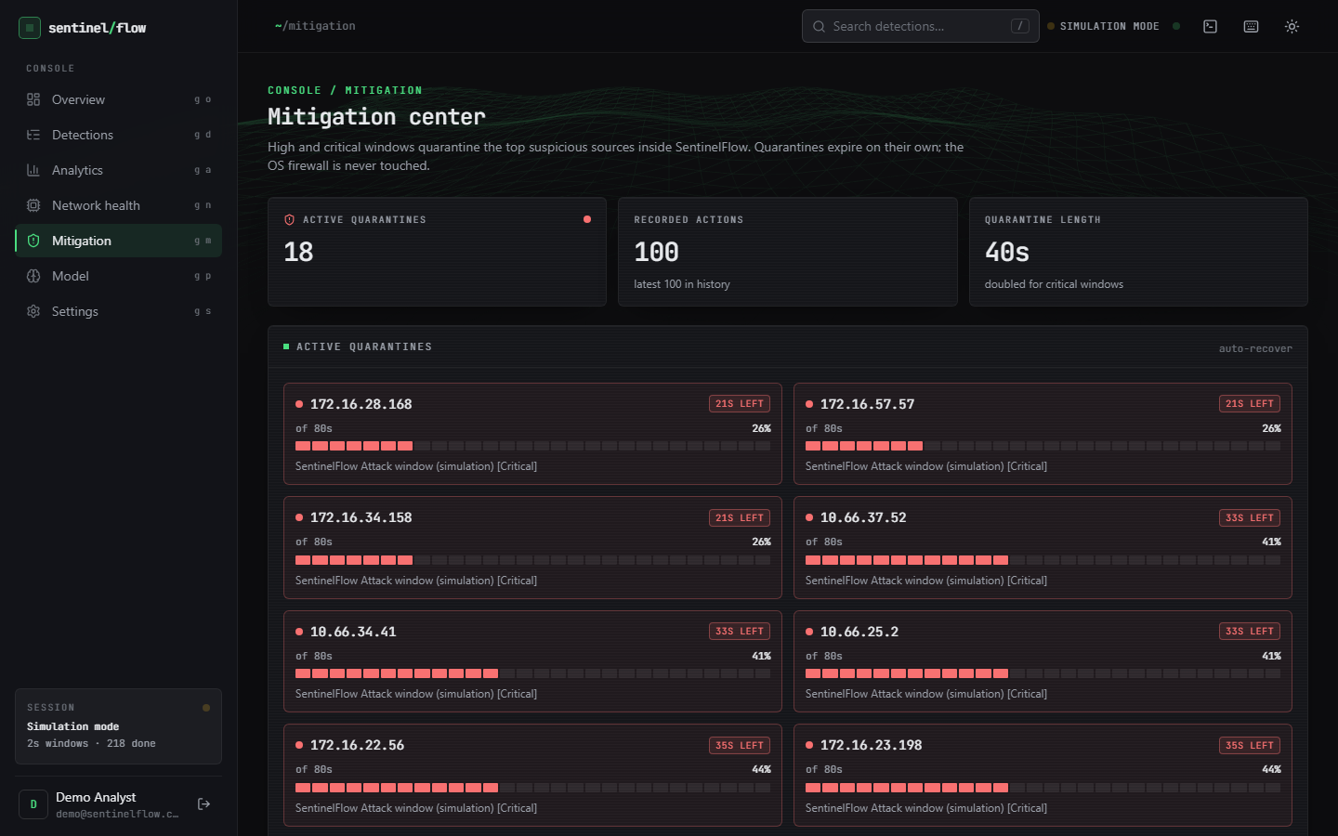
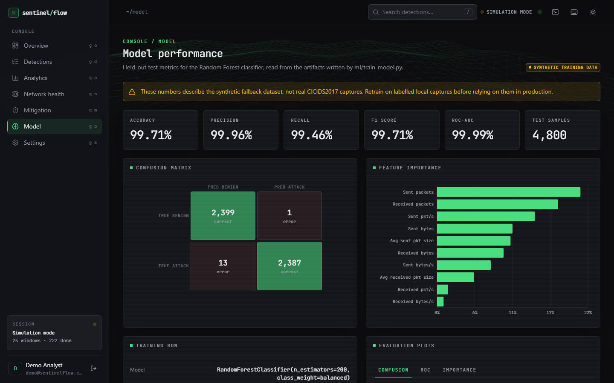
Output screens
Overview: session control, capture-problem banner, live cards
Detections: every scored window
Threat detail: verdict, traffic, risk, factors
Analytics: benign vs attack, severity
Mitigation: active quarantines with countdown
Model: metrics with synthetic-data warning
Real captures of the running console at 1440 x 900 in Simulation Mode: simulated windows scored by the real model.
Notes:
Real screenshots. Every screen labels Simulation Mode; the Model screen warns that the metrics describe the synthetic fallback dataset.

Slide 17
Initial testing and observations
95 / 95
25 / 25
3.5 ms
25 / 25
pytest tests passed (scratch database)
smoke checks passed against the live API
median of GET /api/status over HTTP (127.0.0.1)
malformed-input and abuse probes handled
Observation | Action
At 2 s windows the RF label alone flags 46 % of benign windows as attacks | Severity layer reduces actionable false positives to 6.8 %; 10 s default recommended
Single-window inference takes 313 ms with the saved n_jobs = -1 against 33 ms with 1 (host at 100 % CPU) | Reported; setting n_jobs = 1 is a listed fix
The interface setting accepts a 5,000-character string; the landing page shows 99.71 % without the synthetic caveat | Logged as defects; not changed in this review
Live capture start without Npcap returns a clear reason through /api/status instead of crashing | Simulation Mode used for demonstrations
Notes:
Tests run against a scratch database; the probes and latency come from a scratch copy of the backend over real HTTP. Latency numbers were taken while other jobs used the whole CPU, so they are upper bounds.

Slide 18
Challenges and corrective actions
Challenge | Corrective action
CICIDS2017 could not be downloaded when the product was built | Labelled synthetic fallback in the product; real file obtained later and used for an honest re-check
A flow and a 10-second window have different scales | 6,000 aggregated simulator windows added to training; the gap is measured and reported
Accuracy depends on window length (46 % false positives at 2 s for the RF label alone) | Severity layer with factors and persistence; 10 s default; results given for 2, 5 and 10 s
Npcap is not installed, so live capture cannot run on the development PC | Simulation Mode drives the identical pipeline; the capture error path is tested
CPU shared with other jobs; saved forest uses n_jobs = -1 | Latency reported as upper bounds with the n_jobs comparison
Notes:
Each challenge was met by a design choice or by measuring it and saying so in the report.

Slide 19
Next steps
1
Train on real data
2
Fix window sensitivity
3
Real enforcement
4
Live test and hardening
Retrain the shipped model with the real CICIDS2017 files in data/raw, add the other attack days and multi-class labels, and report the gap honestly.
Make features independent of window length, set n_jobs = 1, and re-measure at 2, 5 and 10 s.
Add an opt-in firewall or rate-limit action and measure recovery of a real service.
Install Npcap and test live capture end to end; add authentication and length checks.
Priority: items 1 and 2 close the largest honest gaps - a model trained on real traffic and a detector that does not depend on window length.
Notes:
Plan to the final review. The first two items address the biggest gaps found by the real-data check.

Slide 20
Thank you
Questions and suggestions are welcome.
Notes:
Likely questions: why the shipped model uses synthetic data; how the real-flow result compares with the base paper (different datasets, indicative only); what mitigation really does (an application-level quarantine, no firewall change); why live capture was not shown.

